Slide 1
FINAL RESULTS Self-powered co-harvesting for batteryless sensing and actuation in two-wheeled IoT applications
University of Trento Department of Industrial Engineering (DII)
Giuseppe Pasquini 239978

Slide 2
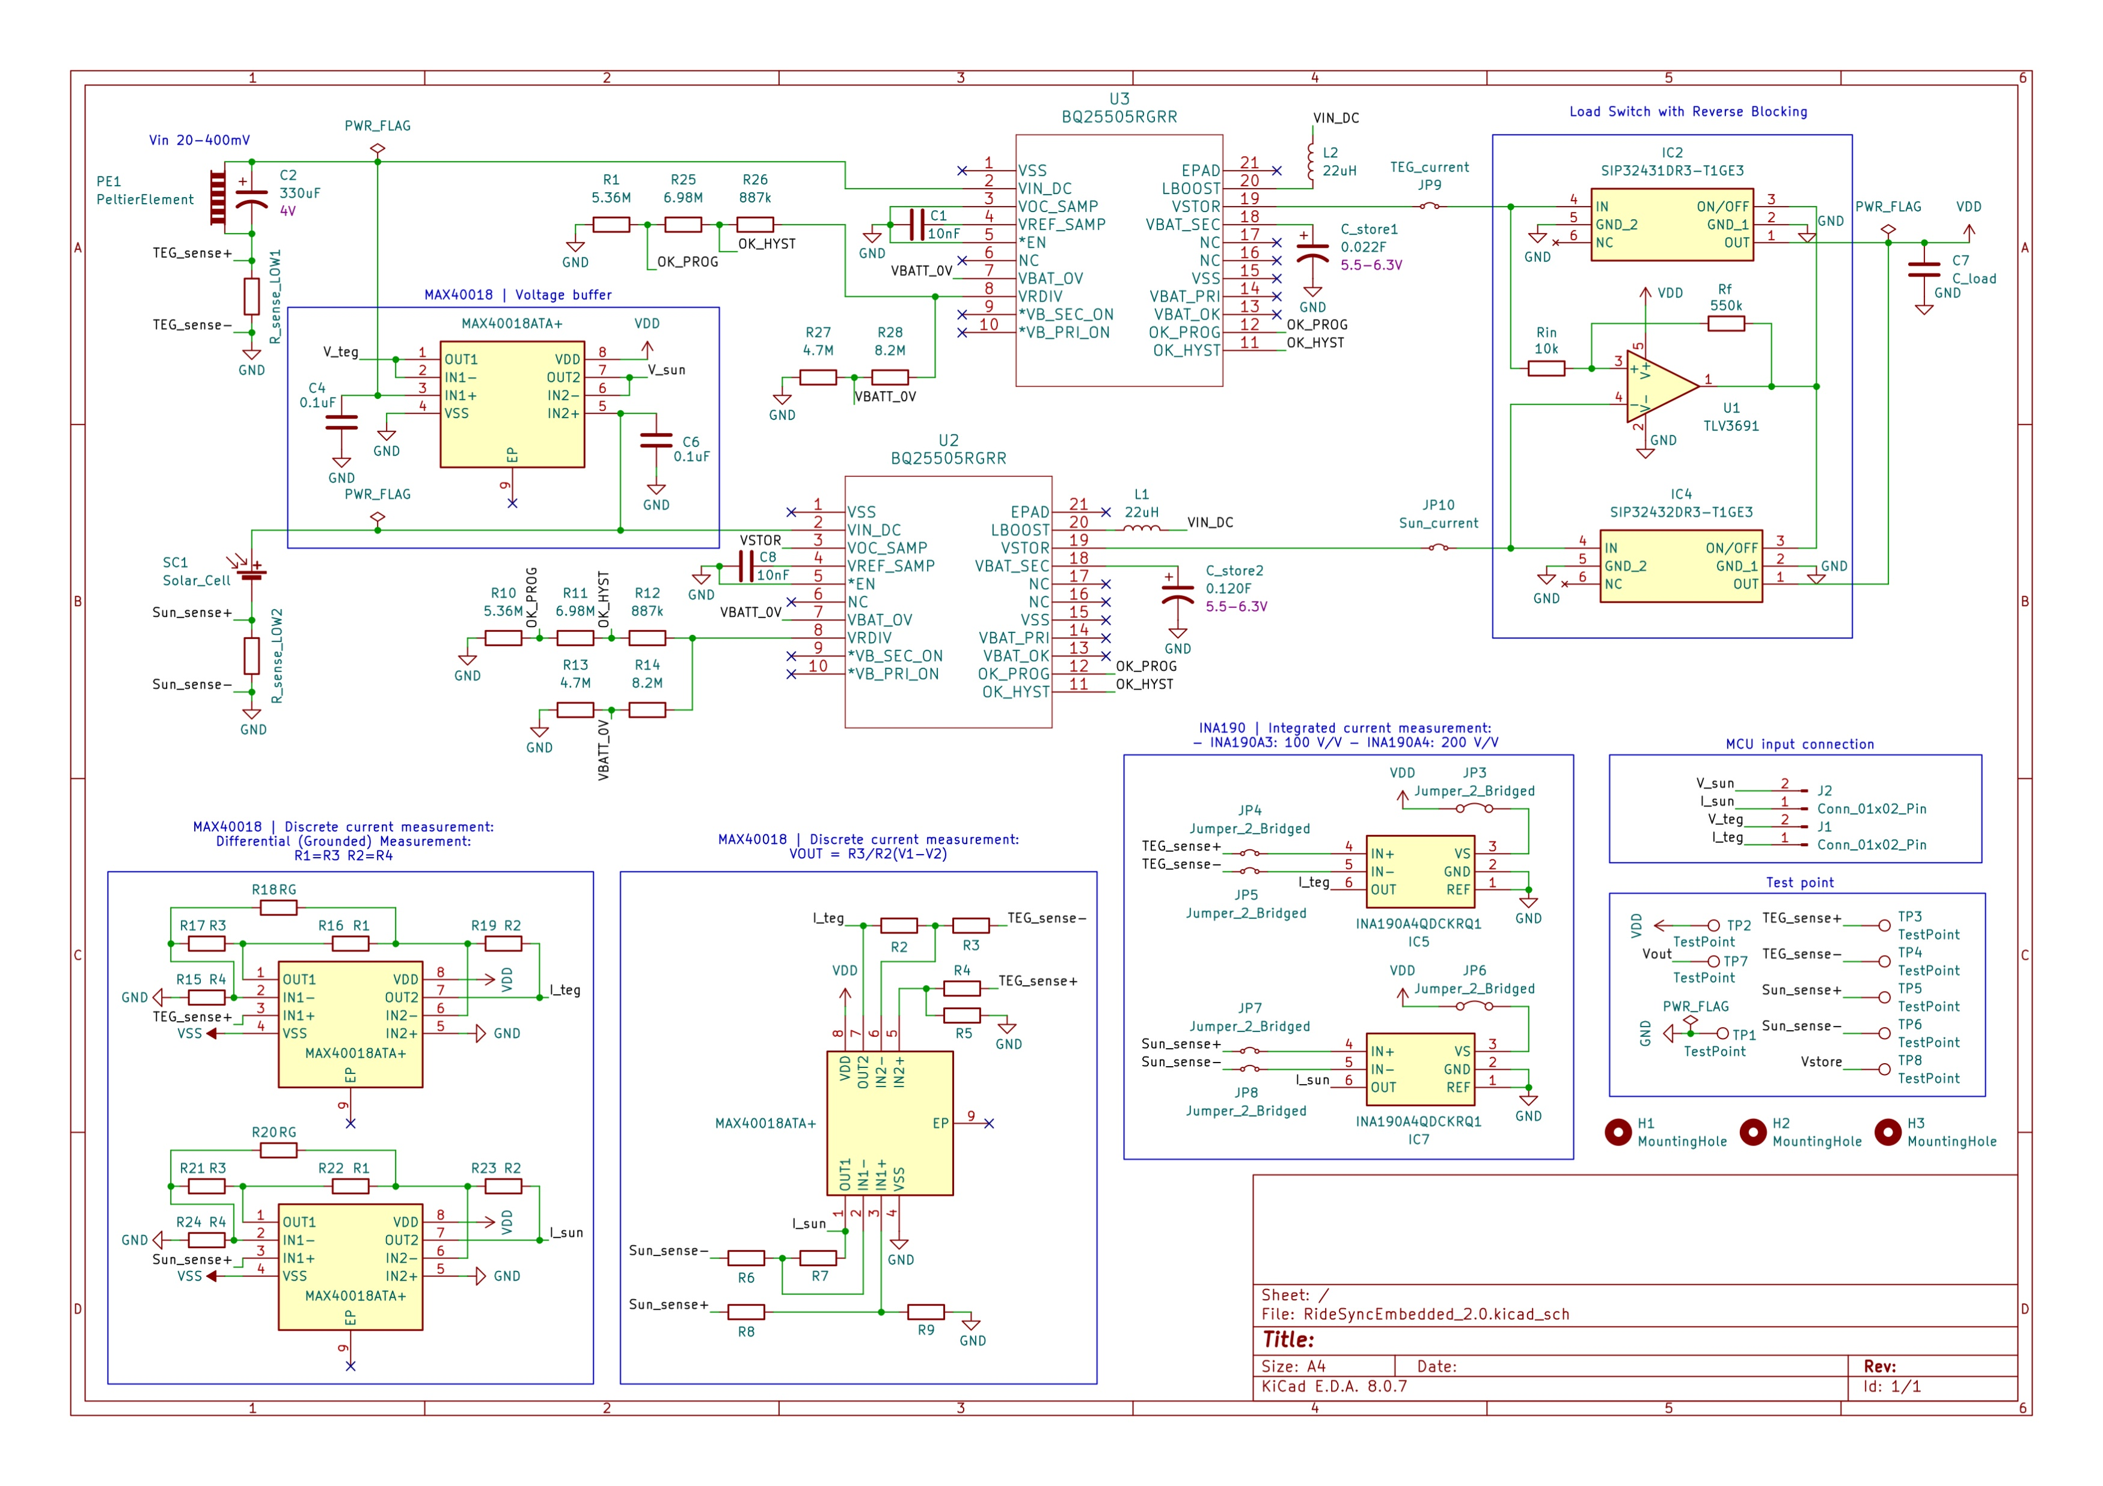
Final schema

Slide 3
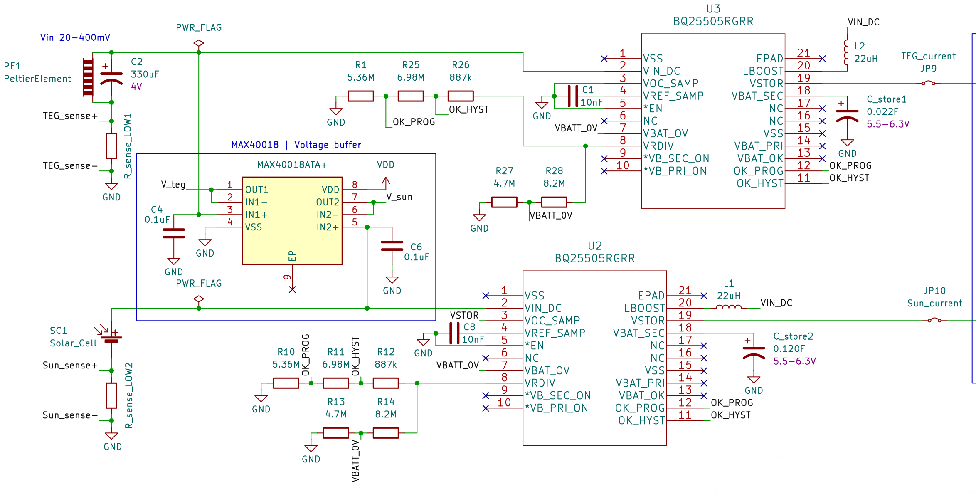
Co-harvesting inputs

Slide 4
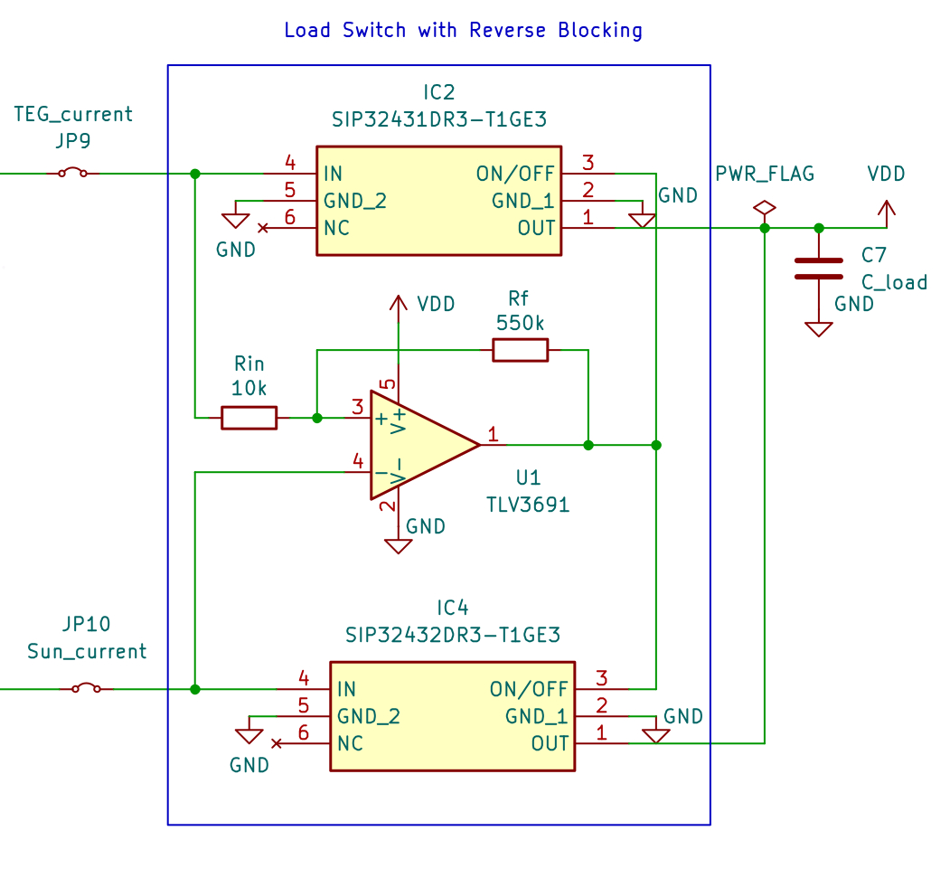
Co-harvesting load switch

Slide 5
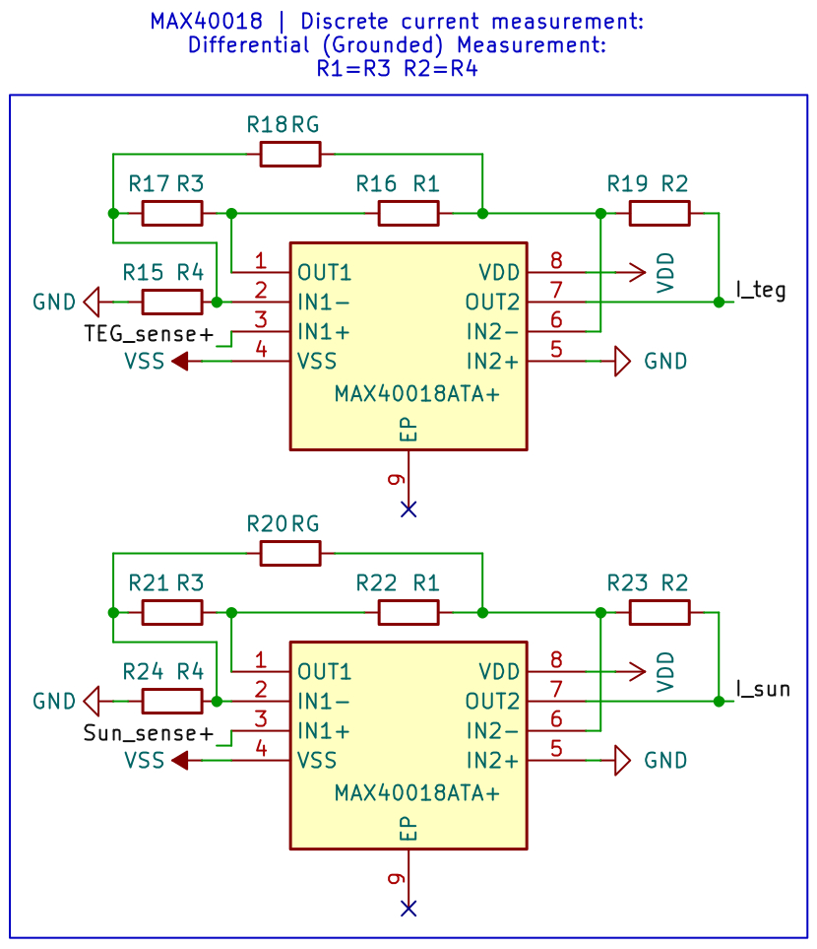
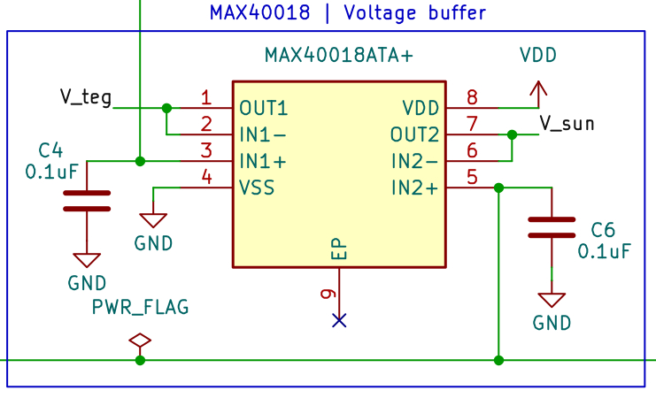
Co-harvesting current & voltage sense

Slide 6
Real ride data
Ride data:
Descent: ∼6 km
Duration: ∼30 min
Maximum TEG hot-side temperature: 46°C
Ambient temperature: ∼16°C
AWG ΔT: 22°C
Cloudy conditions
Theoretical performance (from characterisation):
AWG TEG power (ΔT: 22 °C): 20,5 mW
AWG PV power (100 W/m^2): 3,95 mW

Slide 7
Co-harvesting performance
Final results: P_teg_awg: 18,80 mW P_pv_awg: 3,15 mW
E_in: 12,55 J
E_sto: 8,10 J η = 64,5%
E_out: 7,88 J η = 62,8%
Theoretical performance (from characterisation):
AWG TEG power (ΔT: 22°C): 20,5 mW
AWG PV power (100W/m^2): 3,95 mW

Slide 8
Co-harvesting improvements: C_store rateo
C_store value: C_teg: 0,120 mF
C_pv: 0,021 mF
P_teg/C_teg = P_pv/P_pv
P_awg:
P_awg_teg: 20,5 mW
P_awg_pv: 3,95 mW
0,151=0,149
P/C rateo (TEG-PV) | E_sto efficiency
0,155 – 0,554 | 58,8%
0,151 – 0,149 | 64,5 %
0,156 – 0,103 | 63,1 %
0,157 – 0,061 | 60,1%

Slide 9
Co-harvesting improvements: Hysteresis
Comparator Hyst. | E_sto efficiency | E_in | E_out
20 mV(no res.) | 64,5 % | 12,5 J | 7,88 J
50 mV | 65,8 % | 12,3 J | 7,90 J
100 mV | 69,5 % | 11,2 J | 7,09 J
200 mV | 78,4 % | 9,9 J | 6,47 J

Slide 10
Co-harvesting improvements: Cold start
Cold start:
from off state to C_out = 5V
Theoretical performance (from characterisation):
AWG TEG power (ΔT: 22°C): 20,5 mW
AWG PV power (100W/m^2): 3,95 mW
C_pv | Cold start duration | P_awg_pv | Efficiency
0,0046 mF | 403 s | 1,46 mW | 36,9 %
0,0211 mF | 438 s | 0,71 mW | 17,9 %
0,0304 mF | 447 s | 0,52 mW | 13,1 %

Slide 11
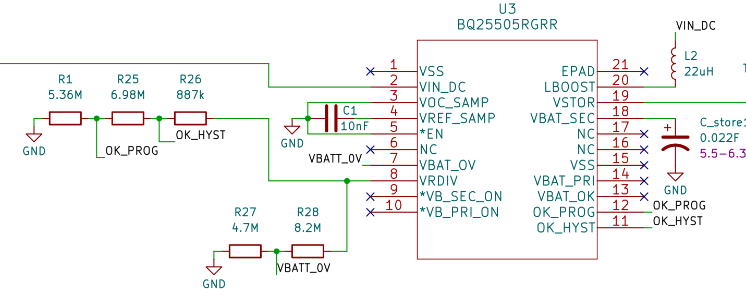
Co-harvesting improvements: BQ efficiency
Theoretical performance (from characterisation):
AWG TEG power (ΔT: 22°C): 20,5 mW
AWG PV power (100W/m^2): 3,95 mW
Vout_teg | Pout_teg | Efficiency_teg
4,9 V | 12,3 mW | 58,3 %
4 V | 11,9 mW | 56,9 %
3,5 V | 11,3 mW | 53,9 %
2,9 V | 10,9 mW | 51,9 %
Vout_pv | Pout_pv | Efficiency_pv
4,9 V | 3,1 mW | 77,6 %
4 V | 3,0 mW | 74,9 %
3,5 V | 2,9 mW | 73,6 %
2,9 V | Under Mpp voltage (3,4V)

