Slide 1
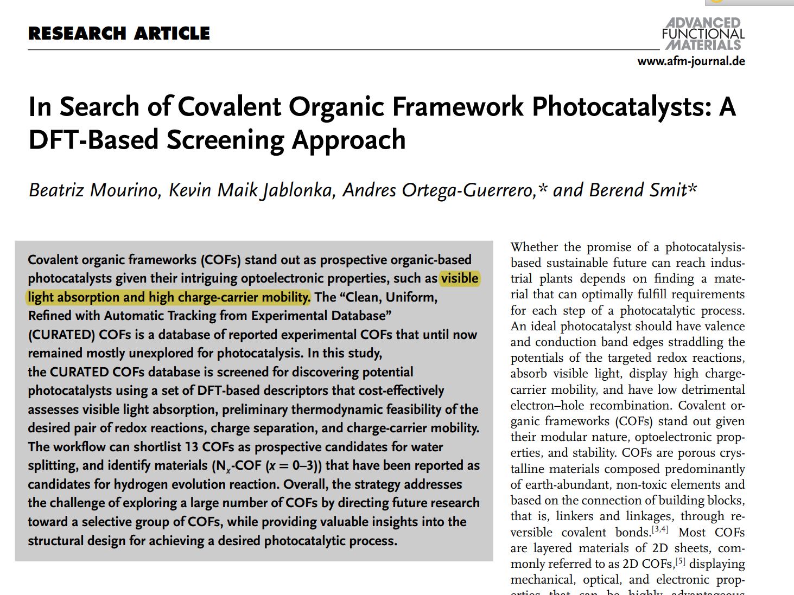

Slide 2
基于能量的描述符
带隙
IP(电离势) EA（电子亲和能）
电荷分离描述符
载流子迁移描述符
1
Bandgap | 带隙
Homo | 导带
Lumo | 价带
spatial_overlap
effective_mass_hole
effective_mass_electron
2
3

Slide 3
数据 | 均值 | 标准差
Bandgap | 2.85 | 0.62
Homo | -5.41 | 0.59
Lumo | -2.50 | 0.58
spatial_overlap | 0.51 | 0.15
effective_mass_hole | 737.08 | 4118.46
effective_mass_electron | 356.47 | 2636.74
QMOF bandgap | 2.09 | 1.13

Slide 4
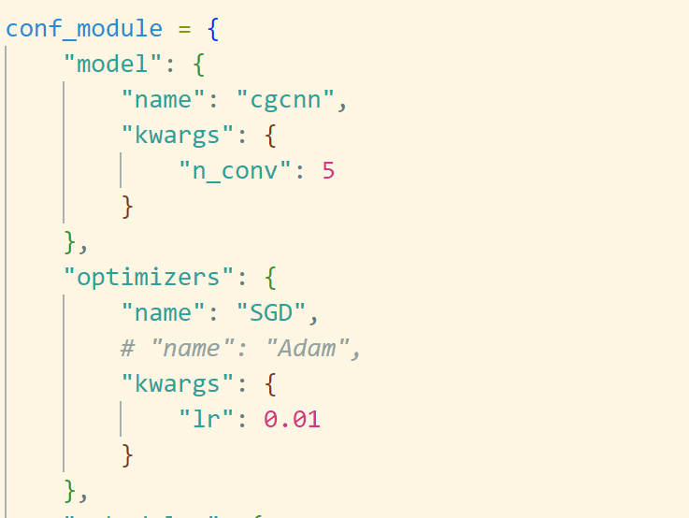
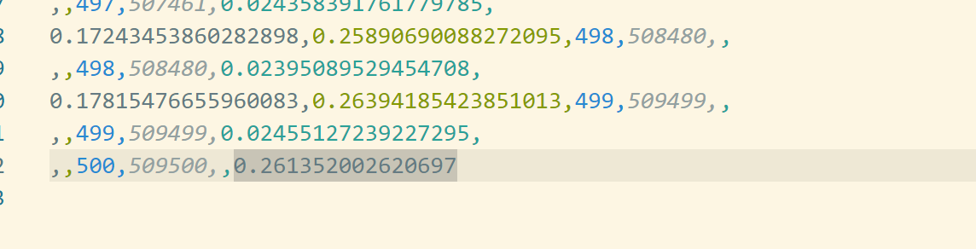
属性\模型 | 训练集平均值 | cgcnn
Bandgap | 0.38202729842500005 | 0.3751552104949951
Homo | 0.5099327540114934 | 0.35222670435905457
Lumo | 0.4607574335291146 | 0.4283232092857361
spatial_overlap | 0.1217832788088173 | 0.14061018824577332
effective_mass_hole | 713.5928738081157 | 637.3421630859375
effective_mass_electron | 2473.8387138814355 | 11553.8359375
QMOF bandgap | 0.9420764823054 | 0.2894246578216553

Slide 6
