Slide 1
Get Yelp
A Comprehensive Analysis of Review Trends
Michael Gigiolio, Dante Pasionek and Dominic Deckys
Notes:
Dante

Slide 2
Question
What relationships lie within the different components of Yelp reviews? What patterns exist within presumably unrelated data such as stars, location and hours of business? How does a user’s profile and activity affect the ratings they give?
What lies in our data?
Notes:
Dante

Slide 3
The Dataset
Reviews
Companies
Users
Review ID
User ID
Business ID
Stars
Date
Business ID
Name
Address
Latitude
Longitude
Stars
Review Count
Categories
User ID
Name
Review Count
Average Stars
Notes:
Michael
Using ID to join data
Ratio Scaled: Inherent zero point (Stars!)
Interval Scaled: Longitude, Latitude, Date

Slide 4
Process
Exploration
Cleaning
Mining
Understanding Data
Determining the content of the datasets and considering how they could be applied. Identifying areas where there may be trends to uncover.
Preprocessing
Making the dataset easy to work with.
Removing useless columns
Handling missing values
Chunking data
Trend Location
Processing the data and comparing one field to another. Plotting the data types to provide visualization. Narrowing down where trends are located for further investigation.
Notes:
Dominic
Dropped attributes, drop missing values, changing data, chunking,

Slide 5
Tools
Python
SciPy
Seaborn
Base code for project
Easily accessible notebooks
Easy to import modules
Useful for complicated math and statistics
K-means clustering
Logistic Regression
Graph display
Notes:
Dante

Slide 6
Tools
Folium
Matplotlib
Pandas
Facilitated mapping
Easy to plot points and clusters
Provided intuitive visualization
Easy graphing
Customizable labels
Allowed different displays of data
Allowed for advanced visualization
Allowed easy import of data
Facilitated data cleaning
Provided some easy calculation techniques
Notes:
Dante

Slide 7
Findings

Slide 8
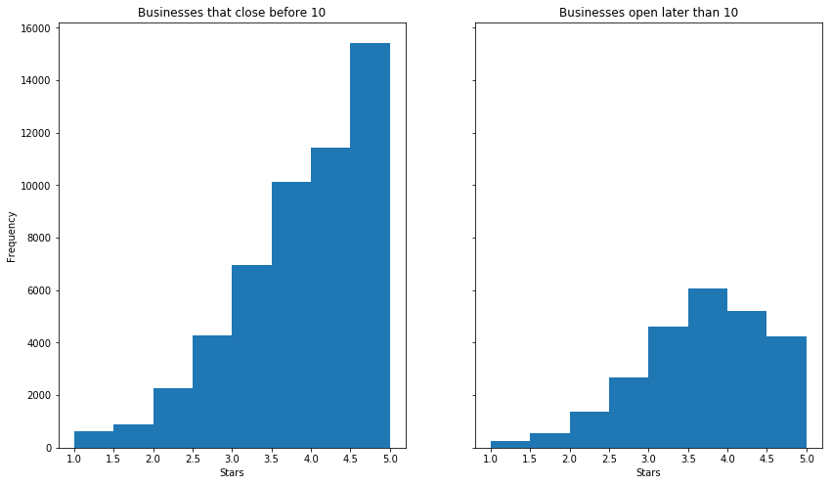
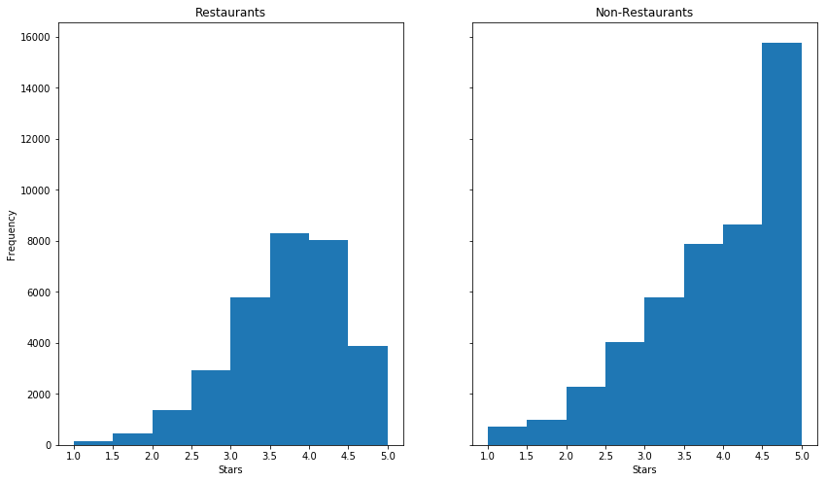
Rating Frequency
Businesses that close early fair better
Most businesses close early
Businesses open later have a mean closer to the sample average
Restaurants fair worse than non-restaurants
Very unlikely for restaurants to get 5 stars
It is likely for non-restaurants to get 5 stars
Notes:
Dominic

Slide 9
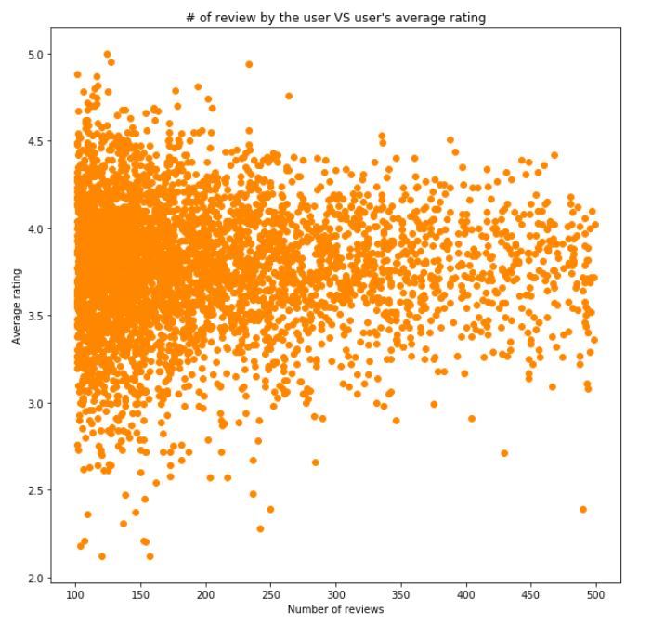
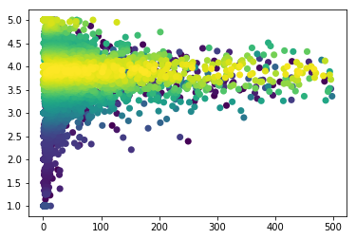
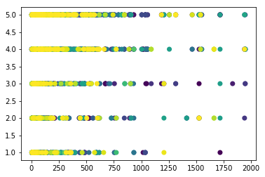
Correlations
Monomodal, negatively skewed data
Global mean of 3.7277
Notable outliers
High density as count grows large around the mean
High density of 5s
Restaurants given rounded scores
Similar trends to user graphs
Interesting high density outliers
Notes:
Michael

Slide 10
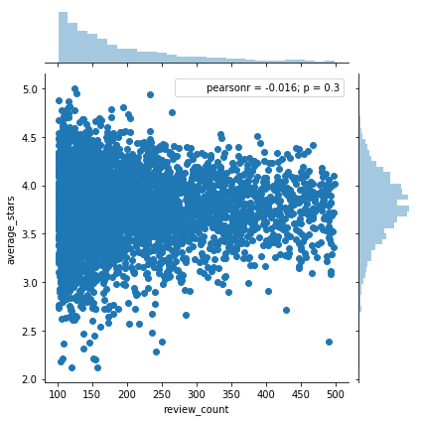
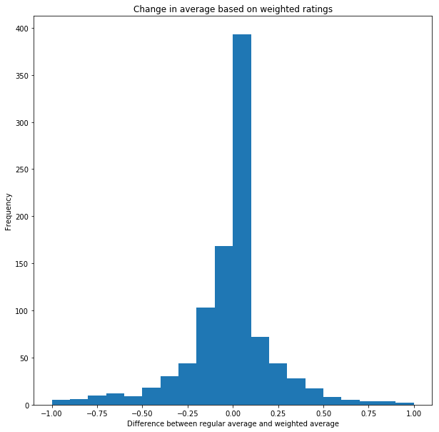
Normalization
Problems with reviews:
User bias
User reliability
Normalization based on:
User review average
Number of user reviews
Notes:
Dominic

Slide 11
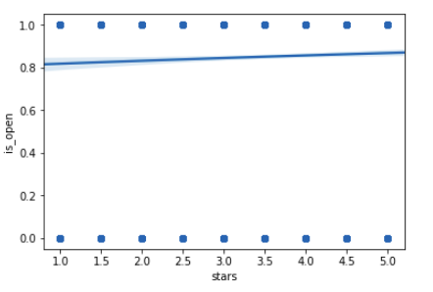
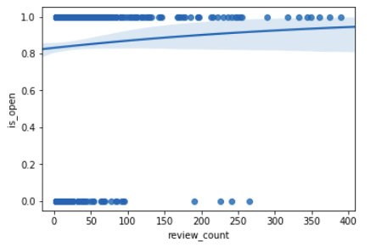
Regression
Logistic regression to determine if Star rating had effect on if a business is currently open
No effect!
Notes:
Michael

Slide 12
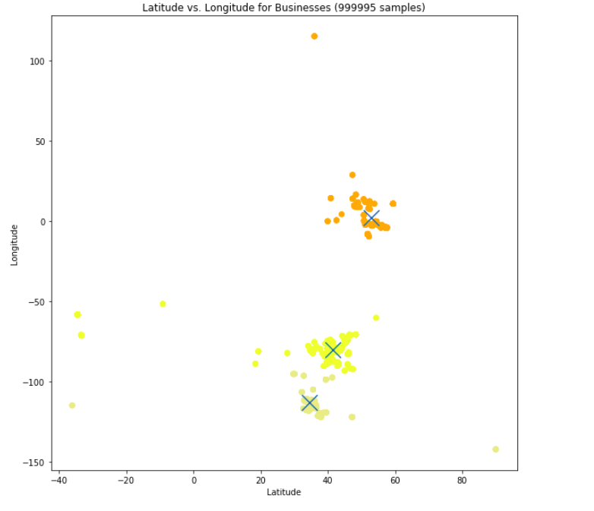
KMeans
2D/3D clustering for business location and star reviews
3 large clusters across two continents
Relatively even distribution across location
Notes:
Dante

Slide 13
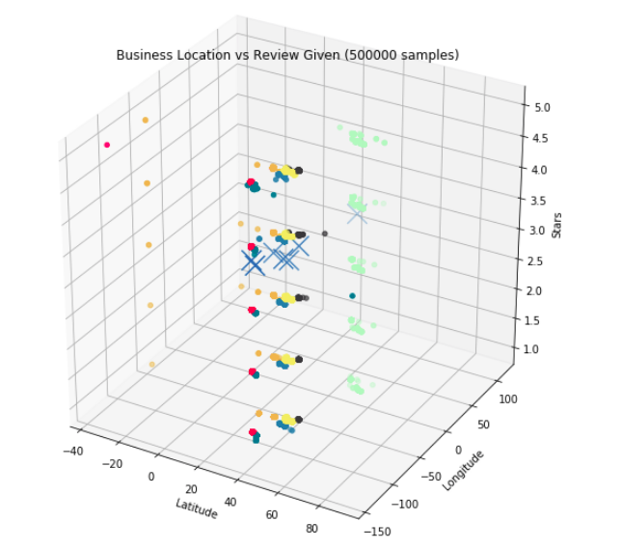
KMeans cont.
2D/3D clustering for business location and star reviews
3 large clusters across two continents
Relatively even distribution across location
Notes:
Dante

Slide 14

Knowledge & Applications
Restaurants perform worse than other businesses
Businesses open later do not rate as well
All businesses receive bad reviews
Location isn’t extremely important
Creating a more comprehensive review system
Remove location factor from real estate analyses
Notes:
Dante

