Slide 1
about_Session
{
"Title" : "7 Mythen über PS 7",
"Speaker": "Thorsten Butz",
"Uri" : "thorsten-butz.de",
"Twitter": "@thorstenbutz",
"Podcast": "slidingwindows.de"
}

Slide 2
about_Myths
Mythos: maskulin, von altgriechisch μῦθος, „Laut, Wort, Rede, Erzählung, sagenhafte Geschichte, Mär“, lateinisch mythus
"(Ein Mythos) ist in seiner ursprünglichen Bedeutung eine Erzählung. Im religiösen Mythos wird das Dasein der Menschen mit der Welt der Götter oder Geister verknüpft.
Mythen erheben einen Anspruch auf Geltung für die von ihnen behauptete Wahrheit."
https://de.wikipedia.org/wiki/Mythos

Slide 3

Mythos 1: Parallelisieren
Notes:
Screenshot: https://www.sportschau.de/tourdefrance/tour-de-france-erste-etappe-114.html

Slide 4
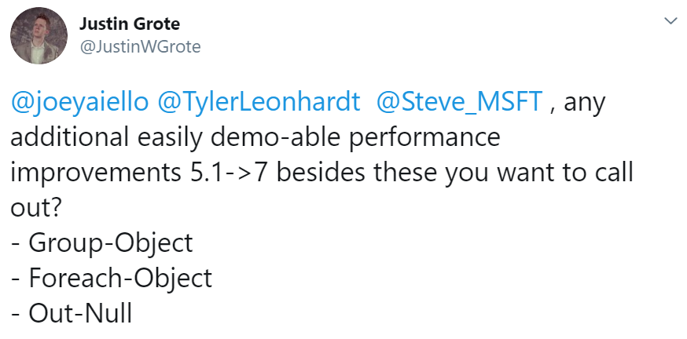
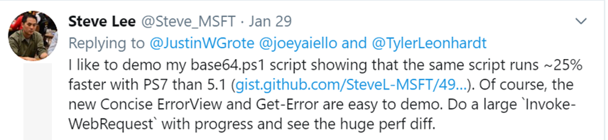

Mythos 2: Geschwindigkeit
Notes:
https://twitter.com/JustinWGrote/status/1222562135508566016?s=20
https://powershell.one/tricks/performance/group-object
https://windowsadmins.com/why-move-to-powershell-7-from-windows-powershell/

Slide 5
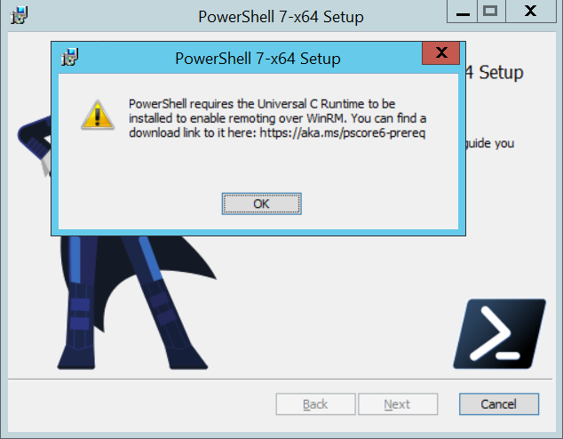
Mythos 3: Feature Parität
> Get-Command | Measure-Object

Slide 6
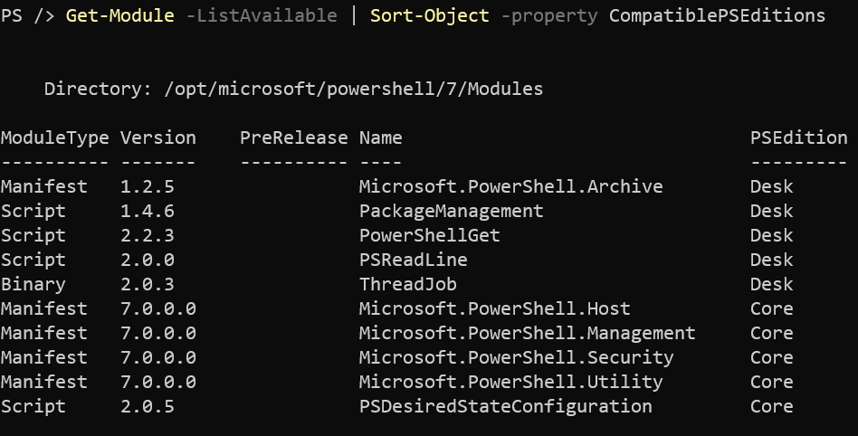
Mythos 4: FullCLR ???
?
PS 7.0 on Debian "Buster" 10

Slide 7
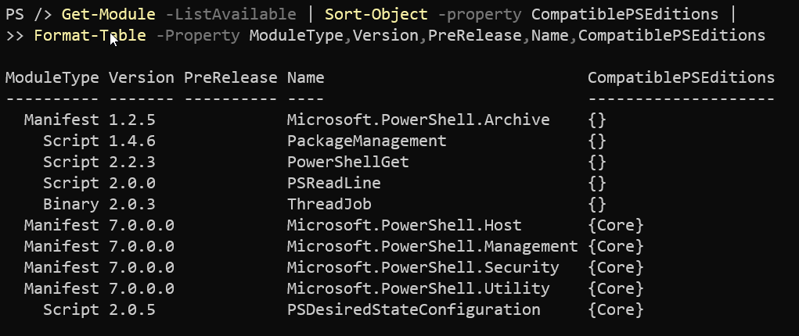
Mythos 4

Slide 8
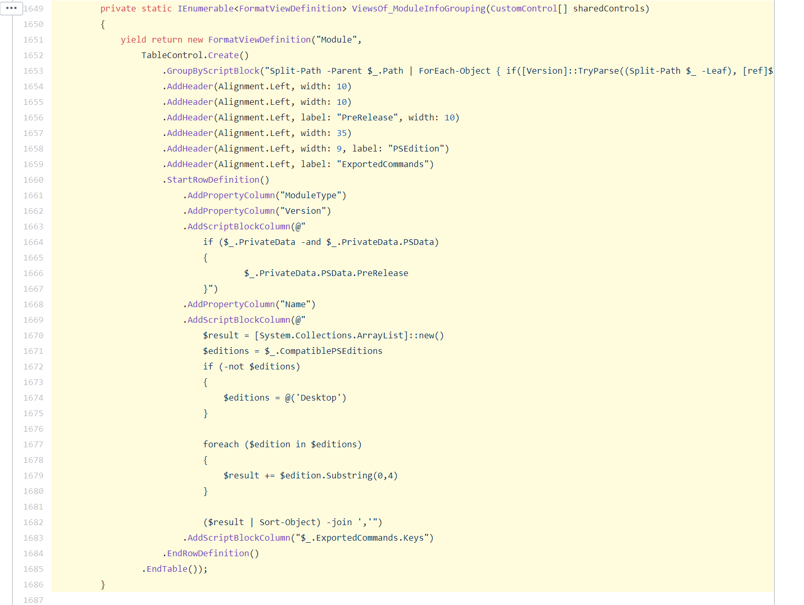
Mythos 4
Notes:
This is an error in the source code:
https://github.com/PowerShell/PowerShell/blob/b1e998046e12ebe5da9dee479f20d479aa2256d7/src/System.Management.Automation/FormatAndOutput/DefaultFormatters/PowerShellCore_format_ps1xml.cs#L1649-L1686
Line 1672-1675 (2020-04-29)
.AddScriptBlockColumn(@"
$result = [System.Collections.ArrayList]::new()
$editions = $_.CompatiblePSEditions
if (-not $editions)
{
$editions = @('Desktop')
}
Issue #7856: "PSEdition module field should not say "Desk" when no CompatiblePSEditions field is given in the manifest" https://github.com/PowerShell/PowerShell/issues/7856

Slide 9
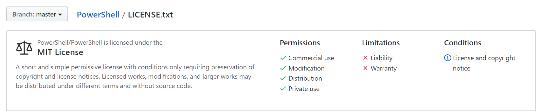
Mythos 5: Open Source
https://github.com/PowerShell/PowerShell/blob/master/LICENSE.txt

Slide 10
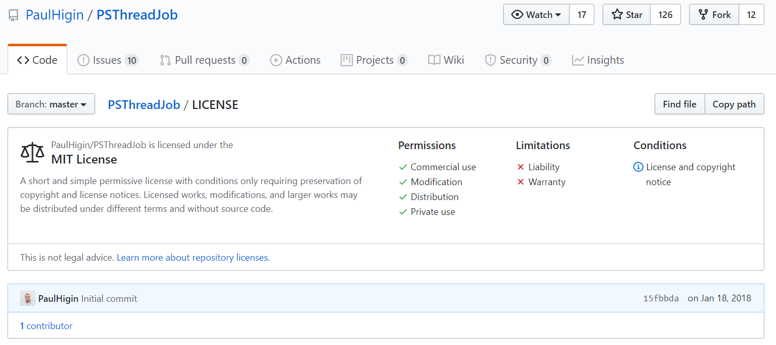
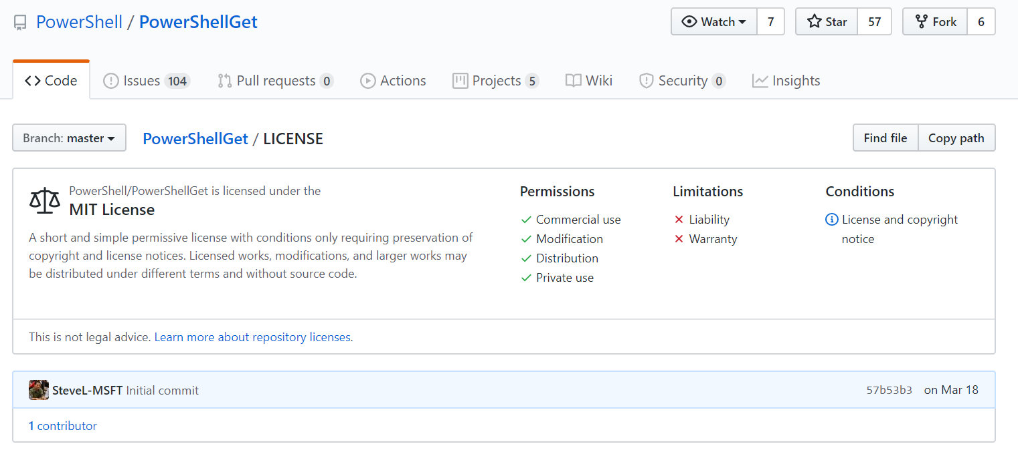
MIT-Lizenz: ThreadJobs, PowerShellGet
https://github.com/PaulHigin/PSThreadJob/
blob/master/LICENSE
https://github.com/PowerShell/PowerShellGet/blob/master/LICENSE

Slide 11
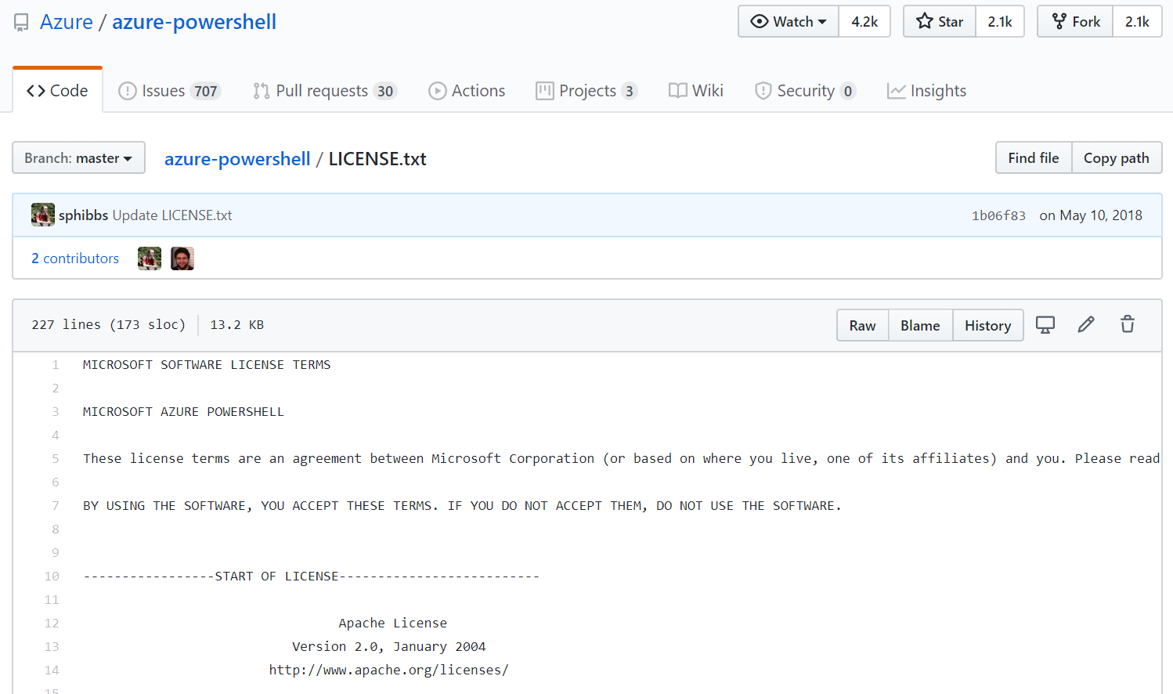
Apache-Lizenz: Azure
https://github.com/Azure/azure-powershell/blob/master/LICENSE.txt

Slide 12
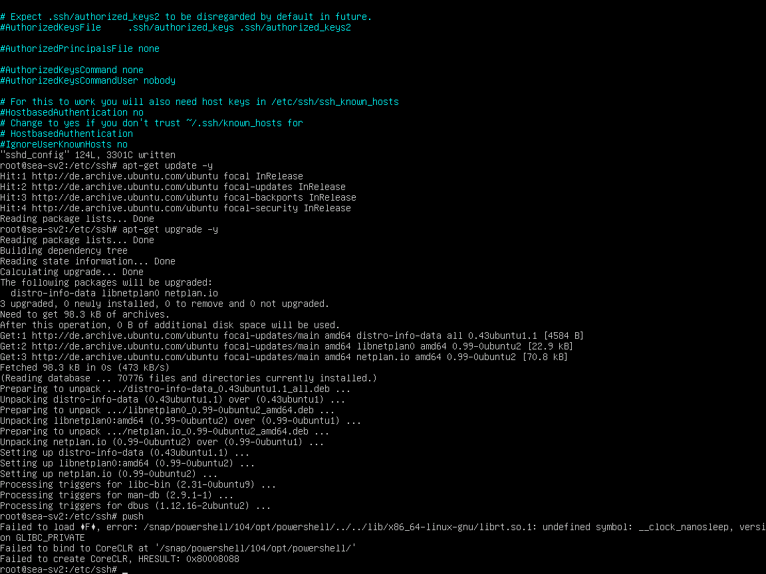
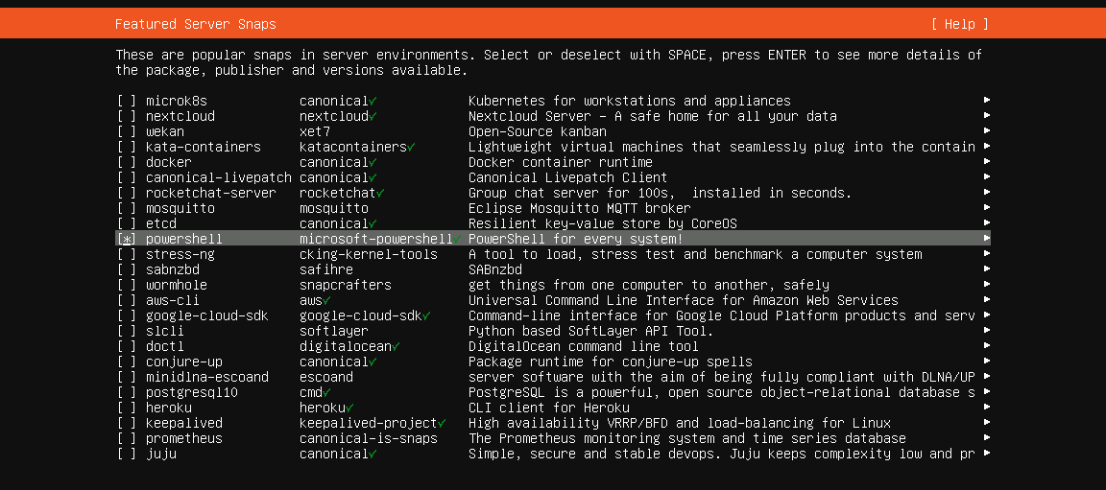
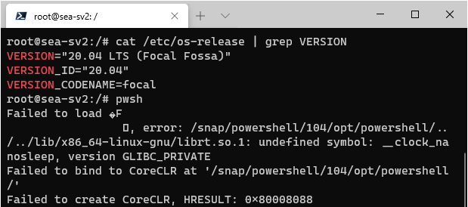
Mythos 6: "Microsoft ♥ Linux"
Ubuntu 20.04
LTS (Server)
snap install powershell –classic
snap remove powershell
Notes:
Ubuntu 20.04 LTS
Focal Fossa
Released: April 23, 2020
# Use PS preview
snap info powershell-preview

Slide 13

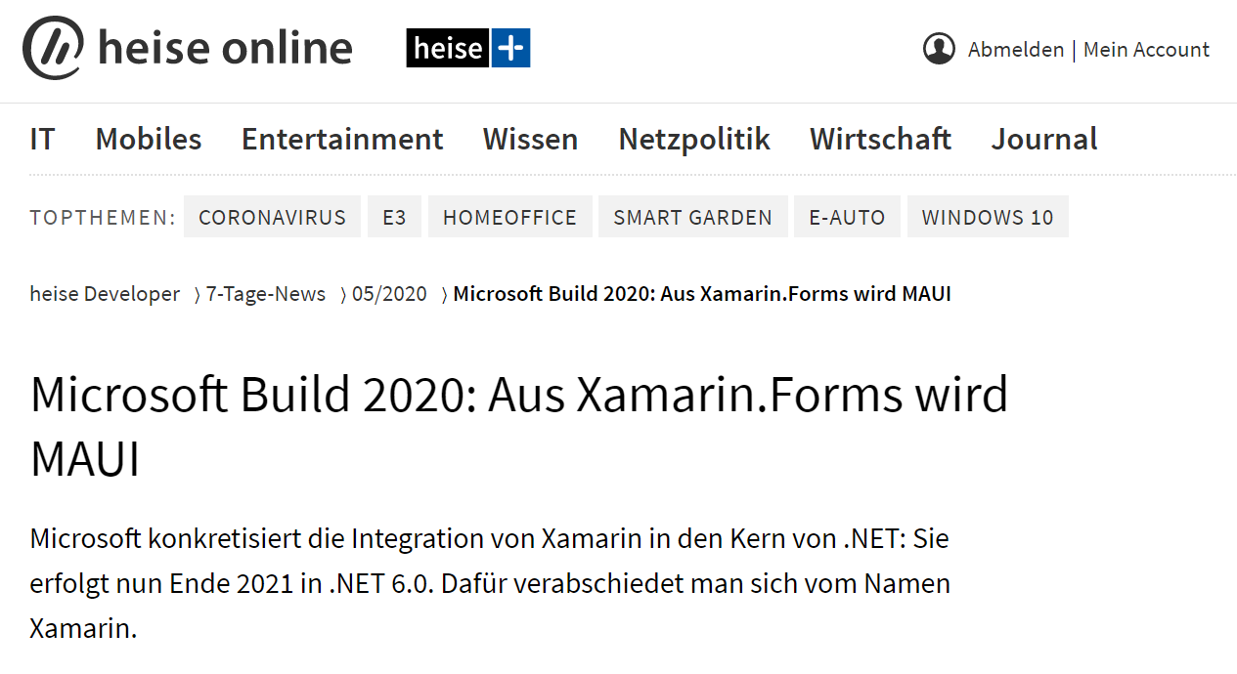
Mythos 6: "Microsoft ♥ Linux"
Notes:
Bild: https://commons.wikimedia.org/wiki/File:Maui,_Hawaii_beach.jpg
https://www.heise.de/developer/meldung/Build-2020-Aus-Xamarin-Forms-wird-MAUI-4724947.html

Slide 14

Mythos 6: "Microsoft ♥ Linux"
Microsoft’s Program Manager David Ortinau closed the thread with the message, “official legal name is .NET Multi-platform App UI and MAUI is an acronym, code name. This has been through legal review”.
https://itsfoss.com/microsoft-maui-kde-row/
https://github.com/dotnet/maui/issues/35
Notes:
Bild: https://commons.wikimedia.org/wiki/File:Maui,_Hawaii_beach.jpg
https://itsfoss.com/microsoft-maui-kde-row/
https://github.com/dotnet/maui/issues/35

Slide 15
Linux ♥ Microsoft ?

Slide 16
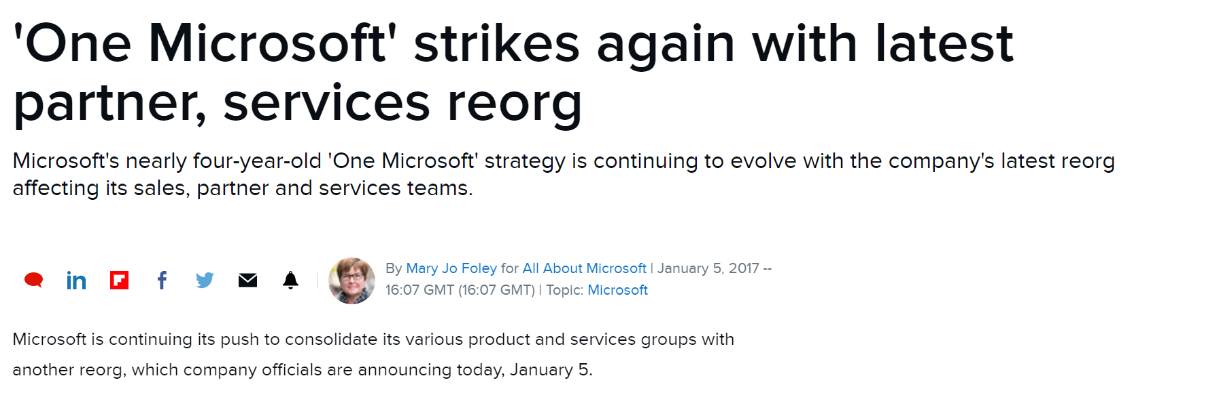
Mythos 7: One Microsoft
https://www.zdnet.com/article/one-microsoft-strikes-again-with-latest-partner-services-reorg/

Slide 17
Bonus?

Slide 18
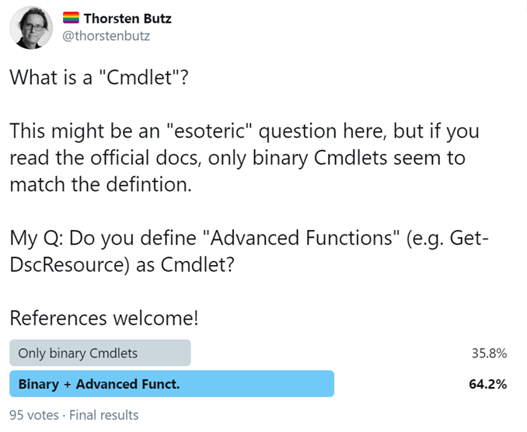
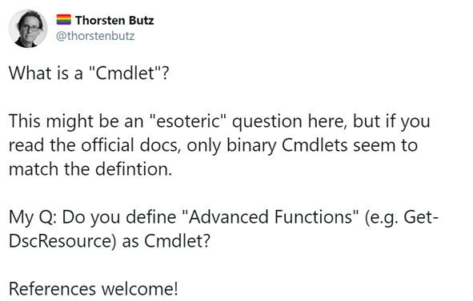
Bonus: "What is a Cmdlet" ?

Slide 19
Vielen Dank für die Aufmerksamkeit!
{
"Title" : "7 Mythen über PS 7",
"Speaker": "Thorsten Butz",
"Uri" : "thorsten-butz.de",
"Twitter": "@thorstenbutz",
"Podcast": "slidingwindows.de"
}

