Slide 1
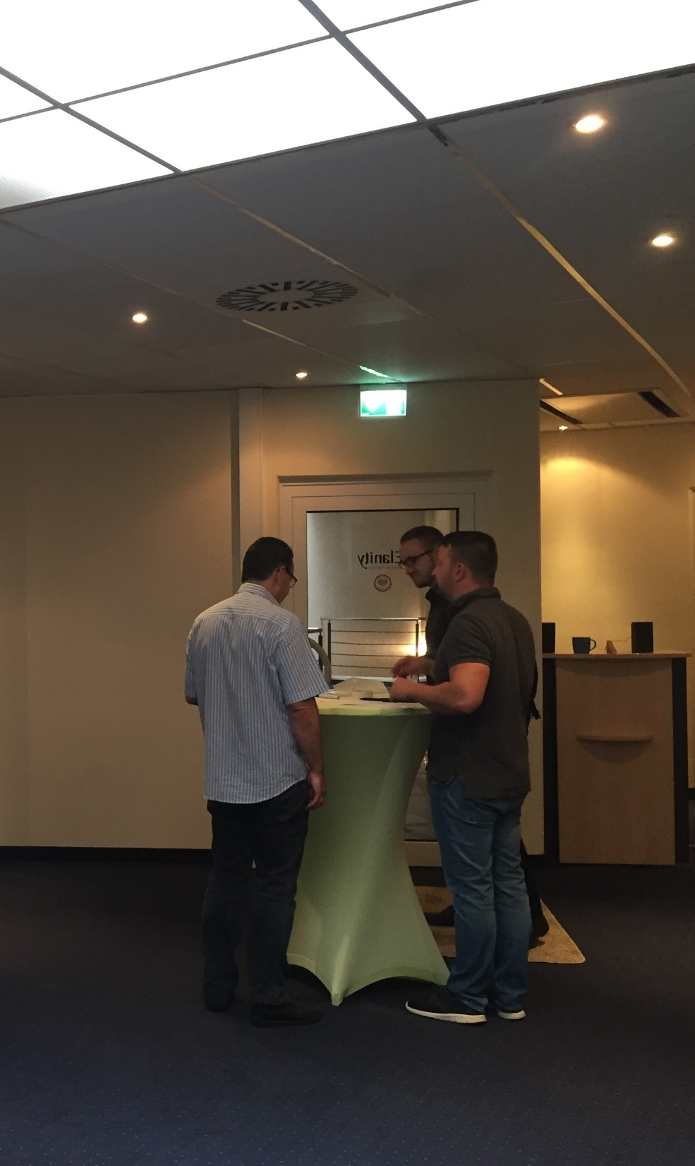
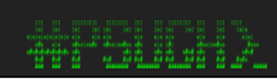


PowerShell Saturday Hannover 2018

Slide 2

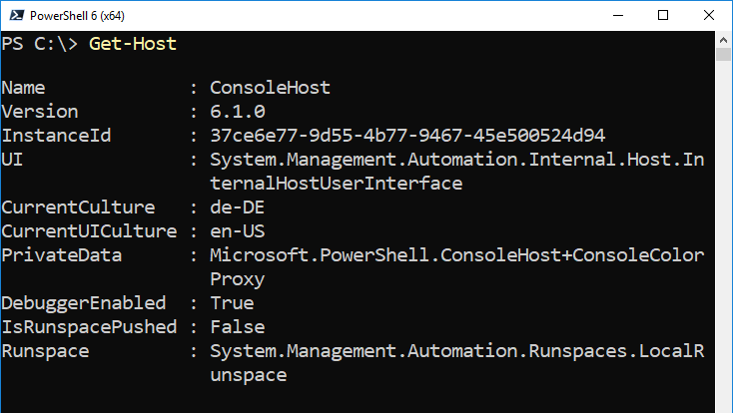
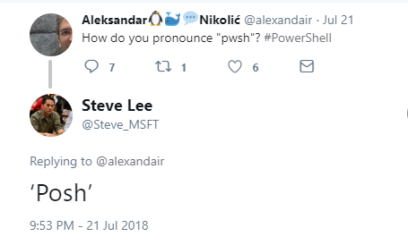
Separated at birth
Notes:
de-DE: "Bei der Geburt getrennt"

Slide 3
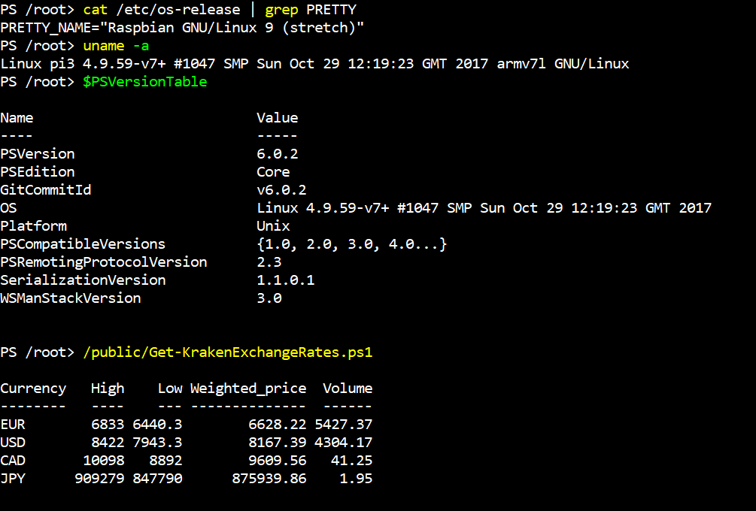
PoSh Core on RasPi
$uri = 'https://github.com/PowerShell/PowerShell/releases/download/
v6.0.1/powershell-6.0.1-linux-arm32.tar.gz'
apt-get install libunwind8
wget $uri mkdir /opt/powershell
tar -xvf ./powershell-6.0.1-linux-arm32.tar.gz -C /opt/powershell
ln -s /opt/powershell/pwsh /usr/bin/pwsh
Notes:
wget 'https://github.com/PowerShell/PowerShell/releases/
download/v6.0.2/powershell-6.0.2-linux-arm32.tar.gz'
apt-get install libunwind8
mkdir /opt/powershell
tar -xvf ./powershell-6.0.2-linux-arm32.tar.gz -C /opt/powershell
ln -s /opt/powershell/pwsh /usr/bin/pwsh

Slide 4
PoSh Core 6.1
1st version of PoSh Core: WS 2016 NANO
Support for Windows 7+
Support for LOTS of Linux distros/releases
Support for MaCOS 10.12+
Supports Unzip/Copy/Paste installations + multiple versions side-by-side
Comes with .NET Core 2.1 "attached", no sides effects on existing installations
Notes:
https://docs.microsoft.com/en-us/powershell/scripting/whats-new/what-s-new-in-powershell-core-61?view=powershell-6

Slide 5
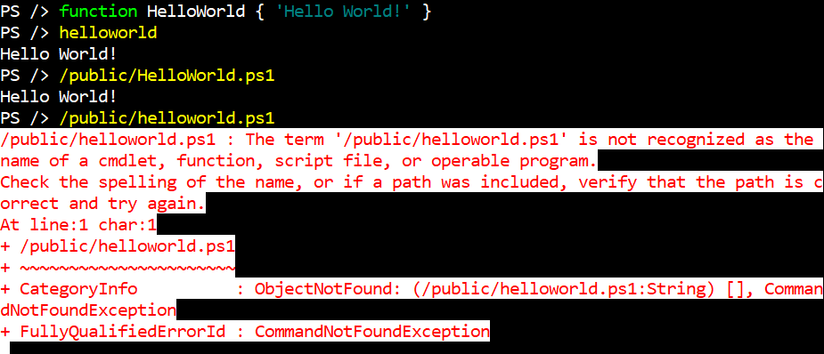
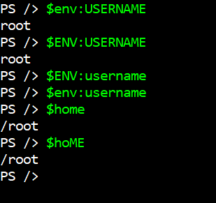
Mind the gap: Windows vs. *nix
"Same" CmdLets with different capabilites: Invoke-Command, ConvertTo-Json, ...
Less Built-In CmdLets
Missing aliases: ls, ps, wget, curl ...
NO RSAT for *nix
Case sensitivity
Notes:
Works:
$env:USERNAME
$ENV:USERNAME
Does not work:
$env:USERname
"cd" is both:
alias in PoSh
standard *nix command

Slide 6
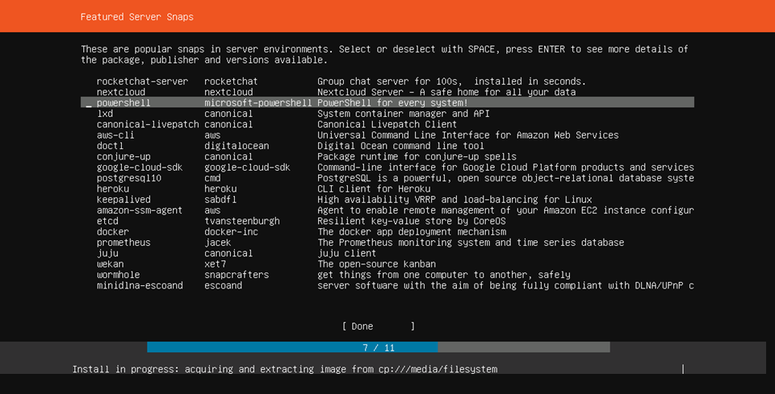
Ubuntu 18.04: Snaps

Slide 7
Demo

Slide 8
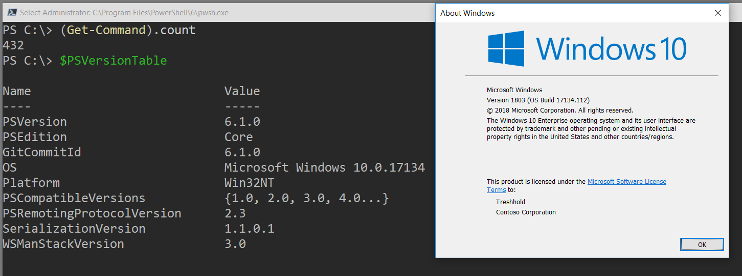
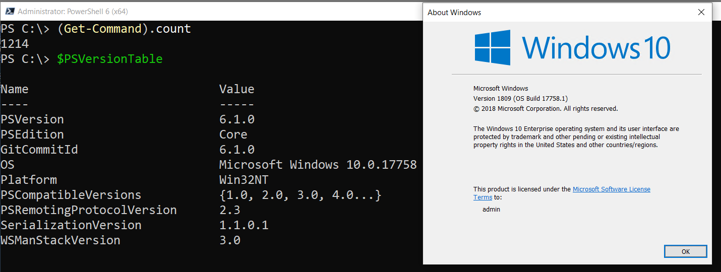
PwSh 6.1 & Windows 10

Slide 9
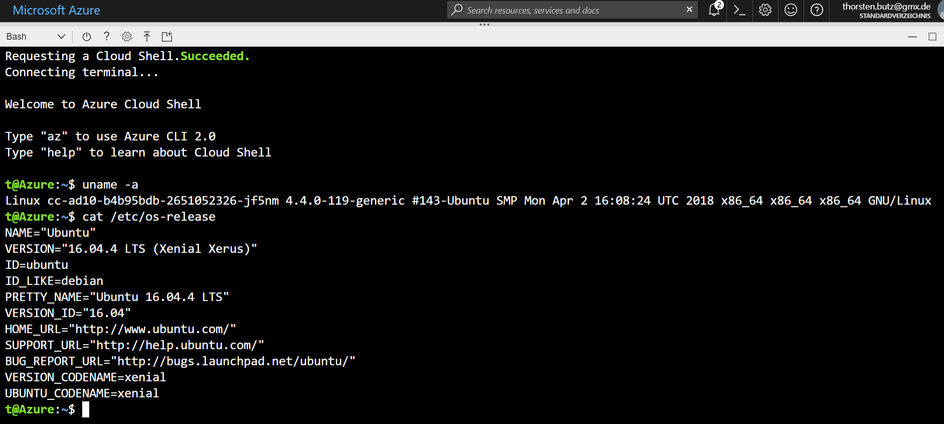
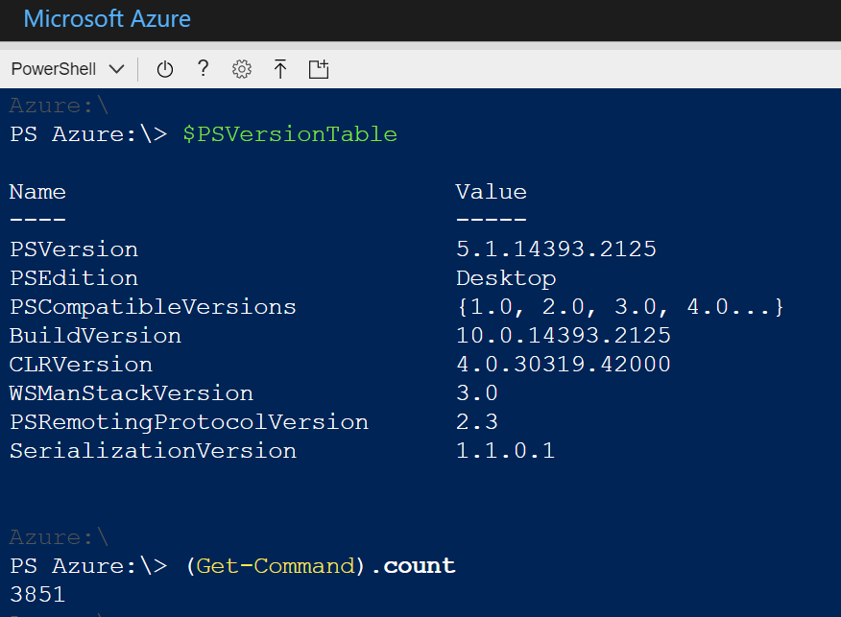
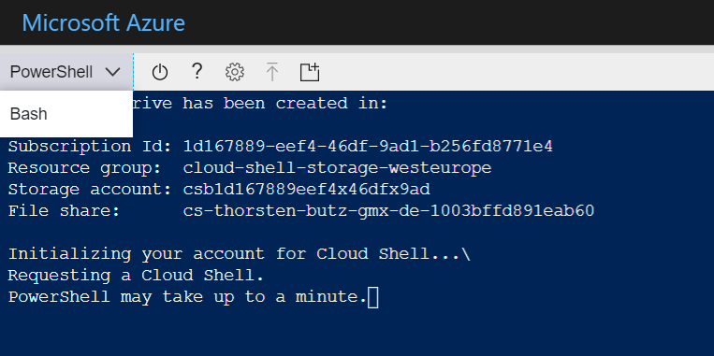
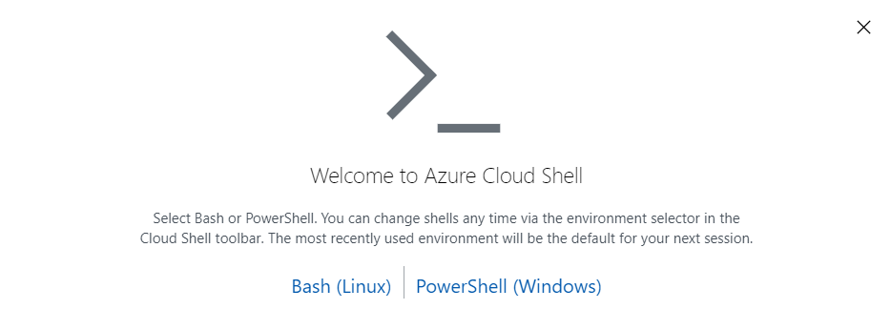
Azure Cloud Shell

Slide 10
Wrap up!
PoSh + Win32_OpenSSH
partially BETA quality
rapid deployment
community driven
$isConfusing = $true
Notes:
Joey Aiello about PowerShell 6
"I really dont see it as Microsoft's product anymore, this is very much a community OpenSoure project
that all of us are working on. "
May MeetUp with Joey Aiello: PowerShell 6 and OpenSSH (Mai 2017)
https://www.youtube.com/watch?v=Pa3P6gFEc6I

Slide 11
Questions?

Slide 12


Podcast: Sliding Windows
www.slidingwindows.de/?feed=slw-mp3
Get-Guest
Jeffrey Snover
Bruce Payette
Bartek Bielawski, Joey Aiello
Rolf Masuch
(..)

Slide 13
Get-Content | more
What's new in PowerShell - BRK3069 https://youtu.be/9fFAND6OCKU
What's New in PowerShell Core 6.1 https://docs.microsoft.com/en-us/powershell/scripting/whats-new/what-s-new-in-powershell-core-61
PowerShell unplugged with Jeffrey Snover and Jason Helmick - BRK2051 https://youtu.be/DPICqEiz3m4

