Slide 1

The future of NANO server
Thorsten Butz
#PSUGH> 'PowerShell Saturday Hannover (2017-08-26)'
Notes:
Intro:
https://www.youtube.com/watch?v=ohXI3po8hK0

Slide 2
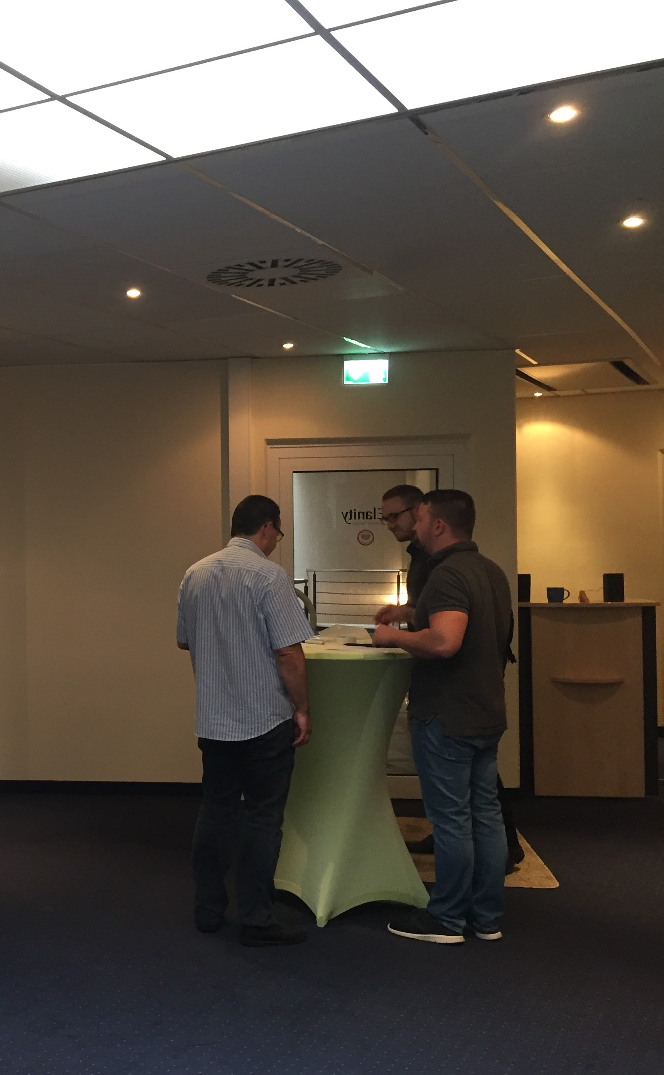
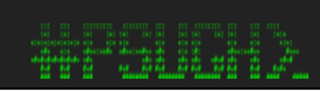


Thanks to the sponsors & organisers

Slide 3

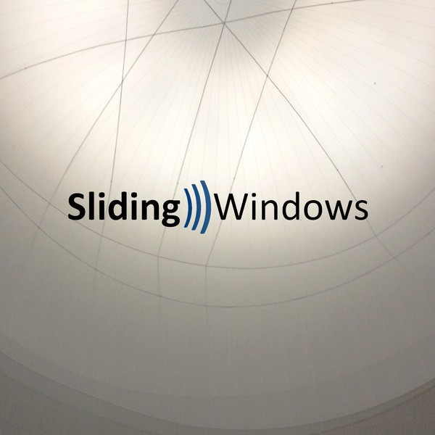
Podcast: Sliding Windows
www.slidingwindows.de/?feed=slw-mp3
Get-Guest
Bruce Payette
Bartek Bielawski, Joey Aiello
Rolf Masuch
(..)

Slide 4

The future of nano server in a nutshell
Notes:
https://www.youtube.com/watch?v=ky0rO7pM3WI

Slide 5
Nano
Chapter 1

Slide 6

Dont look back in anger: NANO (initial release)
# Path to extracted Windows Server 2016 ISO image
$mediapath = 'c:\ws2016\'
# Load module
Import-Module ` "$mediapath\NanoServer\NanoServerImageGenerator\NanoServerImageGenerator.psm1"
# Create
New-NanoServerImage -MediaPath $mediapath -Edition 'Datacenter' `
-DeploymentType Guest -MaxSize 100GB -TargetPath 'c:\nano1.vhdx'

Slide 7

Nano Server in v1607 (initial release of WS 2016)
Install image NanoServer: 169 MB
"Zero foot print": no roles and features onboard
Main purpose: "Compute clusters"
Hyper-V-Host
Storage: SoFS, etc.
Purpose 2: "born-in-the-cloud” application
Usage: physical, virtual, container
Headless, no local logon
Only 64-bit applications
PowerShell Core
Limited roles (e.g. no dc)
No activation required/supported
Manual windows updates
CBB (only)
Must be provisioned
Notes:
https://technet.microsoft.com/windows-server-docs/get-started/getting-started-with-nano-server

Slide 8

Footprints (WS 2016 RTW)
ImageName | ImageSize(Byte) | ImageSize(GB) | FileCount
Windows Server 2012 R2 SERVERSTANDARDCORE | 6897618255 | 6,42 | 70229
Windows Server 2012 R2 SERVERSTANDARD | 12069723893 | 11,24 | 89410
Windows Server 2012 R2 SERVERDATACENTERCORE | 6876269628 | 6,4 | 70120
Windows Server 2012 R2 SERVERDATACENTER | 12066707039 | 11,24 | 89288
Windows Server 2016 SERVERSTANDARDCORE | 9353610808 | 8,71 | 67418 | 60,6%
Windows Server 2016 SERVERSTANDARD | 15433268353 | 14,37 | 113677 | 100,0%
Windows Server 2016 SERVERDATACENTERCORE | 9353315396 | 8,71 | 67092 | 60,6%
Windows Server 2016 SERVERDATACENTER | 15440147913 | 14,38 | 113554 | 100,0%
Windows Server 2016 SERVERSTANDARDNANO | 800233355 | 0,75 | 8182 | 5,2%

Slide 9

Tuva:
170,500 km²
307.930 residents
Vatican: 0.44 km²
690 residents

Slide 10
Windows as a Service
Chapter 2

Slide 11

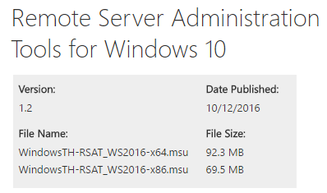
Prelude: Windows as a Service
Windows 10
Version 1507 (initial release, Threshold 1), Build 10240
Version 1511 (November update, Threshold 2, Build 10586
Version 1607 (Anniversary update, Redstone 1, Build 14393 )
Version 1703 (Creators Update, Redstone 2, Build 15063)
Version 1709 (Fall Creators Update, Redstone 3)
Version 1803 ...
Windows Server 2016
Version 1607 (Redstone 1, Build 14393)
Version 1709 (Redstone 3)
..
..
Paid Upgrade
Notes:
https://docs.microsoft.com/en-us/windows/deployment/update/waas-overview
https://blogs.msdn.microsoft.com/daviddasneves/2017/06/18/demystifying-windows-as-a-service-wake-up-please/

Slide 12
Servicing branches: Lifecycle (prior to July 2017)
Current branch for
buisness (CBB)
Current
branch (CB)
Long term services branch (LTSB)
Windows Insiders
Dogfooding

Slide 13
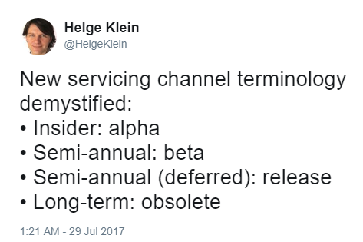
Semi-Annual Channel: Lifecycle (July 2017)
Production /
Broad deployment
Production / Piloting *
Windows Insiders
Dogfooding
Supported lifetime: 18 months
* also referred to as "targeted deployment"
Notes:
https://twitter.com/HelgeKlein/status/891076288626270208

Slide 14
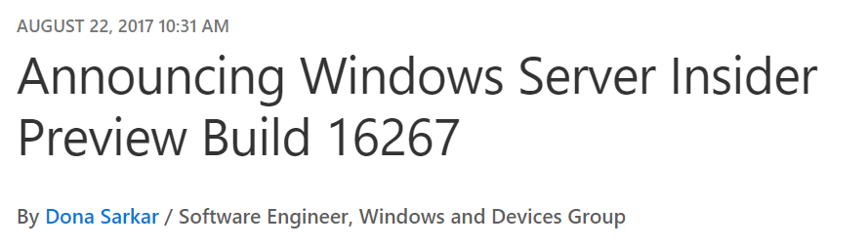
Windows Server 2016: Releases, Branches, Installation Options
v1607:
Core: LTSB
Deskop Experience: LTSB
Nano: CBB
v1709 (insider preview, build 1627)
Core: Semi-annual
1st preview: build 16237
2nd preview: build 16257
3rd preview: build 16267
Notes:
1st Windows Server Insider Preview (JULY 13, 2017)
Donna Sarkar: Announcing Windows Server Insider Preview Build 16237
https://blogs.windows.com/windowsexperience/2017/07/13/announcing-windows-server-insider-preview-build-16237/
AUGUST 8, 2017 10:38 AM
Donna Sarkar: Announcing Windows Server Insider Preview Build 16257
https://blogs.windows.com/windowsexperience/2017/08/08/announcing-windows-server-insider-preview-build-16257
Delivering continuous innovation with Windows Server
Erin Chapple (General Manager, Windows Server)
https://blogs.technet.microsoft.com/hybridcloud/2017/06/15/delivering-continuous-innovation-with-windows-server/

Slide 15
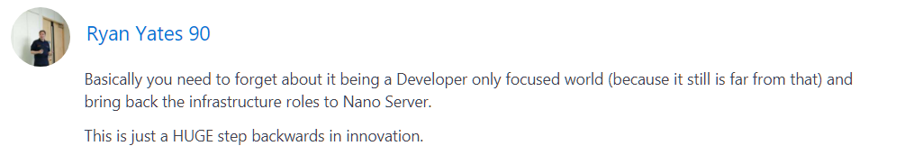
Delivering continuous innovation with Windows Server
Erin Chapple (General Manager, Windows Server), 2017-06-15:
"Based on that feedback, we are making an important change to Nano Server. This next release will focus on making Nano Server the very best container image possible. From these changes, customers will now see the Nano Server images shrink in size by more than 50 percent, further decreasing startup times and improving container density. As part of this effort to focus on containers, we will be removingg the functionality for infrastructure-related roles. "
..
..
https://blogs.technet.microsoft.com/hybridcloud/2017/06/15/delivering-continuous-innovation-with-windows-server/

Slide 16

Nano Server in v1709 (2nd release of WS 2016)
> 50% in size compared to previous
No infrastructure roles
No hyper-V, SoFS
Main purpose: Support of .NET Core applications
Usage: container, IoT Core installations
Windows PowerShell, .NET Core, WM: no longer included by default (can be included when building a container)
No install image, no servicing stack included (anymore); instead: docker hub
Notes:
https://technet.microsoft.com/windows-server-docs/get-started/getting-started-with-nano-server

Slide 17
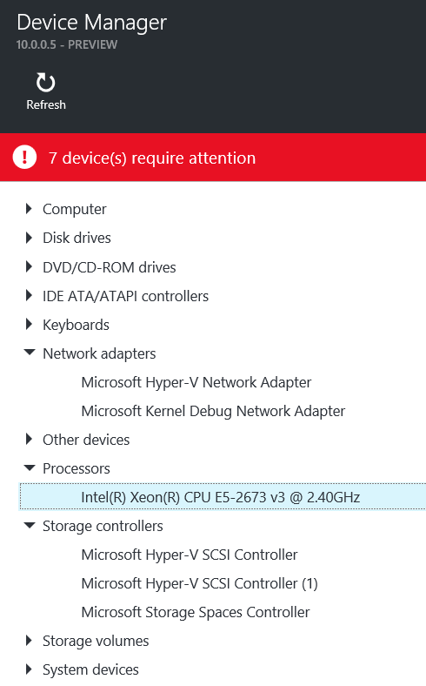
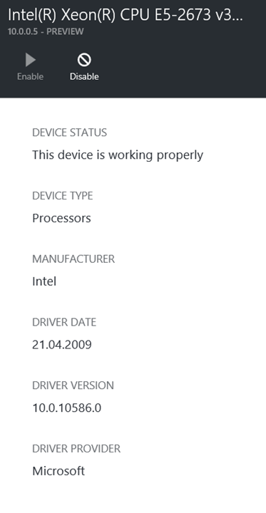
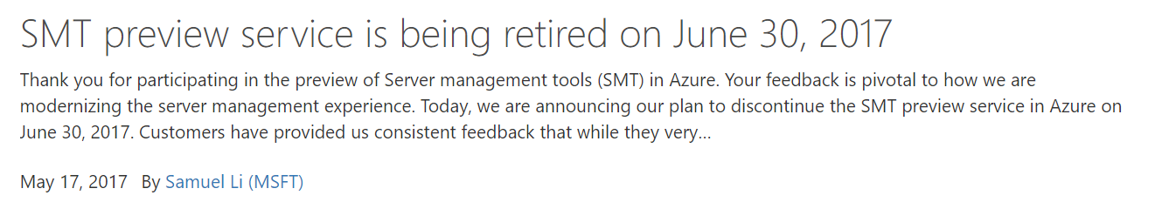
SMT: Server Management Tools

Slide 18
Container
Chapter 3

Slide 19
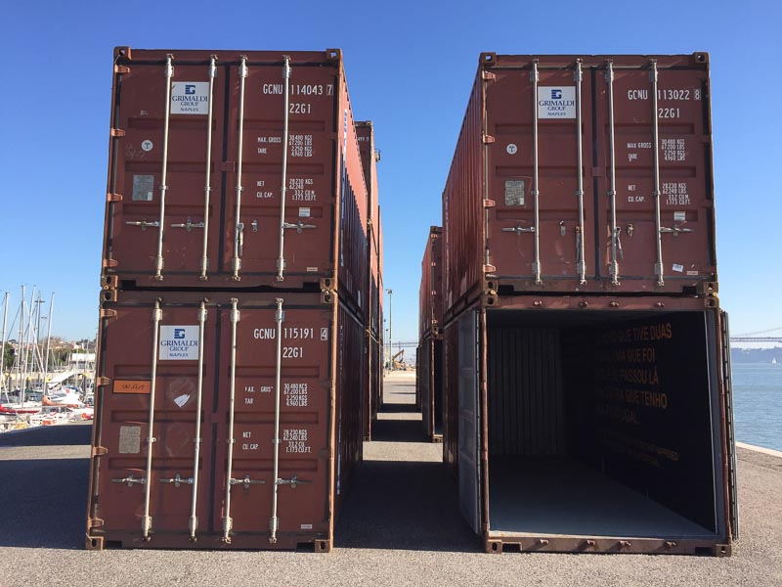
Container
Linux Container: docker.com
Container in Windows Server
Windows Server Container Hyper-V not required
Hyper-V Container requires Hyper-V
LinuxKit Announced at DockerCon 2017
Desktop solutions (Win 10, MacOS ..)

Slide 20
Basic principles
Seperate physical
servers
Virtualiza-tion, e.g. VMWare, KVM,
Hyper-V
Container
Extended Isolation, e.g. jails, container
cost
Simple Isolation, e.g. chroot
MultiUser
OS
hardening

Slide 21

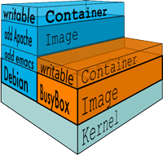
docker.com
Founded 2013
Initially built upon "LinuX Containers" (LXC), since v0.9: libcontainer
Requires Linux 3.8 or later, using "Control Groups" (Cgroups), "Namespaces"
Unifying FS: AUFS, OverlayFS, ZFS ..
Figures: www.docker.com/what-docker

Slide 22
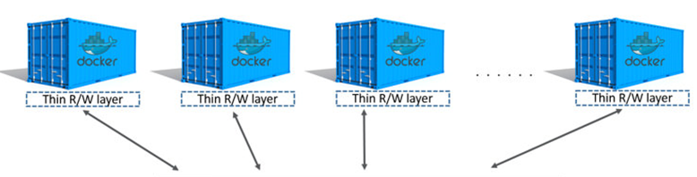
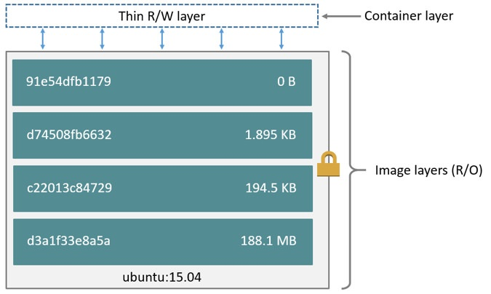
docker: Images and layers
https://docs.docker.com/engine/userguide/storagedriver/imagesandcontainers/

Slide 23
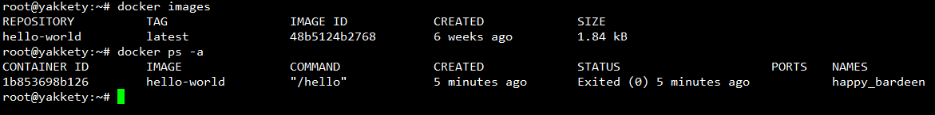
Setup docker (Ubuntu, Debian)
# Install, verify
apt-get install docker.io
docker version
docker info
# List containers docker ps
# List images docker images
# Search the docker hub
docker search hello-world
docker run hello-world
LINUX

Slide 24
From drawbridge to Hyper-V containers
2008: Hyper-V Support for Legacy OS, enlightining modern OS
2011: Research project "Drawbridge" Process isolation container technology for Azure
2013: Microsoft & Docker partnering Development of a common management interface

Slide 25
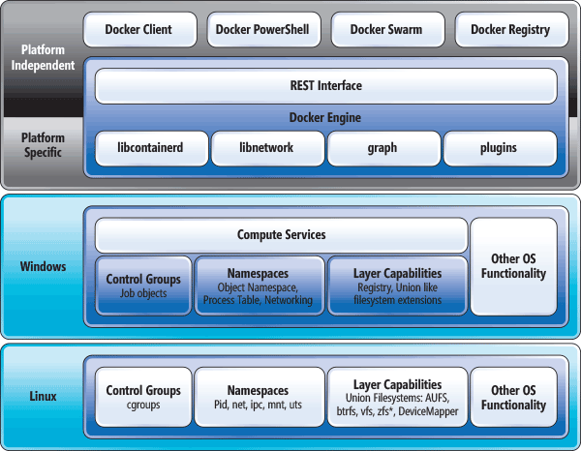
Containers: Linux vs. Windows
"Comparing the Basic Architecture of Containers and Docker Across Windows and Linux", https://msdn.microsoft.com/en-us/magazine/mt797649.aspx

Slide 26
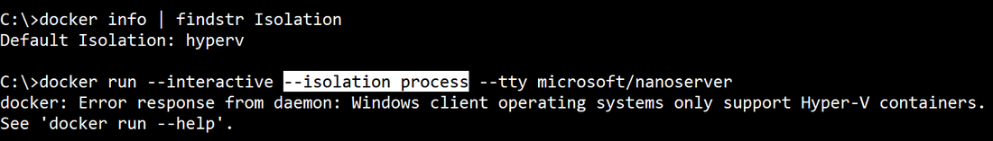
Windows isolation modes
Windows supports:
(default)
process
hyperv
Hyper-V Container (Hyper-V must be enabled): VM worker process "vmwp" on host, each container has it's own csrss process

Slide 27
Setup Windows Server Containers
# Enable Windows feature(s) Install-WindowsFeature –Restart -Name Containers Install-WindowsFeature –Restart -Name Hyper-V # Optional
# Get docker Install-Module -Name DockerMsftProvider -Repository PSGallery Install-Package -Name docker -ProviderName DockerMsftProvider
# Reboot Restart-Computer
# Verify setup Get-ComputeProcess docker version docker info
WINDOWS SERVER

Slide 28
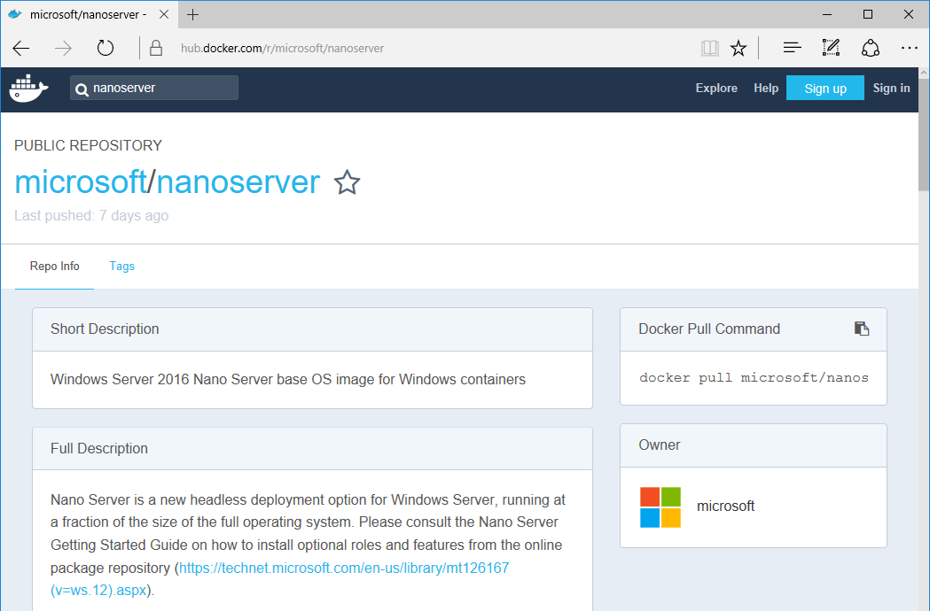

Slide 29
Combinations
HOST OS | Windows Server Container |  | Hyper-V Container |  | Linux Container
 | Nano | Core | Nano | Core | Hyper-V VM | LinuxKit
WS 2016 Nano | ✓ | - | ✓ | ✓ |  | ?
WS 2016 Core | ✓ | ✓ | ✓ | ✓ |  | ?
WS 2016 SaD | ✓ | ✓ | ✓ | ✓ |  | ?
Windows 10 | - | - | ✓ | ✓ | ✓ | ?

Slide 30


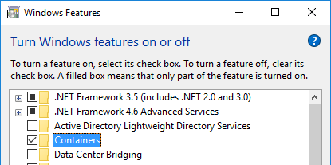
Dazed and confused ..
Docker Toolbox Legacy: "older Mac + Windows OS", uses Virtualbox
Docker for Windows uses Hyper-V + Windows Containers Linux + Windows Containers
Containers for Windows native Windows Containers, no (G)UI, Isolation: Hyper-V
DESKTOP

Slide 31

Install "Docker for Windows" (on Win 10)
#Requires -RunAsAdministrator
Enable-WindowsOptionalFeature –Online -NoRestart -FeatureName 'Microsoft-Hyper-V-All','Containers' Invoke-WebRequest -uri 'https://download.docker.com/win/stable/InstallDocker.msi'
-OutFile 'c:\InstallDocker.msi'
msiexec.exe /i 'c:\InstallDocker.msi' /passive /forcerestart

Slide 32
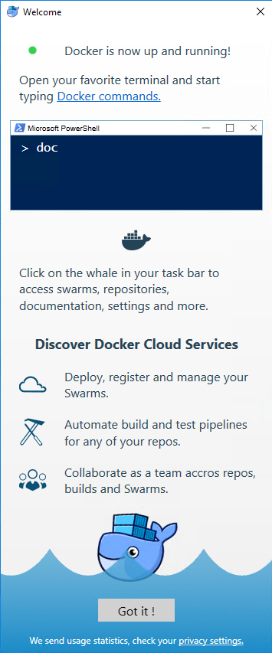
"Docker on Windows" (April 2017)
"Community Edition"
docker version: Version 17.03.1-ce (Client, Server)
Supports Windows Containers, Hyper-V isolation only
Supports Linux Containers via Alpine Linux VM in Hyper-V

Slide 33
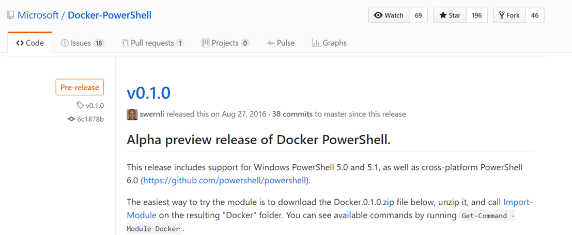
PowerShell Cmdlets for Docker (April 2017)
https://github.com/Microsoft/Docker-PowerShell/releases

Slide 34
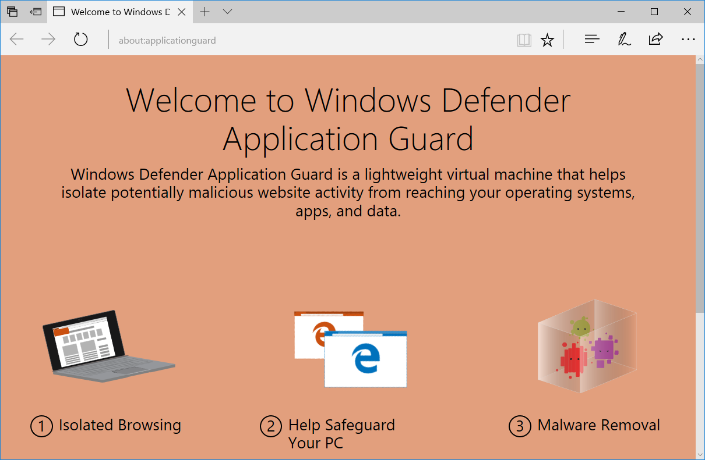
What's beyond ...
Project Barcelona, Windows 10 v1703

Slide 35
The future of nano server
?

Slide 36

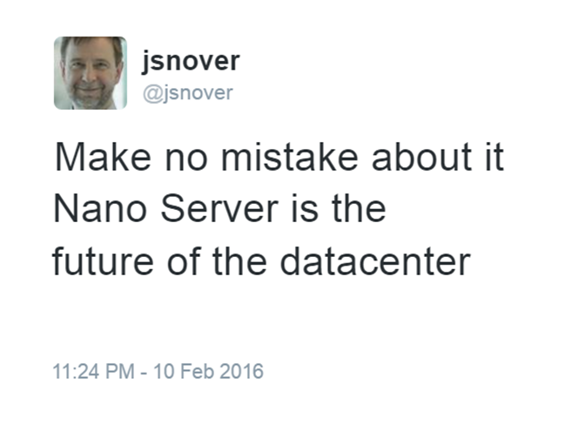
2016 2017
https://blogs.technet.microsoft.com/windowsserver/2016/
02/10/exploring-nano-server-for-windows-server-2016/

Slide 37

KEEP
CALM
AND
ENJOY THE
CONFERENCE
Corbel 57, 28

