Slide 1
Windows Server Container
….
@thorstenbutz

Slide 3
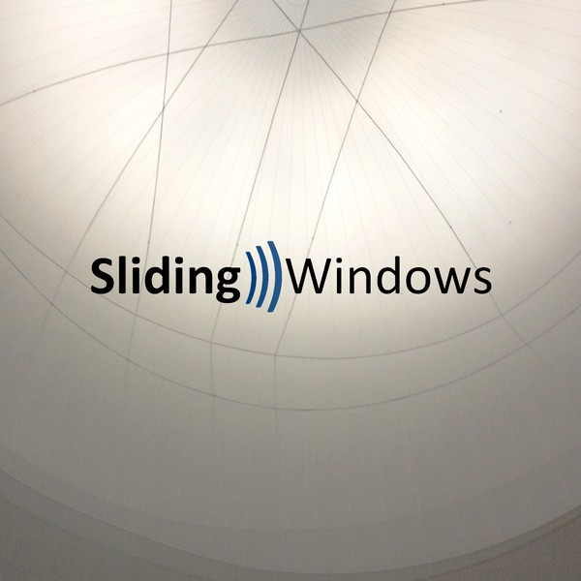

Podcast: Sliding Windows
SLW05: Remote Desktops, Benny Tritsch …
www.slidingwindows.de/?feed=slw-mp3

Slide 4
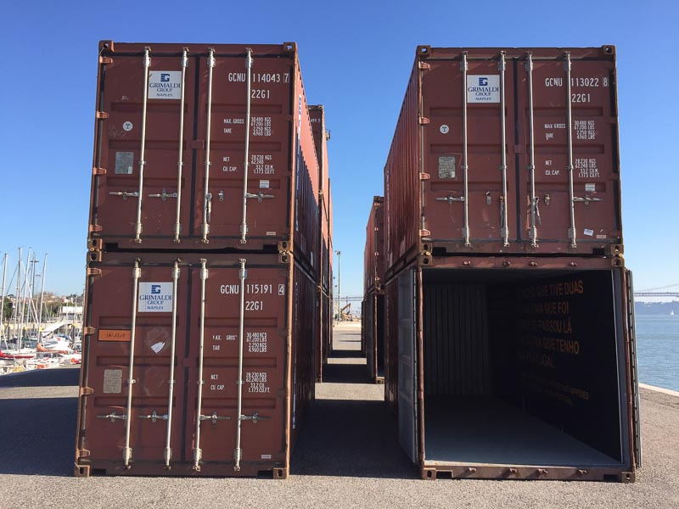
Container
Linux Container: docker.com
Container in Windows Server
Windows Server Container Hyper-V not required
Hyper-V Container requires Hyper-V
LinuxKit Announced at DockerCon 2017
Desktop solutions (Win 10, MacOS ..)

Slide 5
Basic principles
Seperate physical
servers
Virtualiza-tion, e.g. VMWare, KVM,
Hyper-V
Container
cost
Extended Isolation, e.g. jails, container
Simple Isolation, e.g. chroot
MultiUser
OS
hardening

Slide 6

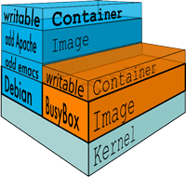
docker.com
Founded 2013
Initially built upon "LinuX Containers" (LXC), since v0.9: libcontainer
Requires Linux 3.8 or later, using "Control Groups" (Cgroups), "Namespaces"
Unifying FS: AUFS, OverlayFS, ZFS ..
Figures: www.docker.com/what-docker

Slide 7
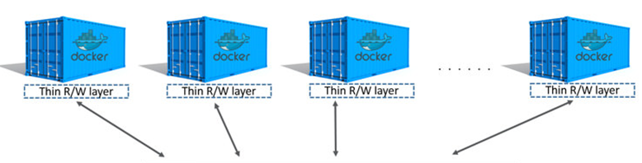
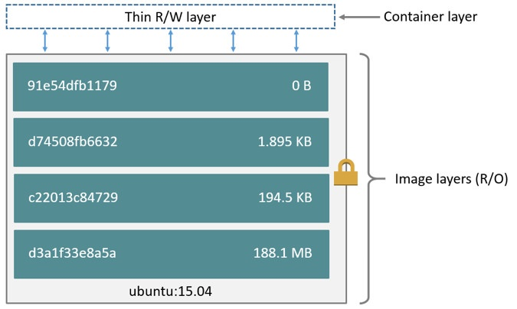
docker: Images and layers
https://docs.docker.com/engine/userguide/storagedriver/imagesandcontainers/

Slide 8
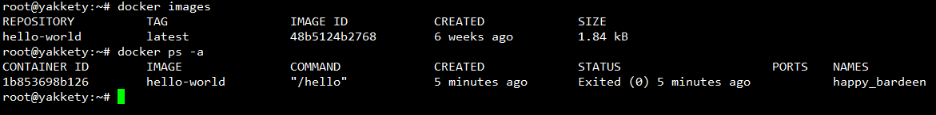
Setup docker (Ubuntu, Debian)
# Install, verify
apt-get install docker.io
docker version
docker info
# List containers docker ps
# List images docker images
# Search the docker hub
docker search hello-world
docker run hello-world
LINUX

Slide 9

KEEP
CALM
IT'S
DEMO
TIME
Corbel 57, 28

Slide 10

Footprints (WS 2016 RTW)
ImageName | ImageSize(Byte) | ImageSize(GB) | FileCount
Windows Server 2012 R2 SERVERSTANDARDCORE | 6897618255 | 6,42 | 70229
Windows Server 2012 R2 SERVERSTANDARD | 12069723893 | 11,24 | 89410
Windows Server 2012 R2 SERVERDATACENTERCORE | 6876269628 | 6,4 | 70120
Windows Server 2012 R2 SERVERDATACENTER | 12066707039 | 11,24 | 89288
Windows Server 2016 SERVERSTANDARDCORE | 9353610808 | 8,71 | 67418 | 60,6%
Windows Server 2016 SERVERSTANDARD | 15433268353 | 14,37 | 113677 | 100,0%
Windows Server 2016 SERVERDATACENTERCORE | 9353315396 | 8,71 | 67092 | 60,6%
Windows Server 2016 SERVERDATACENTER | 15440147913 | 14,38 | 113554 | 100,0%
Windows Server 2016 SERVERSTANDARDNANO | 800233355 | 0,75 | 8182 | 5,2%

Slide 11

Nano Server in v1607 (initial release of WS 2016)
Install image NanoServer: 169 MB
"Zero foot print": no roles and features onboard
Main purpose: "Compute clusters"
Hyper-V-Host
Storage: SoFS, etc.
Purpose 2: "born-in-the-cloud” application
Usage: physical, virtual, container
Headless, no local logon
Only 64-bit applications
PowerShell Core
Limited roles (e.g. no dc)
No activation required/supported
Manual windows updates
CBB (only)
Must be provisioned
Notes:
https://technet.microsoft.com/windows-server-docs/get-started/getting-started-with-nano-server

Slide 12

Tuva:
170,500 km²
307.930 residents
Vatican: 0.44 km²
690 residents

Slide 13
From drawbridge to Hyper-V container
2008: Hyper-V Support for Legacy OS, enlightining modern OS
2011: Research project "Drawbridge" Process isolation container technology for Azure
2013: Microsoft & Docker partnering Development of a common management interface

Slide 14
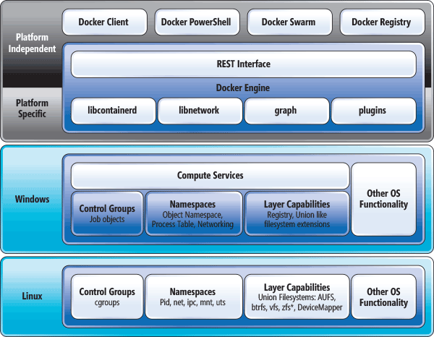
Container: Linux vs. Windows
"Comparing the Basic Architecture of Containers and Docker Across Windows and Linux", https://msdn.microsoft.com/en-us/magazine/mt797649.aspx

Slide 15
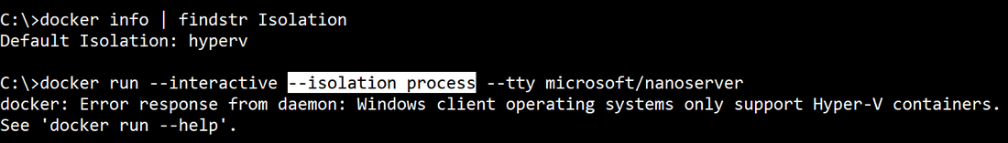
Windows isolation modes
Windows supports:
(default)
process
hyperv
Hyper-V Container (Hyper-V must be enabled): VM worker process "vmwp" on host, each container has it's own csrss process

Slide 16
Setup Windows Server Containers
# Enable Windows feature(s) Install-WindowsFeature –Restart -Name Containers Install-WindowsFeature –Restart -Name Hyper-V # Optional
# Get docker Install-Module -Name DockerMsftProvider -Repository PSGallery Install-Package -Name docker -ProviderName DockerMsftProvider
# Reboot Restart-Computer
# Verify setup Get-ComputeProcess docker version docker info
WINDOWS SERVER

Slide 17
KEEP
CALM
IT'S
DEMO
TIME
Corbel 57, 28

Slide 18
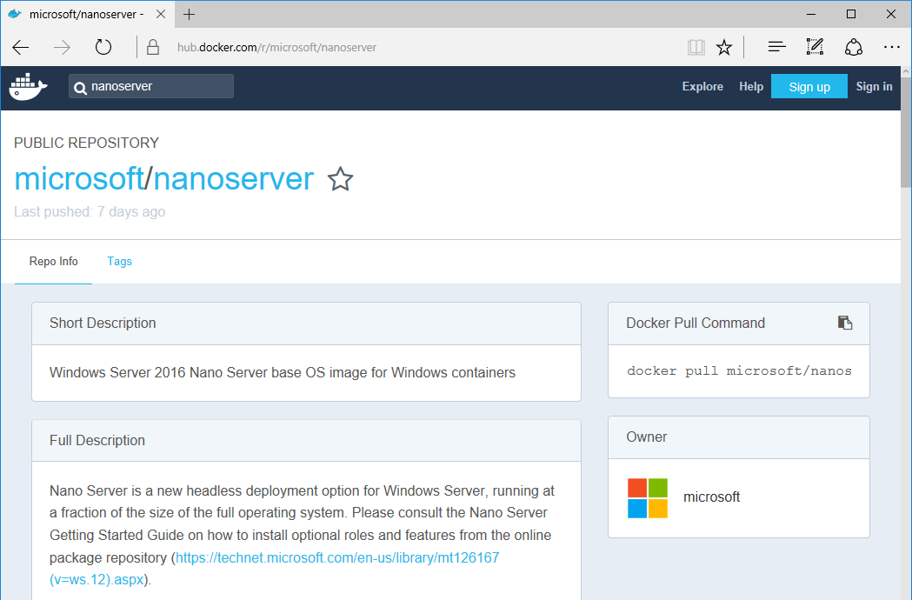

Slide 19
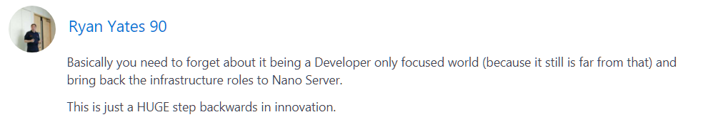
Delivering continuous innovation with Windows Server
Erin Chapple (General Manager, Windows Server), 2017-06-15:
"Based on that feedback, we are making an important change to Nano Server. This next release will focus on making Nano Server the very best container image possible. From these changes, customers will now see the Nano Server images shrink in size by more than 50 percent, further decreasing startup times and improving container density. As part of this effort to focus on containers, we will be removing the functionality for infrastructure-related roles. "
..
..
https://blogs.technet.microsoft.com/hybridcloud/2017/06/15/delivering-continuous-innovation-with-windows-server/

Slide 20

Nano Server in v1709 (2nd release of WS 2016)
> 50% in size compared to previous
No infrastructure roles
No hyper-V, SoFS
Main purpose: Support of .NET Core applications
Usage: container, IoT Core installations
Windows PowerShell, .NET Core, WMI: no longer included by default (can be included when building a container)
No install image, no servicing stack included (anymore); instead: docker hub
Notes:
https://technet.microsoft.com/windows-server-docs/get-started/getting-started-with-nano-server

Slide 21
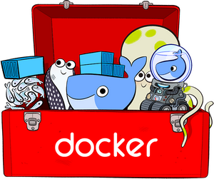
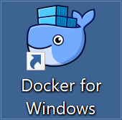
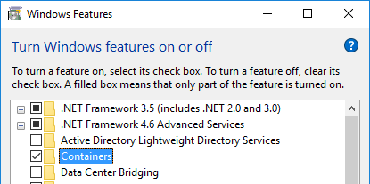
Dazed and confused ..
Docker Toolbox Legacy: "older Mac + Windows OS", uses Virtualbox
Docker for Windows uses Hyper-V + Windows Containers Linux + Windows Containers
Containers for Windows native Windows Containers, no (G)UI, Isolation: Hyper-V
DESKTOP

Slide 22

Install "Docker for Windows" (on Win 10)
#Requires -RunAsAdministrator
Enable-WindowsOptionalFeature –Online -NoRestart -FeatureName 'Microsoft-Hyper-V-All','Containers' Invoke-WebRequest -uri 'https://download.docker.com/win/stable/InstallDocker.msi'
-OutFile 'c:\InstallDocker.msi'
msiexec.exe /i 'c:\InstallDocker.msi' /passive /forcerestart

Slide 23
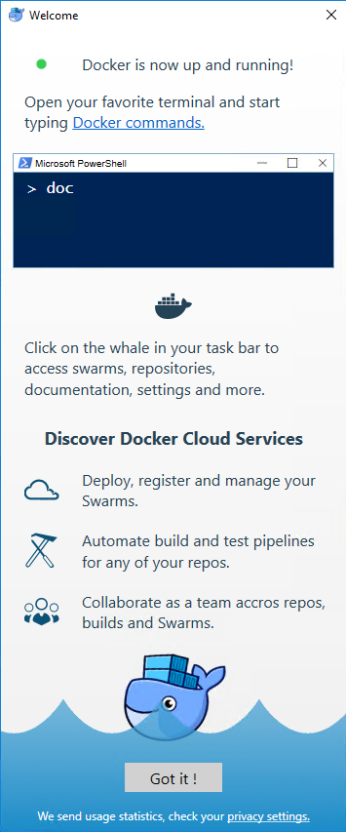
"Docker on Windows" (Sept. 2017)
"Community Edition"
docker version: Version 17.06.2-ce (Client, Server)
Supports Windows Containers, Hyper-V isolation only
Supports Linux Containers via Alpine Linux VM in Hyper-V

Slide 24
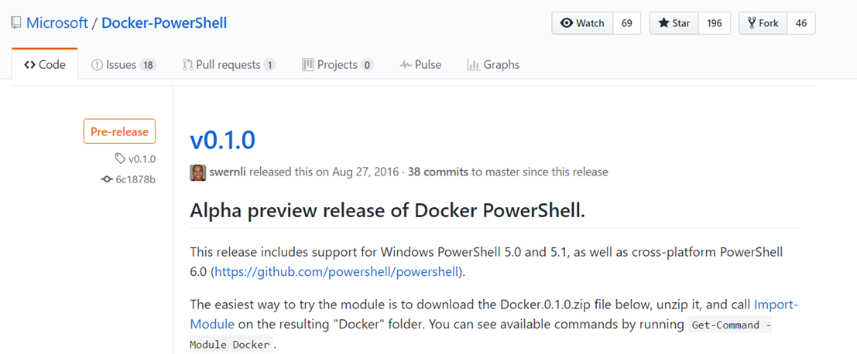
PowerShell Cmdlets for Docker (September 2017)
https://github.com/Microsoft/Docker-PowerShell/releases

Slide 25
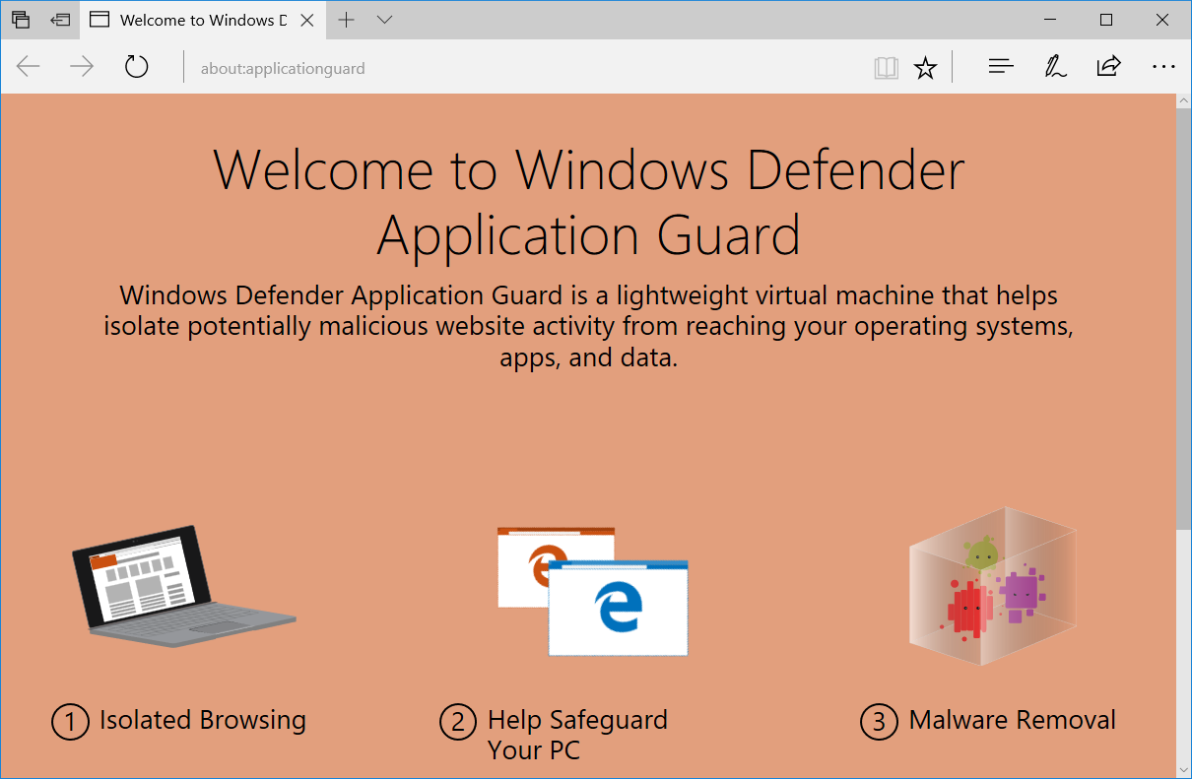
What's beyond ...
Project Barcelona, Windows 10 v1703

Slide 26


Wrap up!
docker.exe or Cmdlets?
Will Hyper-V be obsolete?
Pets or cattles ?
#LinuxKit

Slide 27




Get-Help about_me
$speaker = @{
name = Thorsten Butz
jobrole = Trainer, Consultant, Author
certification = MC*,LPIC-2
^ = thorstenbutz
= facebook.com/thbutz
= www.thorsten-butz.de
}

