Slide 1


about_Containers
A note from the field
Thorsten Butz

Slide 2
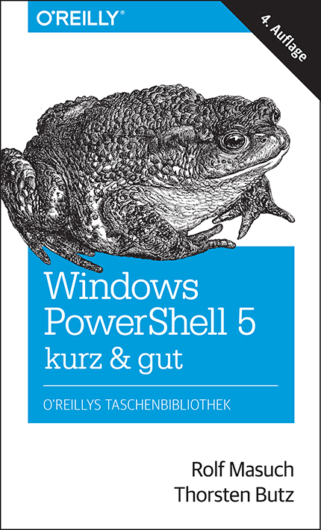



Get-Help about_me
$speaker = @{
name = Thorsten Butz
jobrole = Trainer, Consultant, Author
certification = MC*,LPIC-2
^ = thorstenbutz
= facebook.com/thbutz
= www.thorsten-butz.de
}

Slide 3

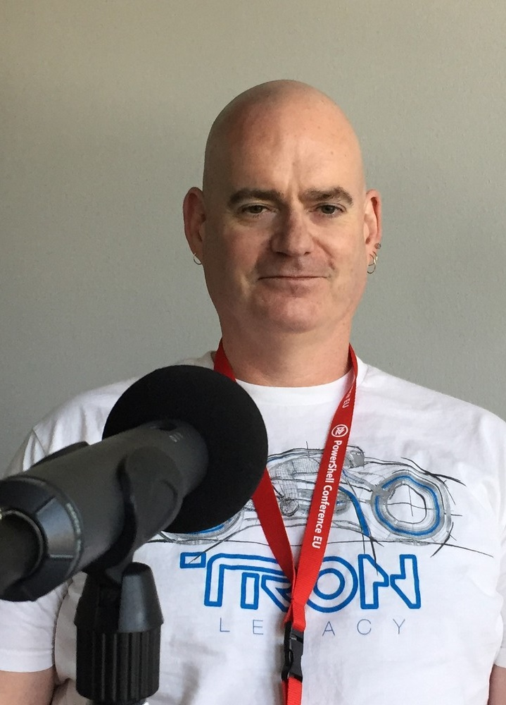
Podcast: Sliding Windows
www.slidingwindows.de/?feed=slw-mp3
Episode 04: "The X files", with Bruce Payette (rec) PSConf 2016

Slide 4
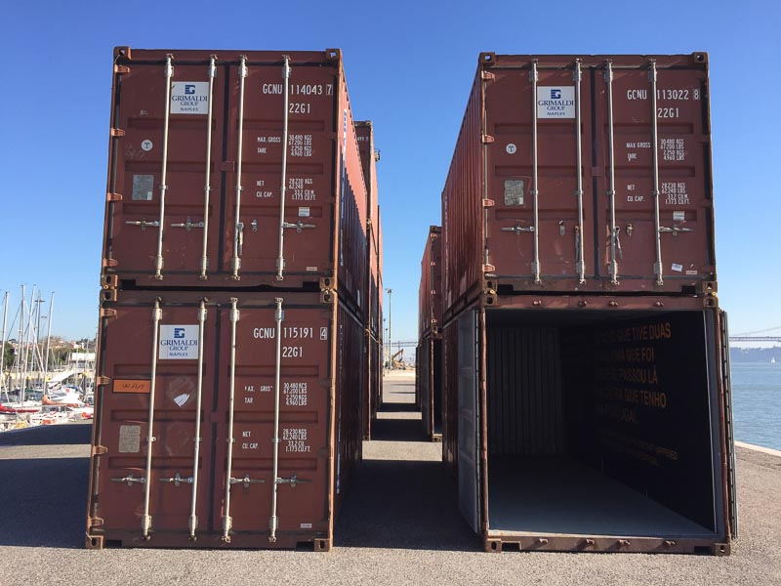
Container
Linux Container: docker.com
Container in Windows Server
Windows Server Container Hyper-V not required
Hyper-V Container requires Hyper-V
LinuxKit Announced at DockerCon 2017
Desktop solutions (Win 10, MacOS ..)

Slide 5
Basic principles
Seperate physical
servers
Virtualiza-tion, e.g. VMWare, KVM,
Hyper-V
Container
Extended Isolation, e.g. jails, container
cost
Simple Isolation, e.g. chroot
MultiUser
OS
hardening

Slide 6

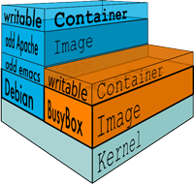
docker.com
Founded 2013
Initially built upon "LinuX Containers" (LXC), since v0.9: libcontainer
Requires Linux 3.8 or later, using "Control Groups" (Cgroups), "Namespaces"
Unifying FS: AUFS, OverlayFS, ZFS ..
Figures: www.docker.com/what-docker

Slide 7
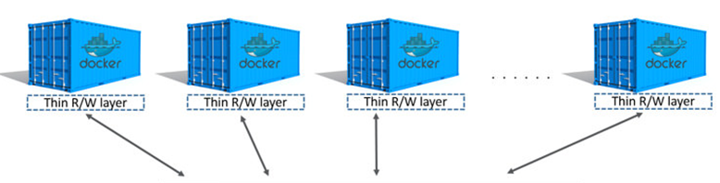
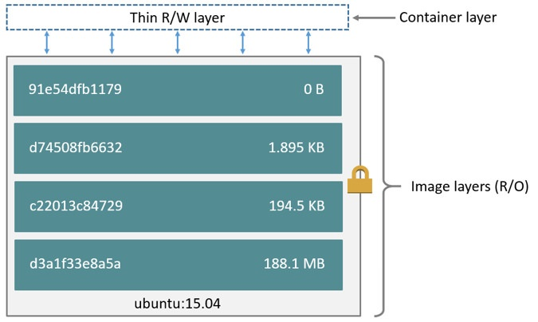
docker: Images and layers
https://docs.docker.com/engine/userguide/storagedriver/imagesandcontainers/

Slide 8
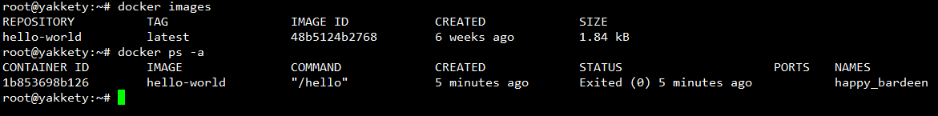
Setup docker (Ubuntu, Debian)
# Install, verify
apt-get install docker.io
docker version
docker info
# List containers docker ps
# List images docker images
# Search the docker hub
docker search hello-world
docker run hello-world
LINUX

Slide 9

KEEP
CALM
IT'S
DEMO
TIME
Corbel 57, 28

Slide 10
From drawbridge to Hyper-V containers
2008: Hyper-V Support for Legacy OS, enlightining modern OS
2011: Research project "Drawbridge" Process isolation container technology for Azure
2013: Microsoft & Docker partnering Development of a common management interface

Slide 11
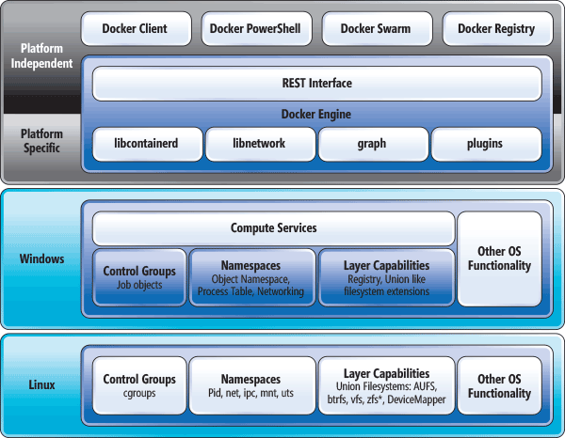
Containers: Linux vs. Windows
"Comparing the Basic Architecture of Containers and Docker Across Windows and Linux", https://msdn.microsoft.com/en-us/magazine/mt797649.aspx

Slide 12
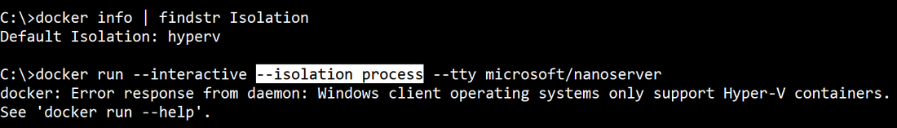
Windows isolation modes
Windows supports:
(default)
process
hyperv
Hyper-V Container (Hyper-V must be enabled): VM worker process "vmwp" on host, each container has it's own csrss process

Slide 13
Setup Windows Server Containers
# Enable Windows feature(s) Install-WindowsFeature –Restart -Name Containers Install-WindowsFeature –Restart -Name Hyper-V # Optional
# Get docker Install-Module -Name DockerMsftProvider -Repository PSGallery Install-Package -Name docker -ProviderName DockerMsftProvider
# Reboot Restart-Computer
# Verify setup Get-ComputeProcess docker version docker info
WINDOWS SERVER

Slide 14
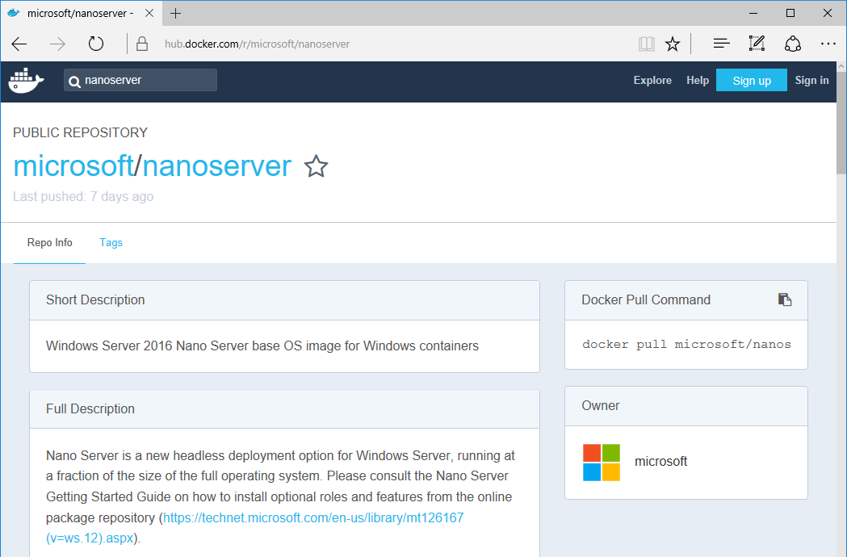

Slide 15
Combinations
HOST OS | Windows Server Container |  | Hyper-V Container |  | Linux Container
 | Nano | Core | Nano | Core | Hyper-V VM | LinuxKit
WS 2016 Nano | ✓ | - | ✓ | ✓ |  | ?
WS 2016 Core | ✓ | ✓ | ✓ | ✓ |  | ?
WS 2016 SaD | ✓ | ✓ | ✓ | ✓ |  | ?
Windows 10 | - | - | ✓ | ✓ | ✓ | ?

Slide 16
KEEP
CALM
IT'S
DEMO
TIME
Corbel 57, 28

Slide 17
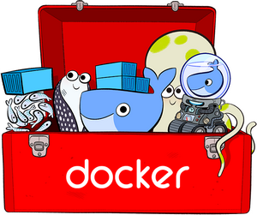
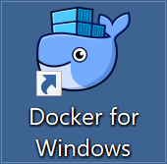
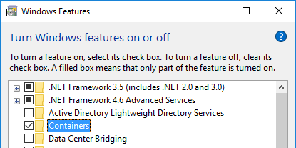
Dazed and confused ..
Docker Toolbox Legacy: "older Mac + Windows OS", uses Virtualbox
Docker for Windows uses Hyper-V + Windows Containers Linux + Windows Containers
Containers for Windows native Windows Containers, no (G)UI, Isolation: Hyper-V
DESKTOP

Slide 18

Install "Docker for Windows" (on Win 10)
#Requires -RunAsAdministrator
Enable-WindowsOptionalFeature –Online -NoRestart -FeatureName 'Microsoft-Hyper-V-All','Containers' Invoke-WebRequest -uri 'https://download.docker.com/win/stable/InstallDocker.msi'
-OutFile 'c:\InstallDocker.msi'
msiexec.exe /i 'c:\InstallDocker.msi' /passive /forcerestart

Slide 19
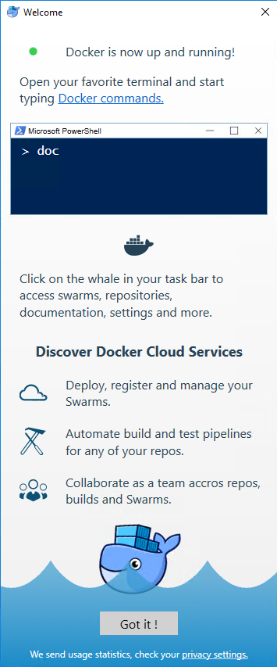
"Docker on Windows" (April 2017)
"Community Edition"
docker version: Version 17.03.1-ce (Client, Server)
Supports Windows Containers, Hyper-V isolation only
Supports Linux Containers via Alpine Linux VM in Hyper-V

Slide 20
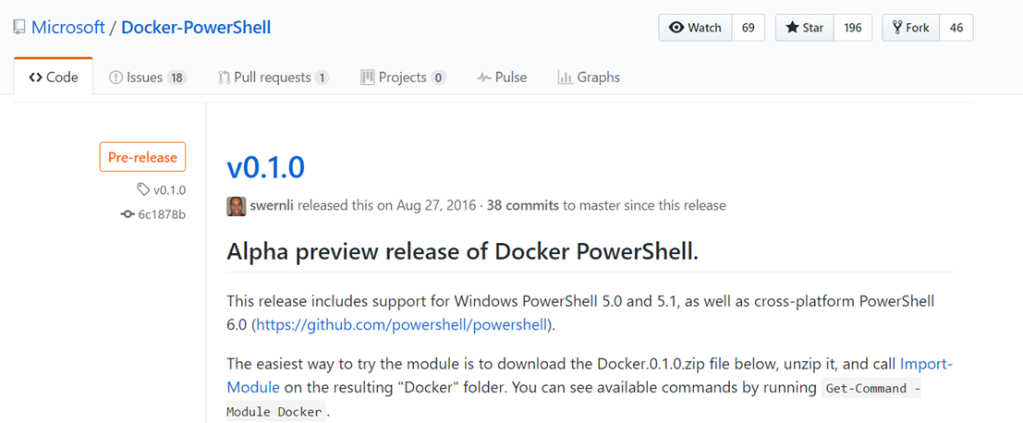
PowerShell Cmdlets for Docker (April 2017)
https://github.com/Microsoft/Docker-PowerShell/releases

Slide 21
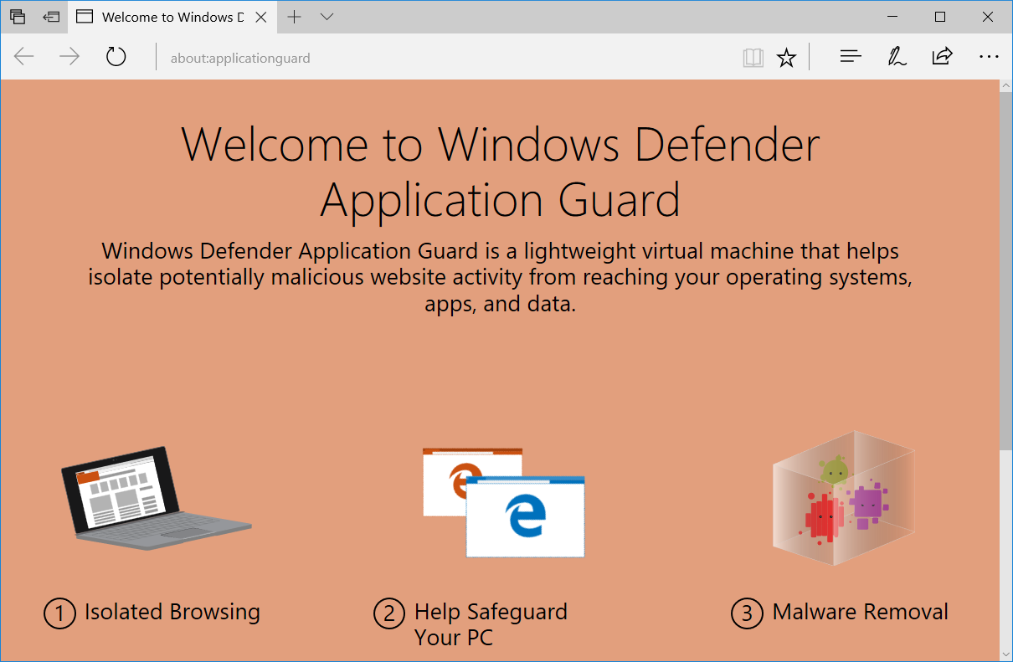
What's beyond ...
Project Barcelona, Windows 10 v1703

Slide 22


Wrap up!
docker.exe or Cmdlets?
Will Hyper-V be obsolete?
Pets or cattles ?
#LinuxKit

Slide 23
New-Question | Out-Speaker
@thorstenbutz

Slide 24
about_Speaker
Thorsten Butz @thorstenbutz; thorsten-butz.de
about_Containers: A note from the field
PowerShell Conference EU 2017 HCC Hannover Congress Centrum, 06.05.2017

