Slide 1
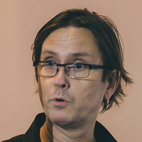
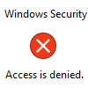
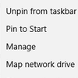
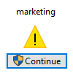
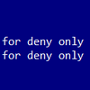
Thorsten Butz
“Everything you
always wanted to know
about file server
❊
But were afraid to ask”
❊

Slide 2





Get-Help about_me
$speaker = @{
name = Thorsten Butz
jobrole = Trainer, Consultant, Author
certification = MC*,LPIC-2
^ = thorstenbutz
= facebook.com/thbutz
= www.thorsten-butz.de = www.slidingwindows.de/?feed=slw-mp3
}

Slide 3

List of content
Episode 1: The untouchables
Episode 2: Hidden beauties
Espisode 3: Adults only

Slide 4
#region Episode 1 The untouchables

Slide 5
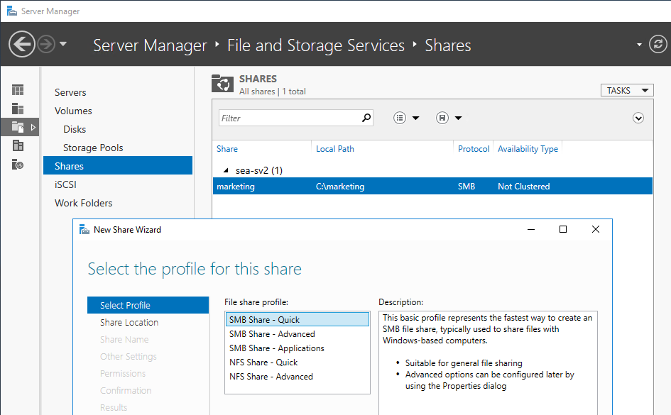
The basic stuff: remote administration

Slide 6
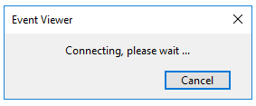
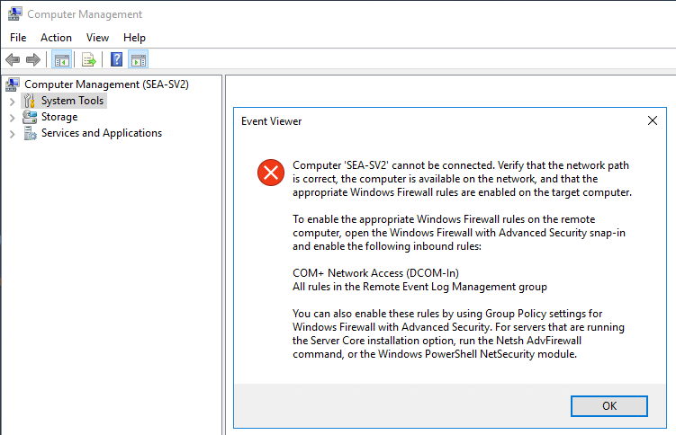
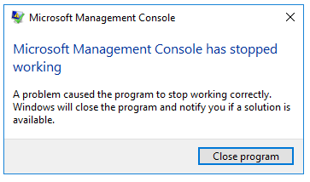
Shadows of the past

Slide 7
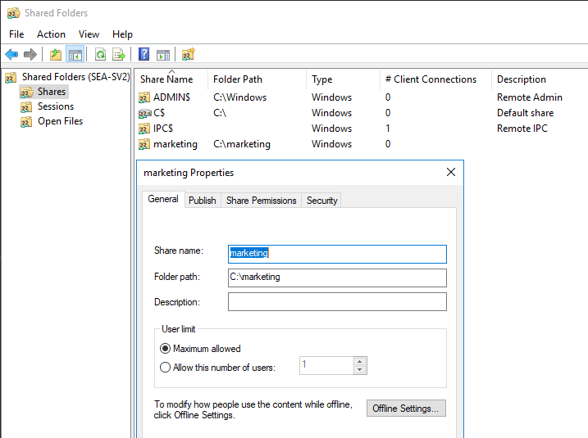
fsmgmt.msc

Slide 8

KEEP
CALM
IT'S
DEMO
TIME
Corbel 57, 28

Slide 9
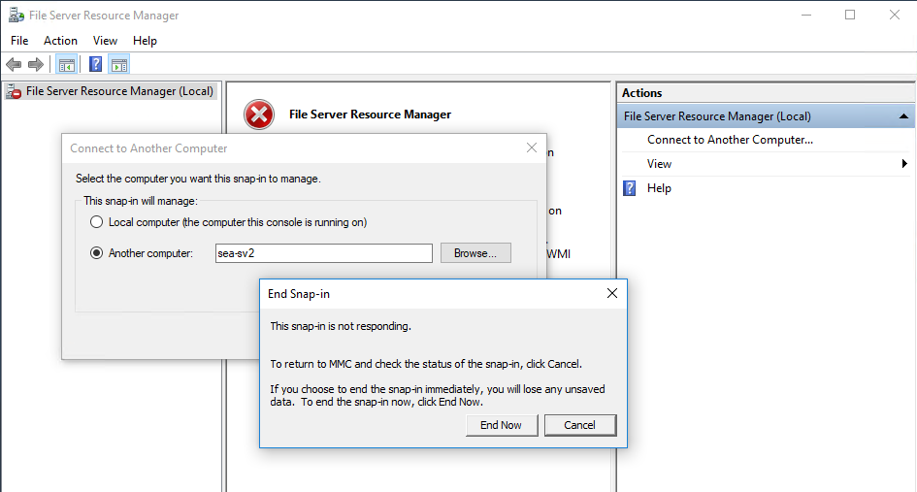
fsrm.msc
Demo

Slide 10
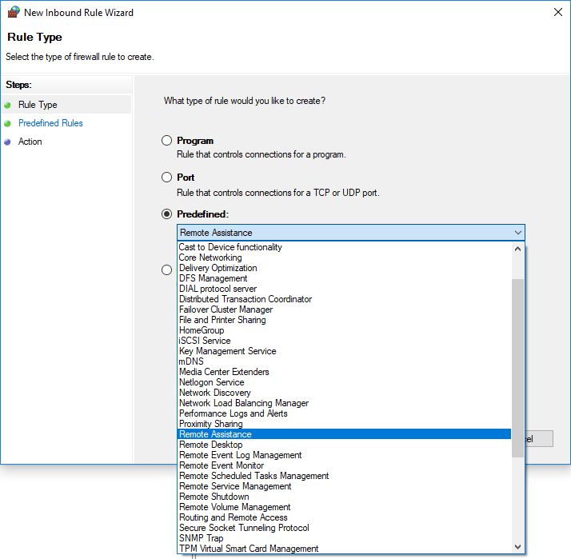
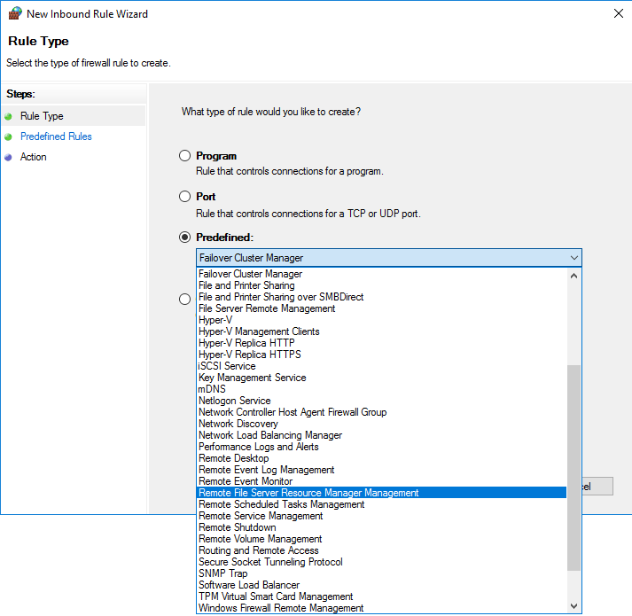
FSRM feature installed FSRM feature not installed
Demo

Slide 11
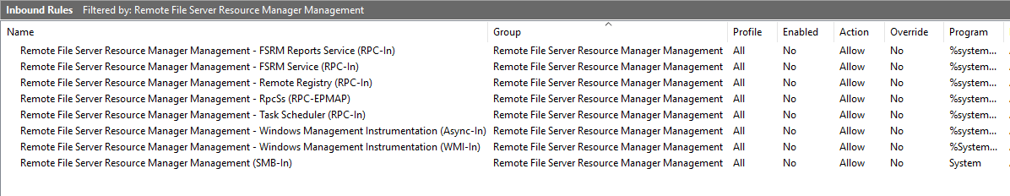
Firewall rules for FSRM
Demo
# Check config
$CimSession = New-CimSession -ComputerName $fileserver
$DisplayGroup = 'Remote File Server Resource Manager Management'
Get-NetFirewallRule -DisplayGroup $DisplayGroup -CimSession $CimSession |
Format-Table Enabled,Display*, *store* -AutoSize
# Enable rules
Get-NetFirewallRule -DisplayGroup $DisplayGroup -CimSession $CimSession |
Set-NetFirewallRule -Enabled True

Slide 12
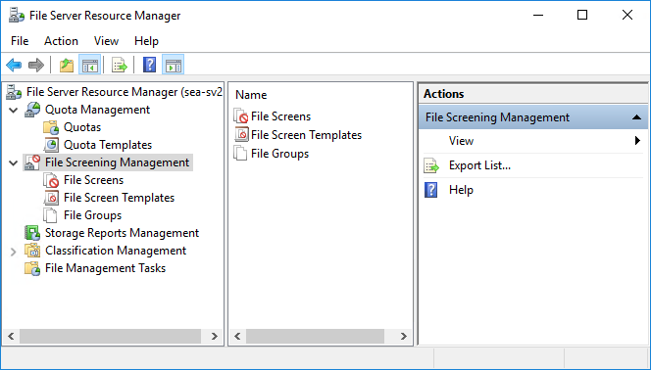
Ready for take off
Demo

Slide 13
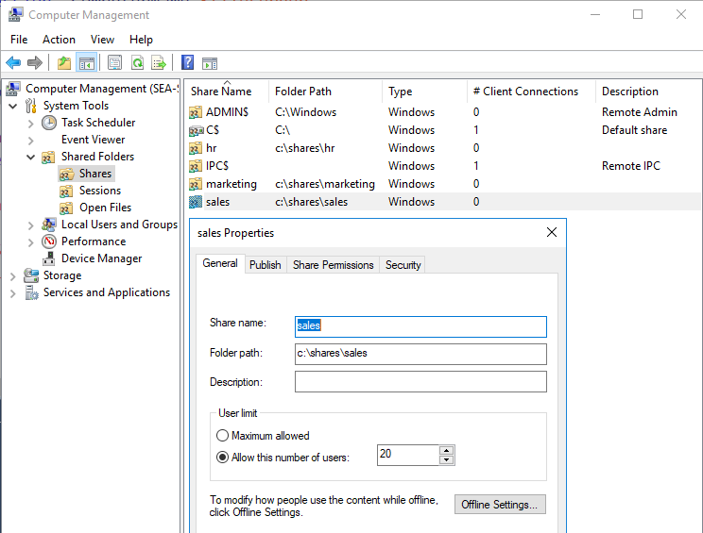
Sharing and mapping
Demo
# A
net.exe use s: \\sea-fs1\Sales
# B
New-SmbMapping
-LocalPath 's:'
-RemotePath '\\sea-fs1\sales'
# C
New-PSDrive
-Name 's'
-PSProvider FileSystem
-Root '\\sea-fs1\sales'
ab

Slide 14
#region Episode 2 Hidden beauties

Slide 15

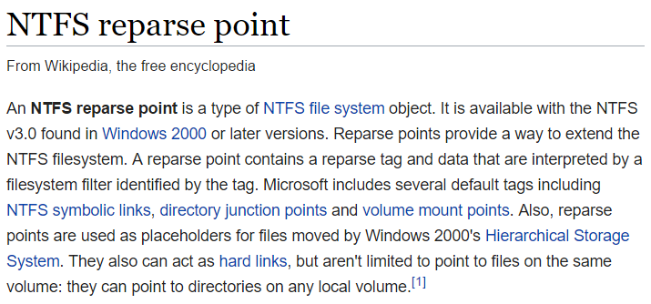
Less known NTFS object types
https://en.wikipedia.org/wiki/NTFS_reparse_point

Slide 16
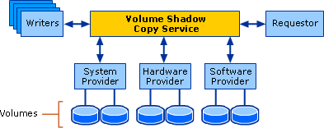
Volume Shadow Copy Service
MSDN: "The Volume Shadow Copy Service (VSS) is a set of COM interfaces that implements a framework to allow volume backups to be performed while applications on a system continue to write to the volumes.
VSS is supported on Microsoft Windows XP and later."
vssadmin.exe list shadows
vssadmin create shadow /for=c:
mklink /D C:\vss \\?\GLOBALROOT\Device\HarddiskVolumeShadowCopy1\
vssadmin delete shadows /all

Slide 17
HardLinks, Symlinks/Softlinks
Hardlinks (files) Can be used in file shares, cannot cross volume borders
Junctions (directories) Can be used in file shares, can cross volume borders
Softlinks Cannot be used in file shares, can cross volume borders

Slide 18
KEEP
CALM
IT'S
DEMO
TIME
Corbel 57, 28

Slide 19
HardLinks, Symlinks/Softlinks
 | Hardlinks (file) | Junctions (directory) | Symlinks (file) | Symlinks (directory)
Can be used in shared folders | YES | YES | NO | NO
Can point from one volume to another | NO | YES | YES | YES
Problem statement:
Weird differences throughout different OS version
Strange collection of (built-in) tools, lacking functionality
Generally not "popular" in Windows

Slide 20
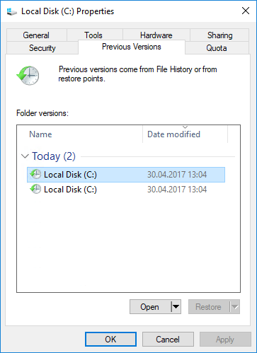
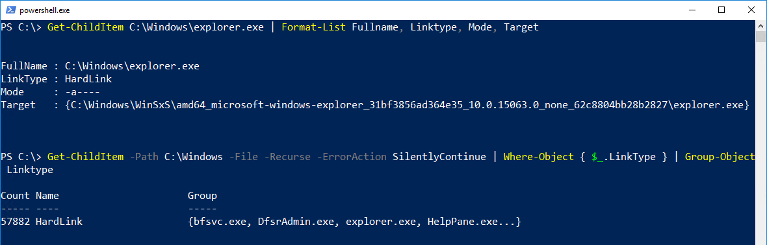
Why do Hardlinks/Symlinks exist?

Slide 21
#region Episode 3 Adults only

Slide 22
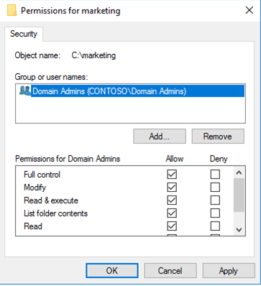
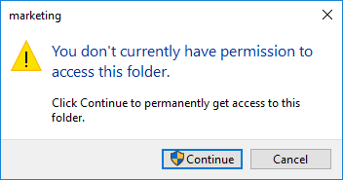
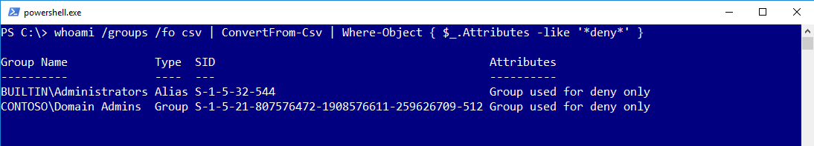
UAC trouble
Protected Administrator
Standard mode
Elevated mode (Run as Administrator)
Standard User Account

Slide 23
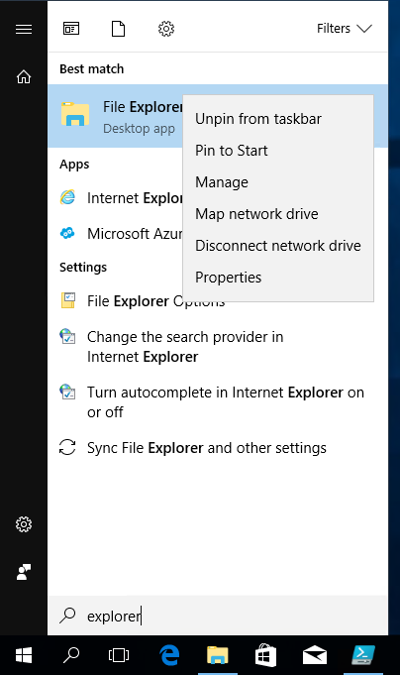
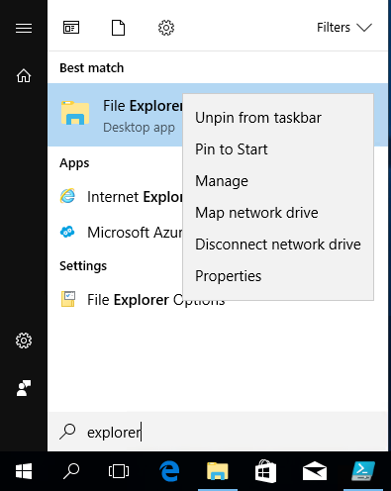
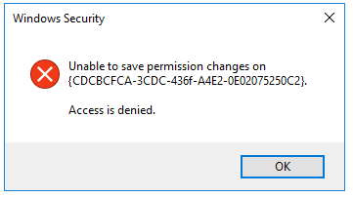
Trouble again with UAC
Very sophisticated: Running Windows Explorer elevated
Requires Registry-Change HKEY_CLASSES_ROOT\AppID\{CDCBCFCA-3CDC-436f-A4E2-0E02075250C2}\RunAs
Owner of the RegKey: "TrustedInstaller"

Slide 24
KEEP
CALM
IT'S
DEMO
TIME
Corbel 57, 28

Slide 25


Avoiding the glitches
Demo
Always (!) use your own groups to grant distinct permissions
Simplify your life:
Seattle Domain Admins
Domain Admins

Slide 26
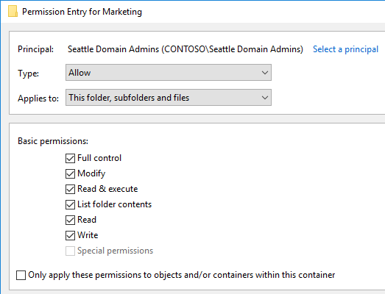
Demo
icacls.exe $fileshareroot /grant "$SeattleAdmins`:(OI)(CI)(F)"
# (OI) Object inherit
# (CI) Container inherit

Slide 27
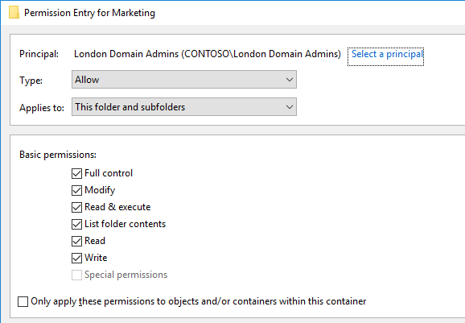
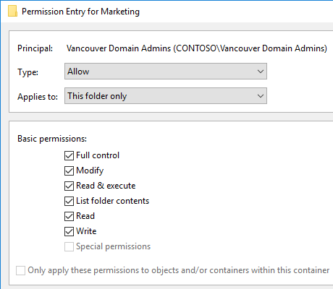
Demo
icacls.exe $fileshareroot /grant "$LondonAdmins`:(CI)(F)"
icacls.exe $fileshareroot /grant "$VancouerAdmins`:(F)"

Slide 28

Implicit deny vs. implict grant
Demo
ICACLS preserves the canonical ordering of ACE entries:
Explicit denials
Explicit grants
Inherited denials
Inherited grants

Slide 29
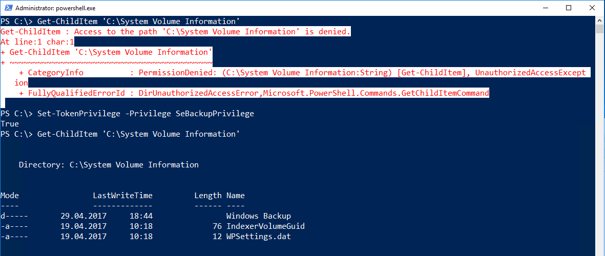
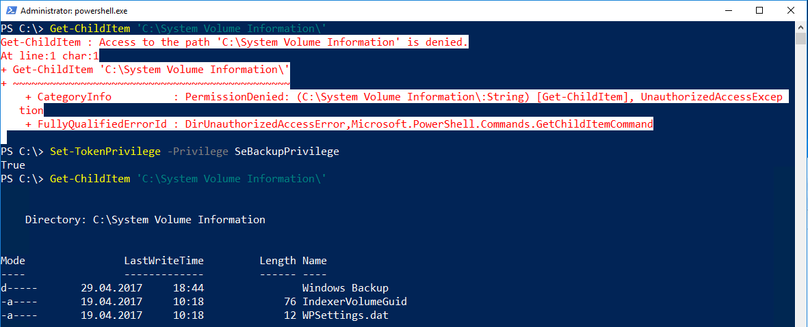
SeBackupPrivilege
http://www.leeholmes.com/blog/2010/09/24/adjusting-token-privileges-in-powershell/

Slide 30
Wrap up!
Remote administration is possible .. but awkward
Not a single solution is feature complete (icacls.exe, takeown.exe, Get-ACL/Set-ACL ..)
No reason to disable UAC, use your own groups!

Slide 31
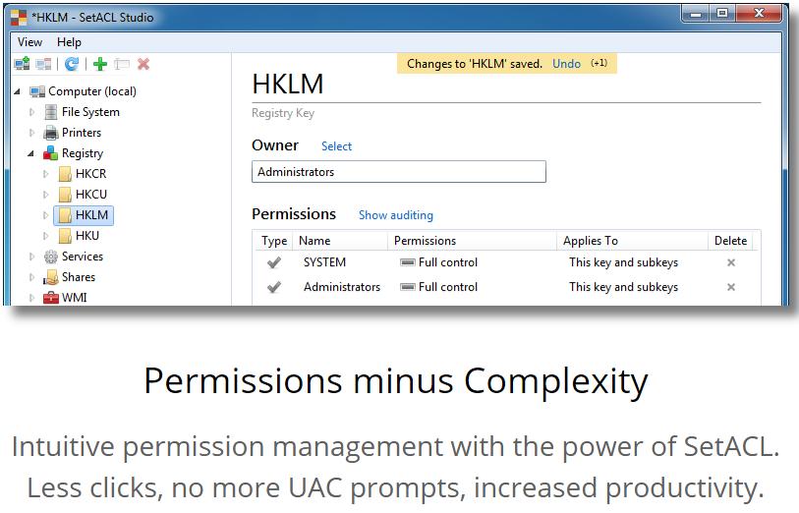
Tip: SetACL Studio by Helge Klein
Free for commercial use!

Slide 32

New-Question | Out-Speaker
@thorstenbutz

Slide 33
about_Speaker
Thorsten Butz @thorstenbutz; thorsten-butz.de
Was Sie schon immer über Fileserver wissen wollten, aber bisher nicht zu fragen wagten
Everything you always wanted to know about file server but were afraid to ask
PowerShell Conference EU 2017 HCC Hannover Congress Centrum, 05.05.2017

