Slide 1
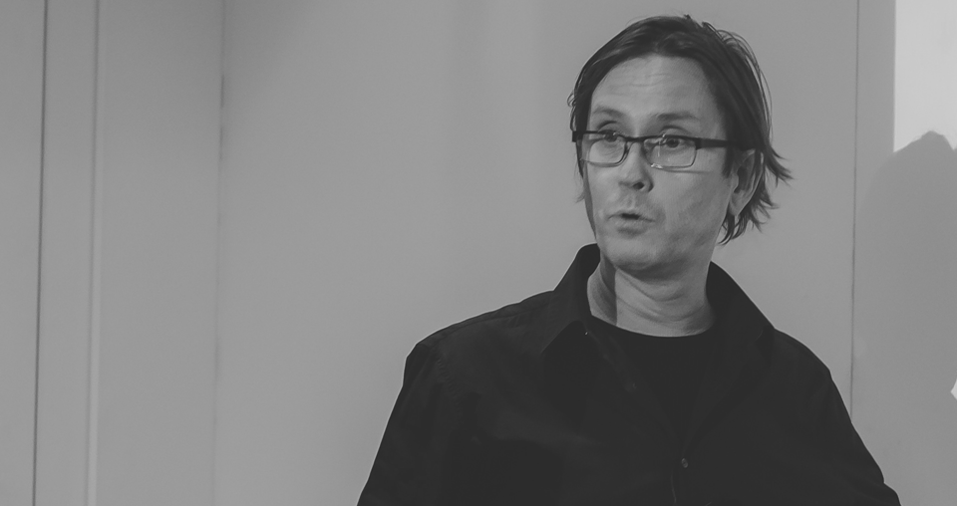

Wer wird Shellionaire?
Who wants to be a Shellionaire?
Thorsten Butz

Slide 2


Slide 3





Get-Help about_me
$host = @{
name = Thorsten Butz
jobrole = Trainer, Consultant, Author
certification = MC*,LPIC-2
^ = thorstenbutz
= facebook.com/thbutz
= www.thorsten-butz.de = www.slidingwindows.de/?feed=slw-mp3
}

Slide 4
5..8 –eq 'Pro'
12 Questions
9..12 –eq 'Hero'
1..4 –eq 'Hobbyist'

Slide 5
about_Joker
50:50
(
I





Slide 6
Invoke-Quiz

Slide 7
about_Speaker
Thorsten Butz @thorstenbutz; thorsten-butz.de
Wer wird Shellionaire?
Who wants to be a Shellionaire?
PowerShell Conference EU 2017 HCC Hannover Congress Centrum, 05.05.2017

