Slide 1
AKTE X LINUXADMINISTRATION MIT DER WINDOWS POWERSHELL
Thorsten Butz

Slide 2


wir danken unseren cim sponsoren
by

Slide 3




about_me
Thorsten Butz
Trainer, Consultant, Author, Podcaster
MC*/LPIC-2
@thorstenbutz
gplus.to/thorstenbutz
thorsten-butz.de
slidingwindows.de

Slide 4
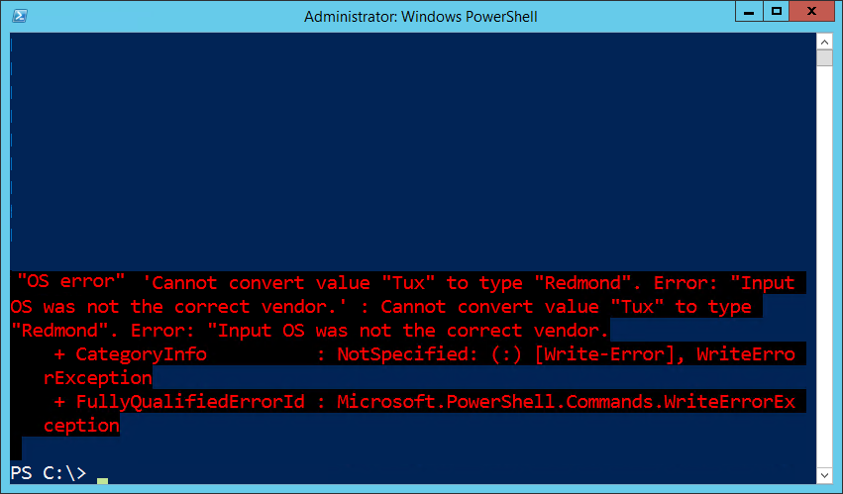


+

Slide 5
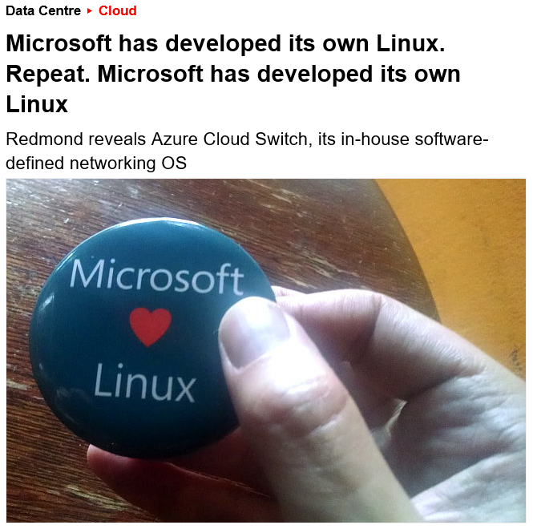
Notes:
http://www.theregister.co.uk/2015/09/18/microsoft_has_developed_its_own_linux_repeat_microsoft_has_developed_its_own_linux/

Slide 6

From HAL to DAL: the big picture
Windows NT (since 1993) Hardware Abstraction Layer
Azure (since 2010) Datacenter Abstraction Layer
Notes:
Starting in 1993 Windows NT supports multiple CPU architectures by means of a "Hardware Abstraction Layer" (hal.dll)
Starting in 2010 The Azure cloud supports multiple OS. Microsoft aims at a uniform management framework: The idea of a "Datacenter Abstraction Layer" is born.
Hardware abstraction (layer)
from Wikipedia
"Hardware abstractions are sets of routines in software that emulate some platform-specific details, giving programs direct access to the hardware resources.
They often allow programmers to write device-independent, high performance applications by providing standard Operating System (OS) calls to hardware."

Slide 7
Standards-based management
}
SSH
OMI
Openwsman
Wiseman
OpenPegasus
SFCB/SBLIM
WBEM
Notes:
OMI "The Open Management Infrastructure stack (OMI, formerly known as NanoWBEM) is an open-source CIM management server sponsored by The Open Group and made available under the Apache Software License 2.0. OMI was contributed to the Open Group by Microsoft on June 28, 2012 …" From: http://en.wikipedia.org/wiki/Open_Management_Infrastructure
Pash-Project/Pash: An Open Source reimplementation of Windows PowerShell, for Mono.
https://github.com/Pash-Project/Pash
https://groups.google.com/group/pash-project
SSH started 1995
PaSH started 2008
WBEM Based Management in Linux
Dell Linux Engineering Team, Feb. 2011
http://linux.dell.com/files/whitepapers/WBEM_based_management_in_Linux.pdf

Slide 8
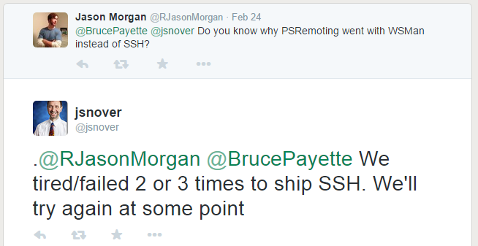
RFC 4251 et al: SSH
Notes:
https://twitter.com/jasonmorgan
https://twitter.com/jsnover
https://twitter.com/brucepayette

Slide 9
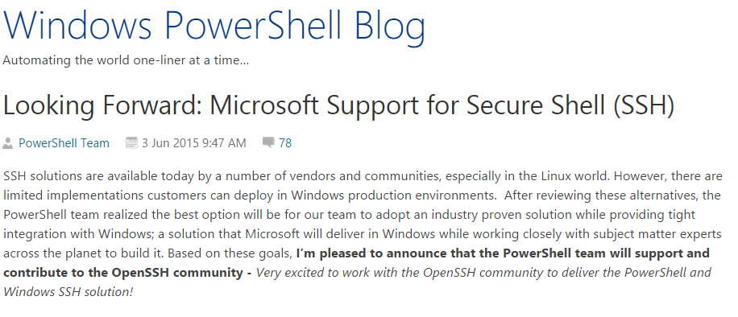
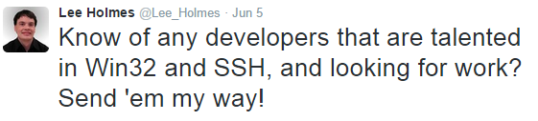
Notes:
https://twitter.com/lee_holmes
http://www.openssh.com/

Slide 10
A brief history of acronyms
Distributed Management Task Force (DMTF) Organization focusing on simplifying management of (heterogeneous) IT environments. Members: Cisco, Dell, HP, Intel, Microsoft, Oracle, VMware, etc. (founded 1992)
Common Information Model (CIM) A conceptual model providing standards to exchange management information of computing devices.
Web Services-Management (WS-Man) SOAP based protocol for the management of computing devices.
Web-Based Enterprise Management (WBEM) A set of management technologies built upon CIM and WS-Man focusing on remote administration in distributed environments.

Slide 11
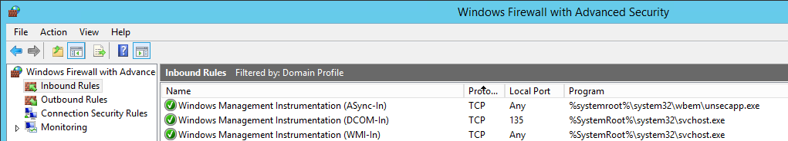
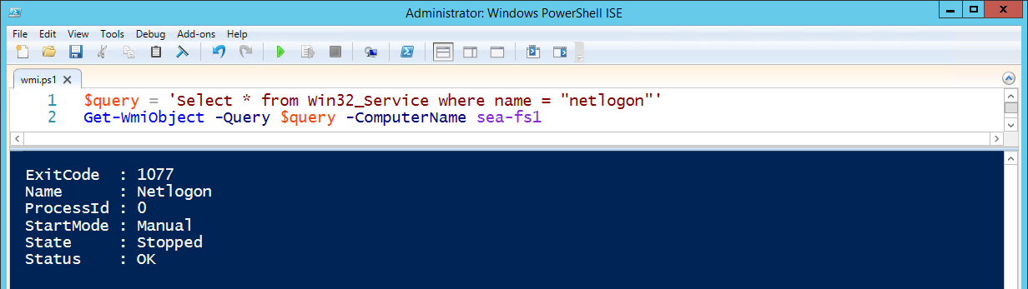
Origins
Windows Management Instrumentation (WMI) Microsoft's primary implementation of WBEM # kind of ..

Slide 12
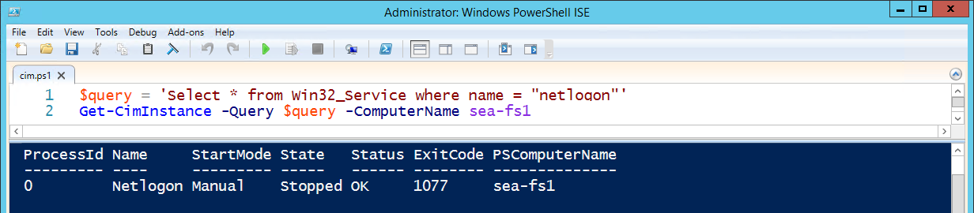
PowerShell version -ge 3
Windows Management Infrastructure (MI) Successor of WMI, fully downwardly compatible
New namespaces e.g. root/StandardCimv2 , root/virtualization/v2
CIM Cmdlets Using WS-Man (TCP 5985, 5986) communication instead of RPC/DCOM
Notes:
Windows PowerShell Blog:
Introduction to CIM Cmdlets
http://blogs.msdn.com/b/powershell/archive/2012/08/24/introduction-to-cim-cmdlets.aspx
Windows PowerShell Blog:
CIM Cmdlets – Some Tips & Tricks
http://blogs.msdn.com/b/powershell/archive/2013/08/19/cim-cmdlets-some-tips-amp-tricks.aspx
Trevor Sullivan, The Scripting Guys
What is CIM and Why Should I Use It in PowerShell?
http://blogs.technet.com/b/heyscriptingguy/archive/2014/01/27/what-is-cim-and-why-should-i-use-it-in-powershell.aspx

Slide 13

OMI (aka NanoWBEM)
Open Management Infrastructure Developed by Microsoft, published in 2012 by
Portable, small foot-print, high performance CIMOM Running Linux, Unix, Windows; networking devices, storage controllers , phones
x86/amd64 systems only
Current version (September 2015): 1.08-1
Notes:
Open Management Infrastructure (OMI)
"CIM/WBEM Manageability Services Broker"
https://collaboration.opengroup.org/omi/

Slide 14
WPSDSCLinux
Windows PowerShell Desired State Configuration for Linux https://github.com/MSFTOSSMgmt/WPSDSCLinux/releases
Current version (September 2015): v1.0.0
Supported OS (x86/x64):
Centos 5, 6, 7
Debian 5, 6, 7
Oracle Linux 5, 6, 7
RHEL 5, 6, 7
SLES 10-12
Ubuntu LTS 12.04, 14.04
Notes:
URIs:
Getting Started with PowerShell Desired State Configuration (DSC): (07) DSC and Linux
http://channel9.msdn.com/Series/Getting-Started-with-PowerShell-Desired-State-Configuration-DSC/07
** Final version **
PowerShell DSC for Linux is now available!
Kristopher Bash
http://blogs.msdn.com/b/powershell/archive/2015/05/06/powershell-dsc-for-linux-is-now-available.aspx
** Beta version **
PowerShell DSC for Linux, Step by Step
Kristopher Bash, Michael Greene
http://blogs.technet.com/b/privatecloud/archive/2014/05/19/powershell-dsc-for-linux-step-by-step.aspx#pi169501=2
WPSDSCLinux
https://github.com/MSFTOSSMgmt/WPSDSCLinux

Slide 15
WPSDSCLinux: Resource Providers
nxArchive | Provides a mechanism to unpack archive (.tar, .zip) files at a specific path
nxEnvironment | Manages environment variables on target nodes
nxFile | Manages Linux files and directories
nxFileLine | Manages individual lines in a Linux file
nxGroup | Manages local Linux groups
nxPackage | Manages packages on Linux nodes. Supported package managers: Yum, Apt, Zypper Standalone package installations: *.rpm, *.deb
nxScript | Runs scripts on target nodes
nxService | Manages Linux services (daemons)
nxSshAuthorizedKeys | Manages public ssh keys for a Linux user
nxUser | Manages local Linux users
Notes:
Technet documentation:
Built-In Windows PowerShell Desired State Configuration Resources for Linux
https://technet.microsoft.com/en-us/library/mt126209.aspx
Get started with Windows PowerShell Desired State Configuration for Linux
https://technet.microsoft.com/en-us/library/mt126211.aspx

Slide 16
Demo 1: Install Bind9 with WPSDSCLinux on Debian GNU/Linux
# OMI binary wget https://collaboration.opengroup.org/omi/documents/32721/
omi-1.0.8.1.packages.tar.gz # WPSDSC-Donwload (MSI): http://www.microsoft.com/en-us/download/details.aspx?id=46919 ## Install OMI and DSC dpkg -i omi-1.0.8-1.pkg/omiserver-1.0.8.ssl_100.x64.deb dpkg -i "Linux Packages/dsc-1.0.0-320.ssl_100.x64.deb"
Notes:
# OMI binary
wget https://collaboration.opengroup.org/omi/documents/32721/omi-1.0.8.1.packages.tar.gz
tar xvf omi-1.0.8.1.packages.tar.gz
# OMI source code
# wget https://collaboration.opengroup.org/omi/documents/32721/omi-1.0.8-1.tar.gz
# tar xvf omi-1.0.8-1.tar.gz
# Copy/Download DSC package to Linux host,
# Official Donwload (MSI) => http://www.microsoft.com/en-us/download/details.aspx?id=46919
tar xvf DSCLinuxPackages1.0.tar
# Check current OS
lsb_release -a
# Check OpenSSL version, Version 0.9.8 or 1.0 required
openssl version
# Install required software, e.g. Curl:
apt-get install curl -y # Prerequisite
# Check if package is part of your (debian) distribution
apt-cache policy omiserver
apt-cache policy dsc
## Install OMI daemon
dpkg -i omi-1.0.8-1.pkg/omiserver-1.0.8.ssl_100.x64.deb
# Check setup
lsof -i | grep omi
/opt/omi/bin/omicli id
/opt/omi/bin/omicli ei root/omi OMI_Identify # Requires OMI + DSC
## Install DSC for Linux
dpkg -i "Linux Packages/dsc-1.0.0-320.ssl_100.x64.deb"
#Check files
ls /opt/microsoft/dsc/

Slide 17
# Define variables
$vm = 'linux-host'
$user = 'root'
$password = ConvertTo-SecureString -String 'Pa$$w0rd' -AsPlainText –Force
$cred = New-Object System.Management.Automation.PSCredential ($user,
$password)
# TEST endpoint
Test-NetConnection -ComputerName $vm -Port 5986 -InformationLevel Quiet
# Initiate Session
$sessionOptions =
New-CimSessionOption -UseSsl:1 -SkipCACheck:1 -SkipCNCheck:1 -
SkipRevocationCheck:1
$session = New-CimSession -Credential $cred -ComputerName $vm
-Port 5986 -Authentication Basic -SessionOption $sessionOptions
Notes:
Getting started on your Windows management host!
Download/install the MSI: http://www.microsoft.com/en-us/download/details.aspx?id=46919
Check the module:
Get-Module -ListAvailable | Select-String nx # Check if nx module is unique
Import-Module -Name nx
Configuration ExampleConfiguration {
Import-DscResource -module nx
}

Slide 18
# A simple DSC test configuration
Configuration MyFirstLinuxDSC
{ Import-DSCResource -Module nx
Node "$vm"{
nxFile myTestFile
{ Ensure = "Present"
Type = "File"
DestinationPath = "/var/tmp/helloworld_dsc.txt"
Mode = "774"
Owner = "root"
Group = "root"
Contents="Hello World! `n" }
}
}
# Apply DCS configurationa
MyFirstLinuxDSC -OutputPath 'c:\LinuxDSC'
Start-DscConfiguration -CimSession $session -Path 'C:\LinuxDSC' -Verbose -Wait
Notes:
$MyTestUser = "Donald"
$MyTestGroup = "Ducks"
$MyTestService = "apache2"
Configuration YetAnotherDSCTest
{
Import-DSCResource -Module nx
Node $vm {
nxUser myTestUser
{
Ensure = 'Present'
UserName = $MyTestUser
Password = 'SuperSecret'
}
nxGroup myTestGroup
{
Ensure = 'Present'
Groupname = $MyTestGroup
MembersToInclude = $MyTestUser
DependsOn = '[nxUser]MyTestUser'
}
nxService myTestService
{
Name = $MyTestService
State = "Running"
Enabled = $true
Controller = "init"
}
}
}
YetAnotherDSCTest -OutputPath "c:\LinuxDSC"
Start-DscConfiguration -CimSession $session -Path "C:\LinuxDSC" -Verbose -Wait

Slide 19
Configuration BindTest1
{ Import-DSCResource -Module nx
Node $vm {
nxPackage bind
{ Name = 'bind9'
Ensure = "Present"
PackageManager = "apt"
}
nxFile named.conf.local
{
Ensure = "Present"
Type = "File"
Contents = "$named_conf_local"
DestinationPath = "/etc/bind/named.conf.local"
Group = "bind"
Mode = "644"
}
[…]
Notes:
Get-CimSession
Test-DscConfiguration -CimSession $session
$vm
$OFS = [Environment]::NewLine # Fix new line problem
$db_contoso_com = Get-Content 'C:\demo_C\db.contoso.com'
$named_conf_local = Get-Content 'C:\demo_C\named.conf.local'
Configuration BindTest1
{
Import-DSCResource -Module nx
Node $vm {
nxPackage bind
{
Name = 'bind9'
Ensure = "Present"
PackageManager = "apt"
}
nxFile named.conf.local
{
Ensure = "Present"
Type = "File"
Contents = "$named_conf_local"
DestinationPath = "/etc/bind/named.conf.local"
Group = "bind"
Mode = "644"
}
nxFile db.contoso.com
{
Ensure = "Present"
Type = "File"
Contents = "$db_contoso_com"
DestinationPath = "/var/lib/bind/db.contoso.com"
Group = "bind"
Mode = "664"
}
nxScript bind_reload
{
GetScript = @"
#!/bin/bash
service bind9 status
"@
SetScript = @"
#!/bin/bash
service bind9 reload
"@
TestScript = @"
#!/bin/bash
service bind9 reload
"@
DependsOn = "[nxPackage]bind","[nxFile]named.conf.local","[nxFile]db.contoso.com"
}
}
}
BindTest1 -OutputPath 'c:\LinuxDSC'
Start-DscConfiguration -CimSession $session -Path 'C:\LinuxDSC' -Verbose -Wait
# @LINUXHOST: check confgig
# dig sea-test3.contoso.com @localhost +short
Resolve-DnsName -Name sea-test3.contoso.com -Server sea-www5 -DnsOnly

Slide 20
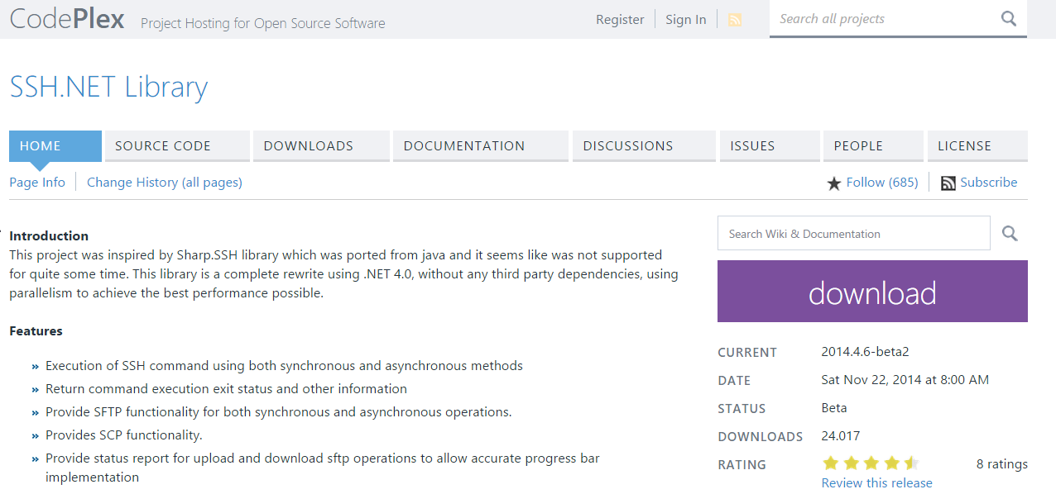
SSH.NET {sshnet.codeplex.com}

Slide 21
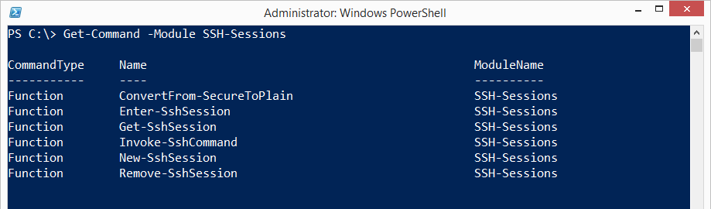
PowerShell SSH modules {1}
"SSH-Sessions" by Joakim Svenson powershelladmin.com/wiki/SSH_from_PowerShell_using_the_SSH.NET_library

Slide 22
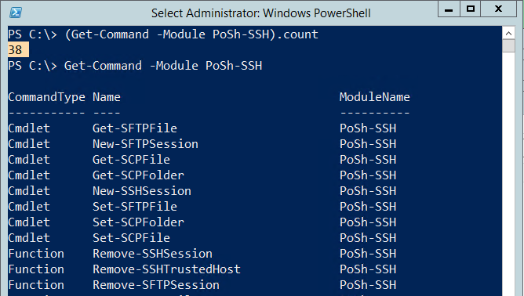
PoSh SSH modules {2}
"PoSh-SSH" by Carlos Perez https://github.com/darkoperator/Posh-SSH

Slide 23
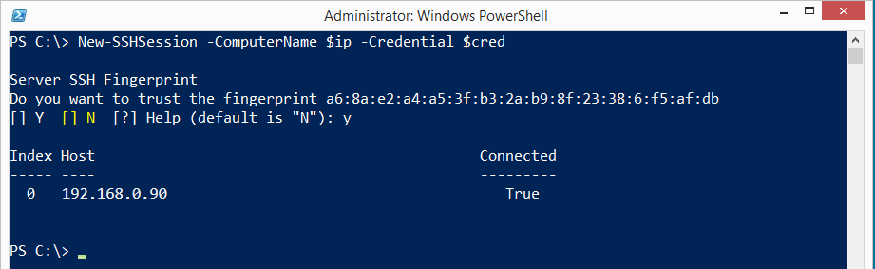
PoSh-SSH (by Carloz Perez)
Requires -Version 3.0
PoSh module written in C#
Open source

Slide 24
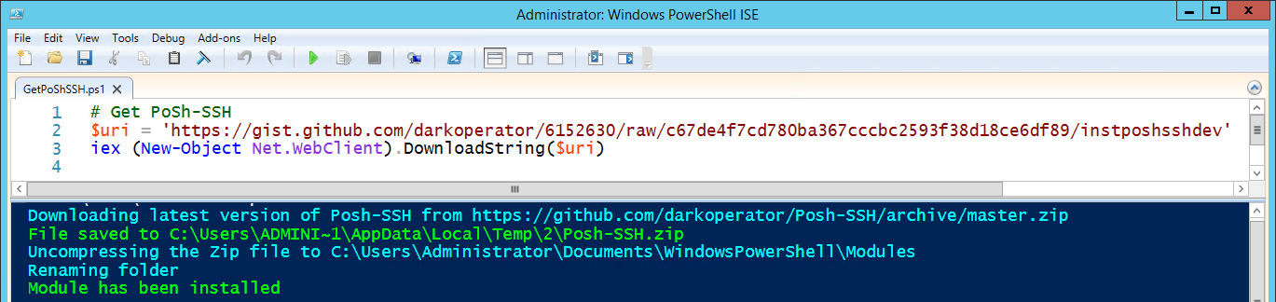
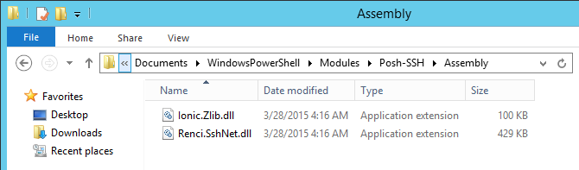
Demo 2: PoSh-SSH # Installation
Notes:
http://www.powershellmagazine.com/2014/07/03/posh-ssh-open-source-ssh-powershell-module/

Slide 25
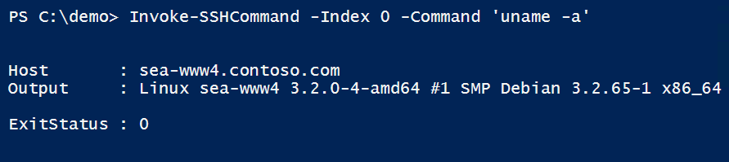
# Define variables
$vm = 'linux-vm.contoso.com'
$user = 'root'
$password = ConvertTo-SecureString -String 'Pa$$w0rd' -AsPlainText –Force
$cred = New-Object System.Management.Automation.PSCredential($user, $password)
# Test SSH port
Test-NetConnection -ComputerName $vm -Port 22 -InformationLevel Quiet
# Initiate session
$sshSession = New-SSHSession -ComputerName $vm -Credential $cred
# Remote command
Get-SSHSession # Mind the SessionID, pipelining not supported
Invoke-SSHCommand -Index 0 -Command 'uname -a'

Slide 26
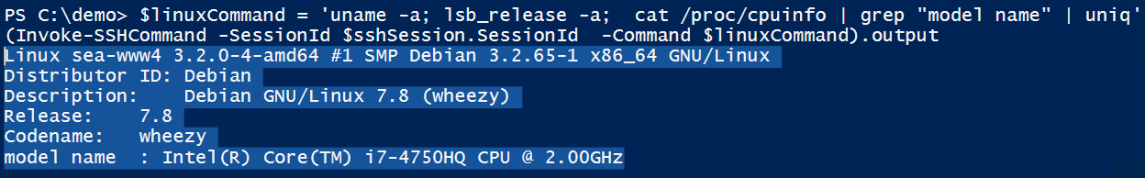
# Remote command, reloaded
(Invoke-SSHCommand -SessionId $sshSession.SessionId ` -Command 'uname -a').output
$linuxCommand = `
'uname -a; lsb_release -a; cat /proc/cpuinfo | grep "model name" | uniq'
(Invoke-SSHCommand -SessionId $sshSession.SessionId `
-Command $linuxCommand).output
# Close session
Get-SSHSession | Remove-SSHSession

Slide 27
# Download single file
$configFullName = '/etc/network/interfaces'
$configFileName =
$configFullName.split("/")[$configFullName.split("/").count-1]
Get-SCPFile -ComputerName $vm -Credential $cred `
-LocalFile $configFileName -RemoteFile $configFullName
Get-Content $configFileName
# Download directory (recursive)
Get-SCPFolder -ComputerName $vm -Credential $cred `
-RemoteFolder '/etc/ssh' -LocalFolder 'c:\download'

Slide 28
Wrap up!
"In the context of Azure we make more money
if someone's using 10 instances of Linux
than they're using 2 instances of Windows."
Jeffrey Snover, March 2015
Notes:
http://channel9.msdn.com/Series/Getting-Started-with-PowerShell-Desired-State-Configuration-DSC/07
"Azure is one of the most important things we're doing. And here's the thing you need to understand:
In the context of Azure we make more money if someone's using 10 instances of Linux than they're using 2 instances of Windows.
In the context of Azure it's pure volume. So we need to do is to help people consume as much computing as they want, wether it's Windows orLinux.
So it is not a check box for us, it's a business imperative that we provide greate support for Linux."
Jeffey Snover, March 2015

Slide 29
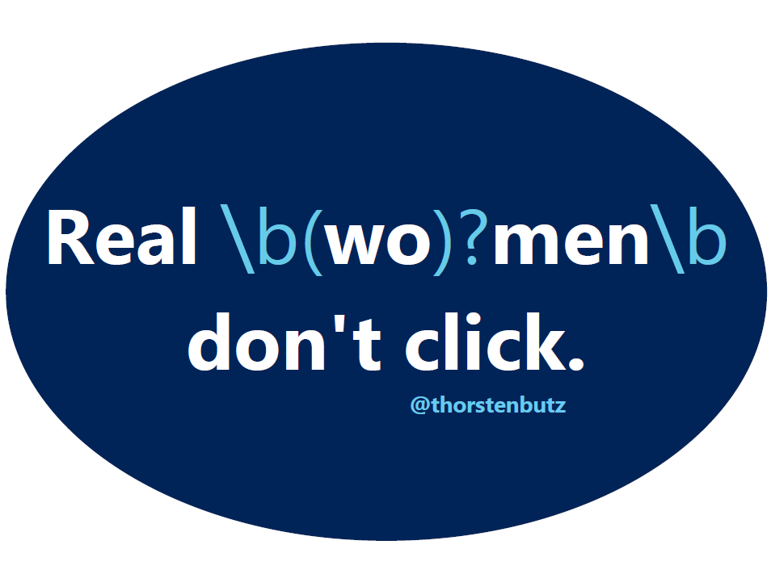
Notes:
http://powershell.com/cs/blogs/tobias/archive/2011/10/27/regular-expressions-are-your-friend-part-1.aspx
Get the sticker: @thorstenbutz, drop me a note on twitter!

