Slide 1
Administration von Linux & Co mit der PowerShell #OMI #DSC #SSH
Thorsten Butz

Slide 2




about_me
Thorsten Butz
Trainer, Consultant, Author, Podcaster
MC*/LPIC-2
@thorstenbutz
gplus.to/thorstenbutz
thorsten-butz.de
slidingwindows.de

Slide 3
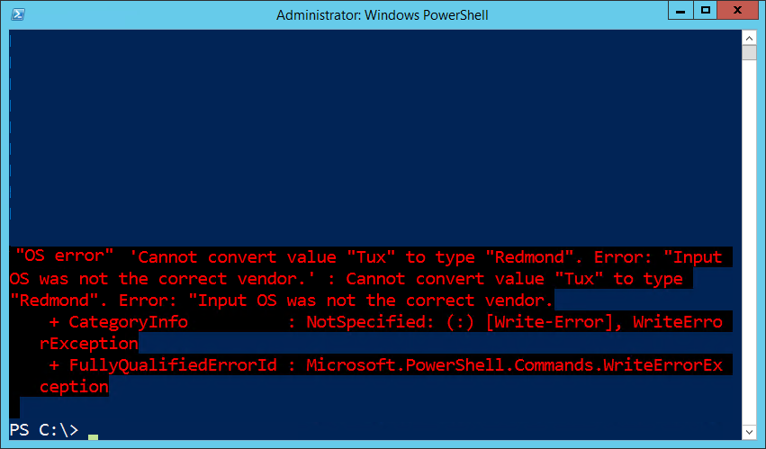


+

Slide 4
Standards-based management
}
OMI
Openwsman
Wiseman
OpenPegasus
SFCB/SBLIM
SSH …
WBEM
Notes:
OMI "The Open Management Infrastructure stack (OMI, formerly known as NanoWBEM) is an open-source CIM management server sponsored by The Open Group and made available under the Apache Software License 2.0. OMI was contributed to the Open Group by Microsoft on June 28, 2012 …" From: http://en.wikipedia.org/wiki/Open_Management_Infrastructure
Pash-Project/Pash: An Open Source reimplementation of Windows PowerShell, for Mono.
https://github.com/Pash-Project/Pash
https://groups.google.com/group/pash-project
SSH started 1995
PaSH started 2008
WBEM Based Management in Linux
Dell Linux Engineering Team, Feb. 2011
http://linux.dell.com/files/whitepapers/WBEM_based_management_in_Linux.pdf

Slide 5
A brief history of acronyms
Distributed Management Task Force (DMTF) Organization focusing on simplifying management of (heterogeneous) IT environments. Members: Cisco, Dell, HP, Intel, Microsoft, Oracle, VMware, etc. (founded 1992)
Common Information Model (CIM) A conceptual model providing standards to exchange management information of computing devices.
Web Services-Management (WS-Man) SOAP based protocol for the management of computing devices.
Web-Based Enterprise Management (WBEM) A set of management technologies built upon CIM and WS-Man focusing on remote administration in distributed environments.

Slide 6
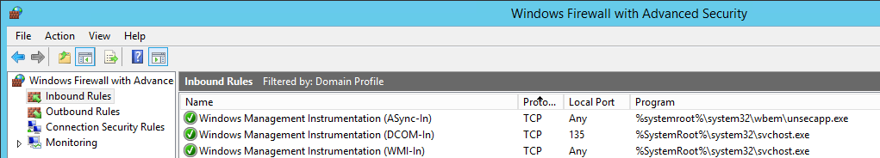
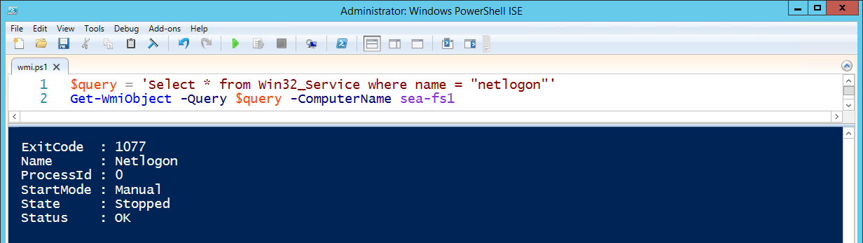
Origins
Windows Management Instrumentation (WMI) Microsoft's primary implementation of WBEM # kind of ..

Slide 7
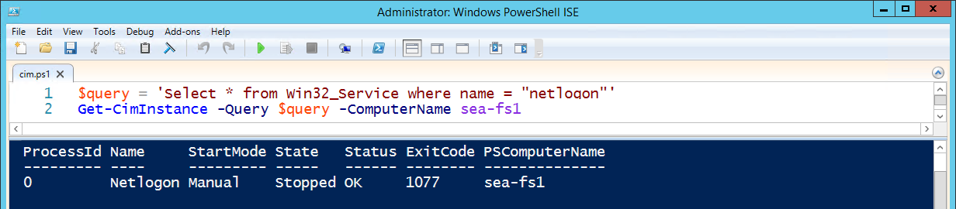
PowerShell version -ge 3
Windows Management Infrastructure (MI) Successor of WMI, fully downwardly compatible
New namespaces e.g. root/StandardCimv2 , root/virtualization/v2
CIM Cmdlets Using WS-Man (TCP 5985, 5986) communication instead of RPC/DCOM
Notes:
Windows PowerShell Blog:
Introduction to CIM Cmdlets
http://blogs.msdn.com/b/powershell/archive/2012/08/24/introduction-to-cim-cmdlets.aspx
Windows PowerShell Blog:
CIM Cmdlets – Some Tips & Tricks
http://blogs.msdn.com/b/powershell/archive/2013/08/19/cim-cmdlets-some-tips-amp-tricks.aspx
Trevor Sullivan, The Scripting Guys
What is CIM and Why Should I Use It in PowerShell?
http://blogs.technet.com/b/heyscriptingguy/archive/2014/01/27/what-is-cim-and-why-should-i-use-it-in-powershell.aspx

Slide 8

OMI (aka NanoWBEM)
Developed by Microsoft, published in 2012 by
Portable, small foot-print, high performance CIMOM Running Linux, Unix, Windows; networking devices, storage controllers , phones
x86/amd64 systems only
Current version (April 2015): 1.08
Notes:
Open Management Infrastructure (OMI) "CIM/WBEM Manageability Services Broker"
https://collaboration.opengroup.org/omi/

Slide 9
WPSDSCLinux
Windows PowerShell Desired State Configuration for Linux https://github.com/MSFTOSSMgmt/WPSDSCLinux/releases
Current version (April 2015): CTP1.0.0
Officially running on CentOS 6
Resource providers:
nxFile (manage files and directory state)
nxScript (runs script blocks on target nodes)
nxUser (manages Linux users)
nxGroup (manages Linux groups)
nxService (manages Linux services: System-V, Upstart, SystemD)
nxPackage # Expected in future versions
Notes:
URIs:
Getting Started with PowerShell Desired State Configuration (DSC): (07) DSC and Linux
http://channel9.msdn.com/Series/Getting-Started-with-PowerShell-Desired-State-Configuration-DSC/07
PowerShell DSC for Linux, Step by Step
Kristopher Bash, Michael Greene
http://blogs.technet.com/b/privatecloud/archive/2014/05/19/powershell-dsc-for-linux-step-by-step.aspx#pi169501=2
WPSDSCLinux
https://github.com/MSFTOSSMgmt/WPSDSCLinux

Slide 10
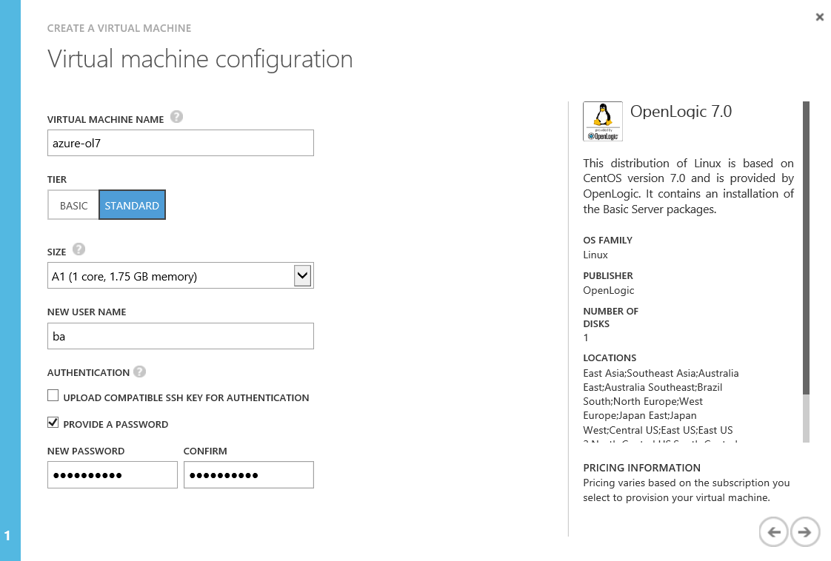
Demo 1

Slide 11
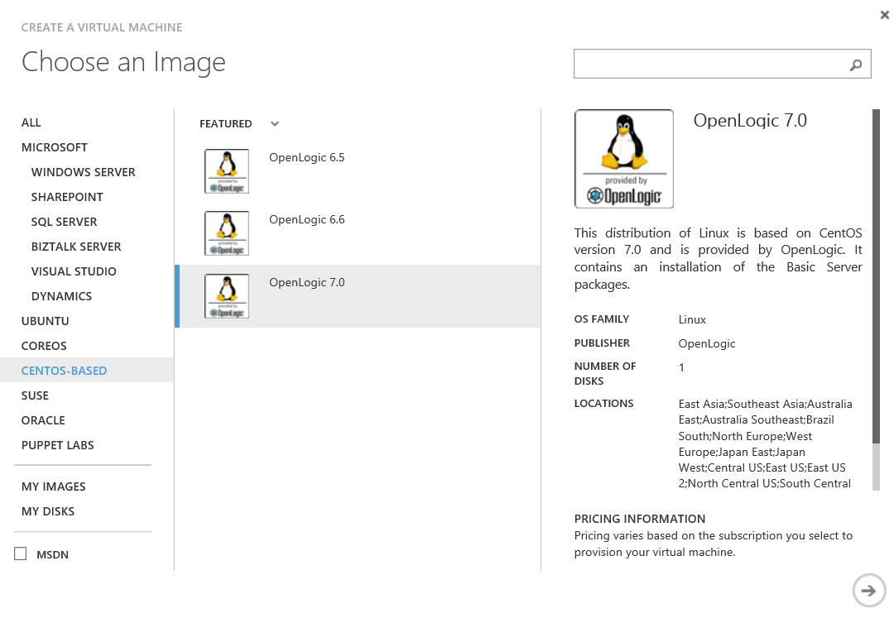
Demo 1

Slide 12
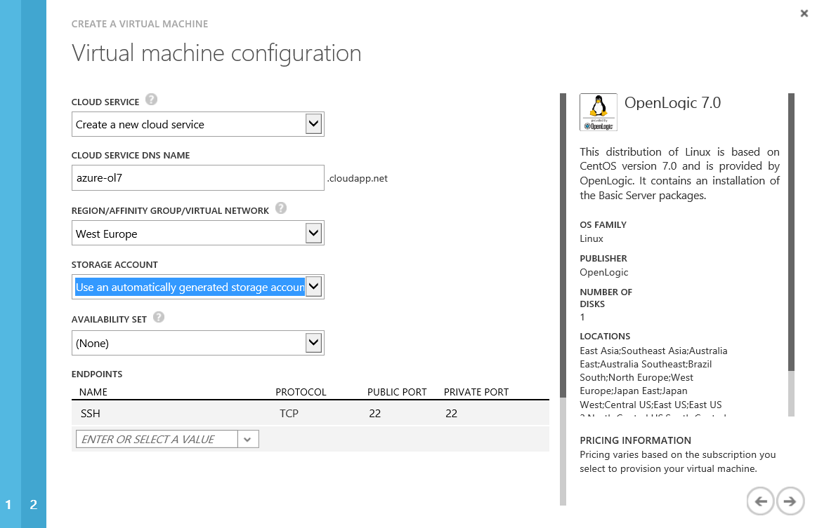
Demo 1

Slide 13
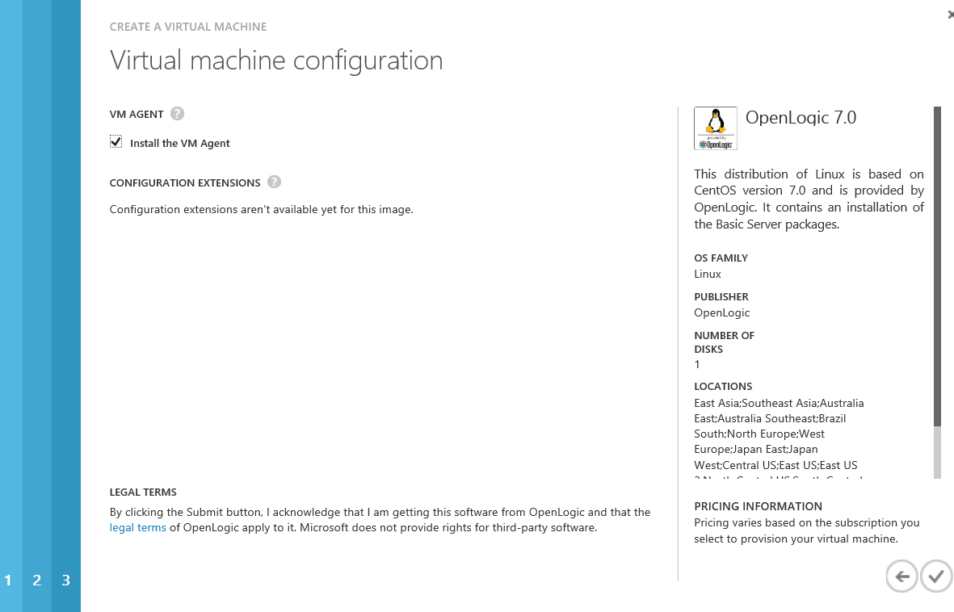
Demo 1

Slide 14
Demo 1
Install Prerequisites for CentOS 6/7: yum -y groupinstall 'Development Tools' yum -y install pam-devel openssl-devel wget yum -y install python python-devel *
Install Prerequisites for Debian/Ubuntu: apt-get -y install build-essential pkg-config libssl-dev libpam0g-dev apt-get -y install python python-dev *
Install Prerequisites for SuSE: zypper install -y --type pattern Basis-Devel zypper install -y pkg-config libopenssl-devel pam-devel zypper install -y python python-devel * * WPSDSCLinux

Slide 15
Demo 1
Download OMI and DSC mkdir ~/Downloads && cd ~/Downloads wget https://collaboration.opengroup.org/omi/documents/30532/omi-1.0.8.tar.gz wget https://github.com/MSFTOSSMgmt/WPSDSCLinux/releases/download/v1.0.0-CTP/PSDSCLinux.tar.gz tar xvf omi-1.0.8.tar.gz tar xvf PSDSCLinux.tar.gz mv dsc/* .

Slide 16
Demo 1
Compile OMI and DSC cd omi-1.0.8/ ./configure && make && make install cd .. make && make reg *
Run OMI OMI_HOME=/opt/omi-1.0.8/ /opt/omi-1.0.8/bin/omiserver –d
* WPSDSCLinux

Slide 17
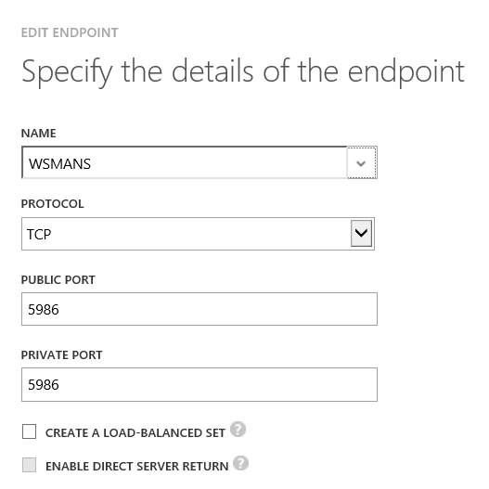
Demo 1
Create azure endpoint to "open" TCP Port 5986 to the Internet

Slide 18
Demo 1
# Define variables
$vm = 'azure-ol7.cloudapp.net'
$user = 'root'
$password = ConvertTo-SecureString -String 'YourPa$$w0rd' -AsPlainText –Force
$cred = New-Object System.Management.Automation.PSCredential ($user, $password)
# TEST endpoint
Test-NetConnection -ComputerName $vm -Port 5986 -InformationLevel Quiet
# Initiate Session
$sessionOptions =
New-CimSessionOption -UseSsl:1 -SkipCACheck:1 -SkipCNCheck:1 -SkipRevocationCheck:1
$session = New-CimSession -Credential $cred -ComputerName $vm -Port 5986 `
-Authentication Basic -SessionOption $sessionOptions
# Verify Session
Get-CimClass -Namespace root/omi -CimSession $session -ClassName OMI_Identify

Slide 19
Demo 1
# Any existing DscConfig?
Get-DscConfiguration -CimSession $session
# DSC test configuration
Configuration MyFirstLinuxDSC
{
Import-DSCResource -Module nx
Node "$vm"{
nxFile myTestFile
{
Ensure = "Present"
Type = "File"
DestinationPath = "/var/tmp/helloworld_dsc.txt"
Contents="Hello World!"
}
}
}
MyFirstLinuxDSC -OutputPath 'c:\LinuxDSC'
Start-DscConfiguration -CimSession $session -Path 'C:\LinuxDSC' -Verbose –Wait # This should work fine
Test-DscConfiguration -CimSession $session

Slide 20
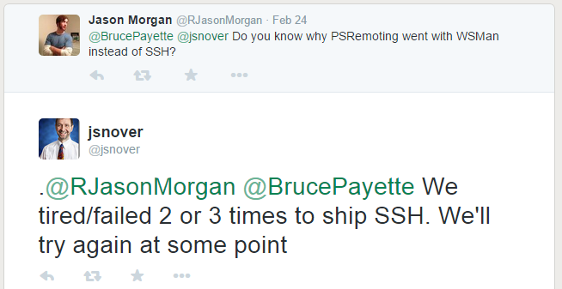
RFC 4251 (et al)

Slide 21
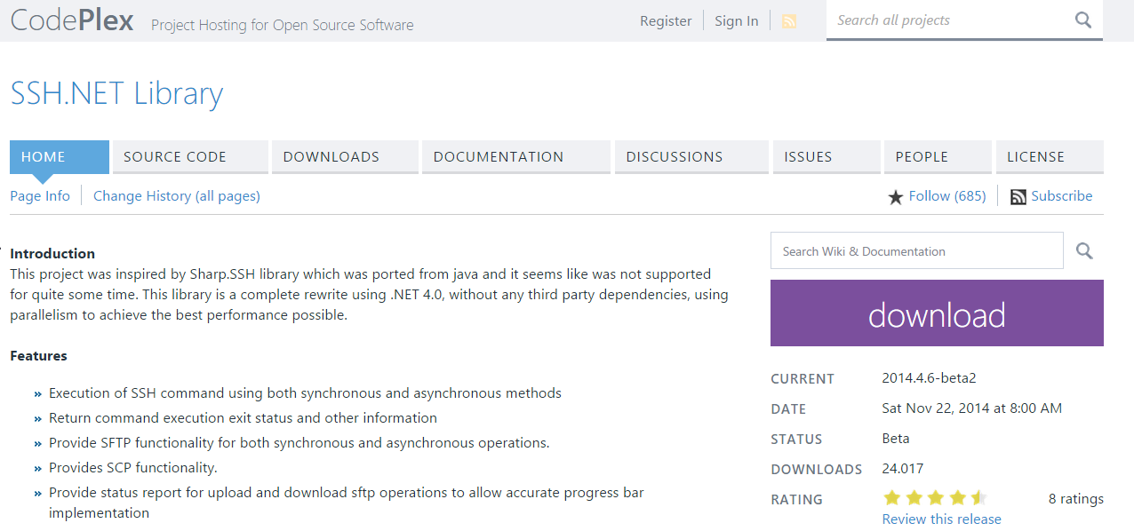
SSH.NET {sshnet.codeplex.com}

Slide 22
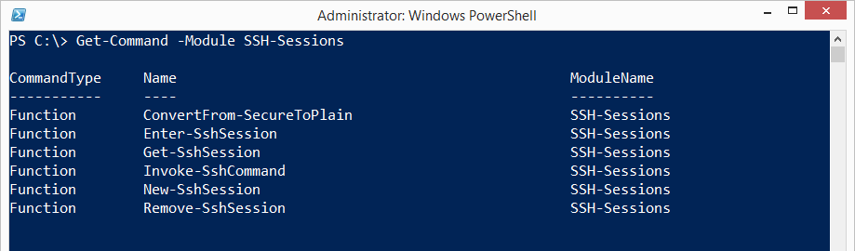
PowerShell SSH modules {1}
"SSH-Sessions" by Joakim Svenson powershelladmin.com/wiki/SSH_from_PowerShell_using_the_SSH.NET_library

Slide 23
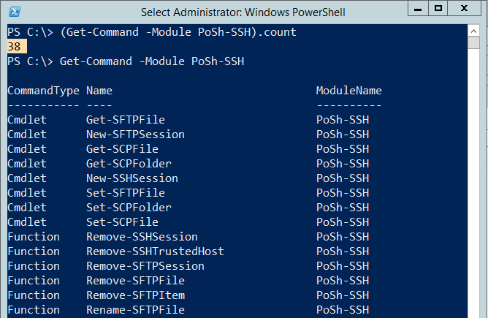
PoSh SSH modules {2}
"PoSh-SSH" by Carlos Perez https://github.com/darkoperator/Posh-SSH

Slide 24
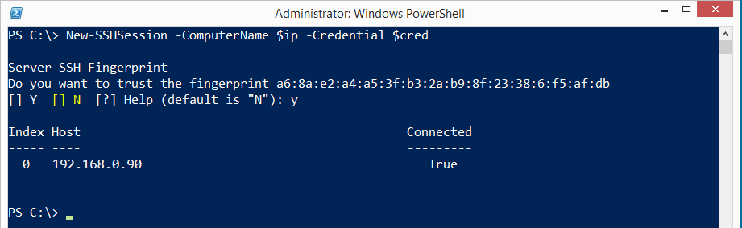
PoSh-SSH (by Carloz Perez)
Requires -Version 3.0
PoSh module written in C#
Open source

Slide 25
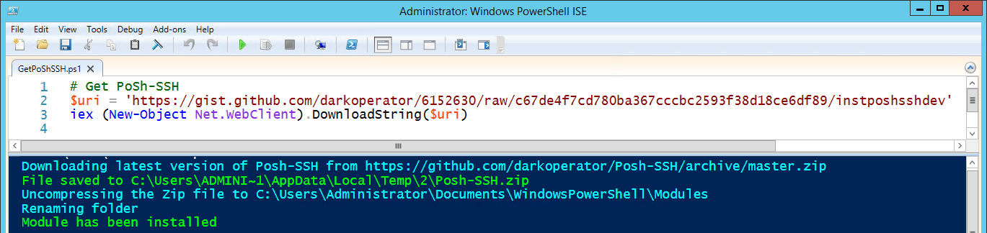
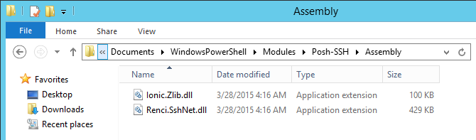
Demo 2
Installation PoSh-SSH
Notes:
http://www.powershellmagazine.com/2014/07/03/posh-ssh-open-source-ssh-powershell-module/

Slide 26
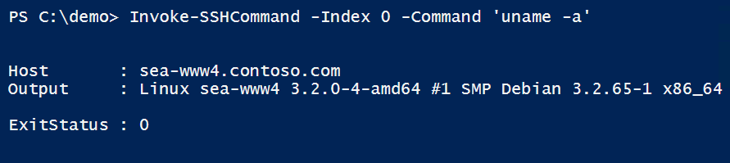
Demo 2
# Define variables
$vm = 'sea-www5.contoso.com'
$user = 'root'
$password = ConvertTo-SecureString -String 'p' -AsPlainText –Force
$cred = New-Object System.Management.Automation.PSCredential($user, $password)
# Test SSH port
Test-NetConnection -ComputerName $vm -Port 22 -InformationLevel Quiet
# Initiate session
$sshSession = New-SSHSession -ComputerName $vm -Credential $cred
# Remote command
Get-SSHSession # Mind the SessionID, pipelining not supported
Invoke-SSHCommand -Index 0 -Command 'uname -a'

Slide 27
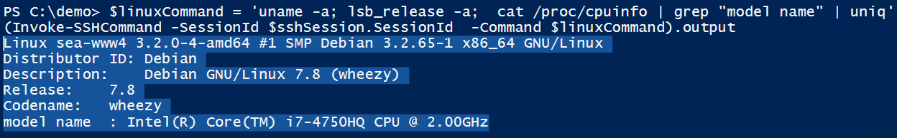
Demo 2
# Remote command, reloaded
(Invoke-SSHCommand -SessionId $sshSession.SessionId -Command 'uname -a').output
$linuxCommand = `
'uname -a; lsb_release -a; cat /proc/cpuinfo | grep "model name" | uniq'
(Invoke-SSHCommand -SessionId $sshSession.SessionId -Command $linuxCommand).output
# Close session
Get-SSHSession | Remove-SSHSession

Slide 28
Demo 2
# Download single file
$configFullName = '/etc/network/interfaces'
$configFileName = $configFullName.split("/")[$configFullName.split("/").count-1]
Get-SCPFile -ComputerName $vm -Credential $cred -LocalFile $configFileName -RemoteFile $configFullName
Get-Content $configFileName
# Download directory (recursive)
Get-SCPFolder -ComputerName $vm -Credential $cred `
-RemoteFolder '/etc/ssh' -LocalFolder 'c:\download'

Slide 29
Wrap up!
"In the context of Azure we make more money
if someone's using 10 instances of Linux
than they're using 2 instances of Windows."
Jeffrey Snover, March 2015
Notes:
http://channel9.msdn.com/Series/Getting-Started-with-PowerShell-Desired-State-Configuration-DSC/07
"Azure is one of the most important things we're doing. And here's the thing you need to understand:
In the context of Azure we make more money if someone's using 10 instances of Linux than they're using 2 instances of Windows.
In the context of Azure it's pure volume. So we need to do is to help people consume as much computing as they want, wether it's Windows orLinux.
So it is not a check box for us, it's a business imperative that we provide greate support for Linux."
Jeffey Snover, March 2015

Slide 30
Real \b(wo)?men\b don't click.

