Slide 1

Start-DUPSUGMeeting -Date '2022-04-13 19:00'

Slide 2

DUPSUG Easter 2022
Introduction: Jaap Brasser, Host @DUPSUG
Special guest: Demetrius Nelon Product manager for the Windows Package Manager
Speaker: Thorsten Butz, Natural Born Trainer
@DuPSUG @Jaap_Brasser,
@DenelonMs
@ThorstenButz

Slide 3
about_Session
{
"Title" : "Winget – behind the scenes",
"Speaker": "Thorsten Butz",
"Uri" : "thorsten-butz.de",
"Twitter": "@thorstenbutz",
"Podcast": "slidingwindows.de"
}

Slide 4
about_AppInstaller

Slide 5
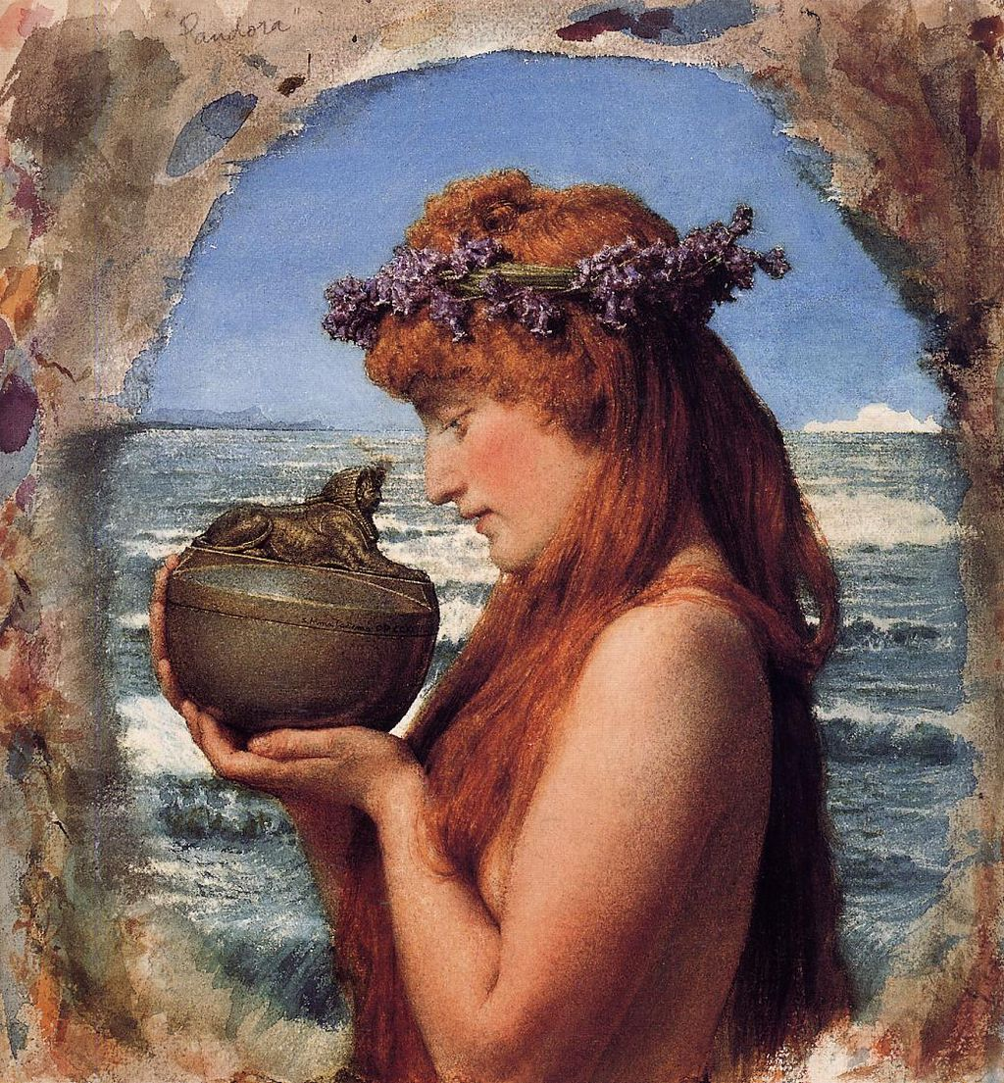
Notes:
https://en.wikipedia.org/wiki/Pandora%27s_box#/media/File:Lawrence_Alma-Tadema_10.jpeg

Slide 6
Definition of terms
¿
?
Windows Package Manager
(Desktop) App Installer (CLI)
WinGet
...

Slide 7
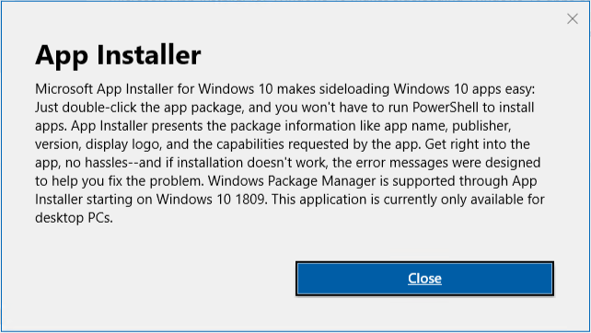
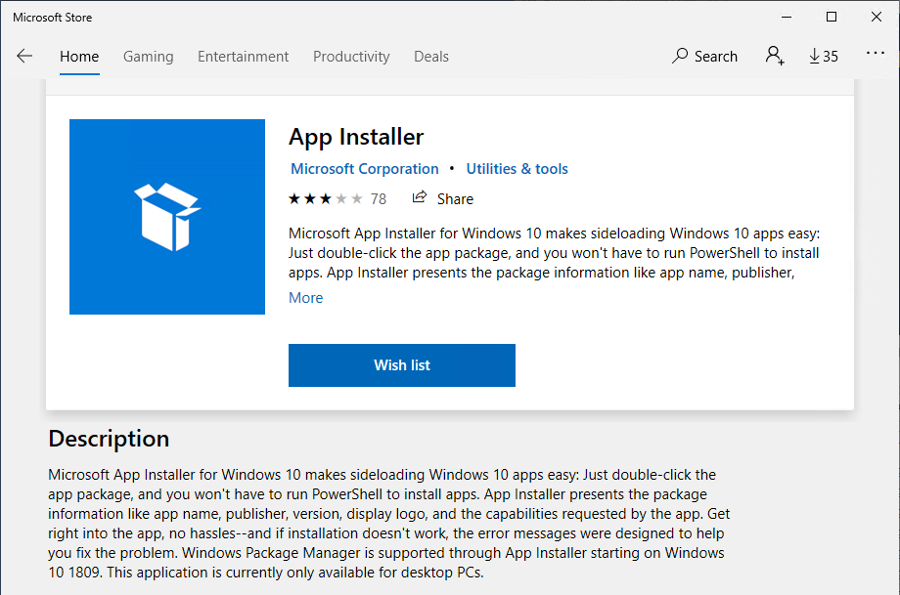
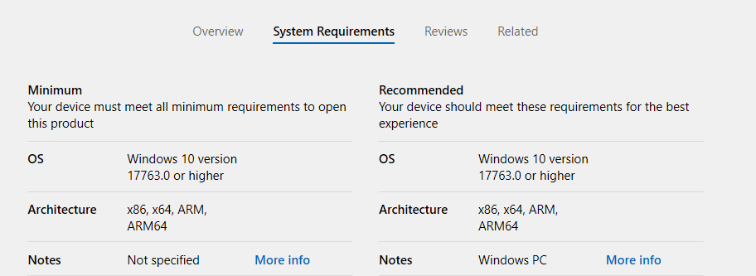
App Installer
Min. required OS:
Windows 10 v1809
(build 17763.0)
Includes "WinGet"
starting with
v1.11.11451.0

Slide 8
Demo A

Slide 9
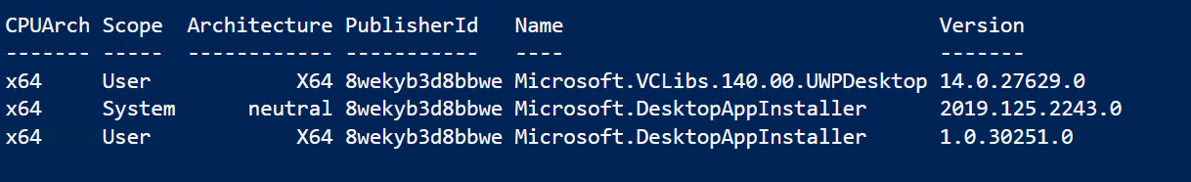
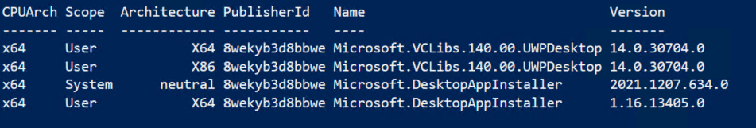
Pre/Post update in Win10 21H2
January 2022

Slide 10
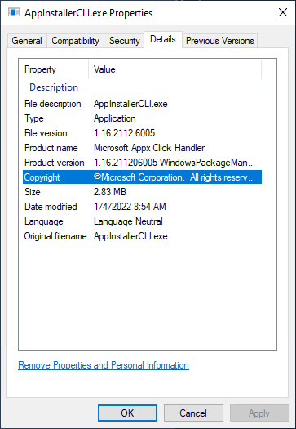
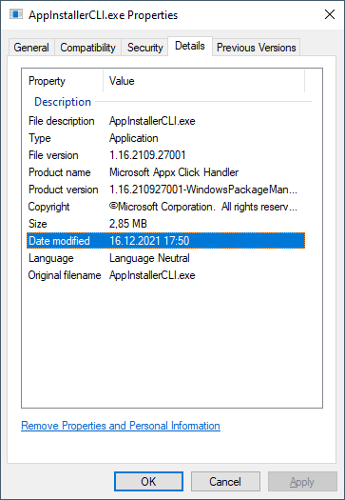
Versioning is not a problem *
Windows Package Manager Version numbers (2022-01-21)
winget.exe --info | 1.1.13405
Get-AppxPackage | 1.16.13405.0
Get-AppxProvisionedPackage | 2021.1207.634.0
File version (AppInstallerCli.exe) | 1.16.2112.6005
Github latest release | 1.1.12653
" Versioning is not a problem. Problems can be solved. " (Jeffrey Snover)

Slide 11
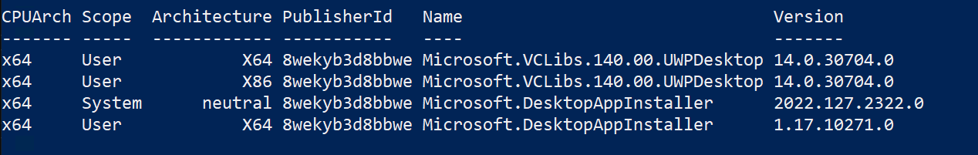
Pre/Post update in Win10 21H2
April 2022
Notes:
2022-04-10

Slide 12
Versioning is not a problem *
Windows Package Manager Version numbers (2022-04-10)
winget.exe --info | 1.2.10271
Get-AppxPackage | 1.17.10271.0
Get-AppxProvisionedPackage | 2022.127.2322.0
File version (WinGet.exe) | 1.17.2201.27001
Github latest release | 1.2.10271
" Versioning is not a problem. Problems can be solved. " (Jeffrey Snover)

Slide 13
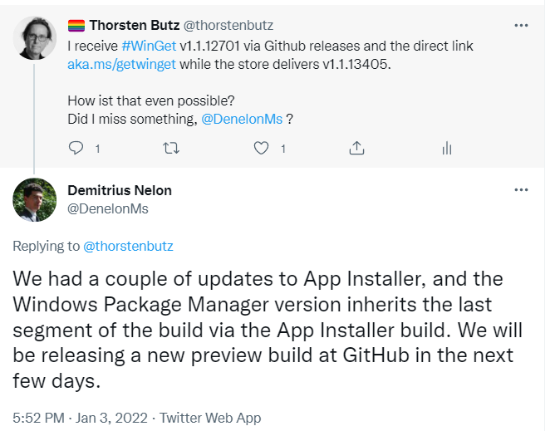
Jan 2021
winget.exe --info | 1.1.13405
Get-AppxPackage | 1.16.13405.0
Get-AppxProvisionedPackage | 2021.1207.634.0
File version (AppInstallerCli.exe) | 1.16.2112.6005
Github latest release | 1.1.12653

Slide 14
about_ModernApps

Slide 15
The AppInstallerCLI.exe (aka winget.exe)
$ENV:LOCALAPPDATA\Microsoft\WindowsApps\ winget.exe
$ENV:LOCALAPPDATA\Microsoft\WindowsApps\ Microsoft.DesktopAppInstaller_8wekyb3d8bbwe\winget.exe
$ENV:ProgramFiles\WindowsApps\ Microsoft.DesktopAppInstaller_1.16.13405.0_x64__8wekyb3d8bbwe\AppInstallerCLI.exe
User
Reparse points
Computer
Jan 2021

Slide 16
WinGet.exe (prev. AppInstallerCLI.exe )
$ENV:LOCALAPPDATA\Microsoft\WindowsApps\ winget.exe
$ENV:LOCALAPPDATA\Microsoft\WindowsApps\ Microsoft.DesktopAppInstaller_8wekyb3d8bbwe\winget.exe
$ENV:ProgramFiles\WindowsApps\ Microsoft.DesktopAppInstaller_1.17.10271.0_x64__8wekyb3d8bbwe\winget.exe
User
Reparse points
Computer
Notes:
2022-04-10

Slide 17
Demo B

Slide 18
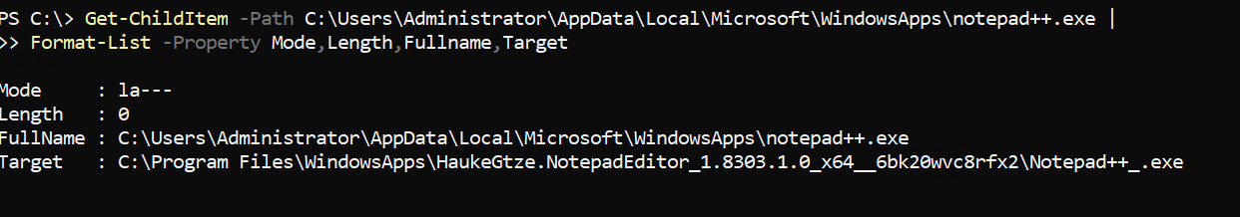
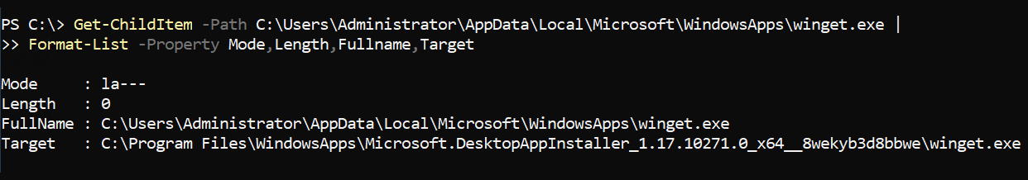
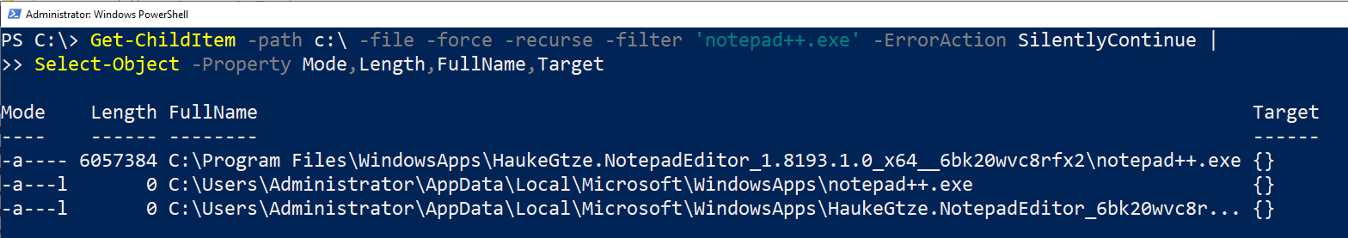
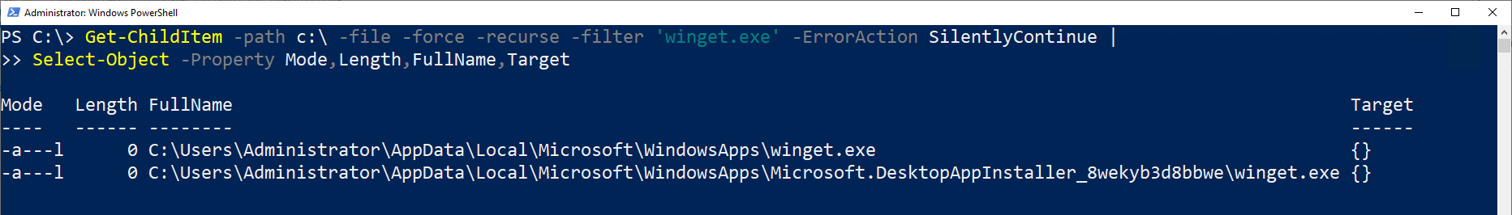
Reparse points
A file or directory can contain a reparse point, which is a collection of user-defined data. The format of this data is understood by the application which stores the data, [...]
For example, reparse points are used to implement NTFS file system link [...]
https://docs.microsoft.com/en-us/windows/win32/fileio/reparse-points

Slide 19
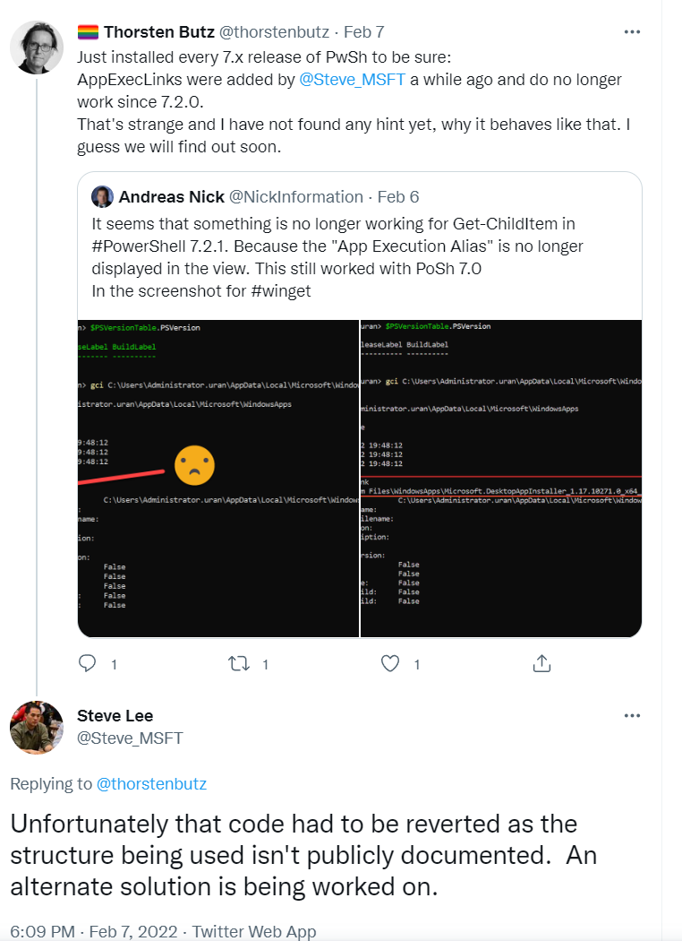
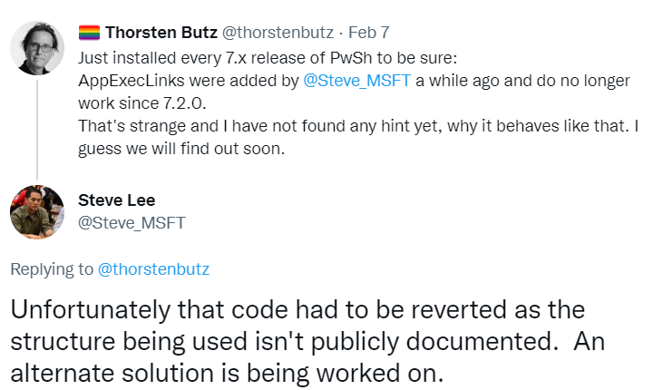

AppExec links and PwSh
PwSh v7.0.3 - 7.1.5 display AppExecLinks
https://twitter.com/thorstenbutz/status/1490734201288769539?s=20&t=h1O7L3DbjML9kC0YoQbzMg
Notes:
2022-02-07

Slide 20
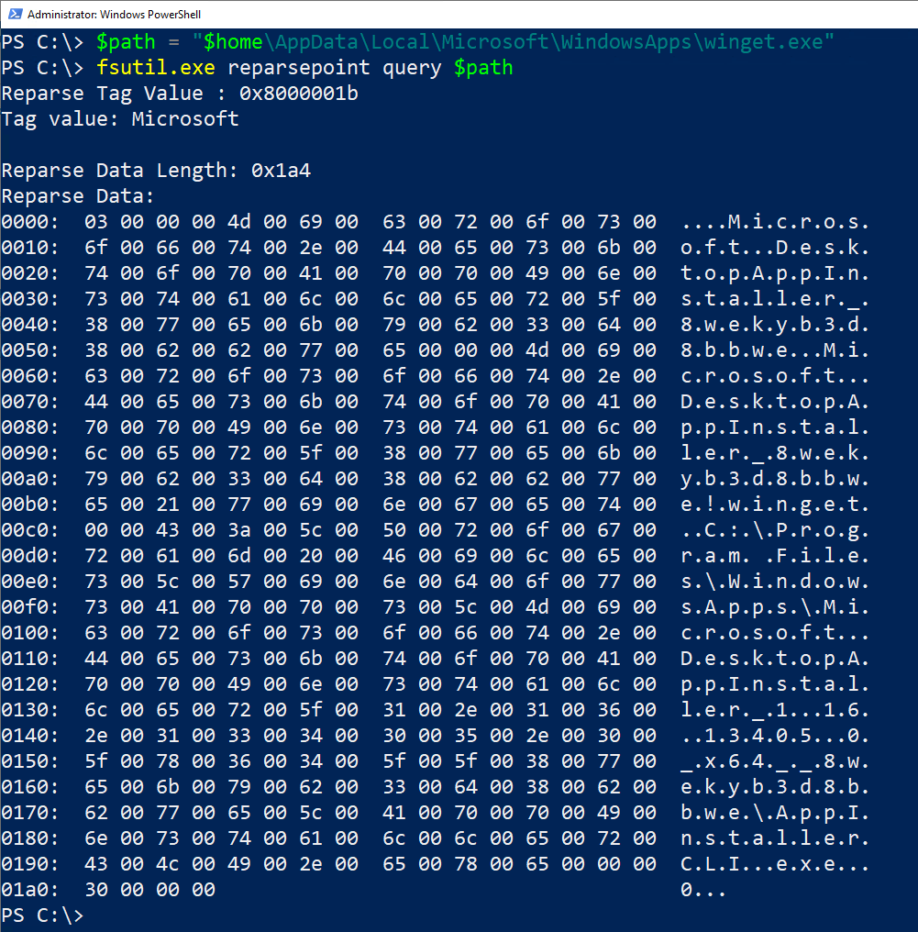
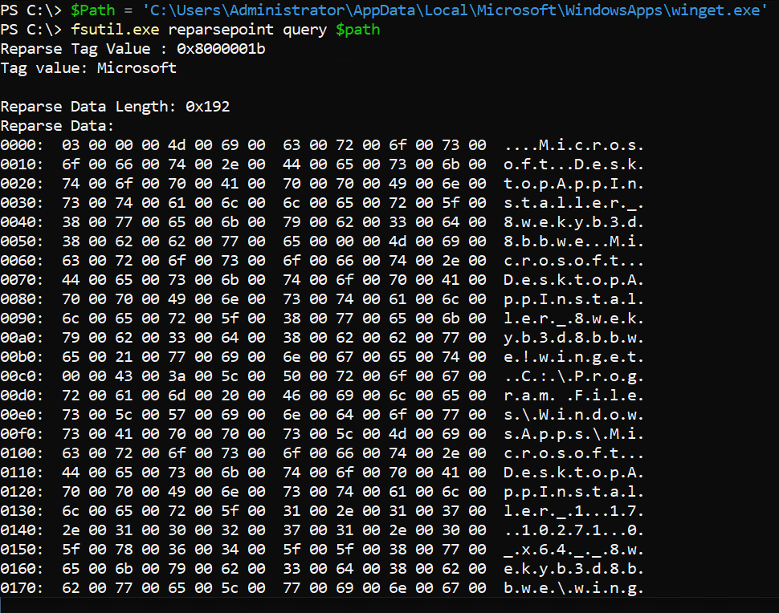

Slide 21
Create your own app execution aliases
Find-Module -Name 'NTObjectManager'| Install-Module
$params = @{
Path = "$($env:localappdata)\Microsoft\WindowsApps\aicli.exe"
PackageName = 'Microsoft.DesktopAppInstaller_8wekyb3d8bbwe'
EntryPoint = 'Microsoft.DesktopAppInstaller_8wekyb3d8bbwe!winget'
Target=
"$((Get-AppxPackage Microsoft.DesktopAppInstaller).InstallLocation)\AppInstallerCLI.exe"
AppType = 'Desktop'
Version = 3
}
Set-ExecutionAlias @params

Slide 22
Create your own app execution aliases
Find-Module -Name 'NTObjectManager'| Install-Module
$params = @{
Path = "$($env:localappdata)\Microsoft\WindowsApps\aicli.exe"
PackageName = 'Microsoft.DesktopAppInstaller_8wekyb3d8bbwe'
EntryPoint = 'Microsoft.DesktopAppInstaller_8wekyb3d8bbwe!winget'
Target=
"$((Get-AppxPackage Microsoft.DesktopAppInstaller).InstallLocation)\winget.exe"
AppType = 'Desktop'
Version = 3
}
Set-ExecutionAlias @params

Slide 23
about_WinGet

Slide 24
WinGet basics
User centric approach (modern app)
Scope: user vs machine
winget settings
Export/Import

Slide 25
Demo C

Slide 26
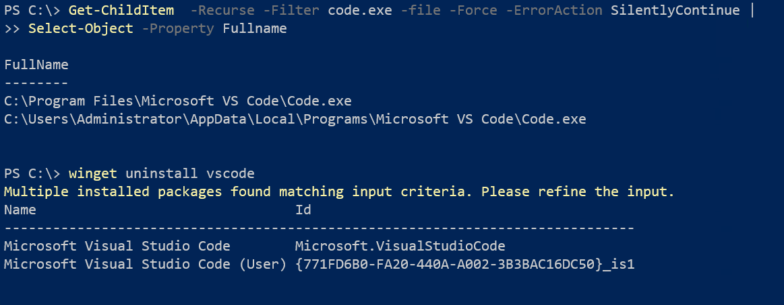
Scope: user vs machine

Slide 27
Settings
{
"$schema": "https://aka.ms/winget-settings.schema.json",
"visual": {
"progressBar": "rainbow"
},
"installBehavior": {
"preferences": {
"scope": "machine"
}
},
"telemetry": {
"disable": true
},
"experimentalFeatures": {
"experimentalCmd": true,
"experimentalArg": false
}
}

Slide 28
about_Manifests

Slide 29
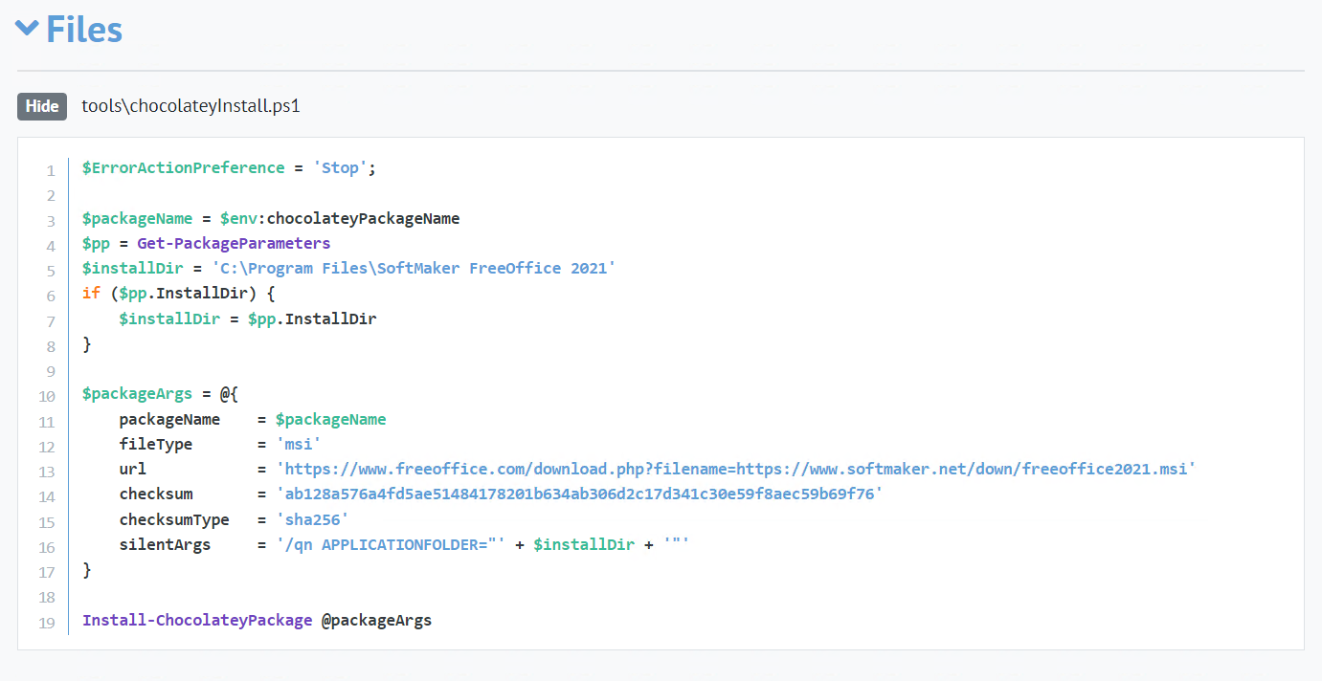

$ErrorActionPreference = 'Stop';
$packageName = $env:chocolateyPackageName
$pp = Get-PackageParameters
$installDir = 'C:\Program Files\SoftMaker FreeOffice 2021'
if ($pp.InstallDir) {
$installDir = $pp.InstallDir
}
$packageArgs = @{
packageName = $packageName
fileType = 'msi'
url = 'https://www.freeoffice.com/download.php?filename=https://www.softmaker.net/down/freeoffice2021.msi'
checksum = 'ab128a576a4fd5ae51484178201b634ab306d2c17d341c30e59f8aec59b69f76'
checksumType = 'sha256'
silentArgs = '/qn APPLICATIONFOLDER="' + $installDir + '"'
}
Install-ChocolateyPackage @packageArgs
https://community.chocolatey.org/packages/freeoffice
Notes:
## Sample chocolatey install file: Free Office
## https://community.chocolatey.org/packages/freeoffice
$ErrorActionPreference = 'Stop';
$packageName = $env:chocolateyPackageName
$pp = Get-PackageParameters
$installDir = 'C:\Program Files\SoftMaker FreeOffice 2021'
if ($pp.InstallDir) {
$installDir = $pp.InstallDir
}
$packageArgs = @{
packageName = $packageName
fileType = 'msi'
url = 'https://www.freeoffice.com/download.php?filename=https://www.softmaker.net/down/freeoffice2021.msi'
checksum = 'ab128a576a4fd5ae51484178201b634ab306d2c17d341c30e59f8aec59b69f76'
checksumType = 'sha256'
silentArgs = '/qn APPLICATIONFOLDER="' + $installDir + '"'
}
Install-ChocolateyPackage @packageArgs

Slide 30
Demo D

Slide 31
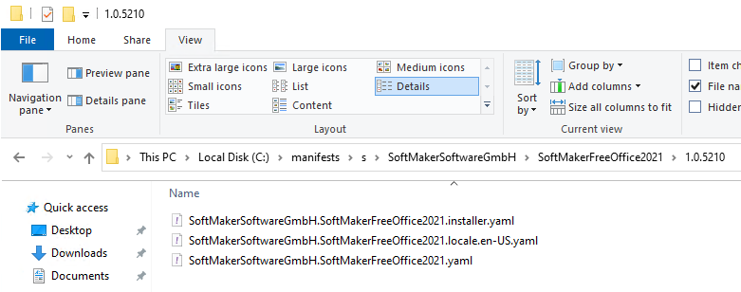
WinGetCreate: <package>.yaml
3
2
1
# Created using wingetcreate 0.4.4.1
# yaml-language-server: $schema=https://aka.ms/winget-manifest.version.1.0.0.schema.json
PackageIdentifier: SoftMakerSoftwareGmbH.SoftMakerFreeOffice2021
PackageVersion: 1.0.5210
DefaultLocale: en-US
ManifestType: version
ManifestVersion: 1.0.0
1

Slide 32
<package>.locale.en-US.yaml
# Created using wingetcreate 0.4.4.1
# yaml-language-server: $schema=https://aka.ms/winget-manifest.defaultLocale.1.0.0.schema.json
PackageIdentifier: SoftMakerSoftwareGmbH.SoftMakerFreeOffice2021
PackageVersion: 1.0.5210
PackageLocale: en-US
Publisher: SoftMaker Software GmbH
PackageName: SoftMaker FreeOffice 2021
License: Copyright (c) Softmaker Software GmbH
ShortDescription: Yet another office suite
ManifestType: defaultLocale
ManifestVersion: 1.0.0
2

Slide 33
<package>.installer.yaml
# Created using wingetcreate 0.4.4.1
# yaml-language-server: $schema=https://aka.ms/winget-manifest.installer.1.0.0.schema.json
PackageIdentifier: SoftMakerSoftwareGmbH.SoftMakerFreeOffice2021
PackageVersion: 1.0.5210
Installers:
- InstallerLocale: en-US
Architecture: x86
InstallerType: msi
InstallerUrl: https://www.freeoffice.com/download.php?filename=https://www.softmaker.net/down/freeoffice2021.msi
InstallerSha256: AB128A576A4FD5AE51484178201B634AB306D2C17D341C30E59F8AEC59B69F76
ProductCode: '{2847114B-5210-4F32-8E22-44DCDFEA77EF}'
ManifestType: installer
ManifestVersion: 1.0.0
3

Slide 34
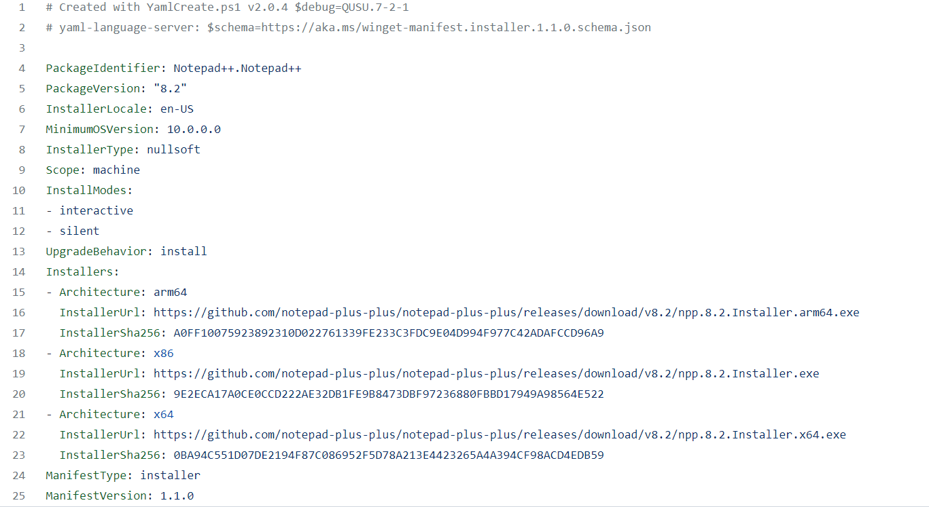
https://github.com/microsoft/winget-pkgs/blob/master/manifests/n/Notepad%2B%2B/Notepad%2B%2B/8.2/ Notepad%2B%2B.Notepad%2B%2B.installer.yaml
Notes:
https://github.om/microsoft/winget-pkgs/blob/master/manifests/n/Notepad%2B%2B/Notepad%2B%2B/8.2/Notepad%2B%2B.Notepad%2B%2B.installer.yaml

Slide 35
about_Origins

Slide 36
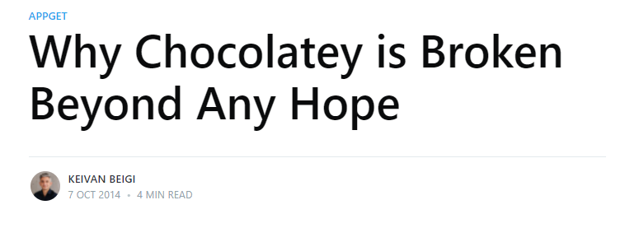
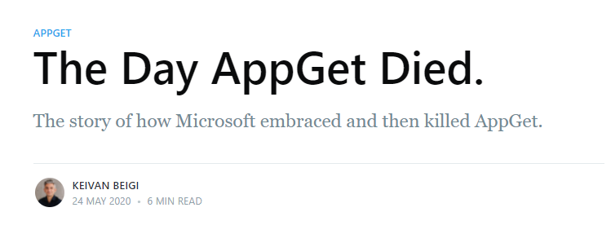
Keivan Beigi
https://keivan.io/why-chocolatey-is-broken
https://keivan.io/the-day-appget-died

Slide 37
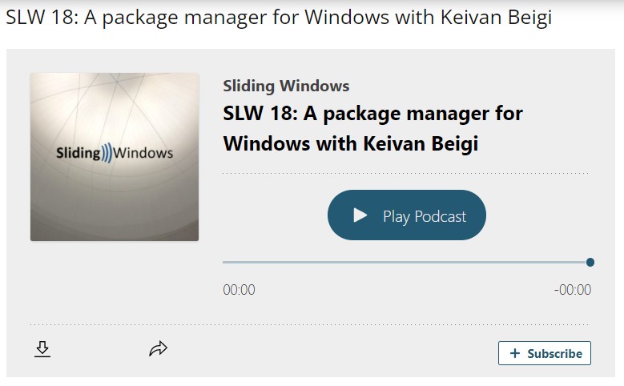

Keivan Beigi
https://www.slidingwindows.de/slw18/

Slide 38
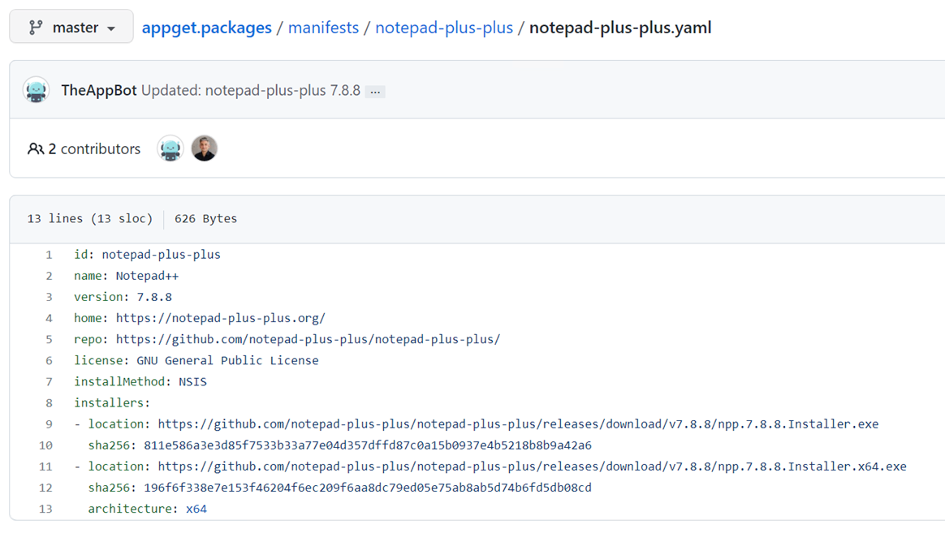
https://github.com/appget/appget.packages/blob/master/manifests/notepad-plus-plus/notepad-plus-plus.yaml

Slide 39
Manifests
AppGet
WinGet

Slide 40
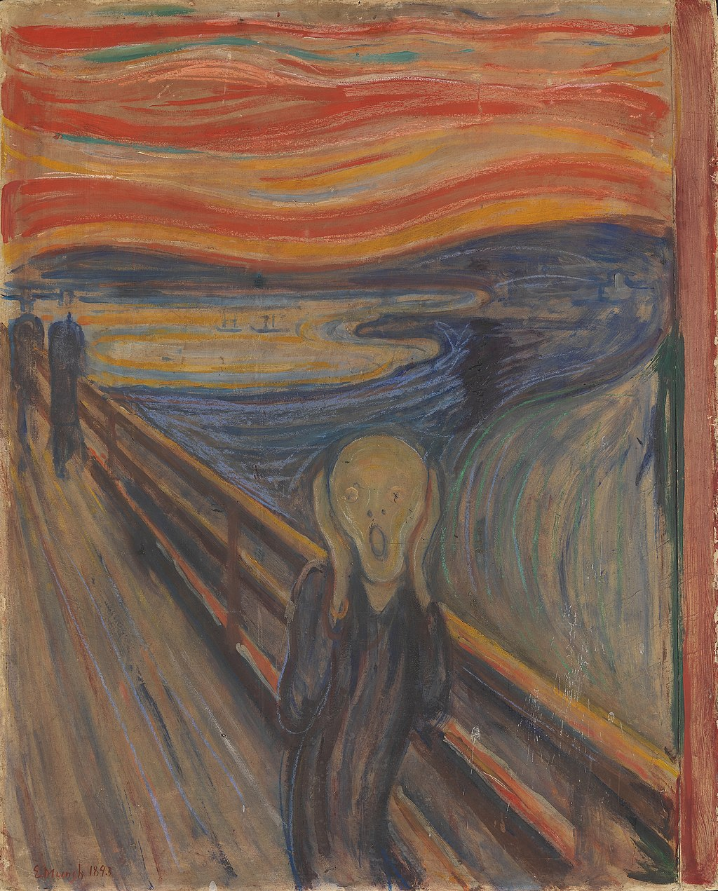
Notes:
https://commons.wikimedia.org/wiki/Category:The_Scream_by_Edvard_Munch?uselang=de#/media/File:Edvard_Munch,_1893,_The_Scream,_oil,_tempera_and_pastel_on_cardboard,_91_x_73_cm,_National_Gallery_of_Norway.jpg

Slide 41
Standing on the shoulders of giants
Andreas Nick (Nick IT) https://www.andreasnick.com
James Forshaw (Tyranid's lair) https://www.tiraniddo.dev
Keivan Beigi keivan.io
Notes:
https://www.tiraniddo.dev/2019/09/
https://github.com/googleprojectzero/sandbox-attacksurface-analysis-tools
https://twitter.com/tiraniddo
https://www.andreasnick.com/112-install-winget-and-appinstaller-on-windows-server-2022.html

Slide 42
Bedankt voor je aandacht en prettige paasdagen!
{
"Title" : "Winget – behind the scenes",
"Speaker": "Thorsten Butz",
"Uri" : "thorsten-butz.de",
"Twitter": "@thorstenbutz",
"Podcast": "slidingwindows.de"
}

