Slide 1

The most optimal community in Calgary to open a new Liquor Store

Slide 2
Background
Calgary
The fifth largest city in Canada
Located in southern Alberta
the center of oil industry of Canada
ranked 32 in the Mercer's "2019 Quality of living city ranking“
population of nearly 1.4 million

Slide 3


Problem?
Which community is the most optimal location to open a new Liquor Store business?

Slide 4



Data
The information regarding community names, their addresses and the population of each community will be collected from the City of Calgary’s Open Data Portal and Citizen Dashboard
Where?
Socrata Open Data API is used to fetch the data from the above source
How?
Foursquare API is used to explore each community to find the number of the Liquor Stores that are currently available within 4 km of the centroid of each community
Then?

Slide 5
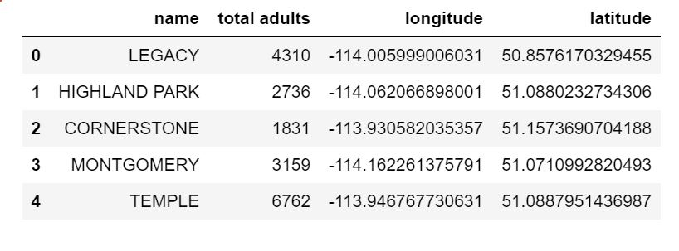
Community names, population and coordinates

Slide 6
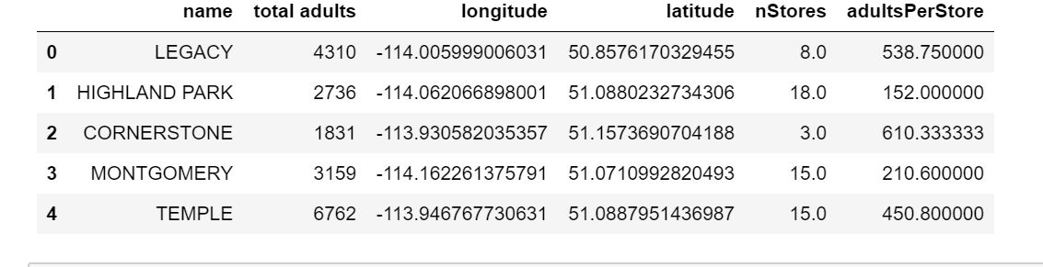
Ratio of total adults per liquor store in each community

Slide 7
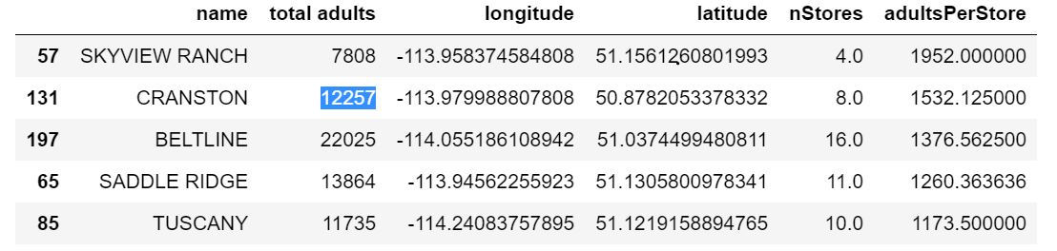
results
Skyview Ranch, Cranston and Beltine respectively have the highest ratios of residing adults between 20-64 years old with respect to the number of Liquor stores located within 4 km of their centroids and therefore are the most optimal communities to open a new liquor stor

