Slide 1

VIETNAM NATIONAL UNIVERSITY INTERNATIONAL UNIVERSITY
OOP FINAL PROJECT REPORT
Game project: Candy Crush
Language: Java 14
Course: OOP – Semester 1 (2020 – 2021) – Group 3
Due date: January, 7th 2021
GROUP 63:
Trần Nam Tuấn – ITITIU19230
Phan Hưng Thịnh – ITDSIU19055
Trương Gia Khang – ITDSIU19041

Slide 2
I. Introduction.
Candy Crush is one of the most popular games which is a free-to-play match-three puzzle video game released by King on April 12, 2012, for Facebook, and another version for iOS, Android, Windows Phone.
This report will present more details of development and implementation of a simple Candy-Crush-style game.
The game is written completely in Java 14 with no additional library installed. Most elements are inherited and implemented from the Java AWT library.

Slide 3
II. Program design. 1. Rules.
The game rules are kept to be simple:
The levels are locked until the last level is completed.
Each level has a target point that the player needs to reach and a provided amount of moves that they can use.
If the target point is reached with enough moves, the player win and the next level is unlocked.
The level resets itself if the player loses.
Candies can be matched if three candies or more are aligned in any direction.
Note: No special candy is implemented yet. The grid layout of each level can be change inside the level configuration to add or remove tiles.

Slide 4
II. Program design. 1. Game design. a) The main class.
The window extends JFrame, size 1280x960.
The main Game class extends Canvas is added the windows. It implements Runnable interface.
There are five key method: start, run, tick, render, stop.
Start method start a thread which called run method.
The game loop is inside run, repeatedly call tick and render.
Game loop is design to execute login independent of frame rate (60 ticks/second).

Slide 5
II. Program design. 1. Game design. a) The main class.
There are three handler: ObjectHandler, MouseHandler, LevelHandler. Handling logic and rendering objects.
Resource manager: TextureManager, LevelManager. Load and store contents in memory.

Slide 6
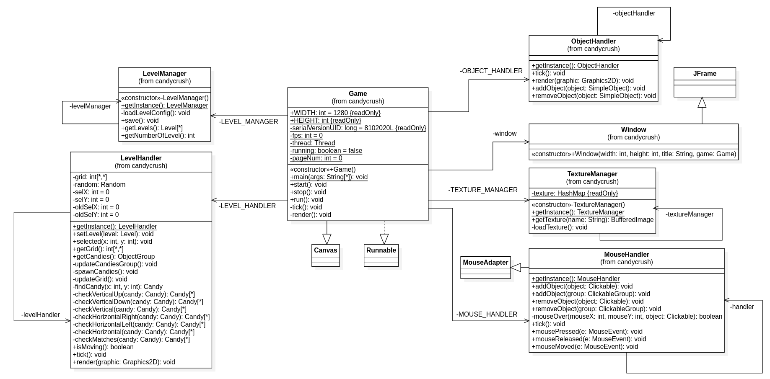
II. Program design. 1. Game design. a) The main class.

Slide 7
II. Program design. 1. Game design. a) Objects.
Most are inherited from SimpleObject.
Are handle by handlers.
Group can be use to organized most object.

Slide 8
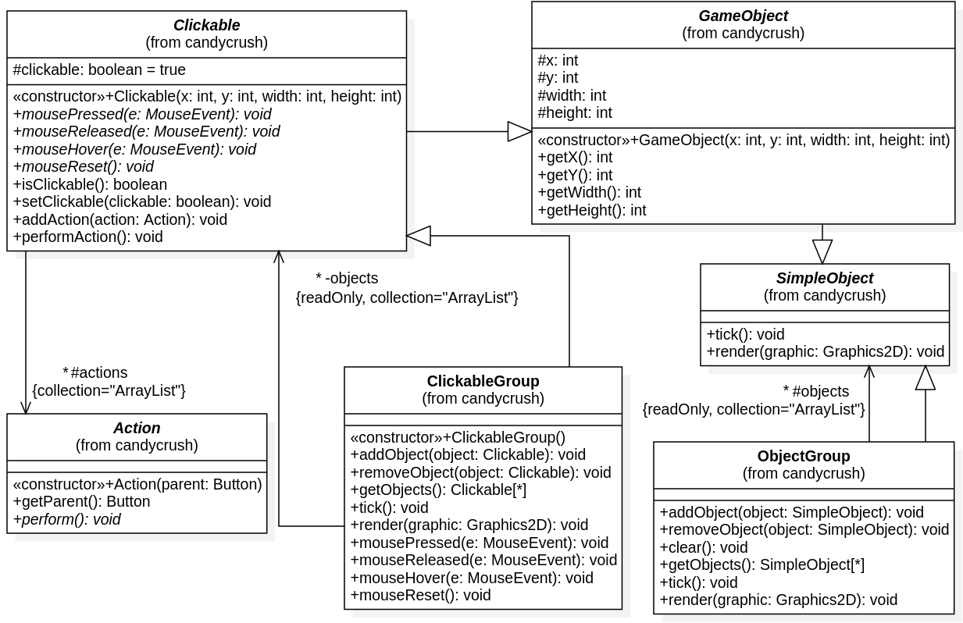
II. Program design. 1. Game design. a) Objects.

Slide 9
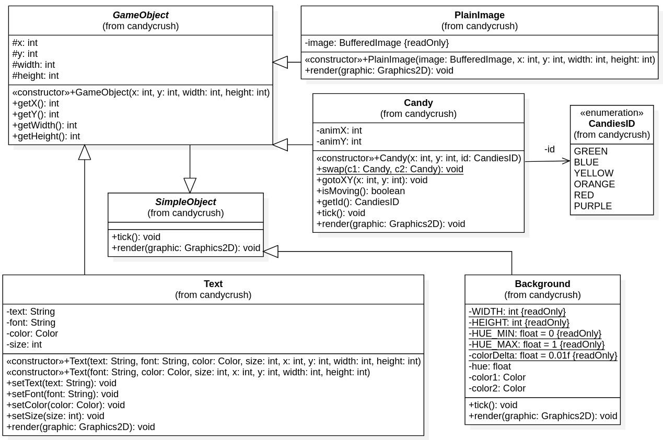
II. Program design. 1. Game design. a) Objects.

Slide 10
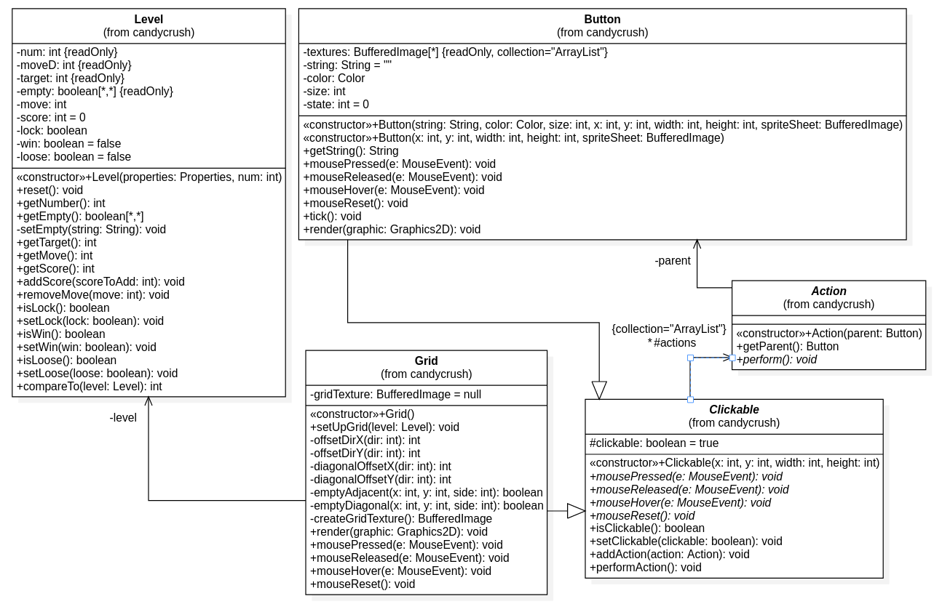
II. Program design. 1. Game design. a) Objects.

Slide 11
II. Program design. 1. Game design. b) Handler.
The handlers manage the objects in the program and is designed as singleton class. This is because there should be only one of each type of handlers every time the program start.
The act of storing object and call them one by one is also adapted from the Command/Observer pattern.
ObjectHandler handles logic and rendering of objects.
MouseHandler extends MouseAdapter class to handle mouse input.
LevelHandler handles most game logic.

Slide 12
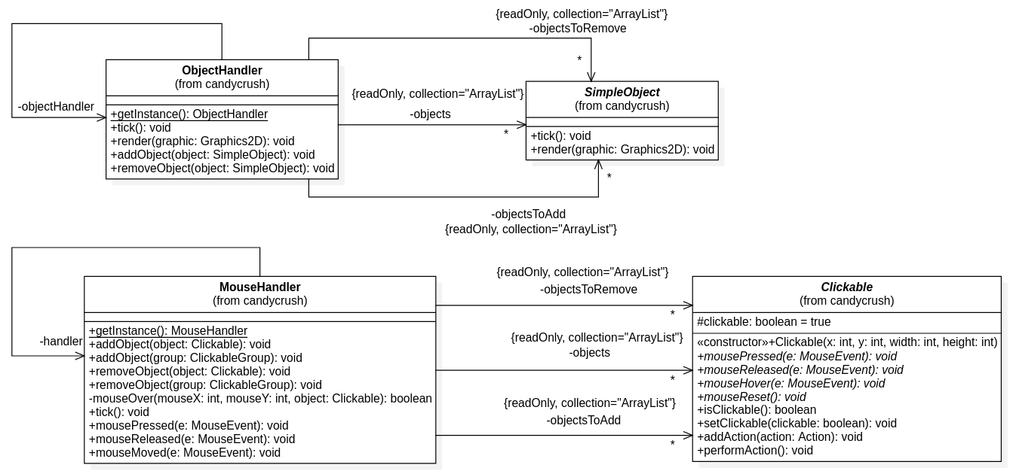
II. Program design. 1. Game design. b) Handler.

Slide 13
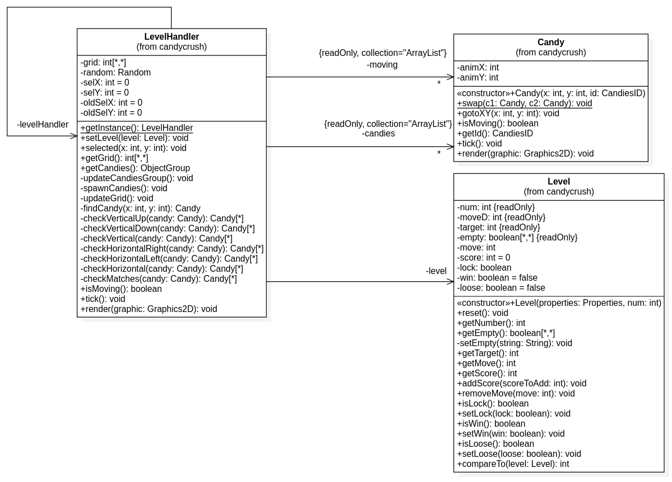
II. Program design. 1. Game design. b) Handler.

Slide 14
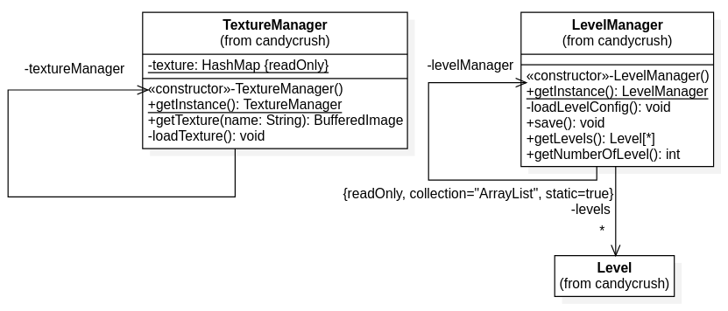
II. Program design. 1. Game design. c) Resource manager.
Resource manager consists of TextureManager for loading and storing texture, LevelManager for loading and saving level information. Both are designed as singletons.

Slide 15
III. Conclusion.
Since the program are design from scratch in Java with no additional library or specialized library for designing game, the process become much harder because there is no predefined standard and efficient workflow.
While Candy Crush is a simple game concept, the approach of only using vanilla Java does not make the development process easy as it lacks specialized tools for designing game. If the project is to be remake, a gaming developing library or toolkit will be use so that time can be spent more on perfecting the game play design rather than wasting on creating a base system.

Slide 16
THE END.

