Slide 1

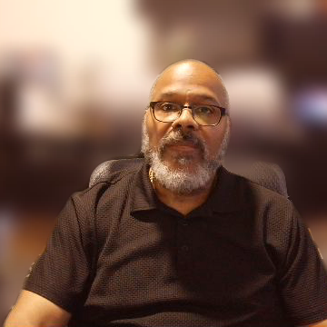

FlagAI powered by The Call AI
An AI-assisted penalty ruling and rule-citation engine for American football
Joseph Hudson Jr.
University of Advancing Technology
B.S. Artificial Intelligence & B.S. Advancing Computer Science, SIP311
Notes:
Good [morning/afternoon]. I'm Joseph Hudson Jr., dual-majoring in Artificial Intelligence and Advancing Computer Science. My project is FlagAI, powered by The Call AI: an AI-assisted penalty ruling and rule-citation engine for American football. FlagAI is the product; The Call AI is the rule engine underneath it.
Bottom Line Up Front: you describe a play in plain English, and in seconds FlagAI tells you what the foul is, quotes the exact rule, and computes the enforcement. Let me show you why that matters.
[~30 sec]

Slide 2
Problem Statement
The problem
Football penalty decisions are made in seconds under the pressure of a live game, by officials who must recall hundreds of interlocking rules, exceptions, and enforcement procedures from memory. Even at the NFL level, rule misapplication and inconsistent enforcement continue to change outcomes. At the youth, high school, and small-college levels, where officials are part-time volunteers with far less training, the gap between what the rulebook says and what gets called is wider still.
Why it matters
Rule misapplication, not judgment on contact, is the category of error the league most often corrects after the fact; one wrong enforcement can decide a game, a playoff berth, or a season.
Coaches, players, broadcasters, and fans have no fast, trustworthy way to check a call against the actual rule text and its enforcement.
Officiating associations face shortages and high turnover, so new officials need faster, cheaper ways to learn and verify rule interpretations.
Who is impacted
Game officials and officiating associations at every level; coaches and team analysts preparing challenges; sports media explaining calls to audiences; and the roughly 1.4 million youth and high school players whose games are worked by the least-resourced officials.
Notes:
Football penalties are called in seconds, under pressure, by officials who have to hold hundreds of interlocking rules and exceptions in their heads. Even in the NFL, rule misapplication still changes outcomes. And the further you get from the NFL, the wider the gap between what the rulebook says and what actually gets called. High school and youth games are worked by part-time volunteers with the least training.
I'm drawing a distinction here that matters for the whole project: judgment errors, like whether contact was enough for holding, versus misapplication errors, like enforcing the wrong yardage or the wrong spot. The second kind is the kind you can fix with software, and it's the category the league itself most often corrects after the fact.
Who's affected? Officials and their associations, who are short-staffed and turning over fast. Coaches preparing challenges. Broadcasters explaining calls. And roughly 1.4 million youth and high school players whose games are worked by the least-resourced crews.
[~60 sec]

Slide 3
Innovation Claim
FlagAI, powered by The Call AI, turns a plain-English description of a football play into a penalty ruling in seconds, with the exact rule, section, and article cited and the enforcement (yardage, spot, and down) computed automatically. Unlike existing AI officiating tools that require stadium camera arrays, it runs a deterministic rule engine built from the official rulebook, using a large language model only to understand the play and explain the answer, so every ruling is fast, consistent, and traceable to the rule text.
What makes it innovative
Faster: rulings in under five seconds instead of minutes of manual rulebook lookup.
More consistent: the same facts always produce the same ruling, because the decision is made by rule code, not by a probabilistic model.
Cheaper and more accessible: no cameras, sensors, or league licensing; works on any browser for a high school crew as easily as a broadcast booth.
Explainable: every output shows the rule text it relied on and what facts would change the call.
Notes:
So here's the innovation claim. FlagAI takes a plain-English description of a play and returns a ruling in seconds, with the rule, section, and article cited, and the enforcement, meaning yardage, spot, and down, computed automatically.
The key design decision is what the AI does and doesn't do. The large language model only does two jobs: understand the play, and explain the answer. The ruling itself comes from a deterministic rule engine built directly from the official rulebook. That split gives me four things: it's faster than flipping through a rulebook; it's consistent, because the same facts always produce the same ruling; it's cheap and accessible, because there are no cameras, sensors, or league licensing, so a high school crew can use it in a browser exactly like a broadcast booth; and it's explainable, because every ruling shows the rule text it relied on and what facts would change the call.
[~50 sec]

Slide 4
Technical Expertise & Skills
Technical domain
Applied AI and software engineering: LLM-based information extraction, rule-based expert systems, and full-stack web development with a secure REST API.
UAT courses that support the MVP
Completed / in progress: CSC382 Data Structures & Algorithms (C++), CSC318 Software Engineering (requirements, UML, Agile, CI/CD), CSC442 Secure Coding, ENG102/ENG330 (technical and research writing), COM226 (presentation and pitch skills), SIP311 Student Innovation Project I.
Still needed: AI-major courses in machine learning and natural language processing (LLM prompting, evaluation, and structured output), a database design course, a web/UX development course, and the remaining SIP sequence through SIP409 for the showcase build.
Technical skills required for the MVP
Have now: Python, C++, C#, FastAPI and REST API design, Git/GitHub, JSON, unit testing, Claude API and agent tooling, Splunk-style log analysis for monitoring, DaVinci Resolve for demo video.
Will gain in SIP: prompt engineering with schema-validated (JSON) LLM output; rule-engine design (encoding rulebook articles as testable condition/penalty records); LLM evaluation and regression testing against a labeled play corpus; SQL database modeling (SQLite → PostgreSQL); React front-end basics; cloud deployment (Docker, Render/Railway) with secure secrets handling; Figma for UI mockups.
Notes:
The technical domain is applied AI and software engineering: LLM-based information extraction, rule-based expert systems, and full-stack web development behind a secure REST API.
My coursework already supports the core. CSC382 gave me the data structures for the rule engine, CSC318 is where I wrote the SRS and use cases for this exact system, and CSC442 covers the secure API. Still ahead of me are the AI-major courses in machine learning and NLP, database design, web/UX, and the rest of the SIP sequence.
Skills-wise, I come in with Python, C++, C#, FastAPI, Git, unit testing, and hands-on experience with the Claude API and agent tooling. Professionally I work as a Splunk engineer, so monitoring and log analysis are second nature. What I'll build during SIP is schema-validated LLM output, rule-engine design, regression testing against a labeled play corpus, SQL modeling, React basics, and cloud deployment with proper secrets handling.
[~50 sec]

Slide 5
Project Description & Scope
FlagAI is a web application and API that accepts a written description of a football play, extracts the relevant facts with an LLM, runs those facts through a deterministic rule engine encoded from the 2026 NFL Rulebook, and returns the ruling, the verbatim rule citation, the enforcement, and a plain-language explanation. Solo project: I design and build every component.
Scope (Iron Triangle)
In scope for the MVP: the 25 most frequently called fouls (holding, false start, offside, pass interference, illegal contact, roughing the passer, etc.) with full enforcement logic; a labeled corpus of 200+ plays for regression testing; a browser UI; a documented REST API; a GitHub repo with CI.
Out of scope (future work): video or computer-vision analysis, live-game integration, NCAA/NFHS rule sets, and mobile apps. Based on peer feedback, the scope was narrowed to the text-in, ruling-out engine so the prototype demonstrably works.
Budget (estimate)
Claude API usage ~$20–40/month; hosting (Render/Railway + PostgreSQL) ~$0–25/month; domain thecallai.com already owned; Figma/GitHub free tiers. Total cash cost through SIP409: under $600. Labor: 8–10 hours/week.
Timeline
SIP311 (Fall 2026): pitch approval, rule-knowledge-base schema, 10 fouls encoded, parser prompt v1, CLI proof of concept.
Next SIP term: 25 fouls with enforcement, FastAPI backend, 200-play test corpus at ≥90% agreement, React UI.
SIP409 (Showcase term): advisory/explanation layer, user testing with 3–5 officials and coaches, deployment, demo video, and final showcase.
Notes:
Here's the scope. The MVP is a web app and API: written play in, ruling plus verbatim citation plus enforcement plus explanation out. It's a solo project; I design and build every component.
In scope: the 25 most frequently called fouls with full enforcement logic, a labeled corpus of 200-plus plays for regression testing, a browser UI, a documented REST API, and a GitHub repo with CI. Out of scope, deliberately: video analysis, live-game integration, NCAA and NFHS rule sets, and mobile apps. My peers pushed me to narrow to the text-in, ruling-out engine so the prototype demonstrably works, and I took that advice.
Budget is small: Claude API and hosting together are well under a hundred dollars a month, I already own the thecallai.com domain, and total cash cost through SIP409 is under six hundred dollars. Labor is eight to ten hours a week.
Timeline: this term, SIP311, is pitch approval, the knowledge-base schema, ten fouls encoded, parser prompt v1, and a command-line proof of concept. Next term, all 25 fouls, the FastAPI backend, the 200-play corpus at 90 percent or better agreement, and the React UI. SIP409 adds the explanation layer, user testing with three to five officials and coaches, deployment, the demo video, and showcase.
[~70 sec]

Slide 6
Target Market
Value created
FlagAI gives anyone who needs to understand a penalty a fast, consistent, rule-cited answer, replacing minutes of rulebook searching (or guesswork) with a verifiable ruling in seconds.
Primary users: football officials and officiating associations
Roughly 2,000–3,000 high school and youth football officials per large state, plus college conference crews; predominantly male, ages 25–65 (Gen X and Millennials), part-time and paid per game, motivated by accuracy and advancement to higher levels. Behaviorally they already use quiz apps and study groups; geographically concentrated in Texas, Ohio, Florida, California, and the Southeast where high school football participation is highest.
Secondary users
Coaches and team analysts (high school through NFL) validating challenges and teaching rules to players.
Sports media and content creators who need to explain a call on air or on social media within minutes.
Fantasy and fan communities (Millennial and Gen Z, mobile-first) who argue calls in real time.
Go-to-market
Freemium web app for fans; per-seat subscription for officiating associations and coaching staffs; API licensing for media and analytics companies.
Notes:
The value FlagAI creates is simple: anyone who needs to understand a penalty gets a fast, consistent, rule-cited answer instead of minutes of searching or guesswork.
The primary users are football officials and their associations. That's roughly two to three thousand high school and youth officials per large state, plus college conference crews. Mostly men, 25 to 65, part-time, paid per game, and motivated by accuracy and by moving up to higher levels. They already use quiz apps and study groups, and they're concentrated where high school football is biggest: Texas, Ohio, Florida, California, and the Southeast.
Secondary users are coaches and analysts validating challenges and teaching rules, sports media who need to explain a call on air within minutes, and fantasy and fan communities who argue calls in real time.
Go-to-market is freemium for fans, per-seat subscriptions for officiating associations and coaching staffs, and API licensing for media and analytics companies.
[~55 sec]

Slide 7
Prior Art (1 of 3)
Sony Hawk-Eye Virtual Measurement (NFL, 2025)
What it is: A six-camera 8K optical tracking system adopted league-wide to measure the line to gain in about 30 seconds, replacing the chain crew, with virtual recreations for broadcast.
How FlagAI differs: Hawk-Eye measures physical position with stadium hardware and does not interpret fouls or cite rules. FlagAI needs no cameras: it reasons over a described play and returns the applicable rule and enforcement, so it works at any level of football.
Sony Electronics. (2025, April 1). Sony's Hawk-Eye Innovations selected by the NFL to revolutionize line to gain measurements [Press release]. https://pro.sony/ue_US/press/sonys-hawk-eye-innovations-selected-by-the-nfl-to-revolutionize-line-to-gain-measurements-pr
NFL Next Gen Stats (AWS)
What it is: An RFID player-tracking platform running roughly 75 machine-learning models on AWS to produce real-time analytics such as completion probability and tackle likelihood for broadcasters and teams.
How FlagAI differs: Next Gen Stats predicts performance outcomes from tracking data and is available only to the league and partners. FlagAI is a rules-reasoning tool, produces deterministic rulings rather than probabilities, and is accessible to individual officials and coaches.
O'Neill, S. (2026, February 2). A decade of NFL Next Gen Stats innovation. Amazon Science. https://www.amazon.science/blog/a-decade-of-nfl-next-gen-stats-innovation
Notes:
Prior art, first the big-league technology. Sony's Hawk-Eye system was adopted by the NFL in 2025 to measure the line to gain with six 8K cameras. It's impressive, but it measures physical position. It doesn't interpret fouls or cite rules, and it requires stadium hardware. FlagAI needs no cameras and works at any level.
NFL Next Gen Stats runs about 75 machine-learning models on AWS to produce analytics like completion probability. It predicts outcomes from tracking data, and it's only available to the league and its partners. FlagAI is a rules-reasoning tool that produces deterministic rulings, not probabilities, and it's accessible to an individual official or coach.
[~40 sec]

Slide 8
Prior Art (2 of 3)
CFB Referee (NCAA rules study platform)
What it is: A web-based NCAA college football rules study tool and interactive rulebook with quizzes, approved rulings, and a penalty reference for officials in training.
How FlagAI differs: CFB Referee is a lookup and quiz reference: the user must already know which rule to search. FlagAI starts from the play itself, identifies the foul, and computes the enforcement automatically, then cites the rule.
CFB Referee. (n.d.). CFB Referee: NCAA football officiating platform. Retrieved September 11, 2026, from https://www.cfbreferee.com/
Referee Quiz: Football Rules (DartBase AI)
What it is: A mobile trivia app with hundreds of multiple-choice questions on football rules, offering Time Attack, Career, and Sudden Death modes for officials and fans studying the laws of the game.
How FlagAI differs: The app tests memorized knowledge with pre-written questions. FlagAI handles novel, free-text plays and returns a cited ruling instead of a score, making it a decision tool rather than a study game.
DartBase AI. (2026). Referee Quiz: Football Rules (Version updated July 28, 2026) [Mobile app]. Google Play. https://play.google.com/store/apps/details?id=com.refai.ref_ai_app
Notes:
Next, the tools officials actually use today. CFB Referee is an NCAA rules study platform with an interactive rulebook and quizzes. It's a lookup reference: you have to already know which rule to search. FlagAI starts from the play, identifies the foul, computes the enforcement, and then cites the rule.
Referee Quiz is a mobile trivia app with hundreds of multiple-choice rules questions. It tests memorized knowledge against pre-written questions. FlagAI handles novel, free-text plays nobody pre-wrote, and returns a cited ruling instead of a score. It's a decision tool, not a study game.
[~35 sec]

Slide 9
Prior Art (3 of 3)
Official 2026 NFL Rulebook (NFL Football Operations)
What it is: The league's authoritative online rulebook with field specifications, definitions, all rules and penalty enforcement procedures, and officiating mechanics, published as static searchable text.
How FlagAI differs: The rulebook is the source of truth but offers no reasoning: a reader must find, interpret, and combine multiple articles for a single play. FlagAI encodes those articles as executable rule records so the interpretation and enforcement happen automatically, while still quoting the original text for transparency.
National Football League. (2026). 2026 NFL rulebook. NFL Football Operations. https://operations.nfl.com/the-rules/nfl-rulebook/
AI officiating research and commentary (frame-by-frame replay, violation detection)
What it is: Industry analyses describe emerging AI officiating tools built on multi-angle replay analysis and real-time violation detection using computer vision and player tracking.
How FlagAI differs: These systems depend on video and sensor feeds and are aimed at professional leagues. FlagAI deliberately separates rule reasoning from perception: it is the rules brain that any such vision system, or a human official, can query with facts, and it ships without any camera dependency.
Rodriguez, A. (2025, August 21). Top 5 AI tools for fair play and officiating in sports. Playbook Sports. https://www.callplaybook.com/reports/top-5-ai-tools-for-fair-play-and-officiating-in-sports
Notes:
Finally, the source of truth itself. The official 2026 NFL Rulebook is authoritative, but it's static text. For a single play, a reader has to find, interpret, and combine several articles. FlagAI encodes those articles as executable rule records so the interpretation and enforcement happen automatically, while still quoting the original text.
And the emerging AI officiating tools described in industry analyses are all built on multi-angle video and real-time violation detection for professional leagues. FlagAI deliberately separates rule reasoning from perception. It's the rules brain that any vision system, or any human official, can query with facts, and it ships without a camera dependency. That separation is the core of how FlagAI differentiates from existing IP.
[~40 sec]

Slide 10
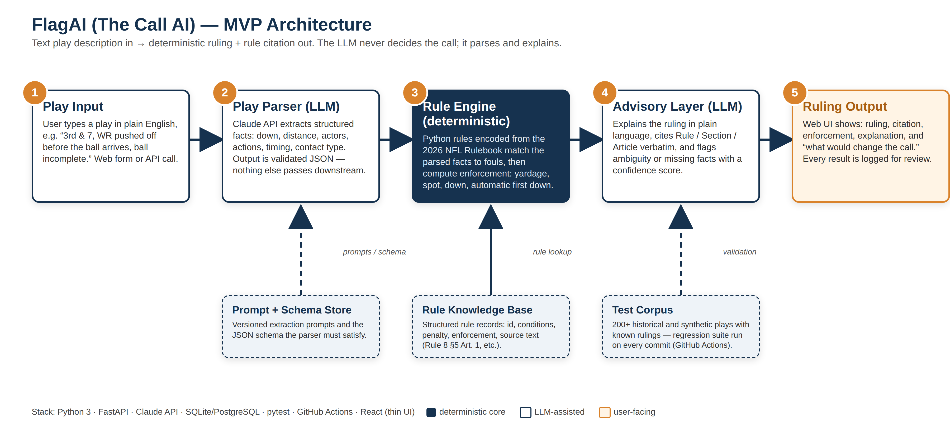
Proof of Concept: MVP Architecture
System flow for the MVP. The LLM parses the play and explains the result; the ruling itself comes from deterministic rule code built from the 2026 NFL Rulebook and validated against a 200-play test corpus.
Notes:
Here's the MVP architecture. Five stages left to right. The user types a play. The Play Parser, which is the LLM, extracts structured facts: down, distance, actors, timing, contact type, validated against a JSON schema. Those facts go into the Rule Engine, which is deterministic code encoded from the 2026 rulebook. It matches the facts to an article and computes the enforcement. The Advisory Layer, the LLM again, explains the ruling in plain language and flags ambiguity. The Ruling Output shows all of it in the UI.
Underneath: a versioned prompt and schema store, a structured rule knowledge base, and a 200-play test corpus that runs on every commit. The thing I want you to take away: the LLM never decides the call. It parses and explains. The ruling is code, so it's testable and repeatable.
[~50 sec]

Slide 11
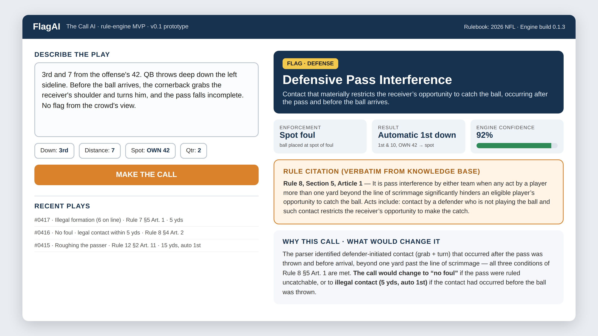
Early-Stage Prototype: Ruling Interface
Mockup of the FlagAI web interface: play description in, ruling with rule citation, enforcement, confidence, and "what would change the call" out. Built from the CSC318 SRS use cases; a CLI version of the rule engine is the first SIP311 build target.
Notes:
And this is the ruling interface mockup, built from my CSC318 use cases. On the left, the play description and the game situation. On the right, the ruling: defensive pass interference, spot foul, automatic first down. Below that, the verbatim rule citation from the knowledge base, Rule 8, Section 5, Article 1. And at the bottom, why this call and what would change it: if the pass were ruled uncatchable it's no foul; if the contact happened before the throw it's illegal contact instead.
This term's first build target is a command-line version of the rule engine behind this screen. Thank you. I'm happy to take questions.
[~40 sec] Total run time ≈ 8.5 min at a comfortable pace; trim slides 2 and 5 to hit 7.

