Slide 1
分类分析
Classification
Lecturer: Ji Shufan
2020.4.20

Slide 2
监督式学习:预测对象的类标签
Known Objects
（With Class Labels）
Training/building
Tentative Objects
（With Class Labels
to be Verified）
resulting
Classifiers
Testing
predicting
Unknown Objects
（Without Class Labels）

Slide 3
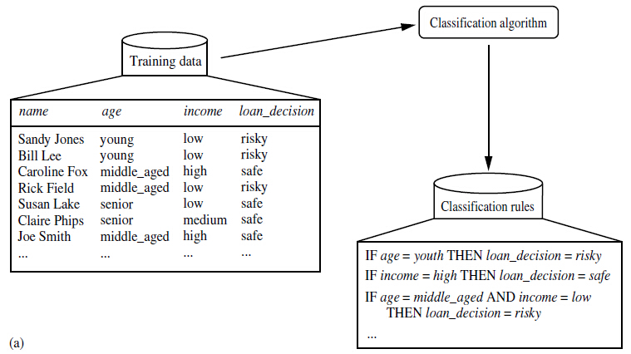
Example: Learning (Training)

Slide 4
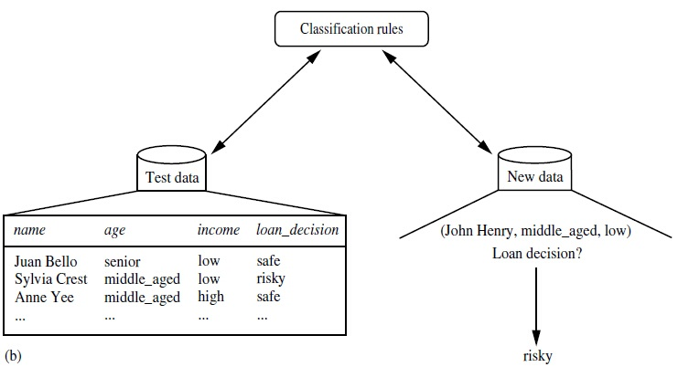
Example: Testing & Predicting

Slide 5
评价指标
预测准确度
计算效率: 建立分类器及预测
对噪音的敏感度
可解读性

Slide 6
数据准备
训练数据→训练建设分类器
验证数据→测试分类器
待预测数据→预测分类标签

Slide 7
数据预处理
Data Cleaning: remove/reduce noises; missing values treatment.
Relevance Analysis: correlation analysis to remove redundancy, attribute subset selection to remove irrelevancy.
Data Transformation and Reduction: e.g. normalization to scale values into a small specific range; generalization, binning, clustering for data compression and reduction.

Slide 8

主要算法
Decision Tree
SVM (Support Vector Machine)
Bayesian Classification
Neural Network
KNN (K-Nearest Neighbors)

Slide 9
Decision Tree Induction
Decision tree induction is the learning of decision trees from class-labeled training tuples.
A decision tree is a flowchart-like tree structure, where each internal node (non-leaf node) denotes a test on an attribute, each branch represents an outcome of the test, and each leaf node (or terminal node) holds a class label.

Slide 10
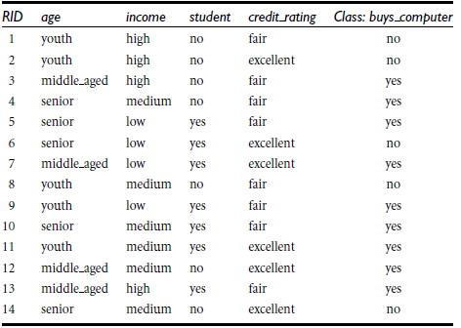
Example

Slide 11
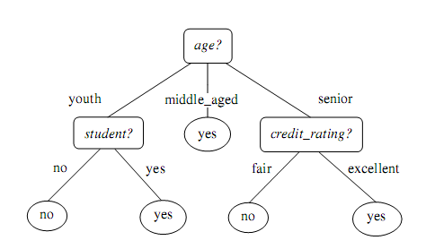
Decision Tree Induction

Slide 12
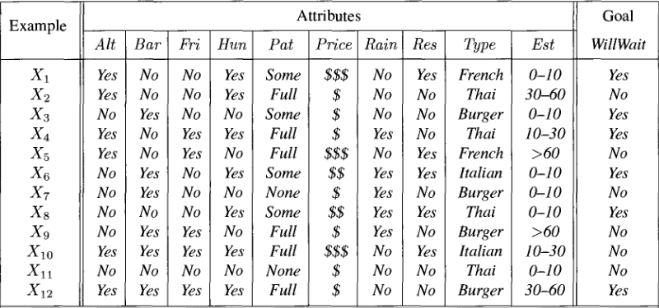
应用实例: 决策树
是否等待餐桌?

Slide 13
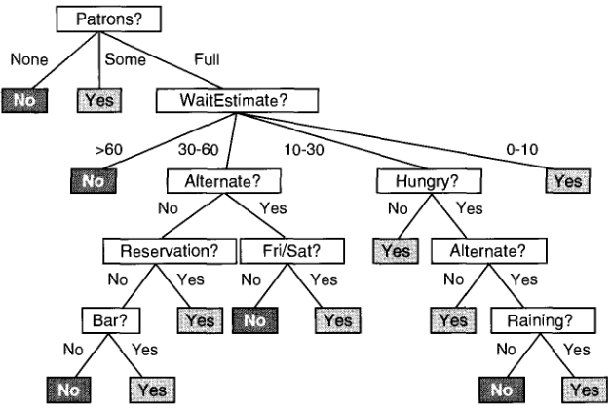
应用实例: 决策树
是否能建一棵更小的树?

Slide 14
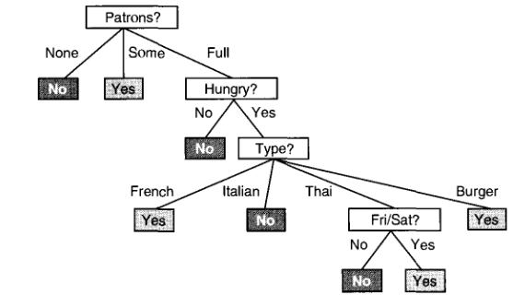
应用实例: 决策树
smaller tree!

Slide 15
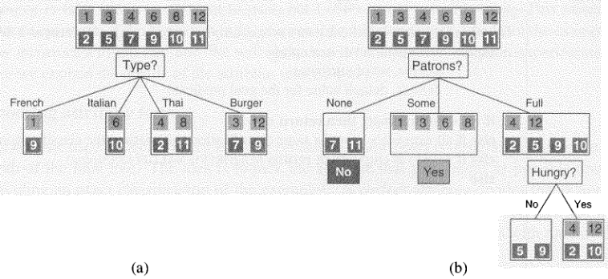
应用实例: 决策树
如何选择分裂属性?

Slide 16
如何选择属性?
[29+,35-]
A₁=?
A₂=?
[29+,35-]
True
False
True
False
[21+, 5-]
[8+, 30-]
[18+, 33-]
[11+, 2-]

Slide 17
Entropy
S is a sample of training examples
p₊ is the proportion of positive examples
p₋ is the proportion of negative examples
Entropy measures the impurity of S
  Entropy(S) = -p₊ log₂ p₊ - p₋ log₂ p₋

Slide 18
Information Gain
Gain(S,A): expected reduction in entropy due
to sorting S on attribute A
Gain(S,A)=Entropy(S) - ∑_{v∈values(A)} |S_{v}|/|S| Entropy(S_{v})

Slide 19
Information Gain Example
[29+,35-]
A₁=?
A₂=?
[29+,35-]
True
False
True
False
[21+, 5-]
[8+, 30-]
[18+, 33-]
[11+, 2-]
Entropy([29+,35-]) = -29/64 log₂ 29/64 – 35/64 log₂ 35/64= 0.99
Entropy([21+,5-]) = 0.71
Entropy([8+,30-]) = 0.74
Gain(S,A₁)=Entropy(S)
-26/64*Entropy([21+,5-])
-38/64*Entropy([8+,30-])
=0.27
Entropy([18+,33-]) = 0.94
Entropy([11+,2-]) = 0.62
Gain(S,A₂)=Entropy(S)
-51/64*Entropy([18+,33-])
-13/64*Entropy([11+,2-])
=0.12

Slide 20
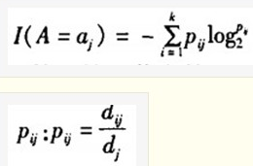
Information Gain Ratio
Information Gain drawback: attributes with many distinct values tend to be chosen, e.g. ID;
Information Gain Ratio: consider number and size of branches when choosing attributes, and correct information gain with intrinsic information.
分裂信息量: 是将属性可选值作为划分，计算节点上样本总的信息熵。

Slide 21
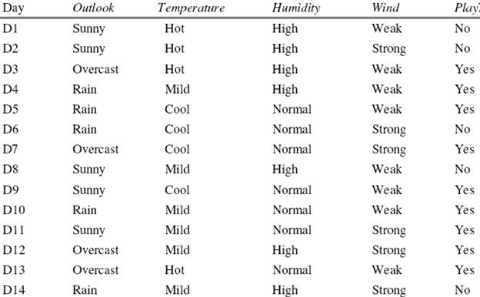
Information Gain Ratio Example
I(Outlook)=I(5,4,5)=-5/14log(5,14)-4/14log(4,14)-5/14(5,14)

Slide 22
Information Gain Ratio: Notice
计算节点熵（分裂后的熵）和计算节点分裂信息量（分裂前基于所选属性的经验熵）的时候，样本的划分标准不同! 前者基于分类标签，后者基于所选属性的不同取值。
信息增益率缺陷：倾向于选择使节点分裂信息量很小的属性，导致对信息增益过度修正。
如何避免缺陷：仅考虑那些信息增益超过平均值的属性，再比较其信息增益率。

Slide 23
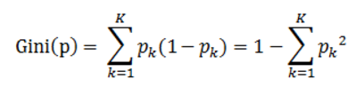
Gini Impurity
Gini Impurity: 基尼指数（基尼不纯度）：表示在样本集合中一个随机选中的样本被分错的概率。
Gini指数越小表示集合中被选中的样本被分错的概率越小，也就是说集合的纯度越高，反之，集合越不纯。
基尼指数（基尼不纯度）= 样本被选中的概率 * 样本被分错的概率
pk表示选中的样本属于k类别的概率，则这个样本被分错的概率是(1-pk)

Slide 24



Gini Impurity Reduction
样本集合D的Gini指数：假设集合中有K个类别
基于特征A划分样本集合D之后的基尼指数：
Reduction in Impurity:
从所有可能划分的Gini(D,Ai)中找出Gini指数最小的划分，这个划分的划分点，便是使用特征A对样本集合D进行划分的最佳划分点,即选择 Gini Impurity Reduction最大的属性。

Slide 25
Gini Impurity Reduction
样本集合D的Gini指数：假设集合中有K个类别
基于特征A划分样本集合D之后的基尼指数：
Reduction in Impurity:
从所有可能划分的Gini(D,Ai)中找出Gini指数最小的划分，这个划分的划分点，便是使用特征A对样本集合D进行划分的最佳划分点,即选择 Gini Impurity Reduction最大的属性。

Slide 26

Variance Reduction
Employed in cases where the target variable is continuous (regression tree), meaning that use of many other metrics would first require discretization before being applied
Variance Reduction of a node N is defined as the total reduction of the variance of the target variable x due to the split at this node:

Slide 27
Attribute Selection: Summary
The three main measures, in general, return good results but
1.Information Gain(ID3):
-biased towards multi-valued attributes
2.Gain Ratio(C4.5):
-tends to prefer unbalanced splits in which one partition is much smaller than the other.
3.Gini Index(CART):
-biased towards multi-valued attributes
-has difficulty when # of classes is large
-tends to favor tests that result in equal-sized partitions and purity in both partitions

Slide 28
Other Attribute Selection Measures
1.CHAID: a popular decision tree algorithm, measure based on χ 2 test for independence.
2.C-SEP: performs better than info. gain and gini index in certain cases
3.G-statistics: has a close approximation to χ 2 distribution
4.MDL (Minimal Description Length) principle (i.e., the simplest solution
is preferred)
5.Multivariate splits (partition based on multiple variable combinations)
CART: finds multivariate splits based on a linear comb. of attrs.
Which attribute selection measure is the best?
Most give good results, none is significantly superior than others.

Slide 29
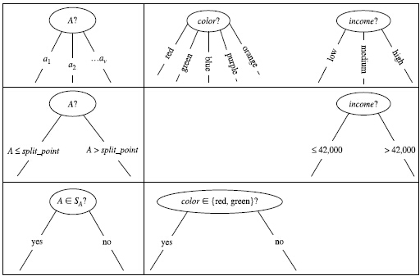
Three Branching Ways
离散值
连续值
二叉树

Slide 30
Split-point of Continuous-valued Attribute A
Sort the values of A in increasing order.
Take the midpoint between each pair of adjacent values as a possible split-point.
Given v values of A, then v-1 possible splits are evaluated.

Slide 31
How Decision Tree Works?
Training: build decision tree from training samples (choose the best split attribute at each level)
Predicting: unknown vector is matched against the tree to determine the class label

Slide 32
Decision Tree Advantages
Simple to understand and interpret
Able to handle both numerical and categorical data
Require little data preparation
Use a white box model
Possible to validate a model using statistical tests. (model reliability: makes no distributional / independence assumptions of the training data)
Perform well with large datasets.
Mirror human decision making more closely than other approaches
In built feature selection.

Slide 33
Decision Tree Limitations
Non-robust: small changes in training data can result in big changes in the tree, and thus big changes in final predictions.
NP-complete tree building: practical heuristics (greedy algorithm) make locally-optimal decisions at each node.
Overfitting: decision-tree learners can create over-complex trees that do not generalize well from the training data.
(Way Out: Statistical based Pruning/Cross-Validation)
Attribute/Branch Repetition:
(Way Out: combine attributes/decision rules)

Slide 34
过拟合问题: 树剪枝方案
由于噪音数据, 建树过程中会生成一些代表不常见样例的树枝。
基于统计分析剪切掉不常见样例的树枝。
剪切过的树会变得更加凝练简洁,会更加迅速准确的预测新数据。

Slide 35
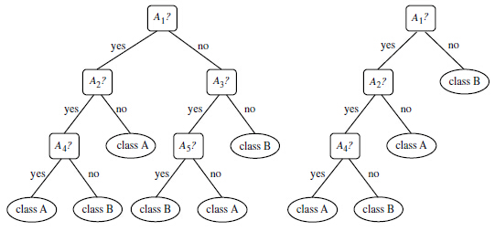
如何剪枝?
The leaf may hold the most frequent class among the subset tuples or the probability distribution of those tuples.
Pre-pruning and Post-pruning

Slide 36
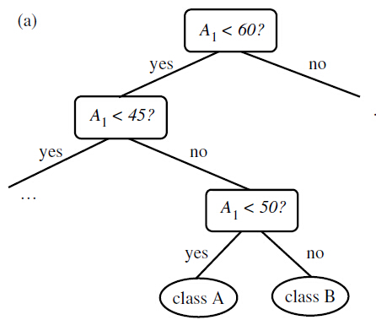
属性重复问题
An attribute is repeatedly tested along a given branch of the tree.

Slide 37
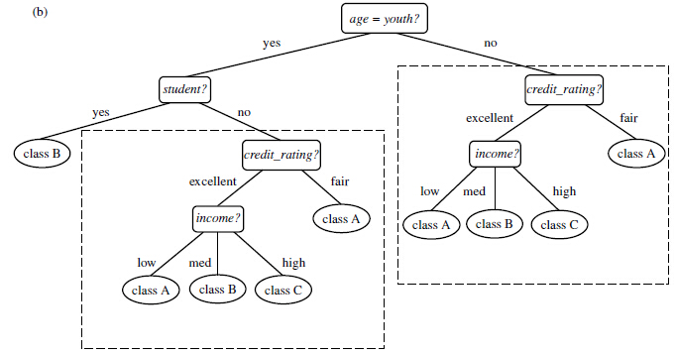
分支重复问题
Duplicate sub-trees exist within a tree.

Slide 38
Notable Algorithms/Implementations
ID3 (Iterative Dichotomiser 3)
C4.5 (successor of ID3)
CART (Classification And Regression Tree)
CHAID (CHi-squared Automatic Interaction Detector). Performs multi-level splits when computing classification trees.
MARS: extends decision trees to handle numerical data better.
Salford Systems CART (which licensed the proprietary code of the original CART authors), IBM SPSS Modeler, RapidMiner, SAS Enterprise Miner, Matlab, R (an open source software environment for statistical computing which includes several CART implementations such as rpart, party and randomForest packages), Weka (a free and open-source data mining suite, contains many decision tree algorithms),Orange, KNIME, Microsoft SQL Server [1], and scikit-learn (a free and open-source machine learning library for the Python programming language).

Slide 39
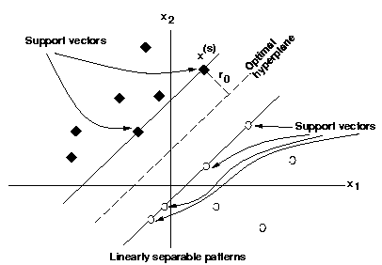
支持向量机 SVM
应用: 二分分类问题。
目标: 寻找最优的平面(w₀^{T}x + b0 = 0) 可以最大距离地线性化分两类训练对象。
训练: 寻找一系列权重，来最大化两类训练对象之间的距离。
原理：通过非线性变换，将训练数据投射到一个更高维空间，并在此空间上寻找一个最优的划分平面，将两个类别的对象分开。当维度足够高，对象总能被区分开。
支持向量：边缘线上的重要对象。

Slide 40
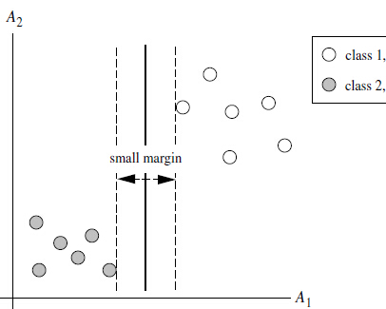
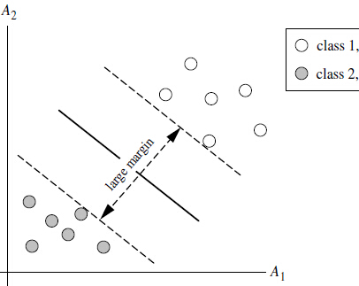
如何选择支持向量?
寻找产生最大间隔距离的切分方式

Slide 41
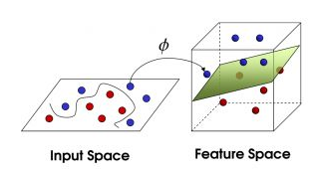
核函数: Kernel Function
Non-linearly Separable in 2D→linearly Separable in ND

Slide 42
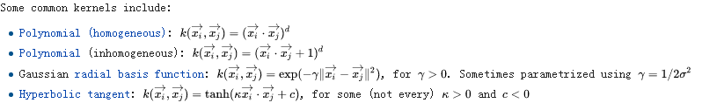
常用核函数选择依据
线性核函数: 特征数N很大,样本数量M很小; 不易产生过拟合,且没有充足数据拟合复杂的非线性分类器。
高斯核函数：N很小，M很大。

Slide 43
SVM评价及常用工具包
虽然SVM的训练时间较长，但预测准确率高。
SVM天生能够抵御过拟合问题。为什么？
支持向量是对训练模型的一种凝练表达。
常见应用: 手写体识别、物体识别、语音识别等。
Kernel SVMs are available in many machine learning toolkits, including: LIBSVM, MATLAB, SAS, kernlab, SVMlight, scikit-learn, Shogun, Weka, Shark, OpenCV, JKernelMachines.

Slide 44
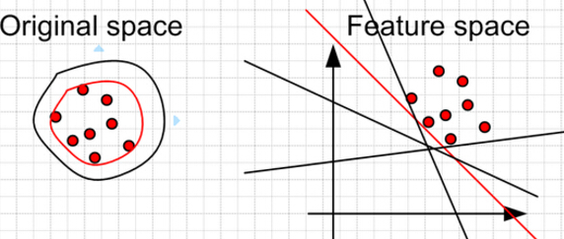
扩展：One-Class SVM
极度不平衡数据分类
奇异点检测
学习过程: 捕获数据集的形状 （寻找边界）
无监督学习，不需要类标签
目标：在feature space寻找离原点较远的Boundary

Slide 45
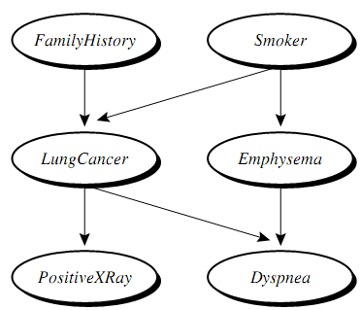

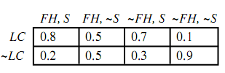
Bayesian 分类
Bayesian分类器是基于统计学的分类器，预测了对象属于某类别的可能性。
基于 Bayes’ 理论:
假设前提: 对象属性值相互独立
准确度和计算效率都很高

Slide 46
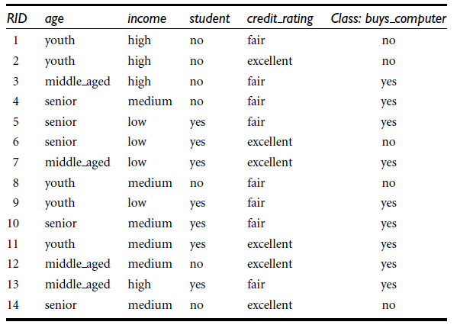
Naïve Bayes Classifier: Example
Training Set
Classify:

Slide 47

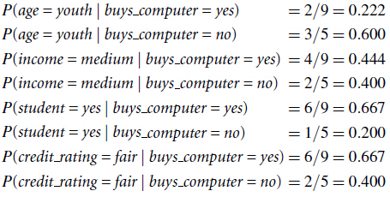
Naïve Bayes Classifier: Example
Prior probability of each class:
Conditional probabilities:

Slide 48
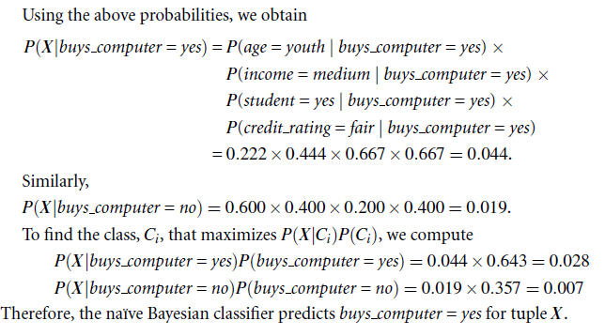
Naïve Bayes Classifier: Example

Slide 49
Bayesian Belief Network
A proposed causal model, represented by a directed acyclic graph.
The conditional probability table for the values of the variable LungCancer (LC) showing each possible combination of the values of its parent nodes, FamilyHistory (FH) and Smoker (S)

Slide 50
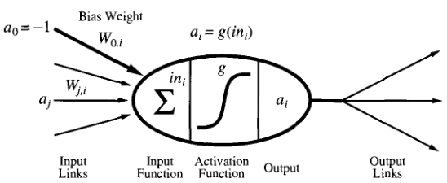

神经网络
神经网络由一群具有权重的输入/输出单元组成，它的训练过程是通过不断调整权重，使输入对象的类标签可以准确预测。
Neuron

Slide 51
神经网络的训练
  训练目的：获得一组权重，使训练数据被准确预测。
步骤
  随机生成一组权重
  基于每个输入对象优化权重
  针对每个输入，进行如下优化：
    Compute the net input to the unit as a linear combination of all the inputs to the unit
    Compute the output value using the activation function
    Compute the error
    Update the weights and the bias

Slide 52
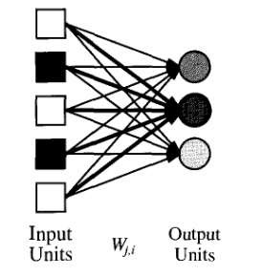
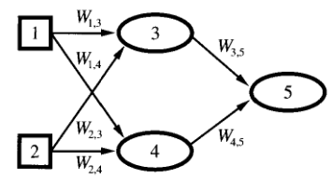

神经网络类型
Single Layer Feed Forward Networks (Perceptron Network)
Multilayer Networks

Slide 53
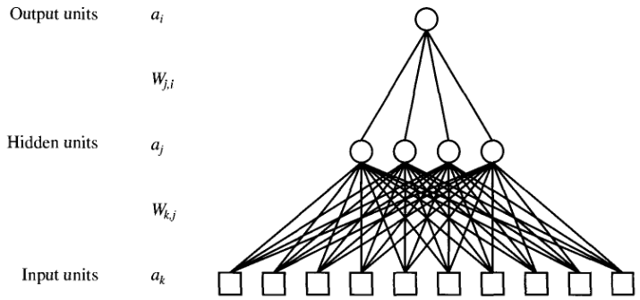
神经网络结构
Can be applied to restaurant problem

Slide 54
神经网络评价
局限:
训练时间过长;
需要的训练数据量大；
需要很多通过经验来设定的参数;
解读性差: 不知所以然。
优点:
非常抗噪音干扰;
适合连续数值型的输入和输出;
天然支持并行处理。

Slide 55
主动学习 vs. 被动学习
主动学习: 预测前主动学习训练数据并建模形成分类器。
被动学习: 预测前不建模，只存储训练数据，特征如下：
计算复杂度高;
需要高效存储技术;
适合并行处理;
天生支持增量挖掘;
无法提供直观的数据内部结构.

Slide 56
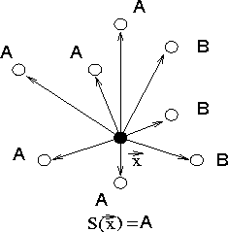
K近邻算法 (KNN)
不训练分类器: 直接使用原始训练数据
排序：找到预测数据的K最近邻
预测：基于K最近邻类标签预测，数值型则计算近邻的平均值。
.缺点: 数据量大时计算复杂度高，受噪音和不相关 属性影响大。
训练数据越多，K取值越大。

Slide 57
分类器评价
准确度评价: 评价指标、评价图、评价方法？
拟合程度评价：过拟合 or 欠拟合？

Slide 58
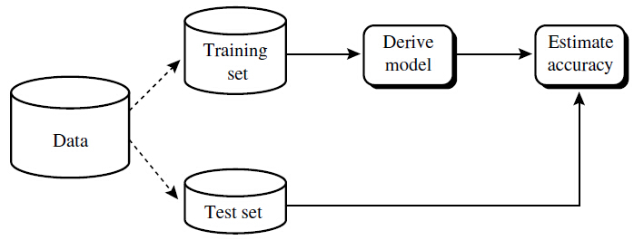
准确度评价指标
Accuracy: percentage of test set that are correctly classified by the classifier.
Sensitivity: true positive rate (proportion of positive data that are correctly identified).
Specificity: true negative rate (proportion of negative data that are correctly identified).
Precision: percentage of data labeled as “positive” that actually are “positive” data.

Slide 59
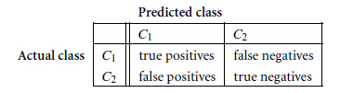
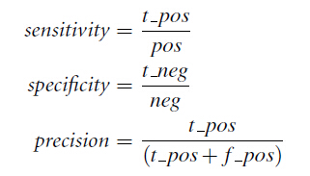

准确度评价指标

Slide 60
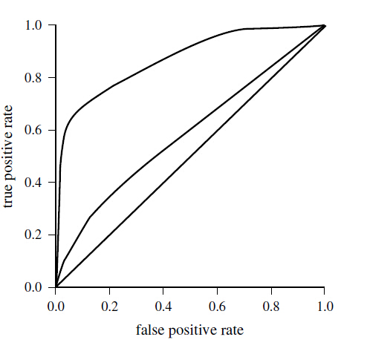
准确度评价图: ROC 曲线
Receiver Operating Characteristic (ROC): 用以比较分类器分类准确性的可视化工具。
反映了true positive rate 和 the false-positive rate之间的平衡代价。
True positive rate 的上升将以false-positive rate的上升为代价。

Slide 61
如何生成 ROC 曲线
降序排列测试对象: 最有可能成为positive 类的对象排在前面。
从坐标原点起，遍历对象序列，每当遇到true positive就向上移动，遇到false positive向右移动。
对角线含义：每当预测一个正确的，将预测一个错误的。因此，越靠近对角线，预测准确度越差。同理，曲线与X轴所围面积越大越好，对角线面积为0.5，理想状态为1。
The vertical axis represents the true
positive rate while the horizontal axis represents the false-positive rate.

Slide 62
准确度评价方法
Holdout Method
Random Sub-sampling
Cross-Validation
Bootstrap

Slide 63
Holdout Method vs. Random Sub-sampling
Holdout Method: the given data are randomly partitioned into two independent sets, a training set (2/3) and a test set(1/3).
Random Sub-sampling: a variation of the holdout method in which the holdout method is repeated k times. The overall accuracy estimate is taken as the average of the accuracies obtained from each iteration.

Slide 64
交叉验证 Cross Validation
In k-fold cross-validation, the initial data are randomly partitioned into k mutually exclusive subsets (folds) of approximately equal size.
Training and testing is performed k times: in iteration i, partition Di is reserved as the test set, and the remaining partitions are collectively used to train the model. Each sample is used the same number of times (k-1) for training and once for testing.
The accuracy estimate is the overall number of correct classifications from the k iterations, divided by the total number of samples in the initial data.
实际应用中多采用10轮交叉验证，因为其误差较低。

Slide 65

Bootstrap
Bootstrap: samples the given training set uniformly with replacement. Each time a sample is selected, it is equally likely to be selected again and re-added to the training set. That is, the machine is allowed to select the same sample more than once.
.632 Bootstrap: given a data set of d samples, the data set is sampled d times, with replacement, resulting in a training set of d samples. The data not in the training set end up forming the test set. On average, 63.2% will end up in the training set, and the remaining 36.8% will form the test set.
Accuracy estimate: repeat the sampling k times, the overall accuracy is estimitated as

Slide 66
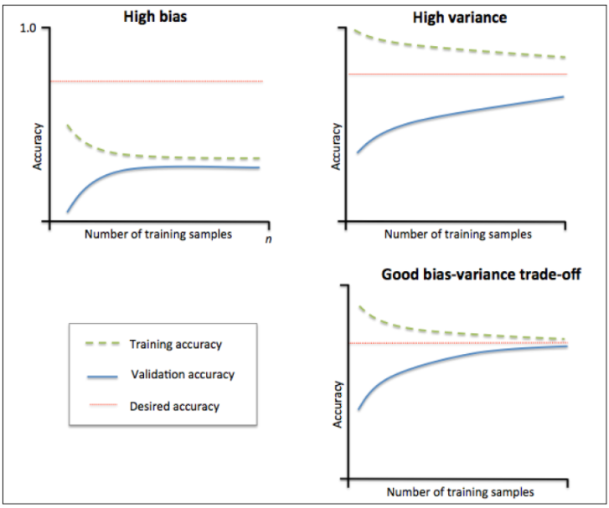
过拟合 or 欠拟合？--学习曲线
欠拟合
学习曲线就是通过画出不同训练集大小时训练集和交叉验证的准确率，可以看到模型在新数据上的表现，进而来判断模型是否方差偏高或偏差过高，以及增大训练集是否可以减小过拟合。
过拟合
理想情况

Slide 67
过拟合 or 欠拟合？
欠拟合：当训练集和测试集的误差收敛但却很高时，为高偏差。左上角的偏差很高，训练集和验证集的准确率都很低，很可能是欠拟合。
策略：增加模型参数，构建更多的特征，减小正则项；此时增加数据量不起作用。
过拟合：当训练集和测试集的误差之间有大的差距时，为高方差。 当训练集的准确率比其他独立数据集上的测试结果的准确率要高时，一般都是过拟合。 右上角方差很高，训练集和验证集的准确率相差太多，应该是过拟合。
策略：增大训练集，降低模型复杂度，增大正则项，或者通过特征选择减少特征数。
理想情况：偏差和方差都很小，即收敛且误差较小。

Slide 68
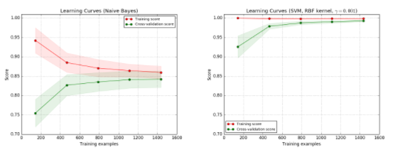
学习曲线 实例
欠拟合
过拟合
左图为用 Naive Bayes 分类器时，效果不太好，分数大约收敛在 0.85，此时增加数据对效果没有帮助。
右图为 SVM（RBF kernel），训练集的准确率很高，验证集的也随着数据量增加而增加，不过因为训练集的还是高于验证集的，有点过拟合，所以还是需要增加数据量，这时增加数据会对效果有帮助。

Slide 69


Q&A
Notes:
http://chalkpaperscissors.com

