Slide 1
聚类分析
Clustering
Lecturer: Ji Shufan
2020.3.30

Slide 2
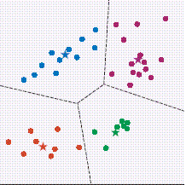
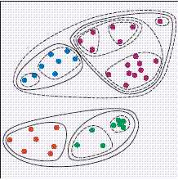
聚类: 无监督学习
将研究对象分组 (不基于类别先验知识)

Slide 3
聚类原则
最大化组内相似度
最小化组间相似度
Inter-cluster distances are maximized
Intra-cluster distances are minimized

Slide 4
Challenge
Scalability (millions of objects)
Different types of attributes
Clusters with arbitrary shape
Minimal domain knowledge to determine parameters
Noise
Incremental clustering and insensitive to input order
High dimensionality
Constraint-based clustering
Interpretability and usability

Slide 5
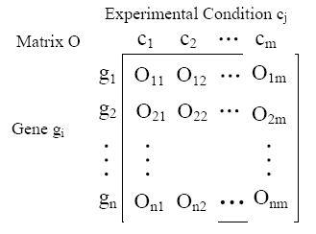
全空间聚类: 基于全局属性

Slide 6
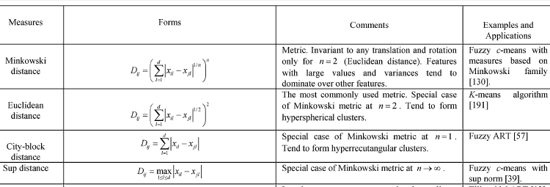
Similarity Measure: continuous features
Magnitude
Euclidean distance：欧氏距离是一个通常采用的距离定义，指在m维空间中两个点之间的真实距离。

Slide 7
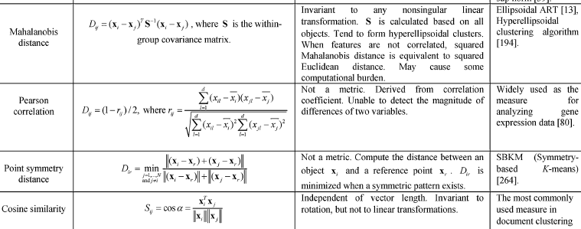
Similarity Measure: continuous features
Linearly Correlated
Orientation
Pearson correlation: [-1,+1], 度量两个变量线性相关的强弱，feature值域无影响。

Slide 8


Similarity Measure: binary features
matched pairs
unmatched pairs
n11: co-occurrence, n00: co-absence
Unmatched pairs are weighted based on their contribution to the similarity.

Slide 9
Partitioning Methods
Given a database of n objects, a partitioning
method constructs k (k<n) partitions of the data, where each partition represents a cluster.
It classifies the data into k groups, which together satisfy the following requirements:
(1) each group must contain at least one object;
(2) each object must belong to exactly one group.

Slide 10
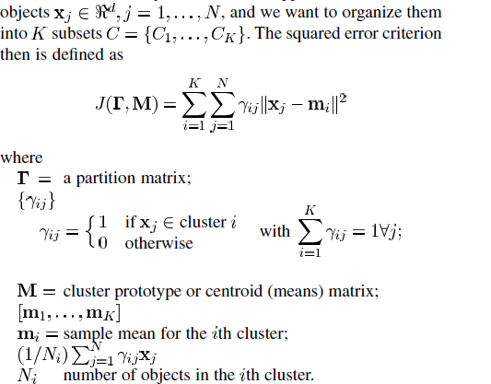
Minimize Squared Error Criterion Function

Slide 11
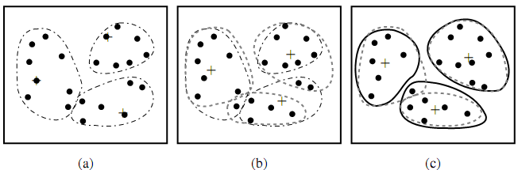
划分类算法：K-Means
  必须预先确定聚类个数K
  对噪音点敏感
  只能挖掘球形簇
  计算复杂度高
  无法保障全局最优
  受限于数值型数据

Slide 12
基于K-means算法的改进
噪音敏感：K-Medoids用真实对象代替簇均值作为中心点。
数据量大：CLARANS只对采样数据聚类。
K值难确定：X-Means 选用指定数值区间的最优K作为聚类个数。

Slide 13
Hierarchical Methods
Group data objects into a tree of clusters.
Be classified as either agglomerative or divisive, depending on whether the hierarchical decomposition is formed in a bottom-up (merging) or top-down (splitting) fashion.

Slide 14
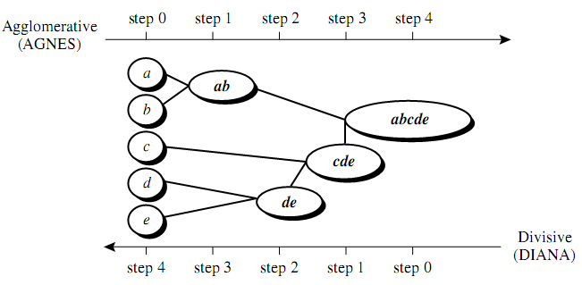
层次类算法
  早期聚合或分裂一旦形成，后期无法优化。
  输入顺序敏感，不利于增量挖掘。
  计算复杂度高。
  簇间层次关系清晰，不须预先确定簇个数。

Slide 15
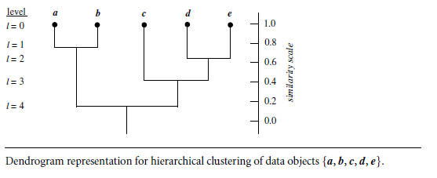
Hierarchical Clustering Result

Slide 16
Algorithm Category
Agglomerative vs. Divisive
Distance between two clusters
  Single linkage
  Complete linkage
  Group average linkage
  Median linkage
  Centroid linkage

Slide 17
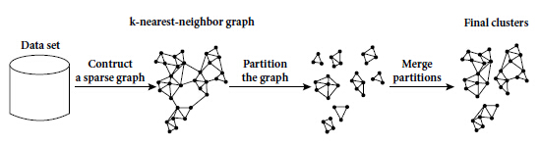
Hierarchical Clustering Improvement
Integrate hierarchical agglomeration with iterative relocation methods. e.g. Chameleon,
Hierarchical clustering based on k-nearest neighbors and dynamic modeling

Slide 18
Density-based Methods
Discover clusters with arbitrary shape.
Regard clusters as dense regions of objects in the data space that are separated by regions of low density (representing noise).

Slide 19
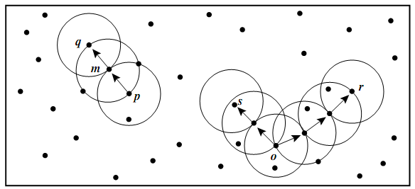
密度类算法: DBSCAN
算法参数: 最小密集区点数, 半径
  1. 噪音鲁棒，擅于剔出噪音。
  2. 簇形状各异，不受球形限制。
  3. 时间复杂度较低，适用于对象数量多的数据。
  4. 参数不易确定，且直接影响聚类结果。.

Slide 20
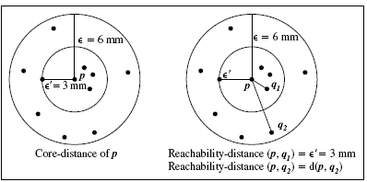
Improvements
OPTICS: core-distance & reachable distance
  Clusters of higher density would be produced earlier.

Slide 21
Grid-based Methods
Use a multi-resolution grid data structure;
Quantize the object space into a finite number of cells that form a grid structure on which all of the operations for clustering are performed.

Slide 22
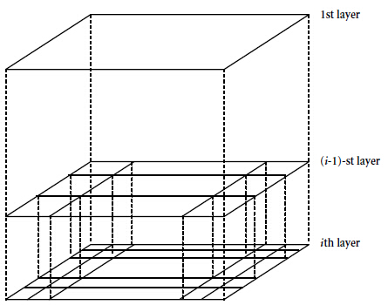
STING: Top-Down Hierarchical Mining

Slide 23
表格类算法: STING
不同层次的分辨率
  1. 计算效率高
  2. 适于并行处理和增量挖掘
  3. 聚类结果取决于表格结构设定
  4. 常应用于基于地图的空间聚类问题

Slide 24
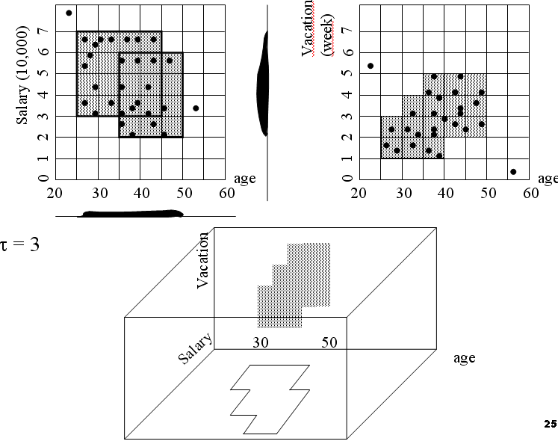
CLIQUE
  1. Insensitive to order of Input
  2. Scale linearly
  3. Sensitive to grid size and
  density threshold
  4. Large result overlap

Slide 25
聚类算法扩展

Slide 26
Fuzzy Clustering
Each object can belong to all of the clusters with a certain degree of membership
When boundaries among clusters are not well separated and ambiguous

Slide 27
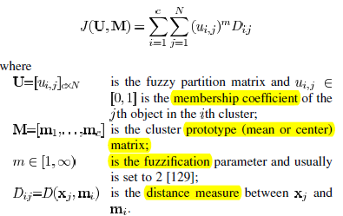
Fuzzy Clustering--FCM
FCM attempts to find a partition to minimize the cost function.

Slide 28
Kernel-Based Clustering
Nonlinearly transform a set of complex and nonlinearly separable patterns into a higher-dimensional feature space, to make them linearly separable.
Kernel-K-means: find K centers to minimize the distance between the mapped objects and their closest center.

Slide 29
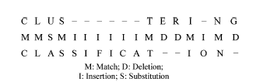
Clustering Sequential Data
Sequence Similarity Oriented (alphabetic form)
sequence comparison→ edit distance
sequence alignment problem

Slide 30
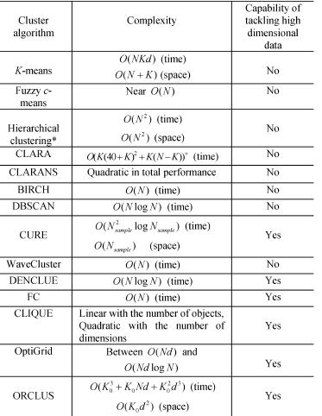
小结: 常用算法复杂度比较
Large-Scale
Subspace

Slide 31
子空间聚类：基于局部属性
双向聚类：Biclustering

Slide 32
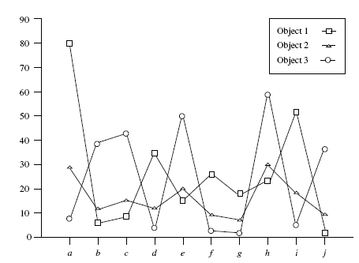
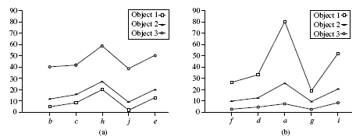
为何双向聚类？
对象只在局部属性上表现出相关性

Slide 33
早期Biclustering算法
1: 随机生成种子
2: 穷举法扩张或缩小种子
基于预先设定的种子质量参数

Slide 34
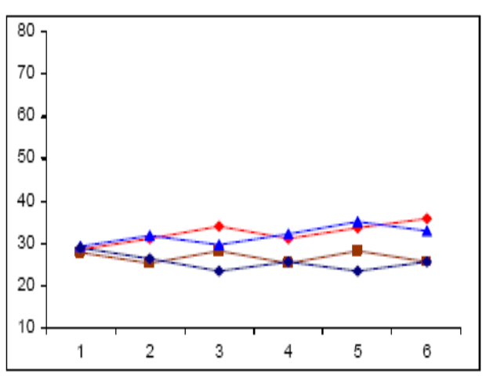
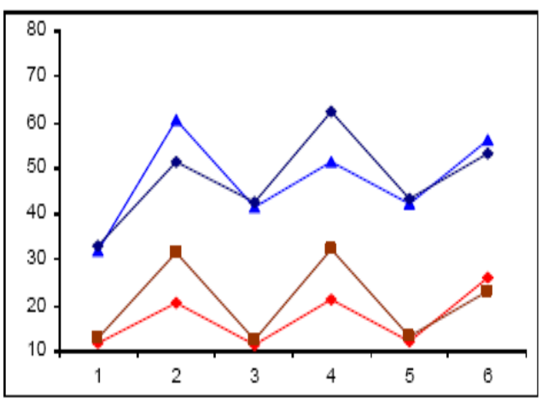
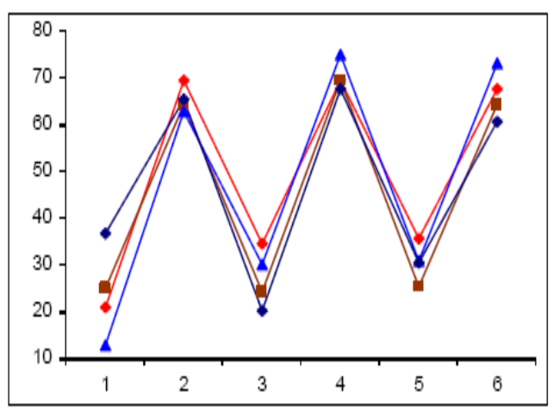
早期Bicluster算法局限性
质量参数不足以度量种子内部对象变化趋势
结果随机，不可避免的信息损失
穷举可能性，效率差
应用反例：质量参数难以度量变化趋势

Slide 35
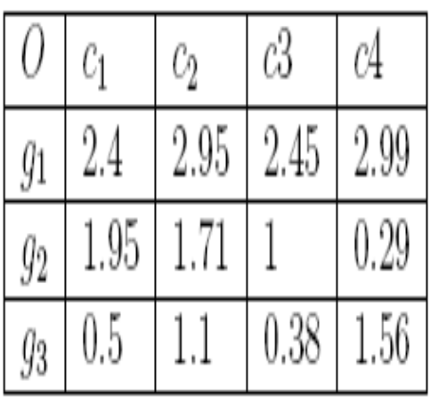
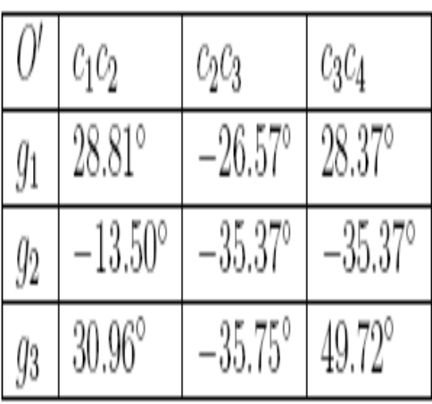
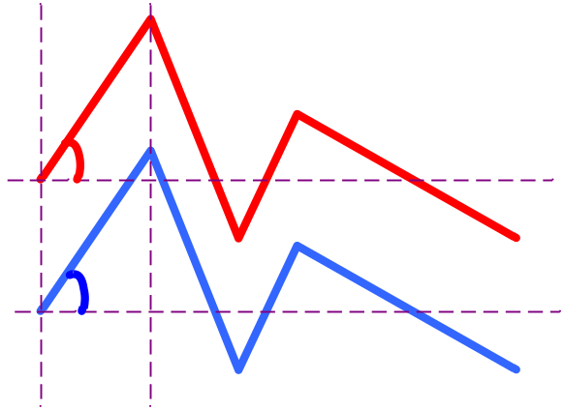
快速层次式双向聚类算法：QHB
Step 1：计算变化幅度
Original Matrix O
Slope Angle Matrix O’
α
β

Slide 36
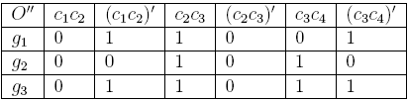
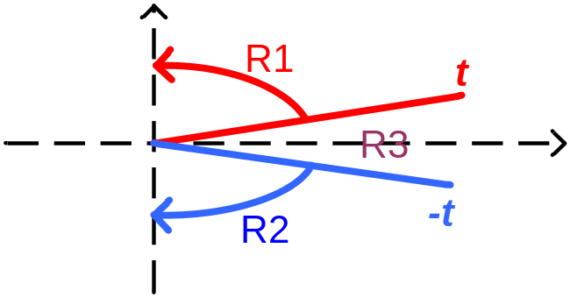
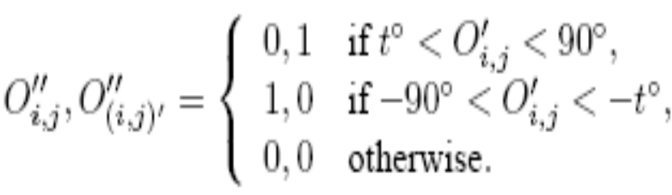
QHB算法
Step 2：数据扩展以拆分不同变化趋势
Slope Angle Matrix O’
Binary Matrix O’’ (t=26.5)
0
90
0
-90

Slide 37
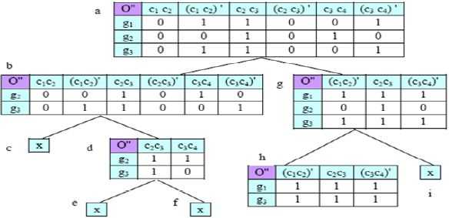
QHB 算法
Step 3: 利用D-Miner空间切分法挖掘

Slide 38
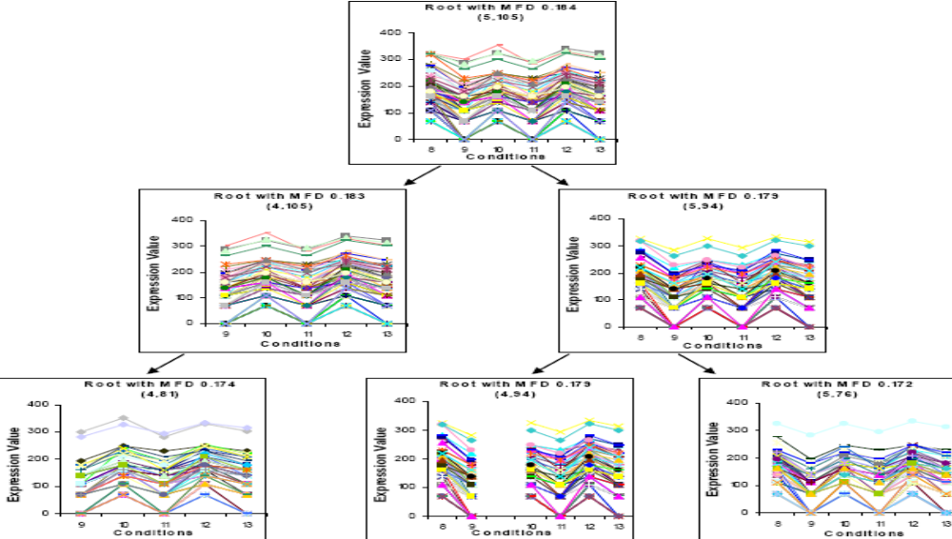
QHB: 挖掘实例

Slide 39
基于MapReduce的聚类算法应用

Slide 40
MapReduce分布式处理架构
User
Program
fork
fork
fork
Master
assign
map
assign
reduce
Input Data
Worker
write
Output
File 0
local
write
Worker
Split 0
read
Split 1
Worker
Split 2
Output
File 1
Worker
Worker
remote
read,
sort

Slide 41
MapReduce: Input & Output
Input: a set of key/value pairs
User supplies two functions:
  map(k,v) → list(k1,v1)
  reduce(k1, list(v1)) →(k1, v2)
(k1,v1) is an intermediate key/value pair
Output is the set of (k1,v2) pairs

Slide 42
MapReduce: 如何Map
Input
key-value pairs
Intermediate
key-value pairs
k
v
map
k
v
k
v
map
k
v
k
v
…
…
k
v
k
v

Slide 43
MapReduce: 如何Reduce
Output
key-value pairs
Intermediate
key-value pairs
Key-value groups
reduce
k
v
k
v
v
v
k
v
reduce
k
v
k
v
v
k
v
group
k
v
…
…
…
k
v
k
v
k
v

Slide 44
Example: Word Count on MapReduce
map(key, value):
// key: document name; value: text of document
for each word w in value:
emit(w, 1)
reduce(key, values):
// key: a word; value: an iterator over counts
result = 0
for each count v in values:
result += v
emit(result)

Slide 45
Example: Word-Count
Can you can a can as a canner can can a can
output
Can you can
(Can,1), (you,1),(can,1)
split
a can as
(a,1), (can,1),(as,1)
a canner can
(a,1), (canner,1),(can,1)
can a can
(can,1), (a,1),(can,1)
Map tasks
Notes:
The Map function for this example uses keys that are of type String (the words) and values that are integers. The Map task reads a document and breaks it into its sequence of words w1, w2, . . . , wn. It then emits a sequence of key-value pairs where the value is always 1. That is, the output of the Map task for this document is the sequence of key-value pairs:
(w1,1), (w2,1),...,(wn,1)
你能够像罐头工人一样装罐头吗？

Slide 46
Example: Word-Count
Grouping by Key
sort/merge
(Can,1)
(Can,1), (you,1),(can,1)
(you,1)
(a,1), (can,1),(as,1)
(can,1,1,1,1,1)
(a,1), (canner,1),(can,1)
(a,1,1,1)
(as,1)
(can,1), (a,1),(can,1)
(canner,1)
Master controller

Slide 47
Example: Word-Count
(Can,1)
hash
(a,1,1,1)
(as,1)
(a,3)
(as,1)
(you,1)
(can,1,1,1,1,1)
(Can,1)
(can,1,1,1,1,1)
(canner,1)
(Can,1)
(can,5)
(canner,1)
(a,1,1,1)
(as,1,1)
(you,1,1,1)
(you,3)
(canner,1)
Reduce Tasks
Notes:
Each key that is output by a Map task is hashed and its key-value pair is put in one of r local files. Each file is destined for one of the Reduce tasks.1
The output of the Reduce function is a sequence of zero or more key-value pairs. These key-value pairs can be of a type different from those sent from Map tasks to Reduce tasks, but often they are the same type. We shall refer to the application of the Reduce function to a single key and its associated list of values as a reducer.

Slide 48
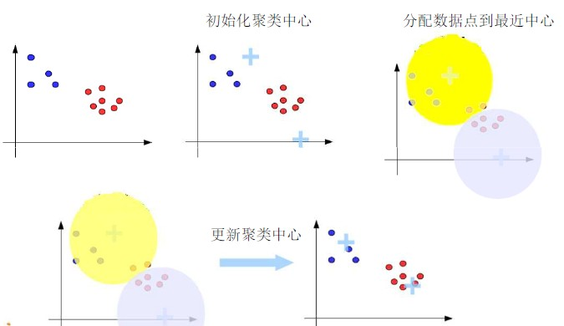
单机K-Means 聚类算法

Slide 49
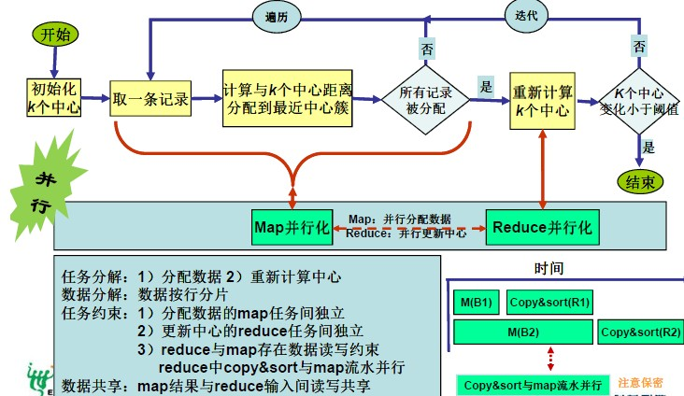
K-Means 在 MapReduce上

Slide 50
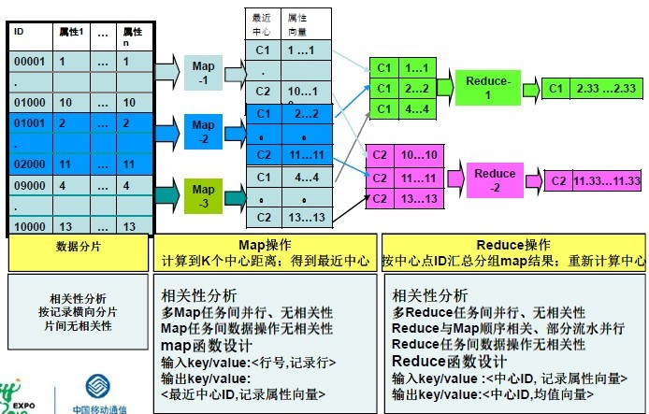
K-Means 在 MapReduce 上

Slide 51
知识小结
数据预处理的必要性：缺失值、噪音、值域差。
根据实际应用需求，杂交设计聚类算法。
属性的选择对聚类效果有重要影响，过多冗余无关属性会扰乱聚类结果，可考虑属性筛选、降维、子空间多向聚类。
考虑分布式挖掘以提高效率。

