Slide 1
Introduction
Lecturer: Ji Shufan
2020.3.2

Slide 2

Contacts
Ji Shufan
Email: jishufan@buaa.edu.cn
Office Location: F324
Cell Phone: 18810609630

Slide 3
Grading
Group Project & Report
Form Your Group (4~5 persons/per group)

Slide 4
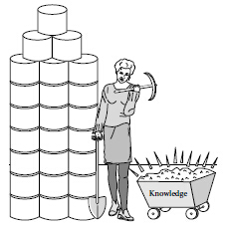
What is Data Mining
Data Mining: extracting or “mining” knowledge from large amounts of data.
Synonym: Knowledge Discovery from Data, or KDD.

Slide 5
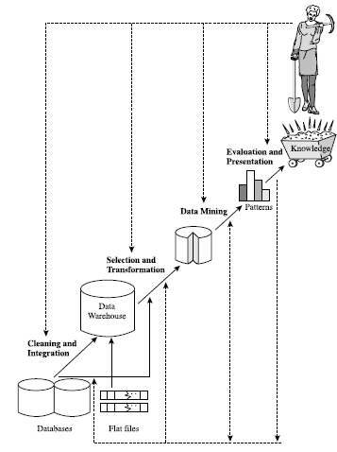

Slide 6
KDD Process
Data Cleaning (remove noise/inconsistent data)
Data Integration (combine multiple data sources)
Data Selection (retrieve data relevant to analysis task from database)
Data Transformation (transform/consolidate data into forms appropriate for mining, e.g., by performing summary or aggregation operations)

Slide 7
KDD Process
Data Mining (apply intelligent methods to extract data patterns)
Pattern Evaluation (identify truly interesting patterns representing knowledge based on interestingness measures)
Knowledge Presentation (present the mined knowledge to the user, e.g., visualization)

Slide 8
Two Categories of Mining Tasks
Descriptive: characterize the general properties of the data.
Predictive: perform inference on the current data
in order to make predictions.

Slide 9
What kinds of patterns can be mined?
(1) Concept/Class Description: Characterization and Discrimination
Characterization: summarization of the general characteristics or features of a target class of data.
Discrimination: comparison of the general features of target class data objects with the general features of objects from one or a set of contrasting classes.

Slide 10
What kinds of patterns can be mined?
(2) Frequent Patterns, Associations, Correlations:
draw associations among objects
Tr# | Items
T1 | Beer, Milk
T2 | Bread, Butter
T3 | Bread, Butter, Jelly
T4 | Bread, Butter, Milk
T5 | Beer, Bread
Frequent Patterns:
Bread, Butter (minSupport=3)
Association Rules:
Bread→Butter (Confidence=75%)
Butter→Bread (Confidence=100%)

Slide 11
What kinds of patterns can be mined?
(3) Classification and Prediction:
Classification: predict categorical (discrete, unordered) labels.
Prediction: model continuous-valued functions, predict missing or unavailable numerical data values, identify distribution trends.

Slide 12
Classification: assign labels to objects
Known Objects
（With Class Labels）
Training/building
Tentative Objects
（With Class Labels
to be Verified）
resulting
Classifiers
Testing
predicting
Unknown Objects
（Without Class Labels）

Slide 13
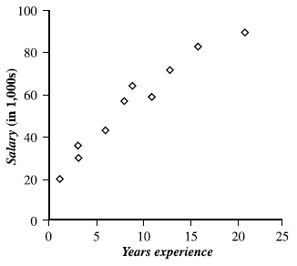
Prediction: regression analysis

Slide 14
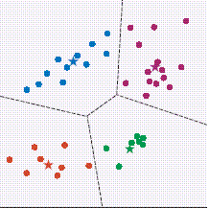
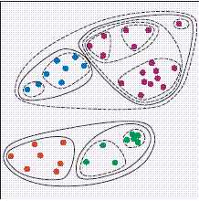
What kinds of patterns can be mined?
(4) Cluster Analysis: establish groups

Slide 15
What kinds of patterns can be mined?
(5) Outlier Analysis: given a set of n objects, find the top k objects that are considerably
dissimilar, exceptional, or inconsistent with respect to the remaining data.
Applications: fraud detection, intrusion detection, special customer behavior in marketing, unusual responses to medical treatments, and etc.

Slide 16
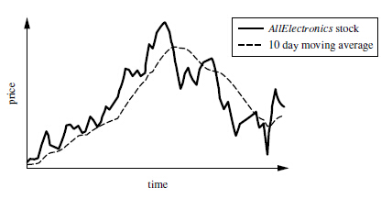
What kinds of patterns can be mined?
(6) Evolution Analysis: model regularities or trends for objects whose behavior changes over time.

Slide 17
Books
Jiawei Han and Micheline Kamber
Data Mining: Concept and Technique
数据挖掘:概念与技术
I.H.Witten and Eibe Frank
Data Mining: Practical Machine Learning Tools and Techniques 数据挖掘:实用机器学习工具与技术
Anand Rajaraman and etc.
Mining of Massive Data
Ian Goodfellow,Yoshua Bengio, Aaron Courville
Deep Learning

Slide 18
Tools for New Learner
Weka
  An open-source implementation in Java
  A collection of data mining algorithms
  Download: http://lucene.apache.org/hadoop/
Python

Slide 19
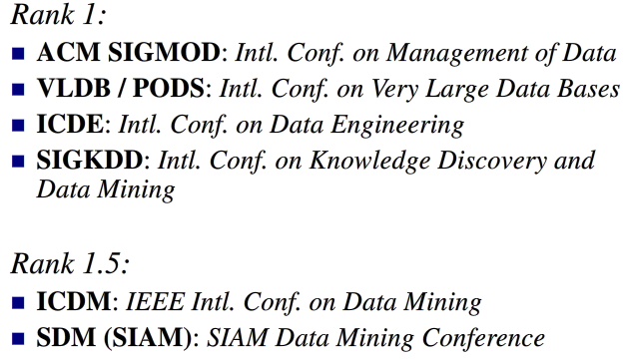
Conference

Slide 20
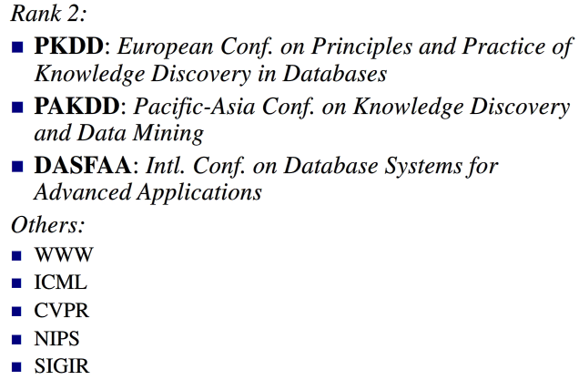
Conference

Slide 21
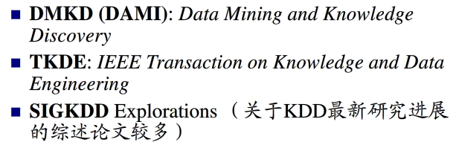
Journal

Slide 22
自学要求
阅读以下资料：
Jiawei Han and Micheline Kamber
Data Mining: Concept and Technique
数据挖掘:概念与技术
第一章
Notes:
http://chalkpaperscissors.com

