Slide 1
Last Section

Slide 2
分支定界
主要的分支定界法相关概念:
Feasible （solution）, Infeasible （solution）, Partial Solution, Optimal Solution, Branch, Bound (tight), Traverse, Backtracking, Prune, DFS, BFS, Frontier Search, Initial solution, Relax
分支定界法的主要思想
分支定界法解整数规划问题
背包问题
TSP
有向图的TSP
分配（指派）问题
匈牙利法
一些说明

Slide 3
问题描述
该类设计问题的目标是，在一组节点之间设计一最小耗费的网络以满足所有的流量需求。
描述该问题所需的信息：
  每个源节点和目的节点对(O-D)之间的流量需求
  在每条边(i,j)上负载流量的价值函数
  C_{ij}=f(t_{ij})

Slide 4
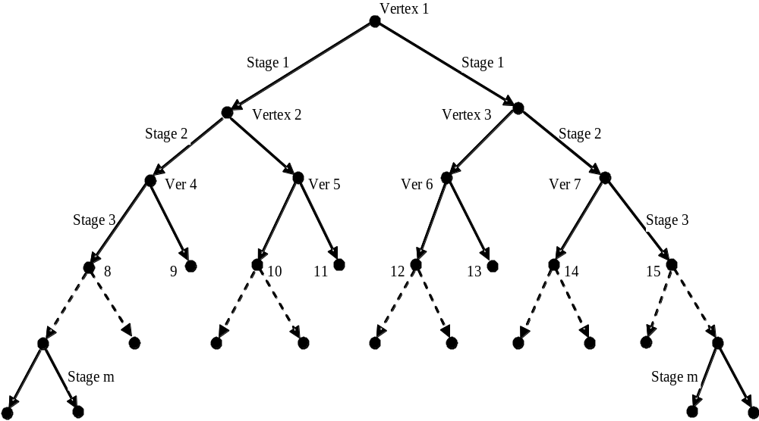
The search tree

Slide 5
Upper Bound & Lower Bound
Existing solution (Initial Solution)
  Updated whenever a better solution is found
SMST
  The capacity constraint relaxed sub-problem

Slide 6
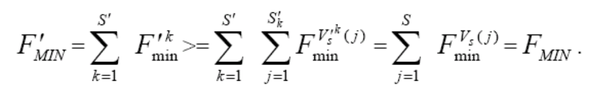
Make the pruning faster
Predicting Violation of Capacity Constraint
Feasibility Bound
  N_{min}
  F_{t}=F_{c}+F_{min}
  tighter

Slide 7
Make the pruning faster
We sort the arcs in the order of ascendant arc cost and give each of them an arc number, from 1 to m, as identification.
  Construction of SMST
  Dominant frontier search
  Total cost bound

Slide 8
The algorithm
Codes

Slide 9
Faster ?

Slide 10
Faster ?
Faster forward traversing guided by SMST

Slide 11
Faster ?

Slide 12
Faster ?
Omitted SMST Construction

Slide 13
Faster ?

Slide 14
Faster ?
Omitted cycle detection

Slide 15
Faster ?

Slide 16
Faster ?
Sequence of function calls

Slide 17
Problem I
Non-linear cost function
What’s your idea?

Slide 18
Problem I
Non-linear cost function
What’s your idea?
Piecewise constant

Slide 19
Problem I
Non-linear cost function
What’s your idea?
Piecewise constant
What would you do?

Slide 20
The efficiency of the algorithm
Problem File Name | Running Steps | Running Time (Seconds)
P100g-1.txt | 169474 | 163
P100g-2.txt | 279842 | 407
P100g-3.txt | 156281 | 140
P100g-4.txt | 188611 | 160
P100g-5.txt | 3312304 | 720
P100g-6.txt | 98158 | 182
P100g-7.txt | 217784 | 400
P100g-8.txt | 140683 | 163
P100g-9.txt | 628903 | 700
P100g-10.txt | 5804 | 8

Slide 21
Lower Bound Arguments

Slide 22
Lower Bounds
Definition: A lower bound of a problem is the least amount of computation that any algorithm must use to solve this problem.
Lower bounds are generally theoretically derived.
The lower bound for a problem is not unique, but the higher the better.
  For example, Ω(1), Ω(n) and Ω(nlogn) are all lower bounds for sorting but among them Ω(nlogn) is the best.

Slide 23
Lower Bounds
At present, if the best lower bound of a problem is Ω(n) and the time complexity of the best algorithm is O(n²). This means that
  we may try to find a better lower bound, e.g. Ω(nlogn);
  we may try to find a better algorithm, e.g. O(nlogn);
  both of the lower bound and the algorithm may be improved.
If the present lower bound is Ω(nlogn) and there is an algorithm with time complexity O(nlogn), then the algorithm is optimal.

Slide 24
Lower Bound Arguments
Trivial Lower Bounds
Information-Theoretic Arguments
Adversary Arguments
Problem Reduction

Slide 25
Lower Bound on Sorting
Comparison sort: A family of algorithms that use comparisons to determine the sorted order of a list.
Examples: Mergesort, Quicksort
Decision tree = A tree that describes the comparisons required to sort a list of data.

Slide 26
A < B < C A < C < B
B < A < C B < C < A
C < A < B C < B < A
A < B
B < A
A < B < C
A < C < B
C < A < B
B < A < C
B < C < A
C < B < A
A < C
C < A
B < C
C < B
A < B < C
A < C < B
C < A < B
B < A < C
B < C < A
C < B < A
B < C
C < B
A < C
C < A
A < B < C
A < C < B
B < A < C
B < C < A

Slide 27
Decision Trees
Given n items there are n! different ways to arrange them (permutation (排列)).
Only one of the permutations is in sorted order.
The aim of sorting is to discover the sorted permutation.
The worst case running time corresponds to the longest path from the root to a leaf.

Slide 28
The power of comparison
Given n, we have M = n! permutations.
Each permutation must appear as one of the leaves in the decision tree.
Every time we perform a comparison, one of two branches eliminates (排除) at most half of the permutations.

Slide 29
The power of comparison
Thus, if sorting is done along the longest path, we will use at least k = log₂M comparisons.
Another proof is that since any binary tree of height k has at most 2^{k} leaves, we have 2^{k}≥ n!.
The best general sorting algorithm requires log₂(n!) comparisons in the worst case.

Slide 30
How much is log₂(n!)?
Method 1
log₂(n!) = log₂(n (n−1) (n−2) … (2) (1))
= log₂n+log₂(n−1)+log₂(n−2)+ … +log₂(2)+log₂(1)
≥ log₂n+log₂(n−1)+log₂(n−2)+ … +log₂(n/2)
≥ n/2 log₂(n/2) = n/2 (log₂n – 1) = Ω(nlogn)

Slide 31
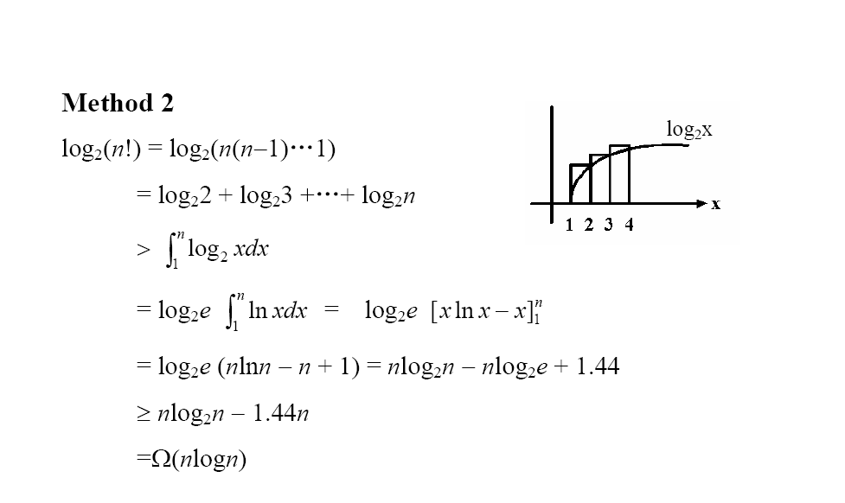

Slide 32
Comparison-based Sorting
Theorem 1. Any comparison-based sorting algorithm must use Ω(nlogn) comparisons for sorting an array of n elements in the worst case.
This means that it is impossible to perform sorting using O(n) or O(log n) or O(n log(log n)) comparisons.

Slide 33
Determining The Maximum
Theorem 2. Every comparison-based algorithm for determining the maximum of a set of n elements must use at least n/2 comparisons.
Proof. Every element must participate in at least one comparison; if not, the uncompared element can be chosen to be the maximum. Each comparison compares 2 elements. Hence, at least n/2 comparisons must be made.

Slide 34
Determining The Maximum
Theorem 3. Every comparison-based algorithm for determining the maximum of a set of n elements must use at least n−1 comparisons.
Proof. To say that a given element, x, is the maximum, implies that every other element has lost at least one comparison with another element (not necessarily x). Each comparison produces at most one loser. Hence at least n−1 comparisons must be used.

Slide 35
Lower Bound for Finding Max and Min
We can compute both the maximum and minimum of a list of n numbers, using (3/2)n−2 comparisons. We will prove that this solution is optimal.
Here is an algorithm: Compare x[1] with x[2], x[3] with x[4], etc. We get n/2 maxima and n/2 minima. Find the maximum on the n/2 maxima with n/2−1 comparisons, and the same for the minima. The total cost: n/2+n/2−1+n/2−1 = 3n/2−2 (when n even).

Slide 36
Lower Bound for Finding Max and Min
Note that x is the minimum and y is the maximum only if
every element other than x has won at least one comparison and
every element other than y has lost at least one comparison.

Slide 37
Lower Bound for Finding Max and Min
Call a win “W”, a loss “L”. For each element, we label it according to the following 4 cases:
N: never compared with anybody;
W: won all comparisons;
L: lost all comparisons;
WL: won at least one and lost at least one.
The algorithm must assign n−1 W's and n−1 L's. i.e., it MUST need 2n−2 “units of information”.
More precisely, n-2 WL's, 1 W and 1 L.

Slide 38
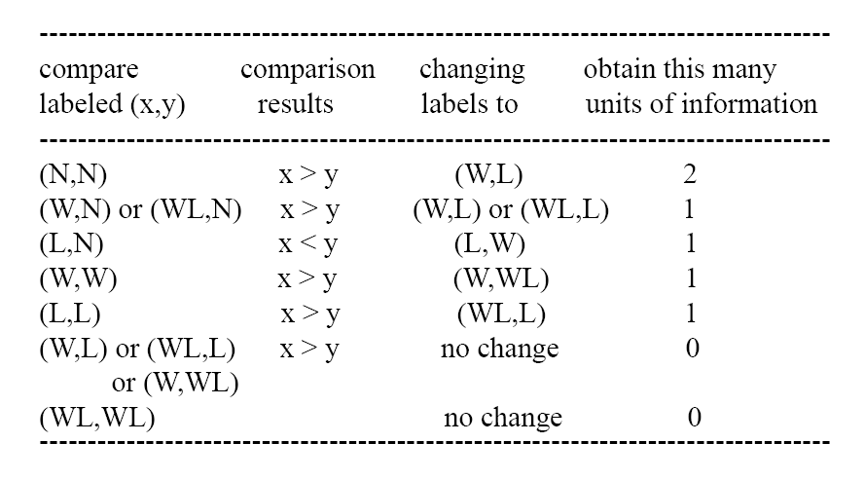

Slide 39
Lower Bound for Finding Max and Min
To prove that the worst case can happen, we will use what is called an adversary (反对者) argument (论证、论据). An adversary is an opponent (对手) that the comparison algorithm plays against.
Its ultimate (最终) goal is to maximize the number of comparisons that the algorithm makes (minimize the amount of information obtained) by constructing an input to the problem.

Slide 40
Lower Bound for Finding Max and Min
The adversary tentatively (暂时地) assigns values to the elements, which may change over time.
However, they can only change in a fashion CONSISTENT (一致的) with previous answers.
That is, an element labeled L may only DECREASE in value (since it has lost all previous comparisons, if it is decreased, it will still lose all of them), and an element labeled W may only INCREASE in value. An element labeled WL cannot change.

Slide 41
Lower Bound for Finding Max and Min
Theorem 4. Every comparison-base method for determining both the maximum and minimum of a set of n numbers must use at least (3n/2)−2 comparisons, in the worst case.
Proof. Assume n is even. As we have seen above, the algorithm must learn 2n−2 units of information. The most it can learn in one comparison is 2 units; but this can only happen in the case (N,N), in which both elements have never participated before in a comparison. This can only happen at most n/2 times. To learn the remaining n−2 units of information, the algorithm must perform n−2 comparisons in the worst case. The total number of comparisons is therefore at least n/2 + n−2 = (3/2)n−2.

Slide 42
Finding the Second Largest
Problem:
given a list of n (distinct) elements, find the 2nd largest.
Naive algorithm
Find the maximum element (n−1 comparisons), remove it and find the maximum among those remaining (n−2 comparisons).
Total: 2n−3 comparisons.

Slide 43
Better Algorithm
Conduct an elimination (淘汰赛). Have players play in pairs, then winners play each other, etc., until a winner is determined. Then the runner-up (亚军) is among those defeated by winner.
Why? Because any other player has at least TWO players superior (优) to him/her.
The winner has k=log₂n opponents (对手) (because n(1/2)^{k} = 1). Thus this algorithm uses n−1+ log₂n−1 = n−2+ log₂n comparisons.

Slide 44
Example
10
6
3
5
12
4
7
11
10
5
12
11
10
12
12

Slide 45
Finding the Second Largest
Theorem 5. The above algorithm is optimal: no comparison-based algorithm uses fewer than n−2+⎡log₂n⎤ comparisons in the worst case.
Proof strategy. Any algorithm to find the 2nd largest element must “know” the largest element (For otherwise the 2nd largest might be the largest!). This needs n−1 comparisons. In the worst case, the largest element should participate at least ⎡log₂n⎤ comparisons. Since the runner-up is the maximum of the ⎡log₂n⎤ elements defeated by the largest element. To determine which is the maximum, we require ⎡log₂n⎤−1 comparisons.

Slide 46
NP - Completeness

Slide 47


Slide 48
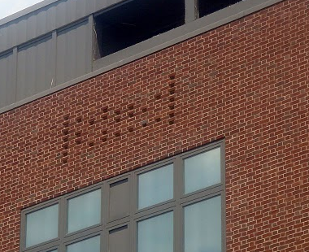

Slide 49
Why the theories ?
One of the primary purposes of scientific inquiry is to help structure the world around us so that we can better understand it.
  The periodic chart of elements
  The genus/species nomenclature
  Discrete/continuous mathematics
Is there a way to develop a structural understanding of algorithms or for the problems to which we wish to apply them?
  Computational complexity theory in early 1970s

Slide 50
Why the theories ?
The theory of NP-completeness helps us to classify a given problem into two broad classes:
(1) easy problems that can be solved by polynomial-time algorithms, and
(2) hard problems that are not likely to be solved in polynomial time and for which all known algorithms require exponential running time.

Slide 51
NP Completeness
Notice that in this classification we want to determine only whether a problem can or cannot be solved in polynomial time;
the order of the polynomial is irrelevant.
Keep this point in mind throughout our subsequent discussion.

Slide 52
Easy or Hard ?
We call a class of problems Easy if we can develop an algorithm to solve every instance of the problem class in polynomial time.
  A polynomial-time algorithm is referred to as an efficient algorithm
  What are they?
We have not developed efficient algorithms for many problems.
Unsuccessful attempts have led us to question whether these problems are inherently hard in the sense that no efficient algorithm could possibly ever solve these problems.

Slide 53
NP Completeness
The theory of NP-completeness is an outgrowth of these inquiries.
Although this theory has been unable to prove that these difficult problems admit no efficient algorithms, the theory has shown that the majority of these problems are equivalent to each other in the sense that if we could develop an efficient algorithm for one problem in this class, we would then be able to develop an efficient algorithm for every other problem in this class.
We refer to this broad class of “computationally equivalent” problems as NP-complete problems.

Slide 54
NP Completeness
The theory of NP-completeness is an outgrowth of these inquiries.
尽管该理论未能证明确实不存在求解这些难问题的高效算法，但是却已证明这些难问题大多数是互相等价的，即：如果我们可以找到针对某一个这类问题的高效算法，那么我们就能找到求解该类问题中其他所有问题的高效算法。
我们把这类 “计算上等价” 的问题称为NP-complete问题.

Slide 55
NP Completeness
This class now includes thousands of problems and possesses the remarkable property (which is somewhat difficult to believe initially) that each problem in this class can be transformed to every other problem in polynomial time;
As a consequence, each problem is “just as hard” as every other problem.
This relationship suggests that NP-complete problems share some generic difficulty that is beyond the reach of polynomial-time algorithms.
Indeed, the research community widely believes that NP-complete problems cannot be solved efficiently.

Slide 56
Bad news vs. Saving your job
The theory of NP-completeness also has its positive aspects.
You are intelligent enough not to return to your boss’s office and report,
“I can’t find an efficient algorithm, I guess I am just too dumb.”
Proving its inherent difficulty could be as difficult as finding an efficient algorithm. You cannot walk into your boss’s office and declare,
“I can’t find an efficient algorithm because no such algorithm is possible!”
Just as hard as a large number of other problems that have defied solution by an efficient algorithm despite decades of efforts of the brightest researchers.
Then you can confidently march into your boss’s office and announce,
“ I can’t find an efficient algorithm, but neither can these famous people.”

Slide 57
Utility in practice
Whenever we encounter a new problem of some practical or theoretical interest, we try to develop an efficient algorithm for solving it.
If we do succeed, clearly the problem is easy and we and others might make further attempts to develop an even more efficient algorithm.
However, if we do not succeed in developing an efficient algorithm for the problem, we might begin to wonder whether our problem is an NP-complete problem.

Slide 58
Utility in practice
The theory of NP-completeness provides us with several tools for establishing that a problem is NP-complete.
If we do succeed in showing the problem is NP-complete, we have sufficient reason to believe that the problem is hard and no efficient algorithm can ever be developed to solve it.
We should thus abandon our quest for an efficient algorithm and direct our efforts at developing efficient heuristics or
at developing various types of enumeration algorithms or other algorithms that will generally run in exponential time.

Slide 59
Heuristic
A heuristic is
“a technique which seeks good (i.e. near optimal) solutions at a reasonable computational cost
without being able to guarantee either feasibility or optimality,
or even in many cases to state how close to optimality a particular feasible solution is”
  Reeves and Beasley

Slide 60
Problem Reductions and Transformations
The theory of NP-completeness requires that problems be stated so that we can answer them with a yes or no.
（需表示为能够用yes or no来回答的问题）
We refer to this yes-no version of a problem as a recognition version of it.
（判定问题）

Slide 61
TSP Optimization
Given a directed graph G = (N, A) and an integer arc length c_{ij} associated with every arc (i, j) ∈ A, determine a tour W (i.e., a directed cycle that visits each node in the network exactly once) with the smallest possible value of the tour length
∑_{(i, j)∈W} C_{ij}.
求最短路径长度的一个 Tour

Slide 62
TSP-recognition-I
Given a directed graph G = (N, A), an integer arc length c_{ij} associated with every arc (i, j) ∈ A, and an integer k*,
does the network contain a tour W satisfying the condition ∑_{(i, j)∈W} C_{ij} ≤ k*?
是否存在一个tour, 其路径长度≤k*?

Slide 63
Solving TSP-recognition-I problem
If we have a polynomial-time algorithm for TSP-optimization, we can use it to solve TSP-recognition-1.
若存在TSP优化问题的多项式算法，则可用其来求解TSP判定问题I
we use an algorithm for the TSP-optimization to determine an optimal tour W*, and then we check to see whether ∑_{(i, j)∈W*} C_{ij} is less than or equal to K*.
The answer to this question is an answer of TSP-recognition

Slide 64
The Converse Is Also True !
If we have a polynomial-time algorithm for TSP-recognition, we can use it, although applied several times, to solve TSP-optimization in polynomial time.
若存在TSP判定问题的多项式算法，则可用其在多项式时间内求解TSP优化问题

Slide 65
The Converse Is Also True !
First, we perform binary search on the possible tour lengths and solve TSP-recognition at each search point to identify the optimal tour length, say k*, of TSP-optimization .
对可能的路径长度进行二叉搜索；
在各搜索点上解其TSP判定问题以确定TSP优化问题的最优解k*。

Slide 66
The Converse Is Also True !
If C denotes that largest arc length in the network, then using the binary search, we require O(log(nC)) executions of TSP-recognition to identify the optimal tour length k*.
可在O(log(nC)) 时间内求得k*.

Slide 67
The Converse Is Also True !
Next we determine the optimal tour, again by executing the TSP-recognition algorithm repeatedly;
反复调用TSP判定问题算法以确定最优的 tour.
we consider every arc (i, j) ∈ A, and one by one, apply the TSP-recognition algorithm to find whether the network G(N, A -{(i, j )}) contains a tour with length less than or equal to k*.
对每条弧(i, j )依次判断G(N, A -{(i, j )}) 中是否存在≤k* 的 tour

Slide 68
The Converse Is Also True !
if the answer is yes, we delete the arc. After we have considered all the arcs, the remaining graph is an optimal tour of TSP-optimization.
若是，则删除此弧；
剩下的图就是TSP优化问题的解。

Slide 69
Polynomially equivalent
The preceding discussion showed that we could solve TSP-optimization in polynomial time if we could solve TSP-recognition-I in polynomial time.
The optimization and recognition versions are equivalent in terms of whether or not they can be solved in polynomial time.
Alternatively, we say that these two problems are polynomially equivalent.
多项式等价
Recognition problems are not always polynomially equivalent to the corresponding optimization problems.

Slide 70
TSP-recognition-II
Given a directed graph G = (N, A), an integer k*, and an integer arc length c_{ij} associated with every arc (i, j) ∈ A,
does the network contain a tour W for which ∑_{(i, j)∈W} C_{ij} ≥ k*?
是否存在一个tour, 其路径长度≥ k*?

Slide 71
TSP-recognition-III
Given a directed graph G = (N, A), an integer k*, and an integer arc length c_{ij} associated with every arc (i, j) ∈ A,
does every tour W in G satisfying the condition ∑_{(i, j)∈W} C_{ij} ≥ k*?
是否每个 tour 的路径长度均≥ k* ?

Slide 72
TSP-recognition-III
TSP-recognition-III has a no instance if and only if TSP-recognition-I has a yes instance;
We can use TSP-recognition-III, like TSP-recognition-I, to solve TSP-optimization.

Slide 73
TSP-recognition-II
Can we solve TSP-optimization by solving a polynomial number of instances of TSP-recognition-II?
__Perhaps

Slide 74
TSP-recognition-II
Given a directed graph G = (N, A), an integer k*, and an integer arc length c_{ij} associated with every arc (i, j) ∈ A,
does the network contain a tour W for which ∑_{(i, j)∈W} C_{ij} ≥ k*?
是否存在一个tour, 其路径长度≥ k*?

Slide 75
In general
Each optimization problem has several associated recognition problems and we want to select a recognition problem that is polynomially equivalent to the optimization problem.
每个优化问题均伴随着几个判定问题，我们希望找到其中与优化问题多项式等价的。
For most problems that ever arise, some recognition version is polynomially equivalent to the optimization version.
For this reason the theory of NP-completeness, even though it applies formally only to recognition problems, is also suitable for assessing the complexity of optimization problems.
多数问题均有其相应的多项式等价的判定问题，所以NP完备性也适用于优化问题的复杂性评估

Slide 76
Problem Reduction and Transformation

Slide 77
Problem Reduction
A problem P1 reduces to problem P2 if we can solve problem P1 using an algorithm for P2 as a subroutine.
如果可以使用求解P2的算法为子程序求解P1，则称 P1归约为P2。
Problem P1 polynomially reduces to problem P2 if some polynomial-time algorithm that solves P1 uses the algorithm for solving P2 at unit cost.
* The TSP-optimization reduces to TSP-recognition I and III

Slide 78
Problem Reduction
Property I
If a problem P1 polynomially reduces to problem P2 and
some polynomial-time algorithm solves P2 ,
some polynomial-time algorithm solves P1.
若P1多项式规约为P2，
且某算法可在多项式时间内求解P2，
则存在算法可在多项式时间内求解P1。

Slide 79
Problem Transformation
We refer to an instance of the recognition problem as a yes instance if the answer to this problem instance is yes, and a no instance otherwise.
对某判定问题的一个实例，若答案为是，则称该实例为一肯定实例；否则称否定实例。
A special type of problem reduction is of significant interest, which we call problem transformation.
问题转化（或称变换）是一种特殊的归约

Slide 80
Problem Transformation
We say that a problem P1 polynomially transforms to another problem P2 if
for every instance I₁ of problem P1
we can construct in polynomial time (e.g., polynomial in terms of the size of I₁) an instance I₂ of problem P2 so that
I₁ is a yes instance of P1 if and only if I₂ is a yes instance of P2.
对于P1的每一个实例I₁ 均可在多项式时间内构造P2 的一个实例I₂，使得
当且仅当I₂为肯定实例时， I₁为肯定实例。
则称P1多项式转化为P2。

Slide 81
Polynomial reductions and polynomial transformations are useful in the following sense:
If problem P1 polynomially transforms to problem P2, problem P2 is at least as hard as P1: Given an algorithm for problem P2, we can always use it to solve problem P1 with comparable (i.e., polynomial or not) running times. If the algorithm for P2 is polynomial-time, then by using it (and the polynomial transformation) we can also solve P1 in polynomial time.
若P1多项式时间转化为P2，P2 至少与P1 一样难；
总是可以在可比时间内用P2 之Algo2求解P1 。

Slide 82
Polynomial reductions and polynomial transformations are useful in the following sense:
the possibility of making this transformation does not imply that P1 is as hard as P2. In fact, P1 might be easy, while P2 is hard.
但不表明P1与P2 一样难。

Slide 83
Problem classes P, NP, NP-complete, and NP-Hard

Slide 84
Class P
We say that a recognition problem P1 belongs to class P if some polynomial-time algorithm solves problem P1.
存在求解判定问题P1的多项式算法

Slide 85
Class NP
Roughly speaking, we say that a recognition problem P1 is in the class NP, if for every yes instance I of P1, there is a short (i.e., polynomial length) verification that the instance is a yes instance.
对P1的每一个肯定实例，均存在一个多项式时间内的验证。

Slide 86
Class NP
The class NP deals with a measure of complexity that is more closely related to the idea of a proof.
Consider, for example, the TSP-recognition-I. If someone hands you a yes instance and a tour W of length at most k* and asks you to verify whether the problem instance is a yes instance, you can do so rapidly in O(n) time by examining the tour and checking whether it passes through every node exactly once and has a length of no more than k*.

Slide 87
Class NP
suppose, that you are handed a no instance of TSP-recognition-I and you are asked to prove that it is a no instance; then you are in serious trouble.
There is no obvious proof other than
(1) enumerating all possible tours and verifying that each tour length is greater than k*, or
(2) using any algorithm for TSP-optimization to determine the optimal tour length L and verifying that L> k*.
Unfortunately, the time to implement either of these approaches is not polynomial in the size of the instance I.

Slide 88
Class NP
Let P1 be a recognition problem. For an instance I of P1, let │I│ denote the size of the instance (i.e., the number of digits or bits needed to represent I).
We refer to a proof that an instance is a yes instance as its certificate.
对一个实例为肯定实例的证明(证据)，称为该实例的证书（凭证）。

Slide 89
Class NP
For example, for the TSP-recognition-I, the certificate of a yes instance is a tour W whose length is at most k*.
对TSP判定问题-I，一个肯定实例的证书是一个路径长度不大于k*的tour.
Let CR(I) denote the certificate of a yes instance I, and let │CR(I)│ denote its size. We refer to an algorithm that can verify the correctness of a given certificate, that is, the certificate establishes the instance as a yes instance, as a certificate checking algorithm.
证书检验算法

Slide 90
Class NP
For example, for TSP-recognition-I, the certificate checking algorithm might be an algorithm that scans the nodes in a given certificate and verifies that each node is visited exactly once and that the length of the tour is at most k*.

Slide 91
Class NP
Formal definition of the class NP:
We say that a recognition problem P1 is in the class NP if some certificate checking algorithm AL and polynomial p (▪) satisfy the following properties:
P1属于NP，如果证书检验算法和多项式p (▪) 满足
Every yes instance I of P1 has a certificate CR(I);
P1的每一个肯定实例I均有一证书CR(I);
The algorithm AL can verify the correctness of CR(I) in at most p(│I│) steps.
AL能在p(│I│) 时间内验证CR(I) 的正确性

Slide 92
Class NP
We say that a certificate is succinct if it, together with some polynomial p (·), satisfies these conditions.
证书是简明的
Note that since the time to verify the correctness of the certificate CR(I) must be polynomial in |I|, |CR(I)| must also be polynomial in |I|.
由于CR(I) 在对于|I|的多项式时间被证明， |CR(I)| 对于|I|也一定是多项式的。

Slide 93

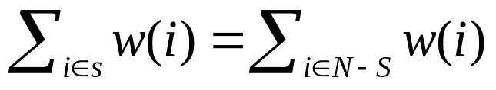
Additional NP problems
Hamiltonian cycle problem. Does a given directed network G = (N, A) contain a directed cycle that visits each node in the network exactly once?
Partition problem. Given a finite set N of elements with element values w(·), does some subset satisfy the property that ?

Slide 94
Additional NP problems
3. 3-cover problem. Given a collection of m (possibly overlapping) sets S₁, S₂,…, S_{m}, each with three elements in a ground set {1, 2, …, n}, do n/3 pairwise disjoint sets from this collection span the entire ground set (i.e., the union of the sets is {1, 2, …, n}?
4. Integer programming feasibility problem. Given a p x q constraint matrix A and a p-vector b, does some nonnegative integer q-vector x satisfy the equations Ax = b?

Slide 95
Class NP vs. P
The definition of the class NP implies that every problem in the class P is also in NP.
P中所有问题均属于NP
Let P1 be a problem in the class P and let AL1 be a polynomial-time algorithm for solving P1.
In this case we could choose the null set as the certificate and choose the algorithm AL1 itself as the certificate checking algorithm.
Then for any given yes instance I of P1, the algorithm AL1 can verify the correctness of I in polynomial time.

Slide 96
Class NP
TSP-recognition-II:
In this case the certificate of a yes instance is a tour W of length at least k*.
The certificate checking algorithm can easily verify the correctness of W in O(n) steps.
Consequently, TSP-recognition-II is in the class NP.

Slide 97
Class NP
TSP-recognition-III:
In this case there is no obvious succinct certificate of a yes instance (enumerating all the tours of the network G requires an exponential amount of space and time), although there is a succinct certificate for a no instance. Therefore, we cannot conclude that TSP-recognition-III is in the class NP. (It probably is not in the class NP, although no one has yet been able to prove this fact.)

