Slide 1
Last Section

Slide 2
NP - Completeness
Why the theories ?
  Classifications
  Practice
Optimization vs. Recognition
Polynomially equivalent
Problem Reduction and Transformation
  The TSP-optimization polynomially reduces to TSP-recognition I and III
  At least as hard as
P, NP, NP-complete
  Certificate
Proving NP-completeness
  Hamiltonian path problem vs. Hamiltonian cycle problem
  Longest path problem vs. Hamiltonian path problem
  Knapsack problem vs. partition problem

Slide 3
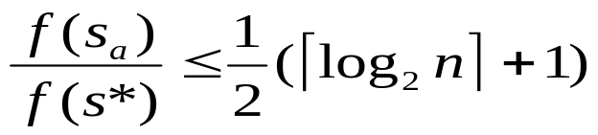
Approximation Algorithm
直观推断、贪婪。。。
相对误差、精确率、性能比、c近似算法；
TSP的近似算法
  Nearest-neighbor algorithm
  欧几里德类型实例
  Twice-around-the-tree algorithm
  Christofide Algorithm
  对TSP的所有实例求解

Slide 4
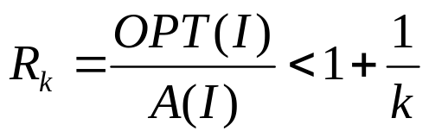
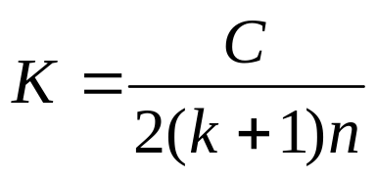
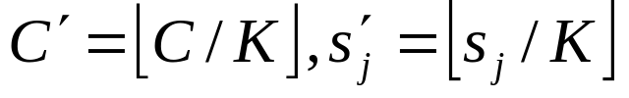
Approximation Algorithm
The Vertex Cover Problem;
  边----点、边； |v| vs. 2
0/1 Integer Knapsack;
  Sahni,生成所有小于等于k个物品的子集,
PAS & FPAS;
  近似度收敛到1的近似算法； R_{Aε}≤1+ε。
SUBSETSUM
  存在伪多项式时间算法的NP难问题，尺度变换， FPAS
  令 , ;Θ（kn²）; R_{Aε}≤1+1/k
Relative Performance Bound vs. Difference Bound

Slide 5
多项式近似方案
某些NP困难的问题存在有有界近似比的近似算法；
有些问题，除非NP=P，否则不可能设计出具有有界近似比的近似算法；
存在这样的问题，对于它们存在着一系列近似度收敛到1的近似算法（背包问题、子集和问题和多处理机调度问题等）。
定义 一个最优问题的近似方案是一个算法族{A_{ε}|ε>0}，使得R_{Aε}≤1+ε。
一个近似方案可以看作是一个近似算法A，它的输入是问题的一个实例 I 和有界误差ε， 使得R_{A}(I, ε)≤1+ε。
定义 一个多项式近似方案（PAS）是一个近似方案{ A_{ε}}, 其中每一个算法A_{ε}在输入实例 I 的规模的多项式时间内运行。

Slide 6
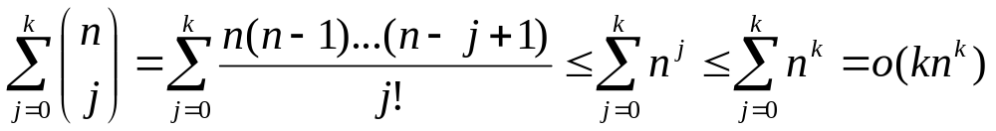
S.Sahni 算法的复杂性
算法生成的子集总数是
对于每一个子集，需要O(n)的时间来确定它可能的扩展；
因此，该算法的效率属于O(kn^{k+1})，是背包问题的一个多项式近似方案。（但不是 k 的多项式）
A_{ε}可能不是1/ε的多项式时间的。

Slide 7
完全多项式近似方案
定义 一个完全多项式近似方案（FPAS）是一个近似方案{A_{ε}}， 其中每个算法A_{ε}在以输入实例的规模和1/ε两者的多项式时间内运行。
定义 伪多项式时间算法是一种算法，它在L值的多项式时间内运行，其中L是输入实例中的最大数值。
为NP难问题找到一个FPAS的想法对存在伪多项式时间算法的问题来说是很典型的。
  对实例I的输入值应用尺度变换和舍入得到实例I′并解之

Slide 8
子集和问题
子集和问题是背包问题的特例，就是在背包问题中各项的值和它们的重量（尺寸）相同：
给出大小为s₁, s₂, …, s_{n}的n个项和背包容量正整数C， 找出这些项的一个子集，使得它们大小的总和最大化，且不超过背包的容量C。
求解该问题可以用同求解背包问题相同的算法。

Slide 9



算法 SUBSETSUM
输入：项集U={u₁, u₂, …, u_{n}}, 大小分别为s₁, s₂, …, s_{n}, 背包容量C。
输出：函数 的最大值，满足对 的项的某个子集， 。
for i←0 to n
T[i,0] ←0
end for
for j←0 to C
T[0, j] ←0
end for
for i←1 to n
for j←1 to C
T[i, j] ←T[i-1, j]
if s_{i}≤j then
x←T[i-1, j-s_{i}]+s_{i}
if x>T[i, j] then T[i, j] ←x
end if
end for
end for
return T[n,C] Θ(nc)
* T[i,j] 表示从前i项中取出来的装入体积为j的背包的物品的最大价值。

Slide 10
0/1 背包问题
当i和j都大于0时，有以下的结论：
V[i,j]是下面两个量的最大值：
V[i-1,j]:仅用最优的方法取自{u₁，u₂，…,u_{i-1}}的物品去装入体积为j的背包所得到的价值最大值。
V[i-1,j-s_{i}]+v_{i}:用最优的方法取自{u₁，u₂，…,u_{i-1}}的物品去装入体积为j-s_{i}的背包所得到的价值最大值加上物品u_{i}的价值。这仅应用于如果j≥s_{i}以及它等于把物品u_{i}加到背包上的情况。
观察结论对于找出最优装背包时的值，有下面的递推式
V[i,j] = 0 若i=0或j=0
=V[i-1,j] 若j<s_{i}
=Max{V[i-1,j],V[i-1,j-s_{i}]+v_{i}} 若i>0和j≥s_{i}

Slide 11
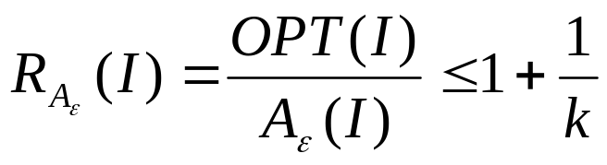
子集和问题的 FPAS
为设计近似算法A_{ε}，其中ε=1/k, k 为某个正整数，使算法对于任意实例I 有
令
首先，对于所有1≤j≤n，设
得到一个新的实例I′。
然后对I′应用算法SUBSETSUM，算法的运行时间现在减少到Θ（nC/K）=Θ（kn²）。

Slide 12
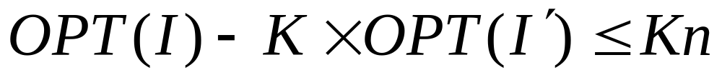
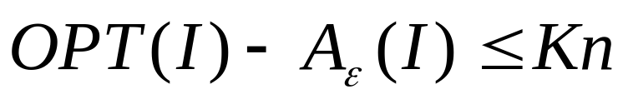
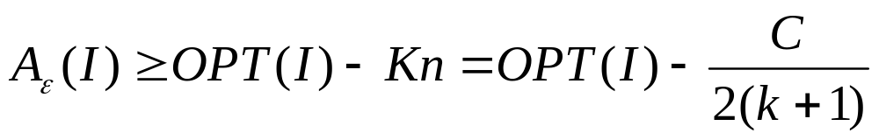
子集和问题的 FPAS
由于最优解不可能包含多于所有的n项，I和I′的最优值之间有如下关系：
(因s_{j}’= s_{j} /K且向下取整)
设实例I的近似解是算法输出的实例I′的解的K倍，则有
或

Slide 13
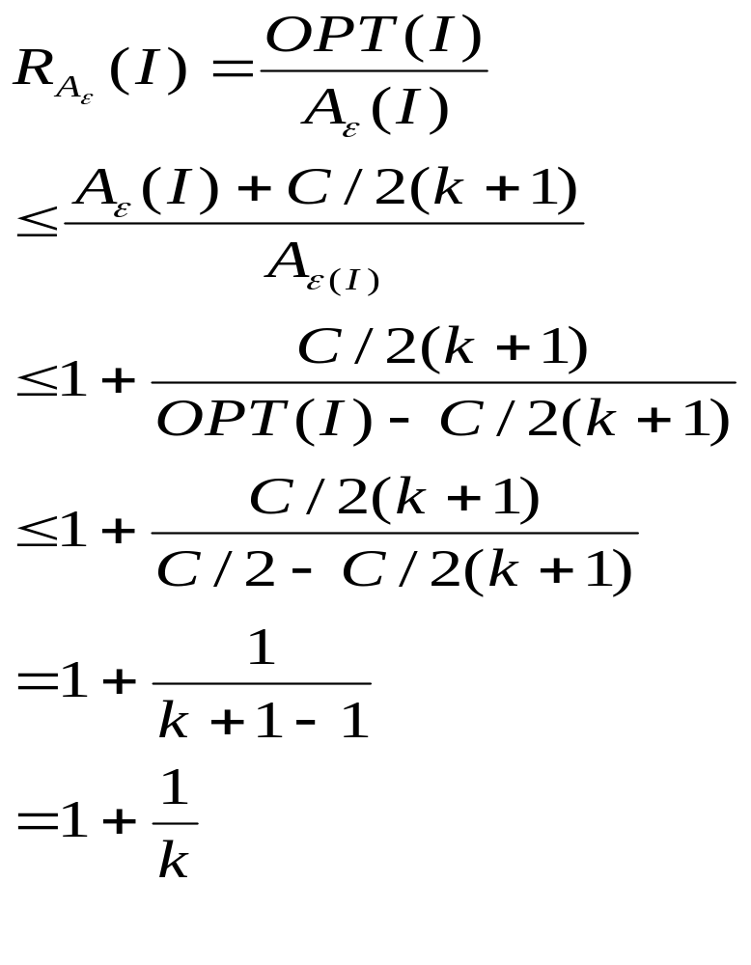
子集和问题的 FPAS
不失一般性，可以假定OPT（I）≥C/2，
因为如果OPT（I）<C/2, 最优解可直接得出；
因此

Slide 14
子集和问题的 FPAS
算法的近似度（性能比）是 1+ε，运行时间是Θ（n²/ε）。
令ε=1/ n^{r}近似度，r≥1，
运行时间是Θ（n^{r+2}）。

Slide 15
Relative Performance Bound vs. Difference Bound
R(I)=A(I)/OPT(I)
D(I)= A(I) -OPT(I) <=K
（minimization）
Planar Graph Coloring
3 color ?
NPC

Slide 16
Relative Performance Bound vs. Difference Bound
R(I)=A(I)/OPT(I)
D(I)= A(I) -OPT(I) <=K
（minimization）
Planar Graph Coloring
An approximation Algo. with the tightest Difference Bound?
D(I)= A(I)-OPT(I)<=1

Slide 17
Relative Performance Bound vs. Difference Bound
R(I)=A(I)/OPT(I)
D(I)= A(I) -OPT(I) <=K
（minimization）
Planar Graph Coloring
D(I)= A(I) -OPT(I)<=1
Integer Knapsack
What a D(I) you can have?

Slide 18
Difference Bound for Integer Knapsack
除非P=NP，不存在有差界的整数背包问题的多项式近似算法
证明：
假设存在有差界的整数背包问题的近似算法A，则对Integer Knapsack 的任一实例 I，有
OPT(I) - A(I) ≤K，K 为正整数。
针对I，构造实例I’，使得对于1 ≤ j ≤ n, 有
s’_{j}=s_{j}, v’_{j}=(K+1)v_{j}

Slide 19
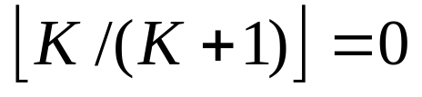
Difference Bound for Integer Knapsack
则：I 与 I’ 的解相同，且I’ 的A算法解值
A(I’)=(K+1)A(I)
I’ 的最优解值
OPT(I’)=(K+1)OPT(I)
因：OPT(I’) - A(I’) ≤K (A算法差界)
有：OPT(I) - A(I) ≤
即：A可求得最优解
而：已知Integer Knapsack 是NP-Hard问题

Slide 20
Randomized Algorithm
随机算法

Slide 21
Deterministic vs. Probabilistic
Deterministic algorithms
  If we run the algorithm twice with the same input, we get two identical execution patterns and results.
Probabilistic algorithms
  Depends also on some random events. The same algorithm may behave differently when it is applied twice to the same instance.

Slide 22
例
假定有一个n个变量的多项式表达式f(x₁, x₂, …, x_{n}), 我们要验证 f 是否恒等于0。分析这一验证本身就是一件复杂的工作。
假设我们可代之以生成一个随机n实向量（r₁, r₂, …, r_{n}）, 并计算f(r₁, r₂, …, r_{n}) 的值
  若f(r₁, r₂, …, r_{n}) <> 0, 那么f<>0
  若 f(r₁, r₂, …, r_{n}) =0，则或者f恒等于0，或者是我们的（r₁, r₂, …, r_{n}）选择非常幸运。
如果这样重复几次，继续得到f = 0，那么就可得出f恒等于0的结论，而出错的可能性很小。

Slide 23
Example: Finding a good student problem
Given n different numbers x₁, x₂, .., x_{n} , find an element that belongs to the upper half
  Deterministic algorithm 1: Find the maximum
    n-1 comparisons
  Deterministic algorithm 2: Find the maximum in x₁,x₂,.., x_{⎣n/2⎦+1}
    ⎣n/2⎦ comparisons

Slide 24
Example: Finding a good student problem
Given n different numbers x₁, x₂, .., x_{n} , find an element that belongs to the upper half
  Deterministic algorithm 1: Find the maximum
    n-1 comparisons
  Deterministic algorithm 2: Find the maximum in x₁,x₂,.., x_{⎣n/2⎦+1}
    ⎣n/2⎦ comparisons
Can we do better (faster)?

Slide 25
Probabilistic Solution
Take two random numbers x_{i} and x_{j}. Suppose x_{i} > x_{j}. Return x_{i}.
  What is the probability that x_{i} is in the upper half?
  Probability (an element belongs to the upper half) = 1/2
  Probability (both x_{i} and x_{j} do not belong to the upper half) = (1/2)×(1/2)=1/4. So probability (x_{i} does not belong to the upper half) = 1/4 (because x_{i} > x_{j}).
  Probability (x_{i} belongs to the upper half) = 3/4.
  It is true that 3/4 is not good enough.

Slide 26
Probabilistic Solution
Extend the same principle: Take k numbers and take the maximum
  What is the probability that the maximum belongs to the upper half?
    = 1 – 1/2^{k}
  If k=10, the probability = 0.999…
    The error is negligible .
  We can find the solution using at most 9 comparisons regardless of the size of the input.

Slide 27
随机算法
将算法必须对所有可能的输入都正确地求解问题的条件放宽，只要求它的可能不正确性解能够相对安全地忽略掉，比如说它的出现可能性非常低;
而且也不要求对于特定的输入，算法的每一次运行的输出都必须相同。
随机算法可以做如下定义：
它是在接收输入的同时，为了随机选择的目的，还接收一串随机比特流并且在运行过程中使用该比特流的算法。
一个随机算法在不同的运行中对于相同的输入可以有不同的结果。由此得出对于相同的输入两次不同的随机算法的执行时间可能不同。

Slide 28
随机算法
在很大的应用范围内随机化对于算法的构造是一个极其重要的工具。
随机算法通常有两个优点：
  首先，较之那些我们所知的解决同一问题最好的确定性算法，随机算法所需的运行时间或空间通常常小一些；
  其次，观察迄今为止已经发明的各种随机算法，我们发现这些算法总是易于理解和实现。

Slide 29
随机算法
在某些确定性算法中，特别是对于那些表现出好的平均运行时间的算法，仅是引入随机性就能将一个自然、简单，在最坏情况下表现不好的算法转化成对于每一种可能的输入都有很高可靠性的随机算法。
平均情况下的期望时间：确定性算法A，对于每一个大小为n的输入，所运行的平均时间。

Slide 30
Types of Randomized Algorithms
  Monte Carlo probabilistic algorithm
  Las Vegas probabilistic algorithm

Slide 31


Slide 32
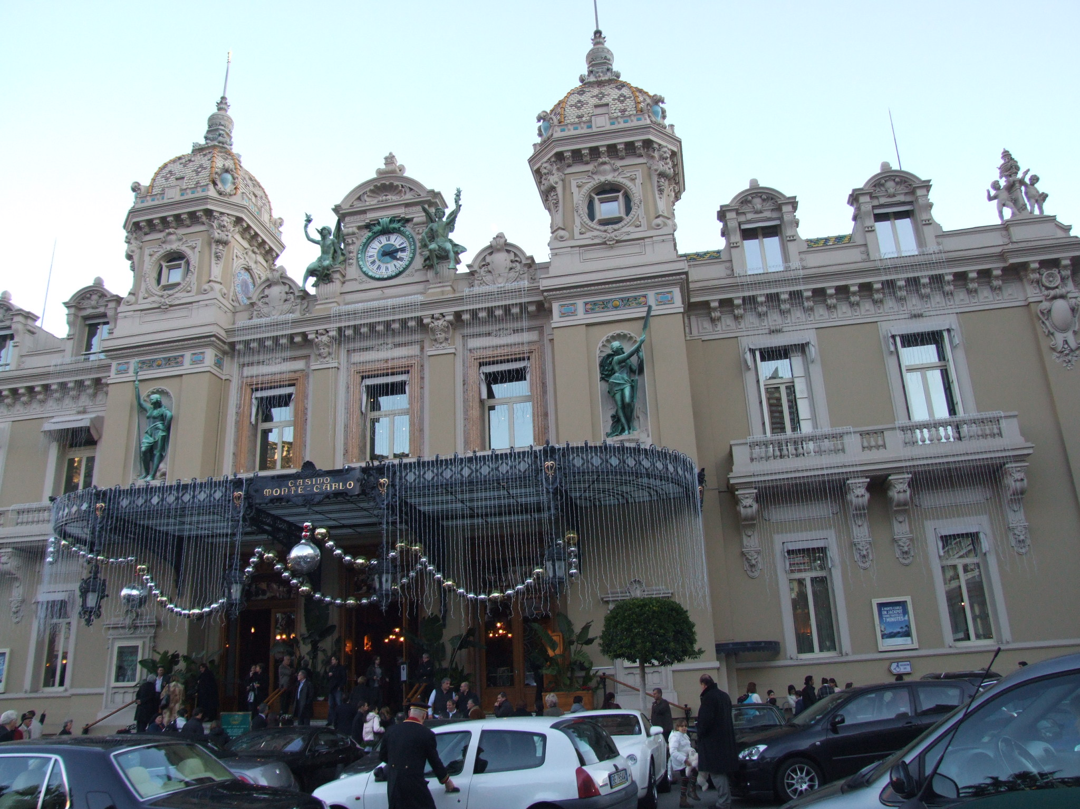

Slide 33


Slide 34


Slide 35


Slide 36


Slide 37


Slide 38
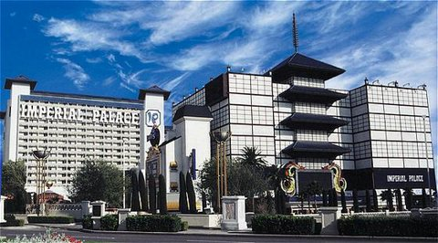

Slide 39


Slide 40
Monte Carlo
Outputs an answer which with high probability is correct (but could occasionally be wrong), e.g. the probabilistic algorithm on the finding a good student problem.
Sometimes they lie …
总是给出解，但是偶尔可能会产生非正确的解。
然而，可以通过多次运行原算法，并且满足每次运行时的随机选择都相互独立，使产生非正确解的概率可以减到任意小。

Slide 41
Las Vegas
Outputs an answer which is always correct or occasionally outputs a message saying that no answer has been found.
Never lie, but sometimes they give up …
总是或者给出正确的解，或者无解。

Slide 42
Verification of Matrix Products
Input: Three n × n matrices,
A, B and C.
Question: Does A×B = C?

Slide 43
Verification of Matrix Products
Deterministic algorithms：
Trivial Algorithms: O(n³)
Strassen: O(n^{2.81})
Best deterministic algorithm: O(n^{2.376})

Slide 44
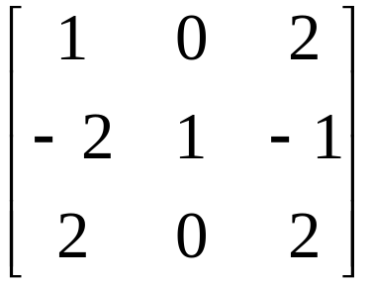
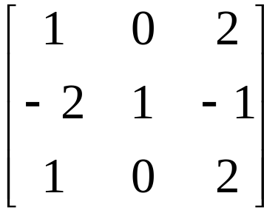
Verification of Matrix Products
Freivalds' Algorithm
AB= C=
Compute the sum of a random subset of the rows of both AB and C.
If the sums are different, return false (AB≠C).
Otherwise, either return true or try again to improve confidence.

Slide 45
Verification of Matrix Products
The sum of any set of rows of a matrix may be computed by multiplying on the left by a row vector of which each element is either 0 or 1, e.g
[1 0 1]× = [1 0 2]+[2 0 2]

Slide 46
Verification of Matrix Products
Note that S×(A×B)= (S×A)×B. To compute (S×A)×B, where S is a row vector (i.e. 1×n matrix):
Y = S×A requires O(n²) time; and
Y×B requires O(n²) time (because Y is 1×n).
We may therefore compute the sum of any subset of rows of A×B in O(n²) time.

Slide 47
Verification of Matrix Products
Now consider the following O(n²) time probabilistic algorithm (Monte-Carlo)
Repeat k times {
Generate a random row vector S from {0, 1};
If (SA)B ≠ SC, then return AB≠C;}
Return AB=C.
Complexity analysis: O(n²)

Slide 48
Verification of Matrix Products
Suppose there is an error on row i of C, i.e. row i of C does not equal row i of AB.
We make no assumptions about the other rows of C.
Also, assume that we select any subset of the n rows with equal probability.

Slide 49
Verification of Matrix Products
There are 2^{n} subsets of the n rows. For example, if n=3, then we have 8 subsets, i.e. (1, 2, 3), (1, 2), (1, 3), (2, 3), (1), (2), (3), and the empty set.
We form 2^{n-1} pairs of subsets so that in each pair, the subsets are the same except that one subset contains row i and the other does not. For example, if n=3 and i=2, then we have 4 pairs, i.e. {(1, 2, 3), (1, 3)}, {(1, 2), (1)}, {(2, 3), (3)} and {(2), the empty set}

Slide 50
Verification of Matrix Products
Consider any pair (S, S’), where S contains i, but S’does not.
Suppose we represent S and S’ by row vectors. Then
(SAB − SC) − (S’AB − S’C)
= S(AB − C) − S’(AB − C)
= (S − S’)(AB − C)
≠ 0
Hence, at most one of the following is true:
SAB = SC or S’AB = S’C

Slide 51
Verification of Matrix Products
For at most 2^{n-1} of the 2^{n} subsets, the sums of the selected rows of AB and C will be equal.
If C ≠ AB, then a single trial will fail to detect an error with probability at most 1/2.
If k trials are done, the algorithm give a wrong result with probability at most 1/2^{k}.
For example, if k=10, then the error probability is at most 0.1%.

Slide 52
随机化快速排序
RANDOMIZEDQUICKSORT
输入：n个元素的数组A[1…n]。
输出：A中按非降序排列的元素。
rquicksort(1,n)
rquicksort(low, high)
if low < high then
v←random(low, high)
互换A[low]和A[v]
SPLIT(A[low…high],w) {w 是主元的新位置}
rquicksort（low, w-1）
rquicksort(w+1, high)
end if

Slide 53
快速排序
QUICKSORT
输入：n个元素的数组A[1…n].
输出：按非降序排列的数组A 中的元素。
Quicksort(A, 1, n)
procedure quicksort (A, low, high)
if low < high then
SPLIT (A[low…high], w) {w 为A[low]的新位置}
qicksort(A, low, w-1)
quicksort(A, w + 1, high)
end if

Slide 54
快速排序
T_{worst} = Θ(n^2)
T_{average} =Θ(nlgn)

Slide 55
随机化快速排序
RANDOMIZEDQUICKSORT
输入：n个元素的数组A[1…n]。
输出：A中按非降序排列的元素。
rquicksort(1,n)
rquicksort(low, high)
if low < high then
v←random(low, high)
互换A[low]和A[v]
SPLIT(A[low…high],w) {w 是主元的新位置}
rquicksort（low, w-1）
rquicksort(w+1, high)
end if

Slide 56
随机化快速排序
期望运行时间：
Θ(nlgn)
但与输入无关，最坏情况出现于随机数生成结果恰好使数组有序----概率极小。

Slide 57
随机化的选择算法
RANDOMIZEDSELECT
输入：n个元素的数组A[1…n]和整数k, 1≤k≤n。
输出：A中的第k 小元素。
rselect(A, 1, n, k)
procedure rselect(A, low, high, k)
v←random(low, high)
x←A[v]
将A[low…high]分成三个数组
  A₁ = {a|a<x}
  A₂ = {a|a=x}
  A₃ = {a|a>x}
case
  |A₁|≥k: return rselect(A₁, 1, |A₁|, k)
  |A₁|+|A₂|≥k: return x
  |A₁|+|A₂|<k: return rselect(A₃, 1, |A₃|, k-|A₁|-|A₂|)
end case 20cn，4cn

Slide 58


寻找第 k 小元素
SELECT
输入：n个元素的数组A[1…n]和整数k, 1 ≤ k ≤n。
输出：A中的第k 小元素。
select(A, 1, n, k)
Procedure select (A, low, high, k)
p ← high – low + 1
if p < 44 then 将A 排序return (A[k])
令q = 。将A分成q组，每组5个元素。如果5不整除p, 则排除剩余的元素。
将q 组中的每一组单独排序，找出中项。所有中项的集合为M.
mm ← select(M, 1, q, ) //mm 为中项集合的中项
将A[low…high] 分成三组
A1 = {a | a < mm}
A2 = {a | a = mm}
A3 = {a | a > mm}
7. case
| A1 | ≥ k: return select (A1, 1, |A1|, k)
| A1| + | A2| ≥ k: return mm
|A1| + |A2| < k: return select(A3, 1, |A3|, k-|A1| - |A2|)
8. end case

Slide 59
随机化的选择算法
RANDOMIZEDSELECT
输入：n个元素的数组A[1…n]和整数k, 1≤k≤n。
输出：A中的第k 小元素。
rselect(A, 1, n, k)
procedure rselect(A, low, high, k)
v←random(low, high)
x←A[v]
将A[low…high]分成三个数组
  A₁ = {a|a<x}
  A₂ = {a|a=x}
  A₃ = {a|a>x}
case
  |A₁|≥k: return rselect(A₁, 1, |A₁|, k)
  |A₁|+|A₂|≥k: return x
  |A₁|+|A₂|<k: return rselect(A₃, 1, |A₃|, k-|A₁|-|A₂|)
end case 20cn，4cn

Slide 60
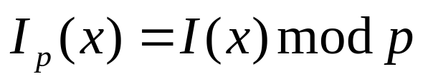
测试串的相等性
A、B各有长串x、y；x=y?
指纹函数：选一素数p
其中I(w)是比特串w表示的整数
若p不很大，则指纹可作为短串发送，传送的比特数是 O（log p)
假匹配：
I_{p}(x)=I_{p}(y), 则不一定有x=y.

Slide 61
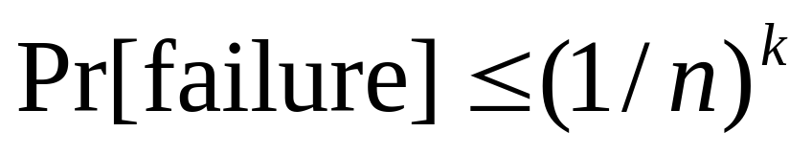
测试串的相等性
STRINGEQUALITYTEST
A从小于M的素数集中随机选择p；
A将p和I_{p}(x)发送给B；
B检查是否I_{p}(x)= I_{p}(y)，确定两个串x和y是否相等。运行k次，每次随机选择p ，M=2n²：

Slide 62
测试串的相等性
例： x和y均为100万位比特串，则M=2 x10¹²
=2^40.86；
需传输p和I_{p}(x)的比特数均为 log(M)=41 即一次运行需传82位。
重复算法5次：
需传输的比特数为 410；
假匹配概率：(1/1000000)⁵=10⁻³⁰

Slide 63

模式匹配
文本串 X=x₁, x₂…x_{n}和模式Y=y₁, y₂…y_{m}
M<=n
比较I_{p}(Y) 和I_{p}(X(j))
递推
设W_{p}=2^{m}(modp), 则

Slide 64
模式匹配
PATTERNMATCHING
输入：长度为n的文本串X和长度为m的模式Y。
输出：如果Y在X中，则返回Y在X中的第一个位置；否则返回0。
从小于M的素数集中随机选择p
j←1
计算W_{p}=2^{m}(mod p), I_{p}(Y)和I_{p}(X_{j})
while j≤n-m+1
if I_{p}(X_{j})= I_{p}(Y) then return j {（可能）找到了匹配}
用等式计算I_{p}(X_{j+1})
j←j+1
end while
return 0 {Y(肯定)不在X中}
nm , O(n)； 假匹配概率 1/n.

Slide 65
转换为 Las Vegas
只要两指纹 Ip(Y) 与 Ip(X(j)) 匹配，就测试这两个串的相等性。
O(n+m)

Slide 66
Genetic Algorithm

Slide 67
Genetic Algorithms Overview
A class of probabilistic optimization algorithms
Inspired by the biological evolution process
Uses concepts of “Natural Selection” and “Genetic Inheritance” (Darwin)
Originally developed by John Holland
Particularly well suited for hard problems where little is known about the underlying search space
Widely-used in business, science and engineering

Slide 68
Genetic Algorithm
A genetic algorithm maintains a population of candidate solutions for the problem,
and makes it evolve by
iteratively applying
a set of stochastic operators

Slide 69
Stochastic operators
Selection (reproduction) replicates the most successful solutions found in a population at a rate proportional to their relative quality
Recombination( crossover ) decomposes two distinct solutions and then randomly mixes their parts to form novel solutions
Mutation randomly perturbs a candidate solution

Slide 70
Concepts
Chromosome
Genes
Locus
Alleles
Genotype
Phenotype
Fitness value

Slide 71
Simple Genetic Algorithm
produce an initial population of individuals
evaluate the fitness of all individuals
while termination condition not met do
select fitter individuals for reproduction
recombine between individuals
mutate individuals
evaluate the fitness of the modified individuals
generate a new population
end while do

Slide 72
The Evolutionary Cycle
parents
selection
modification
modified
offspring
initiate &
population
evaluation
evaluate
evaluated offspring
deleted
members
discard

Slide 73
Components of a GA
A problem definition as input, and
Encoding principles (gene, chromosome)
Initialization procedure (creation)
Selection of parents (reproduction)
Genetic operators (recombination, mutation)
Evaluation function (environment)
Termination condition (time, quality, convergence )

Slide 74
Representation (encoding)
Possible individual’s encoding
  Bit strings (0101 ... 1100)
  Real numbers (43.2 -33.1 ... 0.0 89.2)
  Permutations of element (E11 E3 E7 ... E1 E15)
  Lists of rules (R1 R2 R3 ... R22 R23)
  ... any data structure ...

Slide 75
Representation (cont)
When choosing an encoding method
Use a data structure as close as possible to the natural representation
Write appropriate genetic operators as needed
If possible, ensure that all genotypes correspond to feasible solutions
If possible, ensure that genetic operators preserve feasibility

Slide 76
Initialization
Start with a population of randomly generated individuals, or use
- A previously saved population
- A set of solutions provided by
a human expert
- A set of solutions provided by another heuristic algorithm

Slide 77
Selection
Purpose:
To focus the search in promising regions of the space
Inspiration:
Darwin’s “survival of the fittest”
Trade-off:
Between exploration and exploitation of the search space

Slide 78
Fitness Proportionate Selection
Derived by Holland as the optimal trade-off between exploration and exploitation
Drawbacks
Different selection for f₁(x) and f₂(x) = f₁(x) + c
Superindividuals cause convergence (that may be premature)

Slide 79
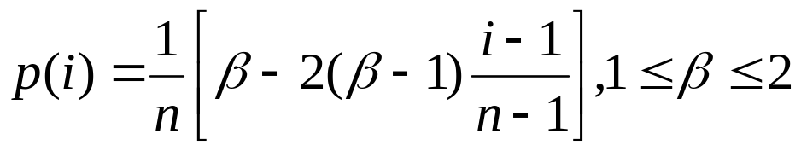
Linear Ranking Selection
Based on sorting of individuals by decreasing fitness
The probability to be extracted for the i^{th} individual in the ranking is defined as
where β can be interpreted as the expected sampling rate of the best individual

Slide 80
Local Tournament Selection
Extracts k individuals from the population with uniform probability (without re-insertion) and makes them play a “tournament”, where the probability for an individual to win is generally proportional to its fitness
Selection pressure is directly proportional to the number k of participants

Slide 81
Recombination (Crossover)
* Enables the evolutionary process to move toward promising regions of the search space
* Matches good parents’ sub-solutions to construct better offspring

Slide 82
Mutation
Purpose: to simulate the effect of errors that happen with low probability during duplication
Results:
- Movement in the search space
- Restoration of lost information to the population

Slide 83
Evaluation (fitness function)
Solution is only as good as the evaluation function;
Similar-encoded solutions should have a similar fitness

Slide 84
Termination condition
Examples:
A pre-determined number of generations or time has elapsed
A satisfactory solution has been achieved
No improvement in solution quality has taken place for a pre-determined number of generations

Slide 85
Example:
The Traveling Salesman Problem (TSP)
The traveling salesman must visit every city in his territory exactly once and then return to the starting point; given the cost of travel between all cities, how should he plan his itinerary for minimum total cost of the entire tour?
TSP ∈ NP-Complete

Slide 86
TSP (Representation, Evaluation, Initialization and Selection)
A vector v = (i₁ i_{2…} i_{n}) represents a tour (v is a permutation of {1,2,…,n})
Fitness f of a solution is the cost of the corresponding tour
Initialization: use either some heuristics, or a random sample of permutations of {1,2,…,n}
We shall use the fitness proportionate selection

Slide 87
TSP (Crossover1)
Builds offspring by choosing a sub-sequence of a tour from one parent and preserving the relative order of cities from the other parent and feasibility
Example:
p₁ = (1 2 3 4 5 6 7 8 9) and
p₂ = (4 5 2 1 8 7 6 9 3)
First, the segments between cut points are copied into offspring
o₁ = (x x x 4 5 6 7 x x) and
o₂ = (x x x 1 8 7 6 x x)

Slide 88
TSP (Crossover2)
Next, starting from the second cut point of one parent, the cities from the other parent are copied in the same order
The sequence of the cities in the second parent is 4 – 5 – 2 – 1 – 8 – 7 – 6 – 9 – 3
After removal of cities from the first offspring we get 2 – 1 – 8 9 – 3
This sequence is placed in the first offspring
o₁ = (2 1 8 4 5 6 7 9 3), and similarly in the second
o₂ = (3 4 5 1 8 7 6 9 2)

Slide 89
TSP (Inversion)
The sub-string between two randomly selected points in the path is reversed
Example:
(1 2 3 4 5 6 7 8 9) is changed into (1 2 7 6 5 4 3 8 9)
Such simple inversion guarantees that the resulting offspring is a legal tour

Slide 90

Example

Slide 91
标准遗传算法
1．随机产生一组初始个体构成初始种群，并评价每一个体的适配值（fitness value）。
2．判断算法收敛准则是否满足。若满足则输出搜索结果；否则执行以下步骤。
3．根据适配值大小以一定方式执行复制操作。
4．按交叉概率pc执行交叉操作。
5．按变异概率pm执行变异操作。
6．返回步骤2。

Slide 92
一个简单的遗传算法
生成一个具有8个符号串(?)的起始群体。
重复步骤3直至解答的适度值收敛。
生成一个新的8符号串群体。步骤如下：
应用繁殖操作两次，亦即用轮盘选出两个符号串。
如果pc>rand[0,1]，则应用交叉操作于这一对符号串。
如果pm>rand[0,1]，则应用突变操作于这一对符号串。
将生成的两个符号串加入新的群体。

Slide 93
Example

Slide 94
GAs
遗传算法是一种迭代算法；
它在每一次迭代时都拥有一组解。这组解最初是随机生成的（或…）；
在每次迭代时又有一组新的解由模拟进化和继承的遗传操作生成。每个解都由一个适应函数给予评价；
这一过程不断重复，直至达到某种形式上的收敛；
新的一组解不但可以有选择地保留一些适应函数值高的旧的解，而且可以包括一些经由其它解结合而得的新的解。

Slide 95
GAs
最简单的遗传算法包括如下组成部分：
一个对参数空间编码的符号串表示；
一个评价符号串的适度函数；
一组产生成新的符号串的遗传操作；
一组控制遗传操作的概率值。

Slide 96
GAs
典型的遗传算法步骤有：
初始化, 随机生成一个符号串群体;
基于适度函数对符号串进行评价;
应用一组遗传操作生成一个新的符号串群体;
重复步骤2和3直到解答收敛。

Slide 97
GA具有以下特点
遗传算法利用生物遗传和进化的思想实现优化
对问题参数编码成“染色体”后进行进化操作，而不是针对参数，这使得它不受某些函数约束条件的限制，如连续性、可导性等；
搜索过程是从问题解的一个集合开始的，而不是从单个个体开始的，具有隐含并行搜索特性，从而大大减小了陷入局部极小的可能；
具有全局搜索能力；
适应性、收敛性。

Slide 98
Neighborhood Search

Slide 99
Neighborhood Search
利用邻域结构进行逐步优化的局部搜索算法：
算法从一初始可行解 s 出发，利用状态发生器持续地在s 的领域中搜索更好的解，若能找到更优解，则以其替代s 成为新的当前解，然后重复上述过程，直至终止条件满足。

Slide 100
Neighborhood Search
特点：
对邻域函数和初值具有依赖性；
局部优化特性

Slide 101
A Special Case of the Minimum Cost Network Flow

Slide 102
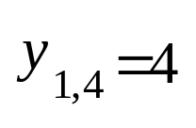
Center
Node 0
Node 1
Node 2
Node 3
4
6
7
8
5
9
10
11
12
13
14
15
16

Slide 103
Center
Node 0
Central Arc
Node 1
Node 2
Node 3
4
6
7
8
5
9
10
11
12
13
14
15
16

Slide 104
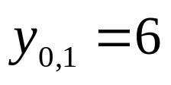
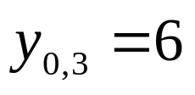
Center
Node 0
Node 1
Node 2
Node 3
4
6
7
8
5
9
10
11
12
13
14
15
16

Slide 105
Frank. H.
Center
Node 0
Node 1
Node 2
Node 3
4
6
7
8
5
9
10
11
12
13
14
15
16

Slide 106
Frank. H.
Center
Node 0
Node 1
Node 2
Node 3
4
6
7
8
5
9
10
11
12
13
14
15
16

Slide 107
Muti-Exchange procedure
Center
Node 0
Node 1
Node 2
Node 3
4
6
7
8
5
9
10
11
12
13
14
15
16

Slide 108
Node-based cycle exchange
4
4
5
3
5
3
0
2
2
0
6
6
8
1
1
7
8
7

Slide 109
Sub-tree Moving
Find an Initial solution
then
Look for better solution by
moving subtreees

Slide 110
Center
Node 0
Node 1
Node 2
Node 3
4
6
7
8
5
9
10
11
12
13
14
15
16

Slide 111
Center
Node 0
Node 1
Node 2
Node 3
4
6
7
8
5
9
10
11
12
13
14
15
16

Slide 112
Center
Node 0
Node 1
Node 2
Node 3
4
6
7
8
5
9
10
11
12
13
14
15
16

Slide 113
Center
Node 0
Node 1
Node 2
Node 3
4
7
8
5
9
10
11
6
14
15
16
12
13

Slide 114
Why subtree ?
Any better solution can be found by moving subtrees
Keep local optimality
Avoid complicate task
Fast computation
* won’t miss considering any situation

Slide 115
Center
Node 0
Node 1
Node 2
Node 3
4
6
7
8
5
9
10
11
12
13
14
15
16

Slide 116
Center
Node 0
Node 1
Node 2
Node 3
4
6
7
8
5
9
10
11
12
13
14
15
16

Slide 117
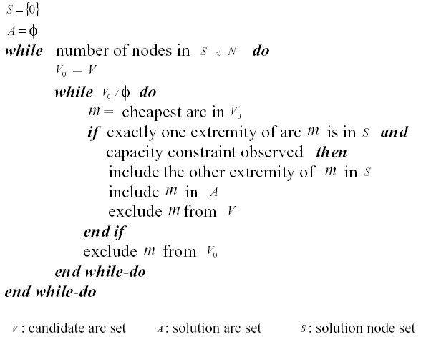
Initial Solution

Slide 118
Initial solution
Center
Node 0
Node 1
Node 2
Node 3
4
6
7
8
5
9
10
11
12
13
14
15
16

Slide 119
How to start ?
Consider
The sequence of adding nodes to solution
The level of nodes
The profit of moving nodes

Slide 120
Sequence
Center
Node 0
Node 1
Node 2
Node 3
4
6
7
8
5
9
10
11
12
13
14
15
16

Slide 121
Level
Center
Node 0(3)
Node 1(2)
Node 3(2)
Node 2
4(1)
6 (1)
7
8(1)
5(0)
9(0)
10
11(0)
12
13
14
15
16(0)

Slide 122
Profit
Center
Node 0
Node 1
Node 2
Node 3
20
10
4
6
7
8
5
17
9
9
10
11
12
13
14
15
16

Slide 123
Profit ? or Feasibility ?
Center
K=7
Node 0
Node 1
Node 2
Node 3
4
6
7
8
5
9
10
11
12
13
14
15
16

Slide 124
Which node to be moved out ?
Center
K=7
Node 0
Node 1
Node 2
Node 3
4
6
7
8
5
9
10
11
12
13
14
15
16

Slide 125
Which node to be moved out ?
Center
K=7
Node 0
Node 1
Node 2
Node 3
4
6
7
8
5
9
10
11
12
13
14
15
16

Slide 126

Core Move

Slide 127
The Algorithm
Sequence Priority Search
Level Priority Search
Profit Priority Search
Random search

Slide 128
Tabu Search

Slide 129

Glover
Fred W. Glover
&
Manuel Laguna
University of Colorado

Slide 130
TS的主要思想
禁忌搜索（TS）是对局部邻域搜索的一种扩展，是一种全局优化算法。TS算法通过引入一个禁忌表和相应的禁忌准则来避免局部迂回，并通过“渴望准则”来挽救某些被禁忌的相对优化解，进而保证全局的有效搜索以实现全局优化。
标记对应已搜索到的局部最优解的一些对象，并在进一步的迭代搜索中尽量避开这些对象，但不是绝对禁止循环，从而保证对不同的有效搜索途径的探索。

Slide 131
基本概念
禁忌对象：
被置于禁忌表中的变化元素；
可以是搜索状态本身；
可以是搜索状态分量；
也可以是适配值或其变化。
通常，禁忌表中禁忌对象采用FIFO方式进行更新，有时也采用动态自适应的方式。禁忌长度是一个关键参数，它决定禁忌对象的任期，其大小直接影响整个算法的搜索进程。

Slide 132
基本概念
邻域（neighborhood）
禁忌表（tabu list）
禁忌任期（tabu tenure）
候选解（candidate）
渴望准则（aspiration criterion）

Slide 133
简单TS算法的基本思想
给定一个当前解（初始解）和一种邻域结构，在当前解的邻域中确定若干候选解；
若最佳候选解对应的目标植优于 “best so far” ，则忽视其禁忌特性，用其替代当前解和“best so far”值，并将相应的对象加入禁忌表，同时修改禁忌表中各对象的禁忌任期；
若不存在上述候选解，则选择在候选解中非禁忌的最佳状态为新的当前解，而无视它与当前解的优劣，同时将相应的对象加入禁忌表，并修改禁忌表中各对象的任期；
重复上述迭代搜索过程，直至满足停止条件。

Slide 134
简单禁忌搜索算法步骤

Slide 135
定义相邻结构和如下算法参数: tt（Tabu tenure）、m (number of candidates）；m > tt ;
以某种方法产生初始解s，置禁忌表为空；
从s的邻域中选取m 个 候选解；
选取候选解中的最优解X；
若X不在禁忌表中，则s=x, 将X存入禁忌表且置其当前禁忌值为tt, 将禁忌表中其它元素值（禁忌值）减 1，然后将禁忌值为0的禁忌元素释放出禁忌表，转到（8）；
若X在禁忌表中，且X的目标函数值优于当前最优解（best so far），则s=x, 将X禁忌值置为tt, 将禁忌表中其它元素值（禁忌值）减 1，然后将禁忌值为0的禁忌元素释放出禁忌表，转到（8）；
若X在禁忌表中，且X的目标函数值不优于当前最优解（best so far），则从候选解中取得下一X，转到（4）；
判断算法终止条件是否满足？若是，则结束算法并输出优化结果；否则转到（3）。

Slide 136
An Example

Slide 137
禁忌搜索算法的设计
要设计一个禁忌搜索算法，需要确定
算法的以下环节：
初始解和适配值函数；
邻域结构和禁忌对象；
候选解选择；
禁忌表及其长度；
渴望准则；
终止准则。

Slide 138
适配值函数
类似于遗传算法，禁忌搜索的适配值函数也是用于对搜索状态 评价，进而结合禁忌准则和渴望准则来选取新的当前状态。

Slide 139
禁忌对象
所谓禁忌对象就是被置入禁忌表中的那些变化元素，而禁忌的目的则是为了尽量避免迂回搜索而多探索一些有效的搜索途径。
禁忌对象通常可选取状态本身或状态分量或适配值的变化等，也可以是搜索状态，特定搜索操作，甚至是搜索目标值等。

Slide 140
禁忌任期(长度)
一般而言，当算法的性能动态下降较大时，可能是当前解附近极小（大）解形成的“波谷（峰）”较深，从而可设置较大的禁忌长度来延续当前的搜索行为，并避免陷入局部极值。

Slide 141
候选解
候选解通常在当前状态的邻域中择优选取，但选取过多将造成较大的计算量，而选取过少则容易造成早熟收敛。

Slide 142
禁忌频率
记忆禁忌频率（或次数）是对禁忌属性的一种补充，可放宽选择决策对象的范围。

Slide 143
静态的频率
静态的频率信息主要包括状态、适配值或置换等对象在优化过程中出现的频率，其计算相对比较简单，如对象在计算中出现的次数，出现次数与总迭代步数的比，某两个状态间循环的次数等。显然，这些信息有助于了解某些对象的特性，以及相应循环出现的次数等。

Slide 144
动态的频率
动态的频率信息主要记录从某些状态、适配值等对象转移到另一些状态、适配值等对象的变化趋势，如记录某个状态序列的变化。显然，对动态频率信息的记录比较复杂，而它所提供的信息量也较多。

Slide 145
动态禁忌频率的常用方法
记录某个序列的长度，即序列中的元素个数，而在记录某些关键点的序列中，可以按这些关键点的序列长度的变化来进行计算。
记录由序列中的某个元素出发后再回到该元素的迭代次数。
记录某个序列相应各元素的适配值的变化。
记录某个序列出现的频率等。

Slide 146
TS算法的主要特点
在搜索过程中可以接受劣解，因此具有较强的“爬山”能力；
新解不是在当前解的邻域中随机产生，而是优于“best so far”的解，或是非禁忌的最佳表现。
对初始解有较强的依赖性，好的初始解可使TS在解空间中搜索到好的解，而较差的初始解则会降低TS的收敛速度；
迭代搜索过程是串行的，仅是单一状态的移动，而非并行搜索。

Slide 147
Simulated Annealing

Slide 148
Simulated Annealing
Metropolis
Kirkpatrick

Slide 149
物理退火过程
加温过程
其目的是增强粒子的热运动，使其偏离平衡位置。当温度足够高时，固体将熔解为液体，从而消除系统原先可能存在的非均匀态，使随后进行的冷却过程以一种平衡态为起点。溶解过程与系统的熵增过程相联系，系统能量也随温度的升高而增大。
等温过程
物理学上，对于与周围环境交换热量而温度不变的封闭系统，系统状态的自发变化总是朝自由能减少的方向进行，当自由能达到最小时，系统达到平衡态。
冷却过程
其目的是使粒子的热运动减弱并渐趋有序，系统能量逐渐下降，从而得到低能的晶体结构。

Slide 150
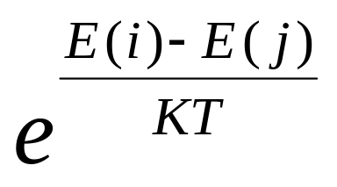
Metropolis
材料在温度 T 下从具有能量 E（i）的状态 i 进入具有 能量 E（j）的状态 j 的机制：
If E（j）<= E（i）,状态转换被接收；
If E（j）> E（i）,状态转换以如下概率被接收：

Slide 151
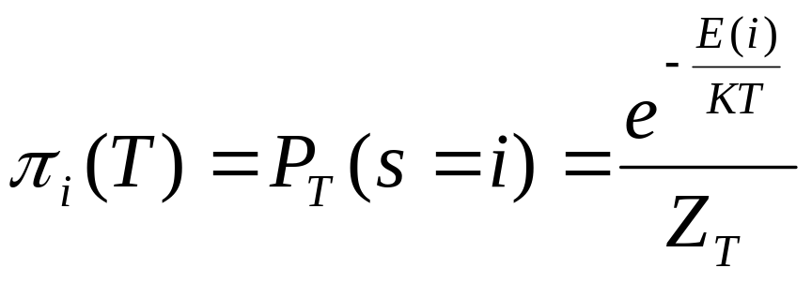
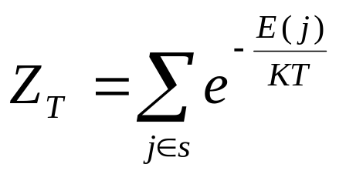
在特定温度下，如果进行足够次数的转换，将达到热平衡。此时材料处于状态 i 的概率可由 波尔兹曼分布表述：
划分函数

Slide 152
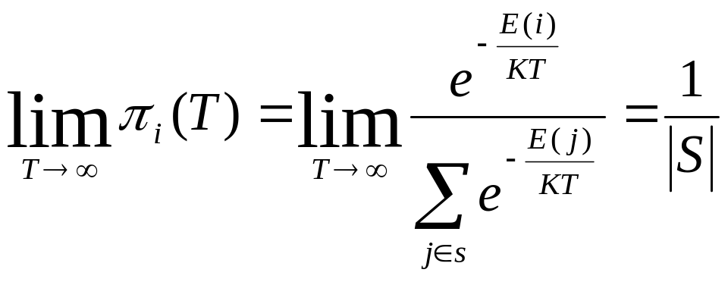
所有状态在高温下具有相同的概率

Slide 153
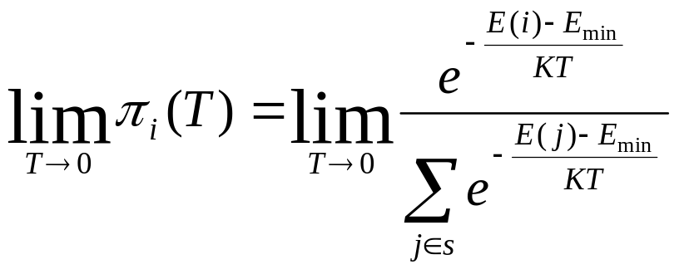
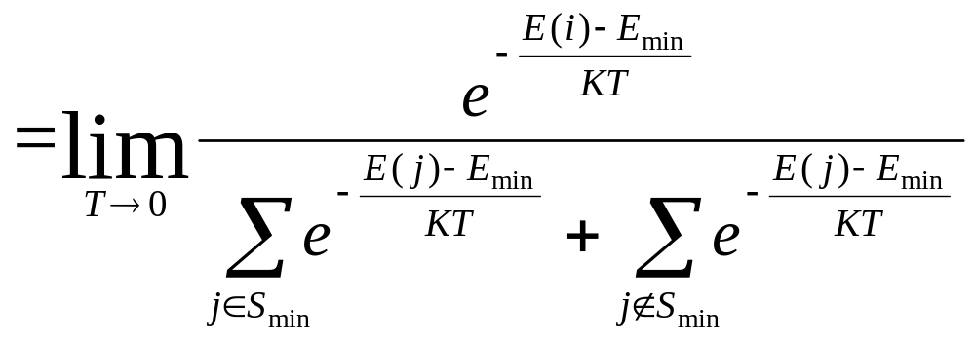
随着温度的下降

Slide 154
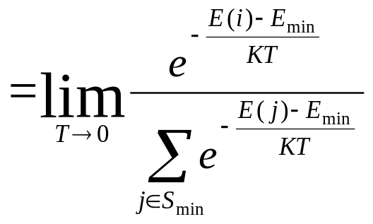
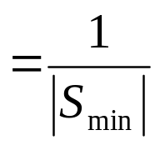
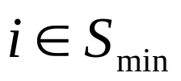



Slide 155
结论
T 降低时
材料倾向于进入具有最小能量的状态

Slide 156
相似性
物理退火 | 组合优化
粒子（系统）状态 | 解
状态（系统）的能量 | 目标函数值
能量最低态 | 最优解
熔解过程 | 设定初温
等温过程 | Metropolis抽样过程
冷却 | 控制参数的下降
温度 | 控制参数

Slide 157
标准SA
给定初温t₀，产生初始状态s₀，设降温次数k=0；
产生新状态s=Generate (s₀);
如果 F（s）< F (s₀)，转到5;
如果 exp(-(F（s）- F (s₀))/t_{k}) < rand (0,1), 转到6
s₀=s;
如果抽样稳定准则不满足，转到2；
t_{k+1}= Update(t_{k}), k=k+1;
如果算法终止条件不满足, 转到2；
输出搜索结果。

Slide 158
状态产生函数
设计状态产生函数（邻域函数）的出发点应该是尽可能保证产生的候选解遍布全部解空间。
状态接受函数
状态接受函数一般以概率的方式给出，不同接受函数的差别主要在于接受概率的形式不同。设计状态接受概率，应该遵循以下原则：
在固定温度下，接受使目标函数值下降的候选解的概率要大于使目标函数值上升的候选解的概率；
随温度的下降，接受使目标函数值上升的解的概率要逐渐减小；
当温度趋于零时，只能接受目标函数值下降的解。
状态接受函数的引入是SA算法实现全局搜索的最关键的因素。
Min(1,exp(-△C/t) )

Slide 159
初温
初始温度t₀、温度更新函数、内循环终止准则和外循环终止准则通常被称为退火历程（annealing schedule）.
初温经常由降温函数t_{k}=m/log(k+k₀)中的m决定，但求解实际问题时很难精确得到值或其下界。
实验表明，初温越大，获得高质量解的几率越大，但花费的计算时间将增加。因此，初温的确定应折中考虑优化质量和优化效率，常用方法包括：
均匀抽样一组状态，以各状态目标值的方差为初温 。
随机产生一组状态，确定两两状态间的最大目标值差△，然后依据差值，利用一定的函数确定初温。例如，t0=-△/ln（p）,其中p为初始接受概率。若取p接近1，且初始随机产生的状态能够一定程度上表征整个状态空间时，算法将以几乎等同的概率接受任意状态，完全不受极小解的限制。
利用经验公式给出。

Slide 160
温度更新函数
温度更新函数，即温度的下降方式，用于在外循环中修改温度值
t_{k}=α/log(k+k0)
t_{k}=β/(k+1)
t_{k+1}=λt_{k}

Slide 161
内循环终止准则
内循环终止准则，或称Metropolis抽样稳定准则，用于决定在各温度下产生侯选解的数目。常用的抽样稳定准则包括：
检验目标函数的均值是否稳定；
连续若干步的目标值变化较小；
按一定的步数抽样。

Slide 162
外循环终止准则
外循环终止准则，即算法终止准则，用于决定算法何时结束。通常的做法包括：
设置终止温度值；
设置迭代次数；
搜索到的最优值连续若干步不变。
检验系统熵是否稳定。

Slide 163
增加某些环节
增加升温过程。在算法进程的适当时机，将温度适当提高，从而可激活各状态的接受概率，以调整搜索进程中的当前状态，避免算法在局部极小解处停滞不前。
增加补充搜索过程，即在退火过程结束后，以搜索到的最优解为初始状态，再次执行模拟退火过程或局部趋化性搜索。
对每一当前状态，采用多次搜索策略，以概率接受区域内的最优状态，而非标准SA单次比较方式。
结合其他搜索机制的算法，如遗传算法等。
上述各方法的综合应用。

Slide 164
Ant Colony

Slide 165

ACO
Marco Dorigo

Slide 166
蚁群的信息系统
包括视觉信号
声音通讯
身体动作
信息素

Slide 167
Pheromone
分泌一种化学物质Pheromone-信息素
形成信息素轨迹
感知其存在及强度
指导自己的运动方向

Slide 168
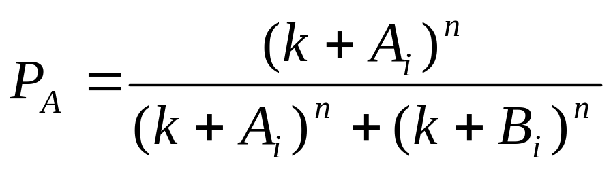
蚂蚁的觅食策略
双(二元)桥实验 Deneubourg
n,k: 2, 20.
非优化结果
无挥发

Slide 169
蚂蚁的觅食策略
Linepithema Humile （Aron）
信息素的挥发
MST

Slide 170
蚂蚁的觅食策略
Eciton Hamatum：分散的昆虫群
稀少，量大
Eciton Rapax：居中
Eciton Burchelli：分散的节肢动物
密集，量少

Slide 171
Deneubourg
二维格子

Slide 172
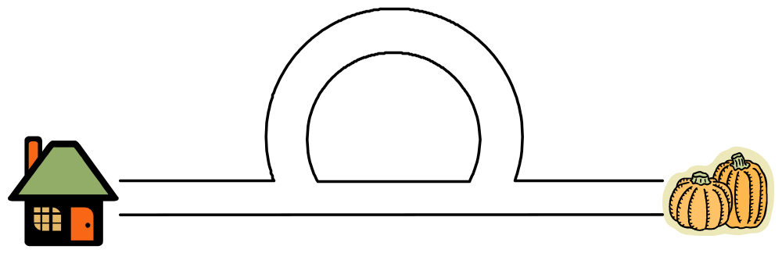
Ant Search
Notes:
AS algorithm is inspired by the discovery conducted by the ethologists. We all know ants are highly organized insects. It has been observed for long time that ants can posses amazing social behavior and work efficiently and cooperatively as a group. For example, the study shows, though lack of sophisticated vision, ant could manage to establish the optimal path between their colony and the food source. In a test setting similar to what is shown in this slide, it is found after a very short period of time, almost all the ants converge to the route at the bottom, instead of the other longer one.

Slide 173
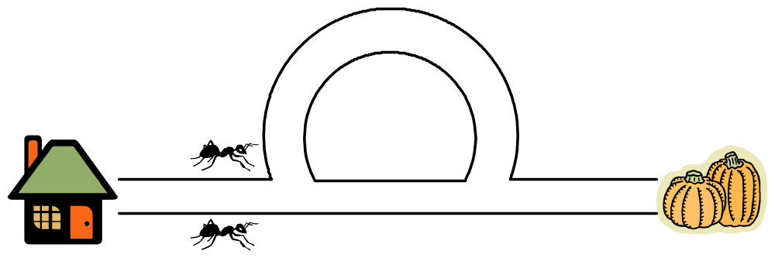
Ant Search
Notes:
Here is the explanation given by the ethological study reported by Goss in the late 80’s last century. They found that the ants achieve this by communicating through the pheromone they deploy on the paths. Say we have two ants set off to find food.

Slide 174
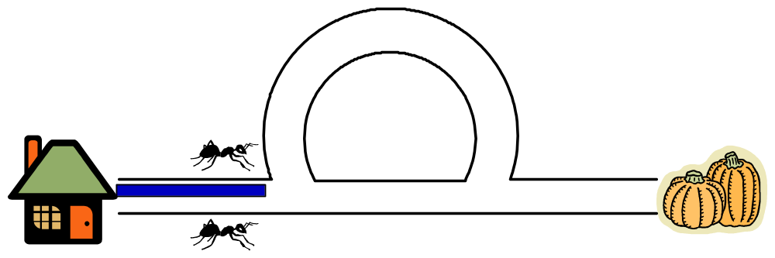
Ant Search
Notes:
While they are traveling, they each leave pheromone trails along the path they follow.

Slide 175
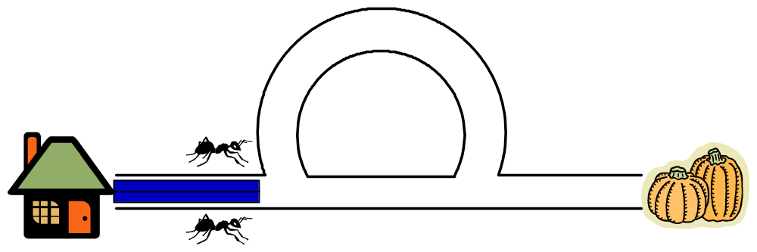
Ant Search

Slide 176
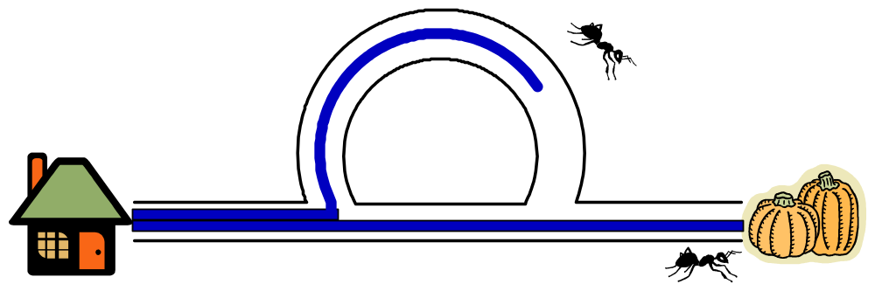
Ant Search
Notes:
At the beginning, there is no differentiation on the two possible paths. The ants have equal possibility to choose either one of the routes. One go straight and one follow the cursive path. Because the bottom path is shorter, the ant that took the bottom route will be able to reach the food quicker.

Slide 177
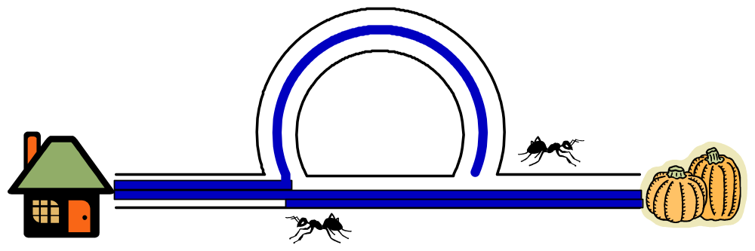
Ant Search
Notes:
It returns to the colony while the other one is still on her mission. Assuming the returning ant reaches the branch point.

Slide 178
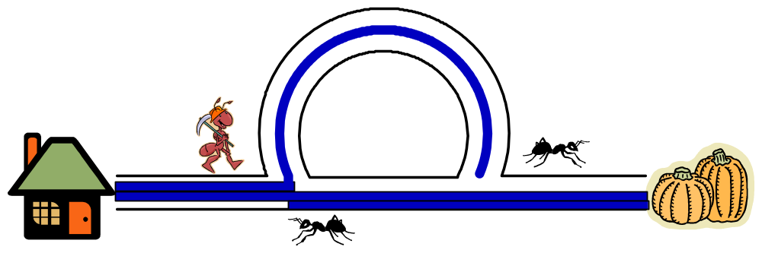
Ant Search
Notes:
Now there comes the third ant.

Slide 179
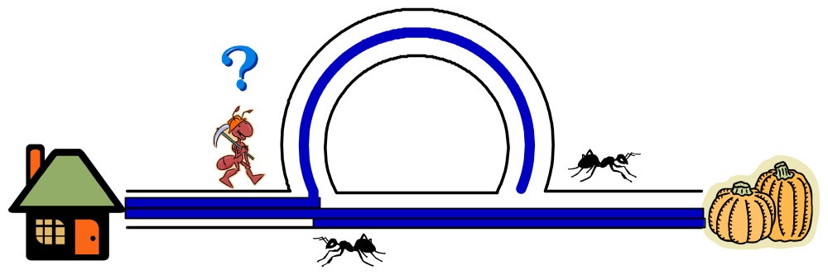
Ant Search
Notes:
The question is which route the third ant shall follow? It is different from the earlier scenery now as there exists extra information about the qualities of the two routes, in the form of the pheromone trails the previous ants have left on the ground.

Slide 180
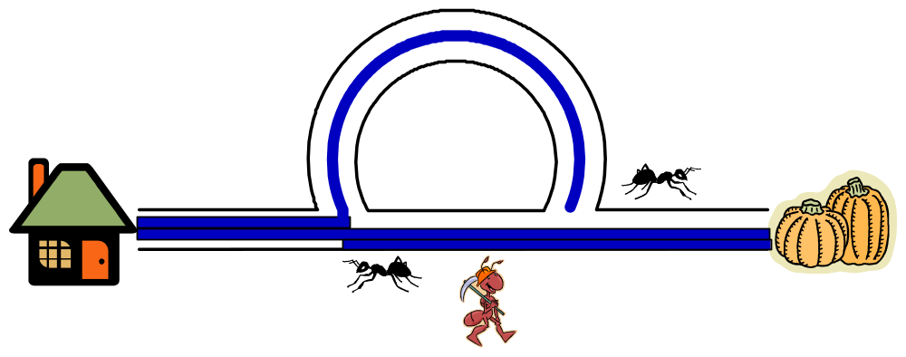
Ant Search
Notes:
It is discovered that the ant is more biased to a path having more pheromone trails. Thus she is more likely to pick the “better” path. This will further enforce the better path, and leads future ants quickly converge to the optimal solution.

Slide 181
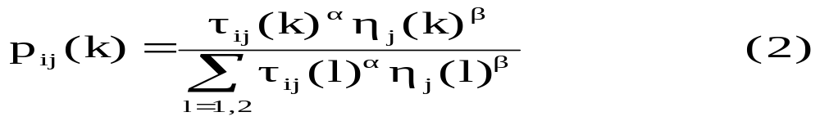
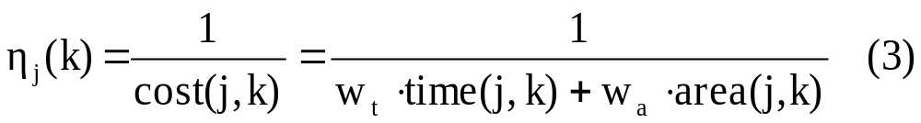
Resource Partition
τ_{ij}(k+1) ← (1 - ρ)τ_{ij}(k) + Δτ_{ij}(k，k+1) (1)
where :
    0 < ρ < 1 is the evaporation ratio, escape from local minima
  Δτ_{ij}(k) =Q/time(s_{best} ) if e_{ij} is colored with c_{k} in s_{best}
  = 0 otherwise

Slide 182
人工蚁群
来自于真实蚂蚁
具备了一些真实蚂蚁所不具备的特性

Slide 183
共同特征
人工蚁和真实蚂蚁有着共同的任务
人工蚁和真实蚂蚁有着共同的任务，那就是寻找连接起点（蚁穴）和终点（食物源）的最短路径（最小代价）。真实蚂蚁不能跳跃，它们只能沿着相邻区域的状态行进，人工蚁也一样，只能一步一步地沿着问题的临近状态移动。

Slide 184
共同特征
人工蚁和真实蚂蚁一样，是一群相互合作的个体：
这些个体可以通过相互的协作在全局范围内找出问题较优的解决方案。每只人工蚁都能够建立一个解决方案，但高质量的解决方案是整个蚁群合作的结果。

Slide 185
共同特征
人工蚁与真实蚂蚁一样也通过使用信息素进行间接通讯
人工蚁能够在全局范围释放信息素，这些信息素被局部地存于它们所经过的问题状态中。
与真实蚂蚁的间接通讯相似，人工蚁之间的通讯也有两个主要特征：
  模仿真实蚂蚁信息素的释放，通过给问题状态分配合适的状态变量来模仿真实蚂蚁信息素的释放。
  状态变量只能被人工蚁局部到达。在人工蚁群中，人工信息素轨迹是一种分布式的数值信息。只有经过信息素轨迹的人工蚁使用相应的状态变量来表明它感受到了信息素，相反，没有经过该轨迹就不能够感受到相应的信息素。蚂蚁通过修改这些信息来反映它们在解决一个具体问题时所积累的经验。在蚁群算法中，局部的人工信息素轨迹是人工蚁进行通讯的唯一渠道。

Slide 186
共同特征
人工蚁利用了真实蚂蚁觅食行为中的自催化机制—正反馈
信息素的挥发机制
在蚁群算法中存在着一种挥发机制，类似于真实信息素的挥发。这种机制可以使蚂蚁逐渐忘记过去，不受过去经验的过份约束，这有利于指引蚂蚁向着新的方向进行搜索，避免早熟收敛。

Slide 187
共同特征
不预测未来状态概率的状态转移策略
人工蚁和真实蚂蚁一样，应用概率的决策机制沿着临近状态移动，从而建立问题的解决方案。
人工蚁的策略只是充分利用了局部信息，而并没有利用前瞻性来预测未来的状态。因此，所应用的策略在时间和空间上是完全局部的。这个策略既是一个由问题状态所表示的信息函数，又是一个由过去的蚂蚁引起的环境局部改变的函数。

Slide 188
区别
人工蚁生活在离散的世界中，它们的移动实质上是由一个离散状态到另一个离散状态的跃迁。
人工蚁拥有一个内部的状态，这个私有的状态记忆了蚂蚁过去的行为。
人工蚁释放一定量的信息素，它是蚂蚁所建立的问题解决方案优劣程度的函数。

Slide 189
区别
人工蚁释放信息素的时间可以视情况而定，而真实蚂蚁是在移动的同时释放信息素。人工蚁可以在建立了一个可行的解决方案之后再进行信息素的更新。
为了提高系统的总体性能，蚁群被赋予了很多其他的本领，如前瞻性、局部优化、原路返回等等，这些本领在真实蚂蚁是找不到的。在许多应用中，蚁群算法中加入了局部更新规则。

Slide 190
影响因素
局部搜索策略
蚂蚁的内部状态
信息素轨迹
蚂蚁决策表

Slide 191
高层次的复杂行为
单个蚂蚁控制的简单并不意味着整个系统设计的简单
要保证多个个体简单行为的交互能够涌现出我们所希望看到的高层次的复杂行为

Slide 192
主要课题
作为一种全局搜索算法，蚁群算法能够有效地避免局部极优。
但同时，对大空间的多点全局搜索，却不可避免地增加搜索所需时间。为了使算法能够更快地找到问题的最优解，在其过程中加入针对具体问题的局部搜索算法加快了求解的过程，寻求二者的完善结合，应该是一个值得研究的课题。

Slide 193
ACO for TSP
蚁密
蚁量
蚁周

Slide 194
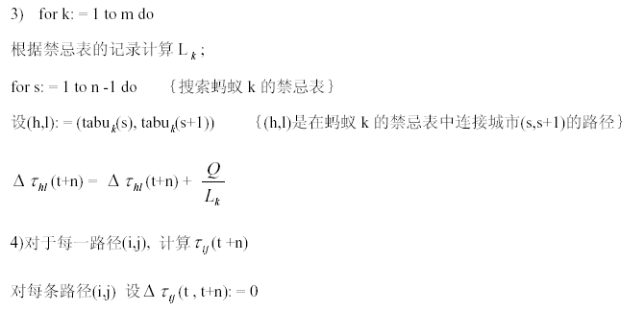
蚁周模型

Slide 195
ACO 的改进
精英策略
优化排序策略
自适应蚁群

Slide 196
混合优化策略

