Slide 1

Practical Course: XML Technology
BlackJack in XML
Supervisor: Prof. Dr. Anne Brüggemann-Klein
Developers: Robert Urban, Anne-Catherine Seeser, Lennert Rienau,
Michael Mitterer, Manuel Ehler
Garching, 08/30/2017

Slide 2
Agenda
Introduction
Technologies
Design and Implementation
Architecture
Testing
Development
Conclusion
Demo

Slide 3
1. Introduction
Team
Requirements
Project’s context
Introduction
Technologies
Design
Architecture
Testing
Development
Conclusion
Demo

Slide 4
2. Technologies
DocBook
XML
Xquery
SVG
XSLT
XHTML
Introduction
Technologies
Design
Architecture
Testing
Development
Conclusion
Demo

Slide 5
3. Design and Implementation
Rules
Number of players
Card deck
Drawing cards
Player actions
Bet
Insurance
Hit
Stand
Winnings status and winnings
Dealer wins against player
Player wins against dealer
Tie between player and dealer
→ Realistic casino experience!
Introduction
Technologies
Design
Architecture
Testing
Development
Conclusion
Demo

Slide 6
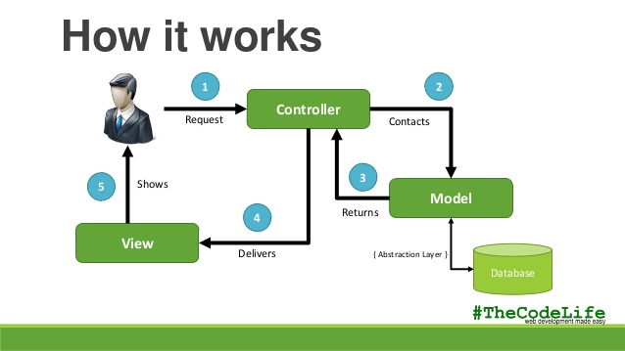
4. Architecture – MVC
Source: https://image.slidesharecdn.com/modelviewcontrollermvc-140211001124-phpapp01/ 95/model-view-controller-mvc-6-638.jpg?cb=1392077579, accessed on 08/23/17 at around 04:19 PM
Introduction
Technologies
Design
Architecture
Testing
Development
Conclusion
Demo

Slide 7
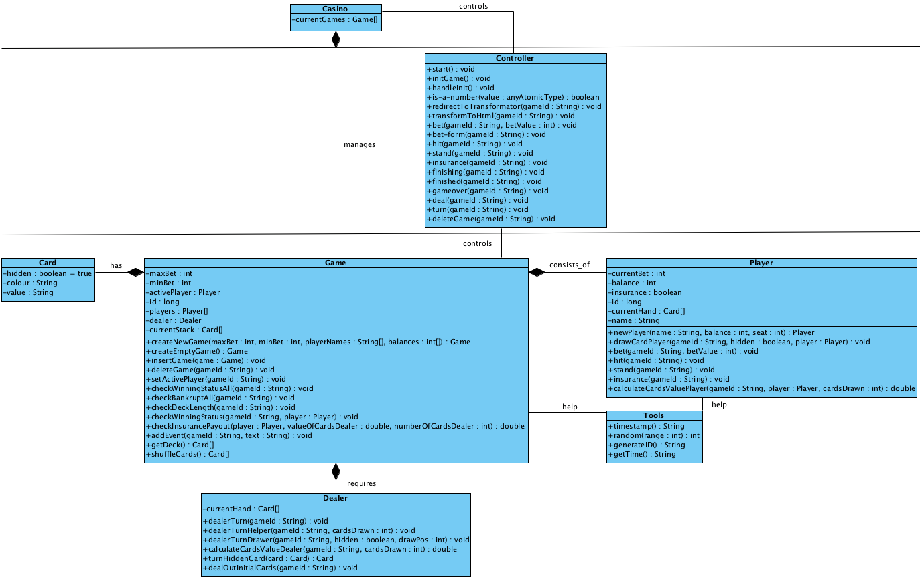
4. Architecture – Class Diagram
Introduction
Technologies
Design
Architecture
Testing
Development
Conclusion
Demo

Slide 8
5. Testing
Reviews
Unit tests
Integration tests
REST queries with additional functions
Borderline cases
Introduction
Technologies
Design
Architecture
Testing
Development
Conclusion
Demo

Slide 9
6. Development – Environment
Oxygen XML Editor
BaseX
GitHub
Introduction
Technologies
Design
Architecture
Testing
Development
Conclusion
Demo

Slide 10
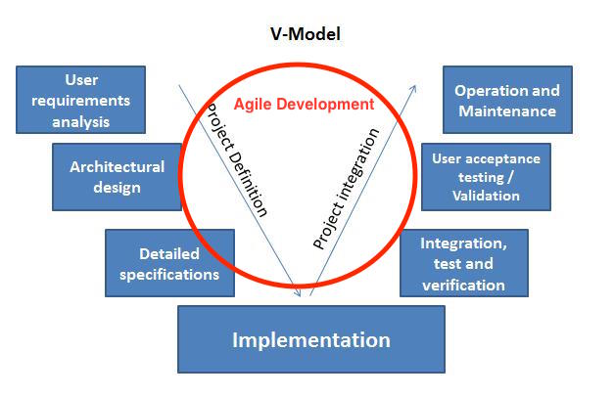
6. Development – Phases
V Modell
Integrated agile development
Source: https://sinergique.files.wordpress.com/2013/10/v-model-illustration.jpg, accessed on 08/24/17 at around 04:20 PM
Introduction
Technologies
Design
Architecture
Testing
Development
Conclusion
Demo

Slide 11

7. Conclusion
Source: http://clipartix.com/wp-content/uploads/2016/04/Thumbs-up-clipart-cliparts-for-you.jpg, accessed on 08/24/17 at around 04:33 PM
Introduction
Technologies
Design
Architecture
Testing
Development
Conclusion
Demo

Slide 12
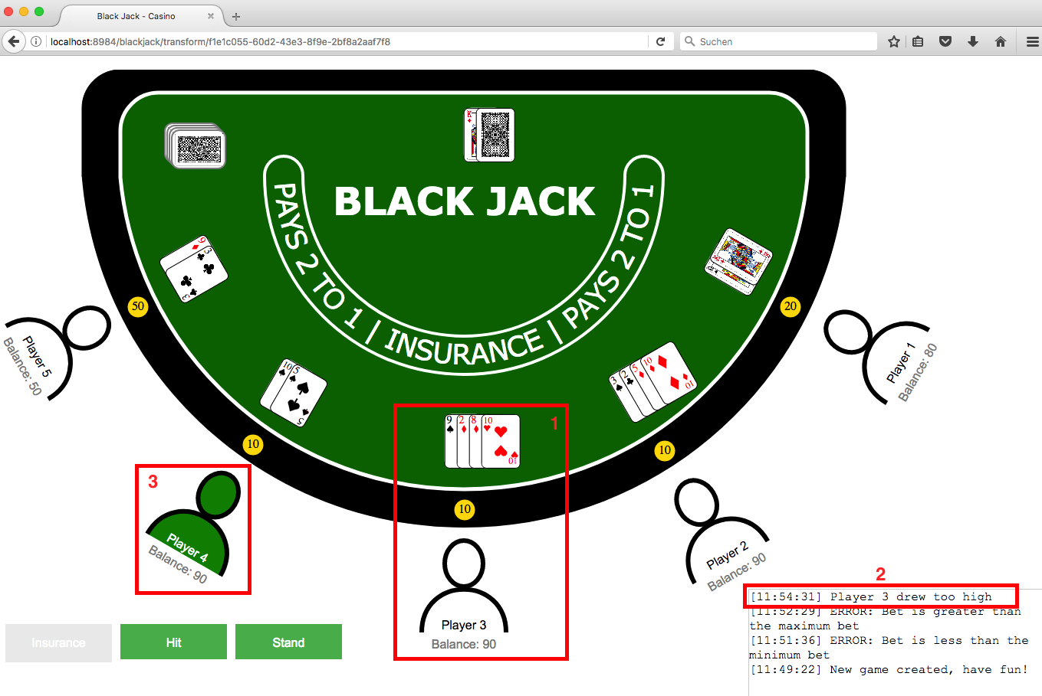
8. Demo – Overview GUI
Introduction
Technologies
Design
Architecture
Testing
Development
Conclusion
Demo

Slide 13
8. Demo – Live
Live-Demo
Introduction
Technologies
Design
Architecture
Testing
Development
Conclusion
Demo

Slide 14
Thank you very much!

Slide 15
Practical Course: XML Technology
Developers: Robert Urban, Anne-Catherine Seeser, Lennert Rienau,
Michael Mitterer, Manuel Ehler
Garching, 08/30/2017

Slide 16
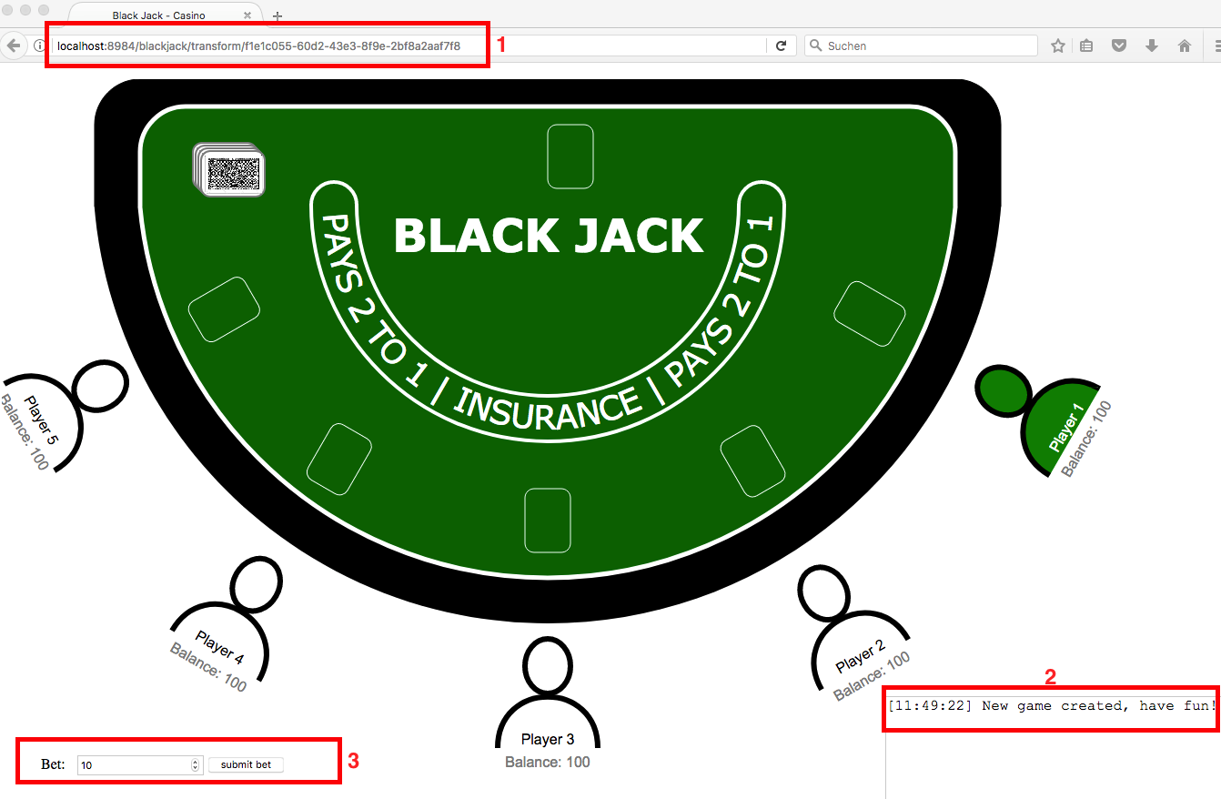
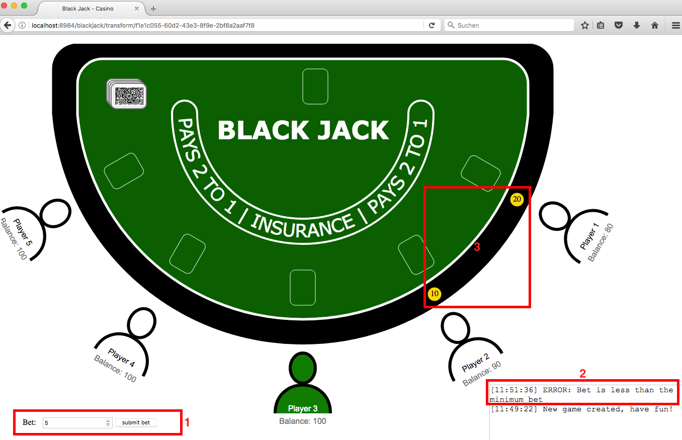
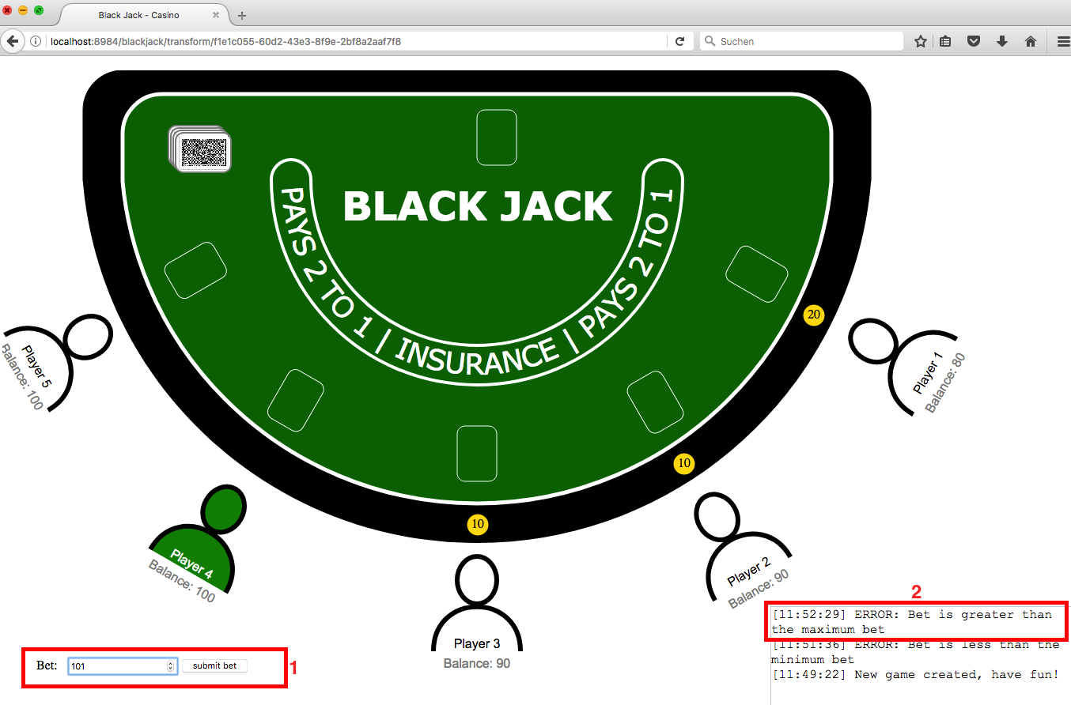
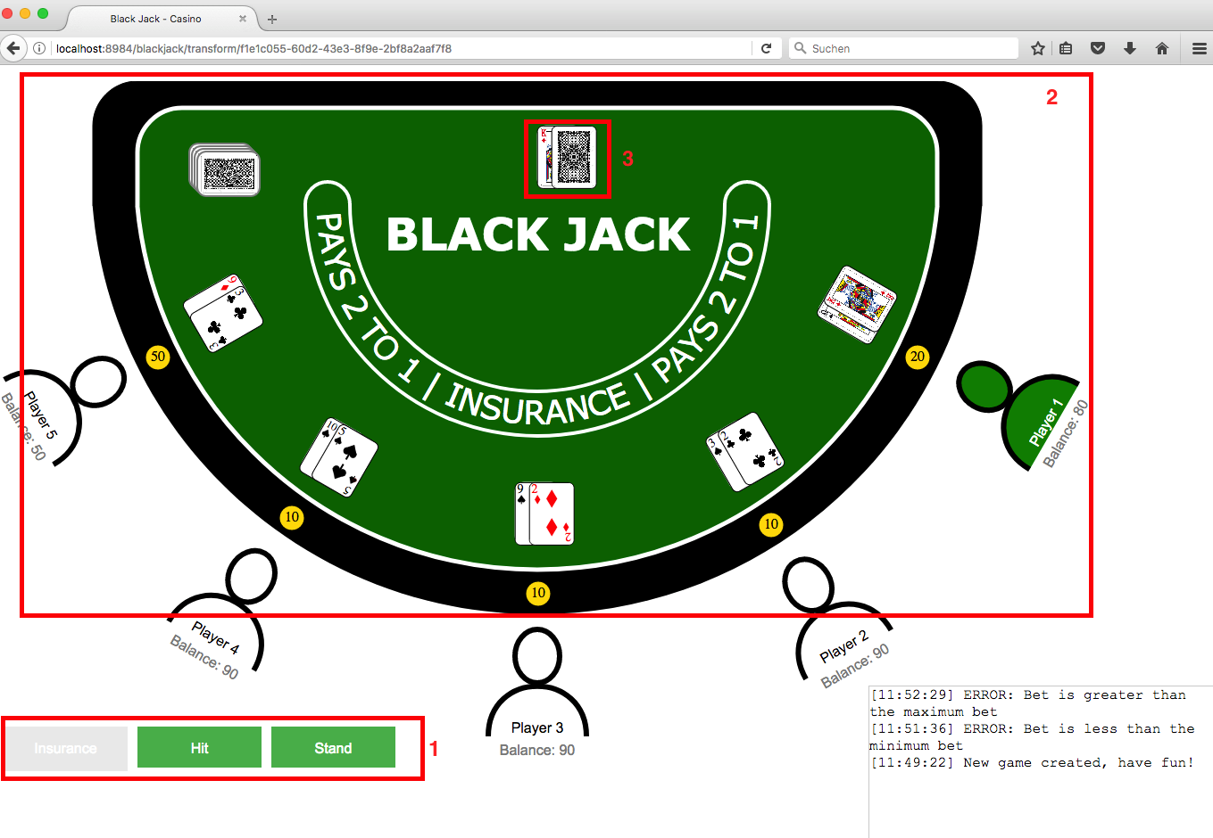
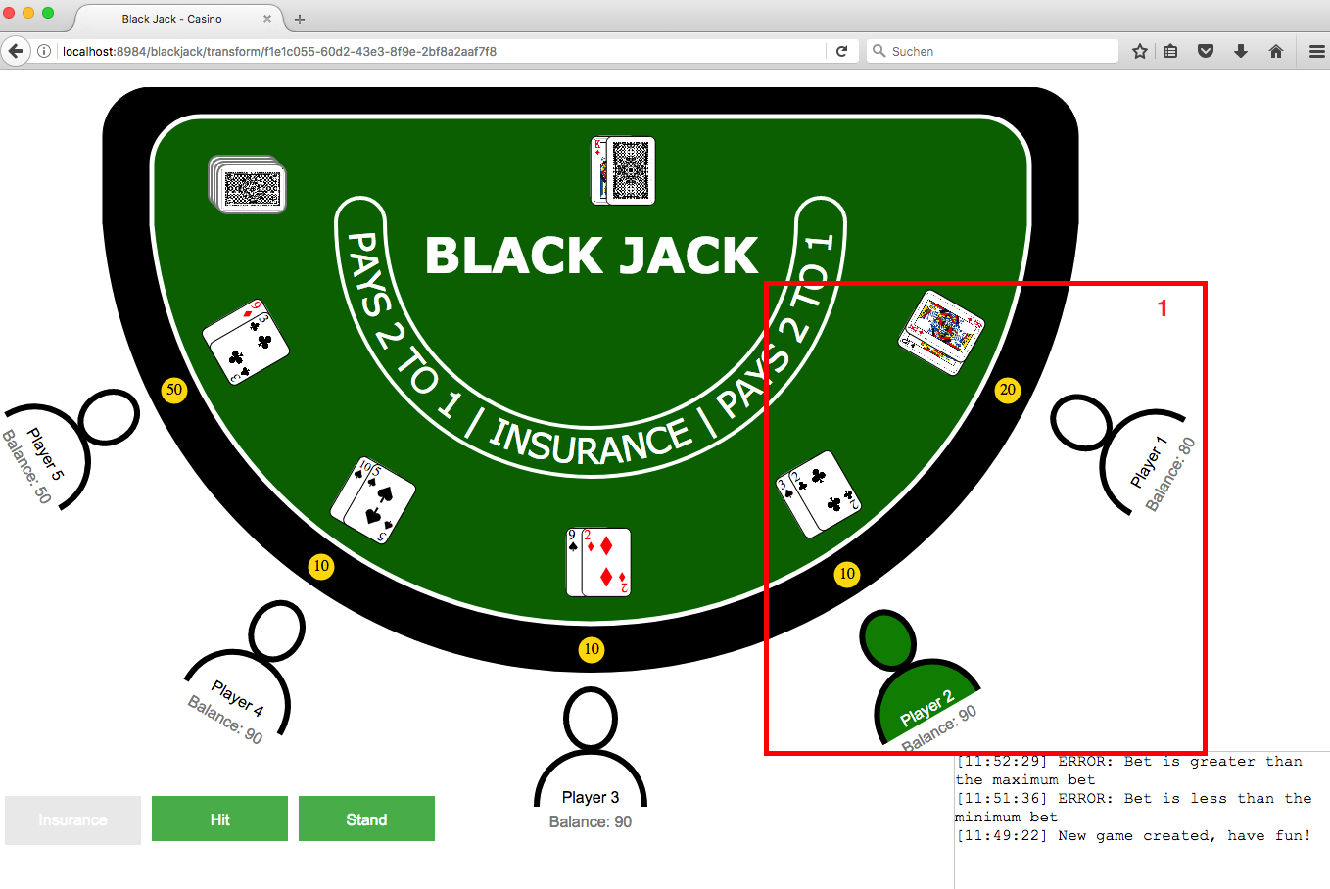
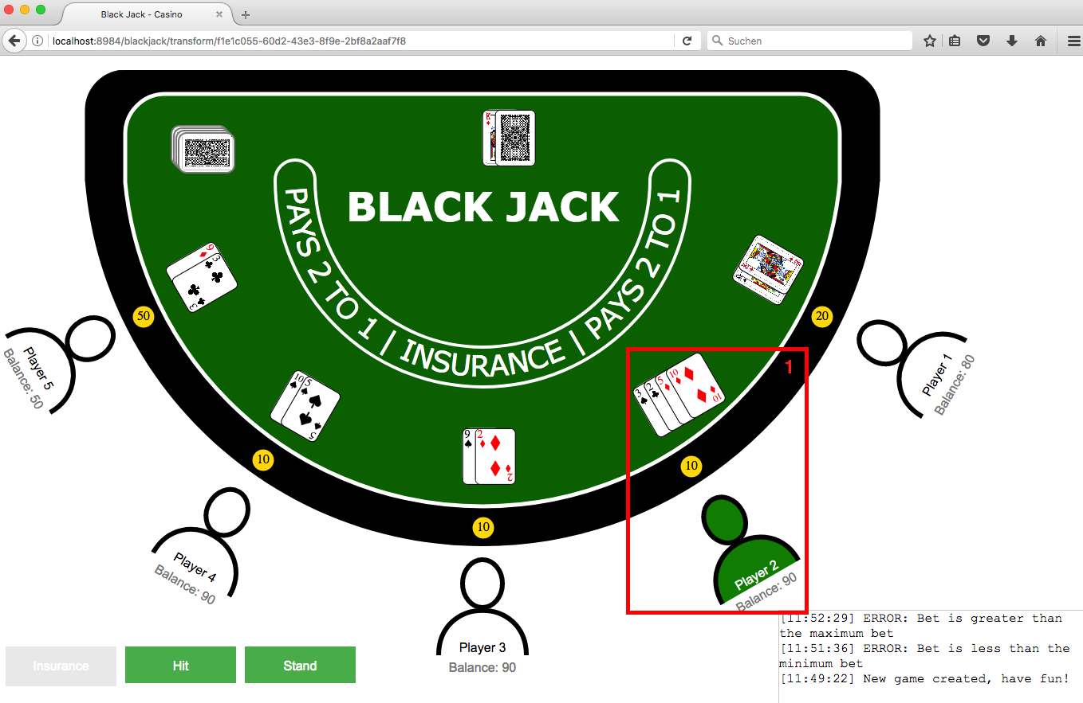
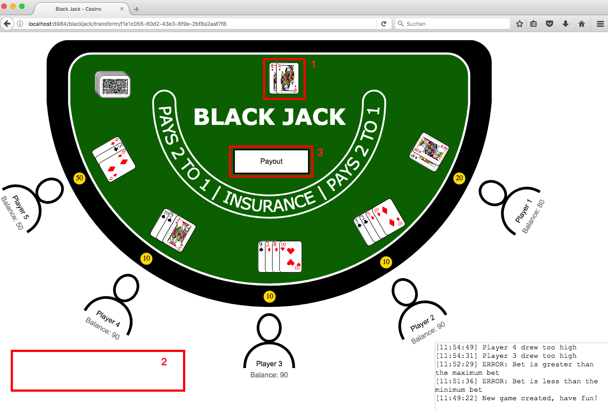
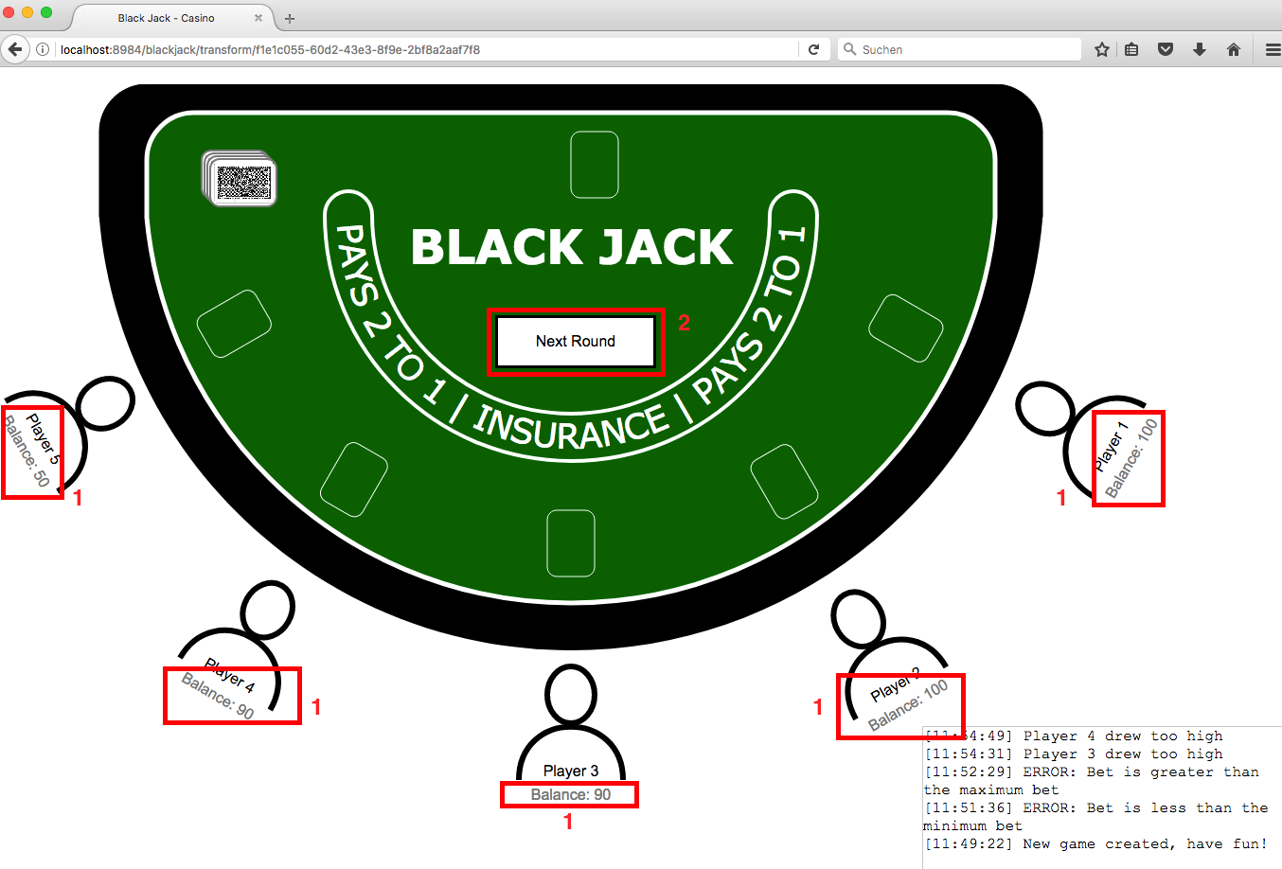
To 8. Demo

