Slide 1

Praktikum XML Technologie CalendarX
Supervisor: Prof. Dr. Anne Brüggemann-Klein
Students: Florian Haffke and Stefanie Mollenkopf
5. August 2015

Slide 2
Agenda
Introduction
Scenario 1
Scenario 2
Demo
Summary

Slide 3
Overview – CalendarX Application
eXist database
User Interface – View mode
1
XQuery, XSLT, SVG
DayView
WeekView
MonthView
XML Schema
CRUD
XML data
User Interface – Edit mode
2
XQuery, XHTML with XForms
EditCalendarX
EditPatterns
Introduction
Scenario 1
Scenario 2
Demo
Summary
Praktikum XML Technologie – Florian Haffke und Stefanie Mollenkopf

Slide 4
Demo – Start CalendarX and Views
CalendarX application
Introduction
Scenario 1
Scenario 2
Demo
Summary
Praktikum XML Technologie – Florian Haffke und Stefanie Mollenkopf

Slide 5
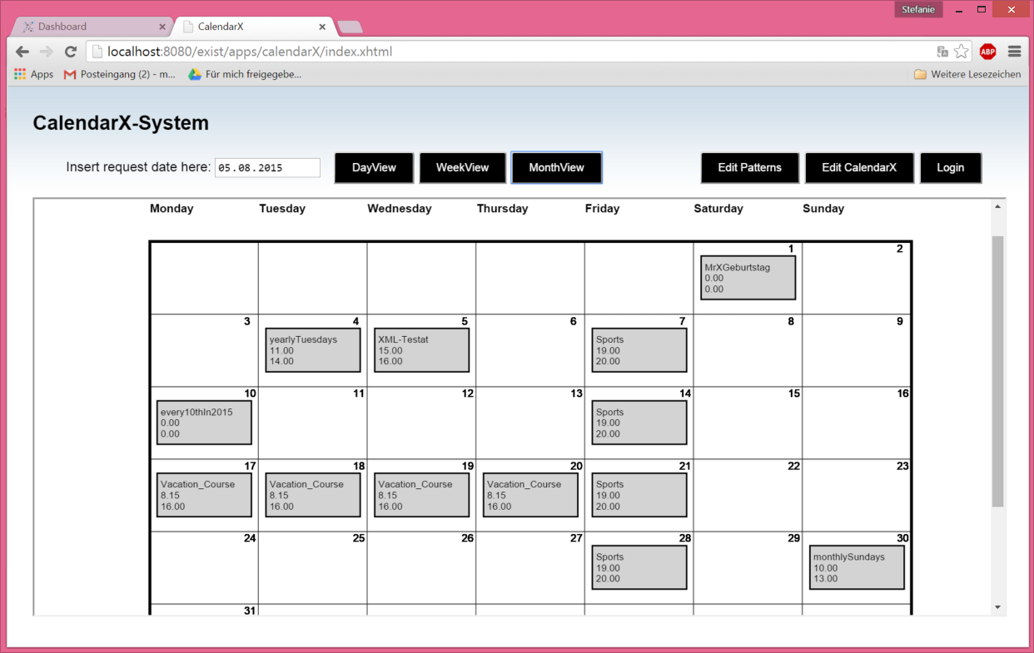
Scenario 1 – Date Request
eXist database
User Interface
app.xql
XQuery
Main Page
index.html
parameter: (queryDate, view)
X View
Intermediate
Database
Schema
Events.xsd
Schema
CalendarX.xsd
XHtml output
XML data
‘intermediate.xml’
XML data
sample-CalendarX.xml
XSLT and SVG
pattern_lib.xquery
XQuery
DayView
WeekView
MonthView
Introduction
Scenario 1
Scenario 2
Demo
Summary
Praktikum XML Technologie – Florian Haffke und Stefanie Mollenkopf

Slide 6

Scenario 1 – Various Event Patterns
DailyPattern
CardinalYearly-
Pattern
WeeklyPattern
OrdinalYearlyPattern
CardinalMonthly-Pattern
WeeklyPattern
OrdinalMonthlyPattern
WeeklyPattern
DailyPattern
Introduction
Scenario 1
Scenario 2
Demo
Summary
Praktikum XML Technologie – Florian Haffke und Stefanie Mollenkopf
Notes:
Welche Daten kann der Kalender speichern?
Demo: 2 ComplexPattern

Slide 7
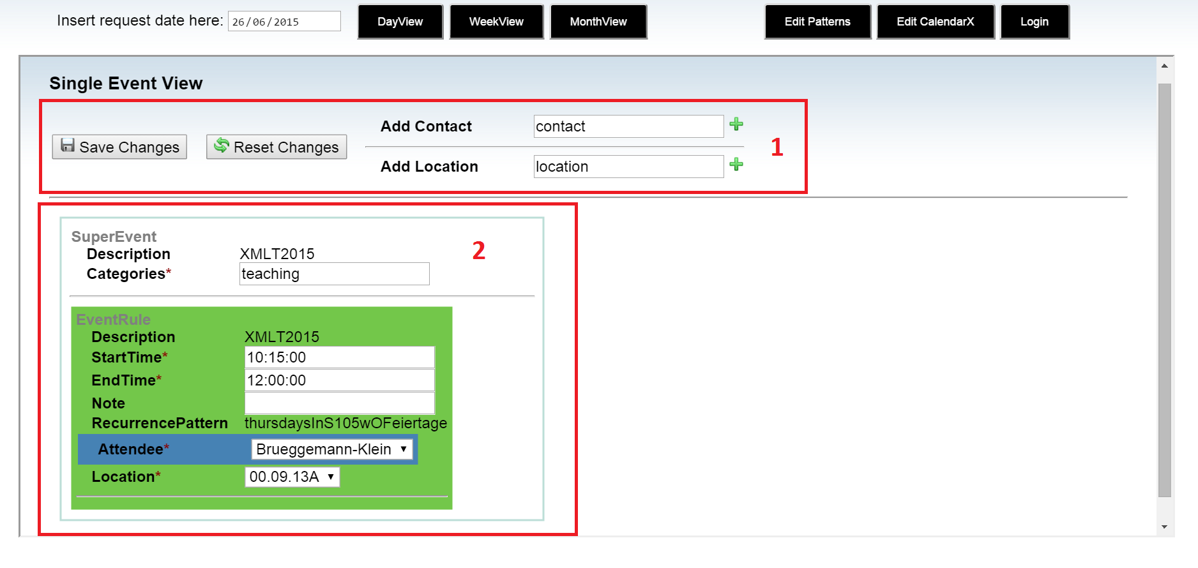
Scenario 2 – Click on Event -> Light Access
Introduction
Scenario 1
Scenario 2
Demo
Summary
Praktikum XML Technologie – Florian Haffke und Stefanie Mollenkopf

Slide 8
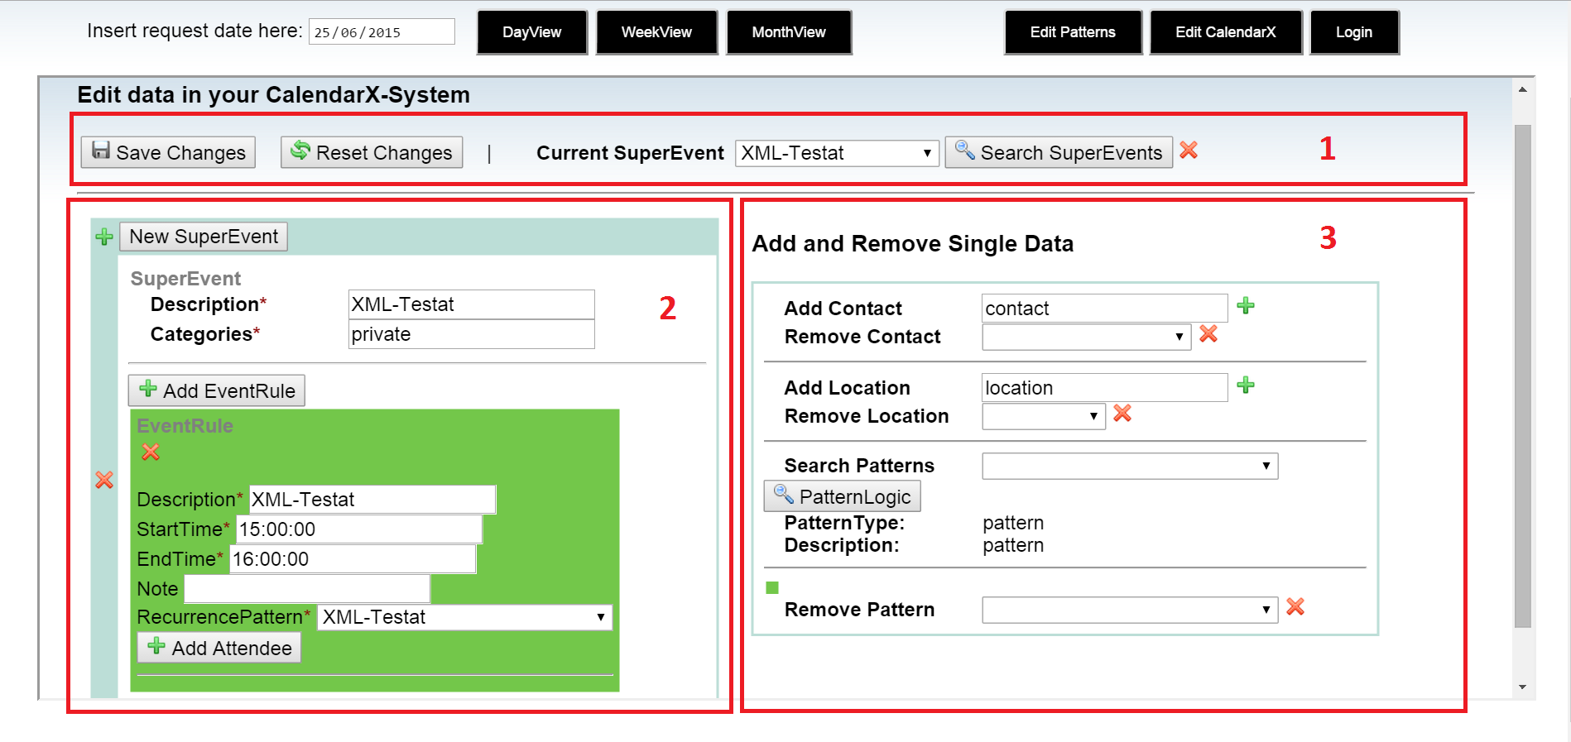
Scenario 2 – Edit CalendarX -> Full Access
Introduction
Scenario 1
Scenario 2
Demo
Summary
Praktikum XML Technologie – Florian Haffke und Stefanie Mollenkopf

Slide 9
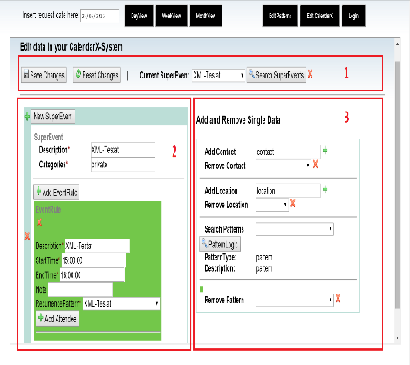
Scenario 2 – Edit CalendarX: CRUD Functionalities
eXist database
Client Model
Server Data
Location
Contact
Location
Contact
Pattern
Super-Event
Pattern
Super-Event
XForms UI
XForms Instances
Template Files
XML Data
CalendarX instance
XML Data
sample-CalendarX.xml
Sync.
Submissions
Introduction
Scenario 1
Scenario 2
Demo
Summary
Praktikum XML Technologie – Florian Haffke und Stefanie Mollenkopf
Notes:
-Templates -> Instances in Model
-Save/Reset Submission = Put/Get HTTP Requests
-View shows only part of CalendarX instance to edit
-Insert/Delete instances

Slide 10
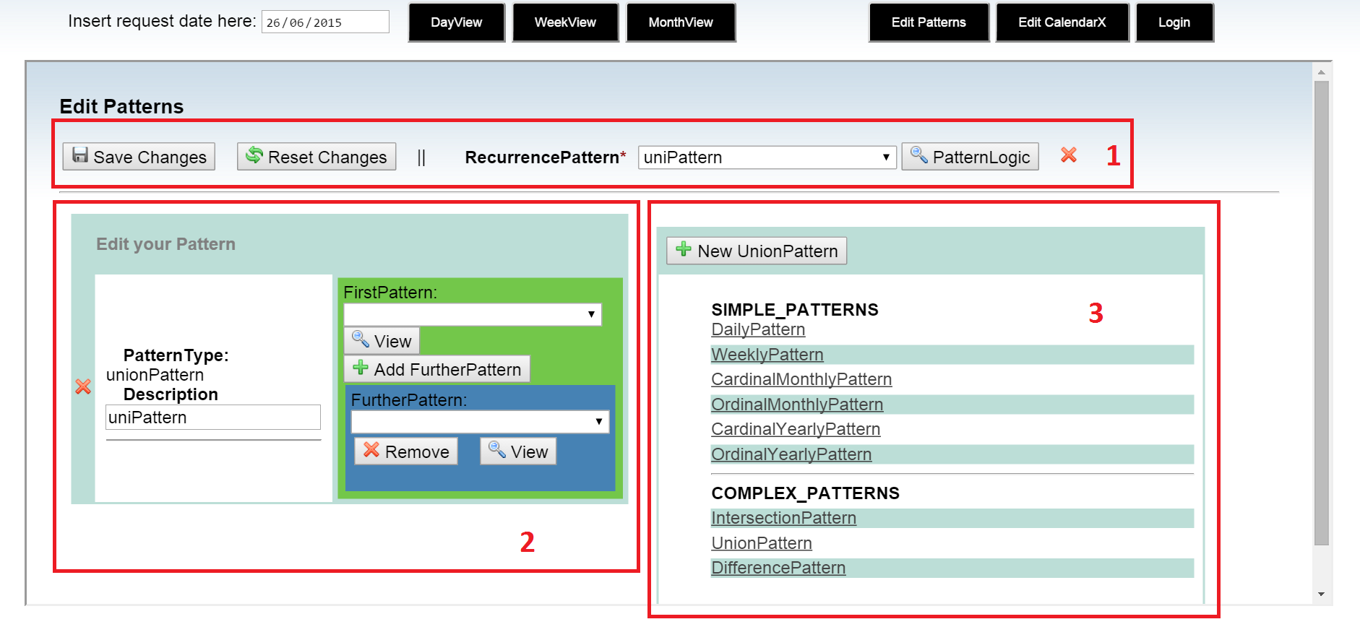
Scenario 2 – Edit Patterns
Introduction
Scenario 1
Scenario 2
Demo
Summary
Praktikum XML Technologie – Florian Haffke und Stefanie Mollenkopf

Slide 11
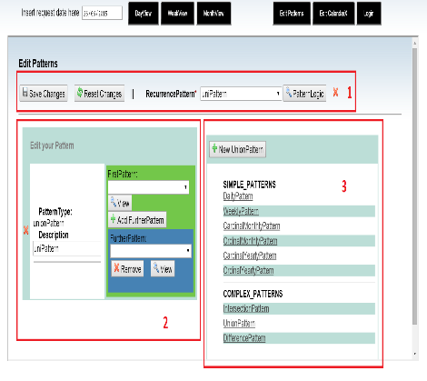
Scenario 2 – Edit Patterns: CRUD Functionalities
eXist database
Client Model
Server Data
Daily-Pattern
Weekly-Pattern
Daily-Pattern
Weekly-Pattern
Union-Pattern
…
Union-Pattern
…
XForms UI
XForms Instances
Template Files
XML Data
CalendarX instance
XML Data
sample-CalendarX.xml
Sync.
Submissions
Introduction
Scenario 1
Scenario 2
Demo
Summary
Praktikum XML Technologie – Florian Haffke und Stefanie Mollenkopf
Notes:
-Templates -> Instances in Model
-Save/Reset Submission = Put/Get HTTP Requests
-View shows only part of CalendarX instance to edit
-Insert/Delete instances

Slide 12
Demo – Edit Mode
CalendarX application
Introduction
Scenario 1
Scenario 2
Demo
Summary
Praktikum XML Technologie – Florian Haffke und Stefanie Mollenkopf

Slide 13
Summary: Technologies
XML Database
XML Schema
XQuery
XSLT
SVG
XForms
XHTML
CSS
eXist - Default Application Structure
Introduction
Scenario 1
Scenario 2
Demo
Summary
Praktikum XML Technologie – Florian Haffke und Stefanie Mollenkopf

Slide 14
Summary: Outlook
The devil is in the details…
Introduction
Scenario 1
Scenario 2
Demo
Summary
Praktikum XML Technologie – Florian Haffke und Stefanie Mollenkopf
Notes:
Dialogfenster Events
Erweiterte Optionen (Attribute, Farben eines Termins

Slide 15
Thank you for the attention

