Slide 1

Prediction on CO2 Emissions by vehicles.
Group No : 7
Name of the student : Rohan Dilip Yadav.

Slide 2
Introduction:
Navigating the Future of Sustainable Development:
1. We embark on a journey into the heart of environmental sustainability, where science and technology converge to address one of the most pressing challenges of our time – Carbon Dioxide (CO2) emissions.
2. As the global community grapples with the consequences of climate change, it becomes imperative for us to explore innovative solutions.
3. Our main focus here revolves around the predictive power of Data Analytics in forecasting CO2 emissions.

Slide 3
The Urgency of the Issue:
1. Before we delve into the intricacies of CO2 Emission prediction, let's take a moment to reflect on the urgency of the issue.
2. Climate change is no longer a distant threat; it's a reality we face today.
3. Rising global temperatures, extreme weather events, and the loss of biodiversity all underscore the critical need to curb CO2 emissions.
4. Our ability to predict and manage these emissions plays a pivotal role in shaping a sustainable future.

Slide 4
The Power of Data Analytics:
1. In this age of information, data has become a formidable force for positive change.
2. With advancements in technology, we can harness the power of data analytics to gain insights into complex environmental patterns.
3. By examining historical data, identifying trends, and employing sophisticated modeling techniques, we can develop predictive models that aid in forecasting CO2 emissions with greater accuracy.

Slide 5
Objectives of the Presentation:
Our presentation aims to achieve the following:
1. Understand the Impact:
Delve into the consequences of unchecked CO2 emissions on the environment and human well-being.
2. Explore Data Sources:
Identify key data sources that contribute to our understanding of CO2 emissions.
3. Modeling Techniques:
Discuss various data-driven modeling techniques used for predicting CO2 emissions.
4. Case Studies:
Showcase real-world examples where CO2 emission prediction has informed sustainable decision-making.
5. Future Implications:
Consider the broader implications of accurate CO2 emission predictions for policy-making, industry practices, and global sustainability.

Slide 6
Let's Begin the Exploration:
As we embark on this exploration of CO2 emission prediction, let us keep in mind that our collective efforts can shape a future where environmental responsibility and technological innovation go hand in hand.
We will be unraveling the potential of data analytics in forecasting CO2 emissions and charting a course towards a more sustainable and resilient world.

Slide 7
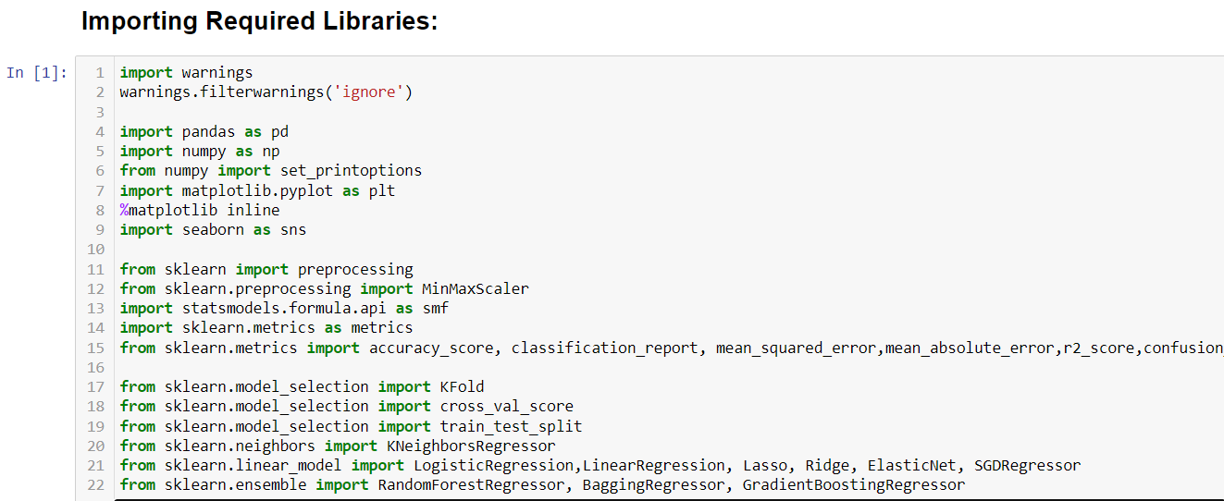
Required Dataset : Co2 Emissions.csv
Importing the required libraries and the required dataset:
Link for the csv file : https://open.canada.ca/data/en/dataset/98f1a129-f628-4ce4-b24d-6f16bf24dd64#wb-auto-6
Importing Libraries :

Slide 8
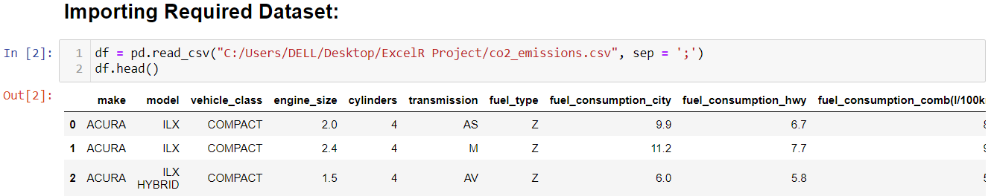
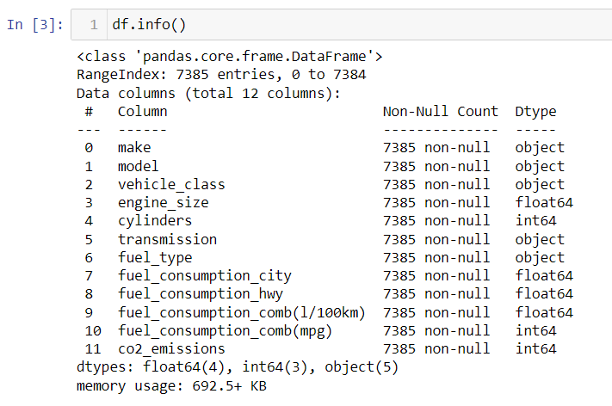
Importing the dataset:
Performing Exploratory Data Analysis:

Slide 9
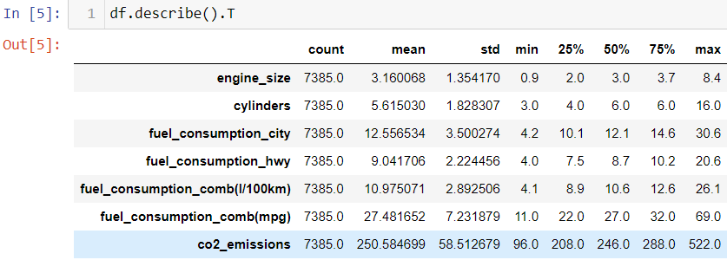
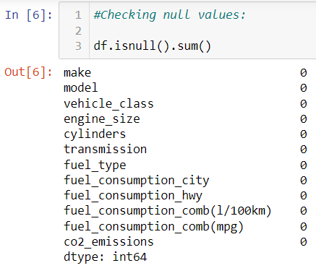
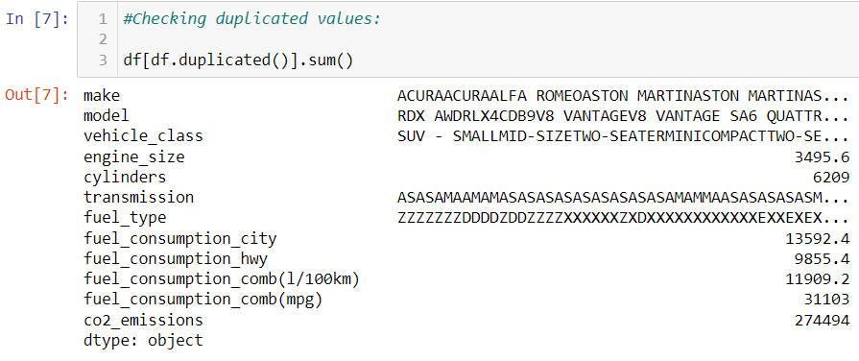
Describing the data:
Finding null and duplicated values:

Slide 10
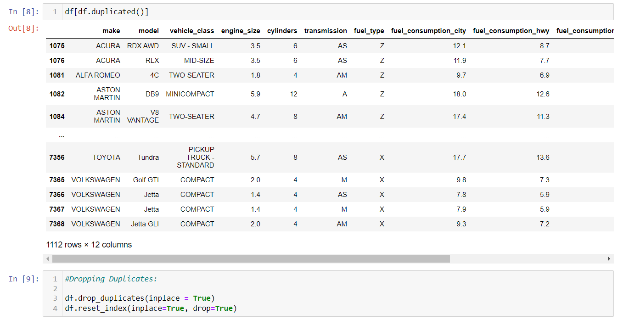
Dropping the duplicated values:

Slide 11
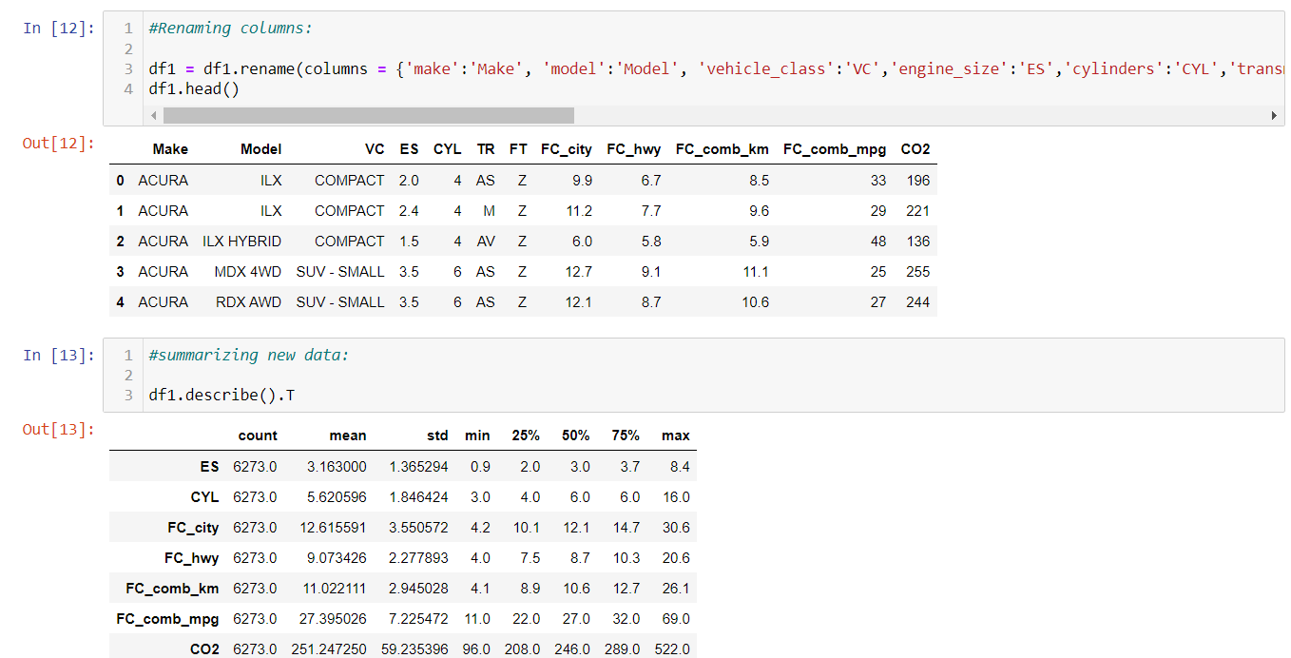
Renaming columns and summarizing new data:

Slide 12
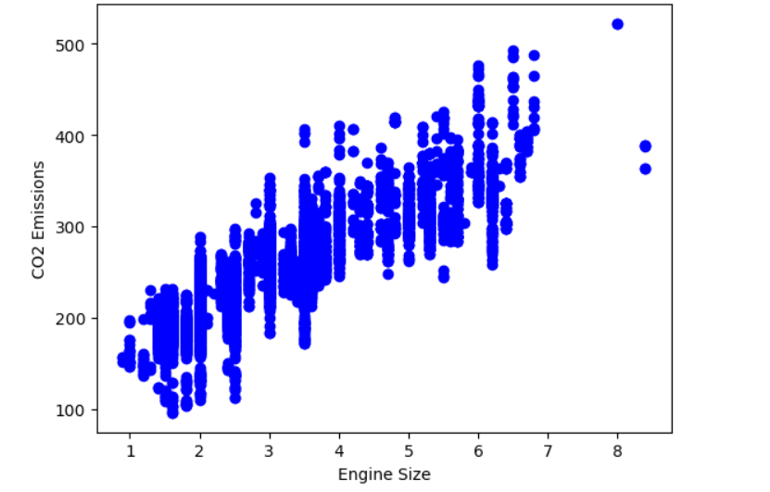
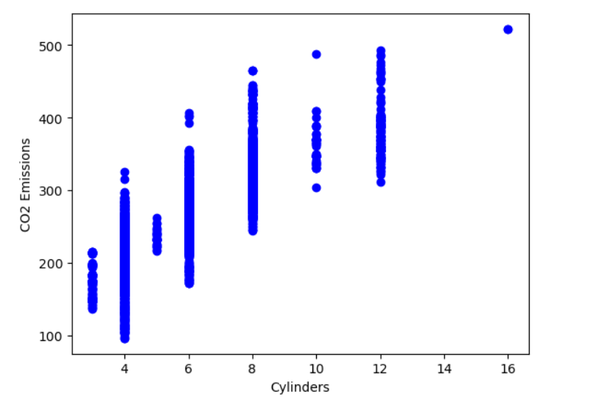
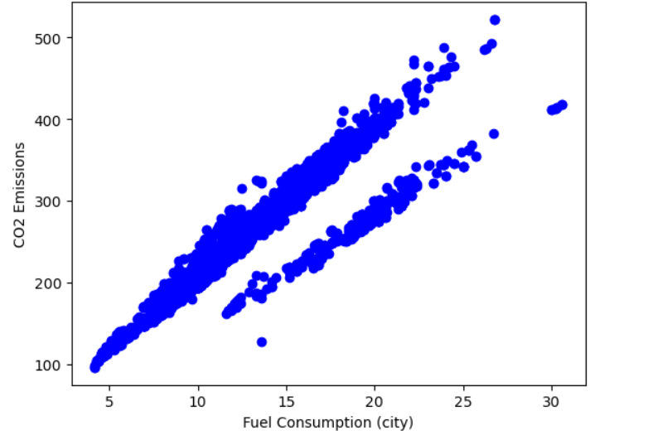
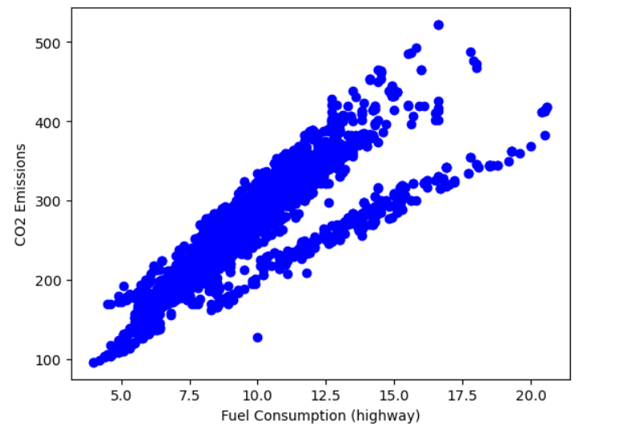
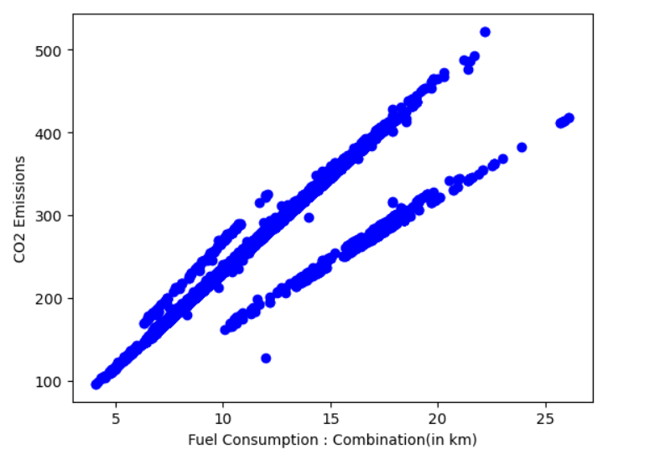
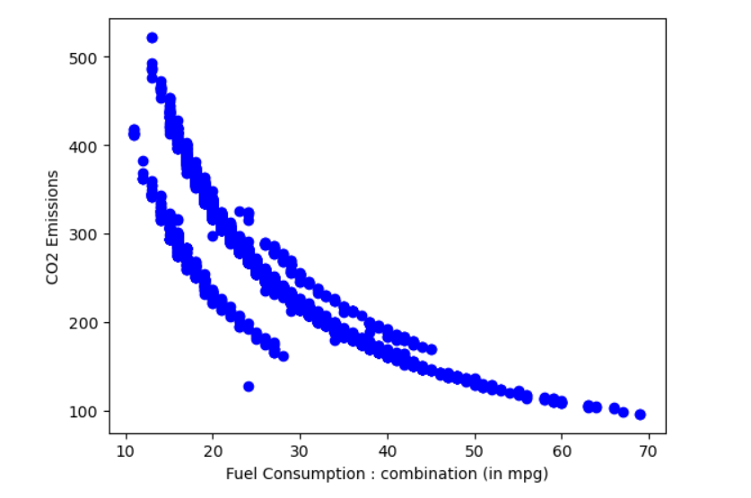
Plotting the data:

Slide 13
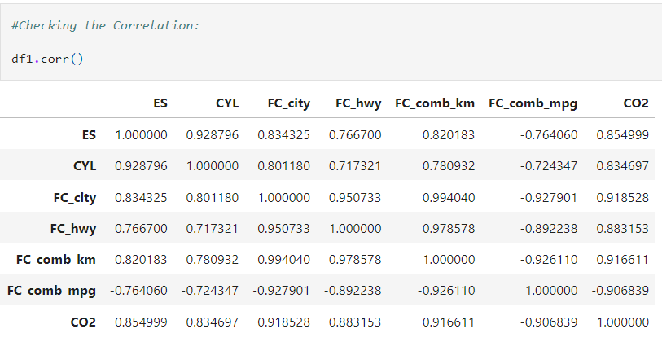
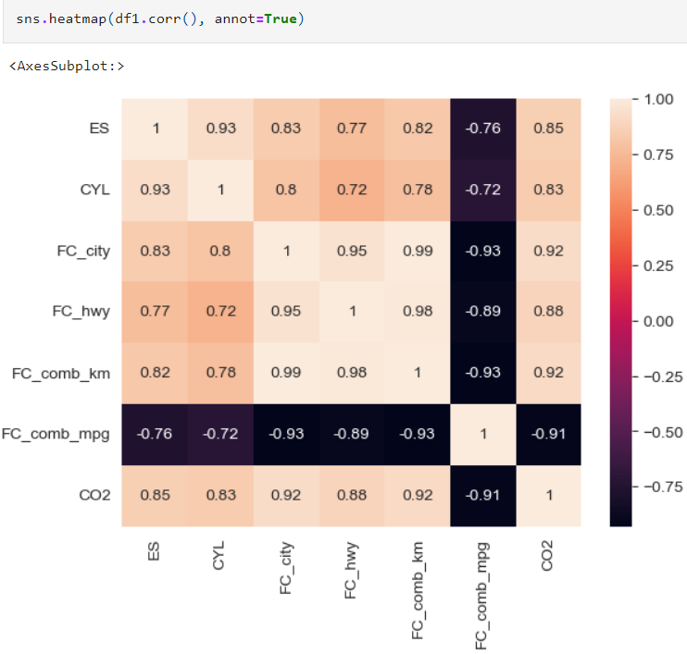
Checking correlation between the target and features:
FC_comb_mpg column is negatively correlated.
It is to be dropped.

Slide 14
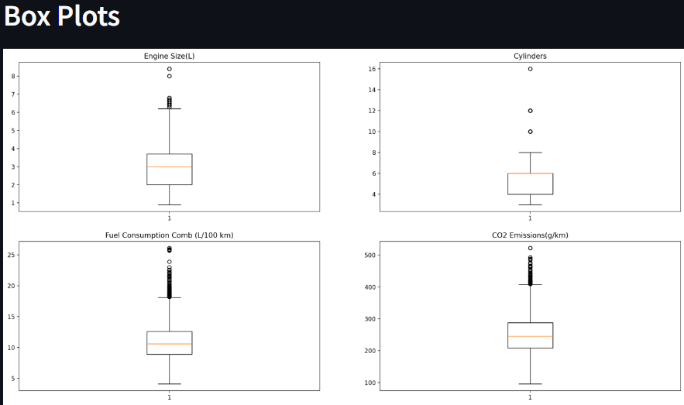
Checking Outliers and removing them:
As we can see, there are outliers in our data.

Slide 15
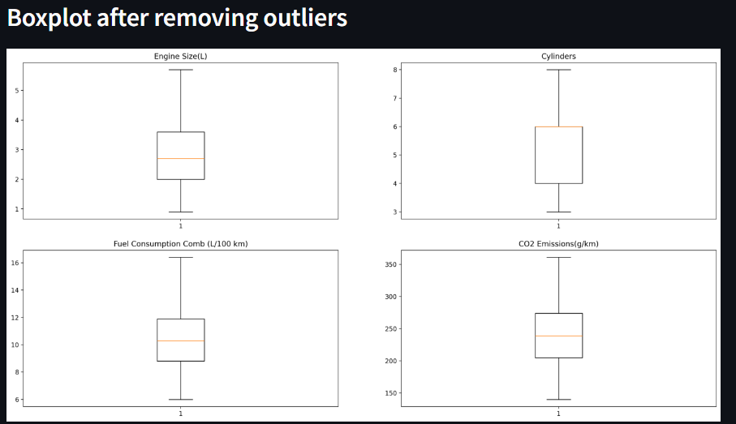
Post deleting Outliers:

Slide 16
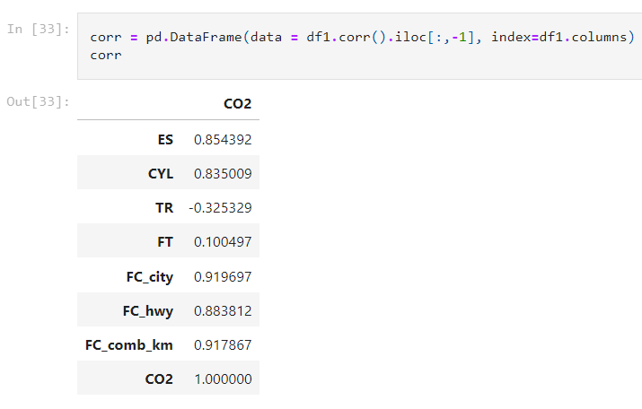
Correlation of the variables in the dataframe after removal of outliers:
As we can see that ES, CYL, FC_city, FC_hwy, FC_comb_km are highly correlated to CO2, we will consider these columns for further process of model building.
And for the execution purpose in the streamlit app, we will only consider ES, CYL and FC_comb_km columns only as our features and CO2 as the target variable. (55% fuel consumption on city and 45% fuel consumption on highway togetherly gives FC_comb_km, so we have dropped FC_city and FC_hwy for execution purpose)

Slide 17
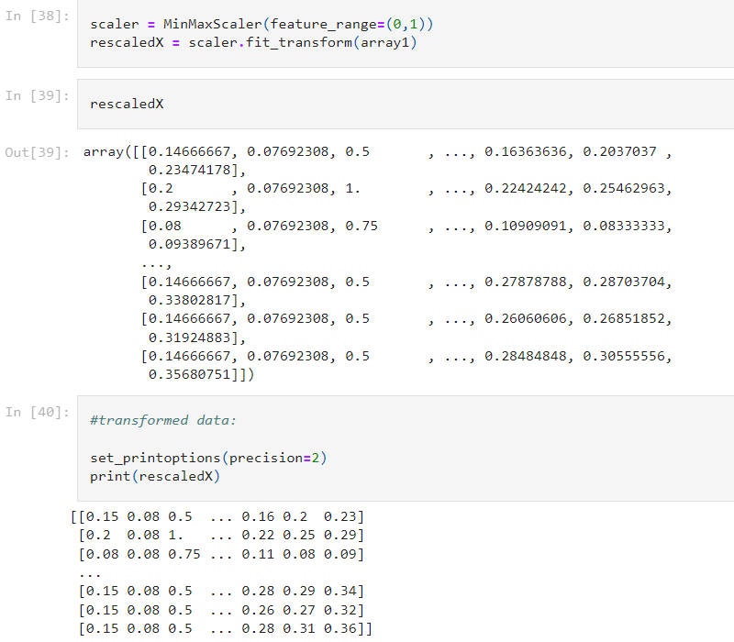
Normalisation of data:
Here, we use MinMax Scaler to normalise the data.
MinMax Scaling:
MinMaxScaler = (Data Value - Minimum Value)/ Range Of The Data

Slide 18
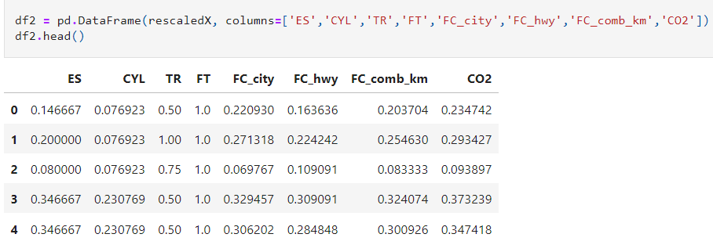
Normalised Dataframe without outliers:

Slide 19
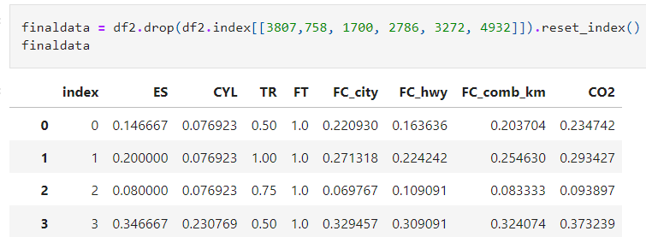
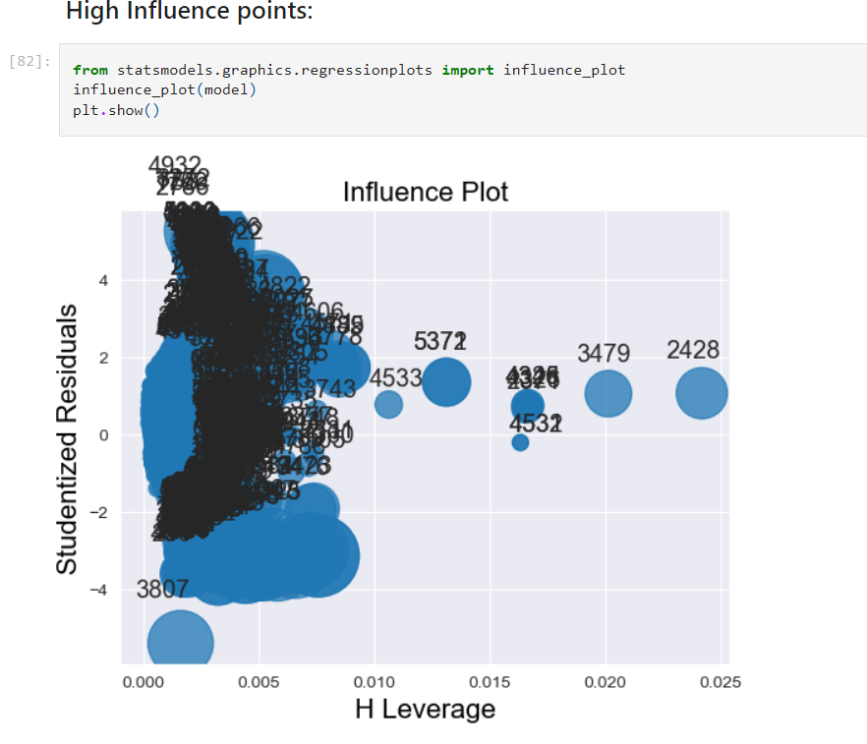
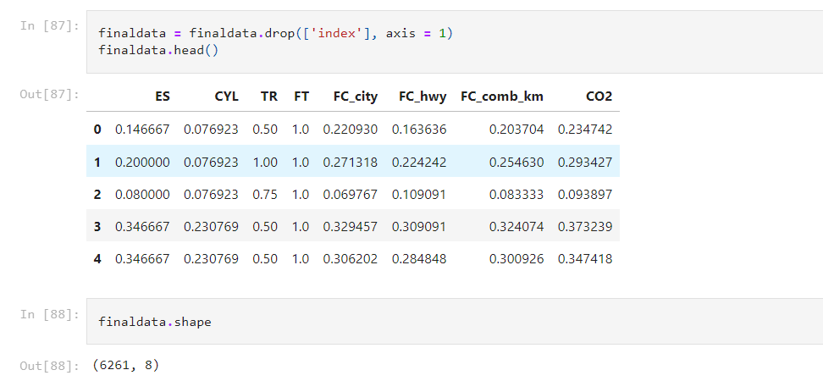
Dropping the Highly Influential and Unnecessary Irrelevant data points:

Slide 20
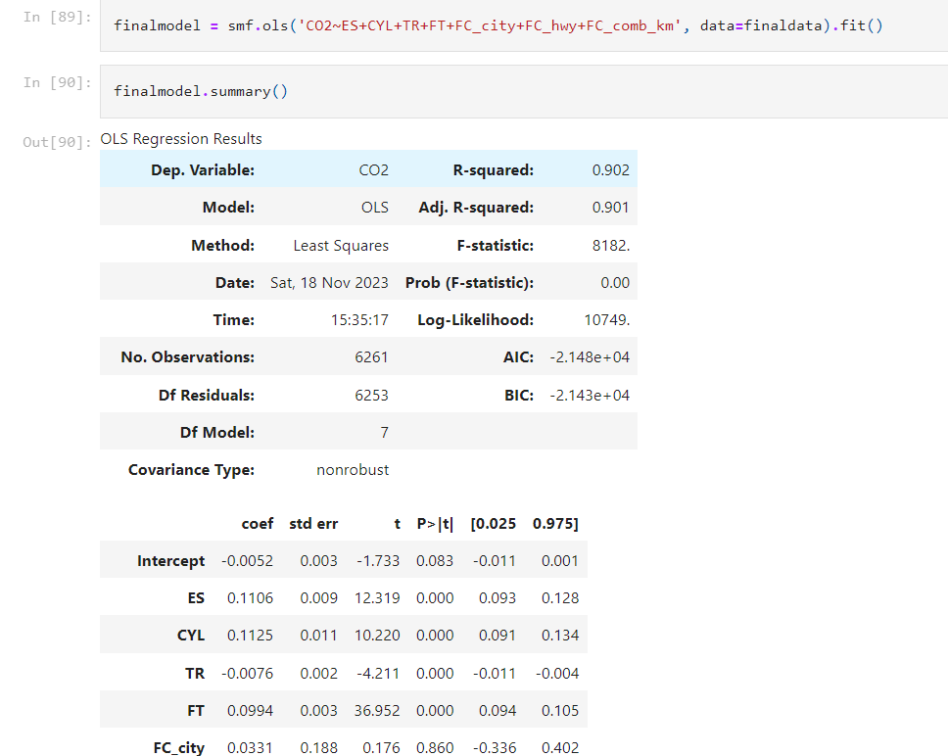
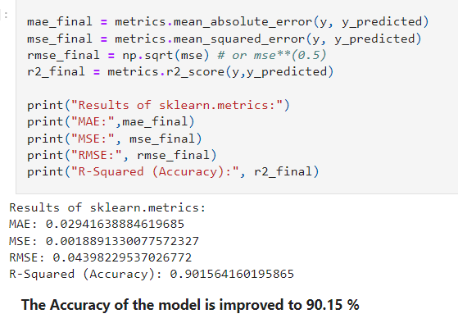
1. Model Building using OLS (Ordinary Least Squares) method:

Slide 21
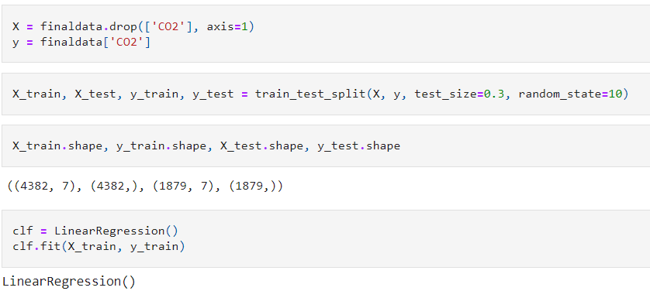
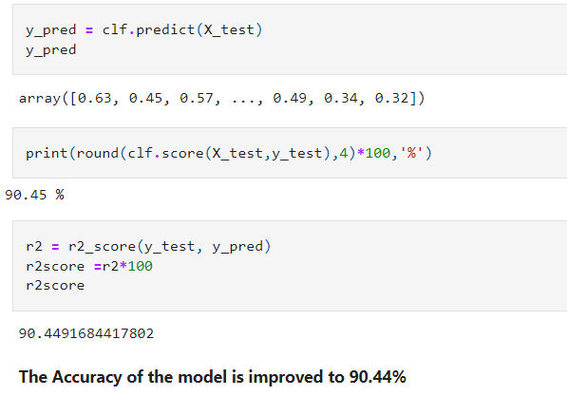
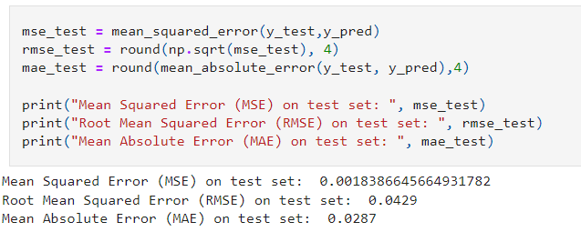
2. Linear Regression using Train Test Split Method:

Slide 22
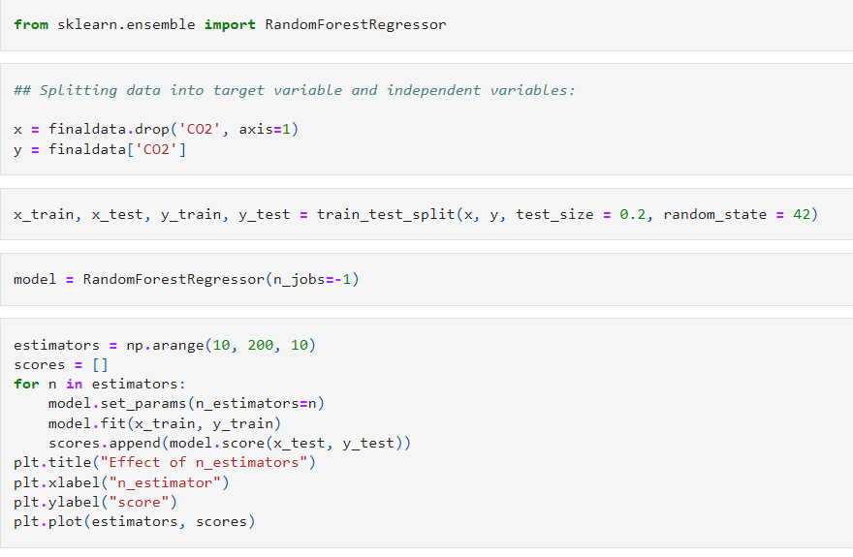
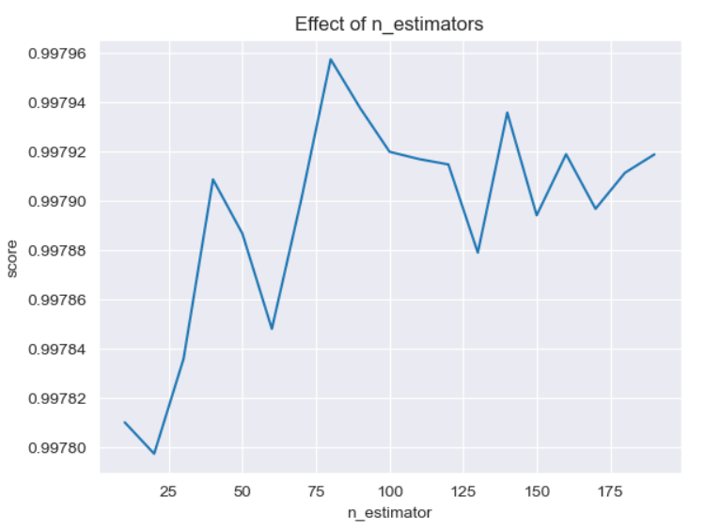
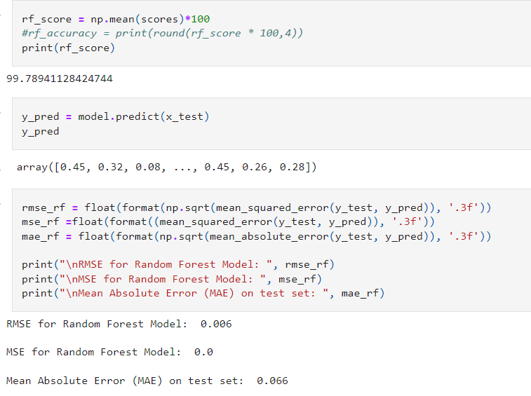
3. Model Building using Random Forest:

Slide 23
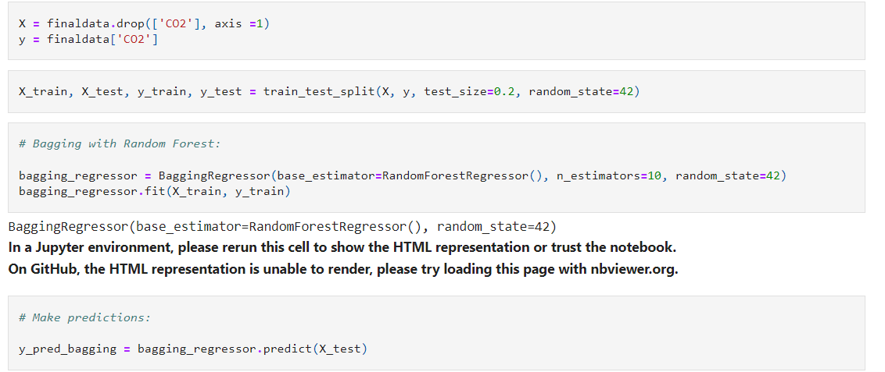
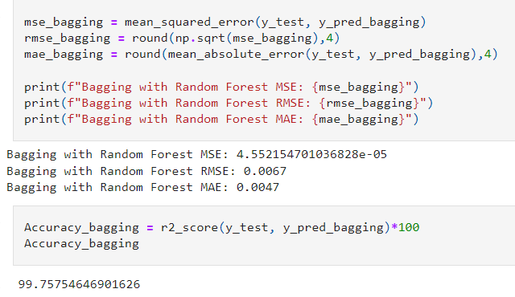
4. Model Building using Bagging Regressor:

Slide 24
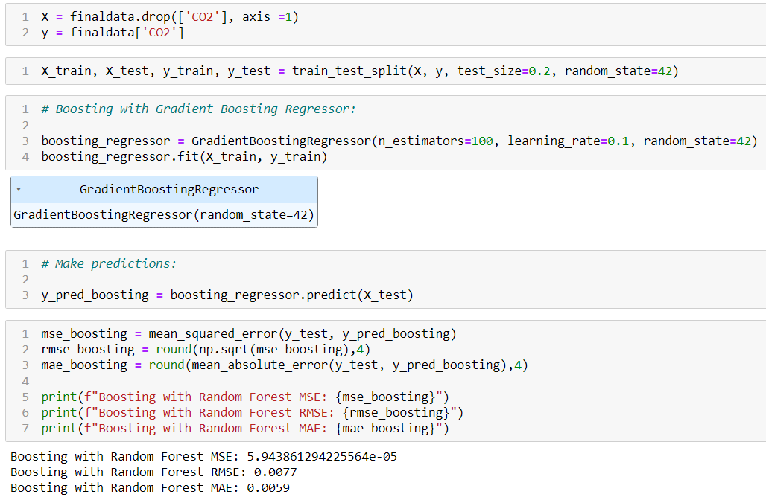
5. Gradient Boosting Regressor:

Slide 25
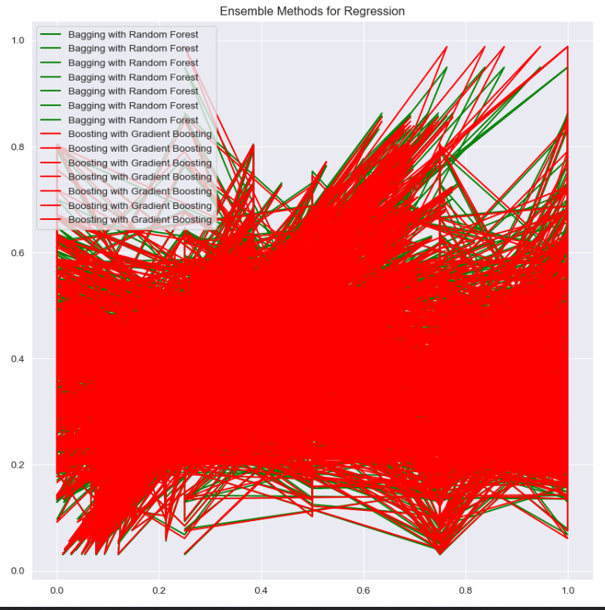
Pictorial Representation of Bagging and Boosting method:

Slide 26
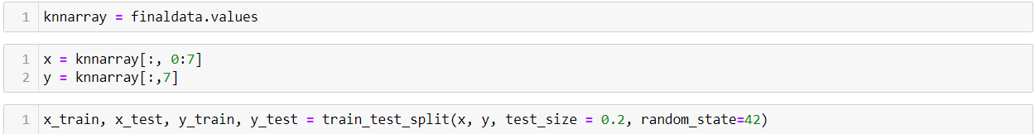
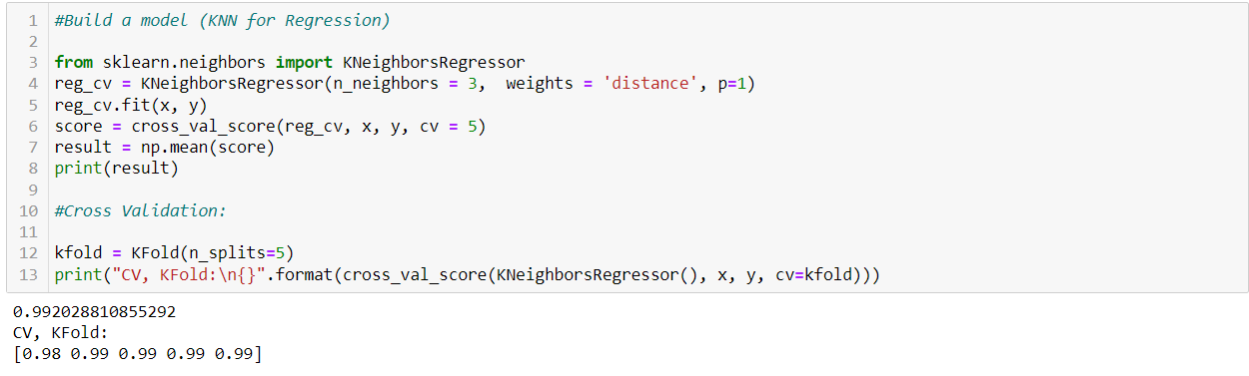
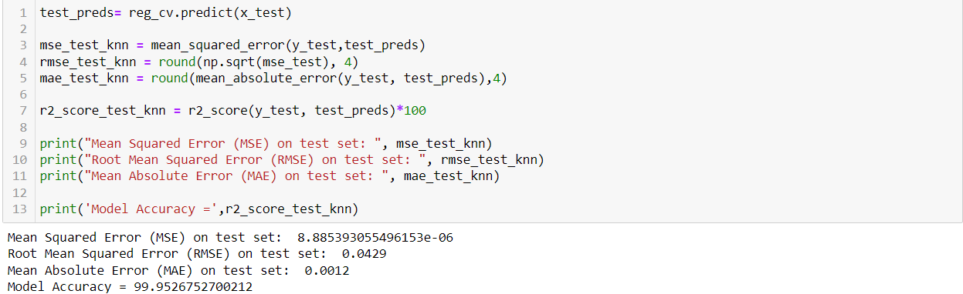
6. Model Building using KNN Regressor:

Slide 27
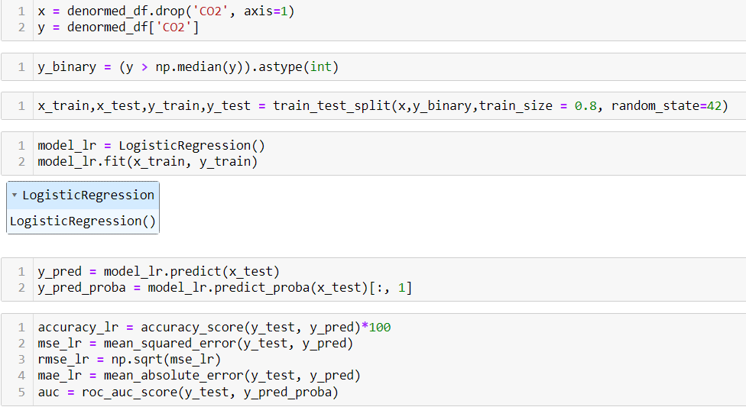
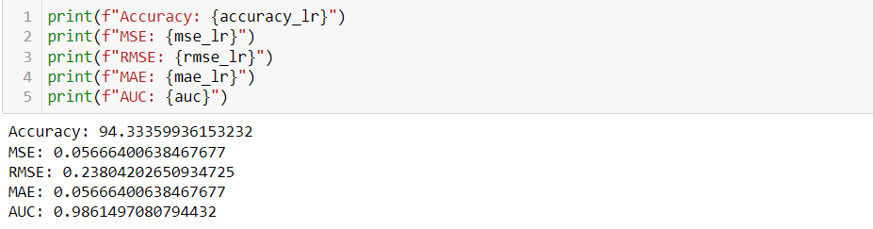
7. Model Building using Logistic Regression:

Slide 28
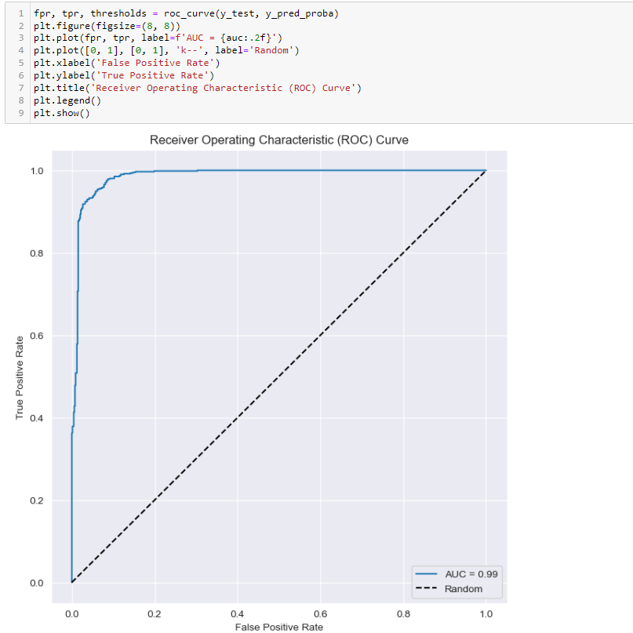
Receiver Operating Characterictics: (ROC curve)

Slide 29
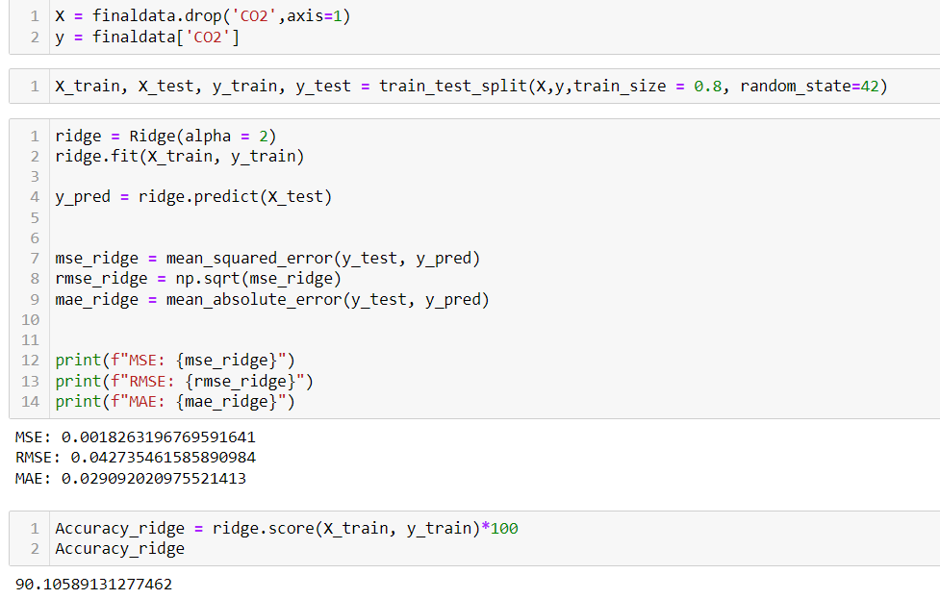
8. Ridge Regression Model:

Slide 30
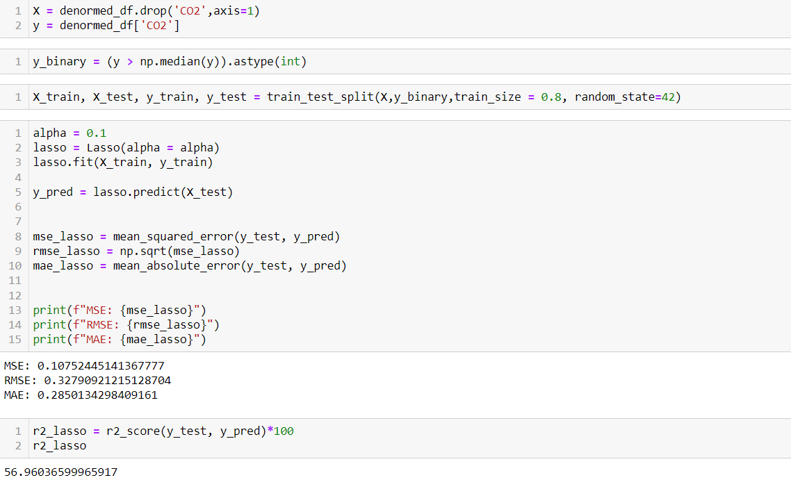
9. Lasso Regression Model:

Slide 31
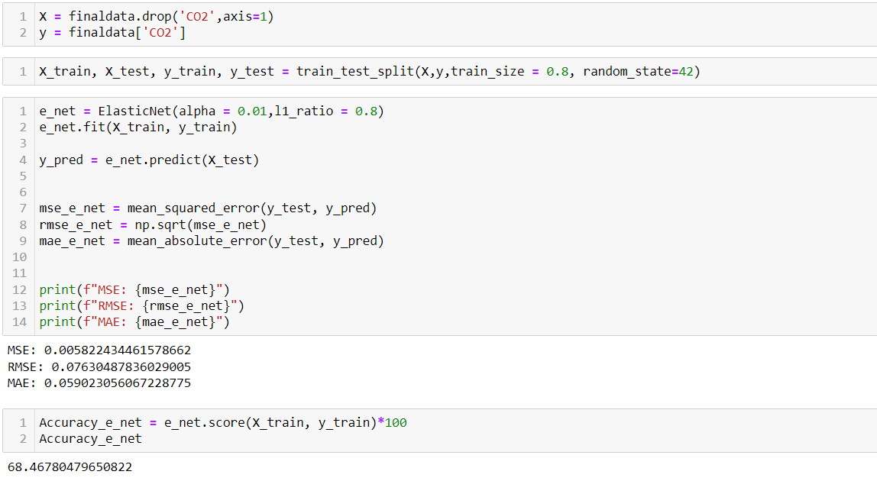
10. Elastic Net Regression Model:

Slide 32
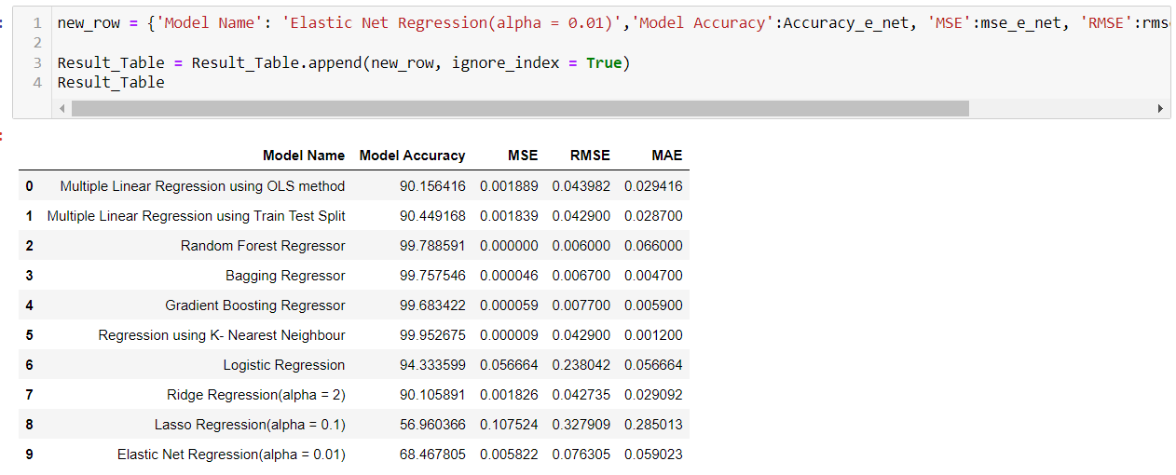
Result Table:
Highest Accuracy (99.78%)
Least Mean Square Error value (0.000000)

Slide 33
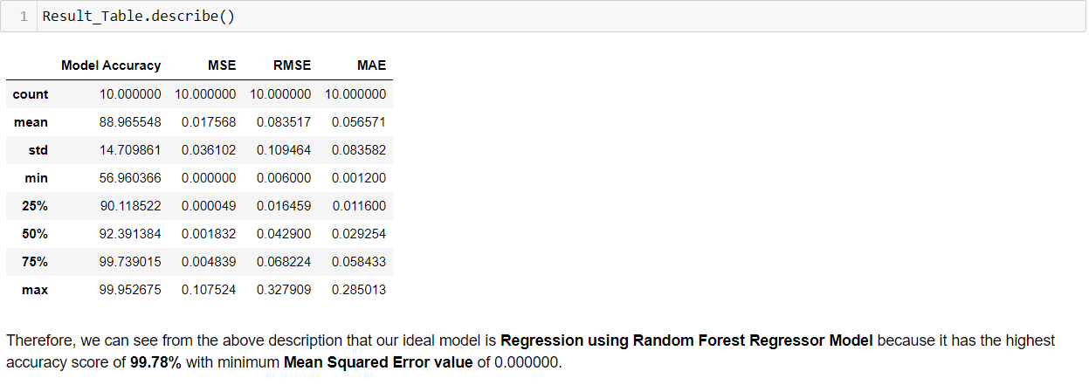
Conclusion:

Slide 34
THANK YOU.

