Slide 1
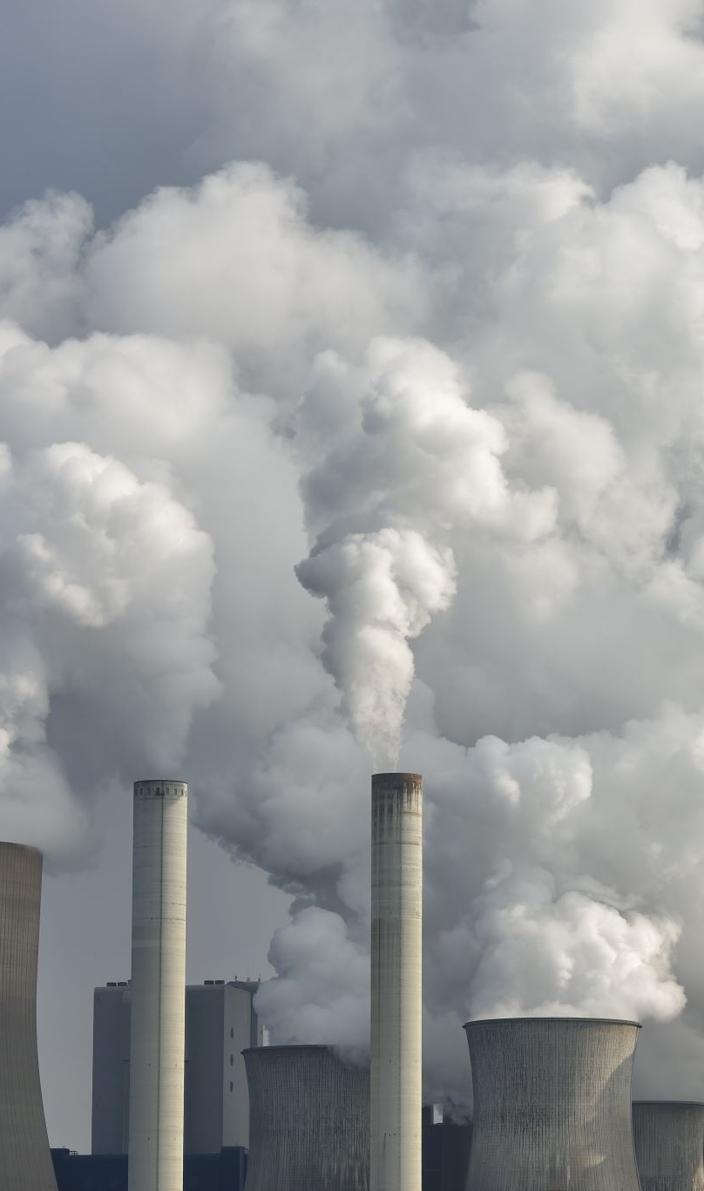
Relationship Between Respiratory Deaths And Particulate Matter (PM) Pollution 2.5 In Texas
Final project
GET PHIT Online Summer Bootcamp
By Isbelis Castro, Alex Chan, Sarah Jaleel, Jennifer Ramos and Melissa Villarreal. –Group Environment.
Dr. Berndt, Virginia K. – Mentor.
August 17th, 2023.

Slide 2
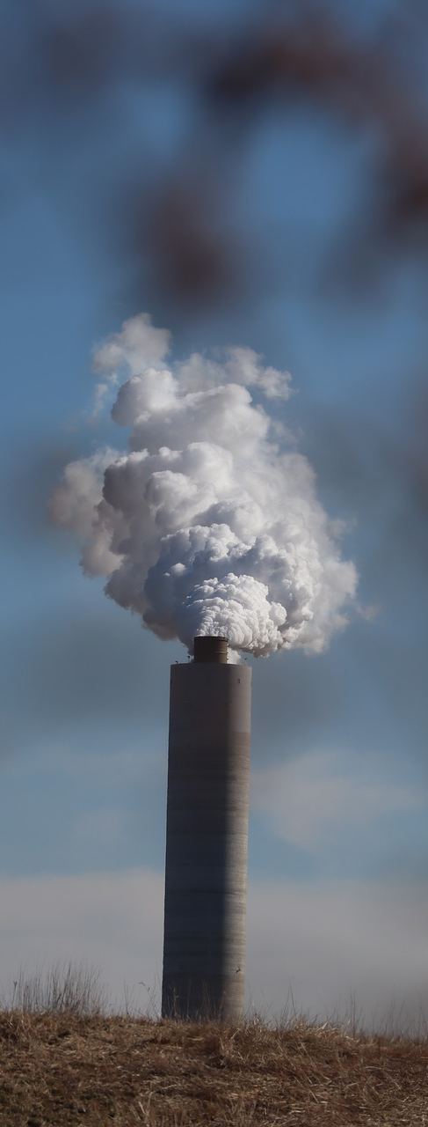
What is Particulate Matter?
Particulate Matter (PM)
acids
organic chemicals
Metal
Dust
soil
a mix of small particles and liquid droplets.⁵
Particulate Matter (PM) 2.5
fine particles that are less than or equal to 2.5 micrometers in diameter.

Slide 3
Health Risks
premature death
increased hospital admissions for
increased mortality in infants
irregular heartbeat
cardiovascular disease, COPD and asthma
aggravated asthma
decreased lung function
nonfatal heart attacks
premature death in people with heart or lung disease
1

Slide 4



What is the relationship between Respiratory Deaths and Particulate Matter (PM) Pollution 2.5 in the State of Texas from 2005-2019?
Research Question

Slide 5



Methods
Variables used for analyses:
Independent
Dependent
(Respiratory Deaths)
# Of Deaths by Cause: 3 year Average Influenza & Pneumonia
# Of Deaths by Cause: 3 yr Average Chronic Lower Resp Dis
Annual Average Particulate Matter
Quantitative and prospective study.
Descriptive Statistic.
Statistical Analysis by Correlation.

Slide 6

Approach
Population: Base data Area Health Resources File (AHRF) 2020 -2021 Release of Texas only -used secondary data.
The base date has 254 observations by country.
Software: Excel (Correlation matrix and Scatter chart)

Slide 7
Variable’s list
VARIABLE NAME | YEAR OF DATA | CHARACTERISTICS
I&P 2017-19 | 2017-19 | 3-Yr Influenza & Pneumonia
I&P 2016_18 | 2016-18 | 3-Yr Influenza & Pneumonia
I&P 2015_17 | 2015-17 | 3-Yr Influenza & Pneumonia
I&P 2014_16 | 2014-16 | 3-Yr Influenza & Pneumonia
I&P 2013_15 | 2013-15 | 3-Yr Influenza & Pneumonia
I&P 2008_10 | 2008-10 | 3-Yr Chronic Lower Resp Dis
CLR 2017_19 | 2017-19 | 3-Yr Chronic Lower Resp Dis
CLR 2016_18 | 2016-18 | 3-Yr Chronic Lower Resp Dis
CLR 2015_17 | 2015-17 | 3-Yr Chronic Lower Resp Dis
CLR 2014_16 | 2014-16 | 3-Yr Chronic Lower Resp Dis
CLR 2013_15 | 2013-15 | 3-Yr Chronic Lower Resp Dis
CLR 2008_10 | 2008-10 | 3-Yr Chronic Lower Resp Dis
2016 | 2016 | Ann Avg Particulate Matter 2.5
2015 | 2015 | Ann Avg Particulate Matter 2.5
2014 | 2014 | Ann Avg Particulate Matter 2.5
2013 | 2013 | Ann Avg Particulate Matter 2.5
2012 | 2012 | Ann Avg Particulate Matter 2.5
2011 | 2011 | Ann Avg Particulate Matter 2.5
2010 | 2010 | Ann Avg Particulate Matter 2.5
2009 | 2009 | Ann Avg Particulate Matter 2.5
2008 | 2008 | Ann Avg Particulate Matter 2.5
2007 | 2007 | Ann Avg Particulate Matter 2.5
2006 | 2006 | Ann Avg Particulate Matter 2.5
2005 | 2005 | Ann Avg Particulate Matter 2.5

Slide 8
Descriptive Statistics
# obs

Slide 9
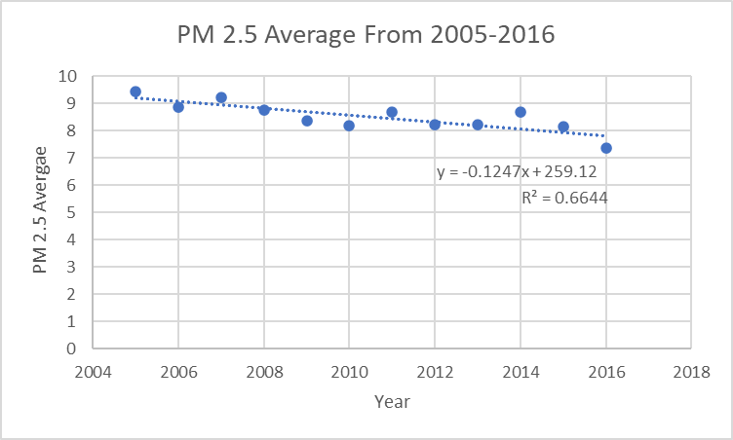
Descriptive Analysis

Slide 10
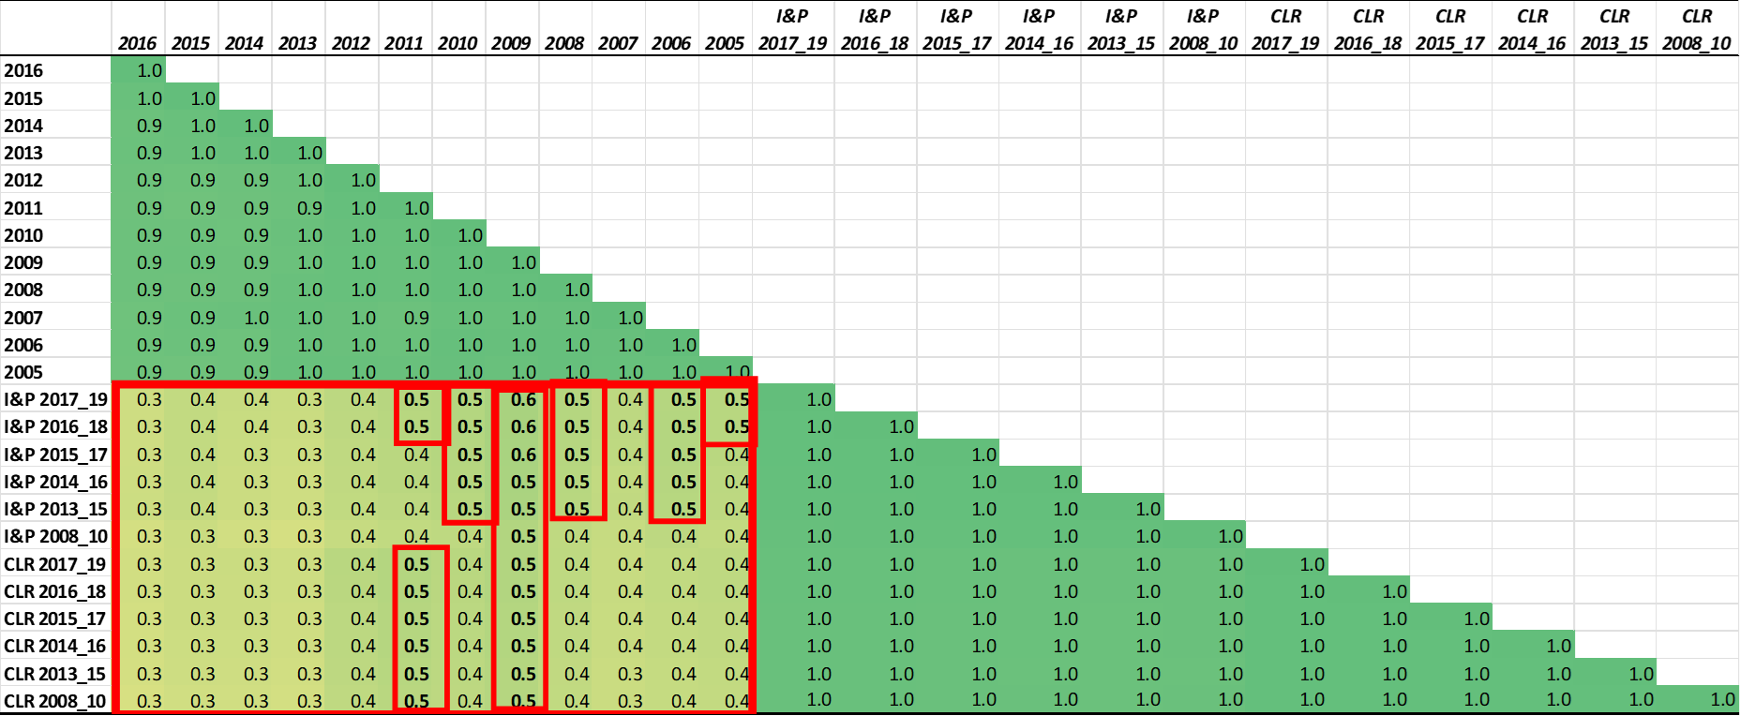
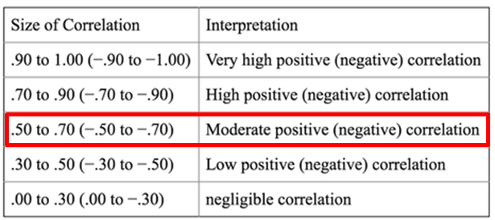
Correlation Matrix
PM 2.5 vs. Deaths by Respiratory Diseases in Texas

Slide 11
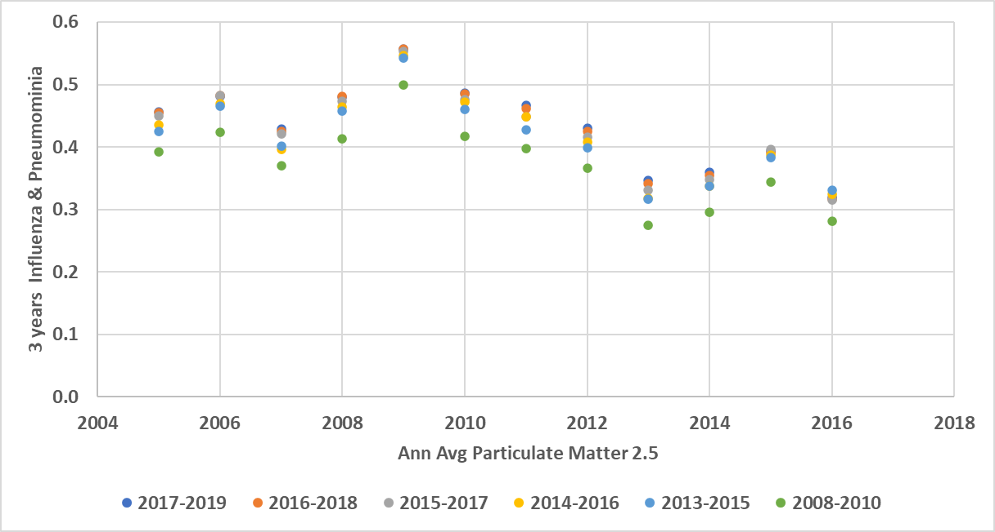
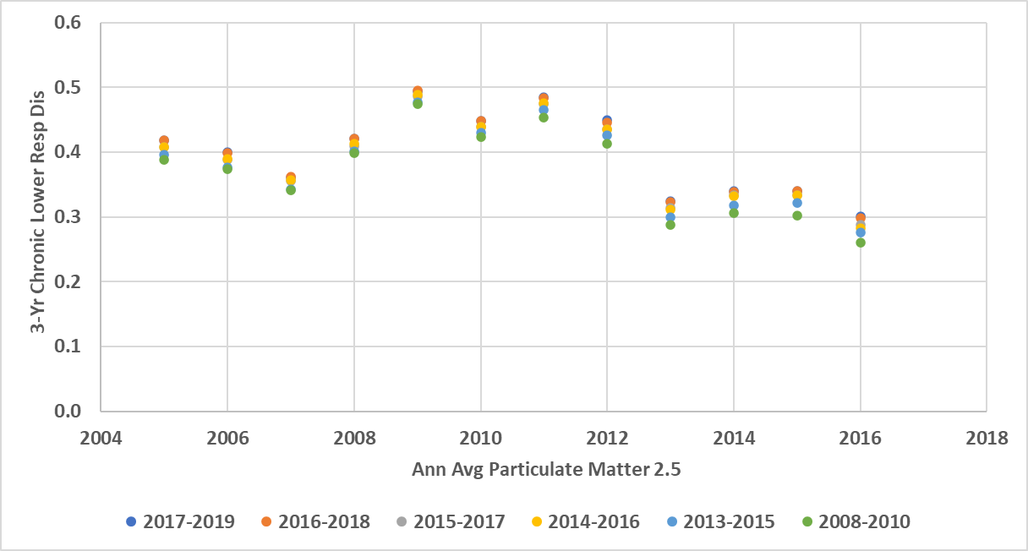
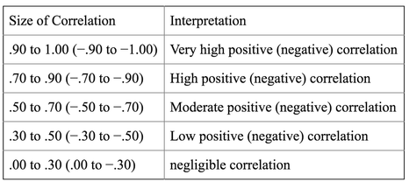
PM 2.5 vs. Deaths by Respiratory Diseases in Texas
Notes:
Correlation between the Ann Avg Particulate Matter 2.5 and influenza & Pneumonia deaths: 0.6. the Ann Avg Particulate Matter 2.5 and deaths of influenza & Pneumonia are moderately positively correlated. That is, the counties that have more PM 2.5 also tend to have more influenza and pneumonia deaths.

Slide 12
Results and Interpretation
Concentration of datas by variables:
< 30%
100 %
<50 % - 59%
Particulate Matter -PM Pollution 2.5.
The average PM 2.5 slightly decreased from 2005-2016
Deaths by Influenza and Pneumonia.
Deaths by Chronic Lower Respiratory Diseases.

Slide 13
Results and Interpretation
Correlation
Ann Avg Particulate Matter 2.5
influenza & Pneumonia deaths
was 0.6, making it a positive moderate correlation
Years that have more PM 2.5 also tend to have more influenza and pneumonia deaths
Over the years, PM 2.5 has decreased, which is possibly associated with the decrease in deaths from influenza and pneumonia along with mortality from chronic lower respiratory diseases.

Slide 14
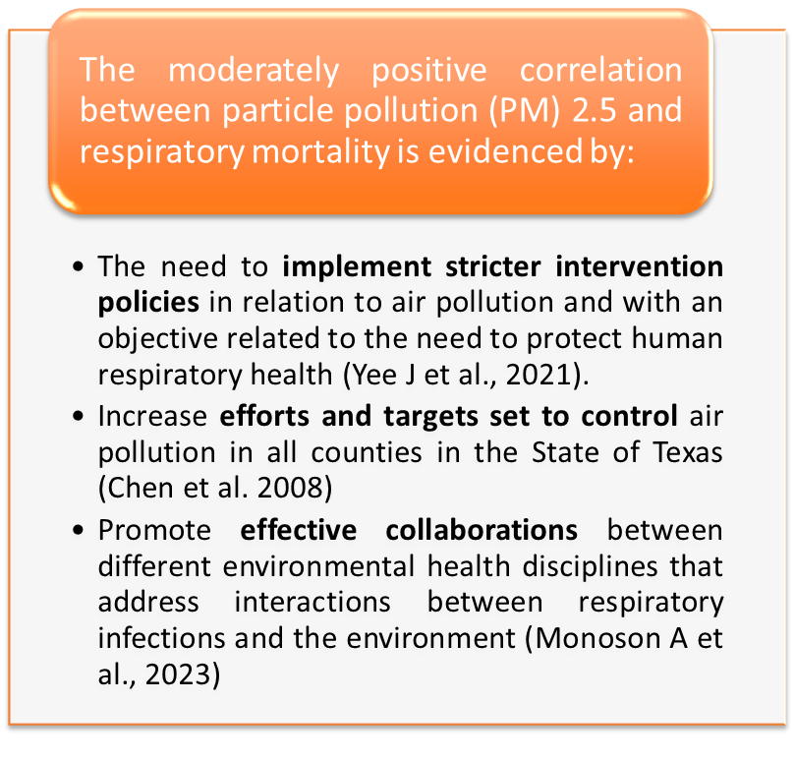
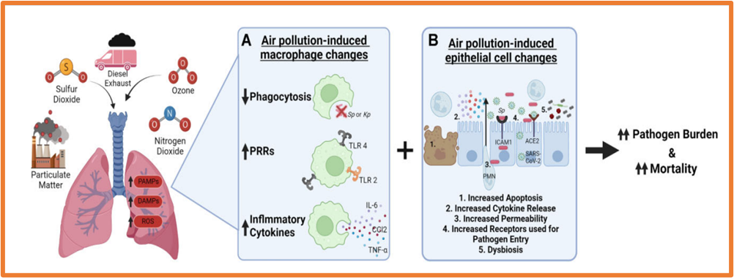


Discussion
Cities and Counties - Health department.
Notes:
There was a spike in 2009 in respiratory related deaths
-A factor to consider is the H1N1 (2009) outbreak
As stated in the H1N1 2009 influenza article by the NIH, “the virus has caused disproportionate disease among young people with early reports of virulence similar to that of seasonal influenza.” (Sullivan, Seth J et al., 2010)
We can see how the outbreak could have contributed to the spike, as the rate of pneumonia and influenza for 2009 were worse than they were in both 2008 and 2010 .

Slide 15


Conclusion
BASED ON OUR ANALYSIS, THE DATA SHOWS A MODERATE CORRELATION BETWEEN AVERAGE PARTICLE MATTER AND DEATHS CAUSED BY INFLUENZA AND PNEUMONIA. THIS CORRELATION FELL BETWEEN THE .50 AND.70 RANGE GIVING US A MODERATE POSITIVE CORRELATION.
BOTH CORRELATIONS REACHED A PEAK IN THE YEAR 2009 WITH BOTH RANGES HAVING A MAJORITY OF PLOTTED DATA POINT FALL BETWEEN 0.4 AND 0.5.

Slide 16
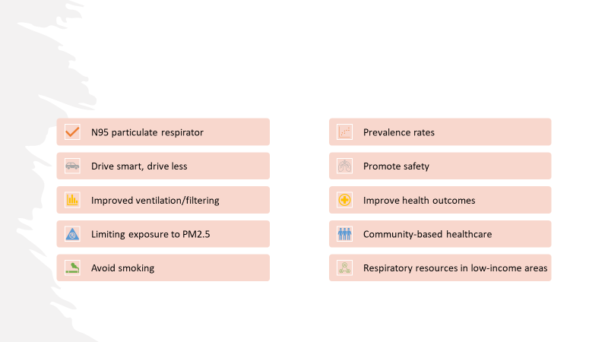
Recommendations

Slide 17


Slide 18
References
American Lung Association. (2023). Particle pollution. https://www.lung.org/clean-air/outdoors/what-makes-air-unhealthy/particle-pollution#:~:text=Some%20of%20the%20strongest%20research,lung%20function%20to%20heart%20attacks.
Croft, D. P., Zhang, W., Lin, S., Thurston, S. W., Hopke, P. K., Masiol, M., Squizzato, S., Van Wijngaarden, E., Utell, M. J., & Rich, D. Q. (2018). The Association between Respiratory Infection and Air Pollution in the Setting of Air Quality Policy and Economic Change. Annals of the American Thoracic Society. https://doi.org/10.1513/annalsats.201810-691oc
Hughes BD, Maharsi S, Obiarinze RN, Mehta HB, Nishi S, Okereke IC. Correlation between air quality and lung cancer incidence: A county by county analysis. Surgery. 2019 Dec;166(6):1099-1104. doi: 10.1016/j.surg.2019.05.036. Epub 2019 Jul 8. PMID: 31296429; PMCID: PMC7063959.
Sohrabi S, Zietsman J, Khreis H. Burden of Disease Assessment of Ambient Air Pollution and Premature Mortality in Urban Areas: The Role of Socioeconomic Status and Transportation. Int J Environ Res Public Health. 2020 Feb 12;17(4):1166. doi: 10.3390/ijerph17041166. PMID: 32059598; PMCID: PMC7068272.
Sullivan, S. J., Jacobson, R. M., Dowdle, W. R., & Poland, G. A. (2010). 2009 H1N1 influenza. Mayo Clinic proceedings, 85(1), 64–76. https://doi.org/10.4065/mcp.2009.0588
Pun VC, Kazemiparkouhi F, Manjourides J, Suh HH. Long-Term PM2.5 Exposure and Respiratory, Cancer, and Cardiovascular Mortality in Older US Adults. Am J Epidemiol. 2017 Oct 15;186(8):961-969. doi: 10.1093/aje/kwx166. PMID: 28541385; PMCID: PMC6915823.
TEXAS COMMISSION ENVIRONMENTAL QUALITY. https://www.tceq.texas.gov/airquality/sip/criteria-pollutants/sip-pm
Atkinson RW, Kang S, Anderson HR, et al Epidemiological time series studies of PM2.5 and daily mortality and hospital admissions: a systematic review and meta-analysis. Thorax 2014;69:660-665.
Croft, D. P., Zhang, W., Lin, S., Thurston, S. W., Hopke, P. K., van Wijngaarden, E., Squizzato, S., Masiol, M., Utell, M. J., & Rich, D. Q. (2020). Associations between Source-Specific Particulate Matter and Respiratory Infections in New York State Adults. Environmental science & technology, 54(2), 975–984. https://doi.org/10.1021/acs.est.9b04295

Slide 19
References cont.
Monoson, A., Schott, E., Ard, K., Kilburg-Basnyat, B., Tighe, R. M., Pannu, S., & Gowdy, K. M. (2023). Air pollution and respiratory infections: the past, present, and future. Toxicological sciences : an official journal of the Society of Toxicology, 192(1), 3–14. https://doi.org/10.1093/toxsci/kfad003
Feng, C., Li, J., Sun, W., Zhang, Y., & Wang, Q. (2016). Impact of ambient fine particulate matter (PM2.5) exposure on the risk of influenza-like-illness: a time-series analysis in Beijing, China. Environmental health : a global access science source, 15, 17. https://doi.org/10.1186/s12940-016-0115-2
Yee J, Cho YA, Yoo HJ, Yun H, Gwak HS. Short-term exposure to air pollution and hospital admission for pneumonia: a systematic review and meta-analysis. Environ Health. 2021 Jan 7;20(1):6. doi: 10.1186/s12940-020-00687-7. PMID: 33413431; PMCID: PMC7792212.
Ibrahim, M. F., Hod, R., Nawi, A. M., & Sahani, M. (2021). Association between ambient air pollution and childhood respiratory diseases in low-and middle-income Asian countries: a systematic review. Atmospheric Environment, 256, 118422.
Kim, K. N., Kim, S., Lim, Y. H., Song, I. G., & Hong, Y. C. (2020). Effects of short-term fine particulate matter exposure on acute respiratory infection in children. International journal of hygiene and environmental health, 229, 113571. https://www.sciencedirect.com/science/article/abs/pii/S1438463920305174?via%3Dihub
He, M., Zhong, Y., Chen, Y., Zhong, N., & Lai, K. (2022). Association of short-term exposure to air pollution with emergency visits for respiratory diseases in children. Iscience, 25(9).
https://www.epa.gov/pm-pollution/particulate-matter-pm-basics#:~:text=Some%20are%20emitted%20directly%20from,power%20plants%2C%20industries%20and%20automobiles.
https://scdhec.gov/environment/your-air/most-common-air-pollutants/particulate-matter/how-reduce-particulate-matter
Chen B, Kan H. Air pollution and population health: a global challenge. Environ Health Prev Med. 2008 Mar;13(2):94-101. doi: 10.1007/s12199-007-0018-5. Epub 2008 Feb 28. PMID: 19568887; PMCID: PMC2698272.

