Slide 1

Warehouse Robot Project
Object-Oriented Design & Simulation
Mickael Osorio J14304002
Jean Jedidia Leong J14304003
Notes:
Hello, today I will present our Warehouse Robot project. This project demonstrates object-oriented programming principles through a simulated robot moving in a warehouse environment.

Slide 2
Live Demo & Code Overview
• Robot moves on a 2D grid
• Target must be reached
• Obstacles and battery (advanced version)
• Agent selects actions
Notes:
In this part, I briefly show the simulation and the code structure. The robot moves on a grid and must reach a target. In the advanced version, obstacles and a battery constraint are added. An agent decides which action to take at each step.

Slide 3
Project Versions
Project 1.0: Basic grid, robot and target
Project 2.0: Obstacles and battery constraint
Project 3.0: Visual display of obstacles and battery
Notes:
The project was developed in three main versions. Each version adds new constraints and improves realism, while keeping the same overall architecture.

Slide 4
Environment Design
• Gymnasium-based environment
• Manages grid, robot, target
• Handles rewards and termination
• Returns observations to the agent
Notes:
The environment follows the Gymnasium interface. It is responsible for managing the grid, the robot position, the target, and the reward logic. It does not know how the agent makes decisions.

Slide 5
Agent Design
BaseAgent (abstract class)
RandomAgent: random actions
GreedyAgent: moves toward target
Same interface, different behaviors
Notes:
Agents inherit from a common abstract base class. RandomAgent chooses actions randomly, while GreedyAgent uses the observation to move closer to the target. This demonstrates polymorphism.

Slide 6
Trainer Class
• Runs episodes
• Connects agent and environment
• Collects statistics
• Independent from implementations
Notes:
The Trainer class orchestrates the interaction between the agent and the environment. It runs episodes and computes statistics such as success rate and average reward.

Slide 7
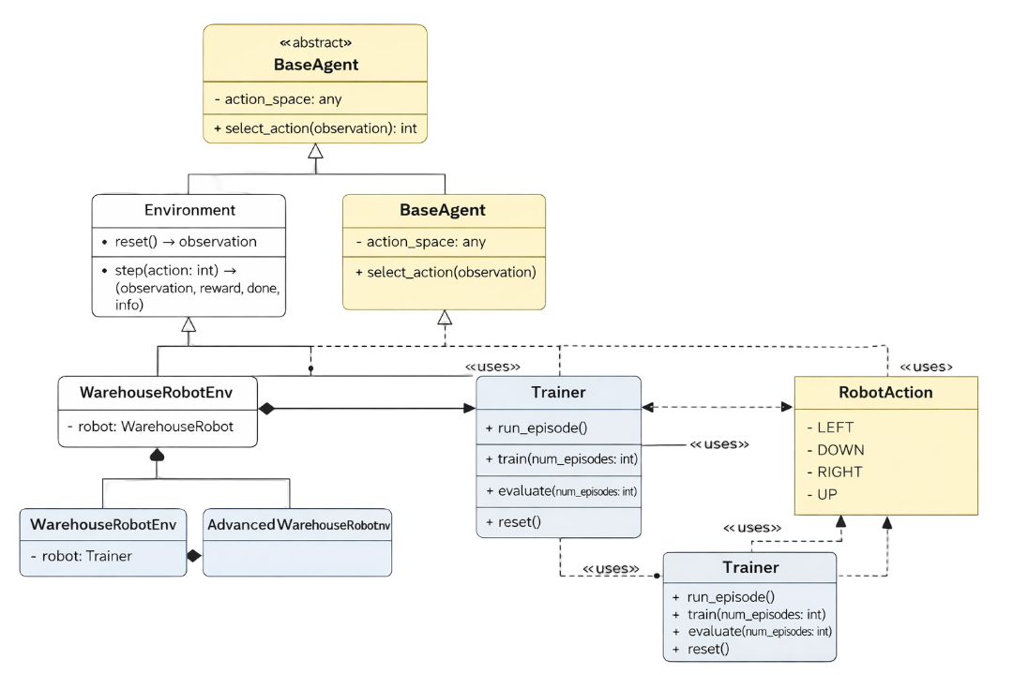
Basic UML Diagram
Notes:
This UML diagram is more complete but still easy to read on a single slide.
WarehouseRobotEnv is the main Gymnasium environment with reset, step, and render.
AdvancedWarehouseRobotEnv inherits from it and adds obstacles plus a battery constraint.
The environment has a WarehouseRobot object, which handles the low-level simulation and rendering.
BaseAgent is an abstract class, and RandomAgent and GreedyAgent inherit from it.
Trainer uses both the environment and the agent to run episodes and compute statistics.
RobotAction is an enum defining the four discrete actions used in the environment.

Slide 8
Conclusion
• Clear OOP architecture
• Modular and extensible
• Ready for reinforcement learning
Notes:
To conclude, this project demonstrates a clean and modular object-oriented design. It can easily be extended with smarter agents or reinforcement learning algorithms.

