Slide 1
U.S.F.P.E.S.
Unified Student Feedback and Psychometric Evaluation System
Under the mentorship of
Dr. Rajesh Bhatia
Chitsimran Singh - 17103012
Manpreet Singh Juneja - 17103022
Shrey Bhardwaj - 17103048
Stuti Sharma - 17103122

Slide 2
Problem Statement
It is believed, that the human brain is a computational system.Through cognitive psychology, we would like to develop a prototype, that can be used to evaluate the stress levels in students, fundamentally through cognitive inputs, by evaluating different events in a week like projects, assignments and quizzes.
To develop a feedback portal, which integrates the student’s emotional well being and academic workload to predict the stress levels and stress givers in a student’s life. Our model strives for neurobiological accuracy and like connectionism, a major account for behavior. The information processing approach to psychometry are implemented and the nature of machine learning and its relationship to psychoanalysis is explored.
Analysis of academic workload and students' activities to predict the psychometric well being of students in academic institutions.

Slide 3
Objective
To help change the student feedback process in our institute,which is currently a form with just 20 questions, to a more intensive,inclusive and comprehensive feedback mechanism, which also includes the psychological well being of students and by extension, the college faculty. The end product will be a better analysis of the mind of the average student of the institute and a better understanding of strengths and weaknesses of the teaching pedagogy of the institute, with a much better understanding of where the strengths and weaknesses lie.
To help get an idea of the optimum workload, i.e. assignments, quizzes, projects etc. to ensure that neither the student loses interest in his academics nor does burnout occur. The optimum workload should be created around the median performance of the entire classroom so that the workload isn’t too high or too low for the entire class as an average. The idea behind this is that the optimal workload can be effectively calculated by analysing and visualising the data obtained.
To create awareness about how mental well-being is an important aspect of an institution’s curriculum, our goal is to promote studies like these in all academic institutions in the country.

Slide 4
Motivation
A more structured and comprehensive student feedback and interest mapping system can be developed using our project, which can be used for placement drives etc.
A targeted student improvement programme can be made by analysing the students having low intrinsic motivation. Which might include special lectures etc.
As learning rate of each student is different, we can identify clusters of students having similar learning rates use this criteria for classification into various courses like Minor Project (where CGPA isn’t a good enough measure).

Slide 5
Proposed Solution
Psytoolkit - PsyToolkit is hosted and maintained by a psychology professor in UK, allowing us to use it's web based features. It also has a repository of surveys and questionnaires dedicated towards analysing a specific trait.
We will be using Django framework for setting up the server and SQLLite3 as the database. For front end we are using HTML, CSS and Javascript.
For report generation, we will be using Clustering to create clusters of students and libraries like sklearn and matplotlib for computation and visualization of data and reports.

Slide 6
Methodology Adopted - Psychometric Tests
WHO quality of life (WHOQOL-BREF)
Ardell Wellness Test
Ten Item Personality Inventory (TIPI/BIG5)
Generalized Anxiety Disorder scale (GAD-7)
Problematic Internet Use Questionnaire (PIUQ)
Depression, Anxiety, Stress (DASS)
Clinical Anger Scale (CAS)
Procrastination scale (Lay’s GP)
Facebook Addiction Scale (BFAS)
Obsessive-Compulsive Inventory (revised, OCI-R)
Social Media Disorder Scale (SMD)
Subjective Happiness Scale (SHS)
Positive Thinking Scale (PTS)
Perceived stress (PSS)
Cognitive Flexibility Scale (CFS)
Self Esteem Scale (Rosenberg)

Slide 7
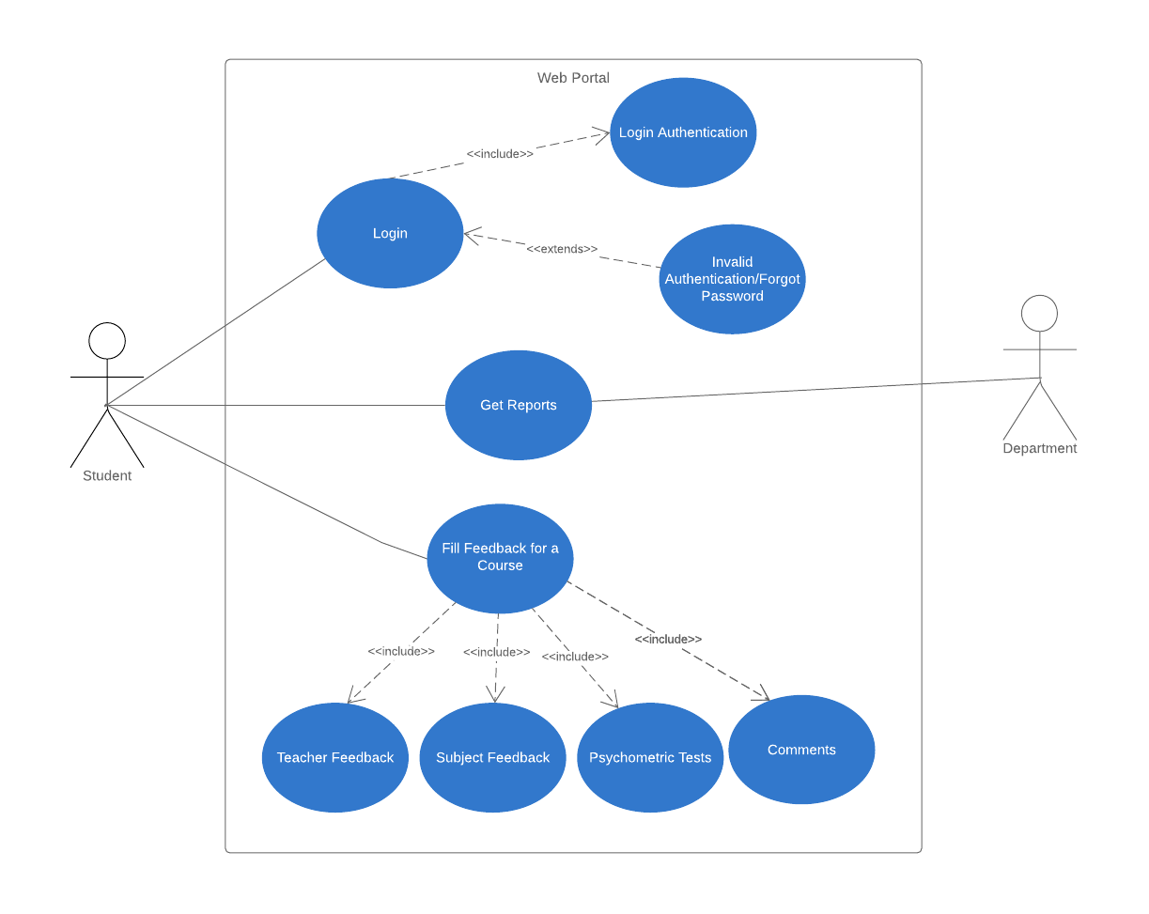
Use Case
Diagram

Slide 8
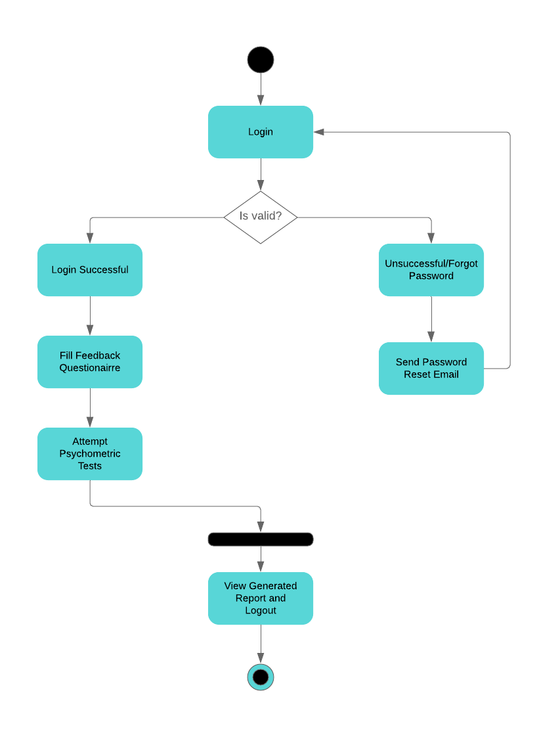
Activity Diagram

Slide 9
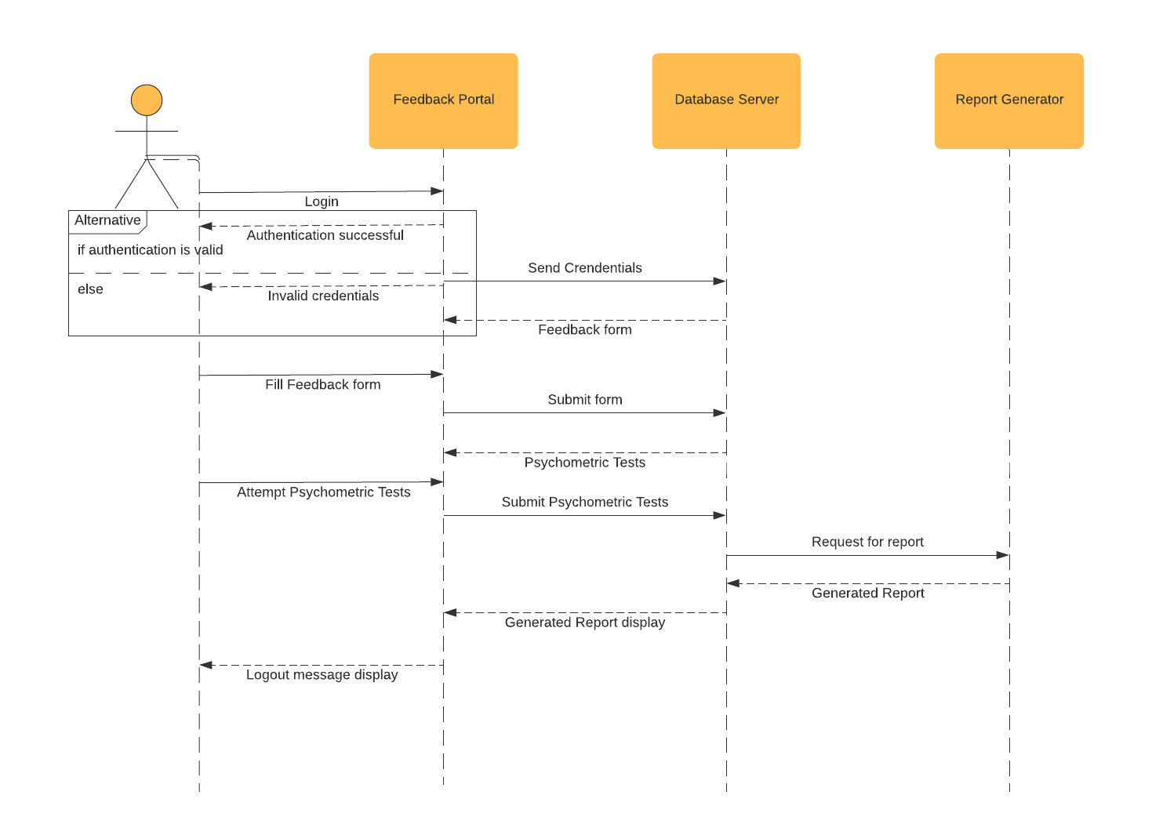
Sequence Diagram

Slide 10
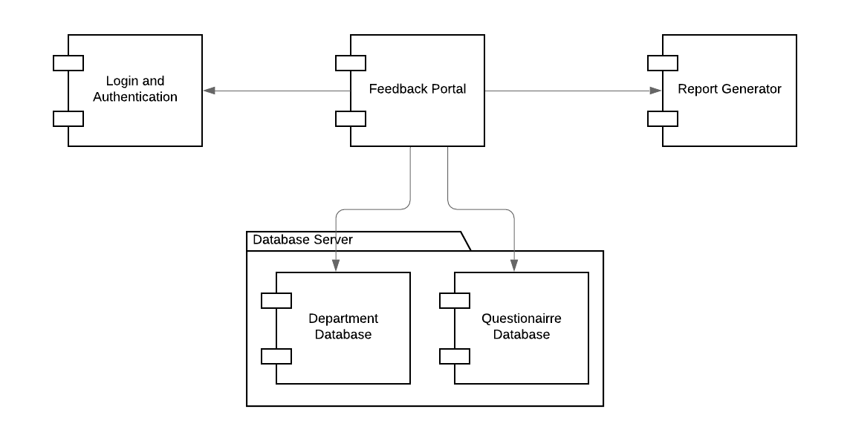
Component Diagram

Slide 11
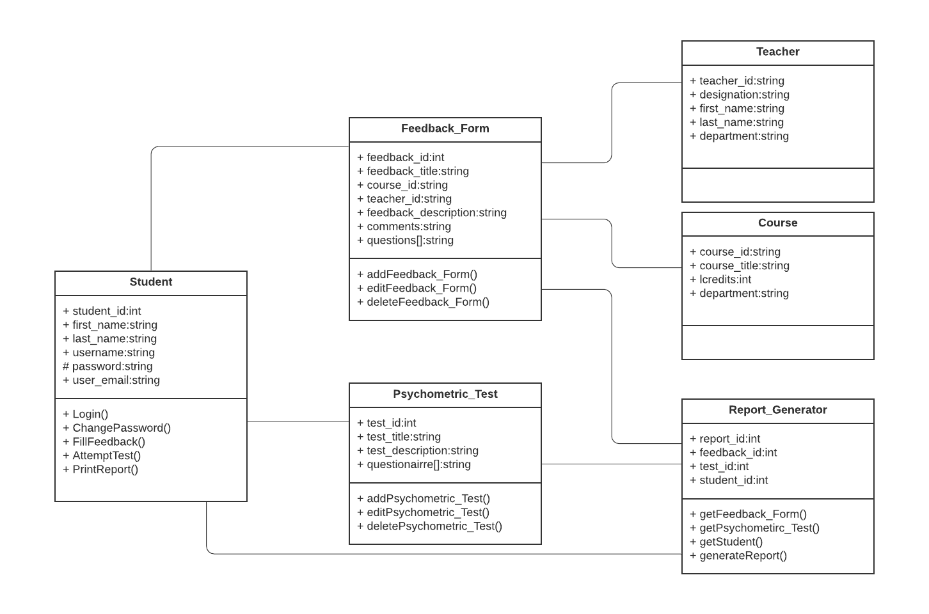
Class Diagram

Slide 12
Conclusion and Future work
Our aim is to develop a prototype that can be used for institutional purposes.
CDGC - Interest mapping on the basis of subject feedback and psychometric tests
Department Feedback - Teacher and Course feedback
Student Well being - Psychometric test
Academic Workload distribution - Through reports generated
At the completion of the student’s degree a holistic progress report will be presented to the student which would include the given four parameters.

