Slide 1
End of Life Benefit Registration
Lifeline use of older technology

Slide 2
Motivation
Lifeline program is administered through Universal Service Administrative Company (USAC) (FCC)
Assists low-income consumers with mobile telecommunications capabilities
VA has a smartphone app, but what about for broadband flip phones?

Slide 3
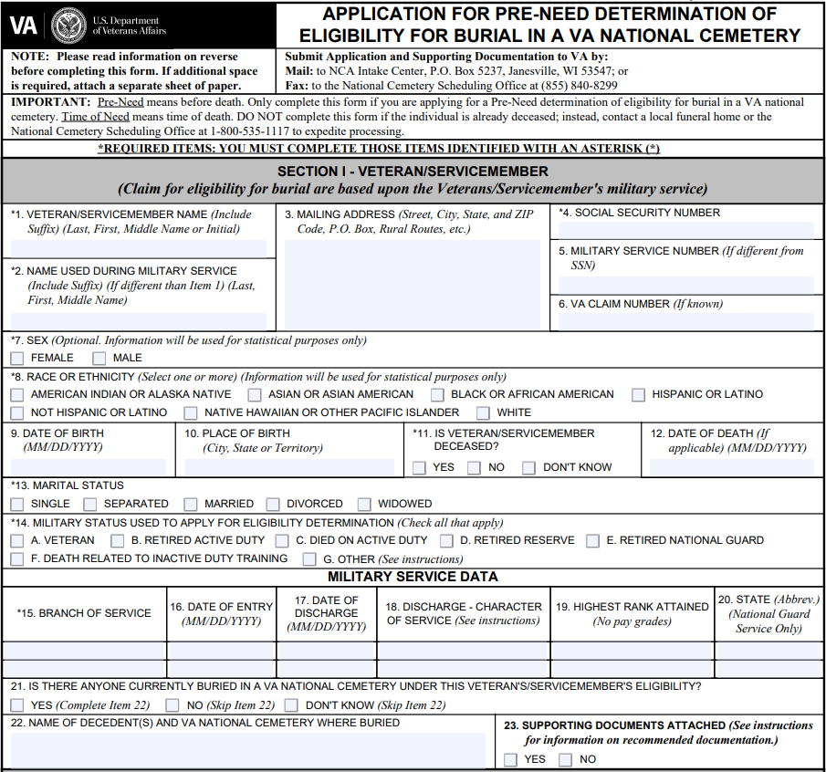
Pre-need Eligibility
Assists family with burial plans for the Veteran
Easier to complete prior to need due to other emotional events
Eases burden on family

Slide 4
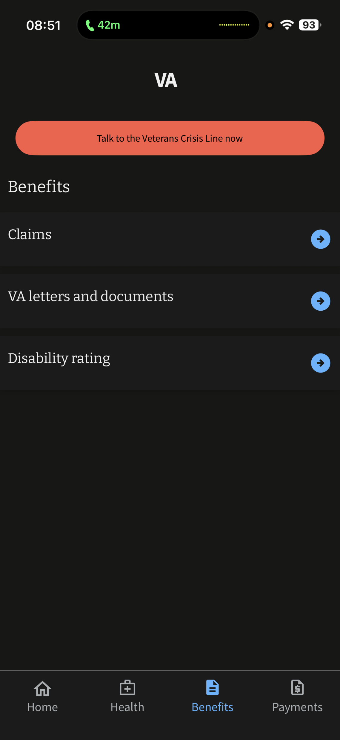
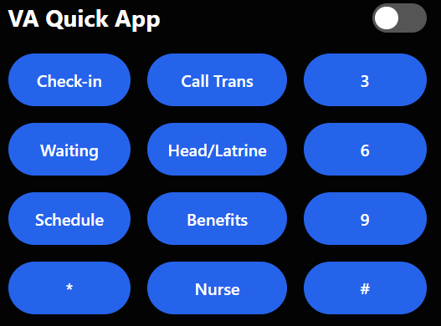
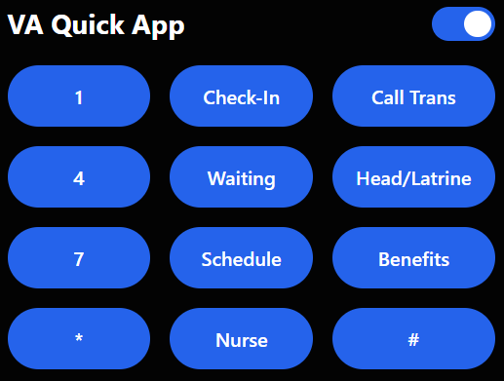
Application
Just like smartphone app, it pulls all information from the Veteran’s profile to complete.
Reduces steps for flip-phone users to complete on the keypad.
Right-handed interface
Left-handed interface

Slide 5
Reference
https://www.fcc.gov/general/lifeline-program-low-income-consumers

