Slide 1
Group 1
Xue Luo, Tyler Butler, Jonathan Anders, Jeremy Black

Slide 2
Project Mission Statement
Deploy, on time, a fully functioning healthcare administrative assist program that meets all written specifications and is tested. This project will be formally approved before release.

Slide 3
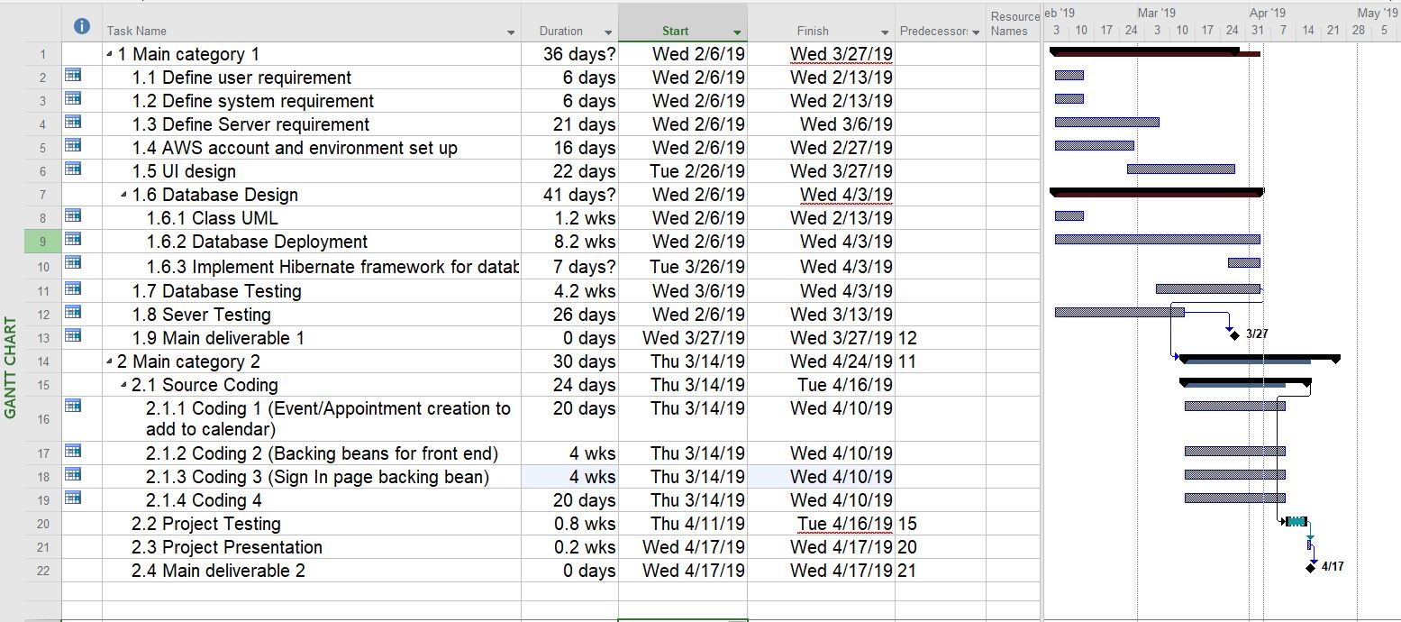
Project Plan Sample

Slide 4
Project Functional and Non-Functional Specifications
Functional Specifications:
Web application
Allow for data persistency
Adding patients and doctors
View patient and doctor info
View patient medical history
Provide calendar with appointment times
Create/Cancel appointments
Implement BootsFaces Framework
Implement Hibernate Framework
Non-Functional Specifications:
Clean UI
Natural flow through website
Organized database view

Slide 5
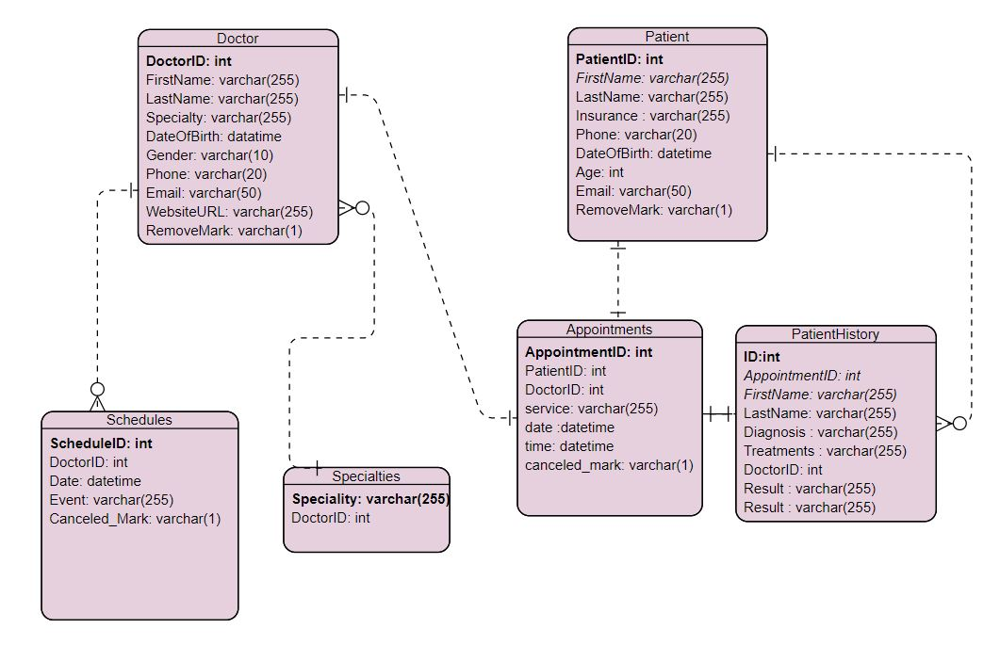
Project E/R Diagrams

Slide 6
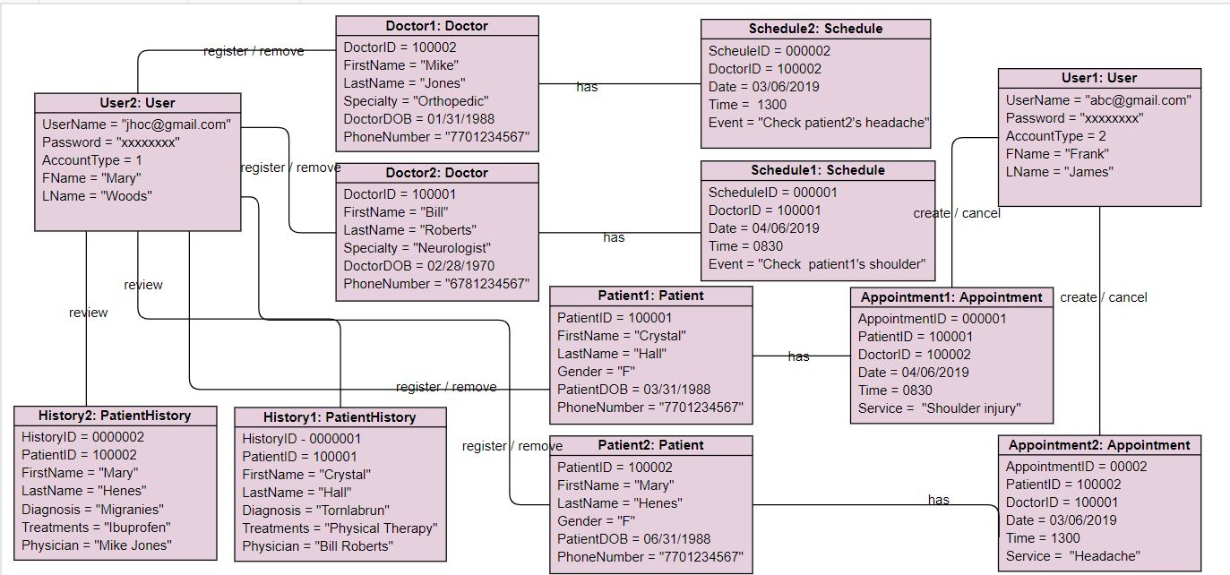
Project Object Diagrams

Slide 7
Project Database Relationships

Slide 8

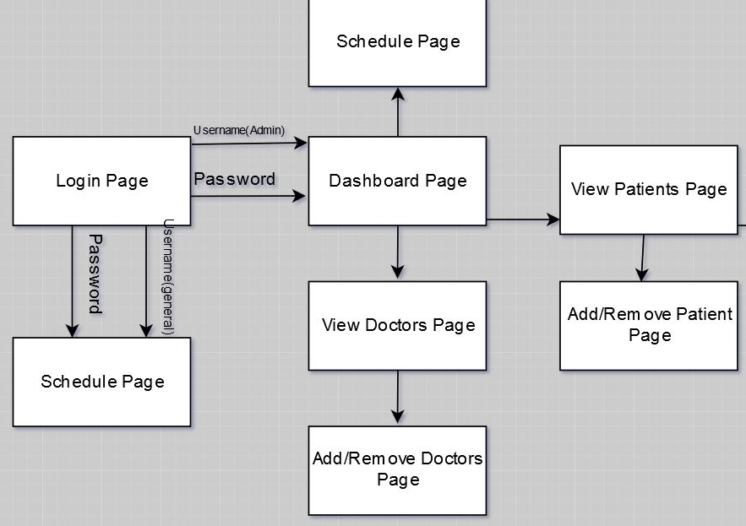
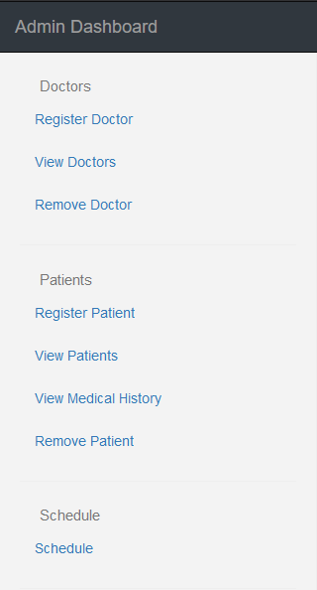
Project Screenflow Diagram

Slide 9
Project Suggested Enhancements
Frameworks
UI components

Slide 10
Project Challenges
Learning Curves
Frameworks
Hibernate
BootsFaces
AWS Free Tier
RDS Database
Elastic Beanstalk Environment
APIs
FullCalendar

Slide 11
Project Successes

Slide 12
Project Takeaways

Slide 13
Team Advice To Others

