Slide 1
Group 1
Xue Luo, Tyler Butler, Jonathan Anders, Jeremy Black

Slide 2
Project Mission Statement
Deploy, on time, a fully functioning healthcare administrative assistant program that meets all written specifications and is tested. This project will be formally approved before release.

Slide 3
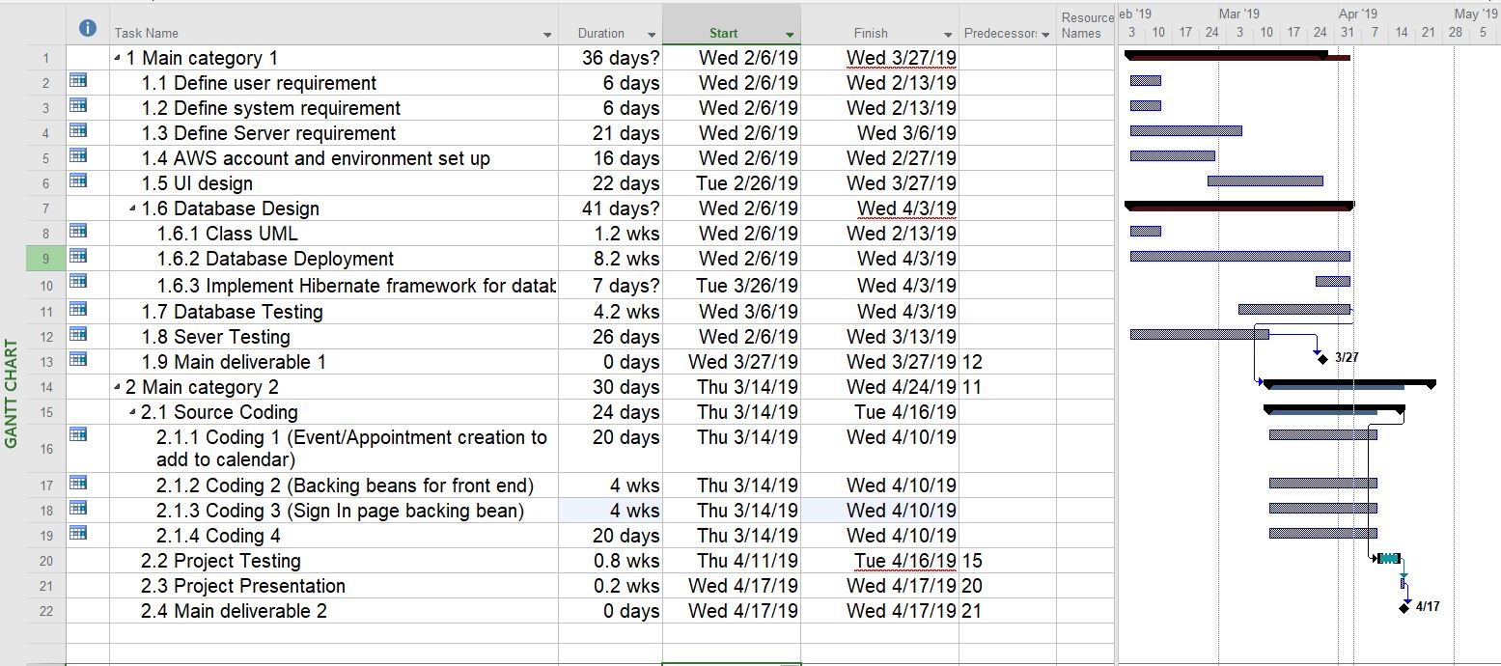
Project Plan Sample

Slide 4
Project Functional and Non-Functional Specifications
Functional Specifications:
Web application
Allow for data persistency
Adding patients and doctors
View patient and doctor info
View patient medical history
Provide calendar with appointment times
Create/Cancel appointments
Implement BootsFaces Framework
Implement Hibernate Framework
Non-Functional Specifications:
Clean UI
Natural flow through website
Organized database view

Slide 5
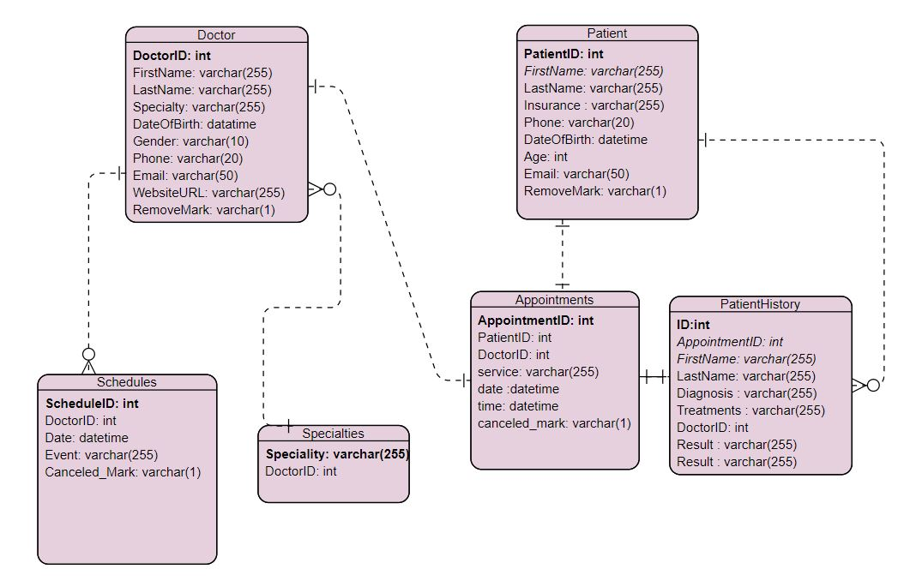
Project E/R Diagrams

Slide 6
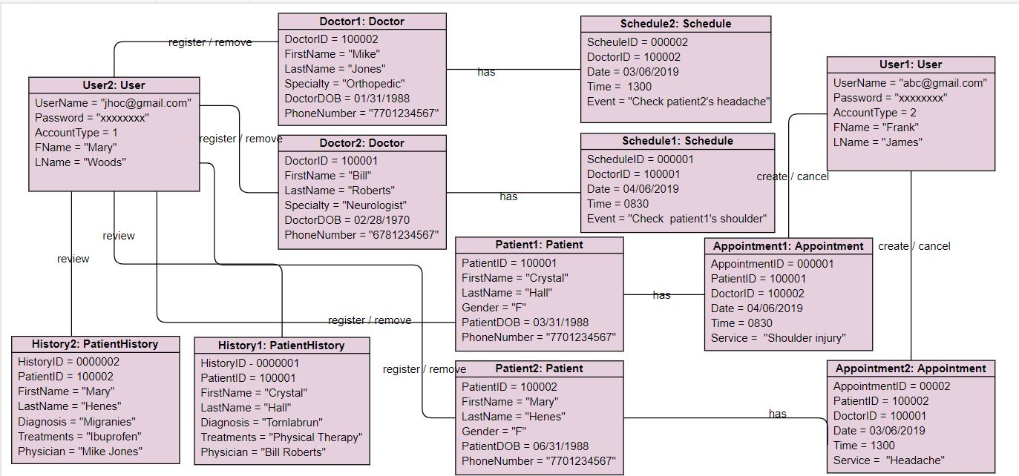
Project Object Diagrams

Slide 7
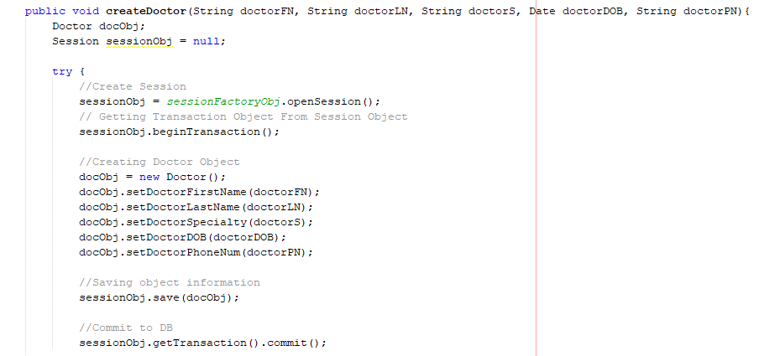
Database Implementation
MySQL Server
Hibernate Framework
AWS Hosted
Hibernate allows our database to Utilize Object Relational Mapping instead of using the traditional Relational Database Model.
This allows the Database to be connected to Java via a mapping XML File and support a more Object Oriented approach to CRUD(Create, Read, Update, Delete) operations.

Slide 8
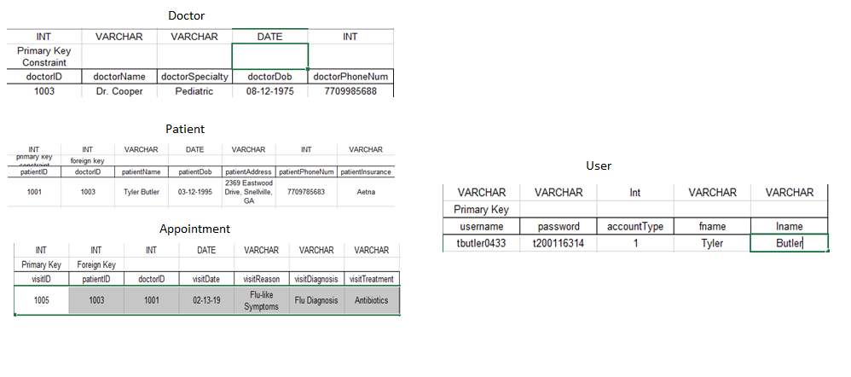
Project Database Relationships
Patient table is our most connected table
Some additional tables may be added where necessary

Slide 9

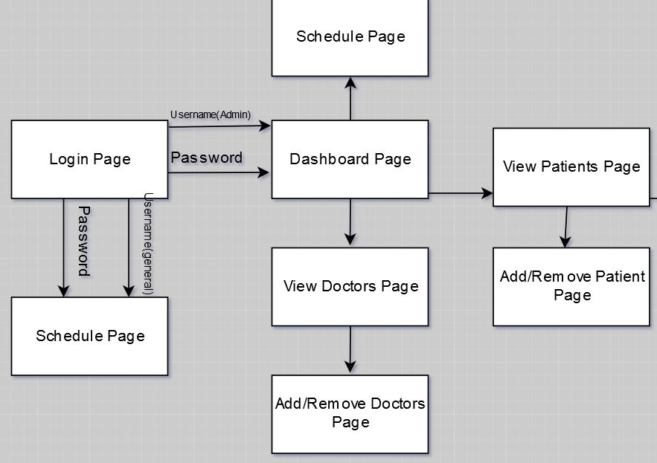
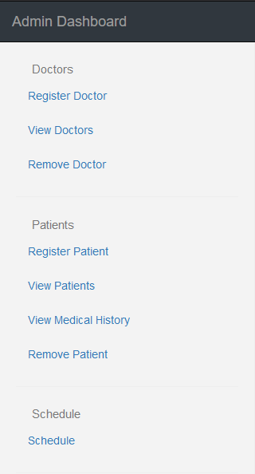
Project Screenflow Diagram

Slide 10
Project Suggested Enhancements
Frameworks
UI components
Break down your UI into reusable and manageable chunks

Slide 11
Project Challenges
Learning Curves
Frameworks
Hibernate
BootsFaces
AWS Free Tier
RDS Database
Elastic Beanstalk Environment
APIs
FullCalendar
Written in JavaScript
Had to use a Json feed for the events

Slide 12
Project Successes
AWS Free tier
Database and Web hosting
Learning how to use various frameworks

Slide 13
Project Takeaways
Frameworks and APIs are worth their weight
You don’t have to build everything from the ground up
Less code to maintain
Frequently updated

Slide 14
Team Advice To Others
If you want to start a new project see if there is a related framework you can use to help build it

