Slide 1
DDoS-Protected Multi-Pod Application
on Kubernetes
Information Security — Final Project
Combining DDoS Mitigation + Container Orchestration
Amantai Akunov

Slide 2
Problem & Motivation
The Threat
The Need
• DDoS attacks cost businesses an avg. $40k+/hour in downtime
• Modern web apps face waves of automated bot traffic
• Slowloris, HTTP flood & layer-7 attacks exhaust resources
• Single-server architectures have no failure isolation
• Without rate limiting, one bad client = entire app down
• Defense at the network edge BEFORE traffic reaches apps
• Horizontal scalability to absorb legitimate traffic spikes
• Self-healing infrastructure that survives pod failures
• Clear separation: public gateway vs. internal services
• Reproducible deploys (config as code, not click-ops)
DDoS-Protected Multi-Pod Application on Kubernetes
2 / 15

Slide 3
Our Solution
A hardened Nginx ingress gateway in front of a multi-pod K8s app
Nginx Gateway
Multi-Pod App
Kubernetes
• DDoS-hardened entry point
• Rate & connection limits
• Bot/UA filtering
• Single public endpoint
• React frontend (SPA)
• Flask REST API backend
• 2 replicas of each
• ClusterIP — internal only
• Service discovery (DNS)
• Health checks (liveness/readiness)
• Self-healing
• Horizontal scaling
DDoS-Protected Multi-Pod Application on Kubernetes
3 / 15

Slide 4
System Architecture
Kubernetes Cluster (multi-pod-app namespace)
FRONTEND React + Nginx Pod 1 | Pod 2 ClusterIP :80 (internal)
GATEWAY (DDoS-Hardened Nginx) • Pod 1 • Pod 2 NodePort :30080
Browser /
Client
BACKEND Python Flask Pod 1 | Pod 2 ClusterIP :5000 (internal)
All external traffic enters through the gateway. Frontend & backend are ClusterIP — unreachable from outside.
DDoS-Protected Multi-Pod Application on Kubernetes
4 / 15

Slide 5
Key Technical Decisions
Nginx as gateway (not Ingress controller)
Full control of every directive — rate limit zones, bot maps, buffer sizes — without depending on an Ingress controller's abstraction layer.
Frontend & backend = ClusterIP (not NodePort)
Only the gateway is externally exposed. Internal services have zero public attack surface — bots can't bypass the gateway.
Return HTTP 429 instead of default 503
429 = 'Too Many Requests' is semantically correct and tells well-behaved clients to back off. 503 implies server failure.
Multiple replicas per Deployment
Two replicas of every tier (gateway, frontend, backend) — survives pod failures, distributes load, demonstrates K8s self-healing.
DDoS-Protected Multi-Pod Application on Kubernetes
5 / 15

Slide 6
DDoS Protections — Gateway Layer
Layer
Nginx Directive
Effect
Rate limit
limit_req_zone — 10 r/s, burst 20
Excess → HTTP 429
Conn. limit
limit_conn_zone — 10 per IP
Excess → HTTP 429
Slowloris
client_*_timeout 10s
Closes slow connections
Buffer DoS
client_body_buffer_size 1k
Rejects oversized headers/body
Bot filter
map $http_user_agent → bad_bot
Empty/sqlmap/nikto → HTTP 403
Methods
if ($request_method !~ ^(GET|HEAD|POST)$)
DELETE/PUT/PATCH → 444
Fingerprint
server_tokens off
Hides Nginx version
XSS/Clickjack
add_header X-Frame-Options + CSP
Browser-side hardening
DDoS-Protected Multi-Pod Application on Kubernetes
6 / 15

Slide 7
Kubernetes Features Demonstrated
Namespace
multi-pod-app
Isolates all resources in one logical group
Deployments
3 deployments × 2 replicas = 6 pods
Declarative pod management with rollout strategy
Service Types
NodePort (gateway) + ClusterIP (internal)
Public entry, private backend
Service Discovery
DNS: backend-service.multi-pod-app.svc.cluster.local
Gateway resolves upstream by name, not IP
Health Probes
readinessProbe + livenessProbe
Auto-removes unhealthy pods from rotation
Resource Limits
CPU & memory requests + limits
Prevents one pod from starving the node
Load Balancing
kube-proxy → endpoints
Requests round-robin'd across pod replicas
Self-Healing
Replica set reconciliation
Killed pods get recreated within seconds
DDoS-Protected Multi-Pod Application on Kubernetes
7 / 15

Slide 8
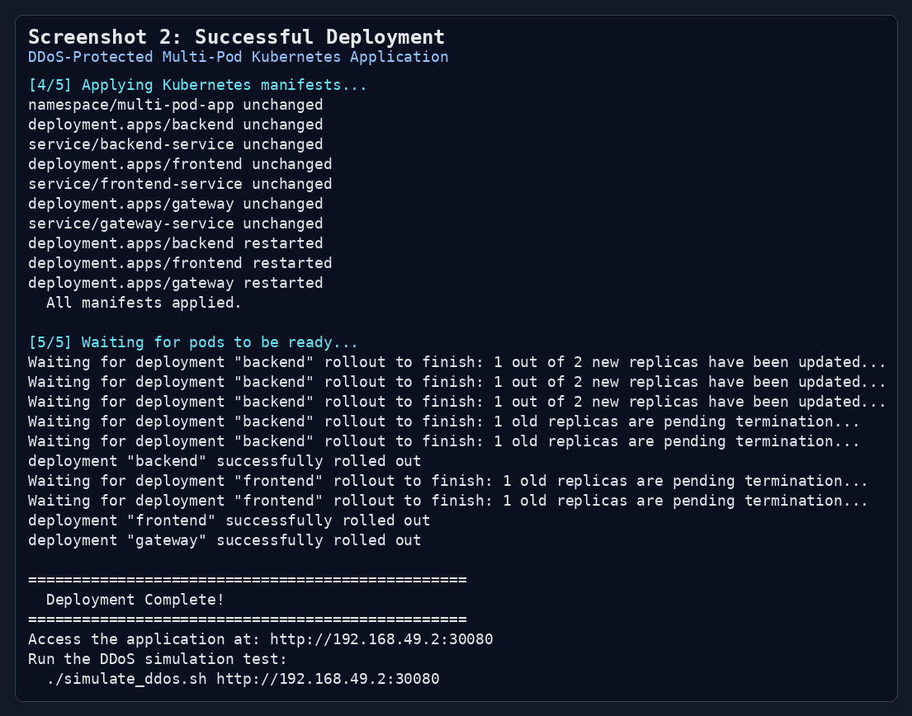
Demo — Deployment Success
./deploy.sh → builds 3 images, applies 7 manifests, waits for rollout
DDoS-Protected Multi-Pod Application on Kubernetes
8 / 15

Slide 9
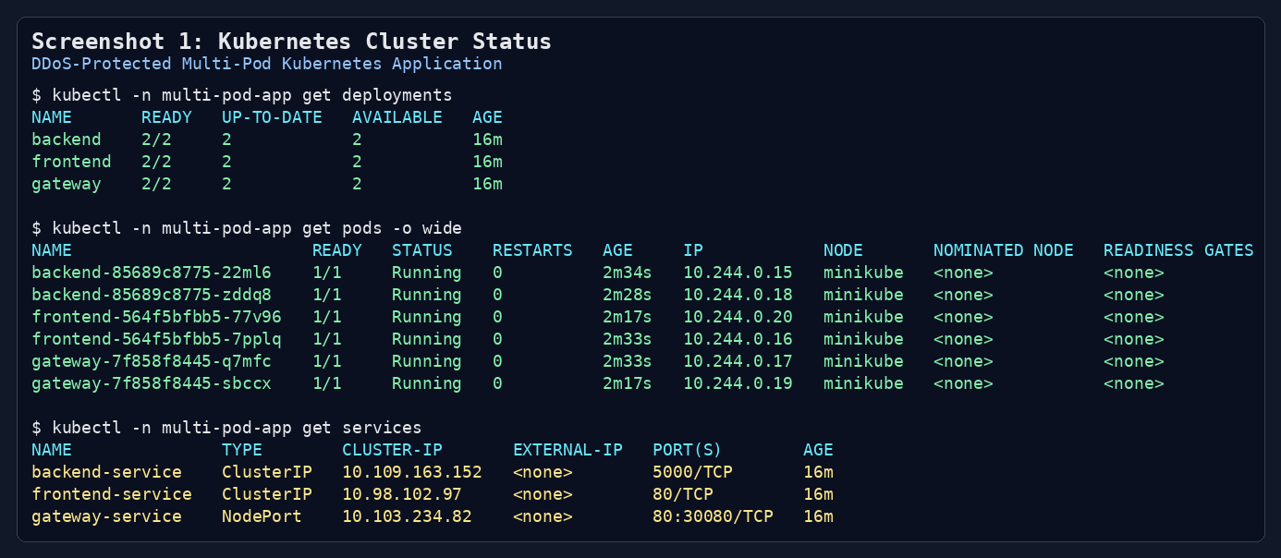
Demo — Running Pods & Services
kubectl -n multi-pod-app get pods + services
DDoS-Protected Multi-Pod Application on Kubernetes
9 / 15

Slide 10
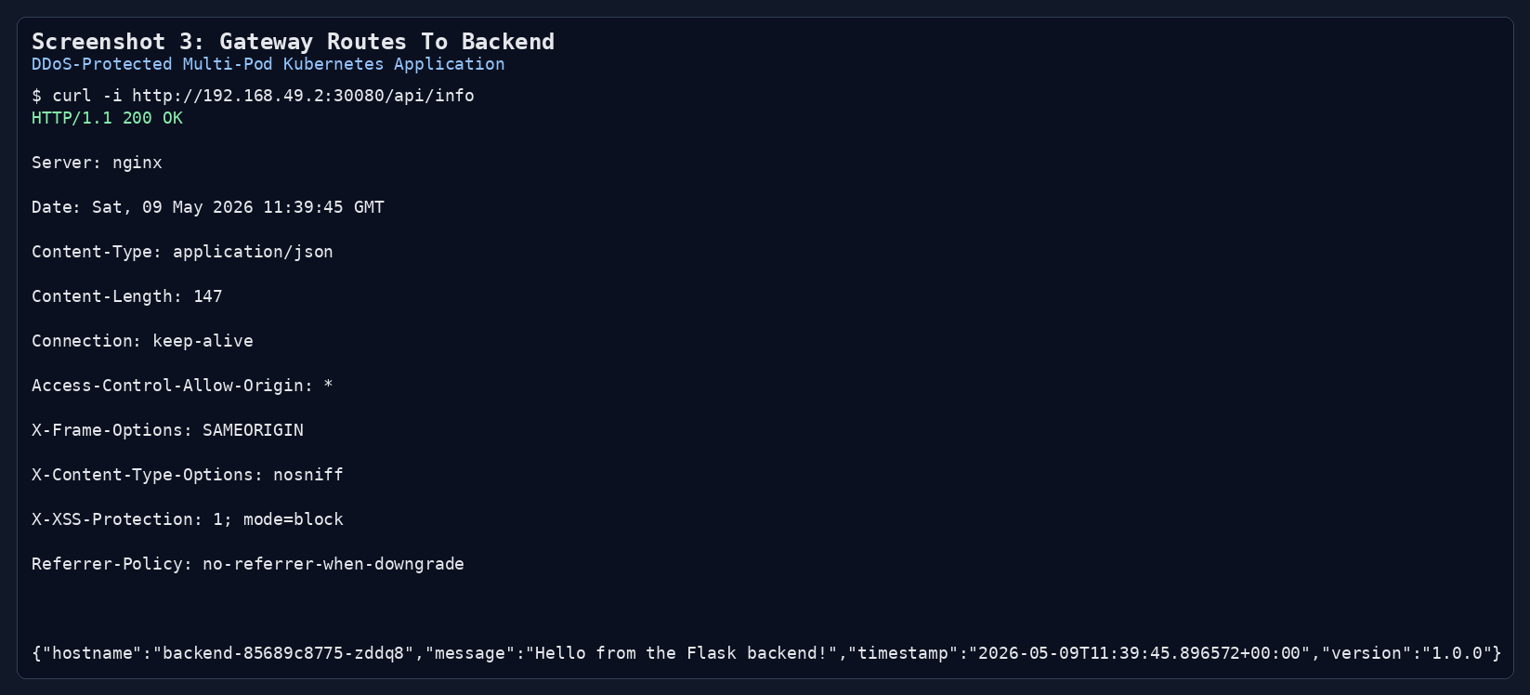
Demo — Gateway Routing (Frontend + Backend)
/ → frontend pods • /api/* → backend pods • all via gateway
DDoS-Protected Multi-Pod Application on Kubernetes
10 / 15

Slide 11
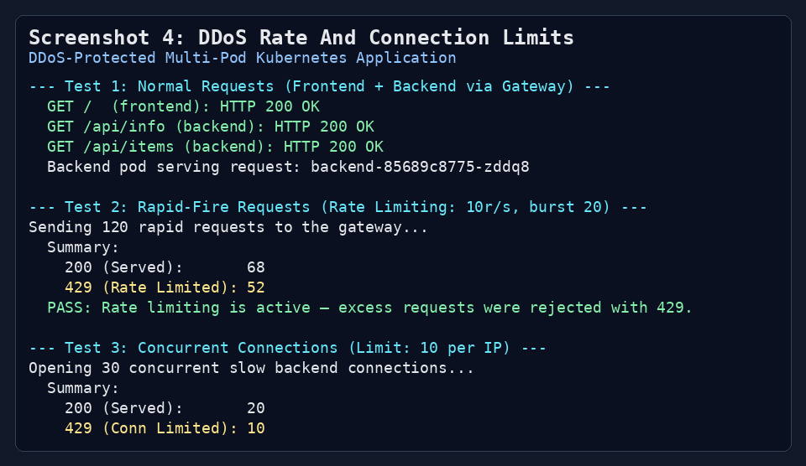
Results — Rate & Connection Limiting
Test 2: Rapid-Fire (120 requests)
Test 3: Concurrent Connections (30)
68
52
20
10
Served (HTTP 200)
Rate Limited (HTTP 429)
Served (HTTP 200)
Conn. Limited (HTTP 429)
→ 43% of attack traffic blocked at the gateway
→ Exactly the configured cap of 10 concurrent per IP
DDoS-Protected Multi-Pod Application on Kubernetes
11 / 15

Slide 12
Results — Kubernetes Load Balancing
6 sequential requests to /api/info — pods responding (round-robin):
Request 1
backend-85689c8775-22ml6
Request 2
backend-85689c8775-zddq8
Request 3
backend-85689c8775-22ml6
Request 4
backend-85689c8775-22ml6
Request 5
backend-85689c8775-zddq8
Request 6
backend-85689c8775-zddq8
PASS — requests distributed across 2 distinct backend pods (3 + 3)
kube-proxy + Service abstraction handles routing transparently
DDoS-Protected Multi-Pod Application on Kubernetes
13 / 15

Slide 13
Conclusion
A single, unified project demonstrating both topics in one architecture.
8/8
6
7
8+
Tests passing
Pods (3 deployments × 2)
Kubernetes manifests
DDoS protections
What this proves
• Both topics aren't separate concerns that they're complementary layers of a defense-in-depth design
DDoS-Protected Multi-Pod Application on Kubernetes
14 / 15

Slide 14
Thank You

