Slide 1
Azure Service Bus
Antariksh Kalita

Slide 2
What is Azure Service Bus?
Azure Service Bus is a fully managed enterprise message broker with message queues and publish-subscribe topics (in a namespace). Service Bus is used to decouple applications and services from each other, providing the following benefits:
Load-balancing work across competing workers
Safely routing and transferring data and control across service and application boundaries
Coordinating transactional work that requires a high-degree of reliability

Slide 3
Overview
Data is transferred between different applications and services using messages. A message is a container decorated with metadata, and contains data. The data can be any kind of information, including structured data encoded with the common formats such as the following ones: JSON, XML, Apache Avro, Plain Text.
Some common messaging scenarios are:
Messaging. Transfer business data, such as sales or purchase orders, journals, or inventory movements.
Decouple applications. Improve reliability and scalability of applications and services. Producer and consumer don't have to be online or readily available at the same time. The load is leveled such that traffic spikes don't overtax a service.
Load balancing. Allow for multiple competing consumers to read from a queue at the same time, each safely obtaining exclusive ownership to specific messages.
Topics and subscriptions. Enable 1:n relationships between publishers and subscribers, allowing subscribers to select particular messages from a published message stream.
Transactions. Allows you to do several operations, all in the scope of an atomic transaction. For example, the following operations can be done in the scope of a transaction.
Obtain a message from one queue.
Post results of processing to one or more different queues.
Move the input message from the original queue.

Slide 4
Azure takes care of those chores for you.
Worrying about hardware failures
Keeping the operating systems or the products patched
Placing logs and managing disk space
Handling backups
Failing over to a reserve machine

Slide 5
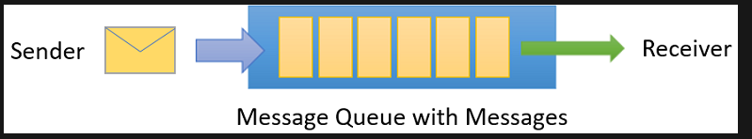
Queues
Messages are sent to and received from queues. Queues store messages until the receiving application is available to receive and process them.
Messages in queues are ordered and timestamped on arrival. Once the broker accepts the message, the message is always held durably in triple-redundant storage, spread across availability zones if the namespace is zone-enabled. Service Bus keeps messages in memory or volatile storage until they've been reported by the client as accepted.
Messages are delivered in pull mode, only delivering messages when requested. Unlike the busy-polling model of some other cloud queues, the pull operation can be long-lived and only complete once a message is available.

Slide 6
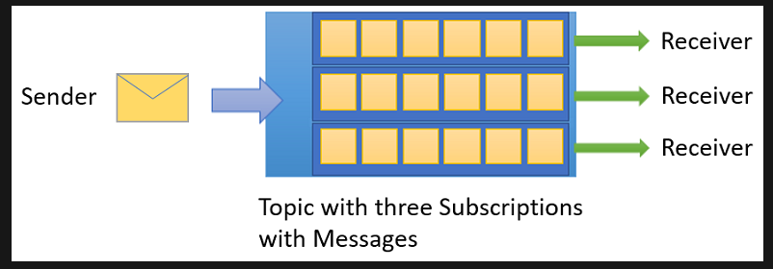
Topics
You can also use topics to send and receive messages. While a queue is often used for point-to-point communication, topics are useful in publish/subscribe scenarios.
Topics can have multiple, independent subscriptions, which attach to the topic and otherwise work exactly like queues from the receiver side. A subscriber to a topic can receive a copy of each message sent to that topic. Subscriptions are named entities. Subscriptions are durable by default, but can be configured to expire and then be automatically deleted.
You can define rules on a subscription. A subscription rule has a filter to define a condition for the message to be copied into the subscription and an optional action that can modify message metadata.

Slide 7
Event Publishing System: Overview
This project consists of a Publisher, flask application, a platform that allows users to subscribe to topics, publish articles. A subscriber service that triggers notifications via Email when a message is published into a topic.
This project contains two services independently interacting with Azure Service Bus.
Publisher Application: A python, flask application that allows users to:
User registration and login
Subscription to multiple topics
Publishing articles to topics
Subscriber Application: a python script that triggers email notification whenever an event is published not a topic

Slide 8
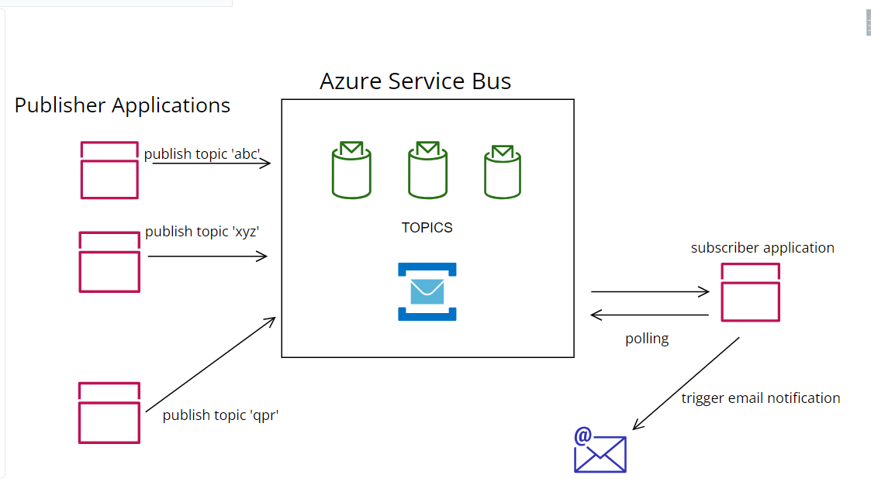
Project High Level Design:

Slide 9
Publisher Application : Features
User Registration: user can register using their email in to the application.
User login: user can only access the application if they are logged in.
Topic Subscription: user can subscribe and unsubscribe to topics.
Publishing: user can publish into a topic they subscribe to and trigger a notification to all the subscribed users to the specific topic into Azure service bus topics.

Slide 10
Subscriber Application: Features
Built using Azure SDK and python.
Polls into the Azure service bus topics.
Triggers emails to the subscribed users with the content published
Does not required publisher service to be up and running simultaneously or concurrently.
For the demonstration, Gmail SMPT service are used to serve emails.

Slide 11
References
https://learn.microsoft.com/en-us/azure/service-bus-messaging/service-bus-messaging-overview
https://learn.microsoft.com/en-us/azure/service-bus-messaging/service-bus-quickstart-topics-subscriptions-portal
https://learn.microsoft.com/en-us/azure/service-bus-messaging/service-bus-quickstart-topics-subscriptions-portal

