Slide 1
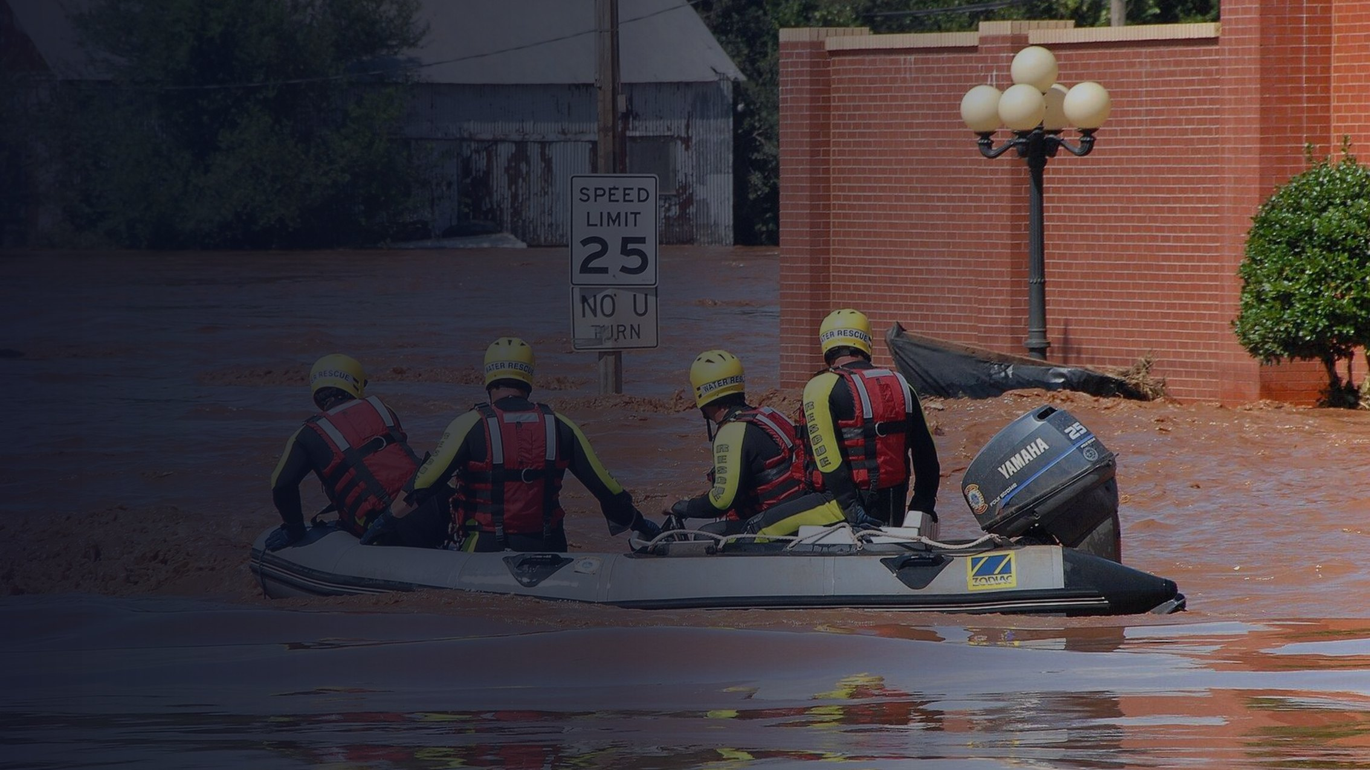

CrisisConnect
Flood response desk
TEAM THEBYTEFORCE · AI HACKATHON 2026
Every SOS in one
trusted queue.
A unified disaster response platform for Sri Lanka. It merges SMS, WhatsApp, hotline and web messages into verified household cases, ranks who to call first, and carries each case through to delivered help.
Four portals, one picture
AI proposes, people decide
English, Sinhala, Tamil
Built with Jac and Jaseci
Notes:
Open on the human problem: a flood night in Kegalle. CrisisConnect is one trusted queue for the duty desk, from first SOS to delivered help.

Slide 2
One flood night. Ninety-four messages.
THE PROBLEM
When the hills around Kegalle flood, help requests arrive by SMS, WhatsApp forwards, hotline calls and web forms, in English, Sinhala, Tamil and Singlish. Many describe the same family.
WhatsApp
18:06
Please help, my grandmother Seelawathie Perera is 78 and in a wheelchair. Water is at the door of our house No. 14 Hettimulla Road, Kegalle.
WhatsApp
18:36
94
64
40
My mother Seelawathie Perera, wheelchair, alone with my son Kasun at No 14 Hettimulla Rd Kegalle. water rising. pls send boat.
messages in one night
asking for rescue
real households
Forward
18:58
Fwd: Seelawathie amma wheelchair eke, 14 Hettimulla Road, call 07X 555 0101
Storm-night scenario: 94 messages written for our evaluation, modelled on Sri Lankan flood reports. Names and numbers are fictional.
SMS
21:15
Update from Kasun: water is now waist deep inside. Still 2 of us, grandmother and me.
4 messages · 3 senders · 1 household
Notes:
Read one bubble aloud. A duty officer sees four tickets here; there is one grandmother in a wheelchair. Multiply that by a whole night.

Slide 3
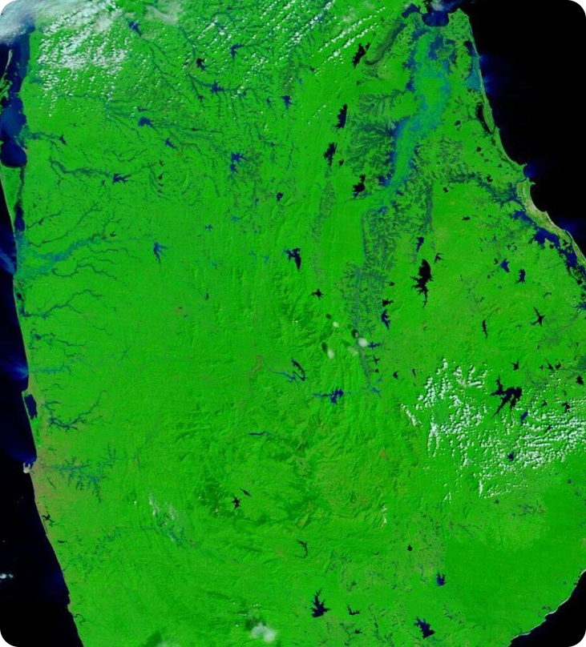



Scattered messages cost calls, time and trust
WHY IT MATTERS
Officers call the same family again and again
Relatives, forwards and updates each look like a new case. In our storm night, 24 of the calls would have been repeats.
The most vulnerable get buried
A wheelchair user or a child with asthma sits under the newest message instead of at the top of the list.
Scams spread with the panic
Flooding in Sri Lanka, 9 Dec 2025 · NASA MODIS
Fake “Ministry” appeals ask for OTP codes, bank logins and deposits to personal accounts.
Notes:
Three costs: wasted calls, buried vulnerability, and scams that follow every disaster. All three come from the same root cause: no shared, verified record.

Slide 4



Information exists. Coordination does not.
THE GAP
What exists today
What a flood desk needs
Hotline numbers and WhatsApp groups
One verified record per household
Alerts, news and government notices
A call queue ranked by need, with reasons
NGO and volunteer efforts
Relief requests linked to delivery
Fund-raising appeals of every kind
Appeals checked before anyone pays
One shared picture for citizens, officers, relief groups and the district
Each works alone. Nobody holds the whole picture.
Notes:
The real gap is coordination, not information. CrisisConnect is built around the five things on the right.

Slide 5
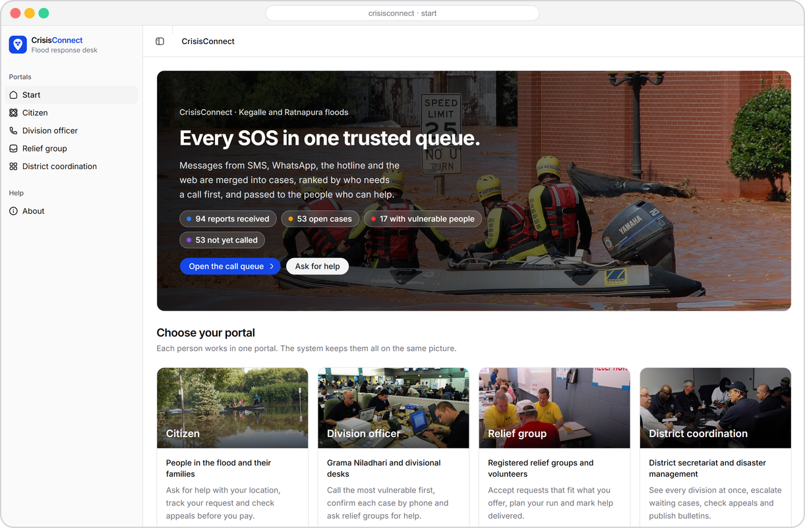




CrisisConnect: one trusted queue
OUR SOLUTION
Every message becomes part of one verified household record that follows the case from the first SOS to delivered help.
Merge Messages that share a phone, a full name or a house become one incident.
Rank Most vulnerable first, and every rank says why.
Verify An officer confirms by phone before help is sent.
Deliver Relief groups accept, dispatch and mark help delivered.
Notes:
This is the real start page. The hero says it plainly: every SOS in one trusted queue.

Slide 6
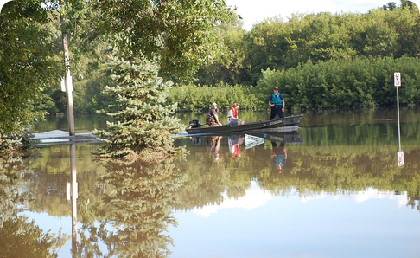
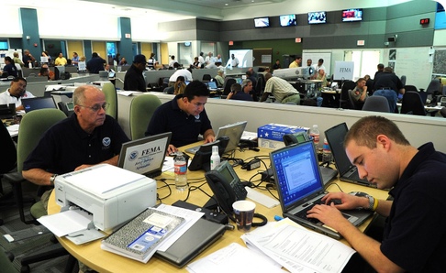
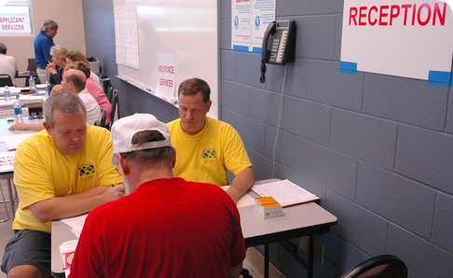
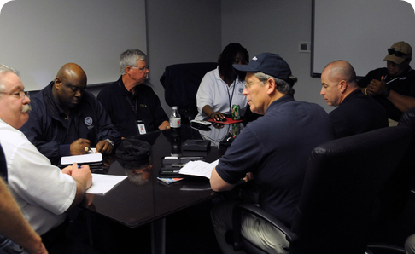




Four portals. One shared picture.
WHO IT SERVES
Citizen
Division officer
Relief group
District
People in the flood and their families
Grama Niladhari and divisional desks
Registered NGOs and volunteers
Secretariat and disaster management
Send an SOS, track the request, and check an appeal before paying.
Call the most vulnerable first, confirm by phone, request relief.
Accept requests that fit, plan the run, mark help delivered.
See every division, escalate, check appeals, publish bulletins.
5 pages · SOS, track, check, map
3 pages · queue, requests, route
4 pages · inbox, route, group
11 pages · map, appeals, agents
Notes:
Each person works in one portal, and every portal reads the same graph, so the citizen, the officer, the relief group and the district always see the same case.

Slide 7





AI reads and ranks. People verify and act.
HOW IT WORKS
ENGINE
1 Read
2 Match
3 Referee
4 Rank
Each SOS, update, offer or appeal is read into the same fields: who, how many, where, which phone, who is vulnerable.
Walkers find messages that share a phone, a full name or a household-level place.
Clear matches merge. Unclear ones wait for a person. Nothing merges on a guess.
Open incidents are ranked by risk, vulnerable people and waiting time, with reasons.
PEOPLE
5 Verify
6 Dispatch
7 Deliver
An officer claims the case and confirms it by phone.
An eligible relief group accepts. A decline reassigns it.
Delivery is recorded and the citizen sees it.
Notes:
Four engine steps, then three human steps. The engine never confirms a case or sends help: a person does.

Slide 8
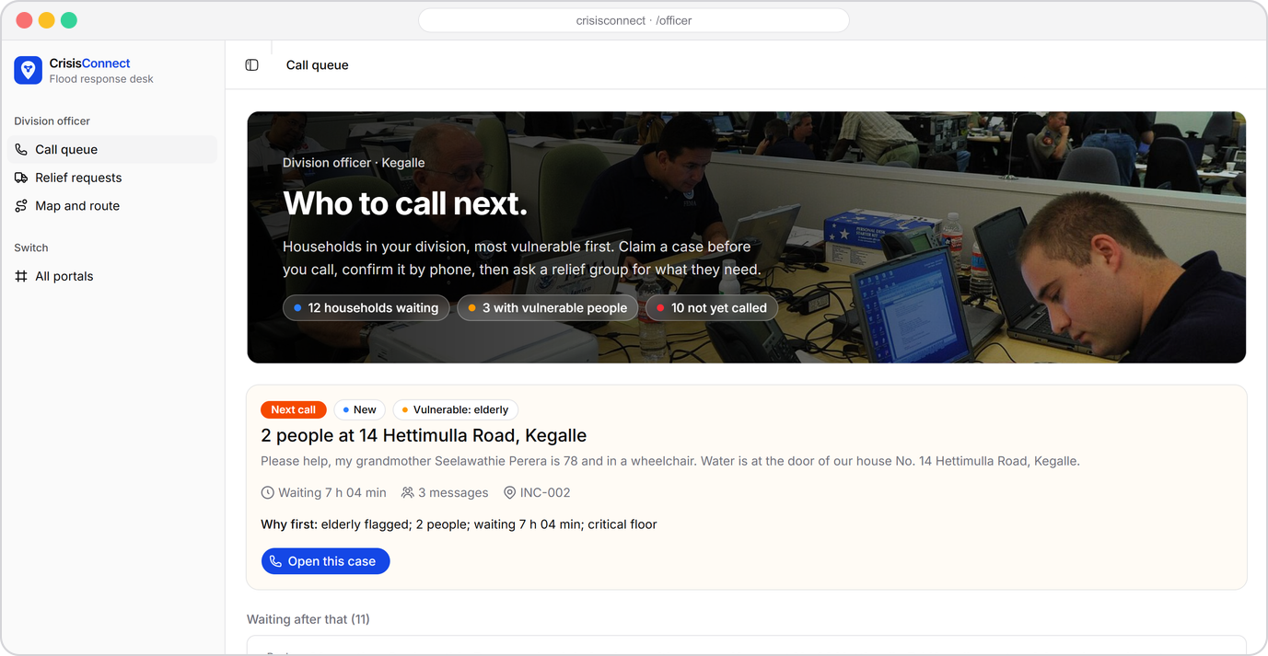
Who to call next, and why
DIVISION OFFICER
1
Most vulnerable first
Elderly, child, medical and pregnant flags lift a household. A model can never lower them.
2
Every rank explained
Each card states why it is where it is, in words, not colour alone.
3
Claim, call, confirm
An officer claims a case, then confirms it by phone. A missed call does not verify anything.
Notes:
The officer's call queue. Point out the vulnerability flags and the plain-language reason on each card.

Slide 9
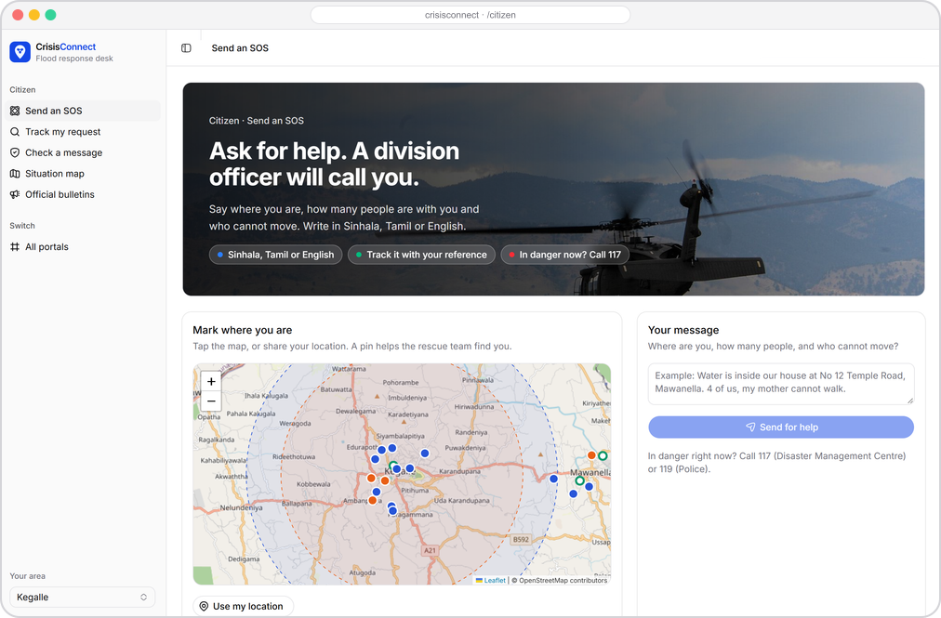
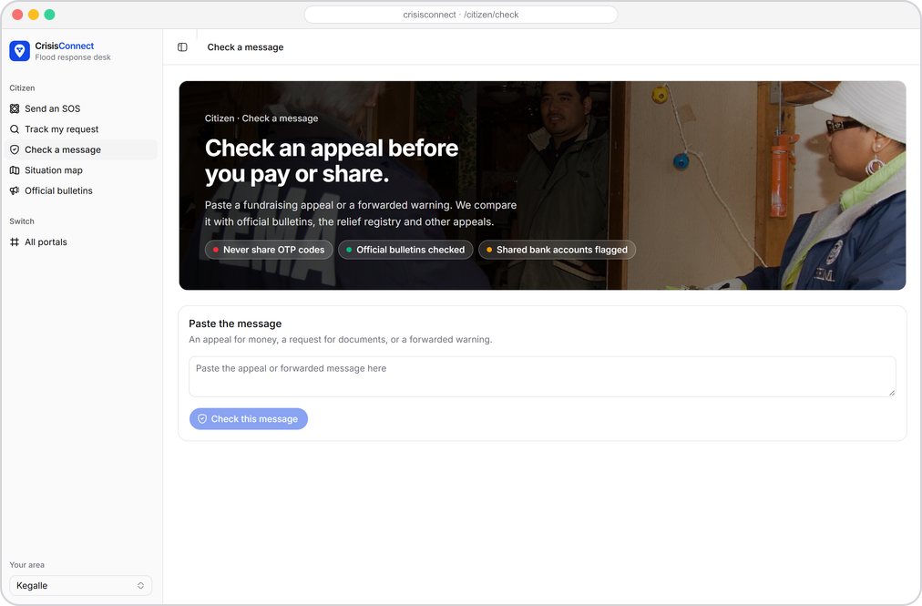
Ask for help once. Check before you pay.
CITIZEN
Send an SOS in Sinhala, Tamil or English, pin the location, and track it with a reference.
Check a message against official bulletins and the relief registry before paying or sharing.
Notes:
The citizen portal: one SOS with a location pin, and a checker for appeals and forwarded warnings. Never share OTP codes.

Slide 10
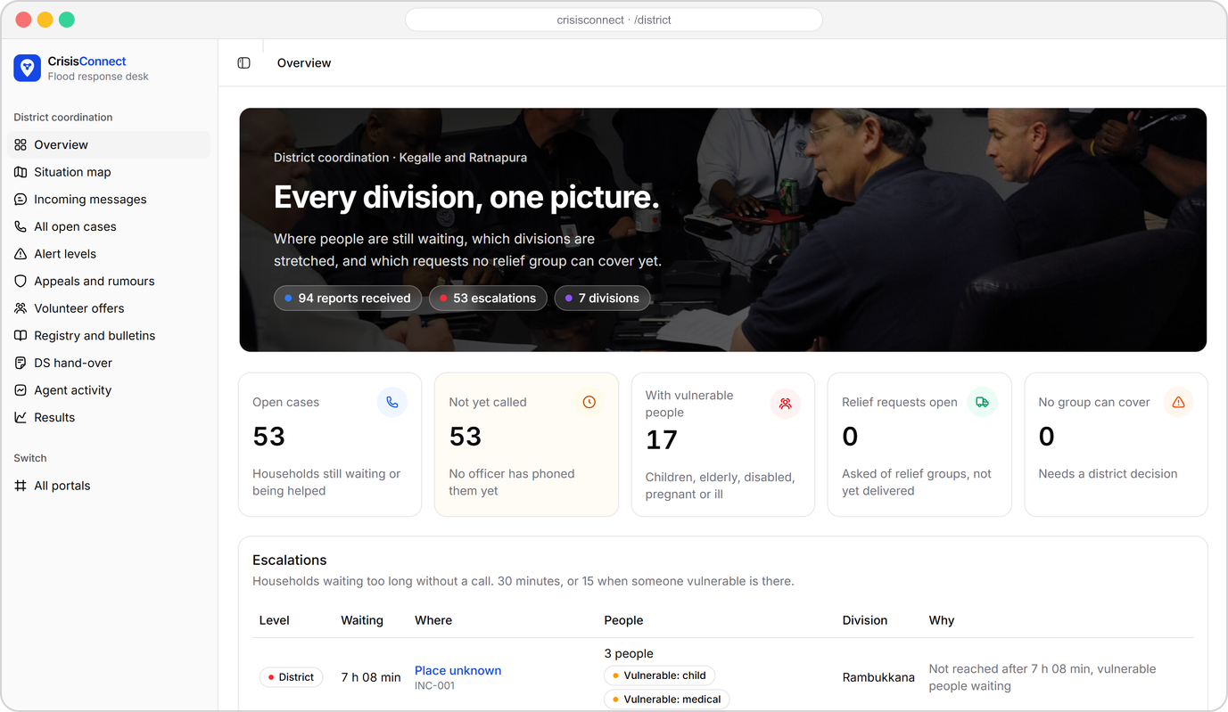



Every division, one picture
DISTRICT COORDINATION
Escalations
Cases waiting too long rise to the district.
Appeals and rumours
Payees and claims are checked against registries and official bulletins.
Agent activity
Every agent proposal, rule and human decision is logged.
Notes:
The district sees all divisions at once and handles what officers can't: escalations, appeals and public bulletins.

Slide 11

One household, from first SOS to delivered help
LIVE DEMO
1
2
3
4
5
6
7
Two reports, one home
Same name, new home
Verified by phone
Smart reassignment
Help on the way
Appeal checks
Delivered
An SMS and a relative's WhatsApp become one incident.
A different Perera household stays separate.
A missed call does not verify. A real call does.
A boat request goes to an eligible group. A decline reassigns it.
The next group accepts and dispatches. The citizen sees it.
An unregistered payee with an OTP request goes to an analyst.
Delivery is recorded and tracking updates for the citizen.
Then open the household story and the Jac graph
Every message, agent proposal, rule, human decision and action is a node you can inspect, with the reason it happened.
Notes:
This is the live demo script. Run the seven steps in the app, then open the household timeline and the graph.

Slide 12
The household is a graph, so we built on one
WHY JAC AND JASECI
Walkers on a shared graph
SMS
Call log
A Blocker walker hops from a new message to its phone and name nodes to find candidate households.
Phone
visit … by llm
WhatsApp
Household
The Resolver walker lets the model choose which neighbouring household to visit.
Full name
Typed by llm functions
Forward
Relief request
Intake, matching and relief choices return typed objects guided by sem notes, not free text.
Rules and commit()
Decision
Appeal
Plain Jac referee rules gate every write. commit() makes each finished unit visible to all portals.
root.shared
Notes:
Messages, identifiers, incidents, calls, appeals and requests are one persistent graph. Walkers traverse it; byLLM gives typed AI calls; referee rules in plain Jac decide what may be written.

Slide 13
The model chooses. The referee decides.
REAL CODE FROM THE ENGINE
R1–R2
A merge needs shared evidence: an exact phone, or a full name plus a house.
walker Resolver {
can start with Message entry {
visit [->:Candidate:->] by resolver_model(
intent="Choose the most plausible household. Exact phones
and a full name plus household place are strong evidence.
Same surname or road is insufficient.",
select=1);
}
}
def assess_match(message: str, incident: str, evidence: list[str],
feedback: str) -> MatchAssessment by resolver_model(temperature=0.0);
sem assess_match = "A shared surname or road is never enough.";
R3
A model can never lower the priority of a medical, child or elderly case.
R4
Confirmed and resolved need a logged phone call.
R7
Rumours never enter the call queue.
R14
Model tools are read-only. One writer applies changes.
crisisconnect/ai/resolver.jac (shortened)
Notes:
This is real code from our repository. The walker asks the model to pick a neighbour; a typed function scores it; then plain Jac referee rules decide whether anything is written.

Slide 14








AI proposes. Rules referee. People decide.
RESPONSIBLE BY DESIGN
Agents propose
Referee checks
People decide
Decision logged
Typed AI calls read, match and suggest. Their tools are read-only.
Plain Jac rules accept, hold or reject. No model is involved.
Officers verify by phone. Analysts review appeals.
Agent, action and reason are saved as a node.
A missed call never verifies a household.
An unverified appeal is never called a scam on its own.
Citizens see their own request and the public map only.
Every status is written as a word. Colour only helps.
Notes:
Our safety model in one line: AI proposes, rules referee, people decide. Every applied change has a logged decision with agent, action and reason.

Slide 15
Tested on a full storm night
RESULTS
94 → 39
25
100%
70%
messages became household incidents
repeat calls avoided
merge precision: no wrong merges
of 20 labelled appeals judged correctly
Read honestly
We chose precision over recall. A missed merge costs one extra call; a wrong merge can hide a family.
The live night cost US$0.35 for 189 model calls. With every model down, rules alone still save 24 calls.
This is our development set, not a held-out benchmark.
Notes:
Numbers come from results/development-rules.json, development-live.json and development-cached.json in the repository. Agents find a third more duplicates than rules alone, and the referee still allowed no wrong merge.

Slide 16





From hackathon build to a pilot division
WHAT COMES NEXT
01
02
03
04
Pilot
Verified registries
Real channels
Access control
One divisional secretariat in Kegalle, with its Grama Niladhari officers on the officer portal.
Connect official relief groups, bank accounts and bulletins instead of our sample registry.
SMS short code, WhatsApp Business and the hotline feeding the same intake.
Authenticated roles for each portal, replacing today's role picker.
Practical boundaries we state up front
Map places inferred from a division are approximate, and road routing does not prove flood-safe access. Human precedents are retrieved memory, not model fine-tuning. Real deployment needs field validation.
Notes:
Be candid: this is a hackathon build. The path to a pilot is clear, and we already say where the system's limits are.

Slide 17

CrisisConnect
Flood response desk
Fewer wasted calls.
More people reached.
One verified household record, from first SOS to relief and appeal checks.
Jac
Jaseci graph
byLLM
Gemini 2.5 Flash
Thank you · TheByteForce · University of Moratuwa
Notes:
Close on the outcome: fewer wasted calls, more people reached. Invite questions and offer to show the graph live.

