Slide 1
SeqGAN: Sequence Generative Adversarial Nets with Policy Gradient
ITRI Sep 30
James, Andrew

Slide 2
What is GAN?
in GAN a discriminative net D learns to distinguish whether a given data instance is real or not, and a generative net G learns to confuse D by generating high quality data.
Discriminator D
Generator G

Slide 3
Sentence Generation
Generator G
ITRI is one of the …
Discriminator D
(LSTM)
Real: 1 / Generated: 0
generative model G to produce a sequence

Slide 4


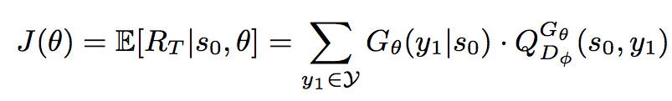
RL-based Generator
Policy: LSTM -> Generate next “word” based on the previous sequence
Q value: the estimated probability of being real
Objective function (performance)

Slide 5
Problem: the discriminator only provides a reward value for a finished sequence.

Slide 6
What do we care?
Traditional LSTM: Generate word based on previous token.
We actually care about the long-term reward, we should not only consider the fitness of previous tokens but also the resulted future outcome.
Monte Carlo search ->

Slide 7

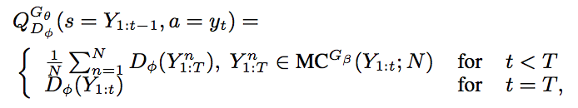
Monte Carlo search
Monte Carlo search with a roll-out policy G to sample the unknown last T tokens.
We run it for N times, thus we have

Slide 8

Policy Gradient
Objective Function
the gradient of the objective function

Slide 9
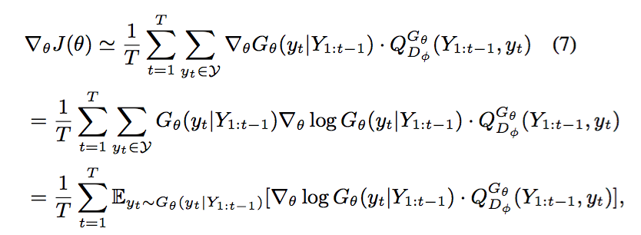

the gradient of the objective function
Update
policy gradient

Slide 10
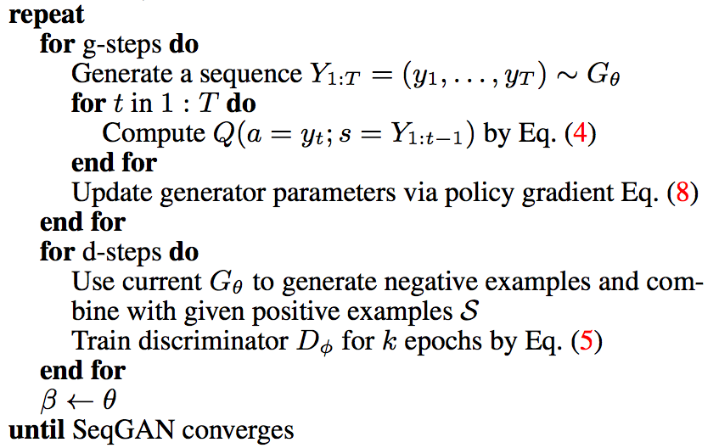
Algorithm
Pre-trained G & D
Iteratively update the network

Slide 11
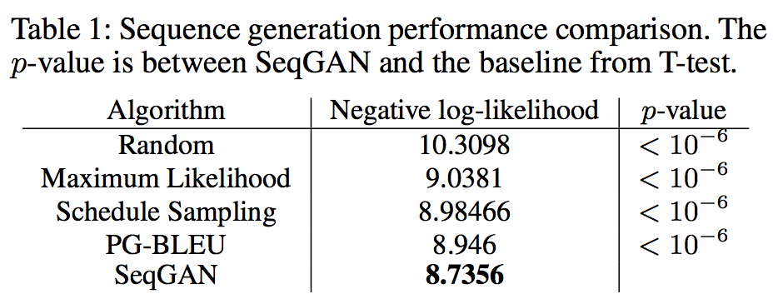
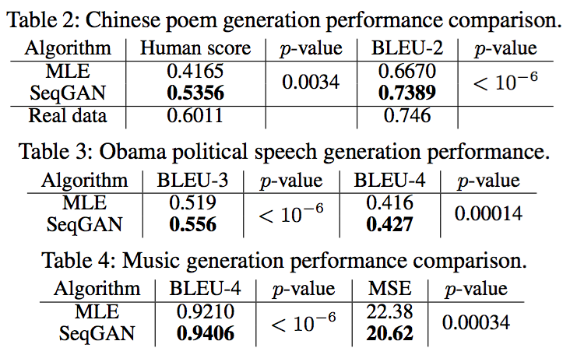
Performance

