Slide 1
Database Design &
Implementation
for a Fitness Center
Database Design & Implementation — Group Project
Week 13 Presentation
Presented by: Marcus Podnar and Nickolas Gabrialovitch

Slide 2
Agenda
01
Project Overview
Objective and scope of the fitness center database
02
Conceptual Model (EER Diagram)
Entities, attributes, and relationships
03
Relational Model
Logical data model and normalization to 3NF
04
SQL: Create & Insert
Table creation scripts and sample data
05
MongoDB Collections
NoSQL implementation for Locations and Coaches
06
SQL SELECT Statements
Queries mapped to wireframe screens
07
Summary
Key design decisions and takeaways

Slide 3
Project Overview
OVERVIEW
Database Design & Implementation for a Fitness Center
Objective
14
4
Reinforce database design concepts by building a full database system for a fitness center — from business rules through to implementation.
Tables
Wireframes
Deliverables Completed
in the relational model
mapped to SELECT queries
Conceptual EER Diagram
Relational Data Structure Diagram (3NF)
SQL: CREATE TABLE scripts
SQL: INSERT sample data
MongoDB Collections (Locations & Coaches)
SQL SELECT statements (4 wireframes)
2
3NF
NoSQL
Normal Form
MongoDB collections
all tables verified

Slide 4
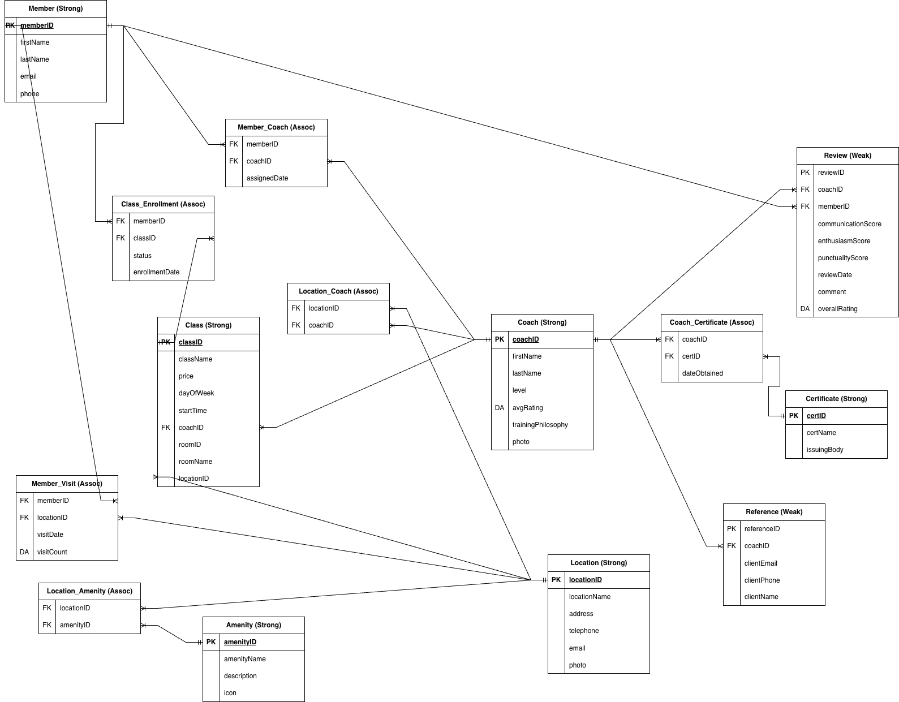
Conceptual EER Diagram
CONCEPTUAL MODEL
Deliverable 1 — designed using Draw.io
Strong entities: Member, Coach, Location, Class, Amenity, Certificate | Weak entities: Review, Reference | Association tables resolve many-to-many relationships

Slide 5
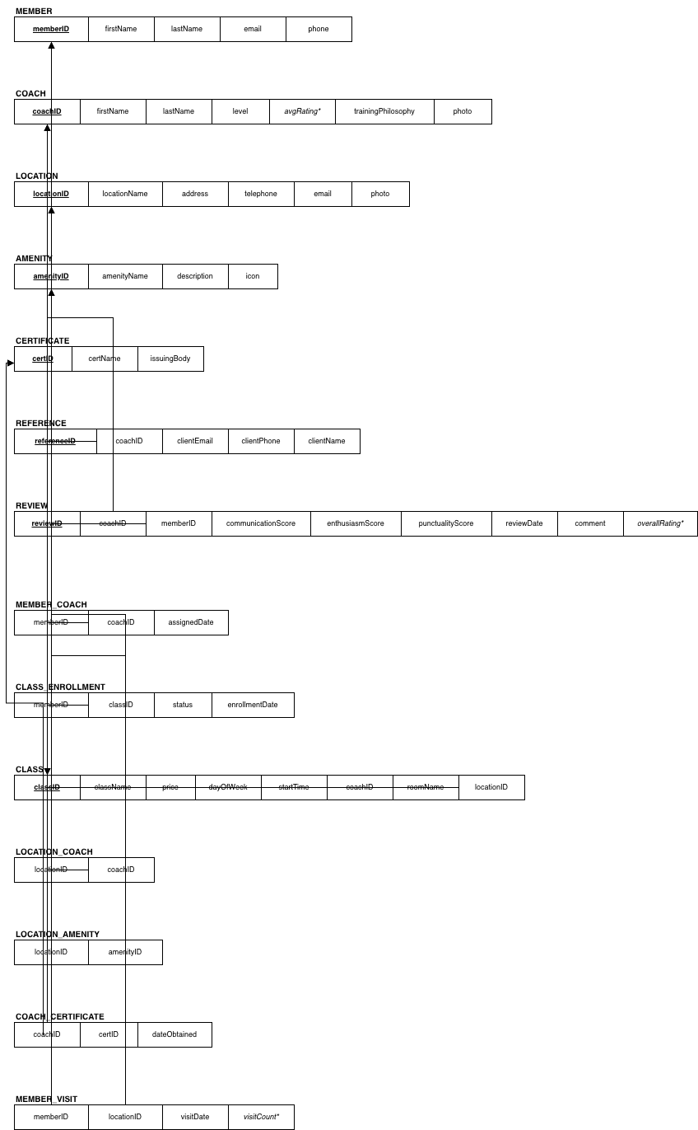
Relational Model (3NF)
RELATIONAL MODEL
Deliverable 2 — ER to Relational conversion
Third Normal Form (3NF)
1NF: All attributes are atomic, no repeating groups.
2NF: Every non-key attribute depends on the full primary key.
3NF: No transitive dependencies — attributes depend only on the PK.
Association tables (Member_Coach, Location_Amenity, etc.) use composite PKs to resolve many-to-many relationships.
avgRating and overallRating are derived attributes, kept for query performance.
14 Tables Total
Member, Coach, Location, Amenity, Certificate, Class, Review, Reference_, Member_Coach, Class_Enrollment, Coach_Certificate, Location_Coach, Location_Amenity, Member_Visit

Slide 6
SQL: CREATE TABLE Scripts
SQL IMPLEMENTATION
Deliverable 3 — enforcing constraints and relationships
CREATE TABLE Member (
memberID INTEGER PRIMARY KEY,
firstName TEXT NOT NULL,
lastName TEXT NOT NULL,
email TEXT NOT NULL UNIQUE,
phone TEXT
);
CREATE TABLE Coach (
coachID INTEGER PRIMARY KEY,
firstName TEXT NOT NULL,
lastName TEXT NOT NULL,
level TEXT,
avgRating REAL,
trainingPhilosophy TEXT,
photo TEXT
);
CREATE TABLE Location (
locationID INTEGER PRIMARY KEY,
locationName TEXT NOT NULL,
address TEXT NOT NULL,
telephone TEXT,
email TEXT,
photo TEXT
);
CREATE TABLE Location_Coach (
locationID INTEGER NOT NULL,
coachID INTEGER NOT NULL,
PRIMARY KEY (locationID, coachID),
FOREIGN KEY (locationID)
REFERENCES Location(locationID),
FOREIGN KEY (coachID)
REFERENCES Coach(coachID)
);
All 14 tables follow the same pattern. Foreign key constraints enforce referential integrity. Association tables use composite primary keys.

Slide 7
SQL: INSERT Sample Data
SQL IMPLEMENTATION
Deliverable 4 — one row per table to validate structure
-- Sample Member
INSERT INTO Member (memberID, firstName, lastName, email, phone)
VALUES (1, 'Alex', 'Johnson', 'alex.j@email.com', '647-555-0101');
-- Sample Coach
INSERT INTO Coach (coachID, firstName, lastName, level, avgRating, trainingPhilosophy)
VALUES (1, 'Jordan', 'Park', 'Senior', 4.8, 'Strength-first progressive overload');
-- Sample Location
INSERT INTO Location (locationID, locationName, address, telephone, email)
VALUES (1, 'Downtown Hub', '123 King St W, Toronto, ON', '416-555-1001', 'downtown@gym.com');
-- Sample Class
INSERT INTO Class (classID, className, price, dayOfWeek, startTime, coachID, locationID)
VALUES (1, 'Morning HIIT', 20.00, 'Monday', '07:00', 1, 1);
-- Link Member to Coach
INSERT INTO Member_Coach (memberID, coachID, assignedDate)
VALUES (1, 1, '2024-01-15');
One INSERT row was added to every table to confirm schema validity and test foreign key constraints.

Slide 8
MongoDB Collections
NOSQL
Deliverable 5 — Locations and Coaches as NoSQL documents
use("fitness_center");
db.createCollection("locations");
db.locations.insertOne({
locationID: 1,
locationName: "Downtown Hub",
address: "123 King St W, Toronto, ON",
telephone: "416-555-1001",
amenities: ["Swimming Pool", "Sauna", "Spin Studio"]
});
db.createCollection("coaches");
db.coaches.insertOne({
coachID: 1,
firstName: "Jordan", lastName: "Park",
level: "Senior", avgRating: 4.8,
locations: ["Downtown Hub"],
certificates: [{ certID: 1, dateObtained: "2018-06-15" }],
references: [{ clientName: "Marcus Reid",
clientEmail: "mreid@corp.com" }]
});
Why MongoDB?
Amenities and certificates are variable-length arrays, ideal for document storage.
Avoids extra junction tables required in relational SQL.
Locations and Coaches are self-contained documents, making reads faster.
Demonstrates polyglot persistence: SQL for structured data, MongoDB for flexible embedded data.

Slide 9
SQL SELECT Statements
SELECT QUERIES
Deliverable 6 — queries mapped to 4 wireframe screens
Wireframe 1
Wireframe 2
Locations Tab
Midtown Location Tab
SELECT l.locationName,
SUM(mv.visitCount) AS timesVisited
FROM Member_Visit mv
JOIN Location l
ON l.locationID = mv.locationID
WHERE mv.memberID = 1
AND strftime('%Y-%m', mv.visitDate)
= strftime('%Y-%m', 'now')
GROUP BY l.locationID;
SELECT locationName, address,
telephone, email
FROM Location
WHERE locationName = 'Midtown Studio';
SELECT a.amenityName FROM Amenity a
JOIN Location_Amenity la
ON la.amenityID = a.amenityID
JOIN Location l
ON l.locationID = la.locationID
WHERE l.locationName = 'Midtown Studio';
Wireframe 3
Wireframe 4
Coaches Tab
Coach Profile Tab
-- My Coaches
SELECT c.firstName, c.lastName,
c.level, c.avgRating
FROM Coach c
JOIN Member_Coach mc
ON mc.coachID = c.coachID
WHERE mc.memberID = 1;
-- All Coaches
SELECT firstName, lastName,
level, avgRating FROM Coach;
SELECT firstName, lastName, level,
avgRating, trainingPhilosophy
FROM Coach WHERE coachID = 1;
SELECT cert.certName
FROM Certificate cert
JOIN Coach_Certificate cc
ON cc.certID = cert.certID
WHERE cc.coachID = 1;

Slide 10
Summary
What we built, what we learned.
01
02
03
04
EER Diagram
Relational Model
SQL Implementation
MongoDB & Queries
Identified 8 strong entities and 2 weak entities from wireframe analysis. Relationships and cardinalities documented.
Converted all entities to 14 normalized tables. All tables verified to be in Third Normal Form.
CREATE TABLE and INSERT scripts written for all 14 tables. Referential integrity enforced via foreign keys.
Locations and Coaches modelled as flexible documents. SELECT queries cover all 4 wireframe screens.
Thank You — Questions Welcome

