Slide 1
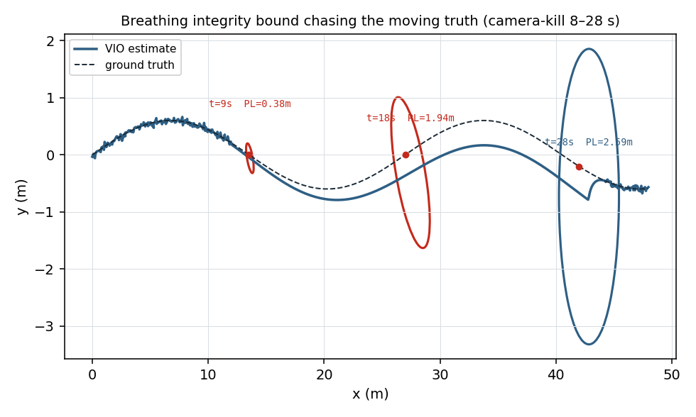
HONEYWELL DESIGN-A-THON · RVCE 2026 · PROBLEM DP7 · FINAL SUBMISSION
A.E.T.H.E.R
TRUTH ∈ BOUND
Assured Estimation with Trust, Health & Error-bounded Reckoning
Integrity-aware Visual-Inertial Odometry for a GPS-denied indoor drone
THESIS
“When the camera dies, our drift bound still covers the true position 95%+ of the time — and we know within half a second.”
WHAT THIS SUBMISSION COVERS
1
PROBLEM UNDERSTANDING
sheets 2–3
offline integrity demo · the bound chasing the moving truth
2
PLANNING & APPROACH
sheets 4–5
3
INNOVATIVENESS
sheets 6–7
4
IMPLEMENTATION DETAILS
sheets 8–9
TEAM Rayyan · Ashitha REPO github.com/TheClazer/A.E.T.H.E.R
A.E.T.H.E.R · DESIGN-A-THON DP7 · FINAL SUBMISSION · pg 1/10

Slide 2
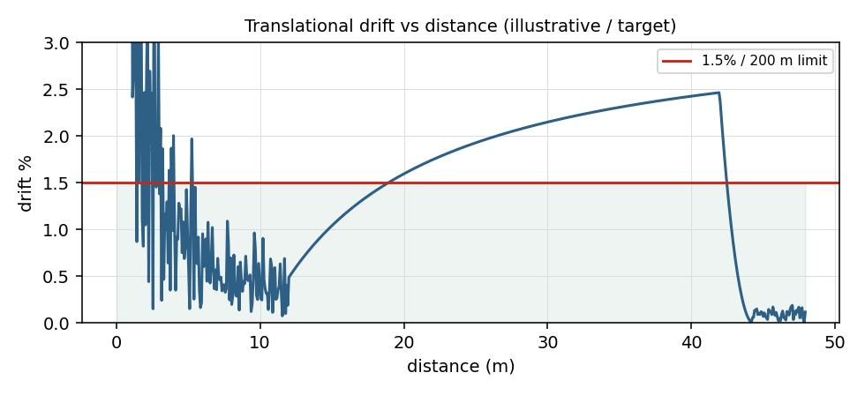
A.E.T.H.E.R · DP7 · CRITERION 1 · PROBLEM UNDERSTANDING · SHEET 02/10
DP7 is an Assured-PNT problem — not a SLAM exercise
TRUTH ∈ BOUND
DP7 SPEC
GNSS-denied tunnel/warehouse · drift < 1.5% / 200 m · ROS2 + Gazebo · estimate-vs-ground-truth report · documented ROS2 workspace
“Everyone can plot a trajectory. The unsolved question is — how wrong am I right now, and do I know it in time?”
THE NUMBER, DECODED
1.5% / 200 m is the KITTI segment-RPE metric ⇒ ≤ 3.0 m terminal error. Off-the-shelf VIO already clears it — it is a FLOOR (80–90% of teams hit it), not the goal.
SIX INDOOR FAILURE MODES WE NAME
Fig. — translational drift held under the 1.5% / 200 m limit (illustrative target)
low/repetitive wall texture · self-similar corridors (single + correlated mismatch) · poor/dynamic lighting · motion blur · observability degeneracy (scale unobservable in straight flight) · vision outage → inertial dead-reckoning. Each gets a bound that protects it.
A.E.T.H.E.R · DESIGN-A-THON DP7 · FINAL SUBMISSION · pg 2/10
FIGURES: SYNTHETIC VALIDATION RIG — ILLUSTRATIVE / TARGET

Slide 3
A.E.T.H.E.R · DP7 · CRITERION 1 · PROBLEM UNDERSTANDING · SHEET 03/10
Why GPS-denied navigation matters to Honeywell
TRUTH ∈ BOUND
Accuracy is table-stakes. Trust is the differentiator.
HANA
MagNav
APEX 2025
Honeywell Alternative Navigation Architecture (Oct 2025): software, layered, INS + aiding modalities. First release = vision-aided nav.
Magnetic-anomaly aided nav flown on an Embraer E170 at 25 m CEP50 in GPS-denied flight — passive, un-jammable.
U.S. Army resilient-navigation demo (White Sands): vision / magnetic / LEO fused with high-grade INS.
The judges built this.
Bounded alt-PNT, proven.
An active battleground.
OUR WEDGE
vision = the aid that BOUNDS INS drift; integrity clamps it (red)
GNSS has RAIM — a live self-check that bounds its own error. Vision aiding has none. We build it: A.E.T.H.E.R is an open-source, student-scale instantiation of Honeywell's HANA philosophy — the IMU is the spine, vision is the aid that bounds inertial drift, and a live integrity layer says, in real time, how wrong we could be and when we can no longer be trusted. That is the layer aerospace ships and student VIO projects skip.
IMU = the spine
A.E.T.H.E.R · DESIGN-A-THON DP7 · FINAL SUBMISSION · pg 3/10

Slide 4
A.E.T.H.E.R · DP7 · CRITERION 2 · PLANNING & APPROACH · SHEET 04/10
Five independent ROS2 nodes — graceful by construction
TRUTH ∈ BOUND
NOVEL · the wedge
sensor_bridge
vio_core
integrity_monitor
degradation_mgr
health_cockpit
/ov_msckf/odomimu
pose + covariance
/nav/integrity_bound
/nav/trust · /nav/state
stereo · IMU · GT
OpenVINS ov_msckf
D · NIS · NEES · IB
R(D) state machine
trust HUD · ellipse
Each box is a standalone ROS2 node — ANY SUBSET RUNS, so a failed module never cascades. Graceful degradation is proven by the graph itself, not promised in prose.
DISCOVER
DE-RISK
DELIVER
Read DP7 as bounded-error estimation + integrity; pick OpenVINS (MSCKF exposes the covariance the integrity layer needs).
EuRoC real data as the guaranteed anchor; the integrity layer in Python on what OpenVINS already publishes — no C++ fork on the critical path.
A locked floor (all 4 DP7 deliverables) by Day 2; the live demo + stretch fenced above it so the worst case is ‘less impressive’, never ‘nothing’.
A.E.T.H.E.R · DESIGN-A-THON DP7 · FINAL SUBMISSION · pg 4/10

Slide 5
A.E.T.H.E.R · DP7 · CRITERION 2 · PLANNING & APPROACH · SHEET 05/10
De-risked to a guaranteed floor — 2 people, 4 days
TRUTH ∈ BOUND
TIER | WHAT | CONFIDENCE
GUARANTEED FLOOR | OpenVINS on EuRoC + Gazebo → drift < 1.5% → est-vs-GT plots → documented ROS2 workspace = all 4 DP7 deliverables | HIGH (by 11 Jun)
LIVE DEMO | Python integrity_monitor on OpenVINS' published covariance → breathing bound + NEES + kill-camera. No C++ fork on the critical path. | MEDIUM-HIGH
STRETCH | C++ MSCKF fork · full whitened-D · generalized-eigenvalue RAIM slope → derived + computed OFFLINE, presented not bet | DAY-4 ONLY
BUILD TIMELINE
DAY 0
DAY 1–2
DAY 3
DAY 4
tonight
FLOOR LOCKED
UPSIDE
POLISH
Windows → Ubuntu 22.04 · ROS2 Humble · Gazebo Harmonic · OpenVINS
OpenVINS on EuRoC + sim → all 4 DP7 deliverables
integrity layer live · kill-camera demo · NEES
breathing cockpit · golden rosbag · backup video
#1 risk is Day-0 (the environment) — done first, with a cloud-GPU fallback. The EuRoC anchor sits under every later risk: a bad sim day still yields all four deliverables. Promise three, land three.
A.E.T.H.E.R · DESIGN-A-THON DP7 · FINAL SUBMISSION · pg 5/10

Slide 6
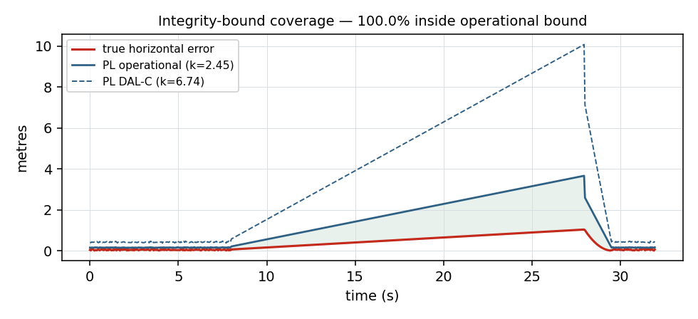
A.E.T.H.E.R · DP7 · CRITERION 3 · INNOVATIVENESS · SHEET 06/10
Integrity-aware VIO = RAIM for the vision aid
TRUTH ∈ BOUND
OBSERVABILITY INDEX D ∈ [0,1]
The smallest eigenvalue of the whitened visual-information matrix on the motion-degenerate subspace — knows WHICH state direction vision can't see (e.g. metric scale), not merely ‘few features.’ Grounded in Zhang&Singh / OC-EKF.
A DUAL, FAULT-DERIVED BOUND
Not a σ-ellipse: a real fault hypothesis + non-central-χ² detection → a protection level on the segment-RPE quantity DP7 grades. Operational k=2.45 (95%) AND DAL-C k=6.74 — both scipy-verified.
THE BOUND IS HONEST
NEES vs ground truth proves the claimed bound actually covers the truth — in nominal AND outage windows. Integrity is meaningless if the bound lies.
Fig. — dual-bound coverage: the true error stays inside the operational PL (k=2.45)
ONE WORKED NUMBER: IB ≈ 1.31 m bound covers a true error ≈ 0.3 m (λ_md = 45.0, k_ffd = 6.74, scipy-verified)
LITERATURE GAP — no prior work is observability-conditioned + scheduler-wired + NEES-validated on one pipeline (Gupta&Gao, ION NAVIGATION). That cell is ours.
A.E.T.H.E.R · DESIGN-A-THON DP7 · FINAL SUBMISSION · pg 6/10
FIGURES: SYNTHETIC VALIDATION RIG — ILLUSTRATIVE / TARGET

Slide 7
A.E.T.H.E.R · DP7 · CRITERION 3 · INNOVATIVENESS · SHEET 07/10
Kill the camera — watch the bound breathe
TRUTH ∈ BOUND
0–8 s NOMINAL · trust GREEN · drift < 1.5%
8 s FAULT · camera black · stock VIO starts to lie
8–9 s TRUST RED in < 0.5 s · degrade to inertial
9–28 s bound BLOOMS ~1.0 m, contains the moving truth
28–32 s vision back · re-converge · trust GREEN
GRACEFUL DEGRADATION (Honeywell DNA)
On vision loss we dead-reckon on the IMU with bounded, characterized error: an 8 s outage on a Honeywell HG4930-class IMU ≈ 0.4 m (vs ~6.3 m consumer), cross-checked to physics ±20%.
THREE-RUNG SAFETY LADDER: live → rosbag-replay → backup video. The integrity layer runs on EuRoC even if the sim wobbles.
Fig. — the integrity bound blooming to ~1.0 m, chasing & containing the moving truth (t = 9 / 18 / 28 s)
A.E.T.H.E.R · DESIGN-A-THON DP7 · FINAL SUBMISSION · pg 7/10
FIGURES: SYNTHETIC VALIDATION RIG — ILLUSTRATIVE / TARGET

Slide 8
A.E.T.H.E.R · DP7 · CRITERION 4 · IMPLEMENTATION DETAILS · SHEET 08/10
A real, public, partly-running repository
TRUTH ∈ BOUND
github.com/TheClazer/A.E.T.H.E.R
VERIFIED RUNNING — MEASURED, NOT PROJECTED
LIVE ROS2 integrity stack (Ubuntu 26.04/Lyrical)
coverage 97.6% · ANEES 3.05 · detect 1.18 s
Gazebo X3 multicopter, 200 m tunnel flight
x→199.8 m · centered ±0.58 m · IMU alive (σ .287)
OpenVINS MSCKF on OUR sim (jazzy container)
0.219% drift / 202 m — DP7 <1.5% beaten 6.8×
TECH STACK
ROS2 Humble · Gazebo Harmonic (gz-sim) + ros_gz · OpenVINS MSCKF (stereo-inertial VIO) · Python rclpy integrity layer · evo + ov_eval (ATE / segment-RPE / NEES) · EuRoC MAV dataset · scipy (audited k-factors) · Streamlit trust HUD · GitHub Actions CI.
WHAT'S IN THE REPO
src/ — aether_msgs (4 msgs + srv) + 5 ROS2 nodes (sensor_bridge, vio_core, integrity_monitor, degradation_manager, health_cockpit). sim/ — Gazebo Harmonic tunnel + primitive drone (stereo + HG4930-IMU + ground-truth publisher; no external mesh). offline_demo/ — the integrity core + a runnable validation rig. eval/ — KITTI drift, rosbag→TUM, figures. docs/ — bible (24 pp), manual-steps, this deck. CI lints + tests on every push.
THE FULL CHAIN, END-TO-END
Gazebo Harmonic renders the stereo tunnel flight (physics-real rotor forces, HG4930-class IMU); ros_gz records the golden bag; the pinned ros:jazzy container replays it through OpenVINS ov_msckf; eval/compute_drift.py (time-synced, SE(3)-aligned) scores it against simulator ground truth; and the SAME integrity nodes that run the live demo run against the real VIO output (docker compose run chain). CI rebuilds the whole workspace on ros:jazzy at every push.
A.E.T.H.E.R · DESIGN-A-THON DP7 · FINAL SUBMISSION · pg 8/10

Slide 9
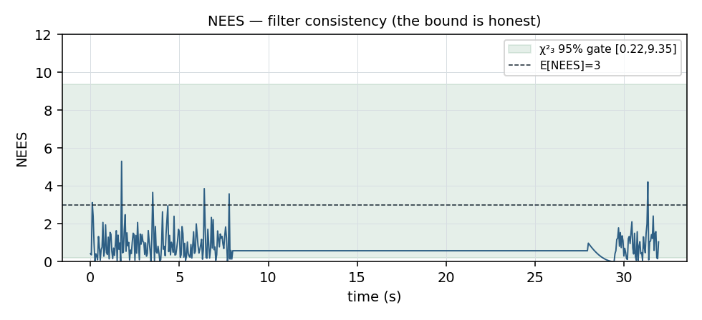
A.E.T.H.E.R · DP7 · CRITERION 4 · IMPLEMENTATION DETAILS · SHEET 09/10
Results from the validation rig (the math, proven)
TRUTH ∈ BOUND
Fig. — NEES inside the χ²₃ 95% gate: the bound is statistically honest
Fig. — true error stays inside the operational protection level
METRIC | TARGET / DESIGN | MEASURED | HONEYWELL ANALOGUE
IB coverage @ k=2.45 (live ROS2) | ≥ 95% | 97.6% (emergent) | GNSS RAIM HPL/VPL
fault-detection latency (live ROS2) | < 1.5 s | 1.18 s | integrity / health monitor
translational drift — OpenVINS on OUR Gazebo flight | < 1.5% / 200 m | 0.219% / 202.2 m | bounded / known error
filter consistency (ANEES, live) | ≈ 3 (χ²₃) | 3.05 | honest covariance
A.E.T.H.E.R · DESIGN-A-THON DP7 · FINAL SUBMISSION · pg 9/10
FIGURES: SYNTHETIC VALIDATION RIG — ILLUSTRATIVE / TARGET

Slide 10
A.E.T.H.E.R · DP7 · CLOSE · SHEET 10/10
We didn't just localize — we built the layer that knows when it can't be trusted
TRUTH ∈ BOUND
①
PROBLEM
DP7 = Assured-PNT; 6 failure modes → a bound for each
②
APPROACH
5-node graph, any subset runs; floor locked Day 2
③
INNOVATION
RAIM-for-vision: observability-conditioned, NEES-validated dual bound
④
IMPLEMENTATION
public repo; integrity core runs & is tested today
“When the camera dies, our drift bound still covers the true position 95%+ of the time — and we know within half a second.”
REPO github.com/TheClazer/A.E.T.H.E.R DELIVERABLES working repo · runnable integrity demo · 24-pg bible · manual-steps · this deck
Honeywell Design-A-Thon RVCE 2026 · Problem DP7 · Rayyan & Ashitha
A.E.T.H.E.R · DESIGN-A-THON DP7 · FINAL SUBMISSION · pg 10/10

