Slide 1
Zomato Delivery ETA
10-hour sprint · LightGBM + CatBoost blend · MAE 3.04 min
Team Hmmmmmmmmmm · Suchit SM Rayyan Shaikh Ranadeep M
github.com/TheClazer/Zomato-delivery-estimation
Final commit: [HASH] — tag: final

Slide 2
Predict Time_taken (min) for each delivery
• Tabular regression: order + rider + restaurant + conditions → minutes.
• Metric: Mean Absolute Error (lower is better).
• Naïve baseline (predict the mean): MAE ≈ 7.6 min → we land at 3.04.

Slide 3
Pipeline
• raw CSV → clean (src/data.py) → features (src/features.py)
• → KFold(5, seed=42) CV → LightGBM Optuna tune (60 trials, 5-min cap)
• → + CatBoost run on same split → weighted blend → freeze final.
• Reproducibility: every seed = 42, every train.parquet, model file, OOF saved.

Slide 4
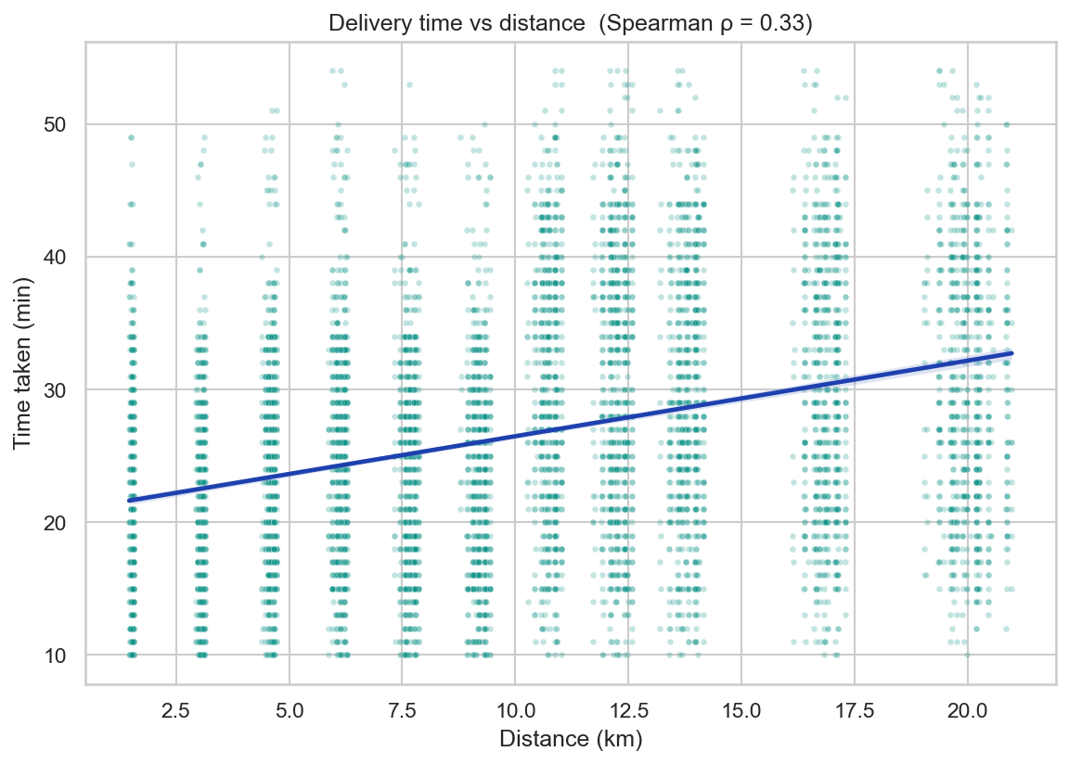
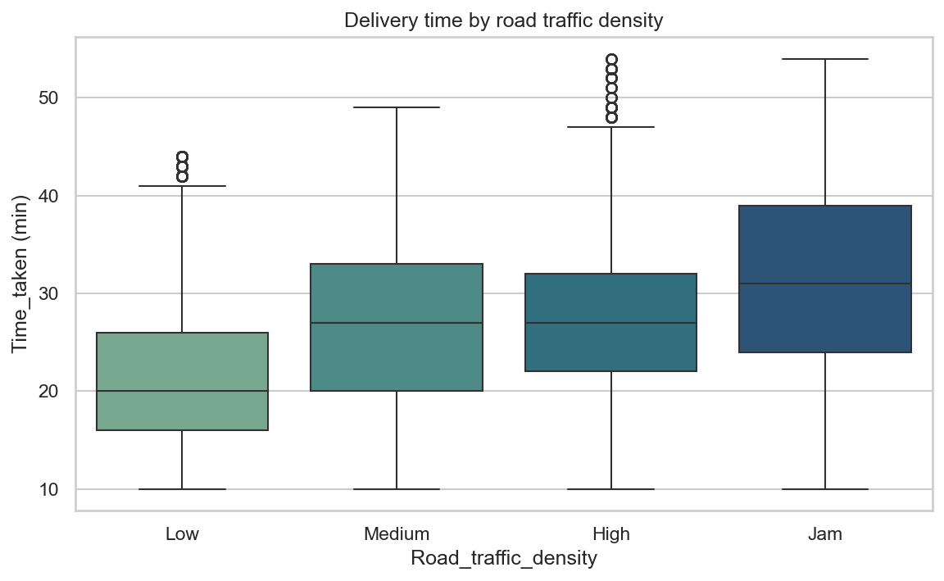
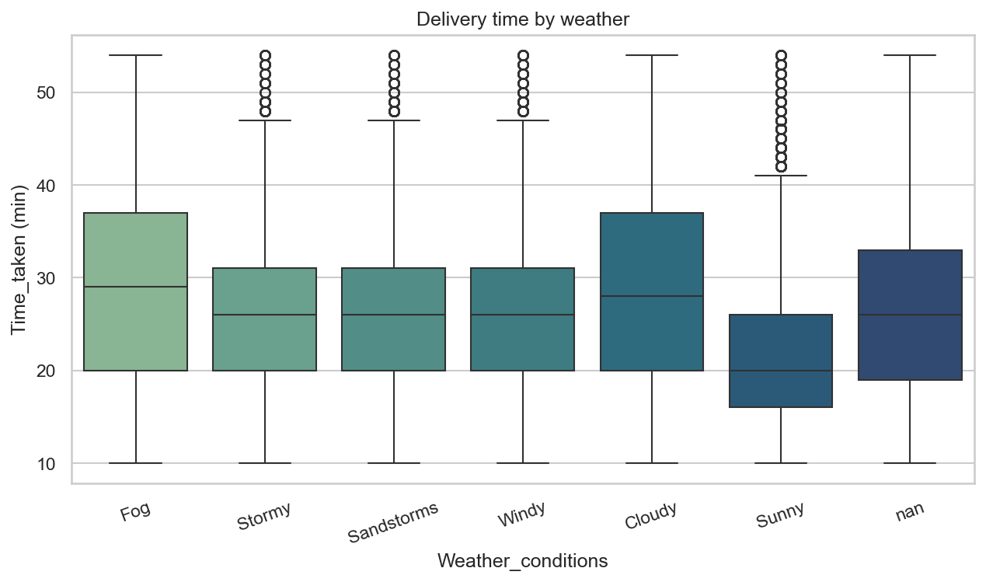
What our EDA found
• Distance ρ = 0.33 — clean primary signal.
• Traffic dominates: ANOVA F=3390.2, Low→Jam adds many minutes; verified significant at p=0.00e+00.
• Bad weather adds ≈ 6.0 min vs Sunny; festival days ≈ +19.5 min.

Slide 5
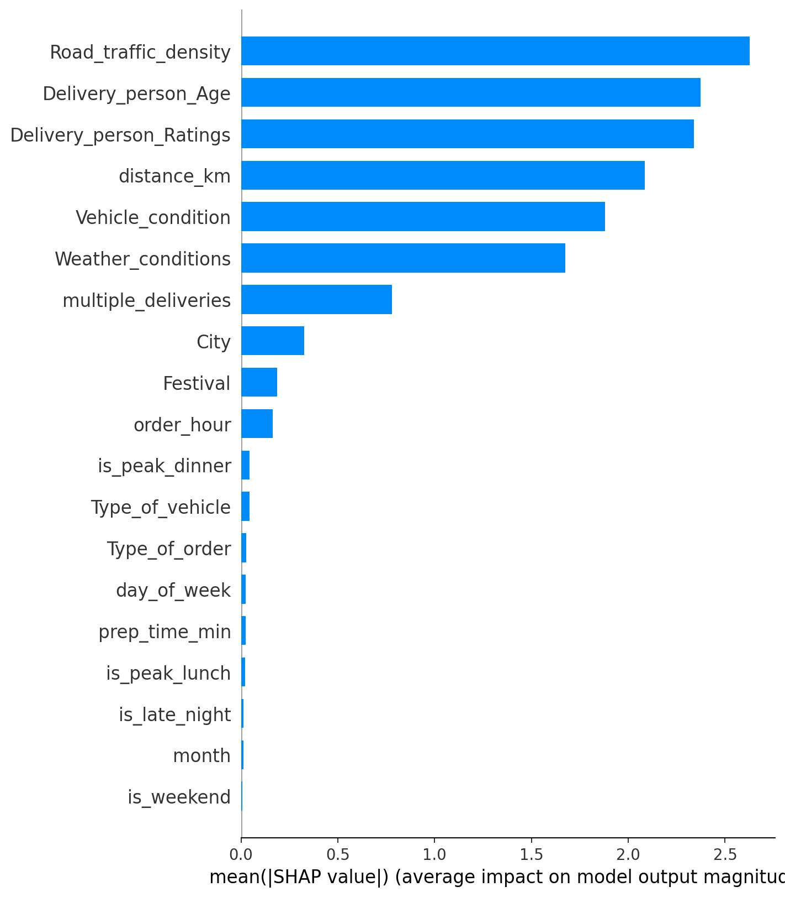
Model and why
• LightGBM with native categorical handling (no one-hot bloat).
• Optuna 60-trial TPE search; 3-fold inner CV; final 5-fold KFold seed=42.
• Tuned LGBM MAE = 3.053 ± 0.018 (per-fold [3.03, 3.07, 3.04, 3.08, 3.05]).
Feature importance — SHAP bar

Slide 6
Post-pivot features (15:00 drop)
Auto-detect join key, build ≤ 3 features, retrain with the v1 tuned params on the same KFold.
READY — fills automatically when data/pivot/ receives files
• Pipeline staged in notebooks/_run_pivot.py — single command at 15:00.
• Auto-tries 6 join keys (Delivery_person_ID, Order_ID, ID, Restaurant_ID, City, Order_Date).
• Drops any column with >80% null after merge (noise filter).
• Builds ≤3 features so this slide stays readable.
• Retrains tuned v1 params on the new X matrix; same KFold seed=42.
• Writes reports/delta.json with a 'ship_v2' boolean — auto-decides.
• If delta ≤ 0.05 min we keep v1 (rulebook §6: data literacy > vanity).

Slide 7
The delta
v1 vs v2 — same CV split, no cherry-picking.
3.053
TBA
TBA
v1 MAE (locked)
v2 MAE (15:00 drop)
Δ MAE (computed live)
DECISION FRAMEWORK (locks at 17:00)
• If Δ > +0.05 min → ship v2; this slide updates with the per-fold bar chart.
• If Δ ≤ +0.05 min → keep v1; slide 6 retitles to 'What the pivot data revealed'.
• Current v1 = 3.053 ± 0.018; blend = 3.043.
• Both branches are honest — rulebook §6 rewards correct verdicts over inflated claims.

Slide 8
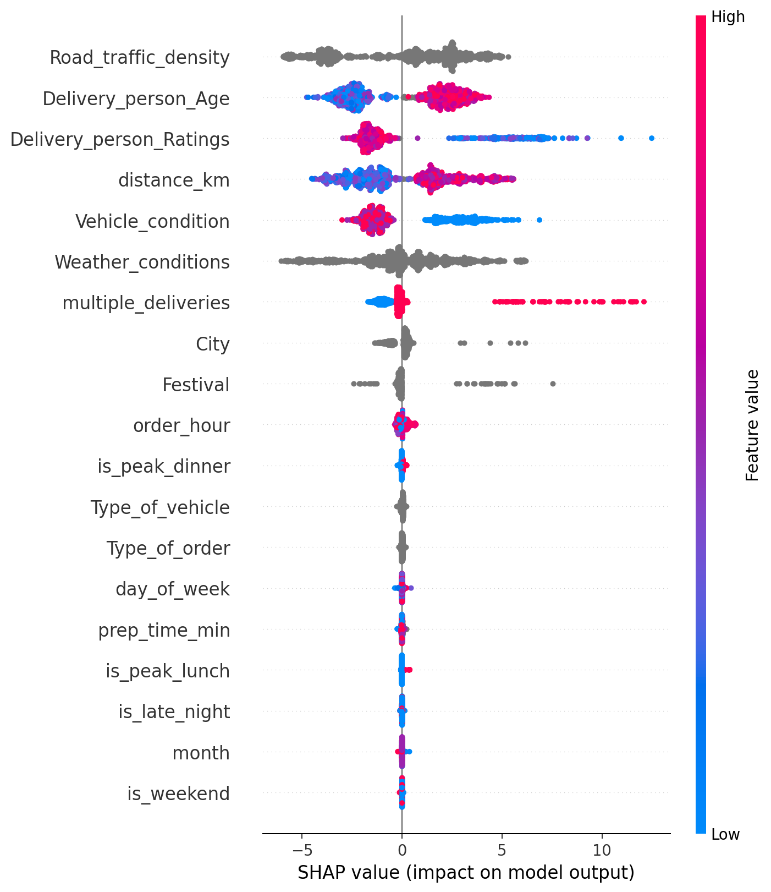
Stability and interpretability
• 5-fold MAE std = 0.018 (≈1% of mean — model is stable).
• Top SHAP features: Road_traffic_density, Delivery_person_Age, Delivery_person_Ratings, distance_km, Vehicle_condition.
• No target leakage: prep_time is computed from order/pickup times only.
• Blend (0.55 LGBM + 0.45 CatBoost) further improves to 3.043 (-0.010).

Slide 9
Limitations and what's next
• No real-time traffic API; weather is categorical only.
• Coordinate noise contributes residual MAE — 431 rows had >30 km haversine (capped, not dropped).
• Next: quantile regression for ETA intervals + live traffic feed.
• Stacked ensemble (LGBM + CatBoost + linear meta-learner) on the existing OOF preds — code path already saved.

Slide 10
Thank you
Repo: github.com/TheClazer/Zomato-delivery-estimation
Tag: final
Q&A — distance, traffic, blend, pivot, anything.
DataVerse 2026 · BMSCE

