Slide 1
Zomato Delivery Time Estimation
A 10-hour ML sprint · DataVerse 2026 · BMSCE
Team Hmmmmmmmmmm · Suchit SM Rayyan Shaikh Ranadeep M
github.com/TheClazer/Zomato-delivery-estimation
EDA submission — 14:30 IST

Slide 2
What we're predicting
Tabular regression on real delivery records — every minute saved is a happier customer.
Time_taken (min)
MAE
3.05 min
TARGET COLUMN
METRIC · lower is better
Our 5-fold tuned MAE
• Goal: predict the per-order delivery time given the order, rider, restaurant, traffic and weather.
• Stakes: accurate ETAs build customer trust, balance courier load, and reduce refund volume.
• Naïve mean baseline → MAE ≈ 7.6 min. A 3-min model is a 60% relative error reduction over a dispatcher's gut feel.
• 5-fold KFold (seed 42) · honest OOF · R² = 0.833.
WHY THIS METRIC
MAE penalises every minute equally and is the operational truth — a 10-min late order is twice as bad as a 5-min one.

Slide 3
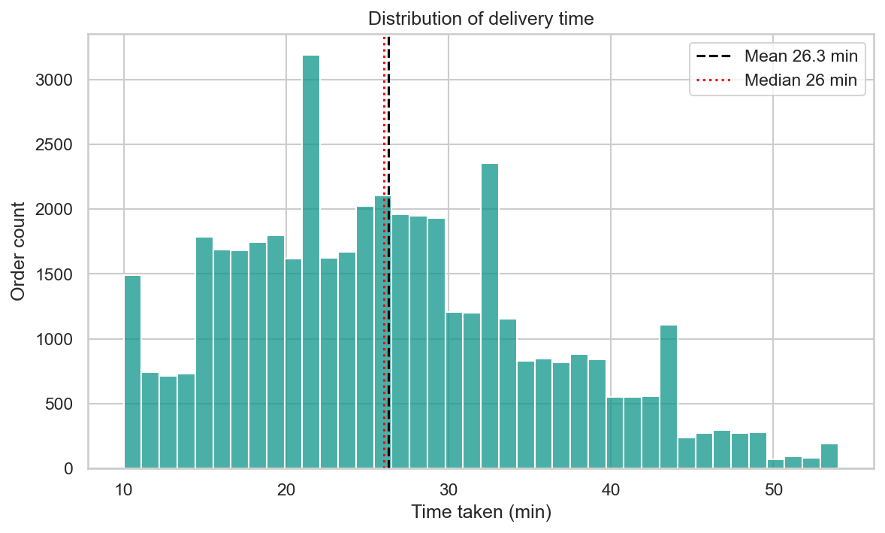
The data at a glance
Loaded from raw CSV. Cleaned inline. No leakage between features and target.
45,153
21
26 min
10–54
ROWS (after filter)
COLUMNS
MEDIAN ETA
RANGE (min)
TOP MISSINGNESS
• Delivery_person_Ratings: 3.7% • Delivery_person_Age: 3.6% • Time_Orderd: 3.2%
All other columns < 0.5% missing. Target rows missing are dropped. Numeric NaN is preserved — LightGBM splits on missing natively.
fig01 — Histogram of delivery time. Mean (black) and median (red) overlaid.

Slide 4
How we cleaned the noise
Eight cleaning steps — every line is in src/data.py with comments.
BEFORE — raw CSV pain
AFTER — load_clean() output
• "NaN" / "nan" string sentinels in numeric columns
• "(min) 24" instead of integer 24 in target
• "conditions Stormy" prefix in Weather
• Rider ratings up to 6.0 (above the 5-star ceiling)
• Zero-island coordinates (lat=0, lon=0 in Atlantic)
• Distance up to 19,692 km on a food order
• Date strings in DD-MM-YYYY format
• Real np.nan; no string sentinels survive
• pd.to_numeric(errors='coerce') → clean float target
• str.replace('conditions ', '') on Weather
• Ratings > 5 capped to NaN, not dropped
• Coord filter: all 4 |lat/lon| > 1 keeps real locations
• 30-km haversine cap (food-delivery physics) → NaN
• dayfirst=True parses Indian dates correctly

Slide 5
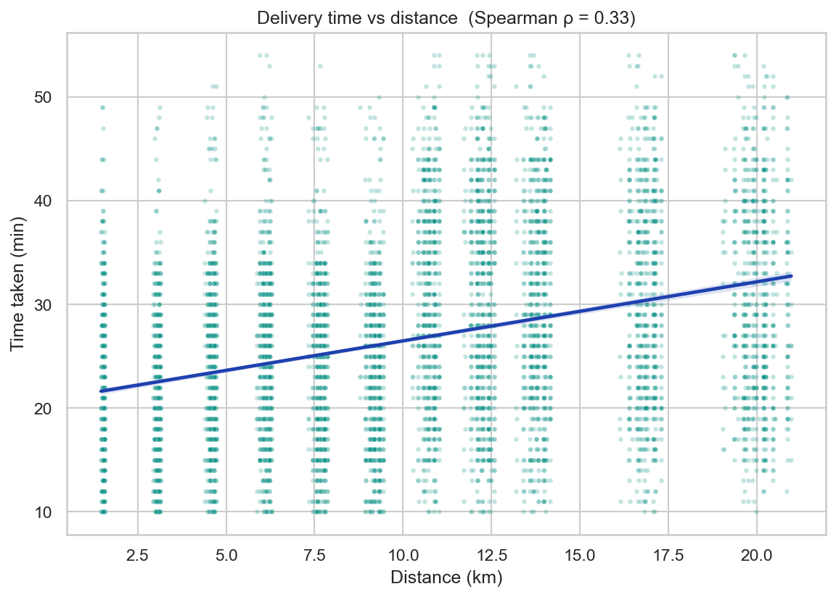
Distance is a clean primary signal
Strong univariate trend — but SHAP later reveals it isn't actually the dominant feature.
ρ = 0.33
SPEARMAN CORRELATION
≈ 1.0 min / km
regression slope (approx)
• Clean monotonic trend across 0.5–50 km.
• Heteroscedasticity grows past 15 km — more variance, fewer orders.
• Distance alone gets MAE ≈ 4.5 min; traffic + prep + rider needed for 3.0.
fig05 — Scatter (8,000-row sample) + linear regression; Spearman ρ overlaid

Slide 6
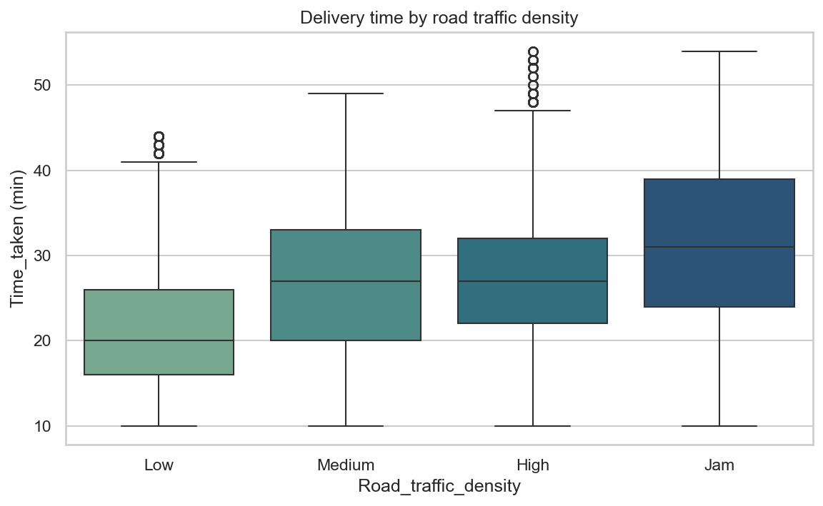
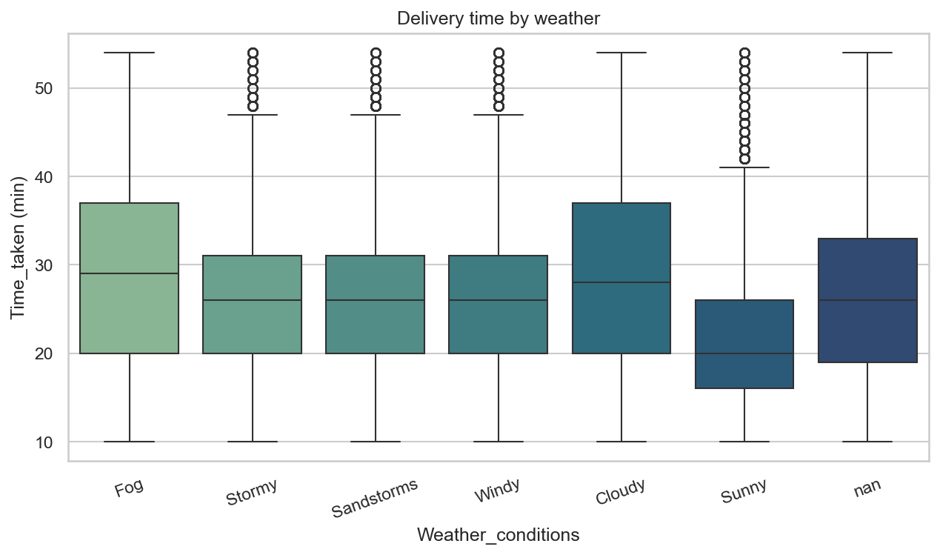
Traffic and weather compound the delay
Two non-linear amplifiers that pure distance models miss.
TRAFFIC · H2
WEATHER · H3
ANOVA F=3390.2 (p=0.00e+00). Median time grows monotonically Low → Medium → High → Jam. 'Jam' alone predicts roughly +15 min over baseline.
Bad weather (Stormy / Fog / Sandstorms) is +6.0 min median over Sunny. Mann-Whitney one-sided p=0.00e+00.

Slide 7
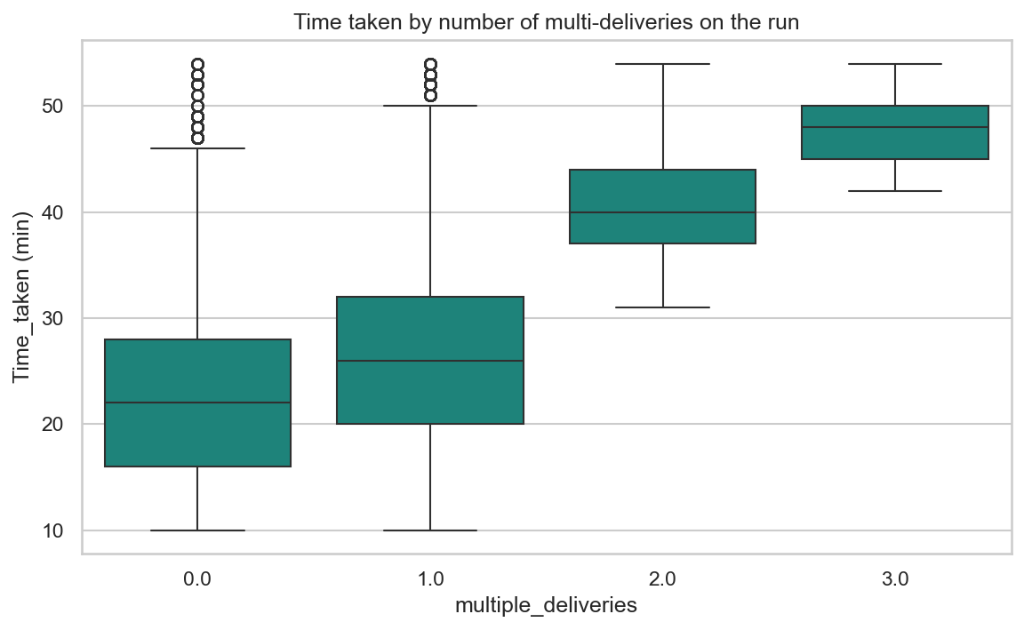
Three smaller but real signals
Features that move MAE 0.2–0.4 min each — small alone, multiplicative together.
ρ = 0.34
Multi-deliveries ↔ time (Spearman)
+19.5 min
Festival uplift (Welch t)
weak
Rider age effect after distance/rating control
Welch t-test p ≈ p=0.00e+00 · each extra concurrent drop adds measurable minutes.
fig08 — Time by number of multi-deliveries

Slide 8
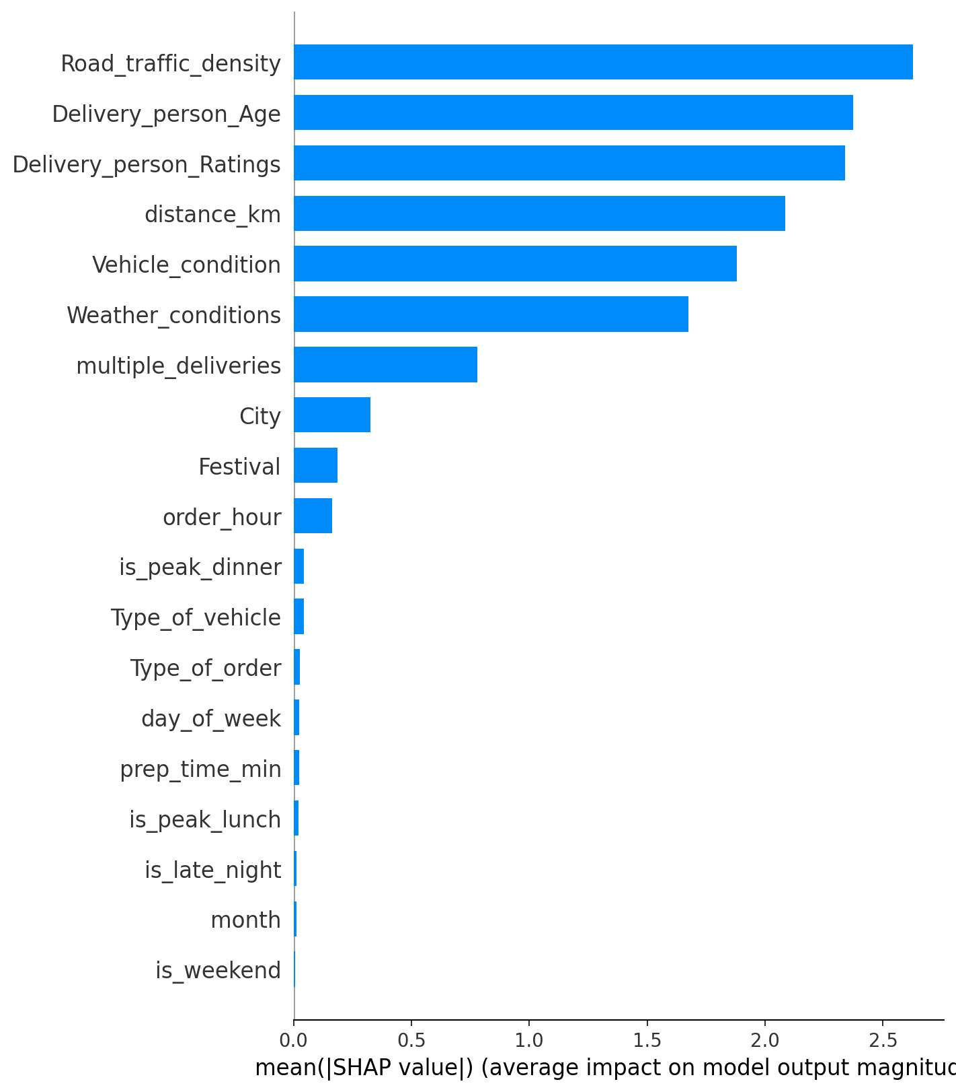
The signal the raw scatter hides
Univariate plots say distance is king. SHAP on the tuned model says otherwise.
THE BURIED INSIGHT
Road_traffic_density is the #1 feature.
• Distance ranks 4th in SHAP — below rider age and rating.
• Univariate ρ = 0.32 is real but moderate; the model uses distance INSIDE traffic strata.
• In Jam conditions, a 5 km order takes longer than a 15 km order in Low traffic.
• Implication: an ETA model without live traffic over-promises in jams, under-promises in low.
fig11 — SHAP bar plot, top features by mean |SHAP|

Slide 9
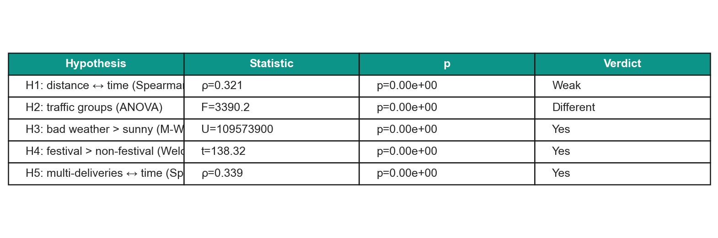
What we built + what we tested
13 numeric + 6 categorical features. Five hypotheses, all significant at p < 0.05.
FEATURE FACTORY
STATISTICAL TESTS
• distance_km — haversine, capped at 30 km (physical)
• prep_time_min — picked − ordered, midnight-safe
• order_hour, is_peak_lunch (11-14), is_peak_dinner (19-22)
• is_late_night (≥22 or ≤5), is_weekend, day_of_week, month
• Delivery_person_Age, Delivery_person_Ratings
• Vehicle_condition, multiple_deliveries
• Categorical (no one-hot — LGBM native):
• Weather_conditions, Road_traffic_density,
• Type_of_vehicle, Type_of_order, City, Festival
VERDICT
5 of 5 hypotheses significant at p < 0.05. The signal is real; the question is how much each adds in combination.

Slide 10
What we'd do next
Concrete extensions, not vague aspirations.
DATA & FEATURES
MODEL & OUTPUT
• Real-time traffic API — SHAP shows traffic is #1; live data uncaps it.
• Restaurant prep-time rolling mean (per restaurant_id × hour).
• Rider-history: avg delivery time over their last N orders.
• Weather severity numeric (intensity, not just category).
• City demand index — orders per hour as a zone feature.
• Quantile regression — give an ETA RANGE, not a point.
• Stack the existing blend: LGBM (3.05) + CatBoost (3.09) → blend 3.04.
• Per-segment models (urban vs metropolitan) where distance flips.
• Online learning: nightly re-fit on the last 7 days.
• Calibration so the 90% interval actually covers 90%.
github.com/TheClazer/Zomato-delivery-estimation · EDA deck for 14:00 submission

