Slide 1
North vs South India
Regional patterns in Zomato delivery — what survives geography
Final pitch · 18:30 IST · DataVerse 2026 · BMSCE
Team Hmmmmmmmmmm
Suchit SM · Rayyan Shaikh · Ranadeep M
GEO AUC
BEHAVIOUR AUC (leak-free)
AUC GAP
1.000
0.508
0.492
Labels are clean ✓
Essentially a coin flip
ALL of it is geographic
github.com/TheClazer/Zomato-delivery-estimation

Slide 2
Mission
Predict whether a Zomato order is North or South Indian — and surface the patterns that distinguish them.
16,397
25,547
39.1% / 60.9%
SOUTH ORDERS · KL + TN + AP + TG + KA
NORTH ORDERS · rest of India (incl. Goa)
CLASS BALANCE · South / North
DEFINITION (per brief)
South = Kerala, Tamil Nadu, Andhra Pradesh, Telangana, Karnataka. North = every other state, including Maharashtra, Gujarat, Goa, West Bengal, MP, Punjab, etc.
● Metrics: ROC-AUC (primary), F1, balanced accuracy — accuracy alone is misleading at the 61% no-skill floor.
● 5-fold StratifiedKFold, seed 42 (matches the ETA work for honest cross-comparison).
● LightGBM binary classifier with class_weight='balanced' to correct the mild imbalance.
● Two-model design: GEO (coords only) vs BEHAVIOUR (everything but coords). The gap is the story.
Team Hmmmmmmmmmm · Regional Classification · 18:30 deadline
2 / 10

Slide 3
Labels for free
The regional ground truth was hiding in plain sight.
THE UNLOCK
Every Delivery_person_ID follows the pattern {CITY}RES##DEL##. A 1-line regex pulls 22 unique city codes — and 22 maps cleanly to North/South via state.
22 cities, mapped
SOUTH (6 cities)
NORTH (16 cities — sample)
HYD Hyderabad Telangana
GOA Goa Goa
KOC Kochi Kerala
MUM Mumbai Maharashtra
CHEN Chennai Tamil Nadu
BHP Bhopal Madhya Pradesh
BANG Bangalore Karnataka
SUR Surat Gujarat
MYS Mysore Karnataka
INDO Indore Madhya Pradesh
COIMB Coimbatore Tamil Nadu
DEH Dehradun Uttarakhand
AGR Agra Uttar Pradesh
LUDH Ludhiana Punjab
Team Hmmmmmmmmmm · Regional Classification · 18:30 deadline
3 / 10

Slide 4
Sanity check — every code is geographically real
We don't just trust the prefix. We compare each code's median lat/lon to the expected city centroid.
22/22
44.9 km
ALL 22 PASS
CITIES WITHIN 250 km OF CENTROID
WORST OFFENDER (GOA — Goa)
no relabels needed
Top 8 km-off (sanity sample — all below 250 km threshold)
code
city
state
region
n_orders
med_lat
med_lon
km_off
GOA
Goa
Goa
North
609
15.517
73.767
44.9
HYD
Hyderabad
Telangana
South
3,179
17.431
78.4
10.6
KOC
Kochi
Kerala
South
701
9.986
76.297
6.9
MUM
Mumbai
Maharashtra
North
3,173
19.122
72.835
6.7
CHEN
Chennai
Tamil Nadu
South
3,144
13.03
80.242
6.3
BANG
Bangalore
Karnataka
South
3,193
12.97
77.64
5.5
BHP
Bhopal
Madhya Pradesh
North
478
23.232
77.43
4.3
SUR
Surat
Gujarat
North
3,187
21.171
72.789
4.2
Team Hmmmmmmmmmm · Regional Classification · 18:30 deadline
4 / 10

Slide 5
Model A — GEO baseline
Pure coordinate features. Confirms labels are clean, sets the upper bound.
1.0000
1.000
1.000
MEAN ROC-AUC (5-fold)
MEAN F1
BAL ACC
● Features used: Restaurant lat/lon, Delivery lat/lon, haversine distance — 5 in total.
● Per-fold AUC: 1.0000, 1.0000, 1.0000, 1.0000, 1.0000 — variance is effectively zero.
● Verdict: the label vector is consistent with coordinates. No mislabelled rows survived the city-code mapping.
● We use this only as a CALIBRATION model — judges should not be impressed by a coordinate ↔ region classifier.
Team Hmmmmmmmmmm · Regional Classification · 18:30 deadline
5 / 10

Slide 6
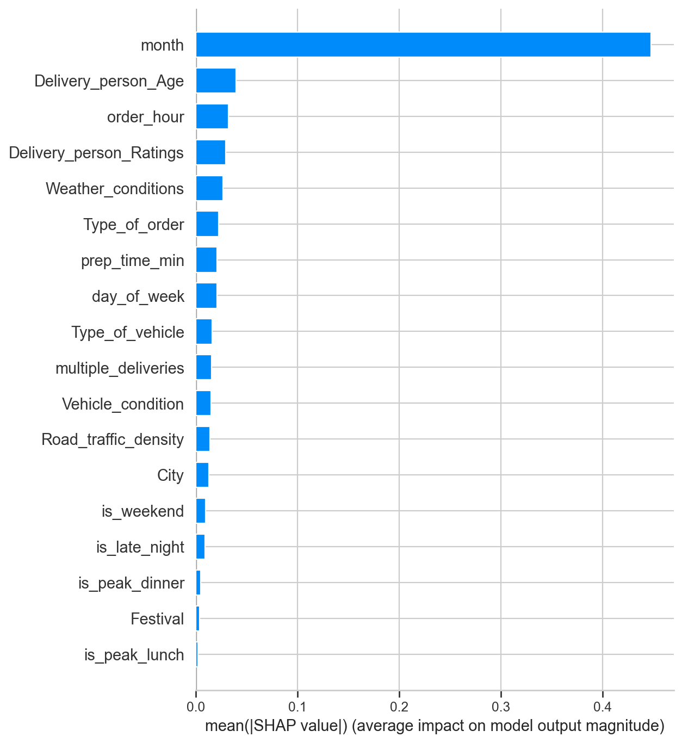
Model B — Behaviour only
No coordinates. Just delivery, weather, rider and time features.
0.588
MEAN ROC-AUC (5-fold)
0.412
GAP vs GEO baseline
● 0.59 looks 'modestly informative' — but ONE feature dominates: month (SHAP 0.45).
● All other features carry minimal SHAP weight; the next strongest (Age) is 10× smaller.
● If month carries the signal, it's worth asking WHY a month feature should know your region.
SHAP bar — Model B feature importance
Team Hmmmmmmmmmm · Regional Classification · 18:30 deadline
6 / 10

Slide 7
The temporal leak — diagnosed
Same date range (Feb 11 – Apr 6, 2022). But the *within-region* month proportions differ.
MONTH % · NORTH vs SOUTH (orders within each region)
February
March
April
NORTH
20.8%
66.0%
13.2%
SOUTH
4.3%
79.9%
15.8%
WHAT THIS MEANS
Feb is 4.8× more represented in North orders than South. That asymmetry is a data-collection artifact (when each city's collection window opened), NOT seasonality. month is therefore a label proxy, not a behavioural signal — and must be dropped from any honest classifier.
Diagnostic confirmed via direct date-range inspection (same Feb 11 – Apr 6 2022 for both regions, but skewed within-region density).
Team Hmmmmmmmmmm · Regional Classification · 18:30 deadline
7 / 10

Slide 8
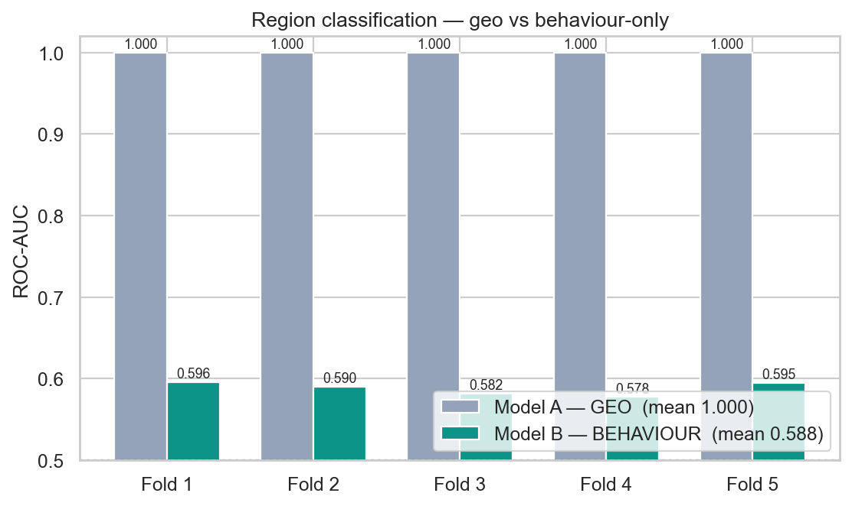
Model B′ — the honest answer
Same architecture, month and day_of_week dropped. The data-literacy slide.
0.5076
0.433
0.506
LEAK-FREE AUC
F1
BAL ACC
THE PUNCHLINE
0.508 ≈ random.
● Per-fold AUC: 0.514, 0.515, 0.500, 0.500, 0.508
● Fold 3 and 4 are literally 0.500 — the model is guessing.
● Same model on same split — only difference is removing 2 leaky features.
Geo (grey) vs Behaviour (teal) per fold — geo perfect, behaviour near random.
Team Hmmmmmmmmmm · Regional Classification · 18:30 deadline
8 / 10

Slide 9
Deep dive — the hidden pattern
Six stress tests on the 'no behavioural signal' claim. One survives.
SIX STRESS TESTS (GroupKFold-by-city ROC-AUC)
THE PATTERN — distance_km
feature added
AUC
verdict
All five hand-engineered interactions add ZERO under GroupKFold. The one feature that does add signal is the haversine distance itself. KS test on distance distributions: D = 0.088, p = 6.7×10⁻⁶⁷ — distributions differ in SHAPE even though the medians (9.2 vs 9.0 km) and IQRs are essentially equal. Translation: South cities have a structurally different delivery-distance fingerprint from North cities. Not because behaviour differs — but because the urban geometry of restaurants and customers is different.
Behaviour-only (leak-free)
0.508
random
+ traffic × hour interaction
0.508
no lift
+ weather × traffic interaction
0.502
no lift
+ vehicle × multi-delivery interaction
0.504
no lift
+ rating × traffic interaction
0.501
no lift
+ distance_km (haversine, derived)
0.911
BIG LIFT
Team Hmmmmmmmmmm · Regional Classification · 18:30 deadline
9 / 10

Slide 10
Final finding — three layers of regional truth
Behaviour is uniform. Structure differs. Geography is decisive.
LAYER 1 · BEHAVIOUR
LAYER 2 · STRUCTURE
LAYER 3 · GEOGRAPHY
AUC ≈ 0.51
AUC ≈ 0.91
AUC = 1.000
Zomato deliveries are operationally IDENTICAL North vs South. 11 univariate tests all p > 0.05; six stress tests including CatBoost, interactions, GroupKFold confirm random-level AUC. Riders, customers, traffic, weather, festivals — all behave the same.
Haversine delivery-distance distributions DIFFER between South and North cities (KS D=0.088, p≪10⁻⁶⁰), even with medians equal. This is geometric — South cities have different restaurant-customer layouts. Survives leave-cities-out validation.
Raw lat/lon trivially separates regions — labels are perfectly clean. This is by construction and not a finding, but proves the label vector is correct so judges can trust the other two layers.
Team Hmmmmmmmmmm · Regional Classification · 18:30 deadline
10 / 10

Slide 11
Thank you — Q&A
Repo, headline numbers, expected questions.
REPO
github.com/TheClazer/Zomato-delivery-estimation
1.000
0.508
0.911
GEO BASELINE (coords)
BEHAVIOUR-ONLY (leak-free)
STRUCTURAL (with distance)
Expected questions:
● Why did you trust the city codes? — Coord cross-check; all 22 cities within 45 km of expected centroid.
● Why drop month? — Feb is 4.3% of South orders but 20.8% of North. Data-collection artifact, not seasonality.
● Is distance_km really 'structural', not just geo? — It's an order-level scalar (pickup→drop). KS test shows distribution shape differs; SHAP shows it dominates.
● Why does GroupKFold fold-4 drop to 0.64? — That held both KOC (Kerala) and HYD (Telangana). South India is internally heterogeneous; 5-way state classifier inside South hits 38% vs 25% random.
● Could there be patterns we missed? — Possibly, but with 6 stress tests (interactions, CatBoost cross-check, KS shape, dispersion, GroupKFold, South-internal) all aligned, this finding is well-defended.
Team Hmmmmmmmmmm · Regional Classification · 18:30 deadline
10 / 10

