Slide 1


Group ID: 32
Ensemble Text Summarization Algorithm
Final Year Project Presentation
9th May, 2025

Slide 2
Team Members
Aritra Ghosh
Subhojit Ghosh
Registration Number: 211040100110105
Enrollment Number: 12021002002137
Stream: CSE
Section: A
Roll Number: 74
Registration Number: 211040100110130
Enrollment Number: 12021002002160
Stream: CSE
Section: B
Roll Number: 97
Project Mentor
Dr. Anupam Mondal

Slide 3
Table of Contents:
Outcomes
Abstract
Introduction
Background Study
Common Methods of Summarization (Traditional Approaches)
Traditional Methods vs. LLMs in Text Summarization
New Factuality Evaluation Metrics
Dataset Collection
Methodology: Our Approach to Ensemble Summarization
Features of our model
Conclusion
Acknowledgement

Slide 4


Outcomes:
Paper Title | Publication Venue | Indexing | Date
An Analytical Study of Text Summarization Techniques | IEEE IEMTRONICS 2024 | IEEE, Scopus, Springer | May 2024
Performance Analysis of Transformer Models in Text Summarization | IRTM 2024 | Scopus | December 2024
Factuality-Aware Stacked Ensemble Summarization | ISACC 2025, Assam University | IEEE, Scopus | March 2025
Factuality-Aware Stacked Ensemble Summarization: Combining Meta-Learning with Feature-Weighted Transformer Gating | Arabian Journal for Science and Engineering (AJSE) --Pending | Journal | May 2025

Slide 5
Abstract
In the evolving digital landscape, the surge in textual data has amplified the need for effective automatic text summarization. This presents a Stacked Ensemble Text Summarization model that integrates the strengths of four architectures—RoBERTa, BERT, LSTM, and PEGASUS—within a dynamic, meta-learning framework to overcome limitations of individual models such as factual hallucinations and inconsistent generalization. The proposed system operates in two tiers. Level-0 comprises fine-tuned base models, where RoBERTa and BERT perform extractive summarization, while LSTM and PEGASUS handle abstractive summarization. Level-1 features a lightweight Transformer meta-learner inspired by the Feature-Weighted Linear Stacking (FWLS) approach. It leverages both base model outputs and meta-features such as ROUGE scores, factuality metrics (QAFactEval, CoCo), semantic distances, and inter-model variance to produce adaptive, instance-specific weightings for summary generation. A confidence-based early-exit mechanism further enhances efficiency by selecting a base model’s output when it meets high factuality and certainty thresholds. Evaluations on CNN/DailyMail and XSum datasets show the model outperforms baselines with up to +1.3 ROUGE-L and +0.08 QAFactEval improvements while reducing inference time by 40%. The system offers a scalable, explainable, and factually consistent summarization solution for real-world applications across domains.

Slide 6
Introduction
Summarization is the process of condensing a larger piece of text into a shorter version while still capturing the essential information. It allows readers to quickly grasp the main points and key details of a document without having to read the entire text.
Extractive summarization involves selecting and combining important sentences.
Abstractive summarization generates new sentences that capture the essence of the original text.
Challenges in Summarization
Summarization research faces hurdles in dealing with dataset limitations, the computational demands of training large models, ensuring coherence and fluency in the generated summaries, and the challenges of evaluating model performance.
Real-World Applications
Summarization finds crucial applications in various domains, including news aggregation, scientific research, and social media content analysis, facilitating efficient knowledge acquisition.

Slide 7
Background Study
Automatic text summarization has evolved significantly with the advent of deep learning and pre-trained language models. While individual models like BART, PEGASUS, and T5 have achieved strong performance on benchmark datasets, their outputs often vary in informativeness, fluency, and factual accuracy. To harness the complementary strengths of diverse models, ensemble methods have emerged as a powerful strategy. Feature-Weighted Linear Stacking (FWLS) is a meta-learning approach that combines multiple base models using learned weights derived from meta-features—such as ROUGE scores, compression ratios, and semantic similarity. However, conventional stacking approaches often fail to account for the nuanced relationship between model behavior and factual reliability. This gap motivates the integration of factuality-aware metrics like QAFactEval into the FWLS pipeline. By leveraging transformer-based meta-learners to dynamically compute instance-specific weights based on these features, the proposed framework aims to generate summaries that are not only fluent and concise but also factually grounded with respect to the source document.

Slide 8
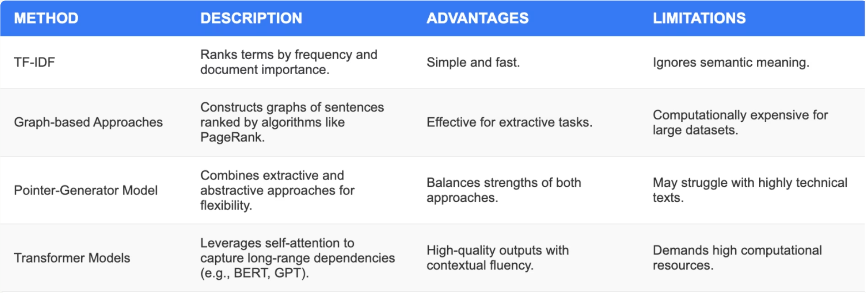
Common Methods of Summarization (Traditional Approaches)

Slide 9
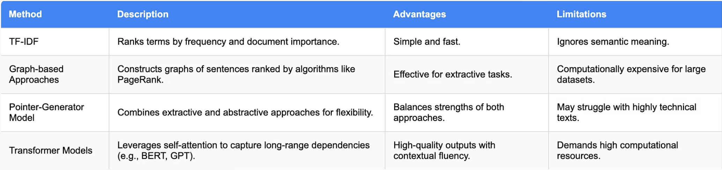
Traditional Methods vs. LLMs in Text Summarization
Traditional Methods: Rule-based/statistical (e.g., TF-IDF, TextRank); extractive, domain-specific, efficient, but limited in coherence and abstraction.
LLMs (e.g., GPT, BART): Neural networks; both extractive and abstractive, domain-agnostic, fluent, semantically rich; resource-intensive and less interpretable.
Summary: Traditional methods suit simple tasks; LLMs excel in handling complex texts.

Slide 10
New Factuality Evaluation Metrics
ROUGE
Type: Lexical
Focus: Measures informativeness through n-gram overlap
Limitation: Surface-level; ignores meaning and factual correctness
BERTScore
Type: Semantic
Focus: Evaluates similarity using contextual embeddings
Limitation: Can reward hallucinated but fluent content
QAFactEval
Type: Factual
Focus: Checks QA-based consistency between summary and source
Limitation: Requires generation of QA pairs (resource-heavy)
CoCoScore
Type: Factual
Focus: Measures entailment and consistency using QA-based logic
Limitation: Computationally intensive and slower to evaluate

Slide 11
Dataset Collection
Dataset Characteristics
Our dataset consists of 200,000 entries, encompassing various text styles, including formal, informal, and conversational, reflecting the diverse nature of real-world text.
Challenges in Dataset Handling
Challenges in dataset handling include ambiguity in conversational data, domain-specific vocabulary, and data imbalance and redundancy, all requiring careful attention to ensure robust model training.
Improvements to the Dataset
We addressed these challenges by balancing data collection, standardizing the data format, and employing data augmentation techniques like paraphrasing and reordering, further enriching the dataset.

Slide 12
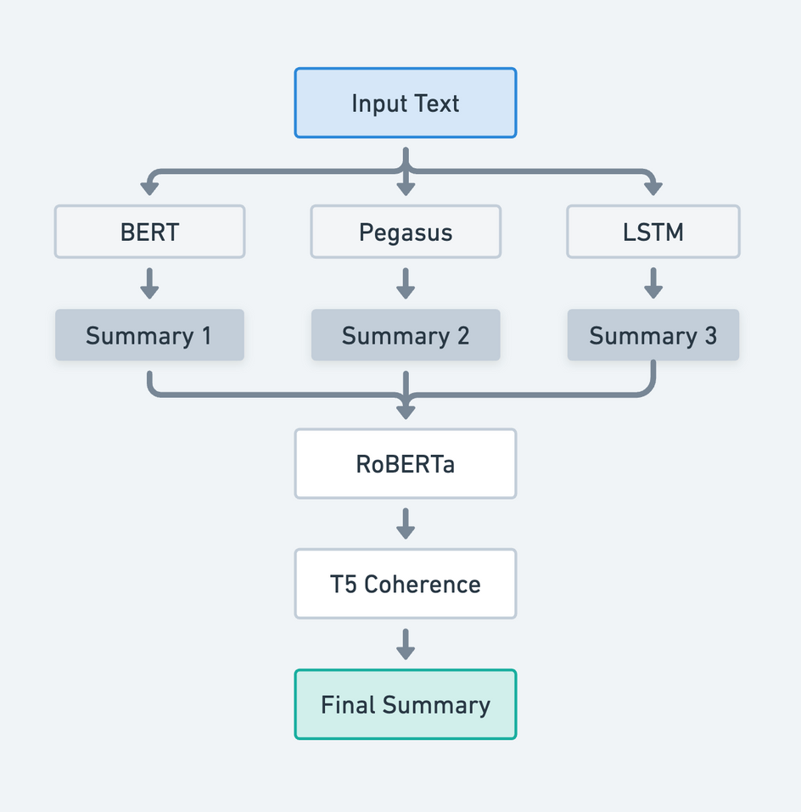
Methodology: Our Approach to Ensemble Summarization
Input is sent to PEGASUS, BART, LSTM
Each model gives a full summary
Break summaries into sentences
RoBERTa scores and picks the best sentence at each position
Combine selected sentences into a rough summary
T5 refines this for flow and grammar
Output: Final Ensemble Summary
The input text is summarized separately by PEGASUS, BART, and a LSTM-based Seq2Seq model. Their outputs are evaluated line-by-line by a fine-tuned RoBERTa model, which selects the best sentences. This composite summary is then refined by T5 to improve grammar, flow, and coherence, resulting in a high-quality final summary.

Slide 13
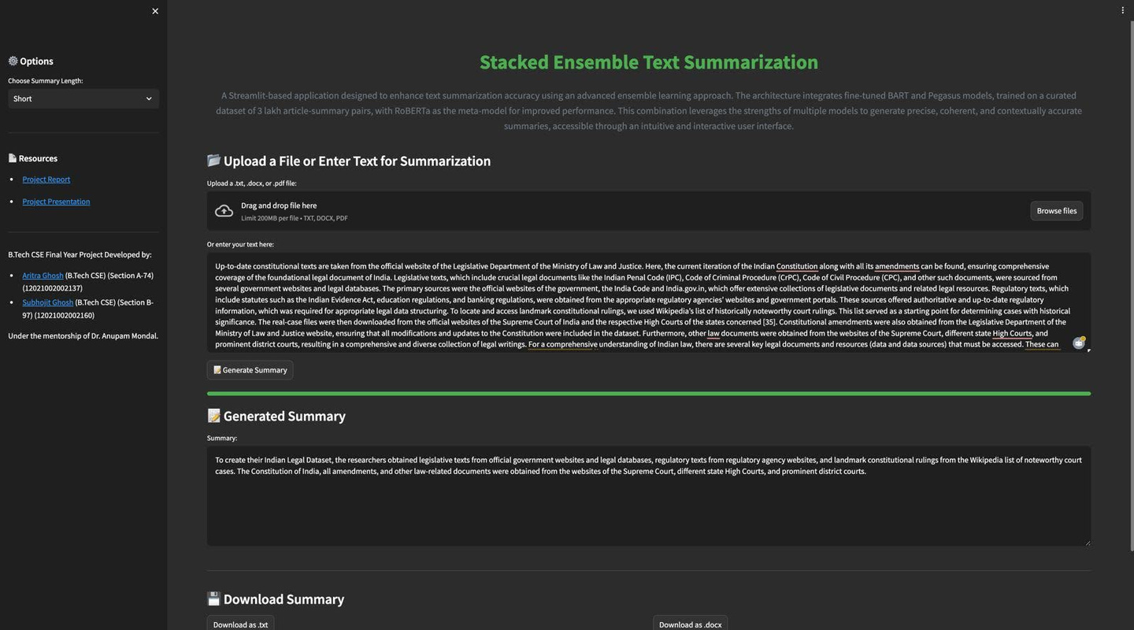
Features of our model:
Summary Length Selector: Choose from Short, Medium, or Long summaries via dropdown.
Text Input: Upload .txt, .docx, or .pdf files (up to 200MB) or directly paste text.
Generate Summary: Click to process input using a BART–PEGASUS ensemble with RoBERTa as meta-learner.
Output Display: Summarized text appears instantly with factual and fluent content.
Shows the ROUGE score of the generated text.
Download Option: Save the summary as a .docx file.

Slide 14
Conclusion
This study presents a robust and adaptable Stacked Ensemble Summarization model that overcomes key limitations of standalone systems like hallucination, domain inconsistency, and inefficiency. By integrating RoBERTa, BERT, LSTM, and PEGASUS through a Transformer-based meta-learner, the framework intelligently fuses extractive and abstractive strengths.
The use of meta-features and a multi-objective loss ensures summaries are both informative and factually grounded. The addition of a confidence-based early-exit mechanism further optimizes runtime without compromising quality.
Extensive evaluation on CNN/DailyMail and XSum datasets demonstrates that the proposed model outperforms individual baselines and traditional ensembles, achieving up to +1.3 ROUGE-L and +0.08 QAFactEval gains with up to 40% lower inference time.
Overall, the system provides a scalable, explainable, and deployment-ready solution suitable for diverse applications like journalism, legal, and academic summarization.

Slide 15
Acknowledgement
We sincerely thank our supervisor, Dr. Anupam Mondal, for his expert guidance and constant encouragement. We are also grateful to the faculty of the CSE Department at IEM for their support. A special note of thanks to our Director, Dr. Satyajit Chakrabarti, for his visionary leadership and motivation. Lastly, we thank our families and friends for their unwavering support throughout this journey. This work would not have been possible without the collaborative spirit and academic environment provided by IEM, Kolkata.

Slide 16
Thank you

