Slide 1


4th Semester Innovative Project
OVERVIEW OF SUMMARISATION
Presented By : Aritra Ghosh and Subhojit Ghosh | 2023

Slide 2
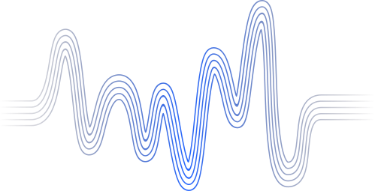

PRESENTED BY:
Aritra Ghosh
Section: A; Roll No: 74
Enrollment Number: 12021002002137
B.Tech CSE
Subhojit Ghosh
Section: B; Roll No: 97
Enrollment Number: 12021002002160
B.Tech CSE
Mentor: Dr. Anupam Mandal

Slide 3
AGENDA
Problem Statement | 4
Introduction | 5
Need for Summarization | 6
Features | 7
Methods | 8
Limitations | 9
Challenges | 10
Solution | 11

Slide 4


Problem Statement
To study the existing methods of text summarisation and identify the challenges in order to come up with a solution for them.

Slide 5
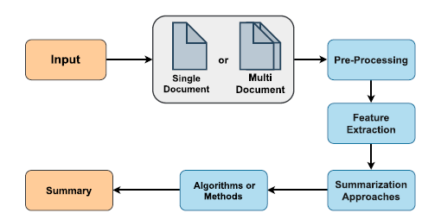

Introduction
Text summarization condenses source text while preserving its meaning and knowledge
Automatic text summarization (ATS) uses algorithms to produce information summaries
Manual text summarization is effective but time-consuming
ATS creates brief and accurate overviews of lengthy text documents
Text summarization focuses on essential parts to provide valuable details while maintaining context

Slide 6


Need for Summarization
Summarization algorithms are necessary due to the vast amount of information available on the internet and elsewhere.
The exponential growth of digital content has made it challenging for individuals to extract important information from large volumes of text.
Summarization algorithms generate concise and informative summaries of longer texts to address this challenge.
These summaries save time and effort for readers by providing essential information in a condensed form.
Summarization algorithms are useful in various contexts, including news articles, scientific papers, legal documents, and business reports, to identify main points, themes, and arguments and survey a large body of literature.

Slide 7


FEATURES
Position Feature
Term Frequency
TF-ISF
Title Feature
Length Feature
Sentence–Sentence Similarity
Sentence Position
Phrasal Information
Title Similarity
Thematic Word
Numerical Data

Slide 8
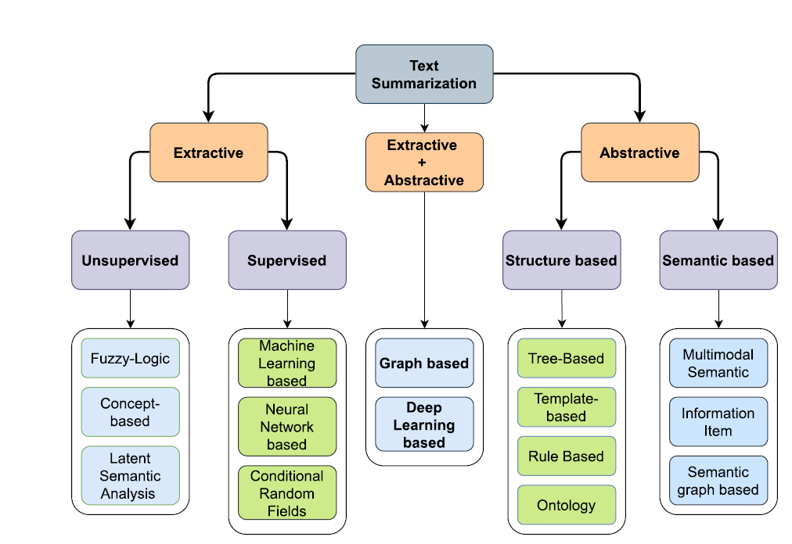
METHODS

Slide 9
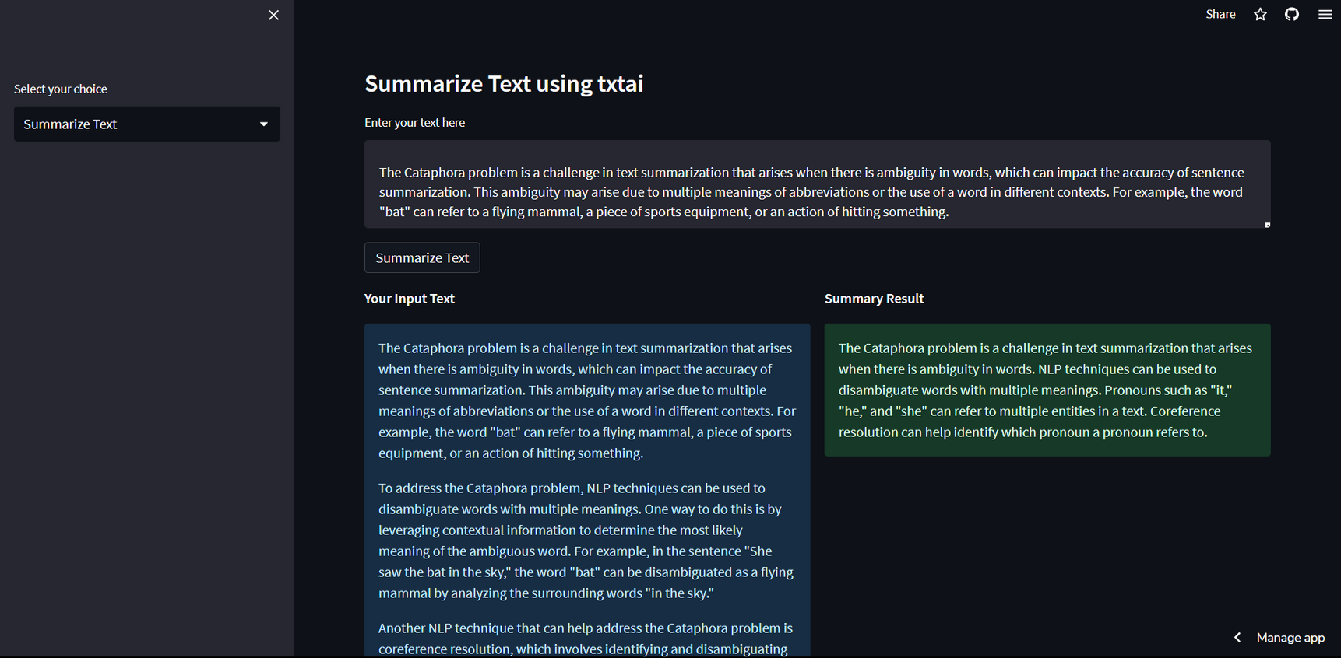
SAMPLE
To understand the problem better we decided to implement it ourselves. Following we have the result of that.
Live Demo: https://thecleveridiott-stapp-app-utibyo.streamlit.app/

Slide 10

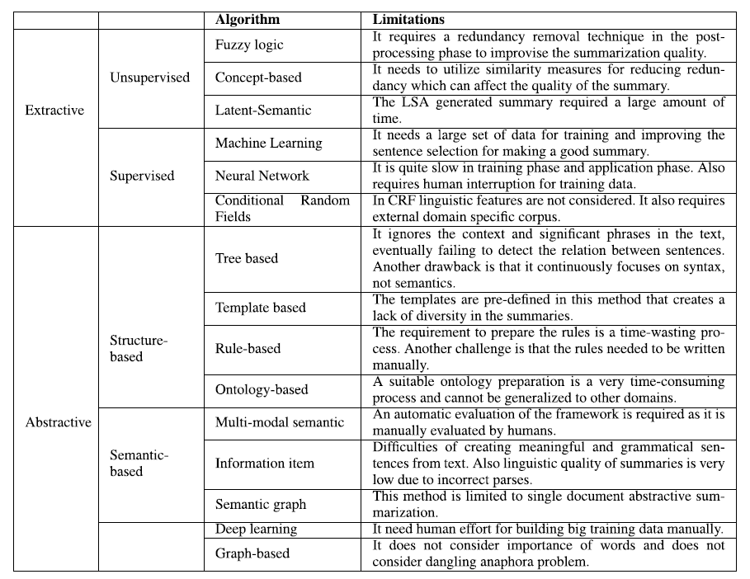
LIMITATIONS

Slide 11

CHALLENGES
Automatic text summarization faces challenges in evaluation due to different datasets and metrics producing varying results.
Selecting important sentences is subjective, and standardized benchmarks are needed for reliable results.
Anaphora problem involves determining which pronoun complements which word.
Template-based algorithms require predefined templates for specific summarization tasks.
Learning methods for text summarization struggle with longer sentences and jargon.
Abstractive models face difficulties in ensuring the interpretability of source content.
The Cataphora problem arises due to ambiguity in words and can be addressed with disambiguation algorithms.

Slide 12

Solutions
NLP techniques can improve the accuracy of text summarization by disambiguating words with multiple meanings and identifying and disambiguating pronouns and named entities.
NLP techniques can be used to address the Cataphora problem by disambiguating words with multiple meanings.
Coreference resolution can help identify and disambiguate pronouns in a text, while named entity recognition can identify and disambiguate named entities..
Contextual information can be leveraged to determine the most likely meaning of ambiguous words.

Slide 13
THANK YOU﻿!!!
WE WELCOME YOUR QUESTIONS
Click to View Report
Click to View Repository
Click to View Demo

