Slide 1




Multi-stage YAML pipelines in Azure DevOps for the rescue!
Kamil Mrzygłód | D&A Platform Engineer, P&G

Slide 2
About me
D&A Platform Engineer @ Procter & Gamble, Warsaw
Trainer, books author
Microsoft Azure MVP

Slide 3
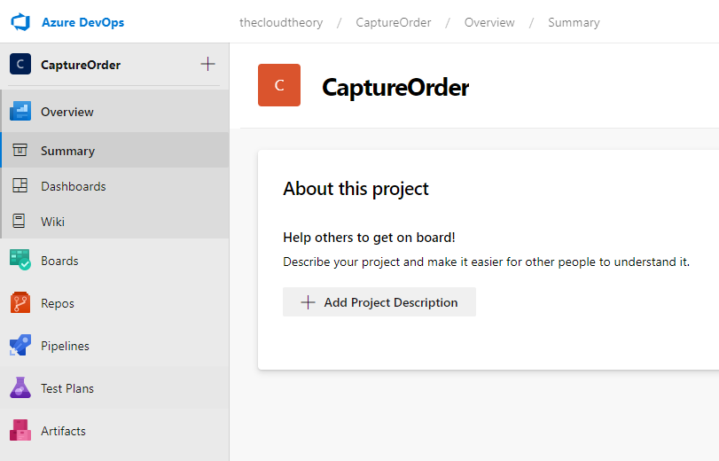
What is Azure DevOps?
All the DevOps tools you need in a single place!

Slide 4
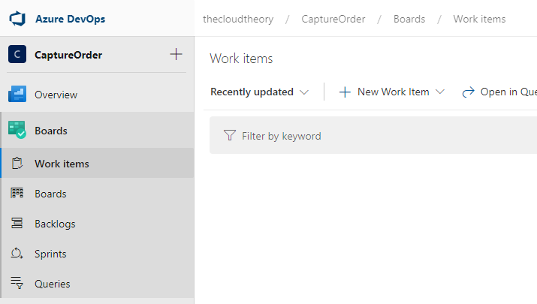
Azure DevOps - Boards
Discuss work items, manage agile boards and review your work using Azure Boards.

Slide 5
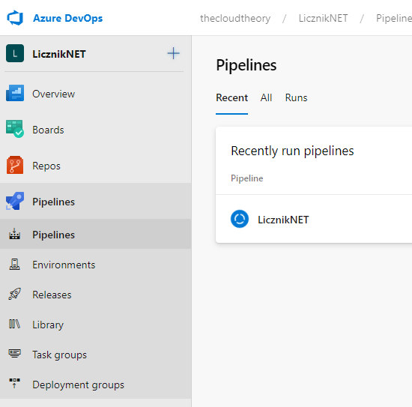
Azure DevOps - Pipelines
Build, test, deploy applications on various platforms using Azure Pipelines.

Slide 6
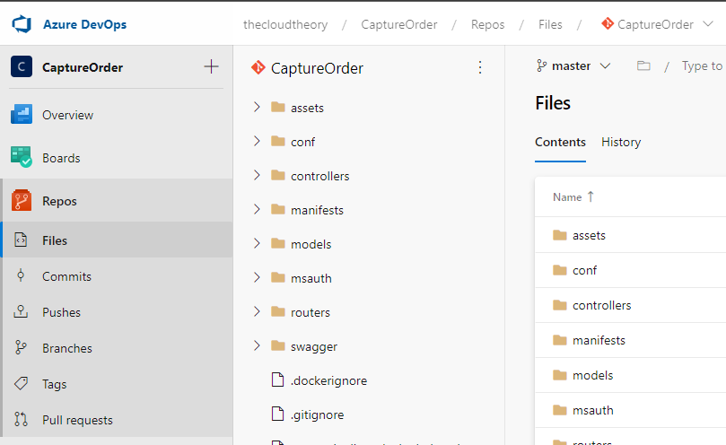
Azure DevOps - Repos
Host private and public Git repos with Azure Repos.

Slide 7
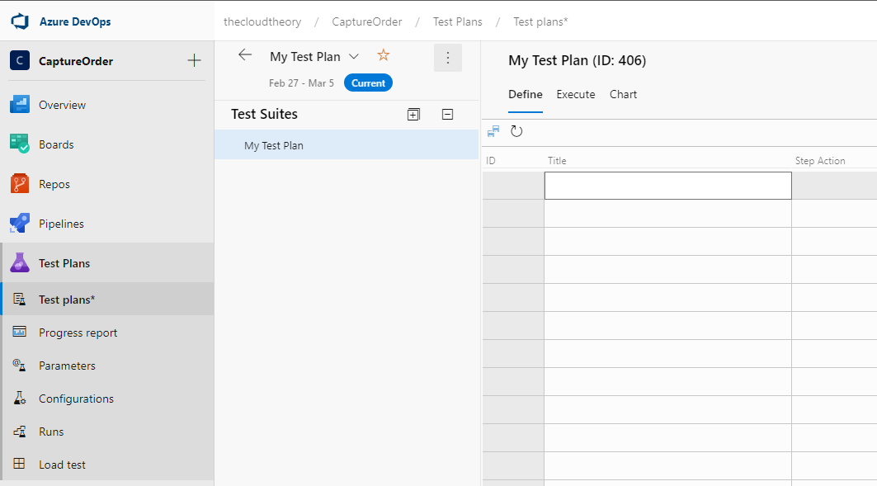
Azure DevOps – Test Plans
Write your own test plans and run tchem along with your CI/CD pipelines Azure Test Plans.

Slide 8
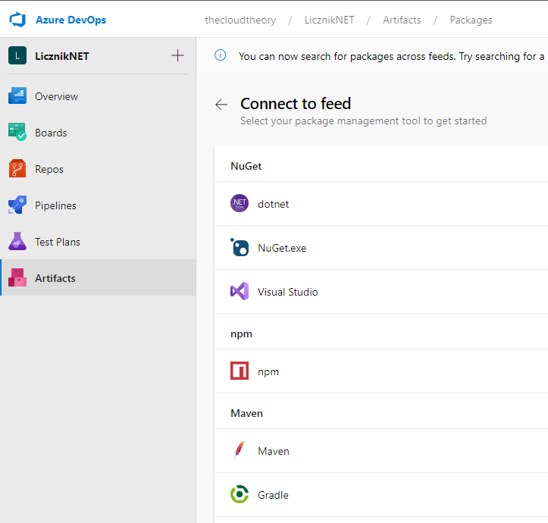
Azure DevOps – Artifacts
Share and and host artifacts and packages Azure Artifacts.

Slide 9
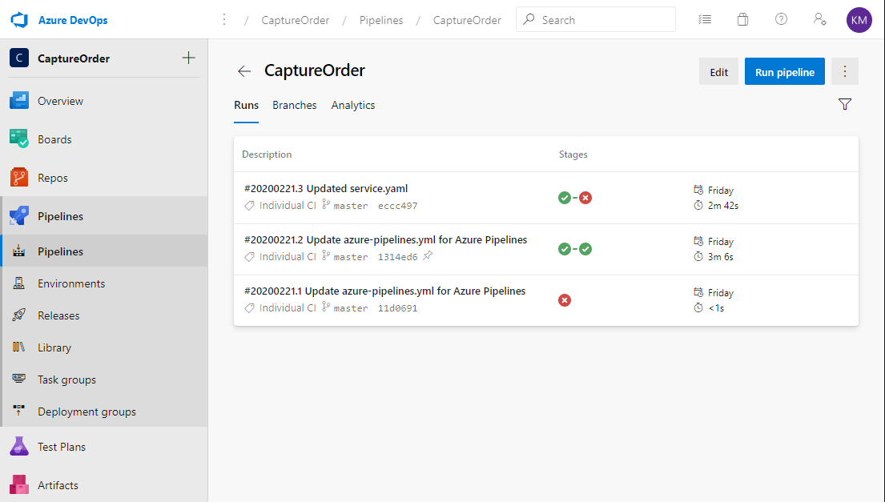
CI/CD with Azure Pipelines

Slide 10
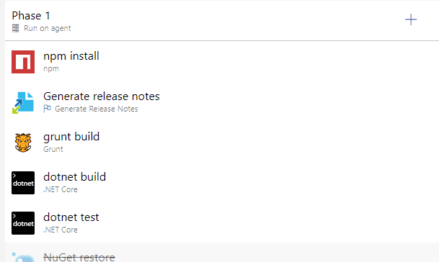
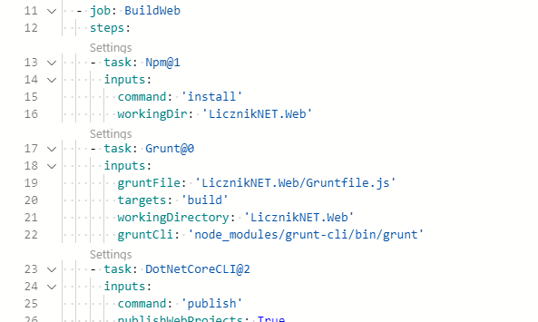
Classic vs YAML pipelines

Slide 11
Classic vs YAML pipelines comparison
Classic | YAML
GUI based | YAML based
Additional tools required to version, export and import | Can be versioned inside your app code
Cumbersome review proces | Can be easily incorporated into your PR process, commented and tested
Tricky forking and modifying | Can be easily forked on a feature branch

Slide 12
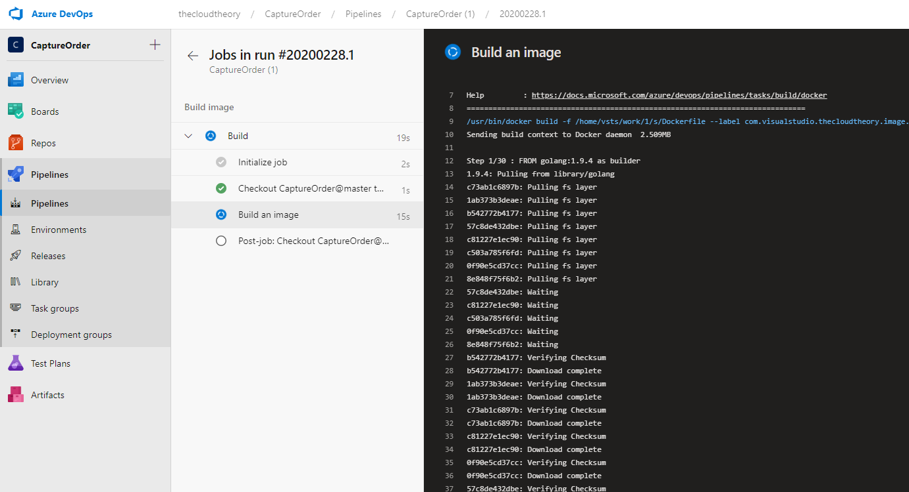
Developing YAML pipeline

Slide 13
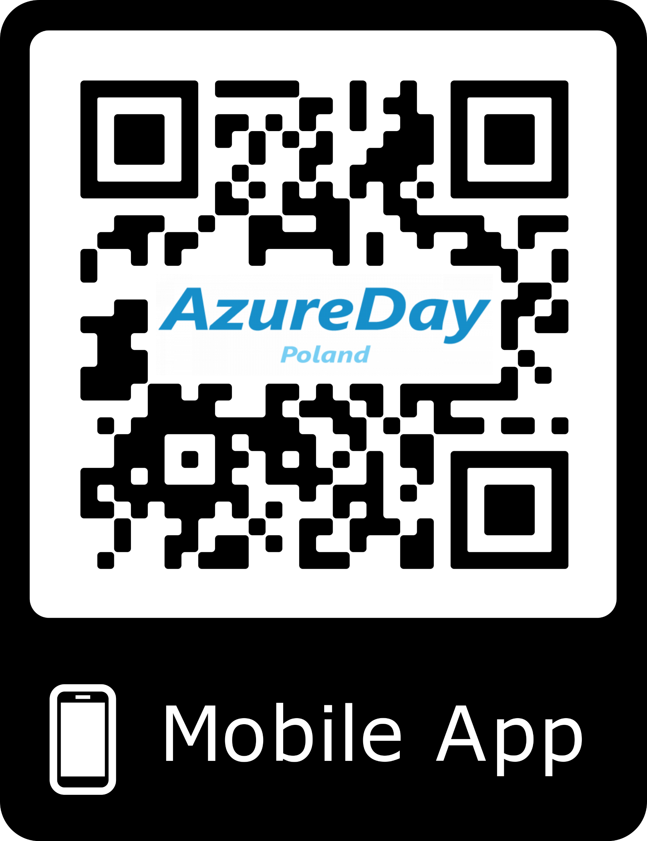
Don't forget to rate my session in Mobile App!

Slide 14

