Slide 1

CompSci 471
Artificial Intelligence
A search algorithm solves the problem you represented —not necessarily the problem you intended.
Lesson 4: Problem Formulation
Turning real missions → searchable models
World
State
Actions
Goal
Cost
Search
Fall 2026
Notes:
Open by connecting Lessons 1–3 to search. Emphasize that we are moving from evaluating AI outputs to building classical AI problem representations. The key message is that formulation precedes algorithm choice.

Slide 2
Retrieval warm-up
Lessons 1–3 focused on trust, systems, and inputs.
A system gives a convincing output.
What version of the problem did the system actually receive?
Included
Missing
Irrelevant
Best
What information is included?
What information is missing?
What details are irrelevant?
What does “best” mean?
Think-pair-share: name one way a poor representation could make an AI system fail.
CS 471 | L04: Problem Formulation
2
Notes:
Ask students to recall the Lesson 2 pipeline and Lesson 3 input-sensitivity workshop. Guide answers toward missing constraints, wrong goals, irrelevant features, and ambiguous objective definitions.

Slide 3
Today’s mission
By the end of Lesson 4, students should be able to…
1
Define states, actions, goal tests, and path costs
2
Formulate real-world problems as search problems
3
Explain how problem representation affects solution difficulty
CS 471 | L04: Problem Formulation
3
Notes:
Tie directly to syllabus objectives. Explain that this lesson supports HW1, Quiz 1, and GR1, but the examples today are intentionally different from assessment scenarios.

Slide 4
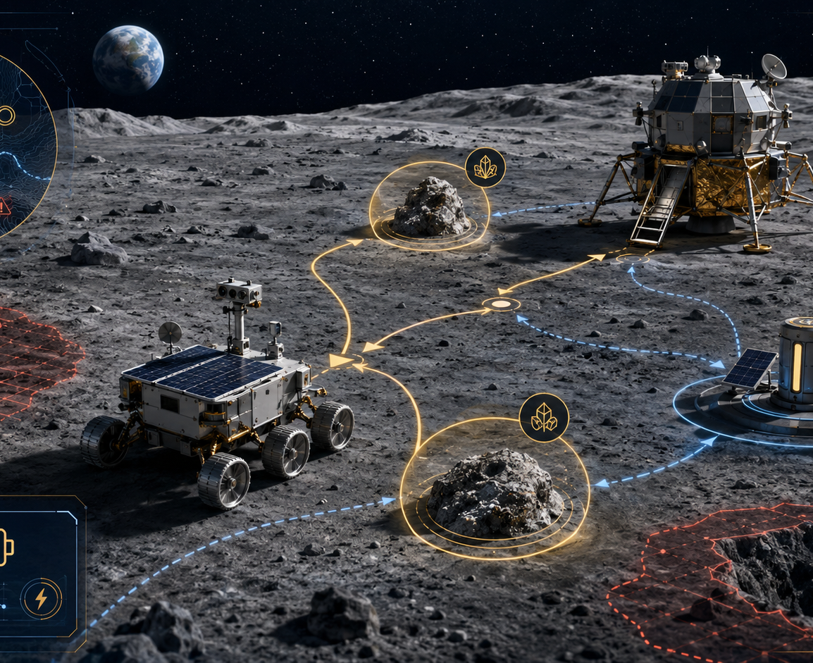
Running scenario: lunar rover mission
How does a messy mission become a searchable problem?
Mission brief
Leave the lander
Collect samples from two sites
Manage limited battery
Avoid unstable terrain
Return to the lander
Question: what must the rover remember to make correct decisions?
CS 471 | L04: Problem Formulation
4
Notes:
Use this as the running scenario. Ask students to list decision-relevant information before formalizing states. Avoid immediately giving the full answer; let them name location, samples, battery, hazards, and return status.

Slide 5
From mission to model
Formulation translates a real task into something an algorithm can search.
Mission narrative
Computational representation
State space
Search algorithm
Solution path
natural language task
states, actions, goals, costs
possible situations
systematic exploration
sequence of actions
Formulation happens before algorithm selection.
A better algorithm cannot fully rescue a poorly represented problem.
CS 471 | L04: Problem Formulation
5
Notes:
This slide is the conceptual bridge into the rest of Module 1. Later lessons teach search execution; today is about what the search algorithm receives.

Slide 6
The four core elements
A search problem answers four questions.
State
Actions
Goal test
Path cost
Where are we?
Decision-relevant situation
What can we do?
Legal moves from a state
When are we done?
Condition that recognizes success
What is better?
Cumulative quantity to minimize
Initial state: the specific state where the problem starts.
CS 471 | L04: Problem Formulation
6
Notes:
Define the four core components and mention initial state as the starting instance. Keep the language reusable so students can apply it to any domain.

Slide 7
States: what must the system remember?
A state is a decision-relevant snapshot, not a complete copy of reality.
Too little
Useful abstraction
Too much
location only
(location, samples, battery)
everything measurable
Cannot know whether samples are already collected.
Supports actions, goal recognition, and cost reasoning.
Adds states without improving decisions.
Real world
State
Actions
Goal
Cost
Search
CS 471 | L04: Problem Formulation
7
Notes:
Stress that states are not arbitrary data dumps. They should include enough information to decide what actions are legal and whether the mission is complete, but not irrelevant detail.

Slide 8
Relevant, missing, and irrelevant information
Representation design is an engineering tradeoff.
Relevant
Missing
Irrelevant
Affects legal actions, goal recognition, or cost
Needed for correct decisions but absent
Adds complexity without changing decisions
current location
samples collected
battery category
sample status
remaining battery
hazard status
paint color
serial number
operator name
Engineering check: does the state support actions, goal tests, and costs?
CS 471 | L04: Problem Formulation
8
Notes:
Students often assume more information is always better. Use this slide to establish the search cost of irrelevant dimensions.

Slide 9
Actions and state transitions
Actions are operations available from a state.
Current state
Move
to neighboring site
Successor state
(site A, sample A collected, medium battery)
updated location, samples, and battery
Collect
only at sample site
Recharge
only at station
Preconditions matter: not every action is legal in every state.
Real world
State
Actions
Goal
Cost
Search
CS 471 | L04: Problem Formulation
9
Notes:
Explain actions and state transitions without executing a full search algorithm yet. Students should see that actions depend on the current state.

Slide 10
Goal tests: when is the mission complete?
The goal test evaluates a state, not the amount of effort spent.
Weak
Incomplete
Complete
Rover is at the lander
At least one sample collected
Both samples collected and rover at lander
May return before collecting samples
May never return safely
Captures the actual mission objective
A good goal test is precise, checkable, and aligned with the actual objective.
Real world
State
Actions
Goal
Cost
Search
CS 471 | L04: Problem Formulation
10
Notes:
Use the three examples to help students recognize incomplete or misleading goals. The correct goal usually combines multiple state features.

Slide 11
Path costs: what does “best” mean?
Changing the cost function can change the preferred solution.
Shortest distance
Least energy
Minimize meters traveled
Minimize battery consumed
Lowest risk
Fastest time
Avoid unstable terrain
Minimize mission duration
Same map. Same goal. Different cost. Different “best” path.
Real world
State
Actions
Goal
Cost
Search
CS 471 | L04: Problem Formulation
11
Notes:
This slide prepares students for later search algorithms, especially UCS and A*. Tie path cost to g(n) later but do not teach g/h/f in detail yet.

Slide 12
Complete rover formulation
Now assemble the pieces into one coherent search problem.
State
(location, samples collected, battery category)
Actions
move, collect sample, recharge, return
Goal test
both samples collected AND rover at lander
Path cost
total energy used, with hazard penalties
This template is reusable across route planning, robotics, cyber response, scheduling, and games.
CS 471 | L04: Problem Formulation
12
Notes:
Students should be able to copy this structure for new problems. Emphasize that answers may vary as long as they support legal action selection, goal recognition, and cost calculation.

Slide 13
Representation changes the state space
More expressive representations create more possible states.
Location only
6 locations
6 states
Bigger is not always worse.
Add samples
The question is whether the added state detail supports correct decisions.
6 × 4 sample statuses
24 states
Add battery
6 × 4 × 3 battery categories
72 states
Richer models may be necessary, but unnecessary detail increases search difficulty.
CS 471 | L04: Problem Formulation
13
Notes:
Use small numbers so the combinatorics are visible. This prepares students for Quiz 1-style representation comparison and HW1-style tradeoff discussion.

Slide 14
The representation tradeoff
Good abstraction preserves what matters and removes what does not.
Appropriate abstraction
Too simple
Too detailed
incorrect or impossible decisions
enough information at manageable complexity
unnecessary search burden
Use this test: can the state determine legal actions, recognize the goal, and calculate relevant costs?
CS 471 | L04: Problem Formulation
14
Notes:
This is the big conceptual takeaway. Use the test sentence repeatedly during student practice.

Slide 15
Debug the formulation
Find the flaw before the algorithm runs.
Inspection vehicle scenario
Group task
An underwater vehicle must inspect two bridge supports, avoid restricted zones, manage battery, and return to the dock.
One missing state feature
One questionable action or precondition
Flawed formulation: state = current location; goal = vehicle reaches a support; cost = number of actions.
One incomplete goal test
One mismatched path cost
CS 471 | L04: Problem Formulation
15
Notes:
Run as a quick group task. Expected issues: no inspected-support status, no battery, no restricted-zone information, incomplete goal, cost not aligned with energy/risk.

Slide 16
Formulation sprint
Build a search problem from a new mission brief.
Scenario
State
What must it remember?
A medical-delivery robot must move through a damaged building, deliver medicine to two rooms, avoid blocked corridors, and return to the lobby.
Actions
What can it do?
Goal test
When is the mission complete?
Path cost
What should be minimized?
Pairs: create the four-part formulation. Be ready to defend one design choice.
CS 471 | L04: Problem Formulation
16
Notes:
Give pairs about five minutes. This mirrors the open-response skill needed for GR1 without reusing the assessment context. Ask them to write compact, defensible answers.

Slide 17
Critique and revise
A formulation is not finished until it survives questions.
Actions
Goal
Does the state tell us which actions are legal?
Can the system recognize success from the state?
Cost
Complexity
Can the path cost be accumulated over actions?
Did we include unnecessary details?
Revision rule: change one element and explain how the change improves the formulation.
CS 471 | L04: Problem Formulation
17
Notes:
Have one or two pairs share. Use these questions to guide class critique. Emphasize that formulation is iterative and evidence-based.

Slide 18
How this shows up in Module 1
Assessment practice builds from recognition to explanation.
HW1
Quiz 1
GR1
Build and test representations
Recognize and compare formulations
Create and justify a new formulation
construction + reflection
quick classification
open-response transfer
You should be able to explain why your formulation would help or hurt search.
CS 471 | L04: Problem Formulation
18
Notes:
This slide makes assessment alignment visible. Avoid disclosing specific assessment items. Say that students should expect new scenarios requiring the same reasoning.

Slide 19
Synthesis: problem formulation
Rebuild the search problem template from memory.
State
Actions
Goal test
Path cost
What information distinguishes situations?
What can the agent do?
How do we know we are done?
What makes one solution better?
Good search begins before the search algorithm runs.
Representation shapes what the system can even consider.
CS 471 | L04: Problem Formulation
19
Notes:
Ask students to reconstruct the four components aloud. Reinforce the central lesson claim.

Slide 20
Exit Ticket
Apply the formulation template to a compact scenario.
Scenario
Write
A cyber-defense agent must investigate hosts in a network, identify a compromised machine, and minimize disruption to mission-critical services.
State
Actions
Goal test
Path cost
One representation tradeoff
Next class: Uninformed Search — once the problem is defined, how should the algorithm explore it?
CS 471 | L04: Problem Formulation
20
Notes:
Collect as an exit ticket or use as next-class retrieval. This checks construction and representation tradeoff skills.

