Slide 1

Submission Cloover3
AI Sales Coach

Slide 2
The problem
Imagine you’re a sales representative at a company that installs solar panels and heat pumps for residential customers in Germany
A new lead comes in—a homeowner in a small town two hours south of Frankfurt.
You know his name, his address, and that he clicked on a heat pump ad. That’s it.

Slide 3
How we understood the problem
The customer wants a solution as soon as possible but has no idea about:
Products
Market conditions
Installation time and scope
Laws and incentives
What information an installer needs
Sales reps need as much relevant installation data as possible
They frequently visit customers but are unable to finalize a quote due to missing data
Filling in the necessary installation information is a difficult and time-consuming process
The sales representative is on the way to meet the customer, and their AI sales coach assistant is giving them final tips
Once there, the end customer and the sales representative will go through various scenarios based on a range of offer options, without having to wait for data to be populated by entering optional information
The salesperson is presented with various options and questions

Slide 4
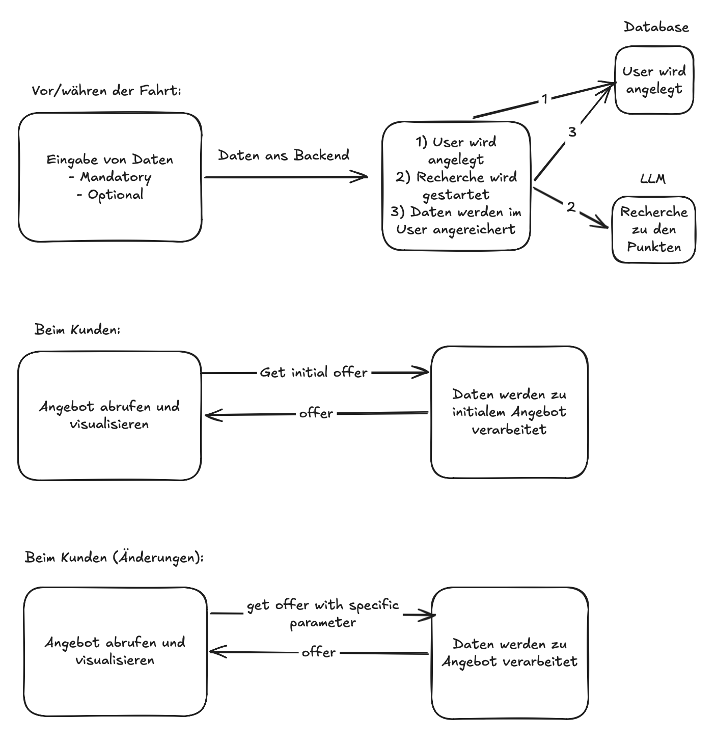
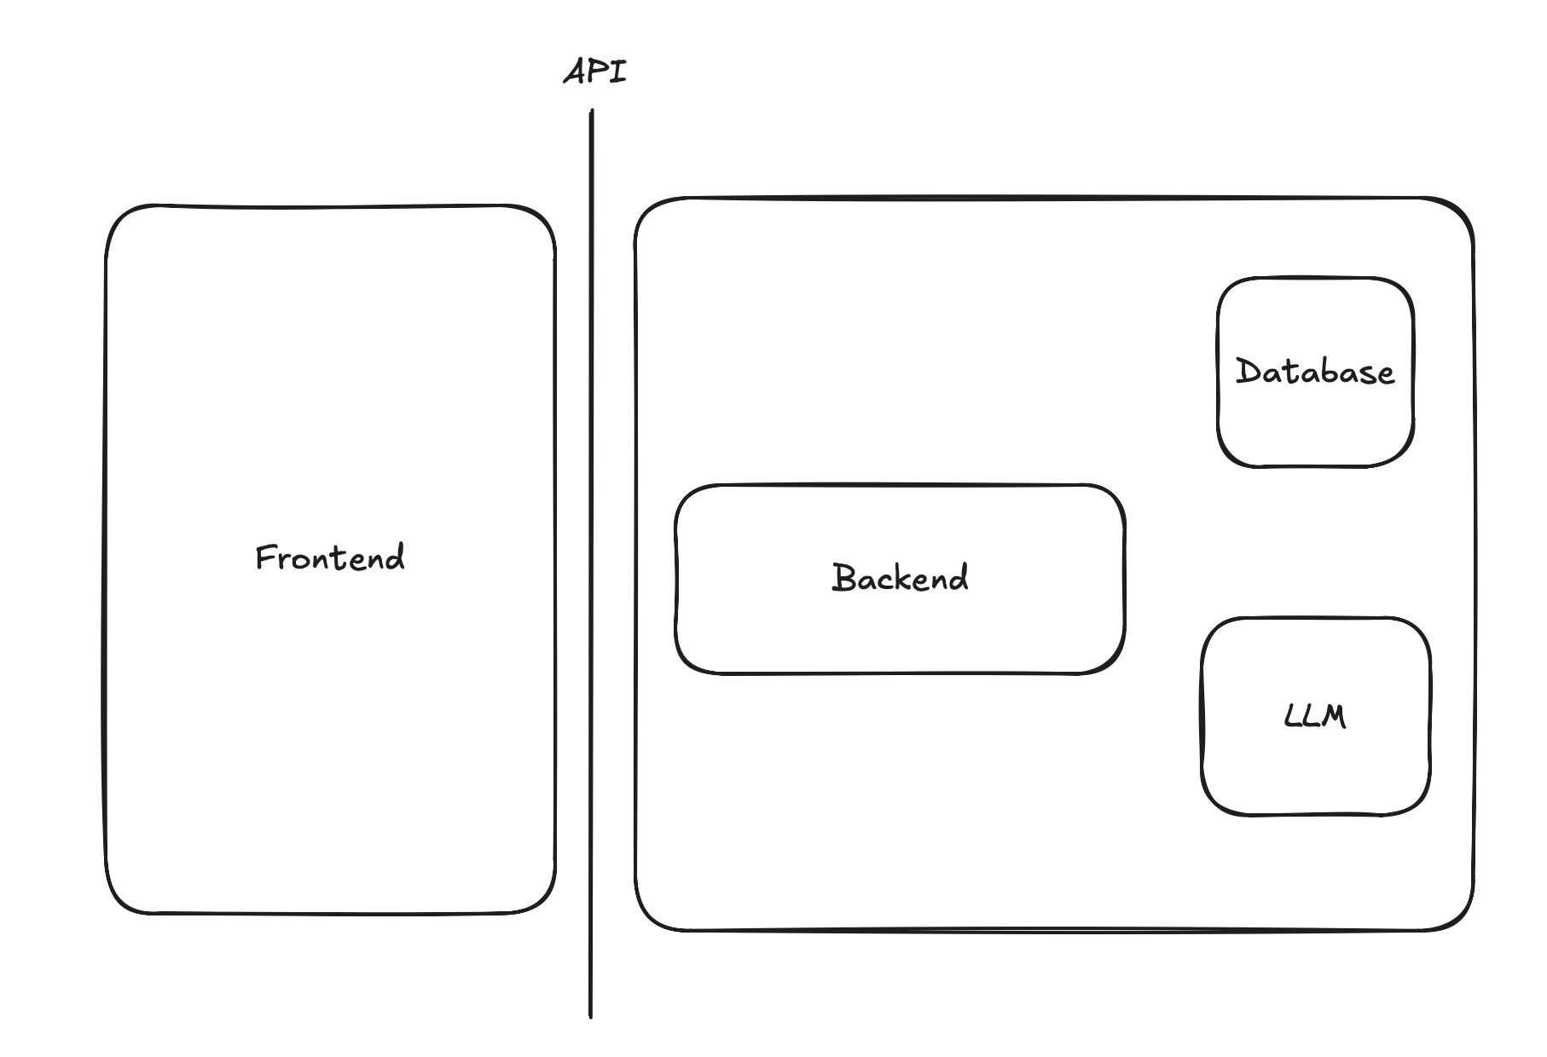
A brief demonstration of the demo
We decided to go with a Svelte + Ktor + PostgreSQL stack

Slide 5
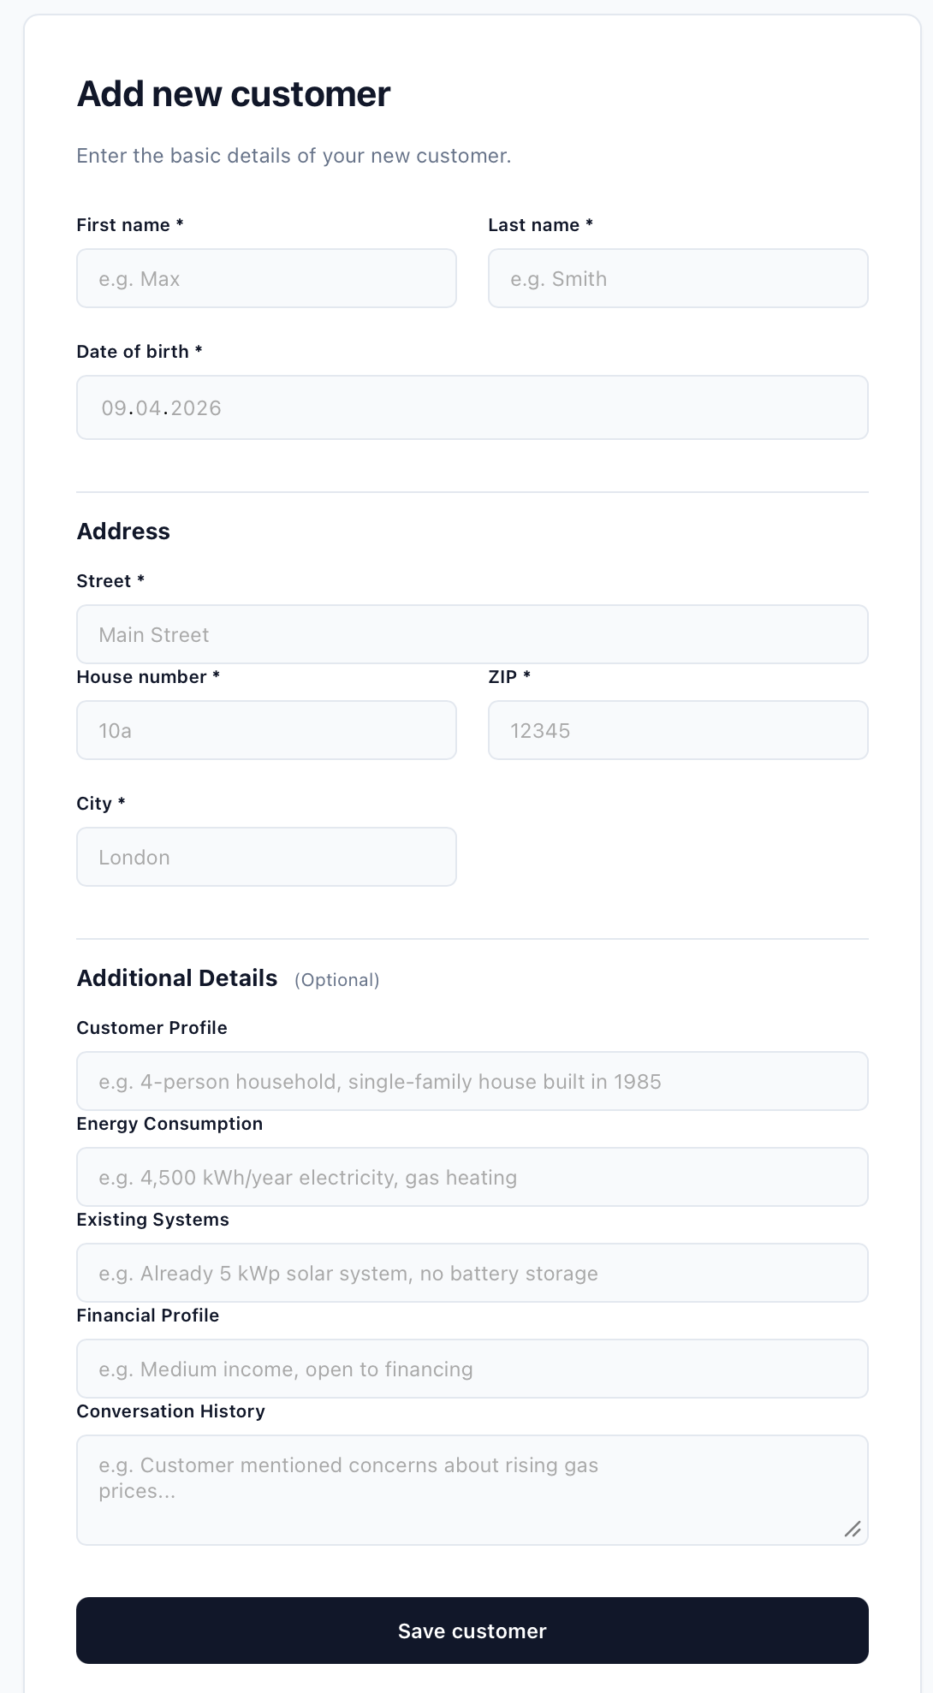
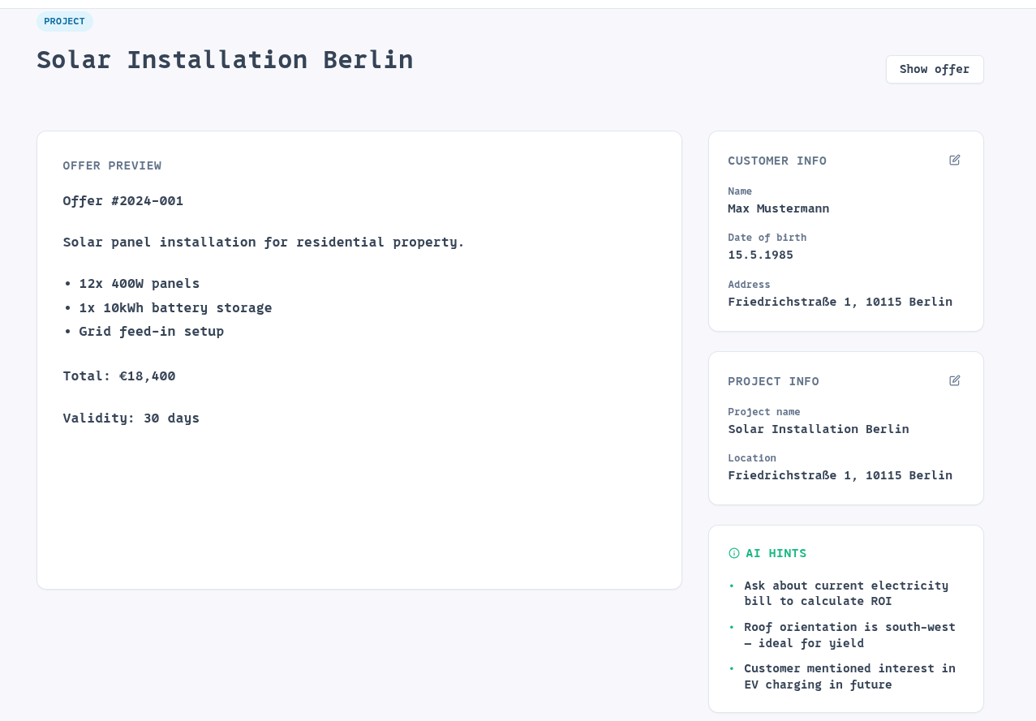
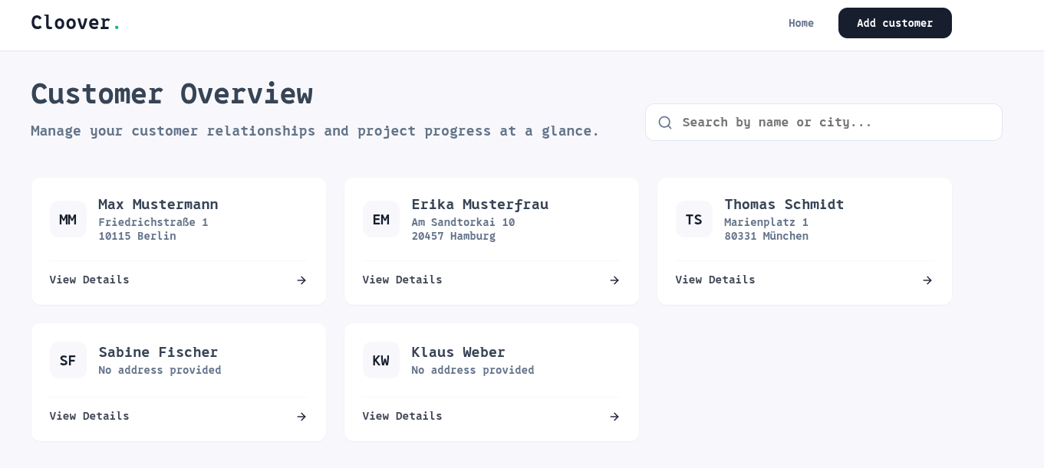
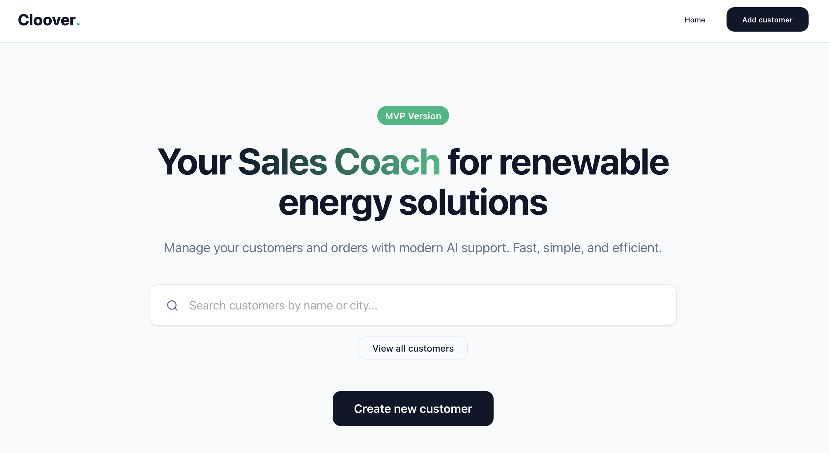
A brief demonstration of the demo

Slide 6
Key assumptions we have made
The customer has already expressed interest in a specific product category
Geodata such as solar factor and heat pump suitability (surface area or depth) are available for Germany and can be queried directly for a property address
For subsidies, only German laws and subsidies apply
Product prices, availability, and information are available on demand

Slide 7
Potential impact of widespread use
Customers are asked more targeted questions
Customers have greater confidence in the process
Customers have a more realistic understanding of the installation
Installers have greater planning certainty
The energy transition can proceed more quickly

Slide 8
Problems
The AI's API token for backend implementation was constantly invalid
AI credits were immediately invalid
Internet bandwidth was no longer sufficient

Slide 9
Thank you 🥳
keep coding

