Slide 1
Who is speaking, Adult or Child
By Thanakorn Tuanwachat
Supervisor: Ke Chen

Slide 2
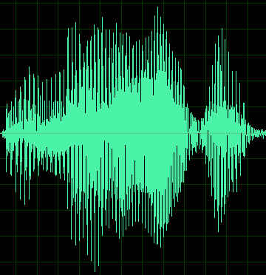
Main Function
My Application
Live or
From File
prediction
Label
Adult/Child

Slide 3
Go and do a demo on Online and Offline test

Slide 4
Testing using Pitch and Formant model
Sample
Pitch and Formant feature
Pitch and Formant model
label
Extract Features

Slide 5
Testing using MFCCs model
Sample
Do a vote
MFCCs feature
label
MFCCs feature
MFCCs model
label
Extract Features
MFCCs feature
label
MFCCs feature
label
.
.
.

Slide 6
Features
Pitch
Feature
Extraction Algorithms
Formant
MFCCs

Slide 7
Each sample is broken into a feature vector
A Sample of 3-4 seconds
Pitch | F1 | F2 | F3
C1 | C2 | C3 | . | . | . | . | . | C12 | C13
C1 | C2 | C3 | . | . | . | . | . | C12 | C13
C1 | C2 | C3 | . | . | . | . | . | C12 | C13
.
. About 400 more samples
. with the same label.

Slide 8
Training
Sample
Pitch and Formant model
Pitch and Formant feature set
208 C
200 A
3-4 seconds
Training
204
Extract Features
SVM
MFCCs feature set
MFCCs model
Testing
204

Slide 9
Evaluation
I did a K-fold cross validation
K = 10
Mean accuracy for Pitch and Formant model is about 90%
Mean accuracy for MFCCs model is about 99%
It will take too long to run

Slide 10
Futher Development
Silence removal
Noise reduction
One more feature so I can make a vote
More sample from YouTube

Slide 11
What is MFCCs
A representation of the short-term power spectrum of a sound
The Mel scale approximates the sensitivity of the human ear
Is mentioned in most of the literature reviews I read
Not Robust to noise
Algorithms
Frame the signal into short frames.
For each frame calculate the periodogram estimate of the power spectrum.
Apply the mel filterbank to the power spectra, sum the energy in each filter.
Take the logarithm of all filterbank energies.
Take the DCT of the log filterbank energies. (discrete cosine transform)
Keep DCT coefficients 2-13, discard the rest.
http://practicalcryptography.com/miscellaneous/machine-learning/guide-mel-frequency-cepstral-coefficients-mfccs/

