Slide 1
BAT6

Slide 2
Welcome
Raphael Frey

Slide 3
Model and Regulation
Reto Freivogel

Slide 4
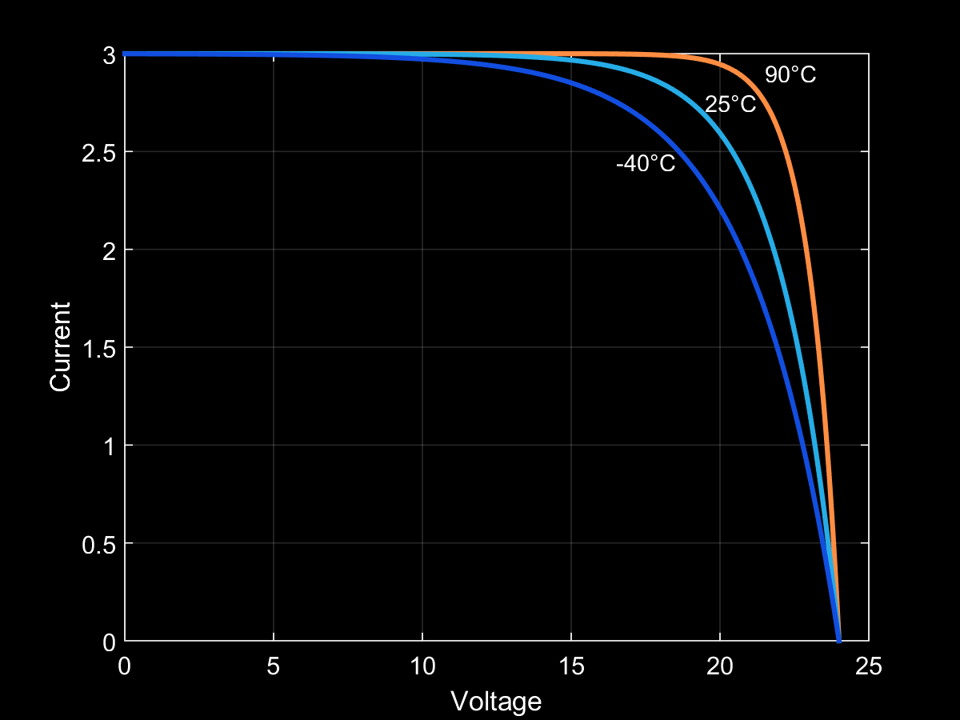
Our Model (Temperature)

Slide 5
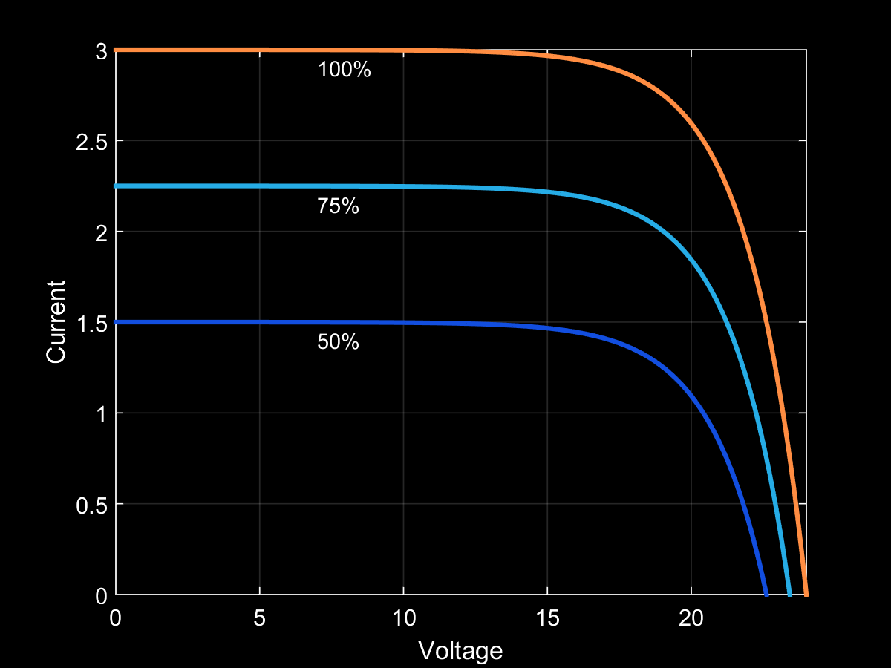
Our Model (Irradiation)

Slide 6
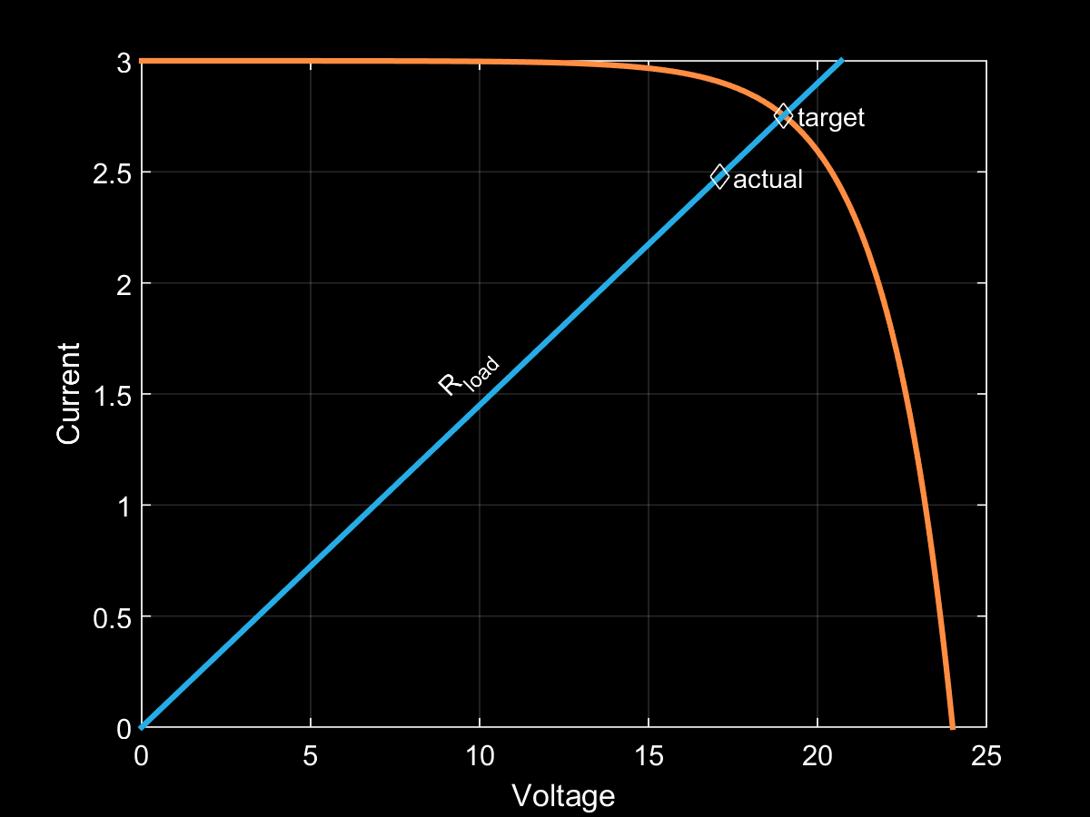
Regulation Algorithm

Slide 7
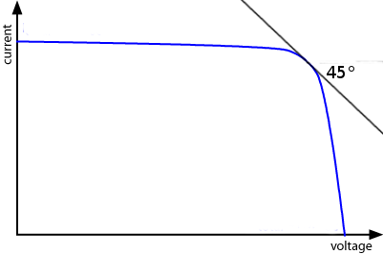
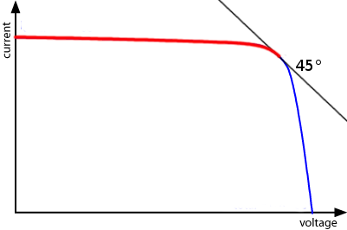
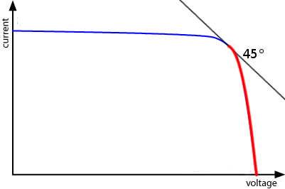
Hardware Implementation
1.5V
Vref
dsPIC33
DAC
ADC
Buck
(LT3741)
ADC
DAC
Notes:
→ the main parts of the regulation
→ Measure V + I at all times
→ If we take a look at a typical IV curve we see there is a part where the voltage is relatively constant
→ Operate in constant voltage mode
→ or constant current
→ to improve accuracy

Slide 8
Hardware
Alex Murray

Slide 9
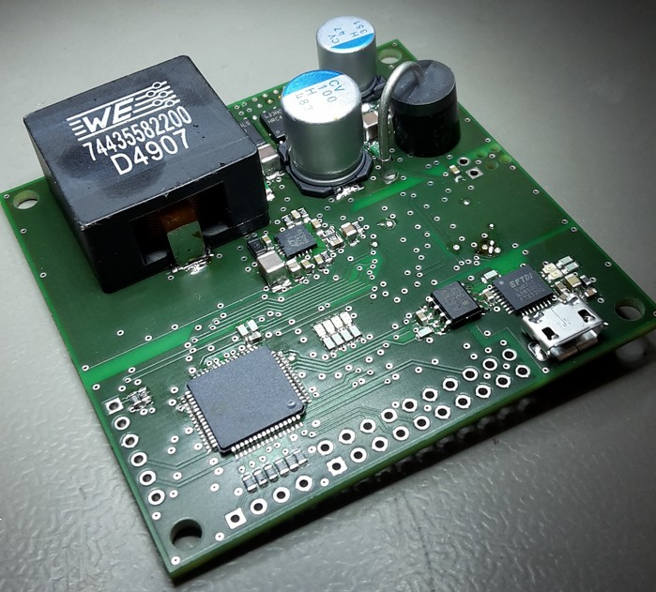
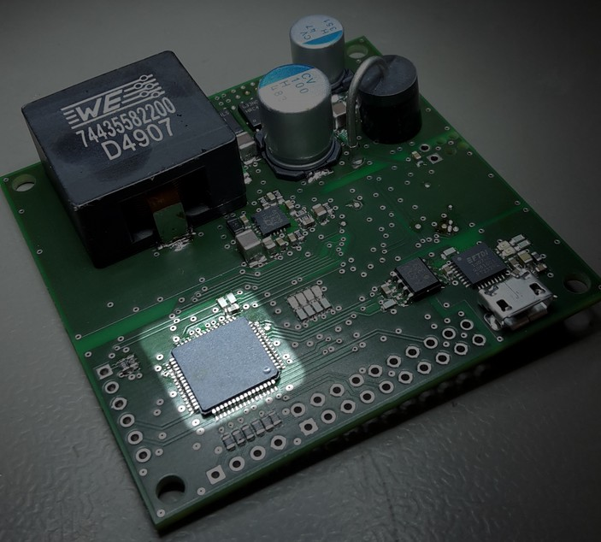
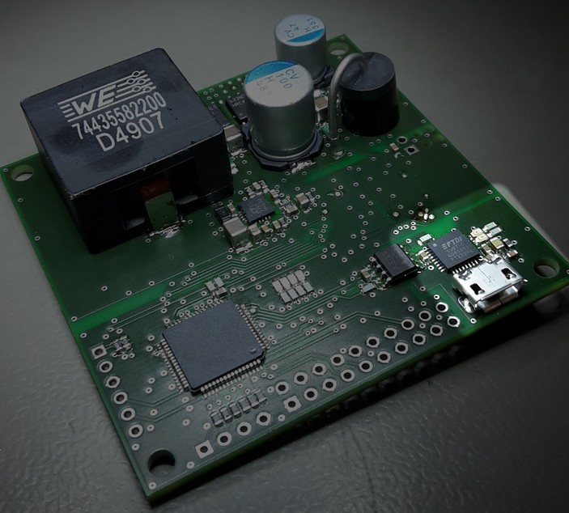
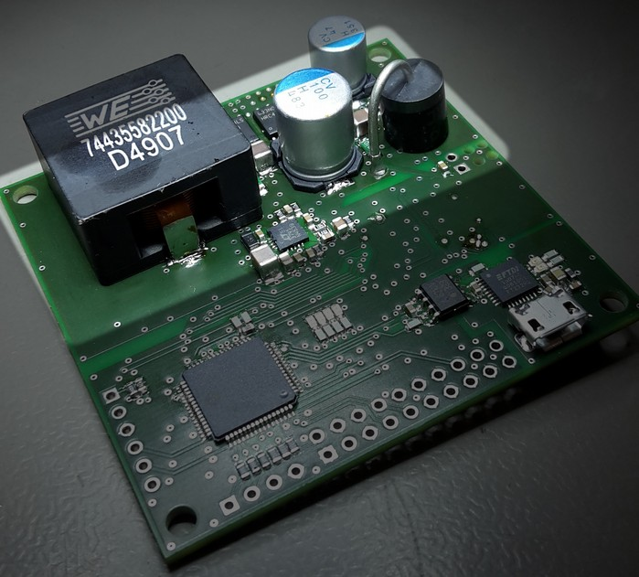
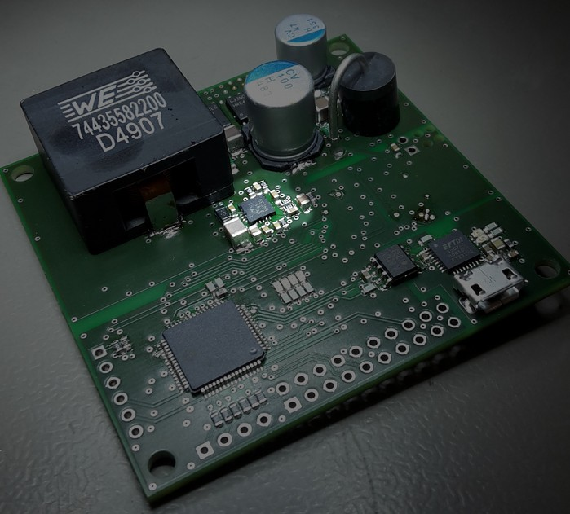
Compact PCB
Notes:
Full use of modern fabrication technologies
→ SMD, tiny ICs, QFN
→ Fabricated PCB
→ Reflow soldering to manufacture
As close as possible to behaviour of a possibly mass produced product

Slide 10
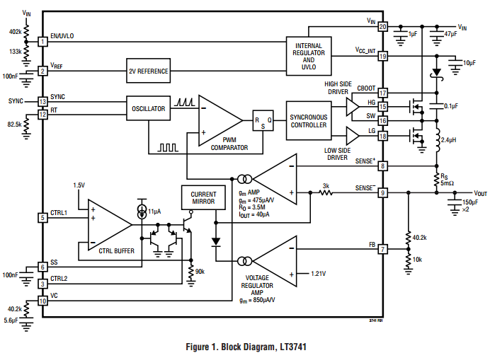
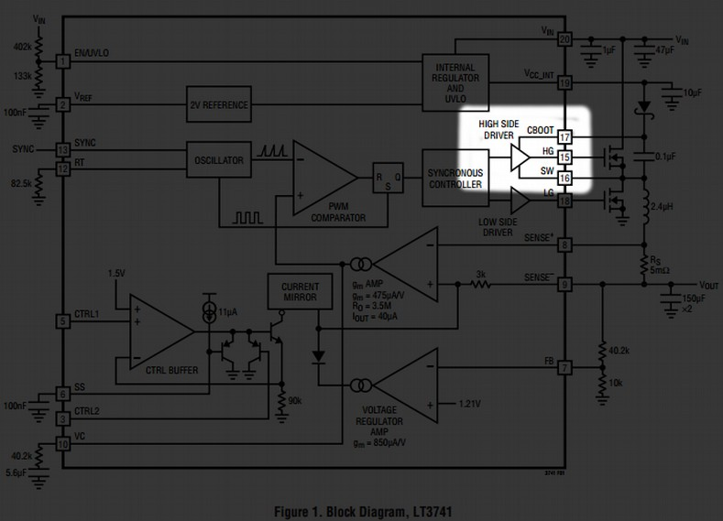
The Issue
MOSFETs are fine
Inductor is fine
No significant heat dissipation
Transients?

Slide 11
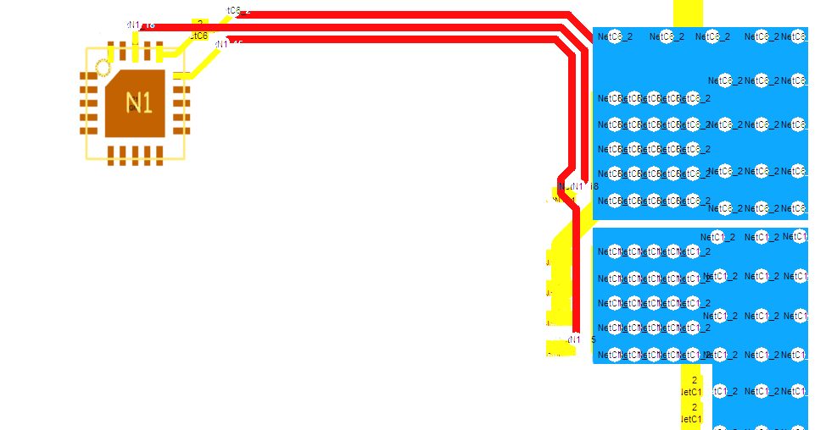
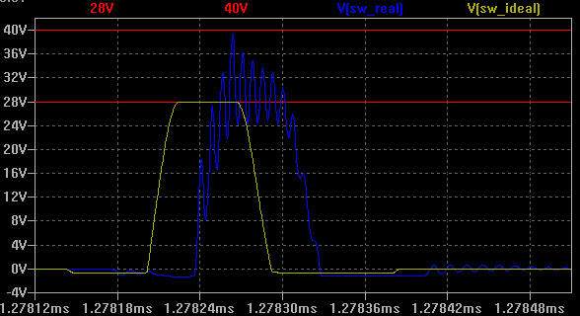
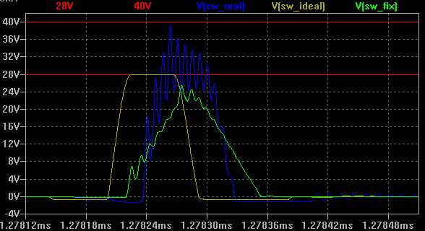
Trace Lengths Are Fairly Long
Resistors

Slide 12
Solutions
Series Resistors
Place LT3741 closer to MOSFETs
Minimise
Notes:
Second Iteration of the design
→ Decrease distance between regulator and MOSFETs

Slide 13
Demonstration
Raphael Frey

Slide 14
Conclusions / TODO
Fix Problems
Test/Verify functionality

Slide 15
Questions?
Project Repository
Gource Time-lapse
github.com/thecomet93/bat6
(todo)

Slide 16
Thank You!

Slide 17
Thank You!

Slide 18
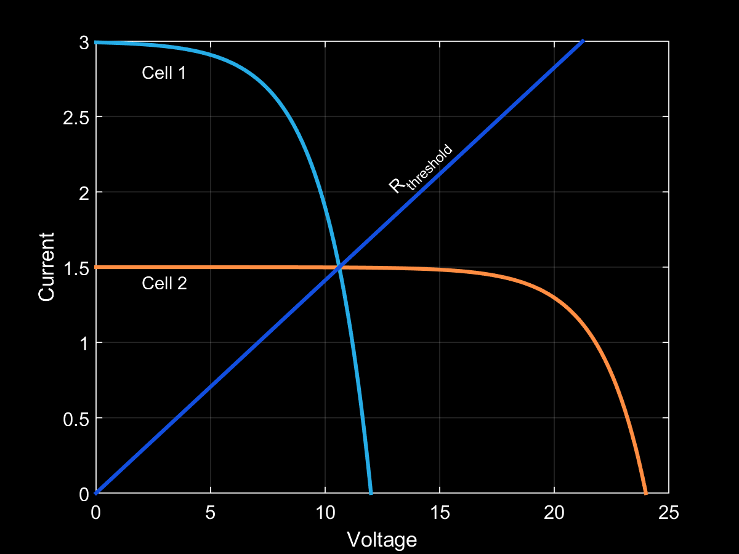
Threshold

