Slide 1

Project THEIA
Phase I Presentation
CptS 484 Software Requirements, Group 8
Warren Christian, Quinn McCarthy, Kaitlyn Ahmann, Genevieve Kochel, Drew Evensen
Notes:
Hi, we're Group 8. This is our Phase I presentation for Project THEIA, a phone app that helps blind and visually impaired people find their way around inside buildings, including buildings with more than one floor and buildings that connect to each other. You use it by voice or with the phone's screen reader, so you never have to read the screen. We'll go through our four AS-IS and TO-BE scenario pairs, then a Lesson 6 analysis of the scenario we think matters most, and then compare THEIA with what blind travelers use now. The app works the same way in every scenario as it does in our WRS, and we'll mention requirement numbers as we go.

Slide 2
Four Scenario Pairs: What Each Covers and Who Benefits
Pair | Aspect of THEIA | What THEIA adds | Who benefits
1 | Basic indoor navigation | Spoken route from a confirmed start to a chosen room | Stevie, a blind student
2 | Static obstacle warning | Distinct warning, a stop instruction, and an alternate route or help | Stevie
3 | Fall detection and caretaker alert | Cancelable countdown, alert with last confirmed location, delivery status | Stevie and the caretaker he authorizes
4 | Optional schedule suggestions | Opt-in reminder that starts a route only after he confirms | Stevie, if he turns it on
Notes:
This table lists our four scenario pairs. They all use the same person, Stevie, who's a blind student. Pair one is basic navigation from one room to another. Pair two is about a cart left in the hallway. Pair three covers falls. THEIA can alert a caretaker Stevie has approved, so that one helps the caretaker too. Pair four is schedule reminders, which Stevie has to turn on himself. For each pair we'll show what Stevie does now without the app and then what changes with THEIA.

Slide 3
Scenario Pair 1: Basic Indoor Navigation
AS-IS Scenario
Stevie is trying to go to his next classroom. He knows he needs to walk ahead a few steps, and then turn left around the corner.
However, he is not sure when to turn.
He took a guess, but turned too early, hit the wall and hurt his head.
Feature
Getting from one room to another
Who it helps
Stevie, a blind student
Problem today
He has to guess where the turn is, and a wrong guess got him hurt.
Notes:
Pair one is the scenario the course gave us. Stevie is walking to class. He knows he has to go a few steps and then turn left, but he can't tell exactly where the turn is. He guesses, turns too early, and hits his head on the wall. He makes trips like this several times a day, and a mistake can get him hurt, so this is the one we picked as top priority for the analysis later.

Slide 4
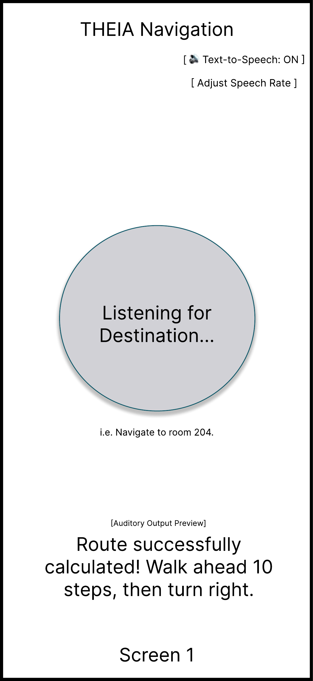
Scenario Pair 1: Basic Indoor Navigation
TO-BE Scenario
The THEIA app asks Stevie to give his current location and the destination.
The app calculates the route from the current location to the destination.
THEIA tells Stevie to “walk ahead 10 steps, then turn left”
Notes:
With THEIA, the app asks Stevie where he is and where he's going, works out a route, and tells him to walk ahead ten steps and turn left. We kept this text the way the course wrote it. In our WRS, entering the destination by voice is FR03, confirming the starting point before a route is calculated is FR05, choosing between routes is FR07, and the spoken turn instructions are FR08. The course version doesn't say how THEIA knows Stevie actually reached the turn, and it never confirms where he started. We look at both of those in the Lesson 6 analysis.

Slide 5
Scenario Pair 2: Static Obstacle Warning
AS-IS Scenario
Stevie walks down the second-floor hallway to class, a route he takes every day.
Overnight, a maintenance cart was left parked in the hall.
His cane hits the cart too late, and he walks into its handle.
He bruises his hip and has to feel his way around a cart he didn't know was there.
Feature
Warnings about things in the way
Who it helps
Stevie
Problem today
His cane only finds the cart when it hits it.
Notes:
Pair two is about obstacles. Stevie is walking down a hallway he uses every day. Someone left a maintenance cart in the hall overnight, and his cane finds it too late, so he walks right into the handle. Knowing the route didn't help, because the cart wasn't there yesterday.

Slide 6
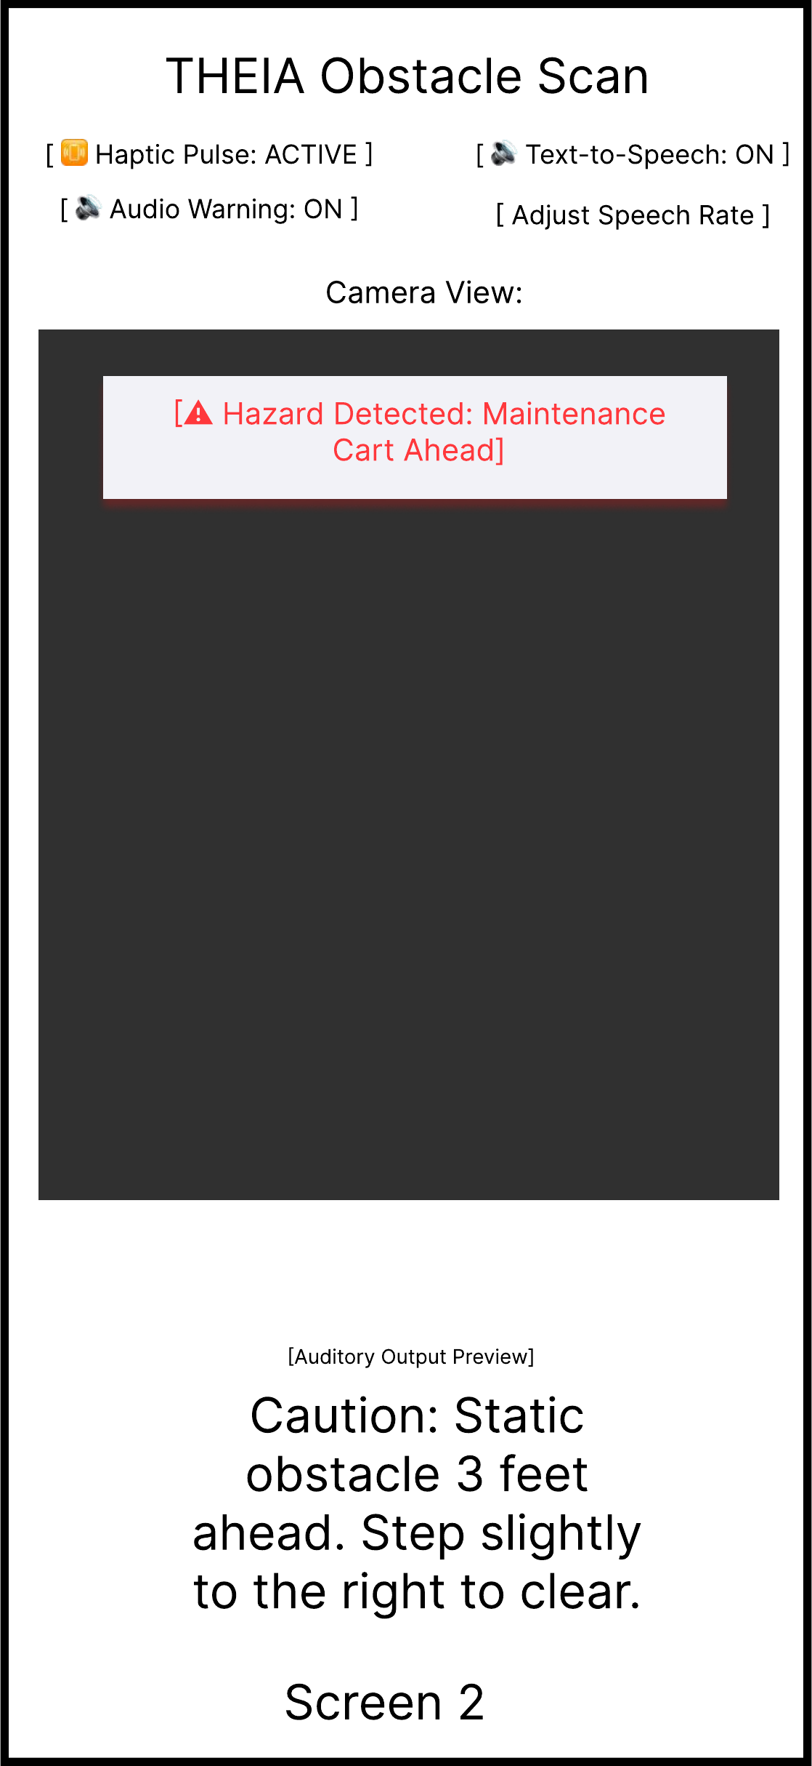
Scenario Pair 2: Static Obstacle Warning
TO-BE Scenario
Stevie is following THEIA's route guidance down the hallway with his phone camera facing ahead.
The detector reports a static obstacle ahead. THEIA interrupts the route instructions with a distinct spoken warning and a haptic pulse.
THEIA tells him to stop and offers a different mapped route, or help if he wants it.
Stevie chooses the alternate route, and guidance resumes from there.
Notes:
With THEIA, Stevie has route guidance on and his phone camera pointed ahead. When the detector picks up something stationary in front of him, THEIA cuts in with a spoken warning and a vibration that feel different from a normal turn instruction. Our WRS covers the warning in FR13, and NFR05 says the alert types have to be easy to tell apart. THEIA tells him to stop and offers another mapped route or help, which is FR14. It won't tell him to step left or right, because the phone can't check whether that's safe. Stevie takes the other route and keeps going. FR12 describes how we test detection, using a wall section, a maintenance cart and an open locker door.

Slide 7
Scenario Pair 3: Fall Detection and Caretaker Alert
AS-IS Scenario
Stevie is alone in a stairwell between classes when he slips and falls hard.
He's dazed, and his phone has slid somewhere out of reach.
Even once he finds it, he can't easily say where in the building he is.
His mom, who usually helps him, doesn't find out until much later.
Feature
Getting help after a fall
Who it helps
Stevie and the caretaker he approves
Problem today
No one knows he fell or where he is.
Notes:
Pair three is about falling. Stevie is by himself in a stairwell and falls hard. He's dazed, his phone slid out of reach, and even after he finds it he can't easily say where in the building he is. His mom usually helps him, but she doesn't hear about it until much later. Falls don't happen often, but when one does, the time before anyone finds out is what makes it dangerous.

Slide 8
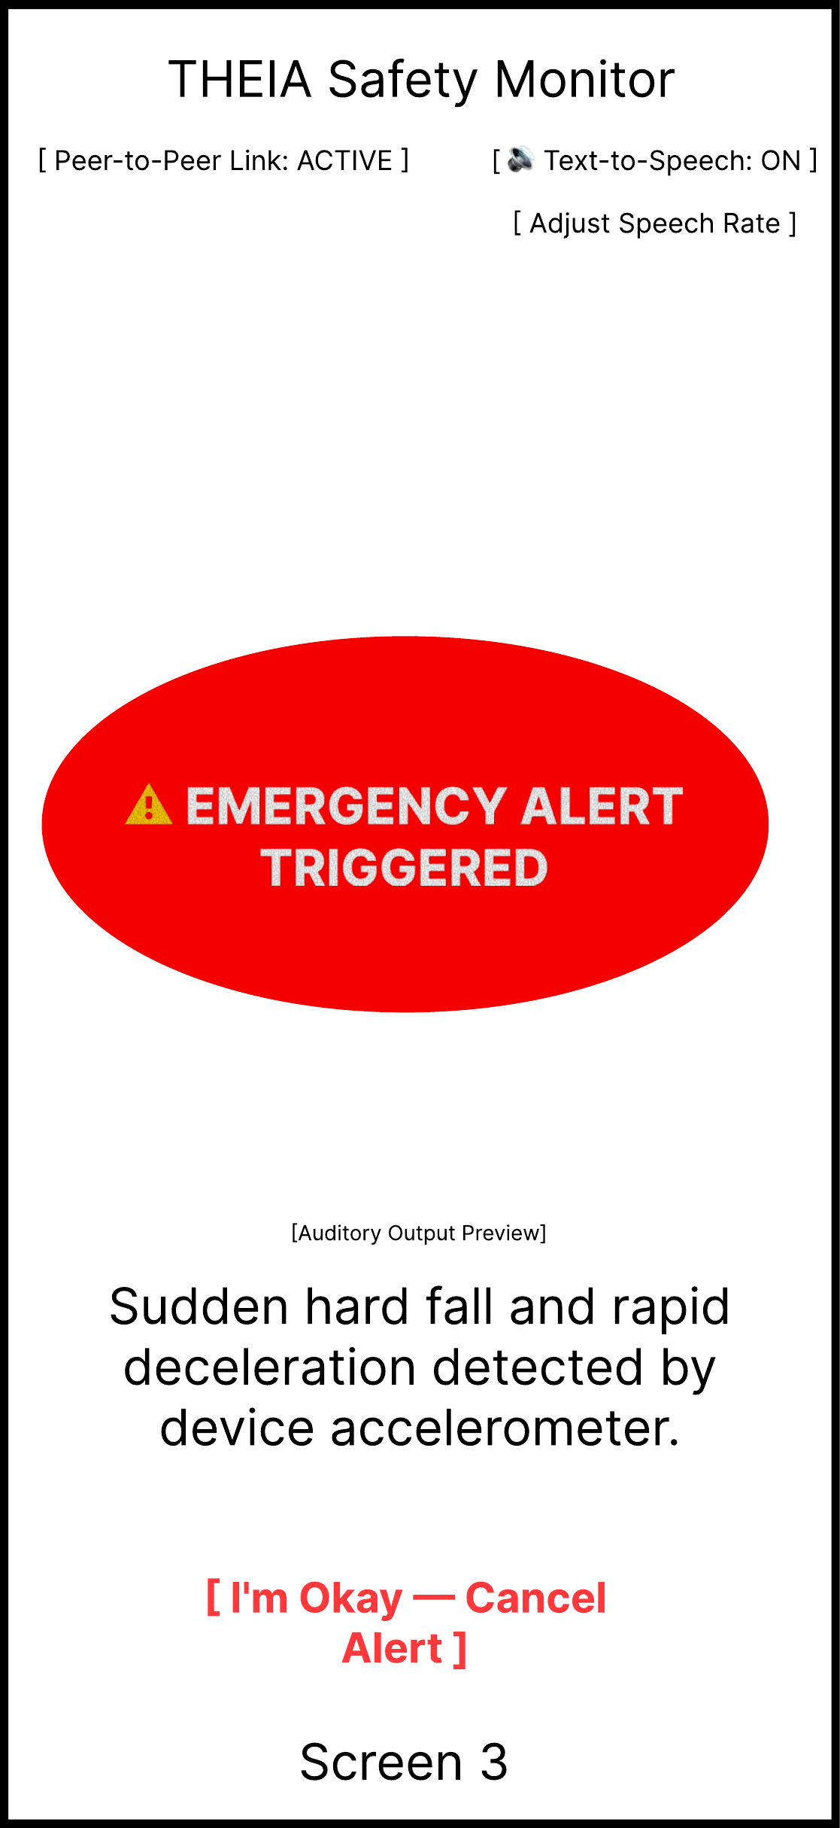
Scenario Pair 3: Fall Detection and Caretaker Alert
TO-BE Scenario
When he set up THEIA, Stevie authorized his mom to receive fall alerts.
He falls in the stairwell. The phone detects a suspected hard fall, and THEIA starts a spoken 15-second countdown he can cancel.
He's too dazed to respond. When the countdown ends, THEIA sends his mom an alert with his last confirmed indoor location.
THEIA tells Stevie whether the alert was delivered, failed, or is unconfirmed. If it failed, THEIA offers the emergency call action.
Notes:
Before any of this, Stevie went through setup and gave his mom permission to get fall alerts. That's in FR18, and he can take the permission back whenever he wants. When the phone detects what looks like a hard fall, THEIA starts a 15-second spoken countdown he can cancel, in case he just dropped the phone. He's too dazed to answer, so when time runs out THEIA sends his mom an alert with the last location he confirmed. That part is FR16, and nothing gets sent before the countdown finishes. Then THEIA tells Stevie whether the alert went through, failed, or hasn't been confirmed yet. If it failed, it offers the emergency call option. Those are FR17 and FR15. THEIA doesn't track him the whole time. It only sends the last spot he confirmed.

Slide 9
Scenario Pair 4: Optional Schedule-Based Suggestions
AS-IS Scenario
A new semester starts, and Stevie's classes move to new rooms and times.
He has to keep track of every time and plan each new route in his head.
On the first Tuesday he loses track of time and leaves late.
He isn't sure how to reach the unfamiliar room and arrives late to class.
Feature
Reminders based on his class schedule
Who it helps
Stevie, if he turns it on
Problem today
He has to keep track of every class time and new route himself.
Notes:
Pair four is about schedules. When a new semester starts, all of Stevie's classes change rooms and times. He has to keep the times in his head and figure out each new route on his own. Early in the semester he loses track of the time, leaves late, has trouble finding a room he hasn't been to, and gets to class late. Nobody gets hurt, but it happens every time his schedule changes.

Slide 10
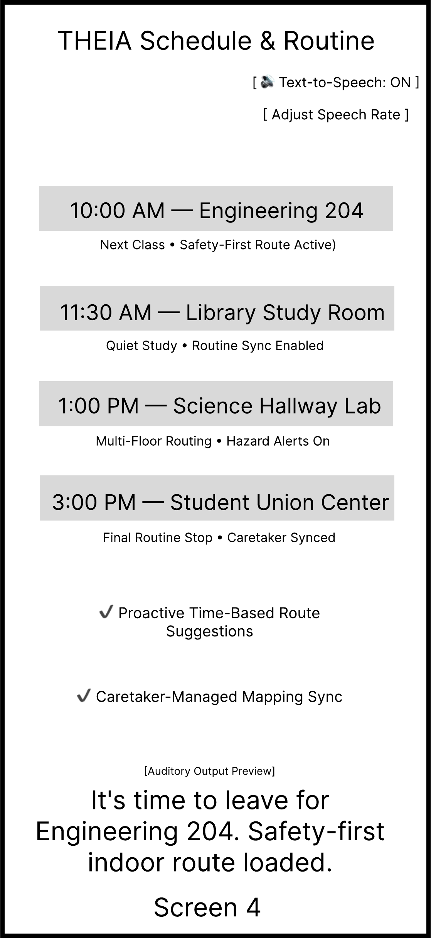
Scenario Pair 4: Optional Schedule-Based Suggestions
TO-BE Scenario
Schedule suggestions are off by default. Stevie turns them on himself and enters his class times and rooms.
At departure time, THEIA says: "Next class: Engineering 204 at 10:00. Start route?"
Stevie says yes and confirms where he is, and THEIA starts guiding him using the verified building map.
He can turn suggestions off or delete any saved entry at any time.
Notes:
Schedule suggestions in THEIA start out turned off. Stevie switches them on and enters his class times and rooms himself, which is FR19. When it's time to leave, THEIA tells him his next class and asks if he wants to start the route, so it never starts guiding him on its own. That's FR20. He says yes, confirms where he is, and guidance starts. The route comes from a building map supplied by an approved map provider, per FR02. His caretaker doesn't draw maps or set his schedule. He can turn the feature off or delete entries whenever he wants. This is a Should requirement, so it comes after the core navigation and safety features.

Slide 11
Analysis of the Top-Priority Scenario: Pair 1 Navigation
Type | Question | Options considered | WRS result
What-if | Start location can't be confirmed? | (i) guess and continue (ii) withhold guidance and ask | FR05, NFR04
What-if | Destination name matches two rooms? | (i) pick the first (ii) read alternatives and ask | FR04
What-if | Stevie misses the turn? | (i) keep giving original directions (ii) detect at landmark and reroute | FR09, FR10
What-if | Hallway is blocked? | (i) suggest a sidestep (ii) stop and offer alternate route or help | FR13, FR14
What-if | Building isn't mapped? | (i) attempt anyway (ii) announce no route available | FR01, NFR08
Why Pair 1 comes first
Lesson 6 says to prioritize scenarios that are critical or high frequency. Pair 1 is both.
Critical
A wrong turn can hurt him, like walking into the wall in the AS-IS.
High frequency
Stevie navigates several times a day, more than he uses any other feature.
Method
We started from the normal scenario and asked all five question types.
The second option in each row is the one we chose.
Notes:
For the Lesson 6 analysis we picked pair one, basic navigation. Lesson 6 says to start with scenarios that are critical or that happen often, and this one is both. A wrong turn can hurt someone, like Stevie in the AS-IS, and he navigates several times a day, more than he'd use anything else in the app. We started with the version where everything goes right and asked what-if questions about what could go wrong. Each row lists the options we thought about and the requirement our choice turned into. For example, if THEIA can't confirm where Stevie is starting from, it holds off on directions and asks him, and that became FR05.

Slide 12
Analysis of Pair 1: When, Who, What-Kinds-Of, How-To
Type | Question | Options considered | WRS result
When | When should a turn be announced? | (i) at the turn only (ii) in advance and at the decision point | FR08
When | When should guidance pause? | (i) never (ii) whenever a landmark is unconfirmed | NFR04
Who | Who supplies the map? | (i) caretaker (ii) verified map provider | FR02
Who | Who picks the route? | (i) app picks fastest (ii) Stevie chooses among suitable routes | FR07
What-kinds-of | What kinds of routes are offered? | (i) shortest only (ii) filtered by accessibility, e.g. avoid stairs | FR06, FR07
What-kinds-of | What kind of distance cue? | (i) step counts (ii) distance (iii) landmarks | FR08
How-to | How does Stevie enter a destination? | (i) on-screen typing (ii) voice or screen reader | FR03
How-to | How does THEIA know he reached the turn? | (i) automatic indoor positioning (ii) Stevie confirms the landmark | FR09
How-to | How does he recover from a wrong turn? | (i) retrace manually (ii) reroute from newly confirmed location or request help | FR10
Notes:
Next we went through the other four question types. For when, we decided turns get announced ahead of time and again at the turn, and guidance stops any time a landmark isn't confirmed. For who, maps come from a verified provider, and Stevie gets to pick his route. For what kinds of, we looked at which routes get offered and what kind of distance cue to give. For how-to, we covered how he enters a destination, how THEIA knows he reached a turn, and how he gets back on track after a wrong turn. The biggest decision on this slide is that THEIA doesn't try to work out his position automatically. Stevie confirms each landmark himself, which is FR09.

Slide 13
Tree-Based Analysis: Navigating to a Destination
Navigating to a destination
Start confirmed
Start unconfirmed
Ambiguous destination
Missed turn
Route blocked
Unmapped building
"What-if"
Caught at landmark confirmation
Not caught until arrival fails
"When"
THEIA reroutes
Stevie requests help
"Who"
Stevie confirms new location by voice
Stevie picks location from nearby mapped list
Dashed lines: branches not expanded on this slide
"How-to"
Notes:
Here's the tree, set up like the meeting scheduler example from Lesson 6. The root is the normal case, navigating to a destination, and the first row is the what-if branches. We only expanded missed turn. On the when level, a missed turn either gets caught when Stevie can't confirm the next landmark, or nobody notices until he doesn't arrive. If it's caught at the landmark, the who level asks who deals with it, so either THEIA reroutes him or Stevie asks for help. Under THEIA reroutes, the how-to level is how Stevie tells THEIA where he is now. He can say it, or pick from a list of nearby mapped spots. The dashed lines are branches we didn't expand.

Slide 14
Pruning: Selected, Discarded, and Undecided Options
Selected
Discarded
Undecided
Landmark confirmation at each decision point (FR09)
Withhold guidance when the start or a landmark is unconfirmed (FR05, NFR04)
Read alternatives for an ambiguous destination (FR04)
Maps from a verified provider only (FR02)
Stevie chooses among accessible routes (FR06, FR07)
Reroute from a newly confirmed location (FR10)
Automatic indoor positioning (ruled out in the WRS)
Telling him to sidestep an obstacle, since the phone can't check it's safe (FR14)
Maps drawn by caretakers (map changes need provider approval, FR02)
Guessing the start location and continuing
Step counts vs. distance vs. landmark-based cues
For now, step counts are kept but always labeled as estimates (FR08)
Result: guidance now waits for Stevie to confirm his start and each landmark. This analysis produced or confirmed FR04, FR05, FR08, FR09 and FR10.
Notes:
The last Lesson 6 step is pruning, where each option gets sorted into selected, discarded, or undecided. The selected ones include confirming a landmark at each decision point, not giving directions when the start or a landmark isn't confirmed, and rerouting from wherever Stevie confirms he is. We threw out automatic indoor positioning since our WRS rules it out, sidestep suggestions because the phone can't check that they're safe, and maps drawn by caretakers. We haven't settled on the distance cue yet. For now we're keeping step counts, and THEIA always says they're estimates. FR04, FR05, FR08, FR09 and FR10 all came out of this analysis or were confirmed by it.

Slide 15
Why THEIA: Comparison with Existing Tools
 | White cane | Guide dog | Sighted helper | Outdoor map apps | THEIA
Knows indoor routes room by room | No | No; handler must know the route | Only if they know the building | Rarely; built for streets | Yes, in buildings with verified maps
Handles floors and connected buildings | No | No; handler directs | Only if they know the building | Rarely | Yes, with floor changes announced
Warns of obstacles ahead | Yes, within the cane's reach | Yes, guides around them | Yes, while walking with you | No | Some static obstacles, not all
Detects a fall and alerts someone | No | No | Only if present | No | Yes, after a 15-second countdown
Available without another person | Yes | Yes | No | Yes | Yes, in supported buildings
Cost to the user | Low | Long wait and ongoing care | Free, but relies on someone | Free | App on a supported phone
Only THEIA has room-level indoor routes and fall alerts. Stevie would still use his cane or guide dog with it.
Notes:
Last, here's how THEIA compares to what blind travelers already use: a white cane, a guide dog, asking someone, and regular map apps, which are made for streets. A cane and a guide dog are good for what's right in front of you, but neither one knows where room 204 is. Another person might, if they know the building and they're around. Map apps mostly stop at the front door. THEIA is the only one in this table with room-level routes inside mapped buildings, and the only one that can alert a caretaker after a fall. It does have limits. It only works in buildings with verified maps, and it won't catch every obstacle. Stevie would still use his cane or guide dog with it, and THEIA would handle the indoor part of the trip. Thanks for watching.

