Slide 1
Who’s Home: Sprint #1
Michael Blake, Patrick Caruana, Caleb Kauffman, Cris Laney

Slide 2
Presentation Overview
Review Project
GitHub
Server & Database
Data Population
Common Requests & Queries
Testing
Scrum Master
Next Sprint

Slide 3


What’s Our Project?
Frontend Technologies: Xamarin (C#, XML, Java)
Backend Technologies: Node.JS, MySQL
Misc. Technologies: Java, Python
Platform: Android

Slide 4
Application Features
Create groups for your roommates or family members
Keep track of group members’ locations
Post to your groups message board
Create lists of items or tasks to be completed
Manage bills for your household

Slide 5
Business Rules
21 business rules
Rules Include…
Any location can be added to the group’s location list by any member of the group.
Any name can be chosen for a location, even duplicate names.
Any member can add an item to the group’s shared list

Slide 6
GitHub
Patrick

Slide 7

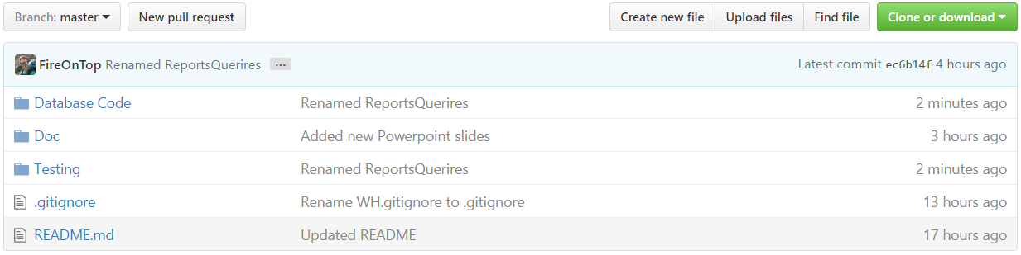
GitHub setup
File structure for all parts of the projects
Code
Documentation
Anything else
GUI based interface... controversial but I found it helps for basic commands

Slide 8
Server & Database
Cris

Slide 9
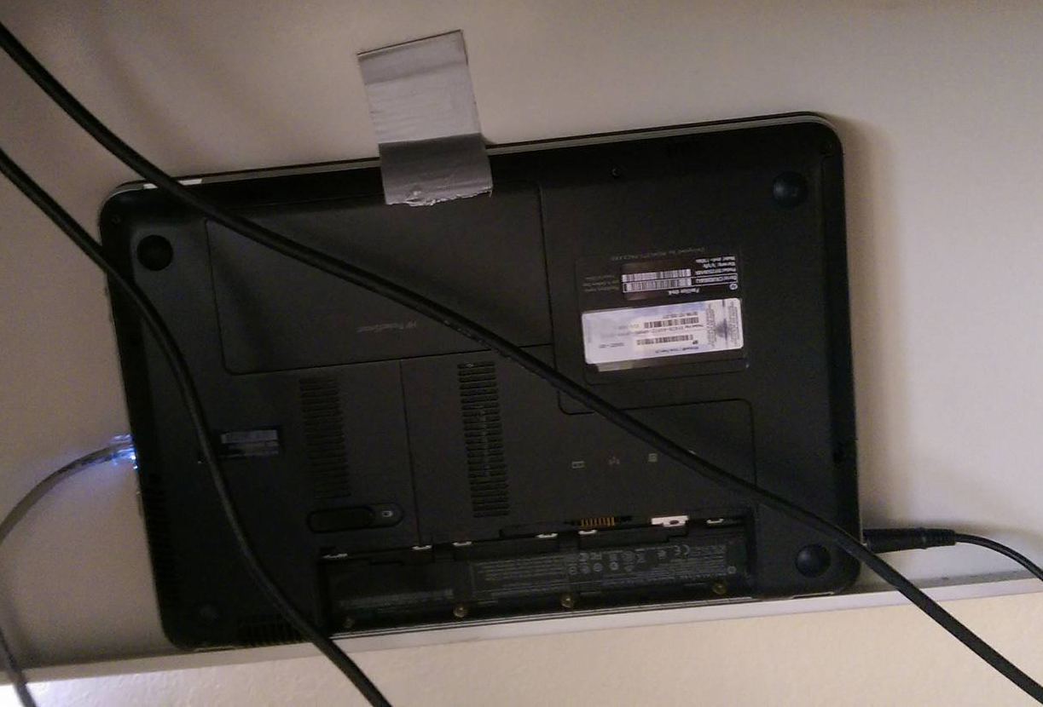
Server Setup
Began with SQL Server
Installed MySQL
Created a single profile with limited privileges for everyone on the team
Installed SSH
Created an account for each member on the team
Installed Node.JS
Port Forwarding
Our “Rack Mounted” Server

Slide 10
Database Creation Script
4 iterations
First was basic representation of database
Second added constraints to certain columns
Third Fixed some incorrect tables (Locations) changed Password from varchar(32) to CHAR(64) for 256 bit encryption
Fourth Changed INT to BIGINT for UserID’s and GroupID’s

Slide 11
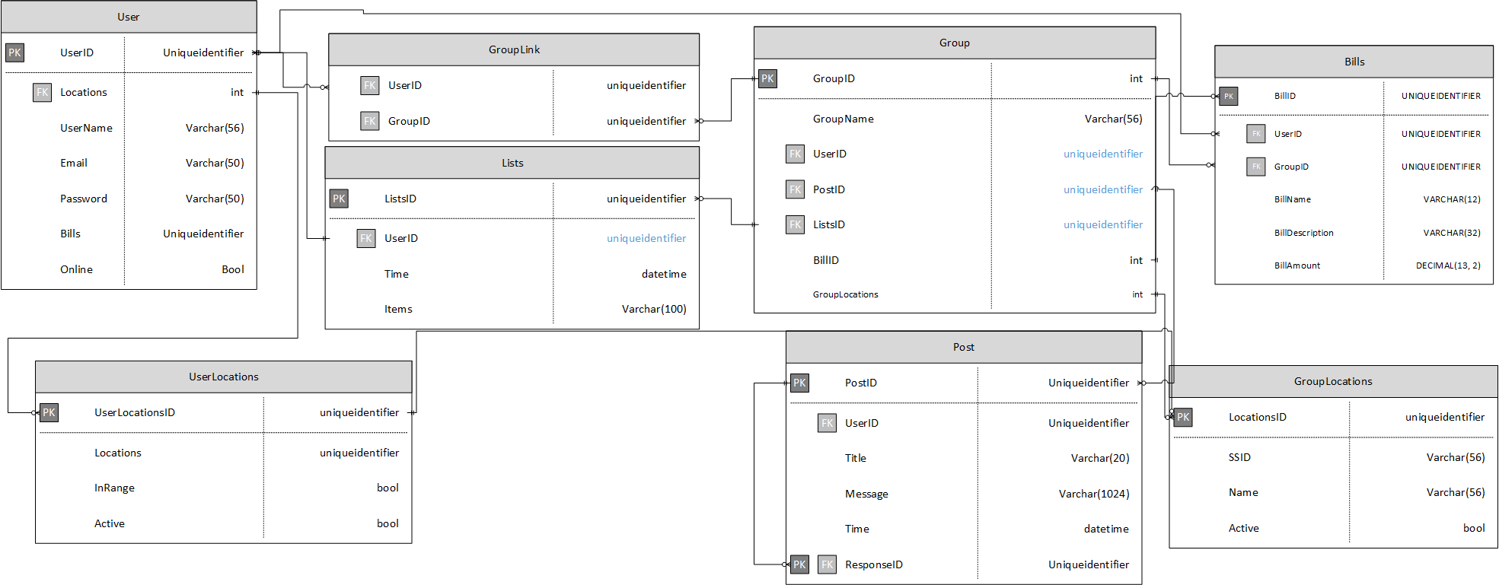

Slide 12
Data population
Caleb

Slide 13


Tools:
DBForge (MySQL)
Mockaroo

Slide 14
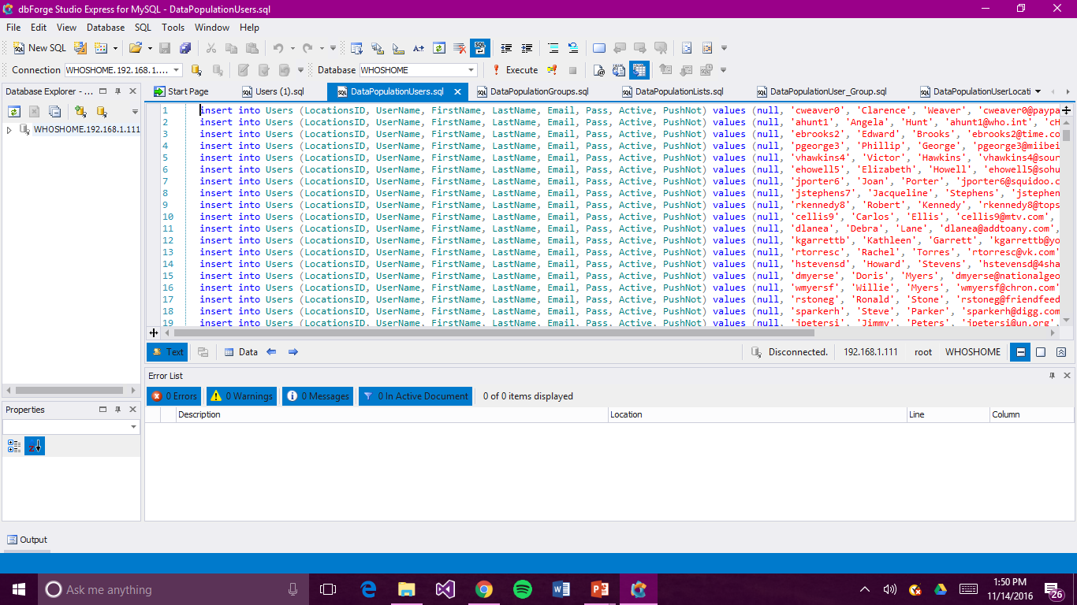

Slide 15
Mockaroo
Online tool for data population
Creates insert statements
Saved hours of creating data

Slide 16
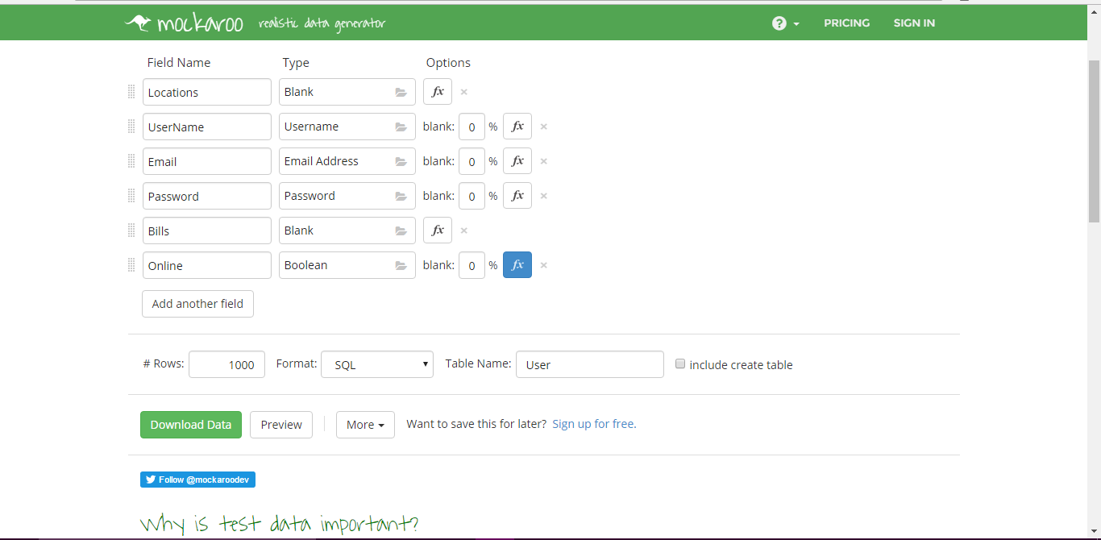

Slide 17
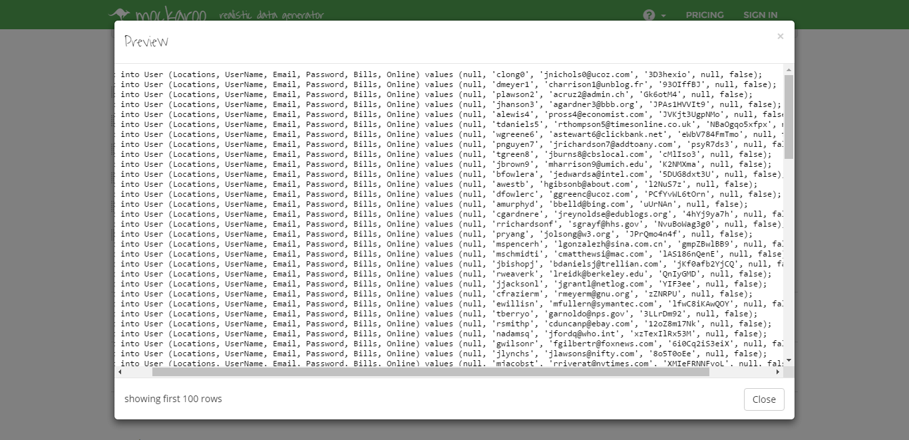

Slide 18
Customized Population:
Mockaroo
Good tool for population
Bad for deeper understanding of data/database
Solution: Write custom population statements

Slide 19
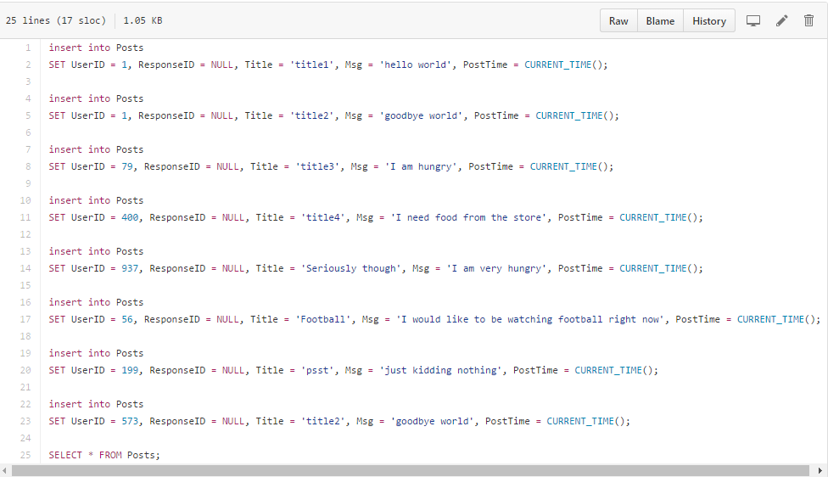
Posts

Slide 20
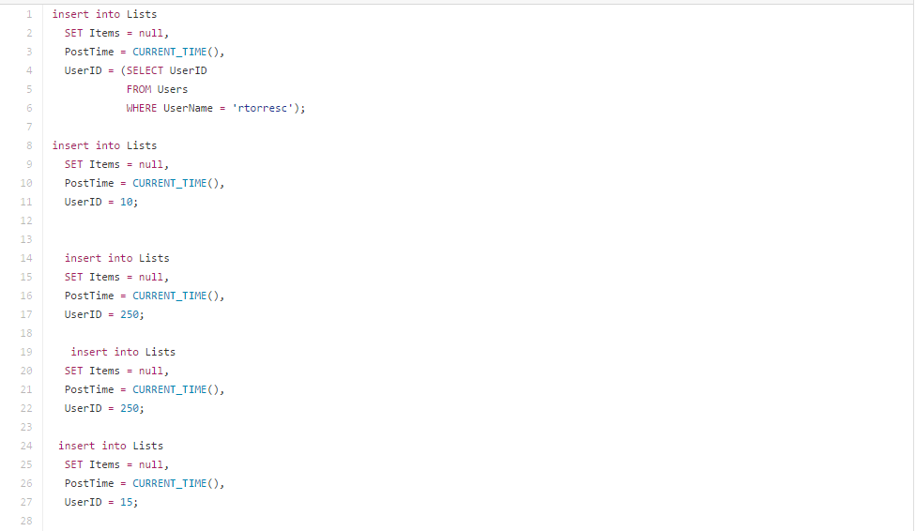
Lists

Slide 21
Common Requests & Queries
Michael

Slide 22
SQL Requests/Queries
Retrieve user and group information
Retrieve post information
Retrieve bill information
Retrieve list information

Slide 23
SQL Update/Delete
Update password for “forgot password”
Update password for “change password” page
Update a user’s location upon change
Delete a location from a group’s list of locations

Slide 24
Testing
Patrick

Slide 25

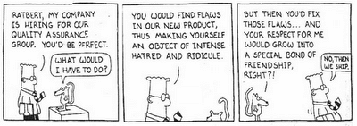
Initial Testing Design
Misunderstanding lead to wasted time pursuing SQL testing
Final database used MySQL
Different than SQL
Only past experience in testing was in Testing with Calvin
Styled testing after traditional unit tests

Slide 26

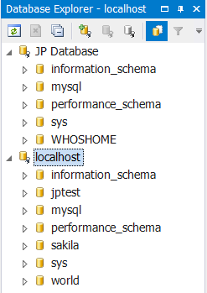

Setup
Created localhost database as a development environment
MySQL Workbench
Used existing creation scrips
Better understood what team members had done earlier in the sprint
Installed Eclipse and brushed up on Java

Slide 27

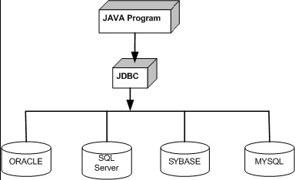
Database Test Program
Used Java for testing program
Used local database for more control in the development process and safety
Backbone of tests is the Java Database Connectivity (JDBC) API

Slide 28
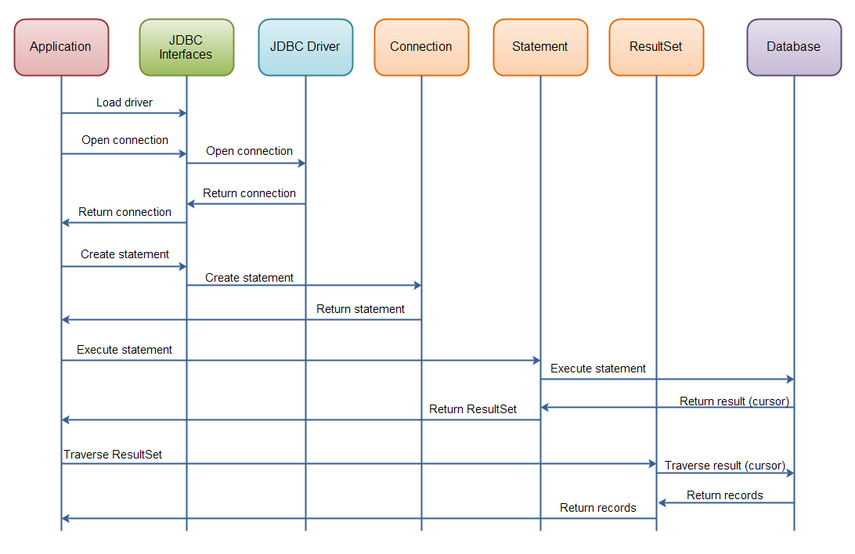
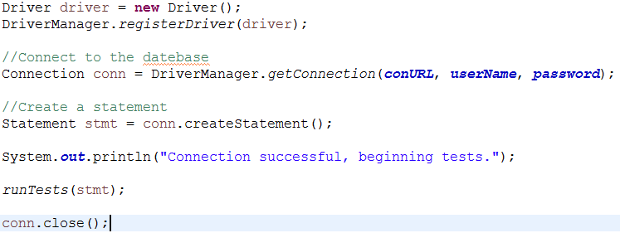
Overview of JDBC component interaction

Slide 29
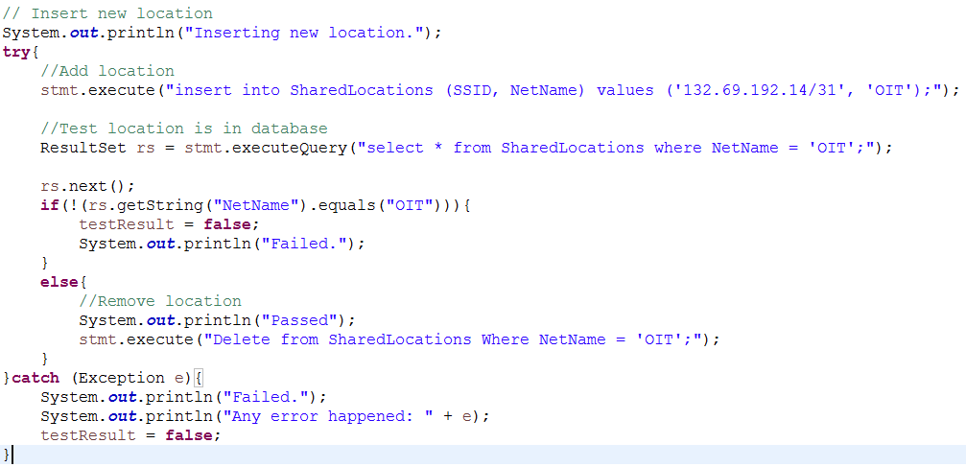
Example of a single unit test for the SharedLocations table

Slide 30
User Interaction Script
Python Script to insert database values based on user workflow
Multi-threaded
Can simulate multiple users

Slide 31
Scrum Master
Patrick

Slide 32
Scrum Master Overview
Frist Scrum master of our JP
Project notebook
Meeting and daily scrum logs
Design documents
Weekly status reports
Did most of the initial technical writing for the group
Group members focused on additions and edits
One of the biggest lessons learned was that organization is key

Slide 33
Sprint #2

Slide 34
What’s Next?
Split into client/server teams
Further testing and implementation
Begin creating application

Slide 35
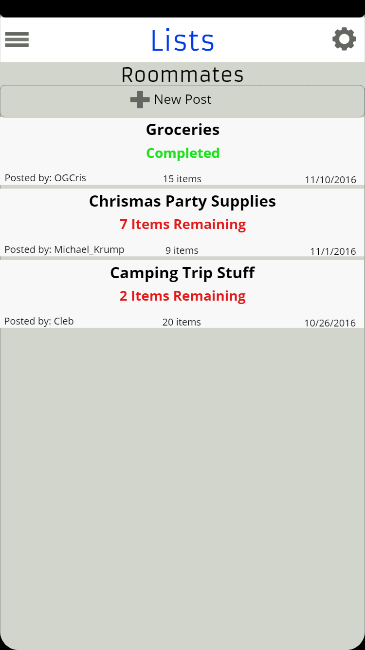
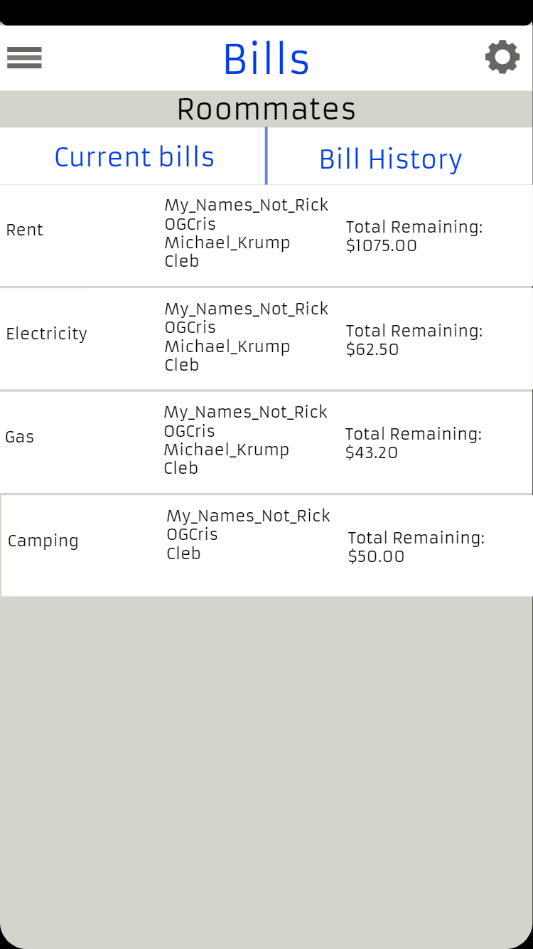
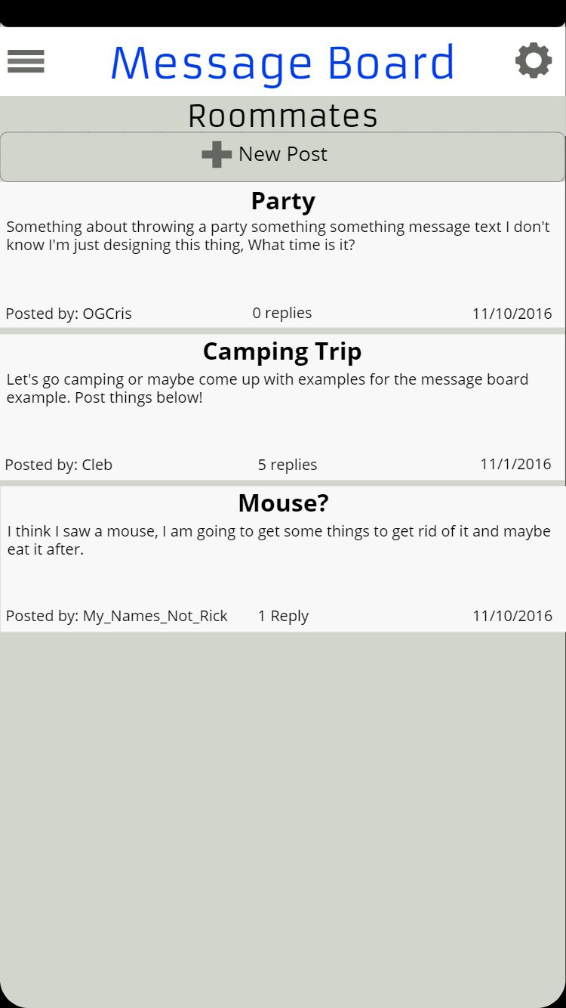

Slide 36
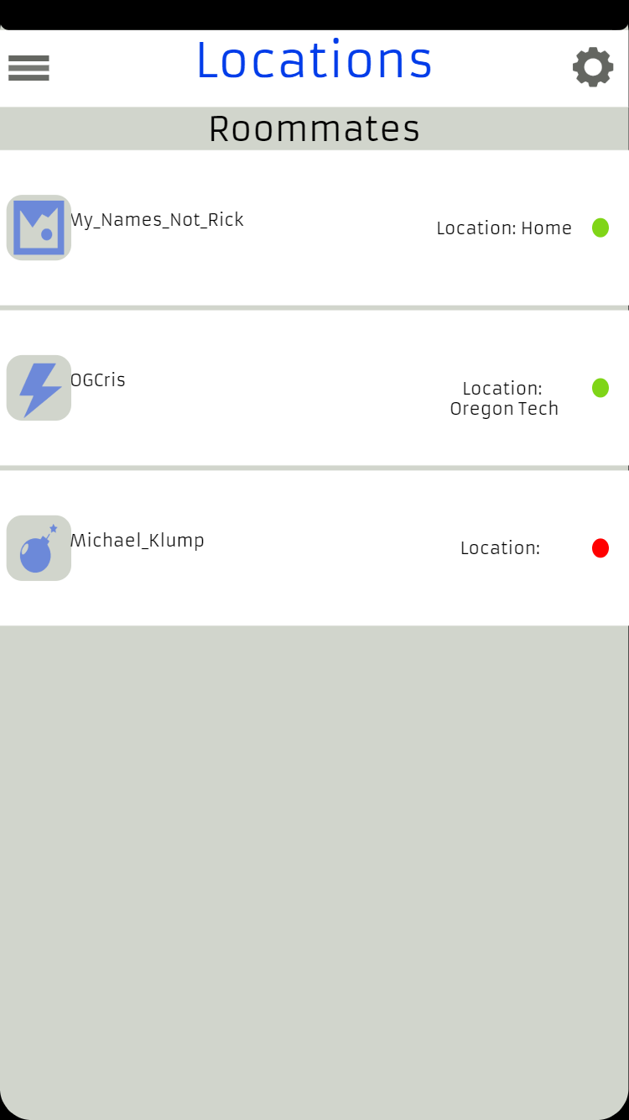
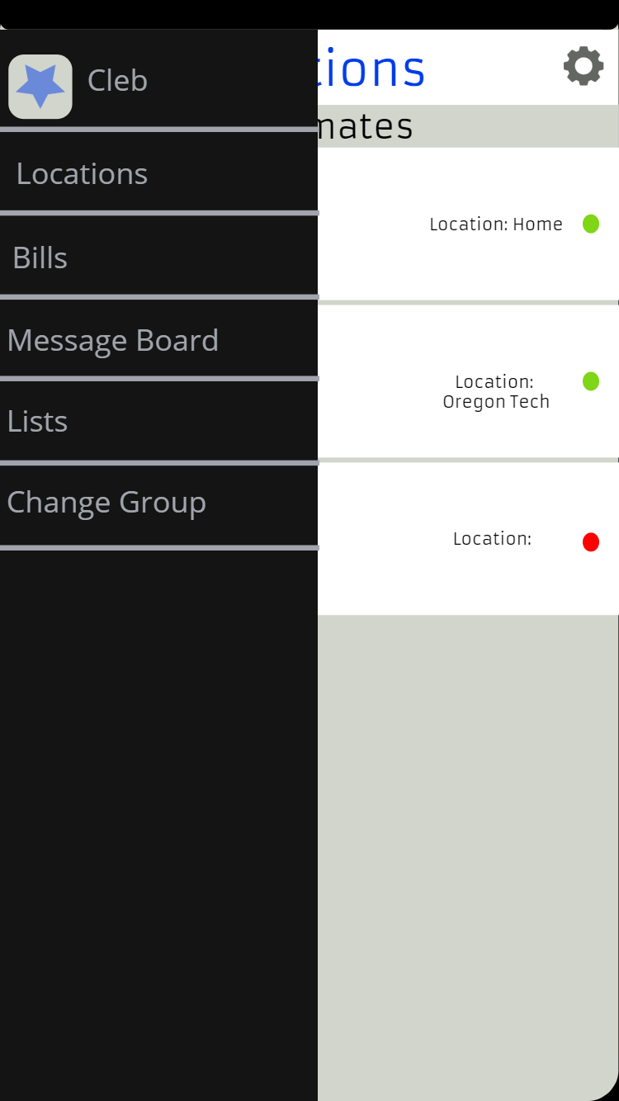

Slide 37
Questions & Comments

