Slide 1
Who’s Home?
Caleb Kauffman, Michael Blake, Cris Laney, Patrick Caruana

Slide 2
Presentation ideas:
Each member summarizes the work he did
Live demo
  Explain UI
  UI -> Server
  Server-> Database
  Database

Slide 3
Overview
Roommate and Family communication app
Post messages
Track bills
Create checklists
See roommates at common locations

Slide 4
User Interface
Caleb

Slide 5
Technologies
Xamarin for Visual Studio
Android
C#
XML

Slide 6
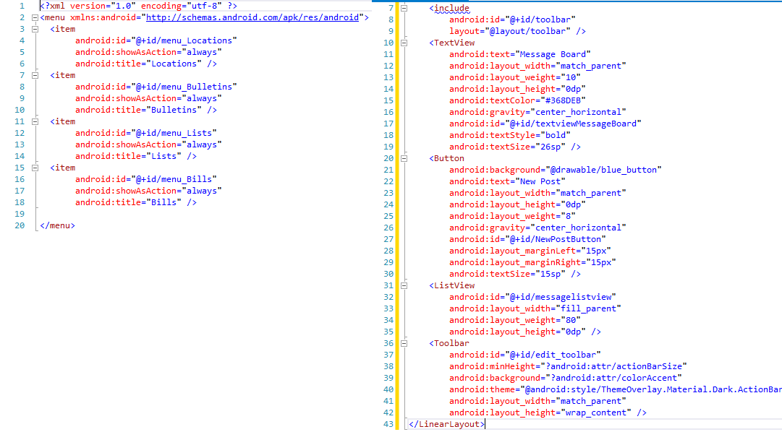

Slide 7
Features
Welcome screen
  Sign up
  Sign in
Top and bottom menu bars
Bulletins
  New post
  List of posts

Slide 8
Demo

