Slide 1
Testing

Slide 2


Initial Testing Design
Misunderstanding lead to wasted time pursuing SQL testing
Final database used MySQL
Different than SQL
Only past experience was in Testing with Calvin
Styled testing after traditional unit tests

Slide 3

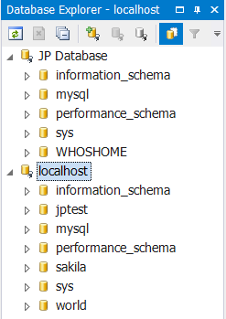

Setup
Created localhost database as a development environment
MySQL Workbench
Used existing creation scrips
Better understood what team members had done earlier in the sprint
Installed Eclipse and brushed up on Java

Slide 4

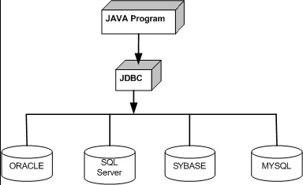
Database Test Program
Used Java for testing program
Used local database for more control in the development process
Backbone of tests is Java Database Connectivity (JDBC) API

Slide 5
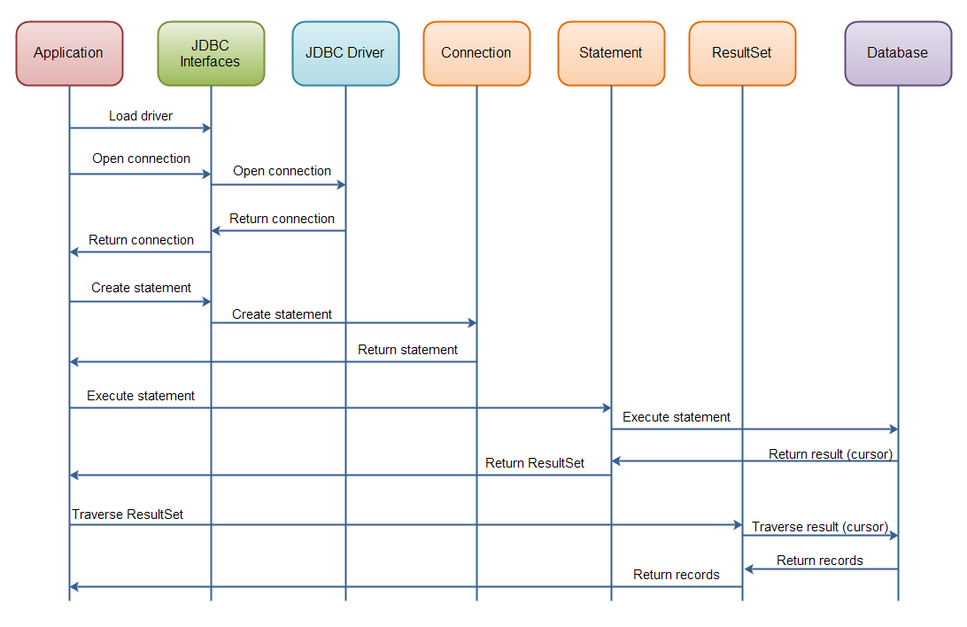
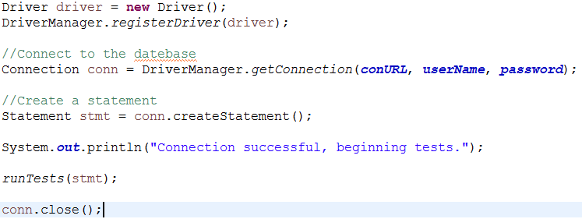
Overview of JDBC component interaction

Slide 6
GitHub

Slide 7

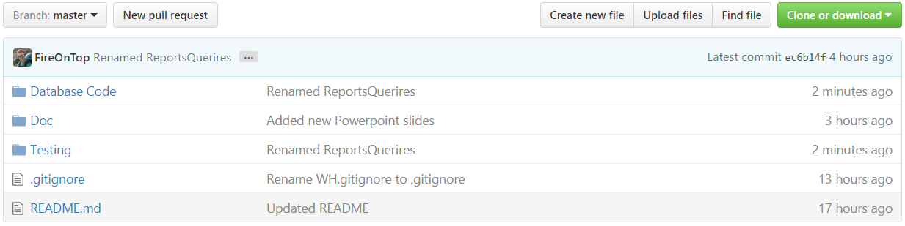
GitHub setup
GUI based interface... controversial but it helps for basic commands

Slide 9
Scrum Master

